Slide 1

Training
Set Up Alerts and Edit Your Profile
Notes:
Welcome to the EDDMapS training. You will learn how to add revisits to reports and how to edit the data in your reports.

Slide 2
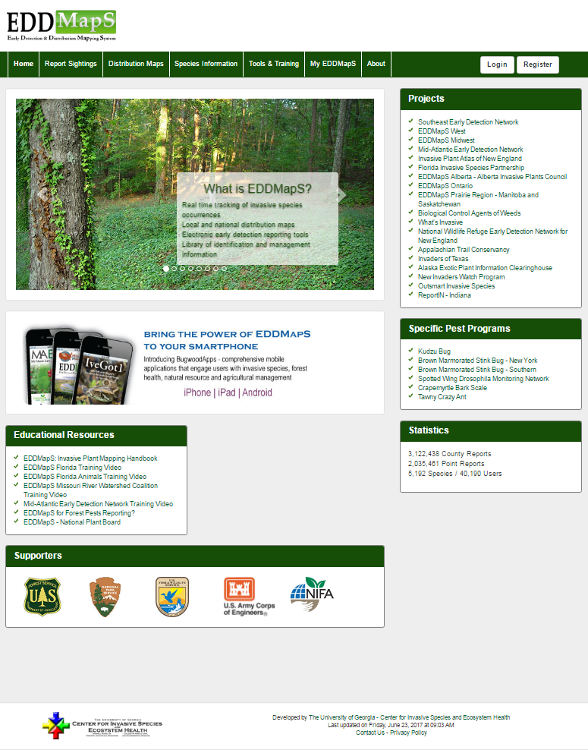

Alerts
The first step is always to sign in to your EDDMapS account
Click on your My EDDMapS tab
Click on My EDDMapS tab
This will take you to your dashboard for EDDMapS
Notes:
Create an alert based on a specific location or a specific organism or group of organisms. You can choose to receive an alert only when a new organism is reported in your area. When a report meets the criteria you choose, you will receive an email alerting you. Quickly Delete Alerts you have set up with the click of a button.

Slide 3
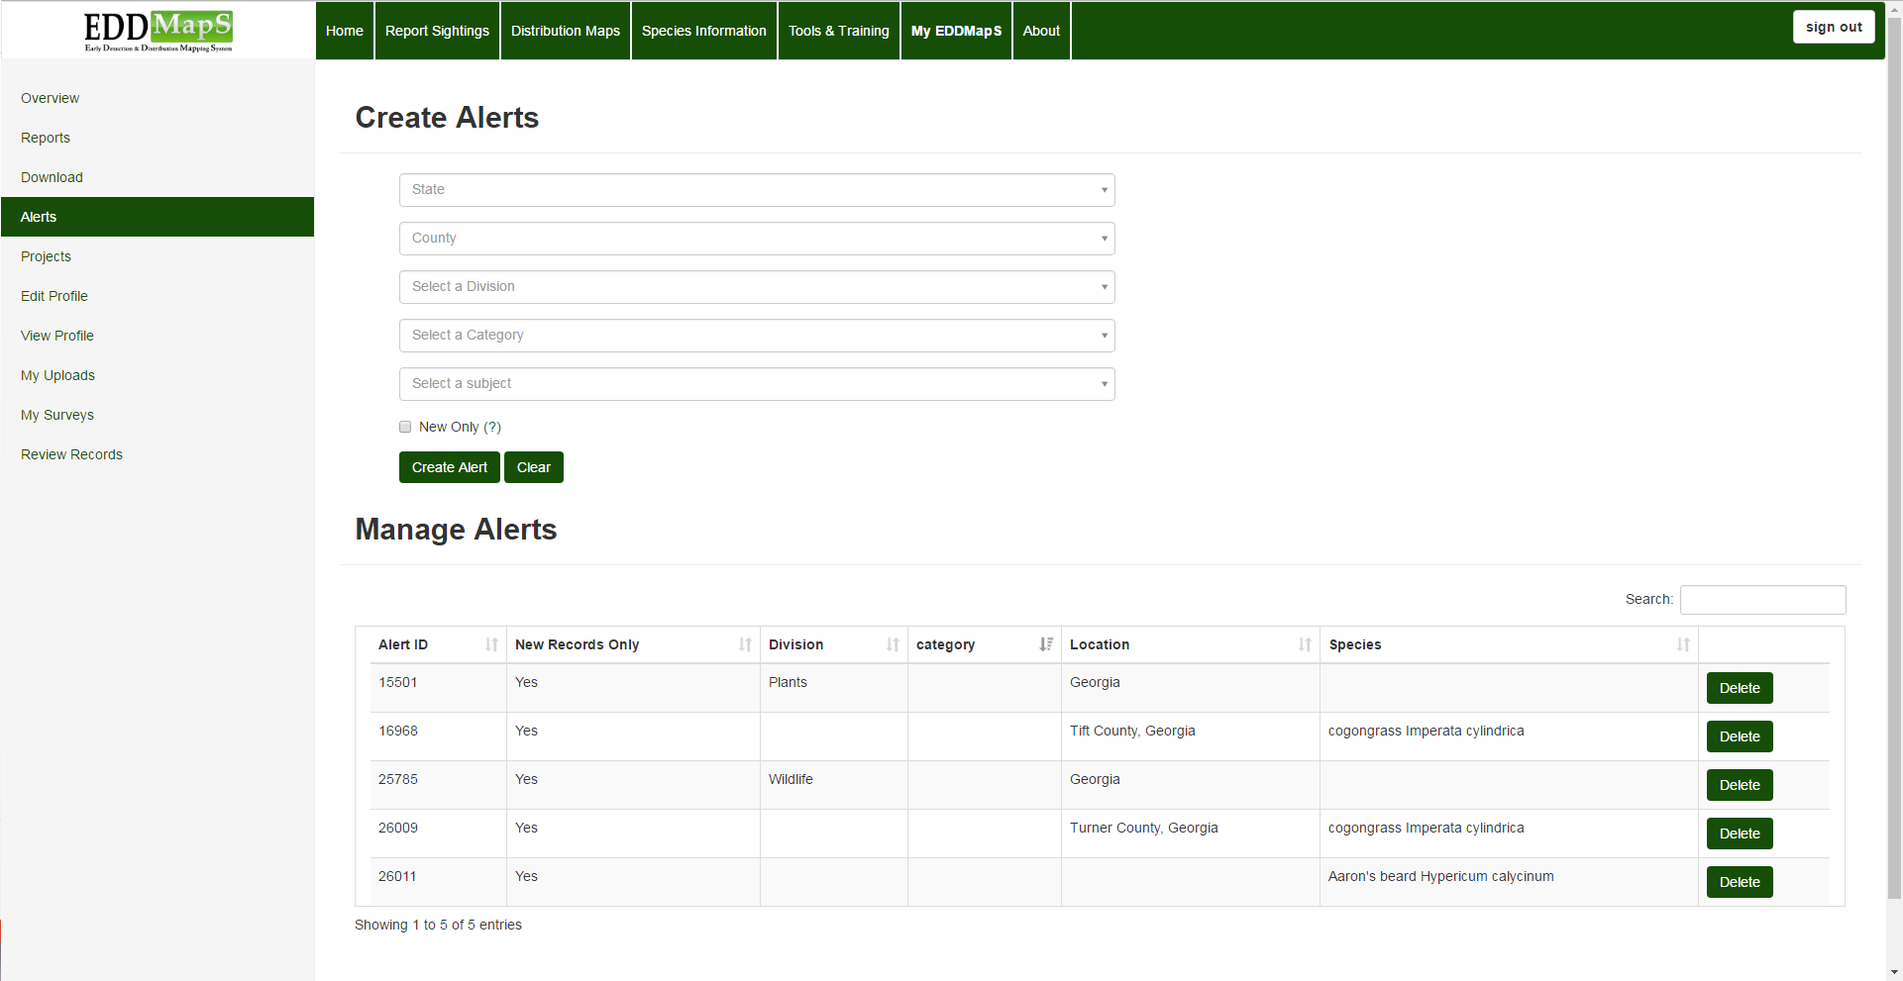
Alerts
Set up email alerts to notify you when species of interest are reported in your region
By Location
State
County
By Organism
Division
Category
Species
Notes:
Create an alert based on a specific location or a specific organism or group of organisms. You can choose to receive an alert only when a new organism is reported in your area. When a report meets the criteria you choose, you will receive an email alerting you. Quickly Delete Alerts you have set up with the click of a button.

Slide 4
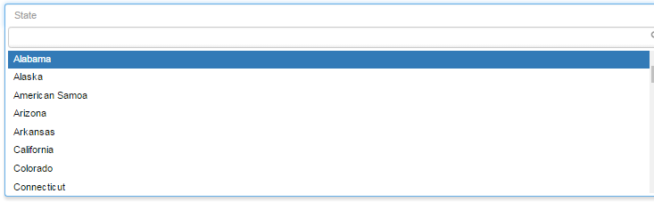
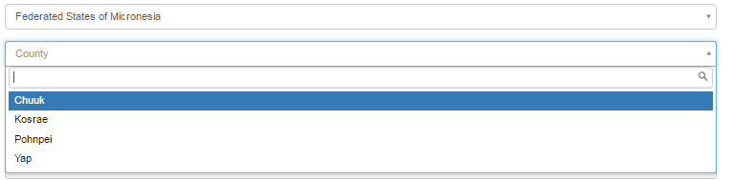
Alerts
Choose the location you want to monitor
Select the U.S. state or territory first. This automatically populates the correct counties, etc. for you to choose from.
Notes:
Choose the location you want to monitor. Select the U.S. state or territory first. This automatically populates the correct counties, etc. for you to choose from.

Slide 5
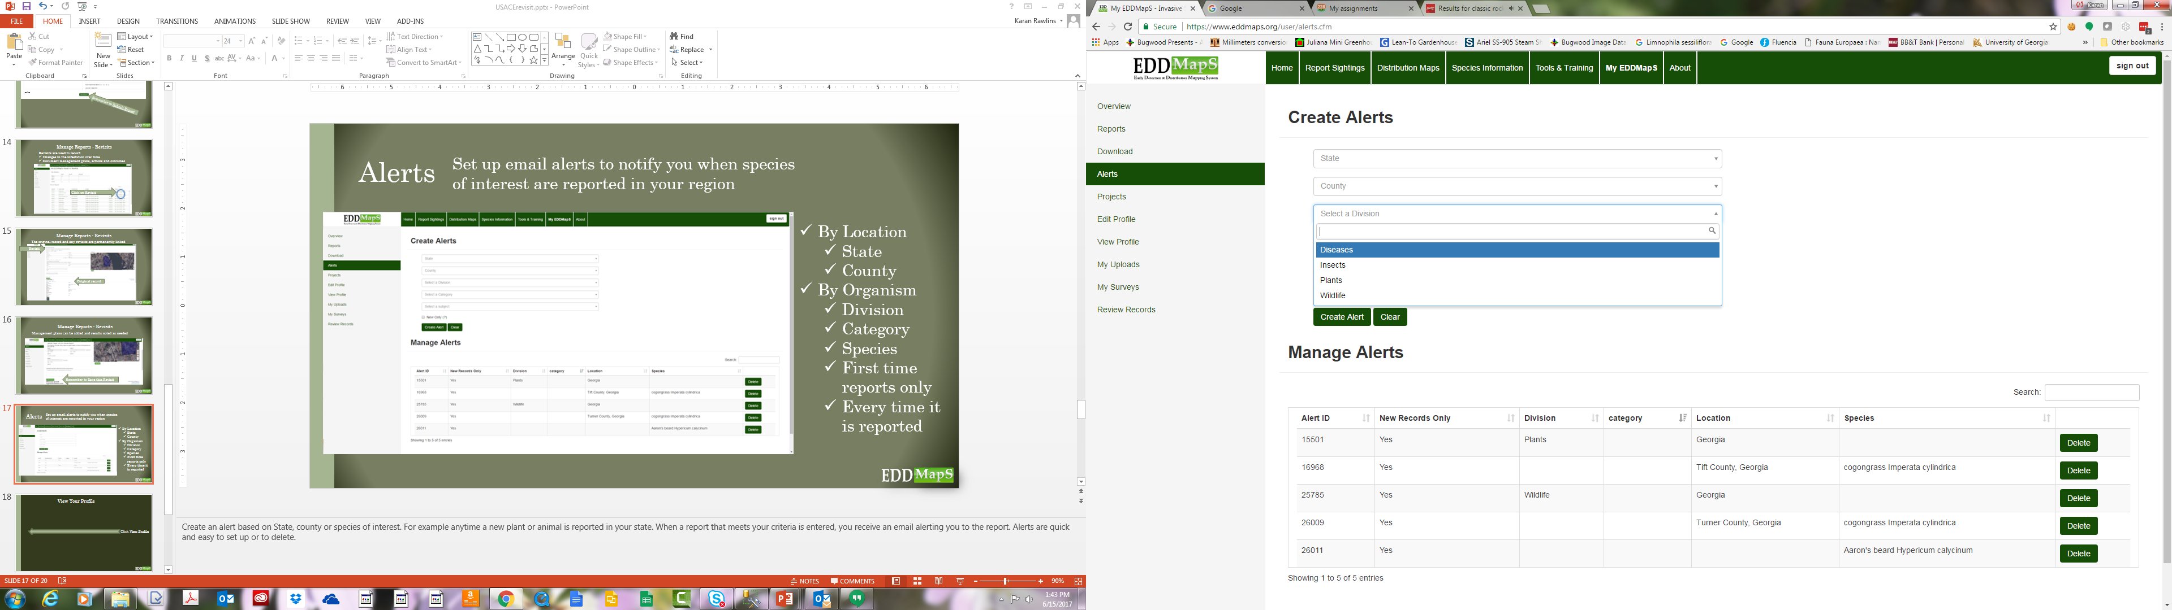
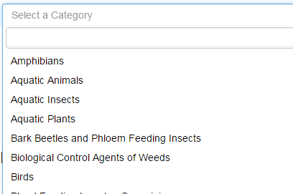
Alerts
Division or Category
Select Division to receive alerts for any pest
Disease
Wildlife
Insect
Plant
Select Category to narrow down the field, e.g.
Aquatic Animals
Trees
Bark beetles
Notes:
If you want to receive alerts for any pest Disease, Wildlife, Insect, or Plant reported in your county or state use Division to make that choice. If you want to narrow down the field a little, set up your alert by Category. For example rather than all Wildlife, you might choose Aquatic Animals.

Slide 6
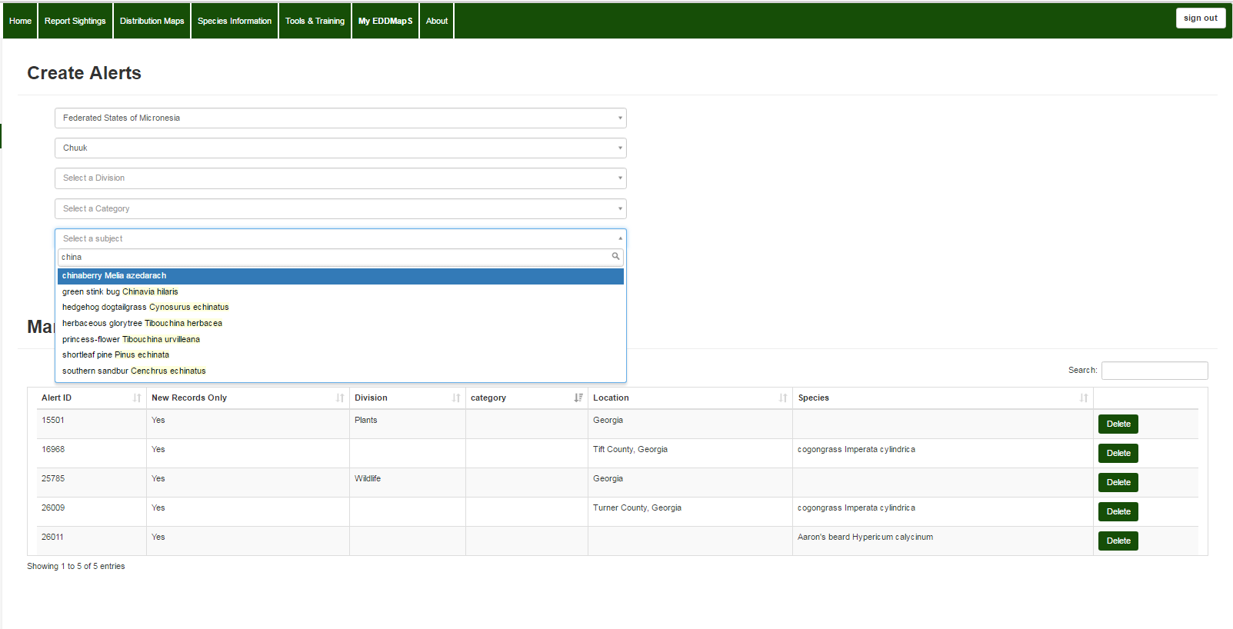
Alerts
Select a Subject -Create an alert based on a single species
Just begin to type the name into the Select a subject field. The name of any organism having that combination of letters will appear in the dropdown menu.
Notes:
Create an alert based on one genus or species. Just begin to type the name into the Select a subject field. The name of any organism having that combination of letters will appear in the dropdown menu.

Slide 7
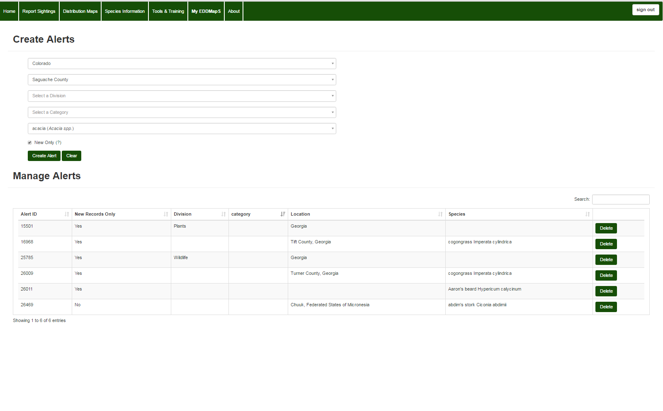
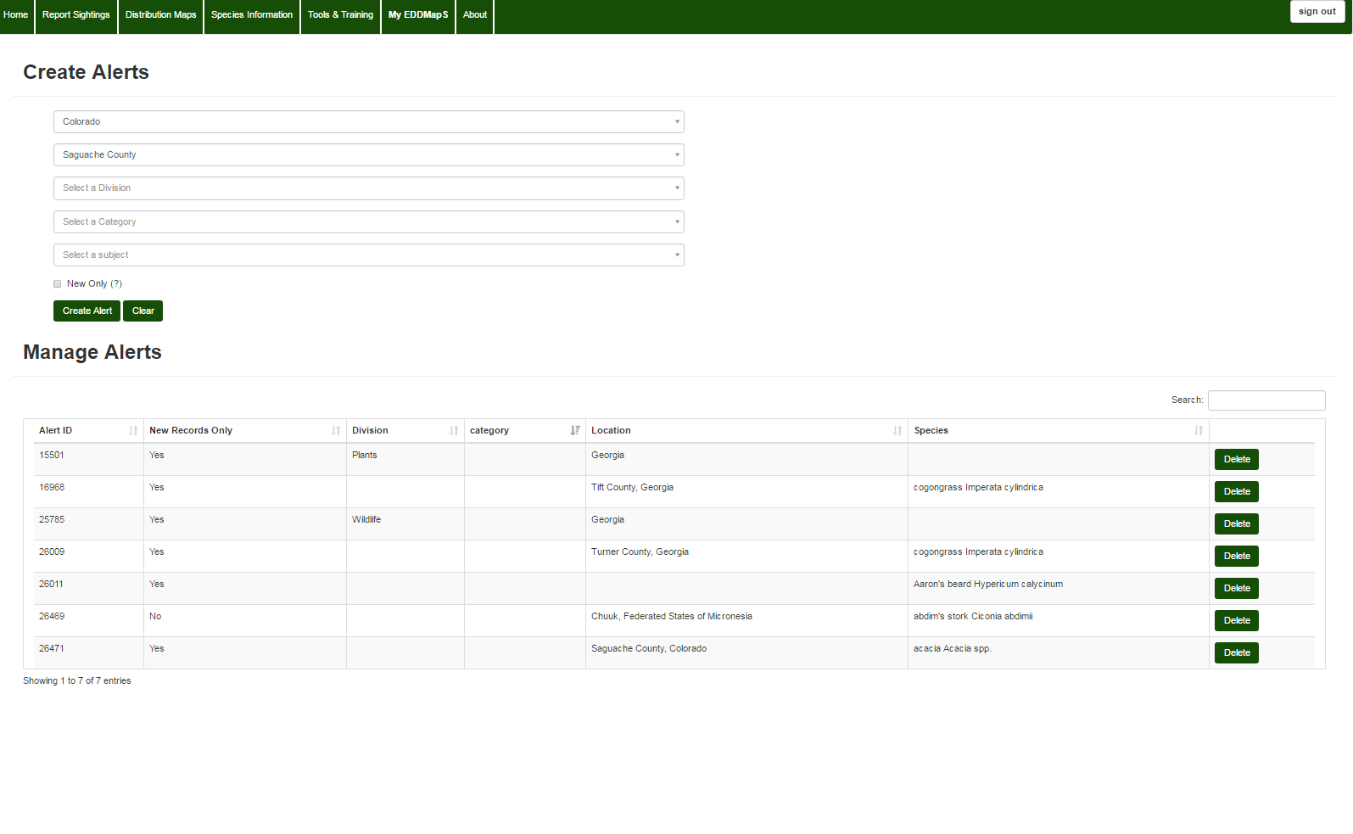
Alerts
Click Create Alert when you have set all the criteria
Your New Alert!
In this example we chose Colorado, and Saguache County
We chose to be alerted when an acacia was reported
By checking the New Only box we will only be alerted when a new acacia is reported in that area, rather than every time one is reported
Notes:
In this example we chose Colorado, and Saguache County. And we chose to be alerted when an acacia was reported, but by checking the New Only box we will only be alerted when a new acacia is reported in that area, rather than every time one is reported.

Slide 8
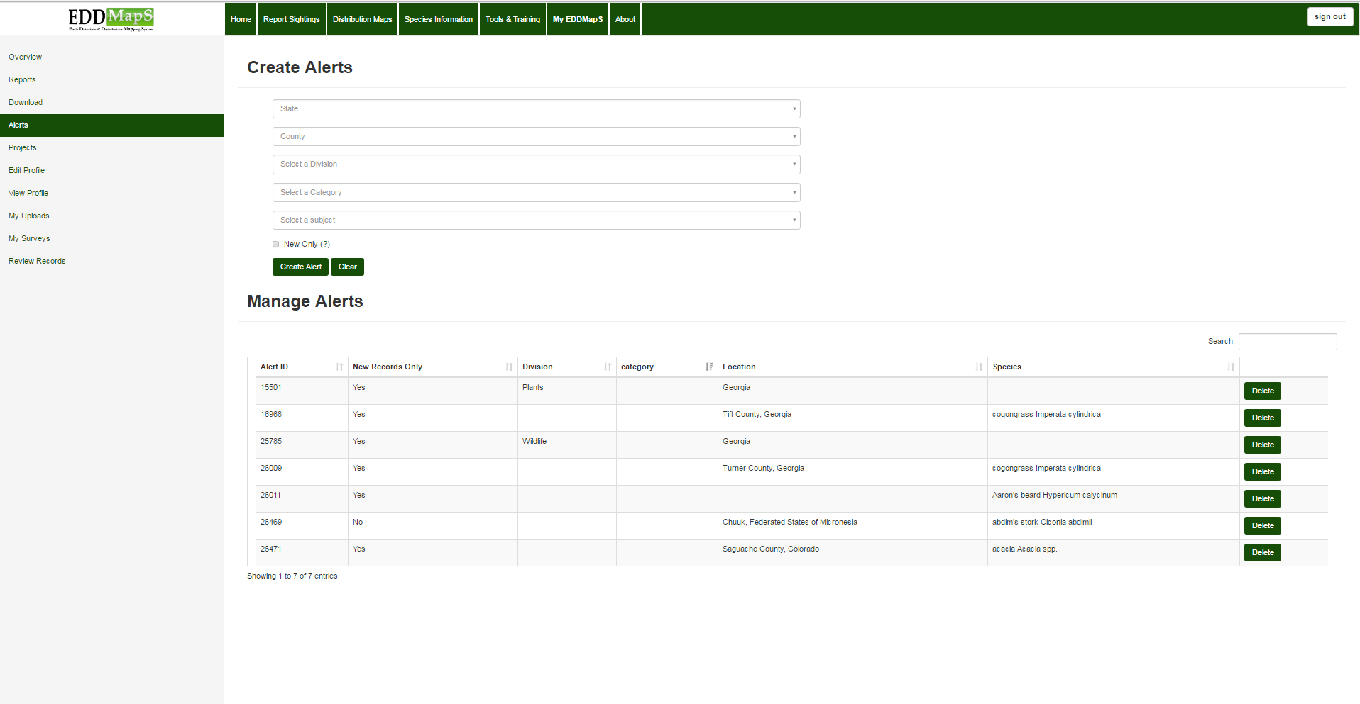
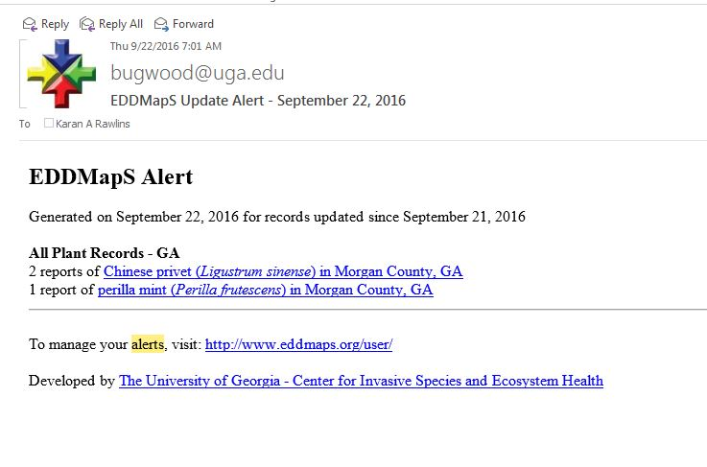
Alerts
Email Notifications and Delete Alerts
Quickly Delete any Alert
When a report meets the criteria you choose, you will receive an email alerting you. It is so easy to change or delete an alert, that it’s a quick fix if you get more emails than you expect.
Quickly Delete Alerts with the click of a button.
Notes:
When a report meets the criteria you choose, you will receive an email alerting you. It is so quick and easy to change or delete an alert, that it’s easy to fix if you get more emails than you expect. Quickly Delete Alerts you have set up with the click of a button.

Slide 9
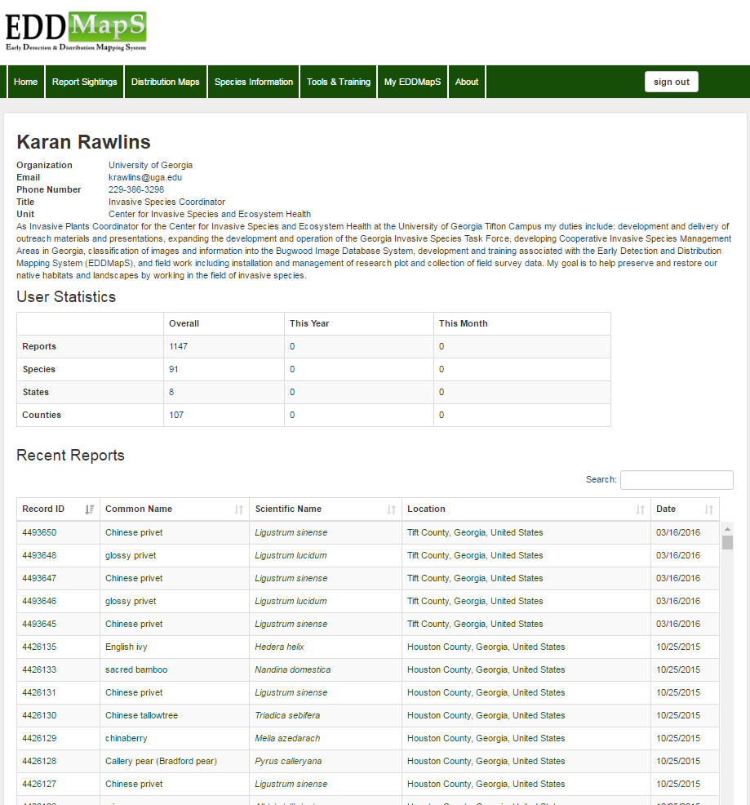
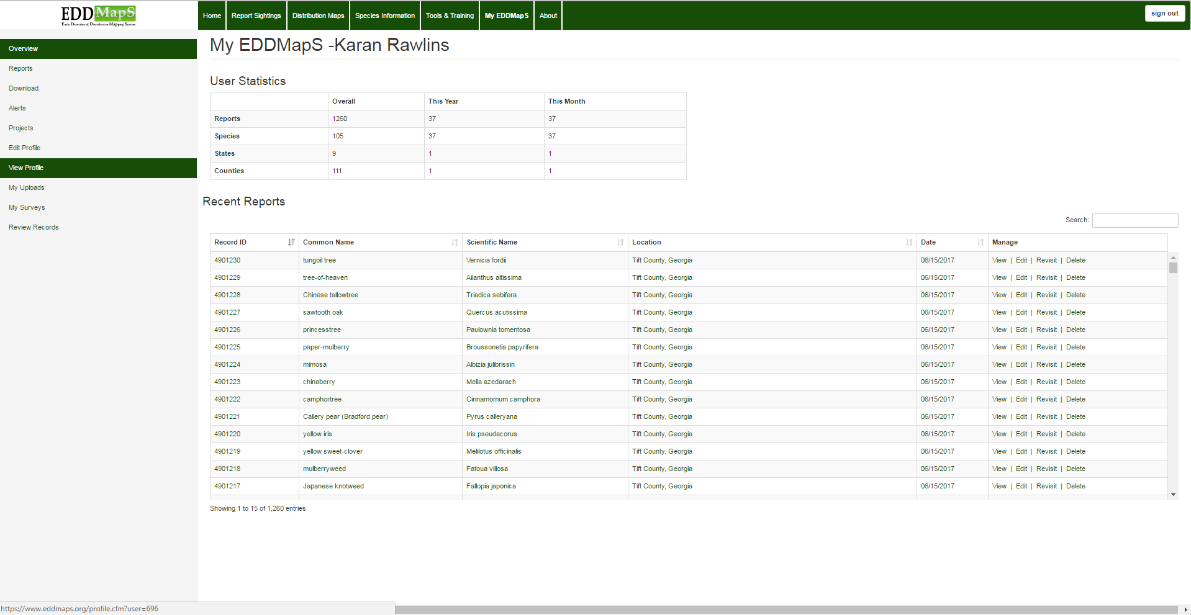
View Your Profile
You can add a picture and a logo
Notes:
Your profile is easy to view and edit. From your My EDDMapS dashboard, click on View Profile. You can add a picture and a logo if you want to.

Slide 10
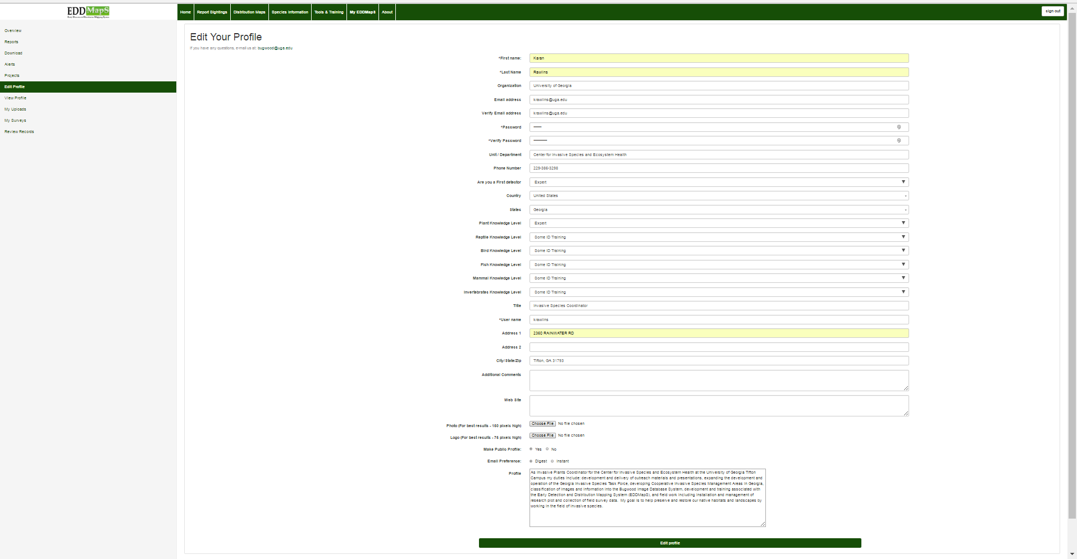
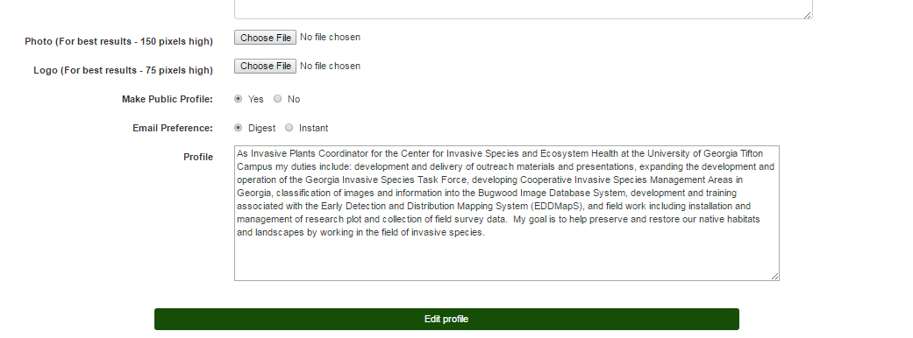
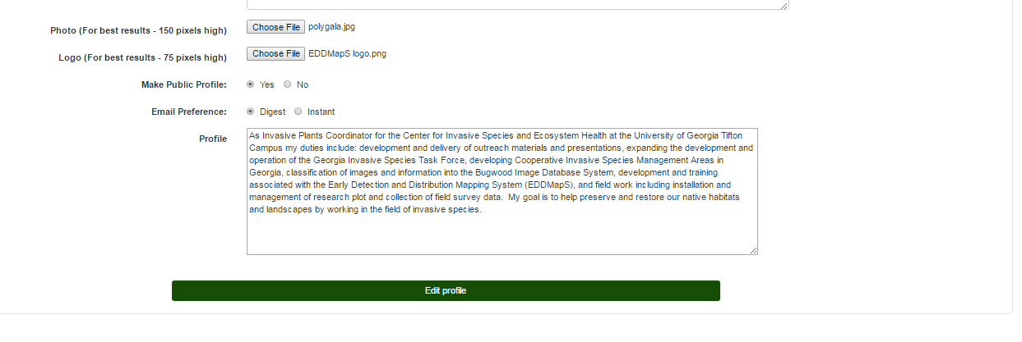
Edit Your Profile
Add, update or delete any information that has changed
You can add an image and logo to your profile
Click on Choose File
Your file is ready
Special Note:
Photo (For best results - 150 pixels high)
Logo (For best results - 75 pixels high)
Photo and Logo need to be jpg’s
Remember to click Edit Profile to save your changes
Notes:
Edit your profile. Add, update or delete any information that has changed. You can add an image and logo to your profile. Special Note: Photo (For best results - 150 pixels high); Logo (For best results - 75 pixels high); Photo and Logo need to be jpg’s. Remember to click Edit Profile to save your changes.

Slide 11
Edit Your Profile
If it didn’t update…
Double check that your emails match
Email address
Verify Email address
Double check that your passwords match
*Password
*Verify Password
Remember to click Edit Profile to save your changes

Slide 12
Thank you for participating in this EDDMapS training.
This and other trainings are available on the EDDMapS Website.
EDDMapS.org
For Questions Contact Rebekah Wallace at bekahwal@uga.edu
Or Karan Rawlins at krawlins@uga.edu
Notes:
Thank you for participating in this EDDMapS training. This and other trainings are available on the EDDMapS Website.

