Slide 1

Training
Edit and Revisit Your Data
Notes:
Welcome to this EDDMapS training. We will cover how to add revisits to existing reports and how to edit the data in your reports.

Slide 2
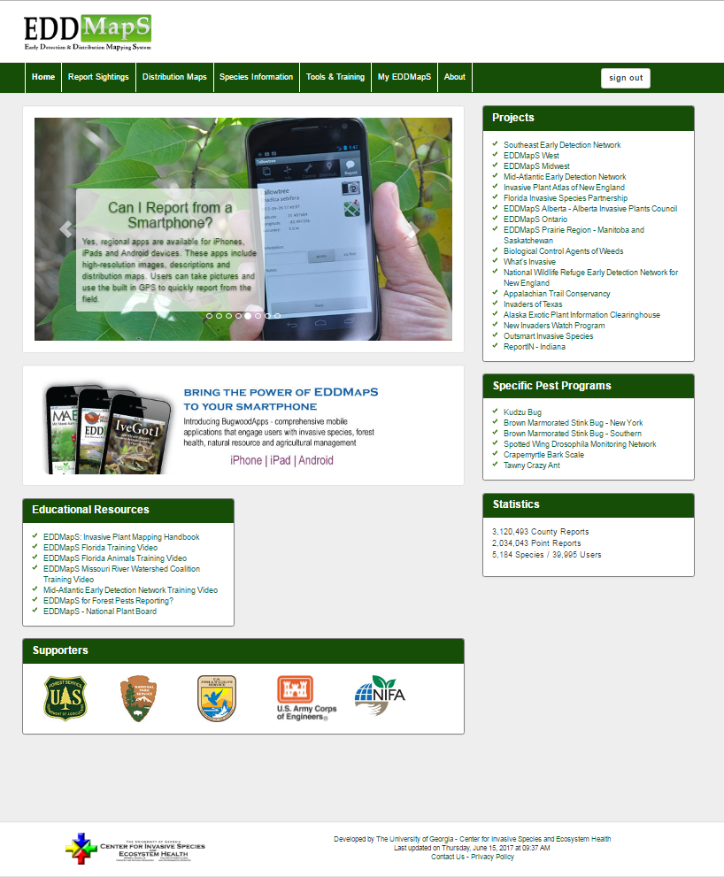
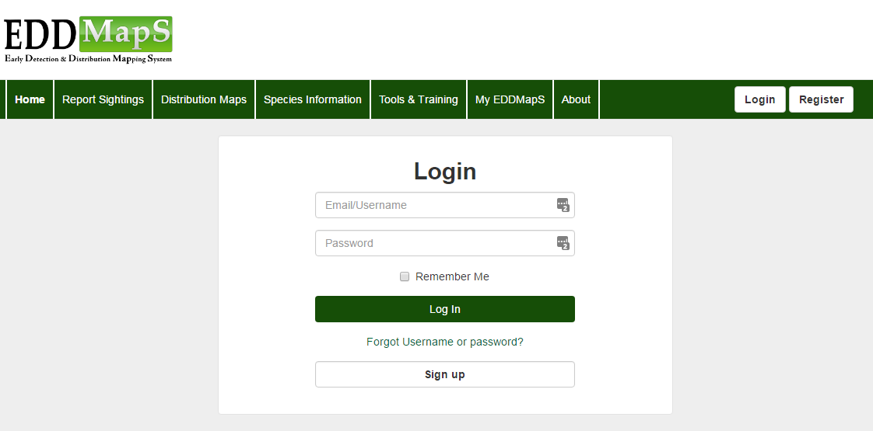

First Step – Login
Notes:
EDDMapS allows you to add revisits to reports previously submitted. Revisits allow you to add information on monitoring and management activities to the original report of an infestation. The Revisit is a separate note that is permanently attached to the original report. The Edit feature allows you to correct mistakes and/or add additional information and images to the original report. To get started the first step is to Login.

Slide 3
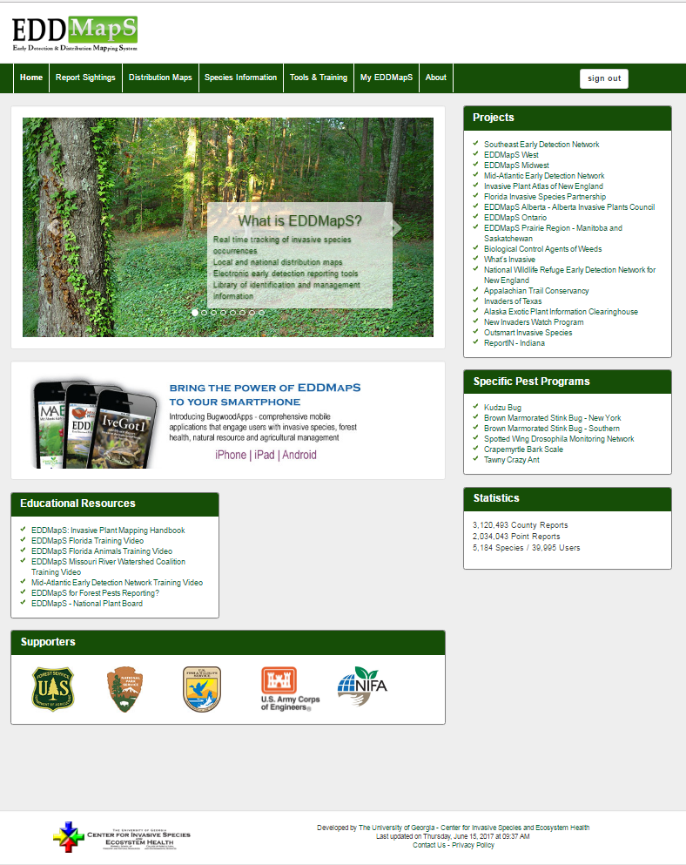
Click on
My EDDMapS
Notes:
After signing in, click on My EDDMapS. This takes you to the dashboard for your EDDMapS page.

Slide 4
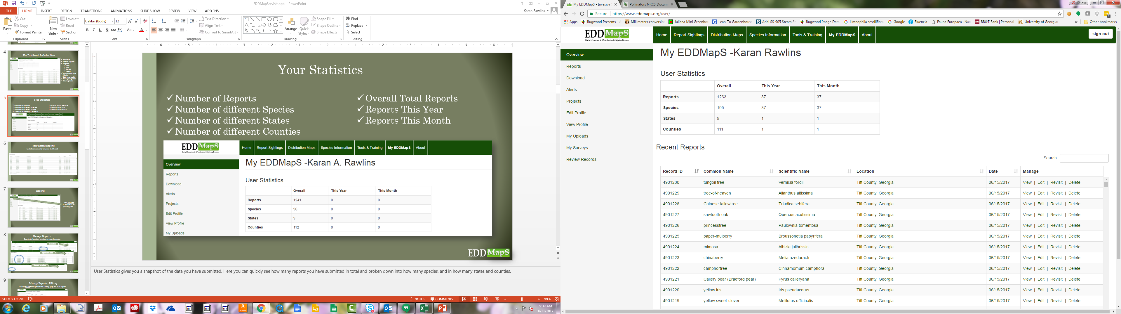
The Dashboard Includes Your:
Statistics
Recent Reports
Reports
  View
  Edit
  Revisit
  Delete
Download data
Alerts
Edit your profile
View your profile
Your uploads
Notes:
The Dashboard Includes your: Reports which you can View, Edit, Revisit, or Delete. This is also where you can find your Downloaded data; manage your Alerts; View or Edit your profile; Upload data in bulk; and view Your uploads. The goal for this training will be to cover how to Edit and Revisit the data in the records you have submitted.

Slide 5
Your Statistics
Number of Reports
Number of different Species
Number of different States
Number of different Counties
Overall Total Reports
Reports This Year
Reports This Month
Notes:
User Statistics gives you a snapshot of the data you have submitted. Here you can quickly see how many reports you have submitted overall or this year or this month. It is also broken down into how many species, in how many states and counties.

Slide 6
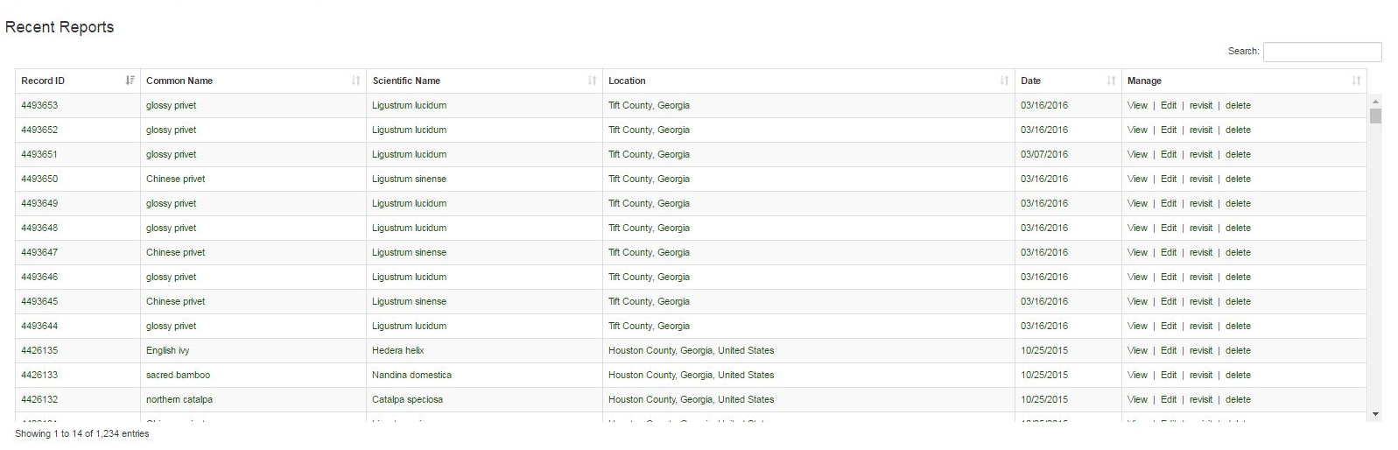
Your Recent Reports
Listed conveniently on your dashboard
Notes:
What you see when you fist enter your dashboard are your most Recent Reports, but you can access all of your reports from here. You can more quickly and easily locate records to view, edit, revisit, delete or download them.

Slide 7
Manage Reports
Click Reports to access all of your reports
Notes:
Click Reports to access all of your reports.

Slide 8
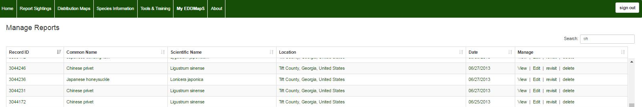
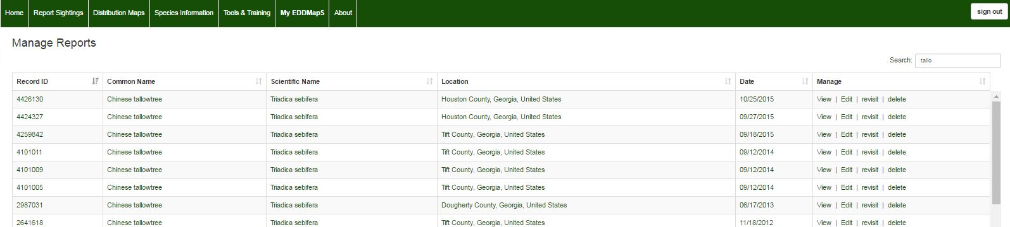
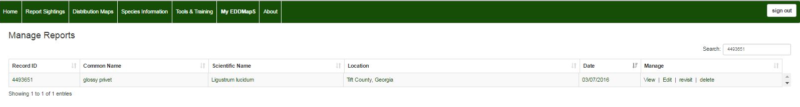
Manage Reports
Search by location, species, or record number
Location
tift
Species name
tallo
Record number
4493651
Notes:
You can search by different criteria under Manage Reports. You can search by record number, location, species (using scientific or common name), or date.

Slide 9
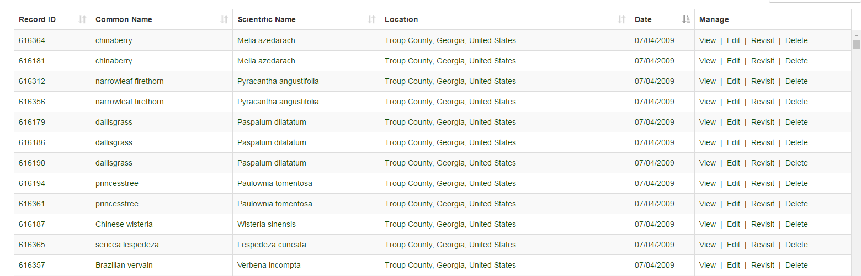
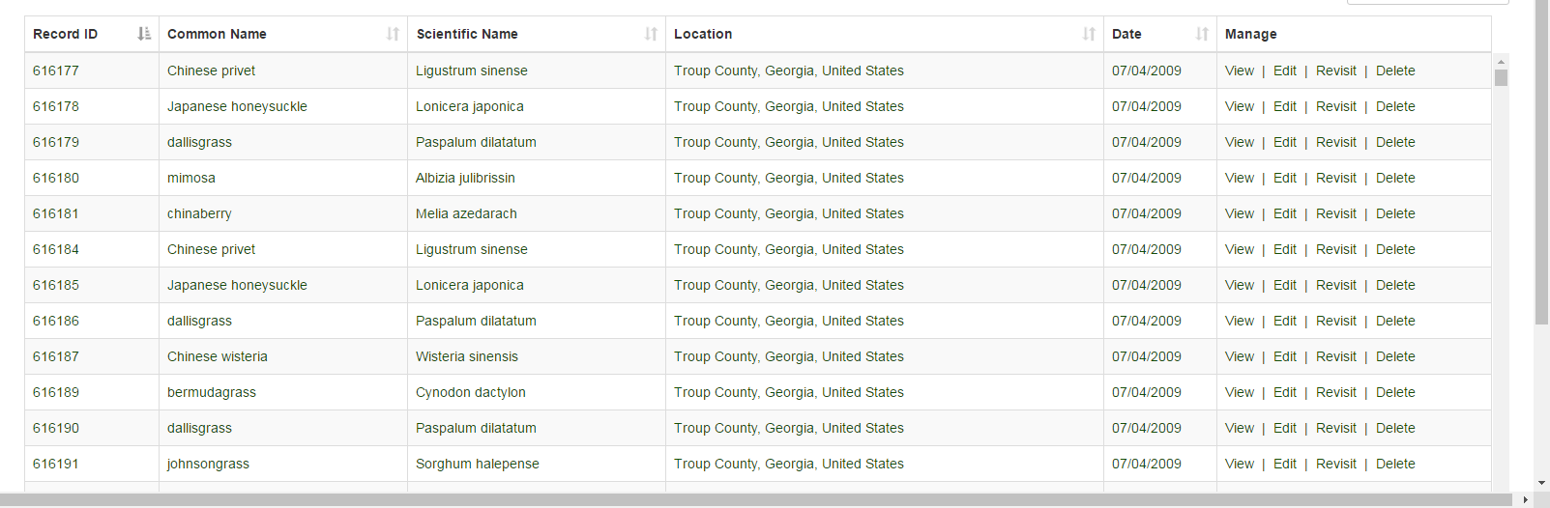
Manage Reports
Click the top of a column to reorder records to according to your needs
By Date
By Record Number
Most recent
Earliest
First record
Oldest
Notes:
Clicking on the top of a numerical column sorts the records from lowest to highest record number or date, and click that column again to sort it from highest to lowest. You can easily find all of your records from 07/04/2009, for example.

Slide 10
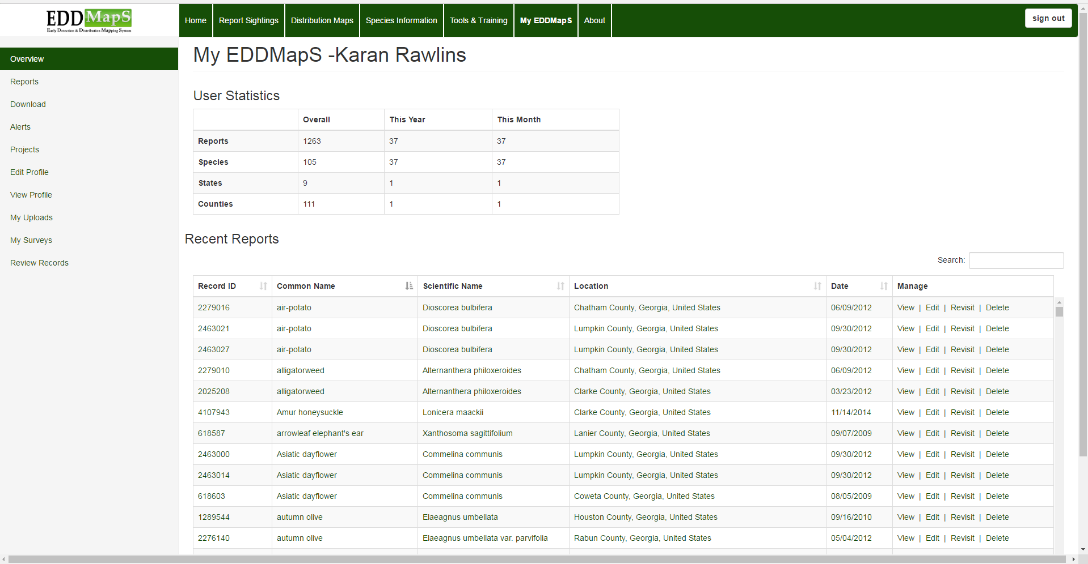
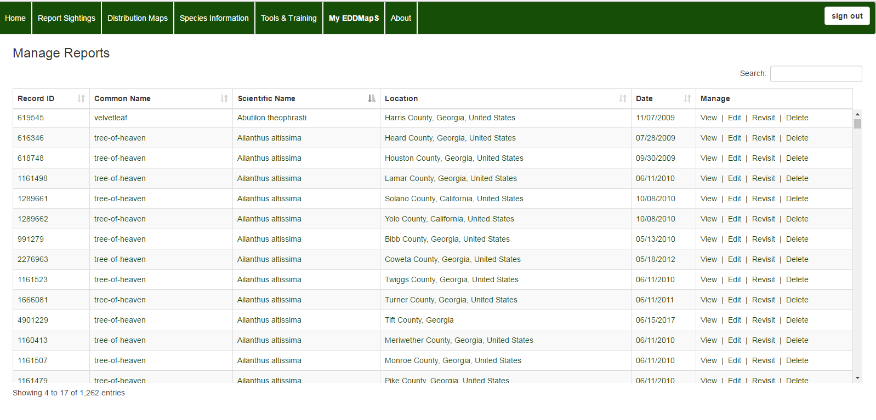
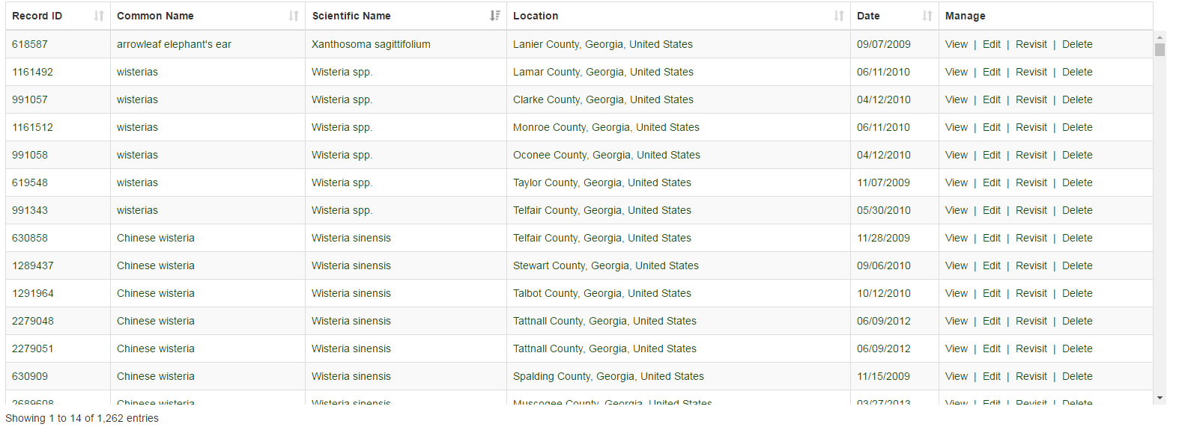
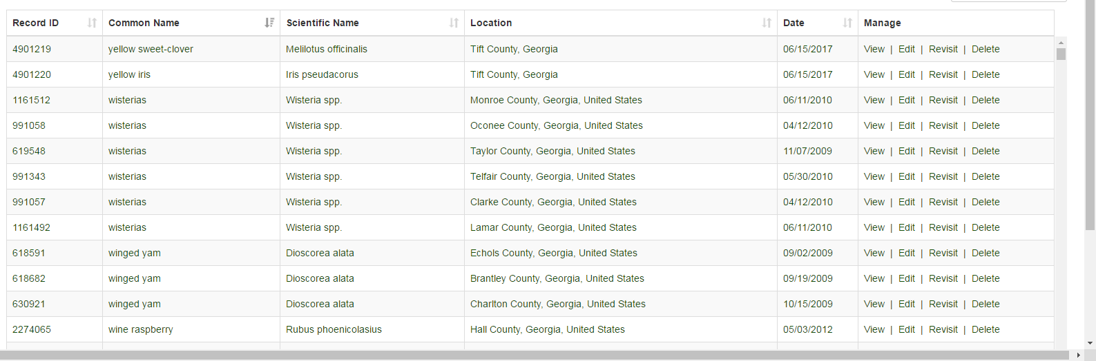
Manage Reports
Click the top of a column to reorder records to according to your needs
A to Z
A to Z
Z to A
Z to A
Notes:
You can also click on the top of the scientific name or common name to alphabetize the entries from A to Z or from Z to A. You easily find all of your reports on Wisteria.

Slide 11
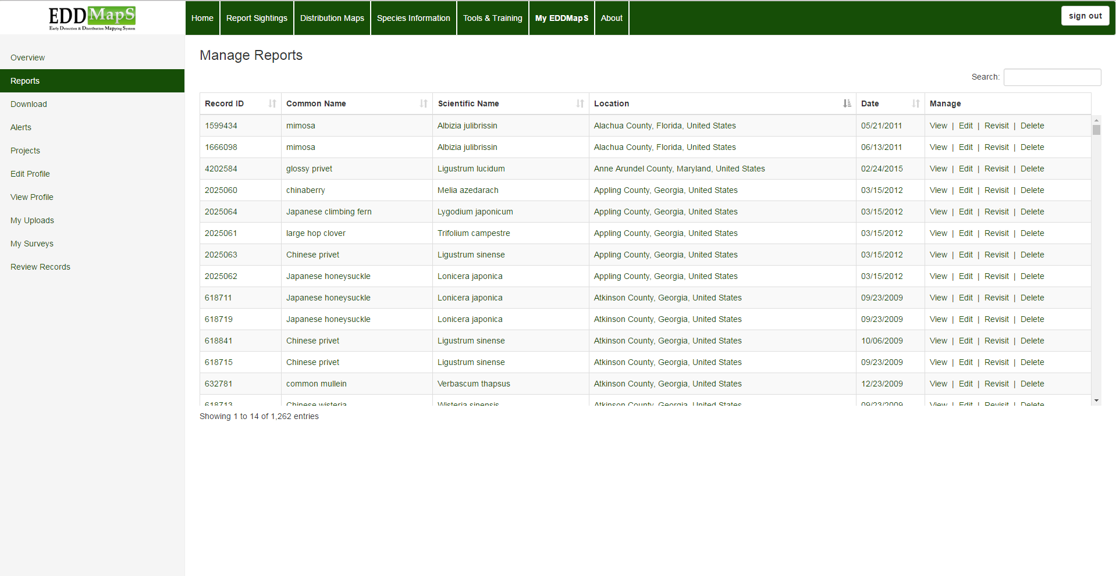
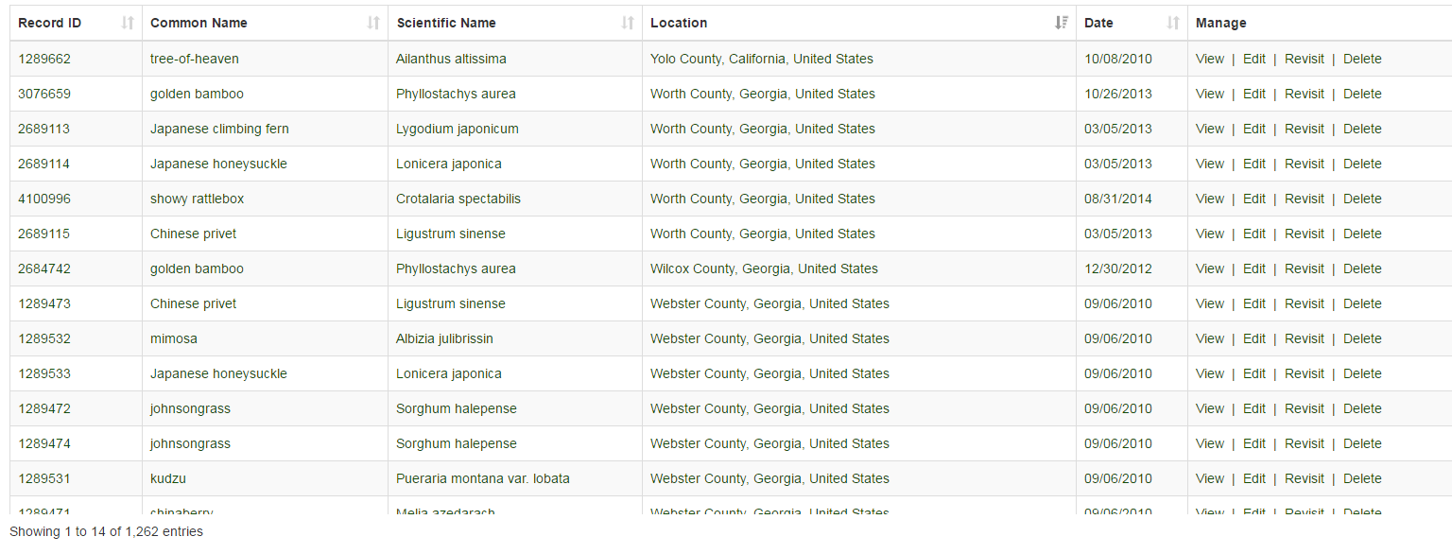
Manage Reports
Click the top of a column to reorder records to according to your needs
A to Z
Z to A
Notes:
You can also click on the top the location column to alphabetize the entries from A to Z or from Z to A. So you can easily find all the records you submitted in Appling County, Georgia.

Slide 12
Manage Reports - Editing
Clicking Edit takes you to the editing page for that report
Notes:
Clicking Edit takes you to the editing page for a particular report.

Slide 13
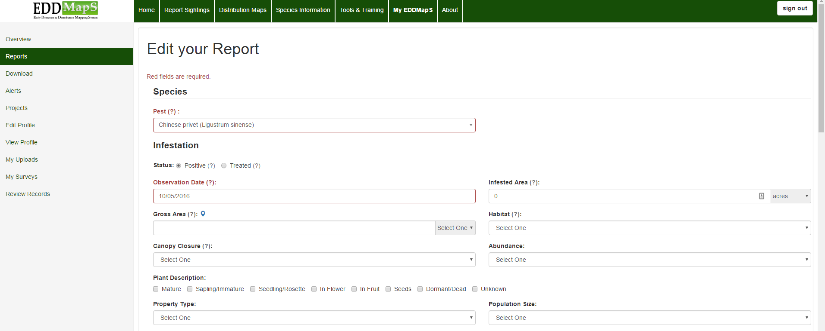
Manage Reports - Editing
You can edit reports you submitted
  On EDDMapS website
  From the smartphone apps
First section Information
on the invasive pest
Notes:
You will have the same fields as the original EDDMapS web form available to edit. You can edit reports you submitted through the EDDMapS website or through the smartphone app. Edits must be completed before the record is verified.

Slide 14
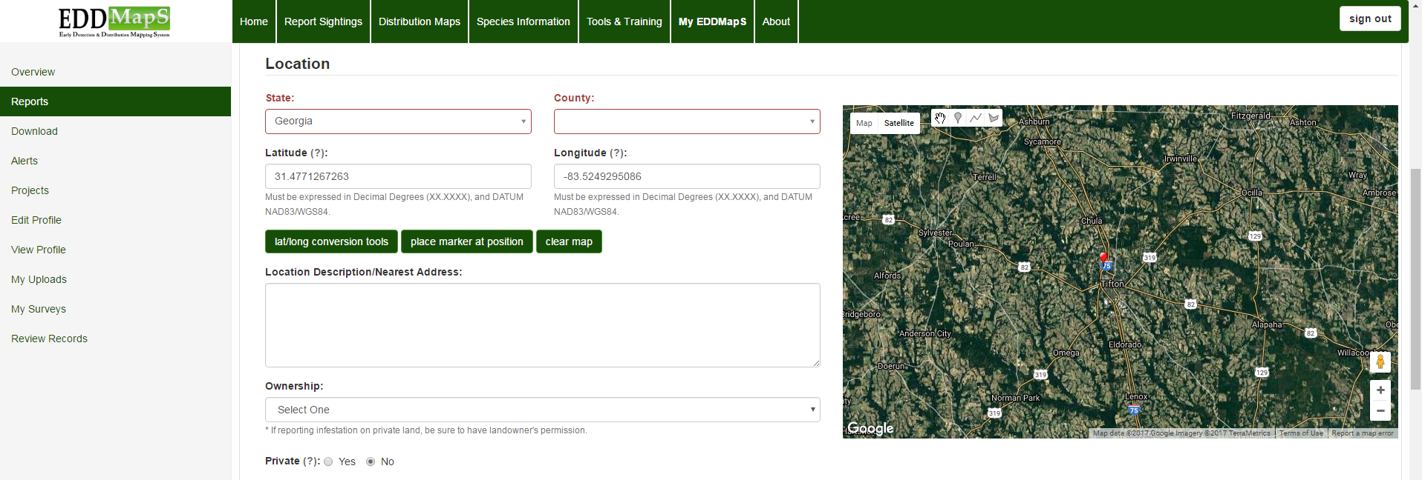
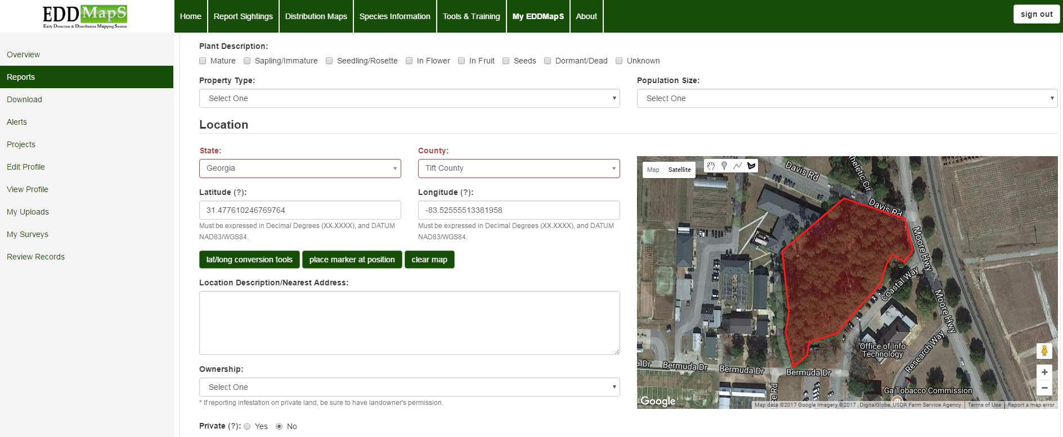
Manage Reports - Editing
Scroll down to Location information
Point
Click on the polygon tool on the map. Now every click of your mouse drops a point on the map, so you can draw the outline of the infested site.
Polygon
You can draw multiple polygons for the site. After you finish your first polygon, click on the polygon icon again to draw another polygon.
Notes:
Next scroll down to the Location information. Additional description of the infested site or details on how to locate can be added easily here. You can change a report from a point to a polygon, by clicking on the polygon tool on the map. Now every click of your mouse drops a point on the map, so you can draw the outline of the infested site.

Slide 15
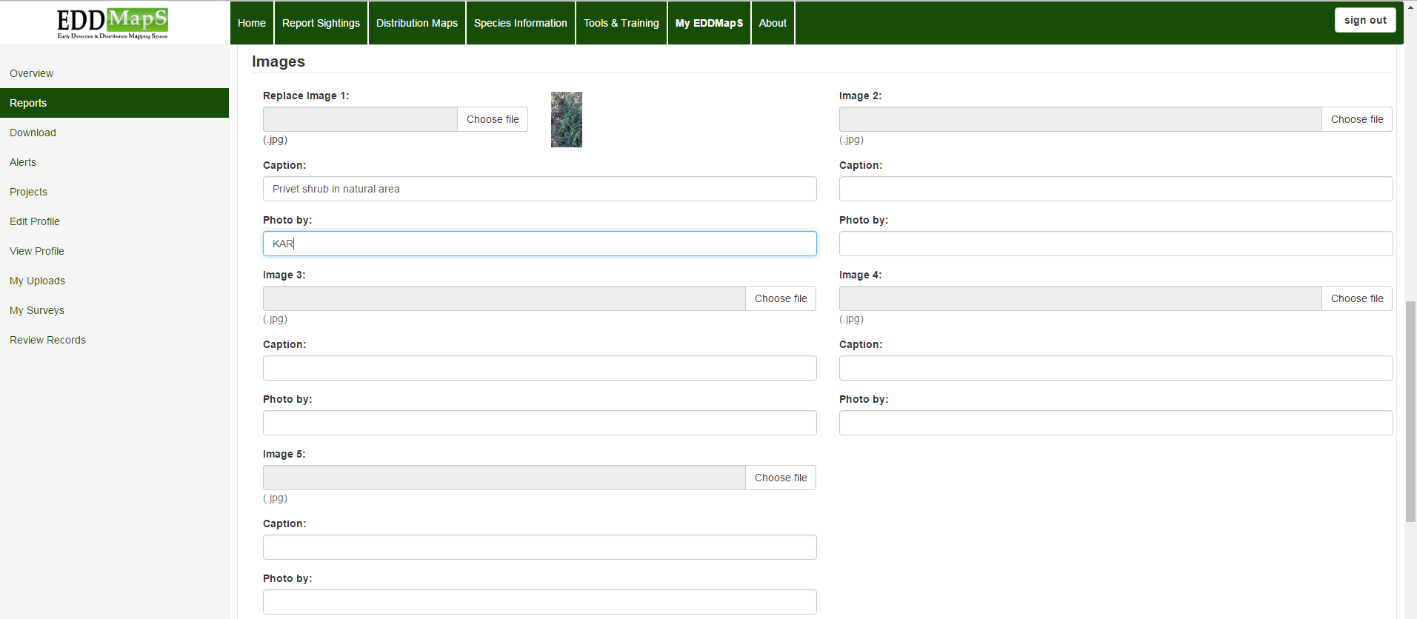
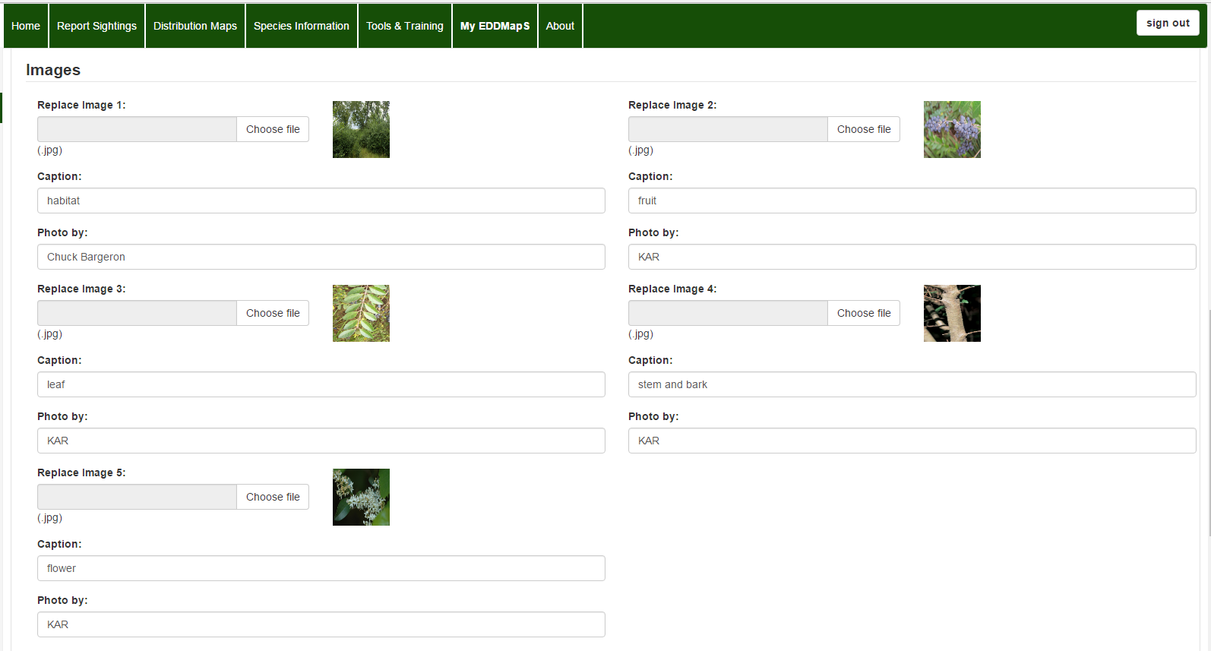
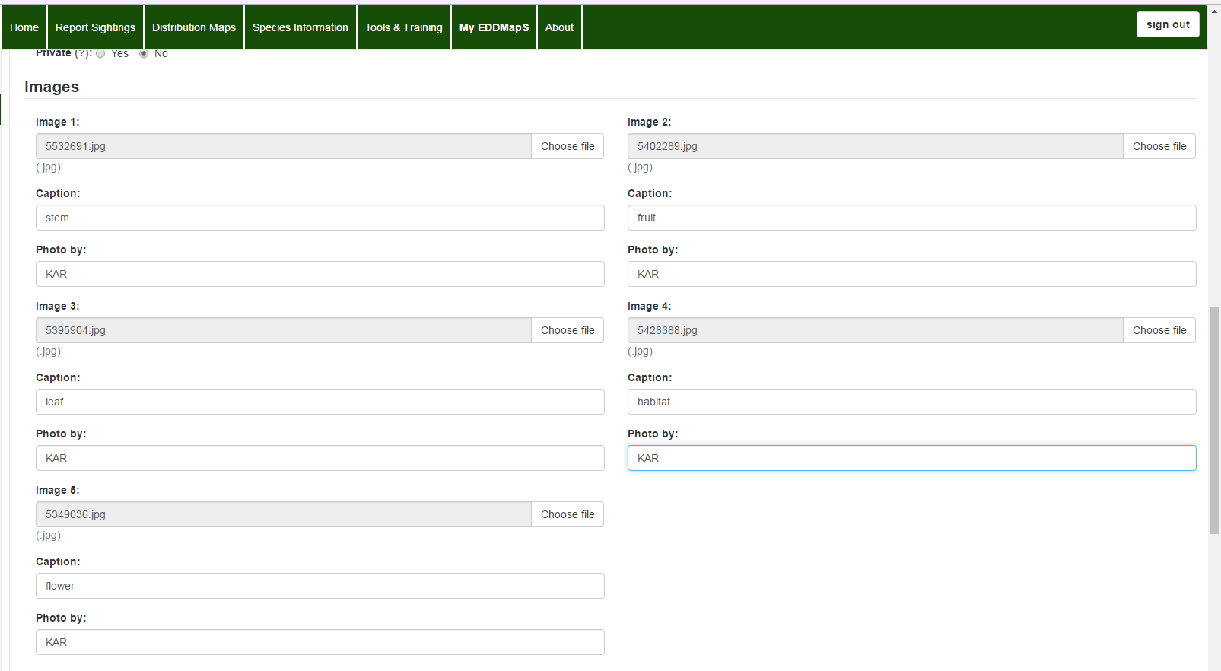
Manage Reports - Editing
Scroll down to the Images section
You can Upload additional images
Photos of identifying characteristics such as flowers, fruit, leaves, bark and stems are good to include to help make identification of the species easier
Notes:
Scroll down to the Images section. From here you have the ability to add or delete images in your report. Clicking on Upload file allows you to choose and upload an image or images that you have already downloaded to your computer. You can use the caption field to label plant parts or add other information on the image. Use Photo by to give credit if someone other than you took the pictures of the invasive organism or infestation.

Slide 16
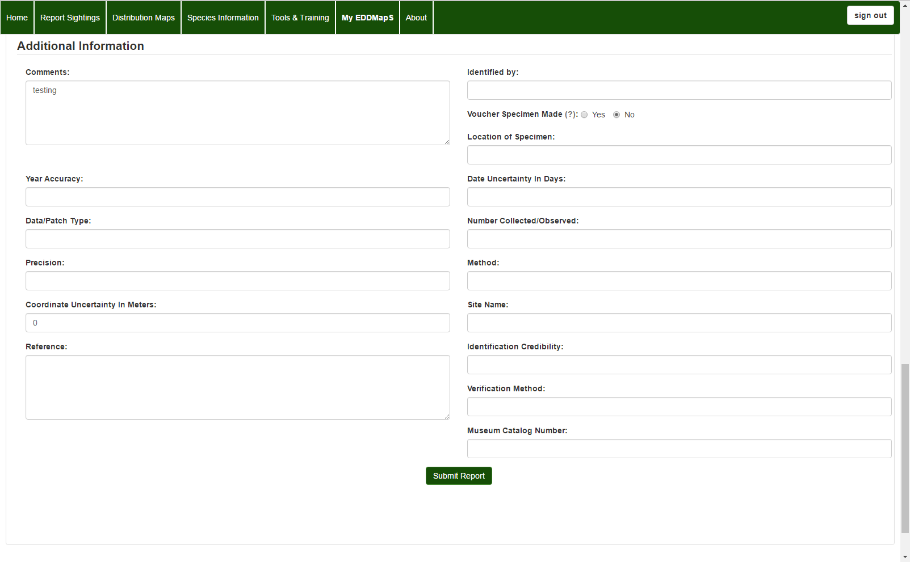
Manage Reports - Editing
Scroll down to the end to
Edit Additional Information as needed
If you collect a specimen to submit to an herbarium, the information would go here.
Some fields have been added to allow bulk data records to be edited if necessary. So if you aren’t sure what a field on the form is asking for, leave it blank.
Remember you can always contact us if you have a question.
Remember to Submit Report
Notes:
Scroll down to the end of the page to add any Additional Information that might be needed. It is also the place to record herbarium information if you collect a specimen to submit. Remember to click on Submit Report when you are finished. Some fields on the reporting form are used by specialty groups, so just leave it blank if you aren’t sure what it is asking for. And remember you can always email us with a question, anytime.

Slide 17
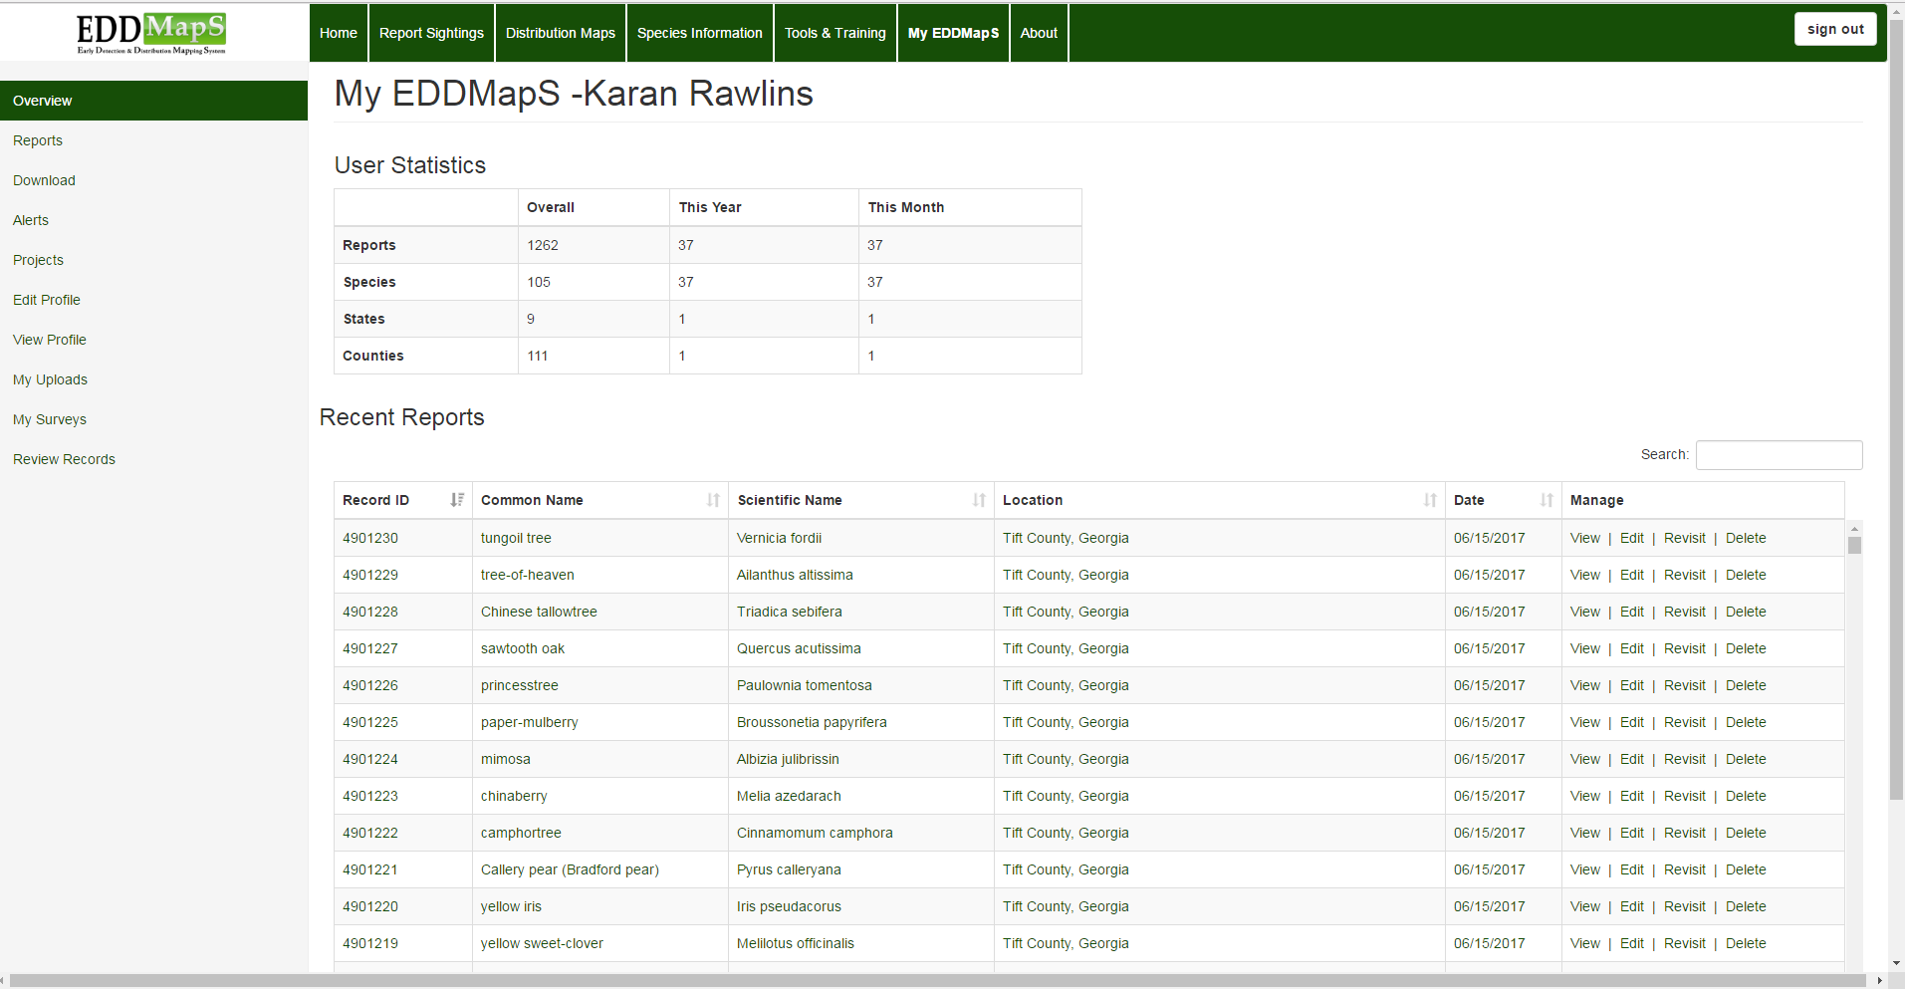
Manage Reports - Revisits
Revisits can be used to record
Monitor site for changes in the infestation over time
Document treatment plans, actions and outcomes
Click on Revisit
Notes:
Manage Reports – Revisits. Revisits are used to record Changes in the infestation over time and to Document management plans, actions and outcomes. Click on revisit to begin.

Slide 18
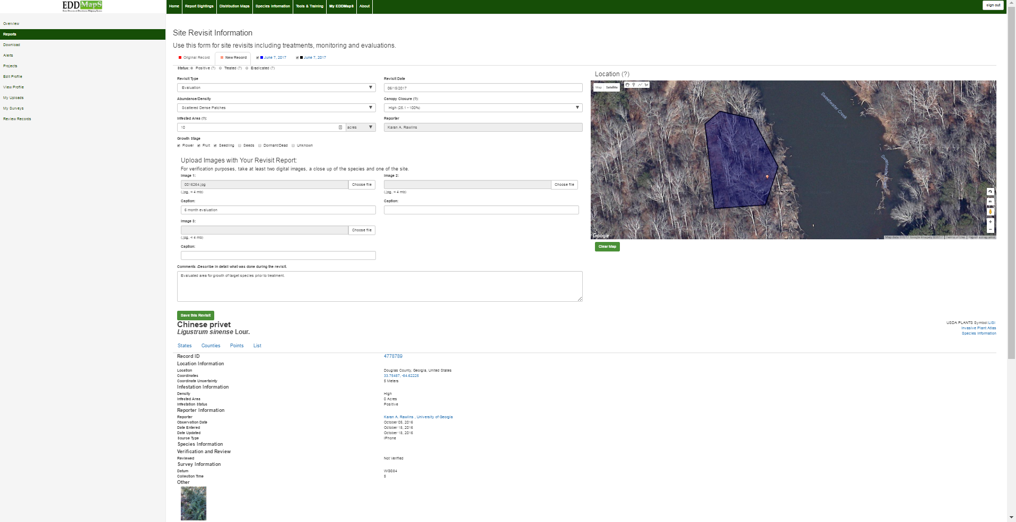
Manage Reports - Revisits
The original record and its revisits are permanently linked
Revisit
Original record
Notes:
The original record and all of its revisits are permanently linked. You can add as many revisits as you need to document the treatment and eradication of an infestation.

Slide 19
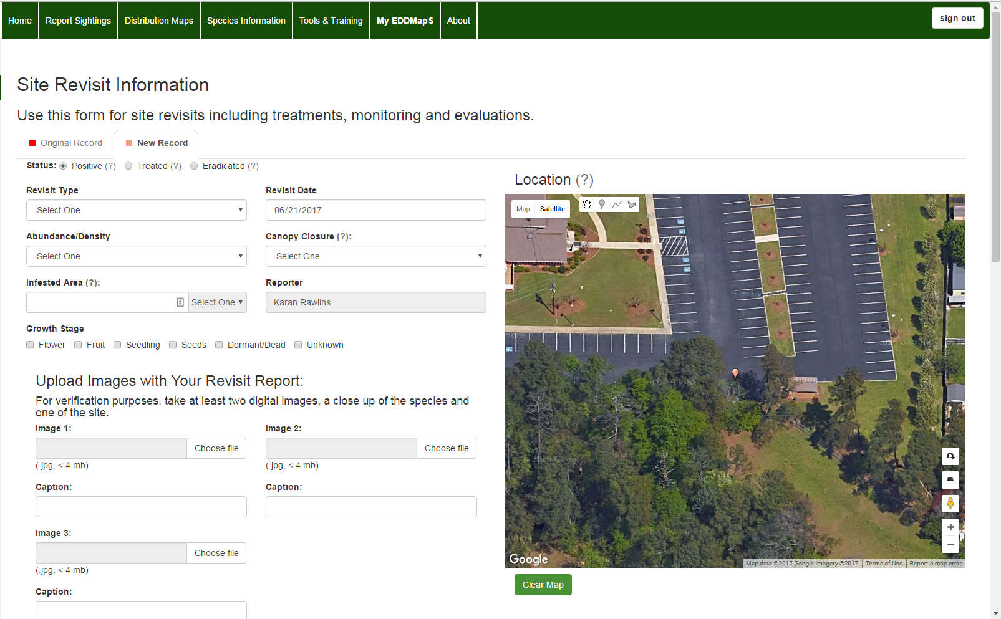
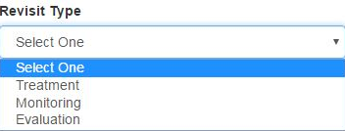
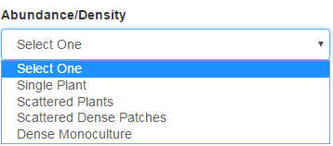
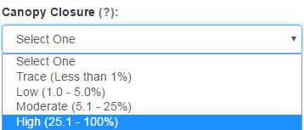
Manage Reports - Revisits
Drop down menus make documenting the site quicker and more consistent
Treating an infestation - Has the infestation changed? Choose the one that fits best now
Notes:
Treatment plans and/or the results can be added as a revisit. In this Revisit we are documenting a treatment that was carried out on the infestation. In Revisit Type we chose Treatment; in Abundance/Density we chose Scattered Dense Patches; and we chose High for Canopy Closure. Dropdown menus help make documenting quicker and more consistent.

Slide 20
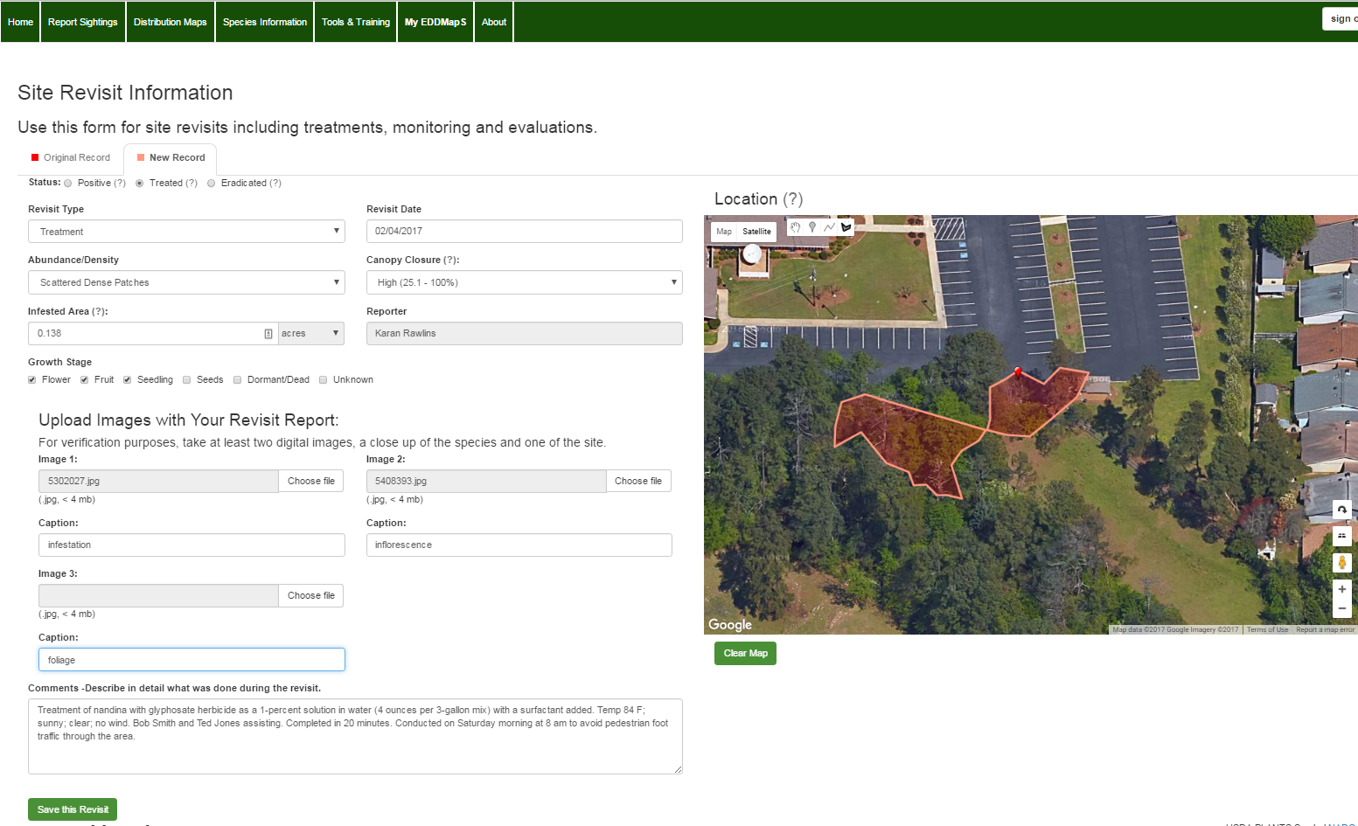
Manage Reports - Revisits
Treatment plans and/or the results can be added as a revisit
Add more images when needed
You can include the necessary details of the treatment to the Comments box .
Notes:
In this revisit we added additional images and we included details of the treatment, which was carried out. Use the Comments box to add the specific treatment information.

Slide 21

Manage Reports - Revisits
Treatment plans and/or the results can be added as a revisit
Change the Location from a Point to a Polygon to more accurately show the dimensions of the site. Click on the polygon tool to drop the points and draw the polygon.
Status
Positive – invasive present
Treated – Invasive present but treated
Eradicated!
Every click of the mouse creates a point. If you need a do over, just click on Clear Map at the bottom left hand corner of the map
Save this Revisit
Notes:
Choose the Status: Positive – invasive present; Treated – Invasive present but treated; Eradicated. Change the Location from a Point to a Polygon to more accurately show the dimensions of the site. Click on the polygon tool with your mouse to drop the points and draw the polygon. Every click of the mouse creates a point. Remember you can draw multiple polygons for the site. After you finish your first polygon, click on the polygon icon again to draw another polygon. If you need a do over, just click on Clear Map at the bottom left hand corner of the map. We added additional images. We included details of the treatment, which was carried out, to the Comments box and the last thing remember is to click Save this Revisit.

Slide 22
Thank you for participating
in this EDDMapS training.
This and other trainings are
available on the EDDMapS Website.
EDDMapS.org
For Questions Contact
Rebekah Wallace at bekahwal@uga.edu
Or Karan Rawlins at krawlins@uga.edu
Notes:
Thank you for participating in this EDDMapS training. This and other trainings are available on the EDDMapS Website.

