Slide 1

Training
Uploading Bulk Data
Notes:
Welcome to the EDDMapS training on how to upload multiple records as bulk data to EDDMapS. This is what to do when you have hundreds to many thousands of records on infestations already collected in another database. The quickest, easiest way to get that data into EDDMapS is via the bulk uploading tool.

Slide 2
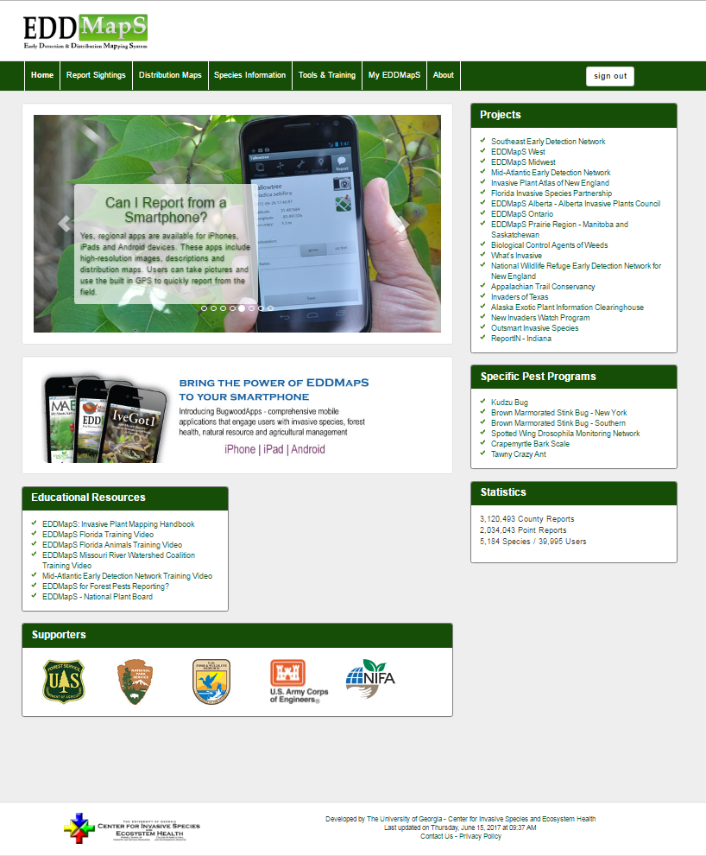
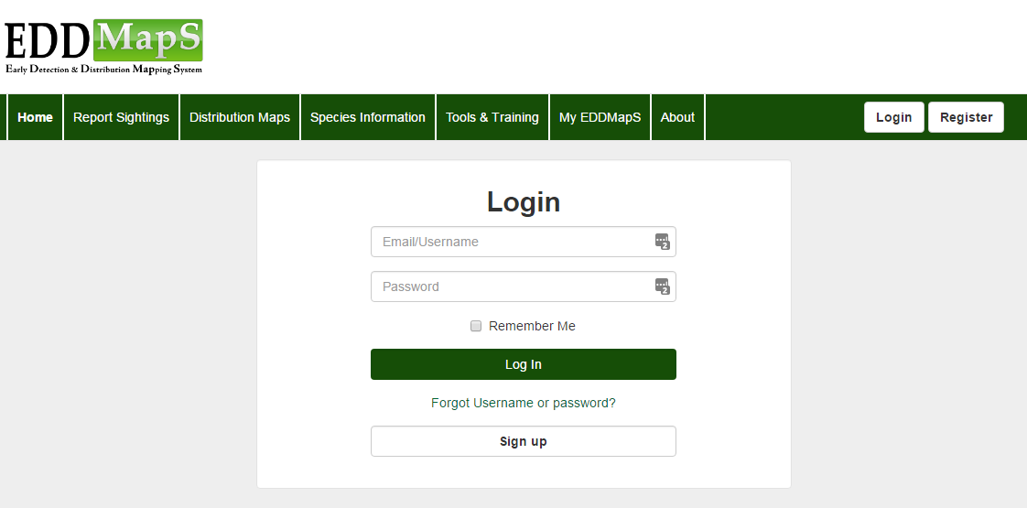

Login to EDDMapS
Notes:
The First step is to Login to your EDDMapS account. Notice, this is also page you can use if you forget your user name or password.

Slide 3
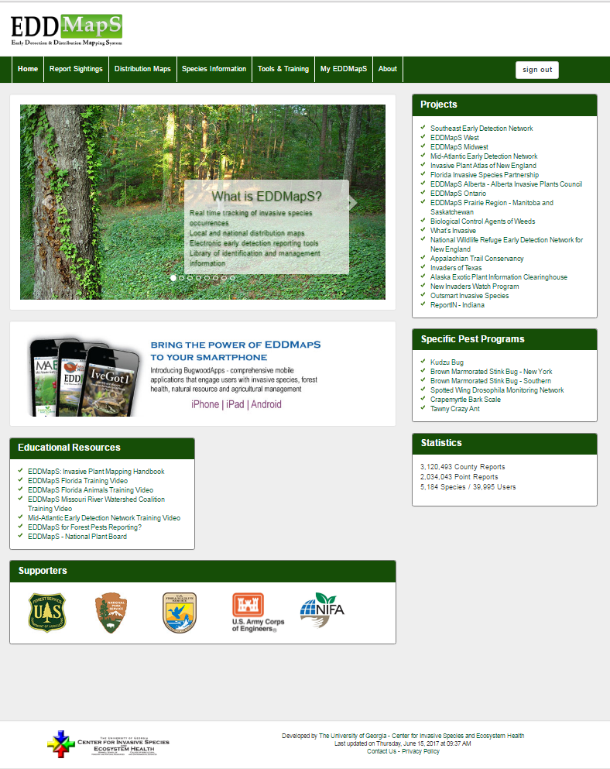
Click on My EDDMapS
Notes:
Now that you are signed in, Click on My EDDMapS to get to your dashboard.

Slide 4
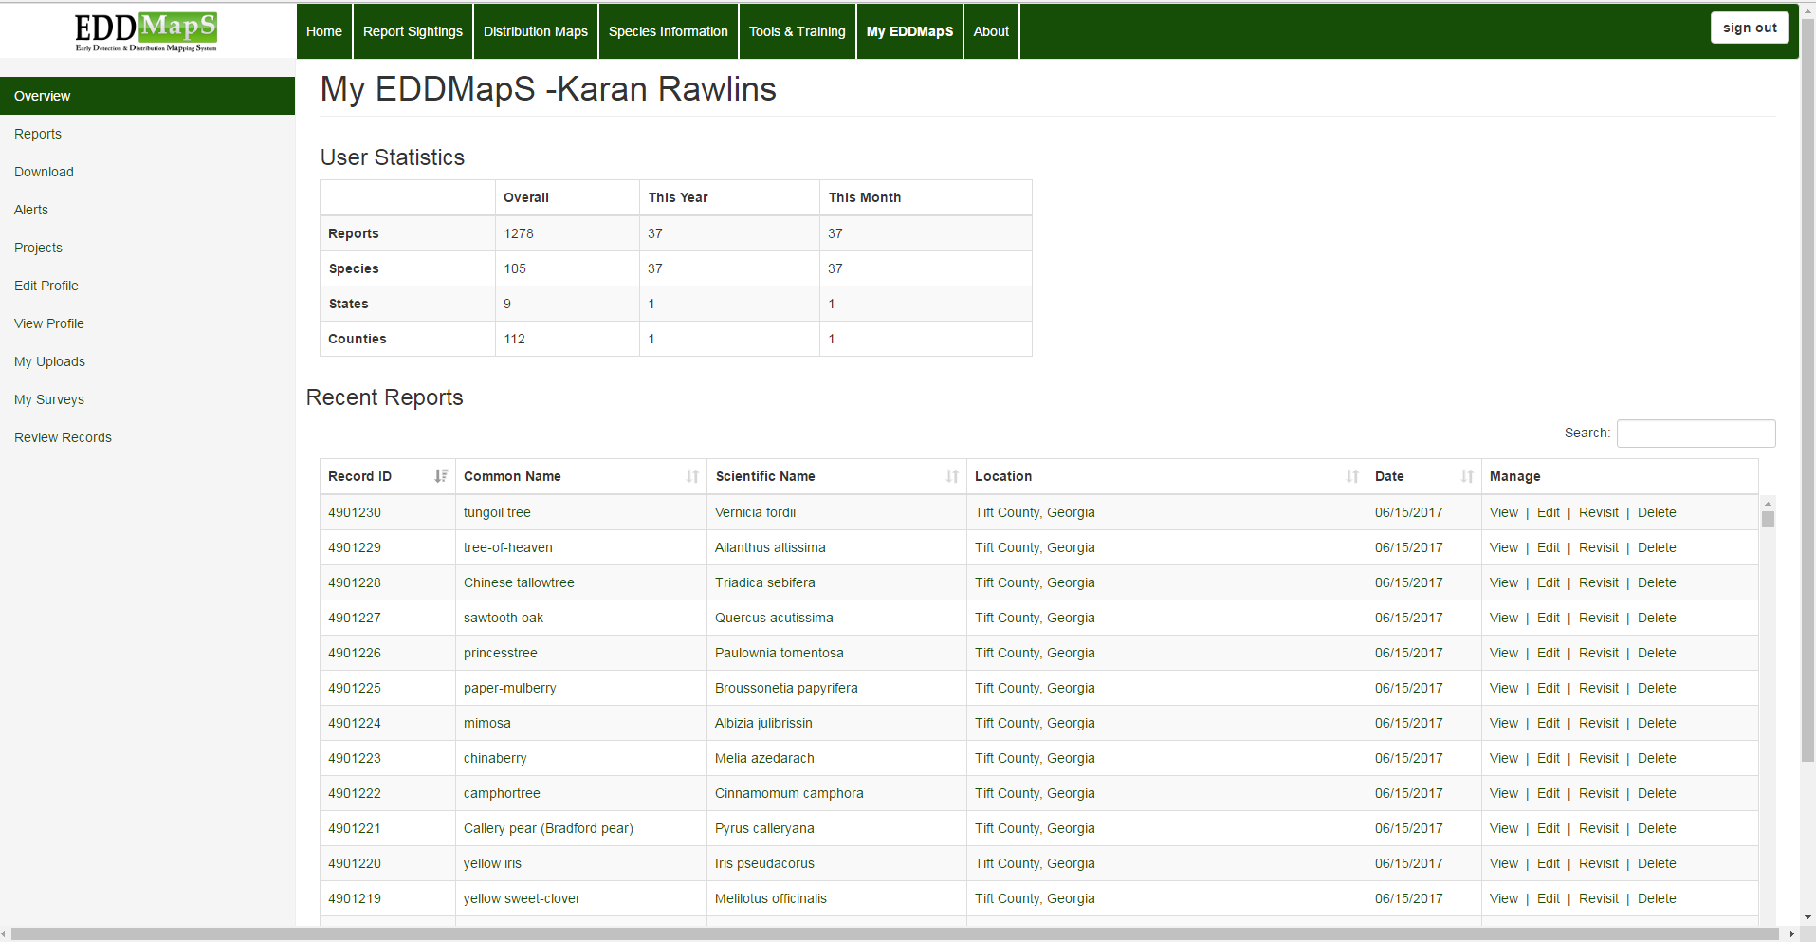
To upload new bulk data or
view your previous bulk data uploads
Click on My Uploads
Notes:
On your EDDMapS dashboard click on My Uploads. This will take you to the upload page where you can upload new bulk data and view your previous bulk data uploads.

Slide 5
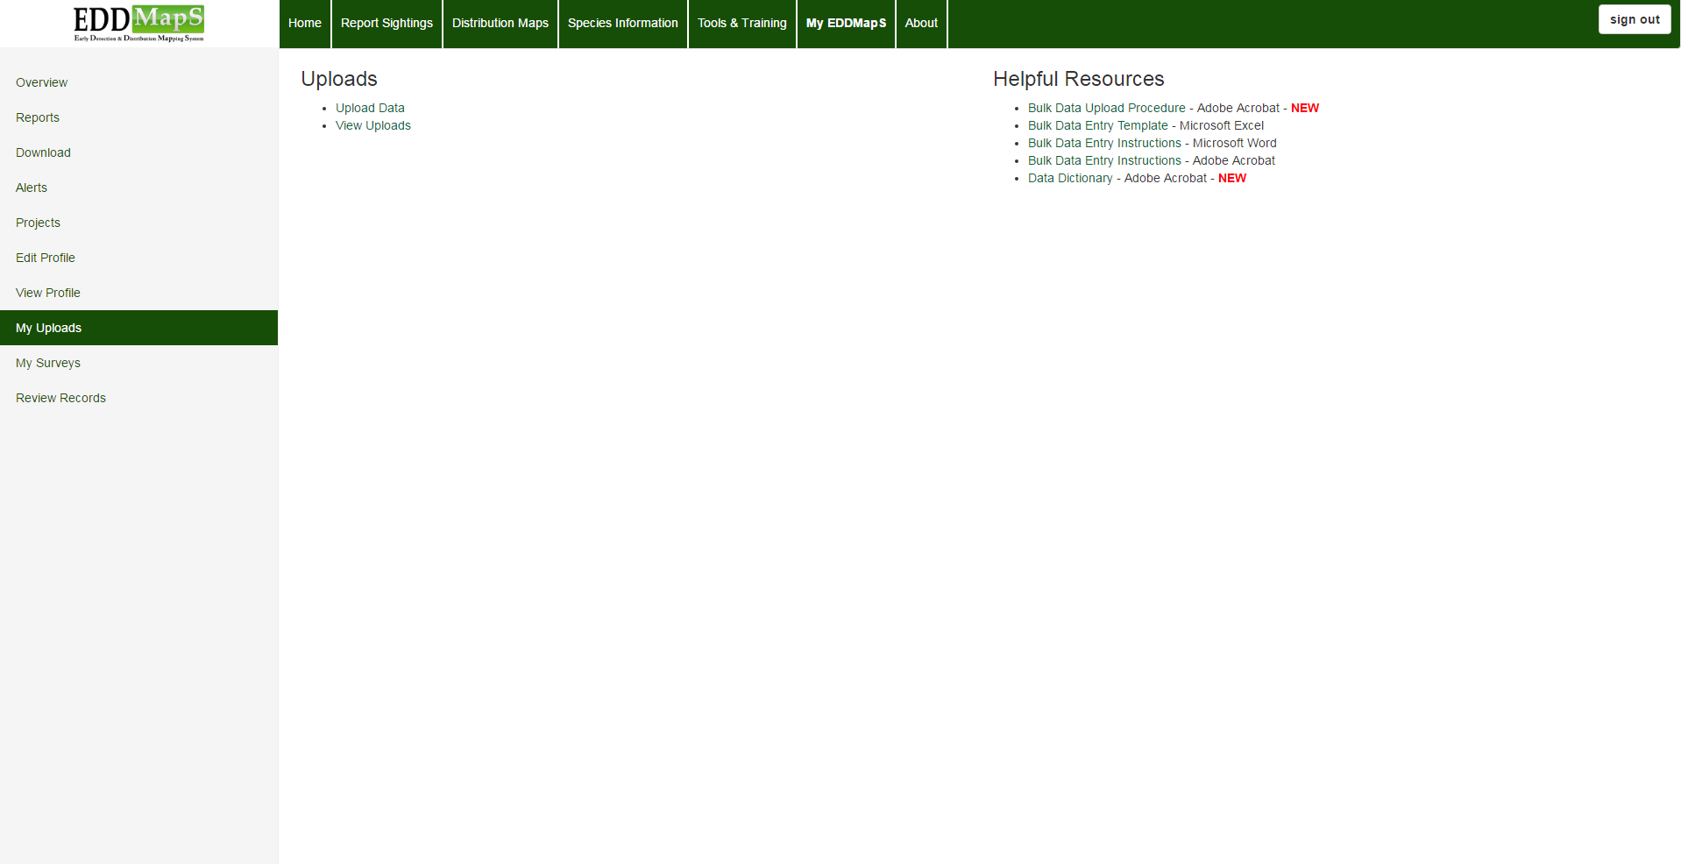
First, how to upload data files that contain multiple records
Click on
Upload Data
to begin
Notes:
To upload data files, which contain multiple records, begin by Clicking on Upload Data.

Slide 6
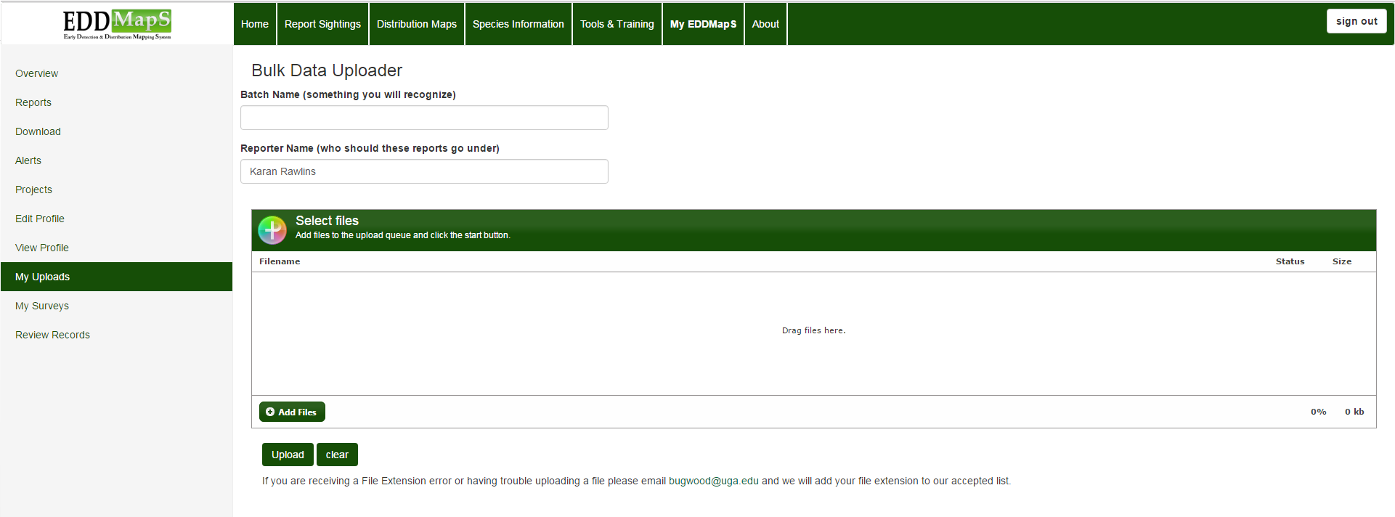
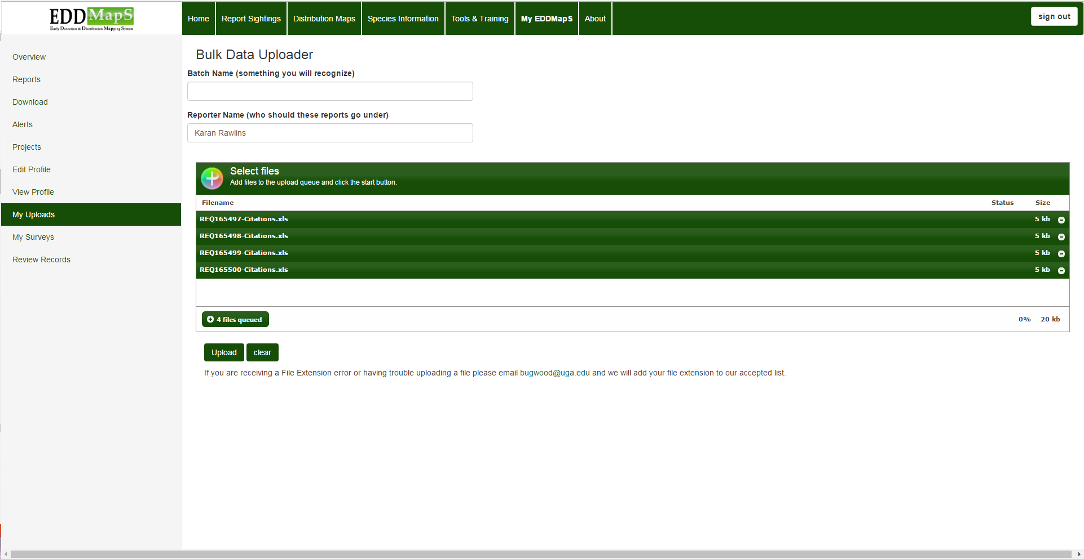
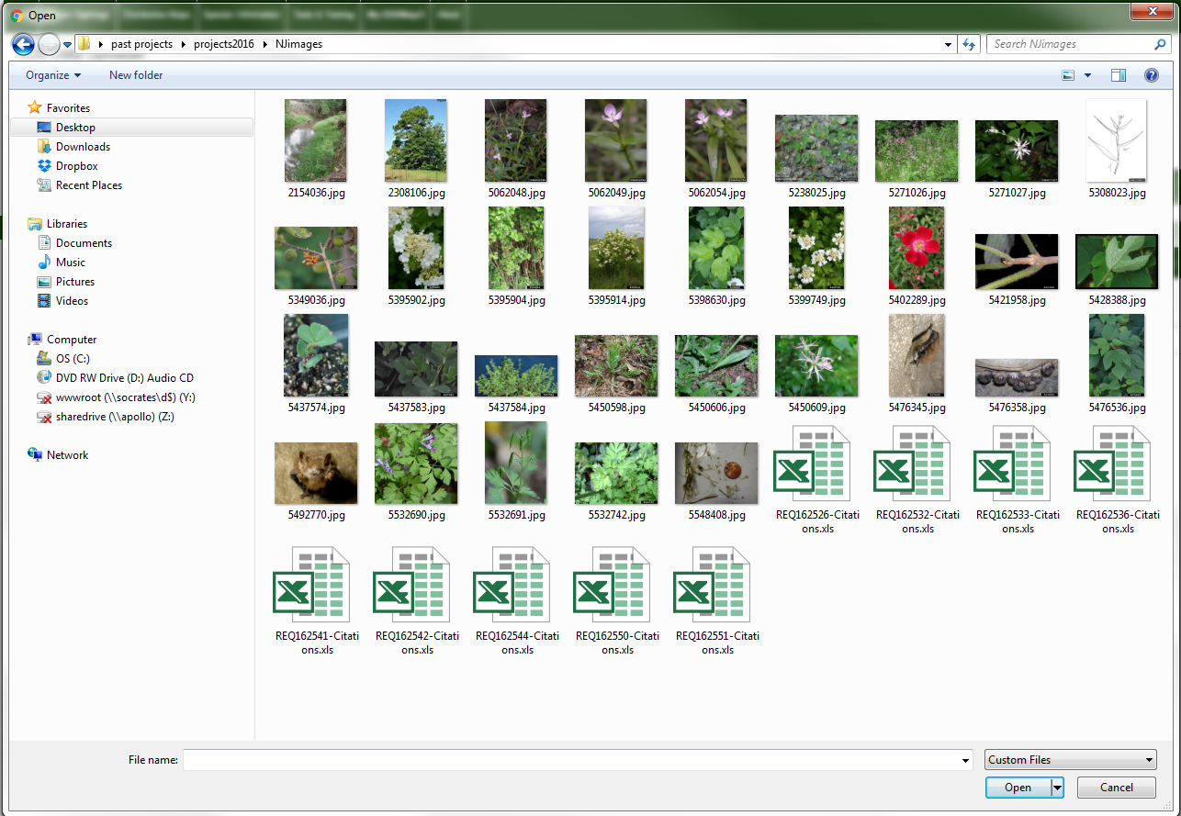
Adding the Files
Batch name is optional
First - Click Add Files to browse to data files, images, metadata, etc. to load to the Upload Queue
Files show in queue here
Remember! - When finished, click Upload And you are done
Notes:
You can add a batch name to make it easier for you to identify the file at a later date. For example the name might reflect where and/or when the data was collected, as in “ReedBinghamStatePark.2016”. Click Add Files to find the files you want to upload from your computer, for example Excel files, images, metadata, etc. . You will be able to see the name of the files in the queue. When you have finished uploading everything to the queue click on Upload. If you receive a File Extension error or you are having trouble uploading a file, please email bugwood@uga.edu and we will add your file extension to our accepted list.

Slide 7
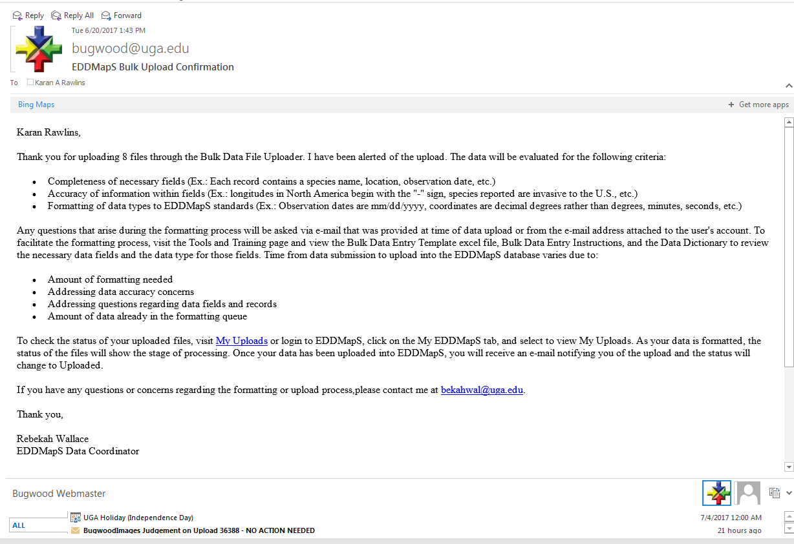
EDDMapS Bulk Upload Confirmation
You will receive an email confirming that someone at Bugwood was notified of your data upload
Someone will review the bulk data records you just uploaded and let you know if additional data is needed
You have contact information for the EDDMapS Database Coordinator in case you have questions about the bulk uploading process
Notes:
You will receive an email confirming that someone at Bugwood was notified of your data upload. Someone will review the bulk data records you just uploaded and let you know if additional data is needed. You have contact information for the EDDMapS Database Coordinator in case you have questions about the bulk uploading process

Slide 8
To see and check the status of the files you uploaded, which contain bulk data, click on View Uploads
Click View Uploads
Notes:
To see and check the status of the files you uploaded, which contain bulk data, click on View Uploads

Slide 9

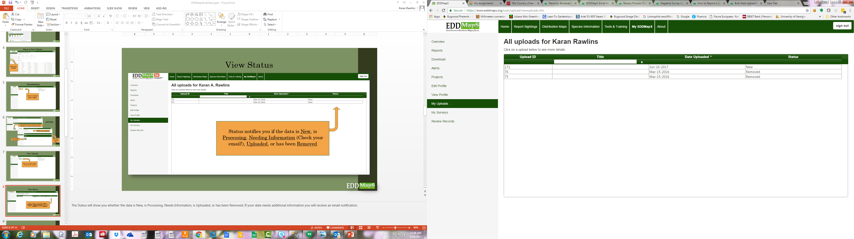
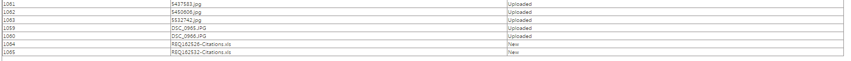
You can search your uploads by clicking on the heading of any column
Upload ID
Title
Date
Status
Status tells you
New
Processing
Needing Information (Check your email!)
Uploaded
Removed
Notes:
You can search your uploads by clicking on the heading of the column you want: Upload ID, Title, Date, or Status. The Status will show you whether the data is New, Processing, Needs Information, Uploaded, or has been Removed. If your data needs additional information you will receive an email notification.

Slide 10
Helpful Resources for uploading bulk data
Bulk Data Upload Procedure - Adobe Acrobat - NEW
Bulk Data Entry Template - Microsoft Excel
Bulk Data Entry Instructions - Microsoft Word
Bulk Data Entry Instructions - Adobe Acrobat
Data Dictionary - Adobe Acrobat - NEW
Notes:
Helpful Resources for uploading bulk data are conveniently located right here on your dashboard.

Slide 11
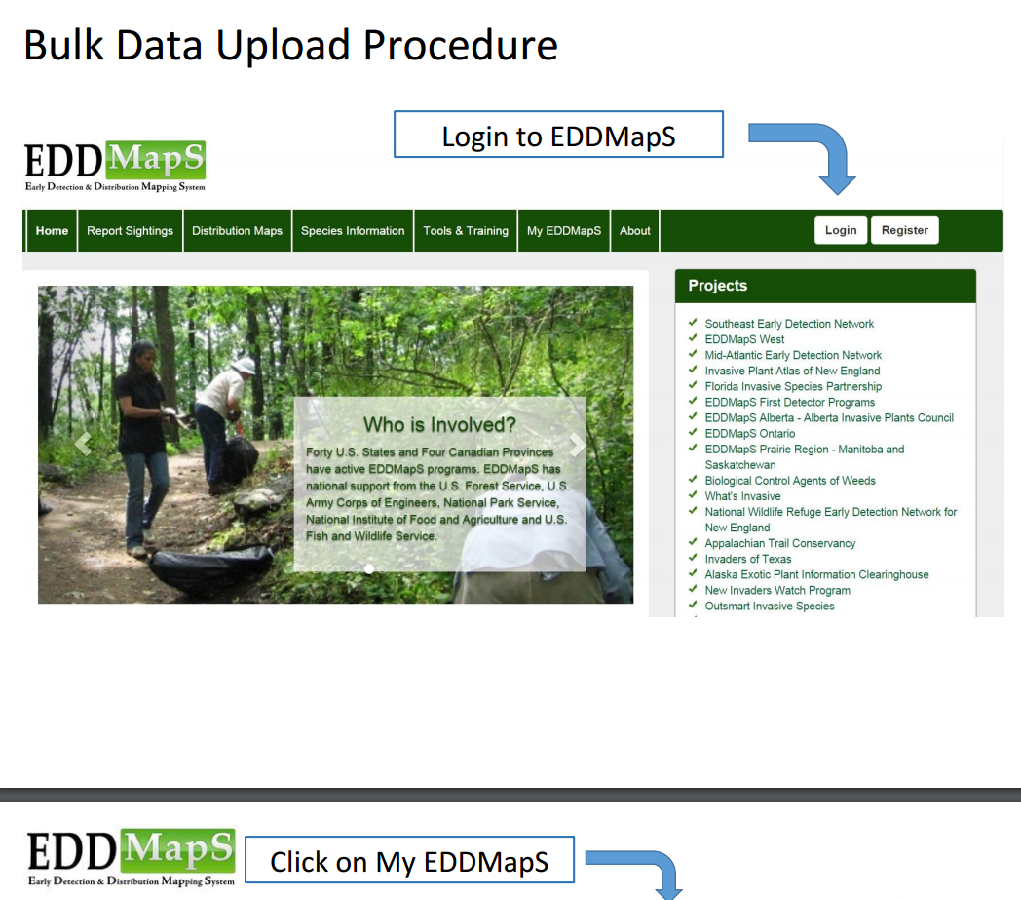
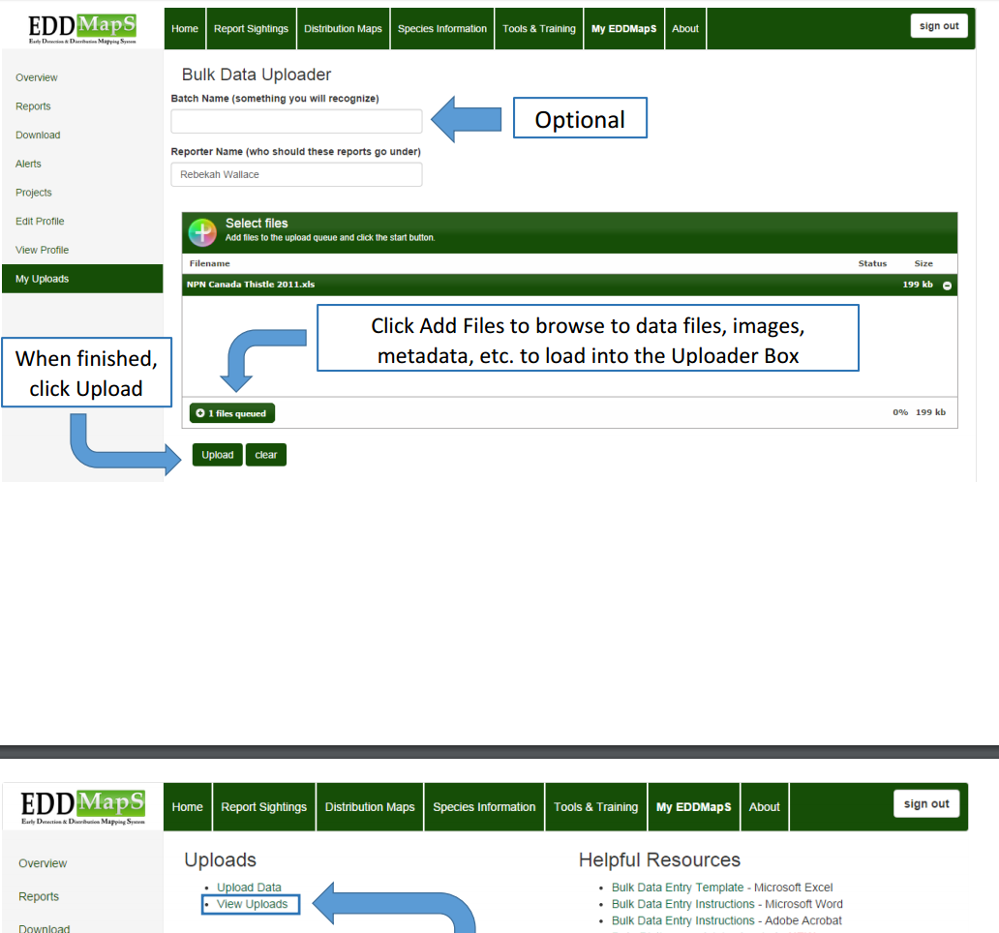
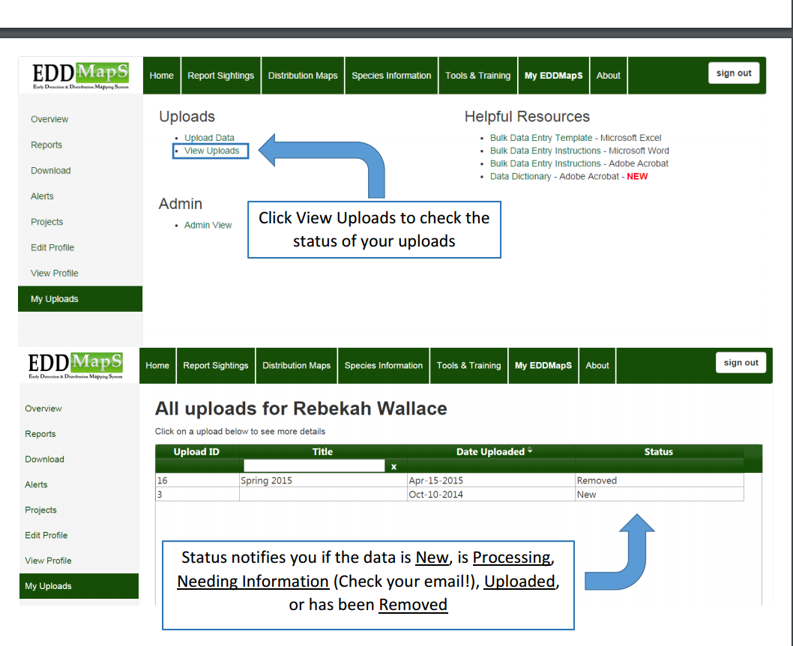
Bulk Data Upload Procedure - Adobe Acrobat - pdf
Step by step guidelines with pictures and notes to walk you through the process
Scroll through the pdf on your desktop
Download the pdf and print it
Notes:
Bulk Data Upload Procedure in an Adobe Acrobat – pdf gives you step by step guidelines with pictures and notes to walk you through the process of uploading bulk data.

Slide 12
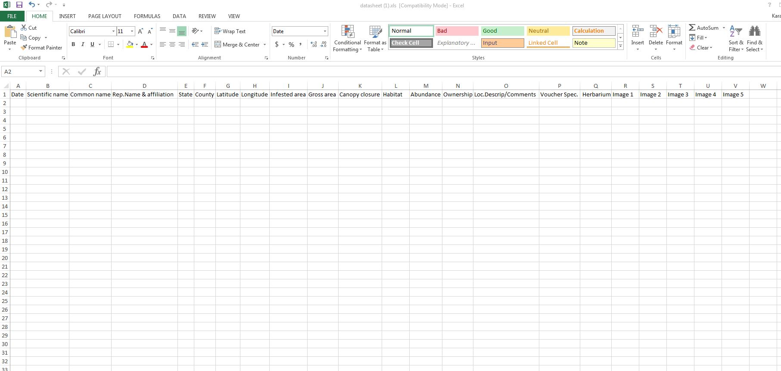
Bulk Data Entry Template - Microsoft Excel
Bulk Data Entry Template - Microsoft Excel
Date
Scientific name
Rep.Name & affiliation
State
County
Latitude
Headings in the excel file show you the types of information to upload as part of your bulk data reports
Marked columns show the minimum information required, but remember the more information you include the more valuable your data becomes
Longitude
Notes:
Headings in the excel file show you the types of information to upload as part of your bulk data reports. Marked columns show the minimum information required, but remember the more information you include the more valuable your data becomes.

Slide 13
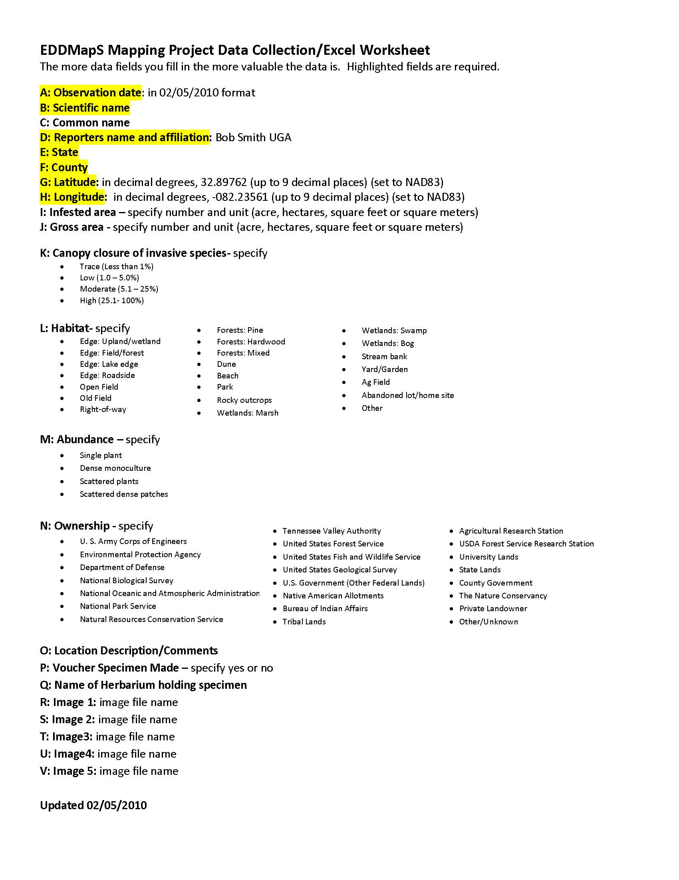
Bulk Data Entry Collection Instructions
Microsoft Word – so you can edit the form as needed
Adobe Acrobat – easy to print
EDDMapS Mapping Project Data Collection Worksheet
Can provide useful information when:
Collecting data or taking notes in the field
Filling out a Bulk Data Excel Worksheet
Provides accepted choices for the fields listed in Data Dictionary
For Example: Habitat has 22 types to choose from
• Ag Field
• Abandoned lot/home site
• Other
• Forests: Pine
• Forests: Hardwood
• Forests: Mixed
• Dune
• Beach
• Park
• Rocky outcrops
• Wetlands: Marsh
• Edge: Upland/wetland
• Edge: Field/forest
• Edge: Lake edge
• Edge: Roadside
• Open Field
• Old Field
• Right-of-way
• Wetlands: Swamp
• Wetlands: Bog
• Stream bank
• Yard/Garden
Notes:
Bulk Data Entry Collection Instructions are available both in Microsoft Word and Adobe Acrobat. The Data collection worksheet shown here can also be used to help when you are entering bulk data, by giving you a list of the available choices. For example listed here are 22 choices to choose from when describing the Habitat type in Bulk Data Entry Template - Microsoft Excel seen on the previous slide.

Slide 14
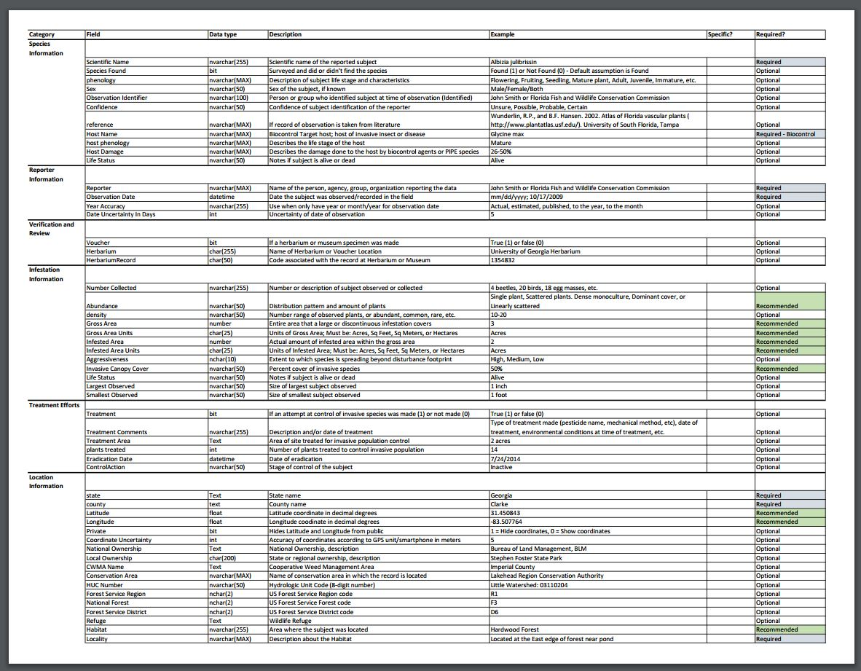
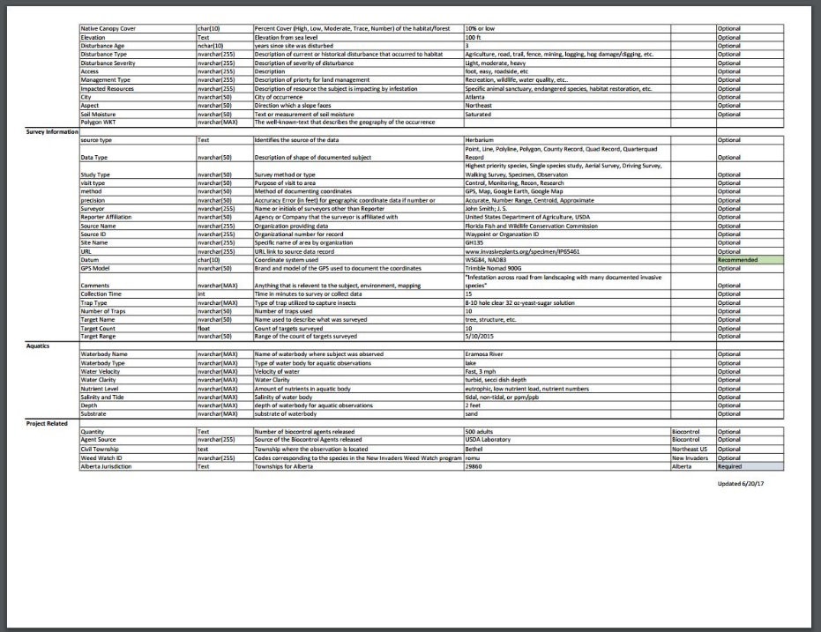
Data Dictionary - Adobe Acrobat
Example 1
Category - Location Information
Field - Habitat
Data type - nvarchar(255)
Description - Area where the subject was located
Example - Forest
Required? - Recommended
Example 2
Category - Reporter Information
Field - Reporter
Data type - nvarchar(MAX)
Description - Name of the person, agency, group, organization reporting the data
Example - John Smith or Florida Fish and Wildlife Conservation Commission
Required? - Required
Example 3
Category - Location Information
Field - Habitat
Data type - nvarchar(255)
Description - Area where the subject was located
Example - Forest
Required? - Recommended
Data dictionary, page 2
Notes:
The data dictionary gives you a lot more detail on the information requested in EDDMapS. In example 1, The first column heading is Category, which groups similar information together. Examples are Location Information, Species Information, etc. ; the Field column includes Habitat, Locality, Latitude, Longitude, etc.; Data type refers to what kind of data can be used for that type of information in the SQL server database and how many characters can be used (nvarchar(255) = national varying character), so characters can vary – numbers, letters, etc. and the maximum number that can be used for this field is 255 characters; Description basically gives you a definition of what is in the Field column. In Example 1, it is Habitat, which is defined here as - Area where the subject was located. This means the natural environment or ecosystem of the area; The Habitat type in Example 1 is Forest; The last Column is Required?, which asks if EDDMapS requires this information, and the three choices are Required, Recommended, or Optional. Please remember the more information you can include, the more valuable your data becomes.

Slide 15
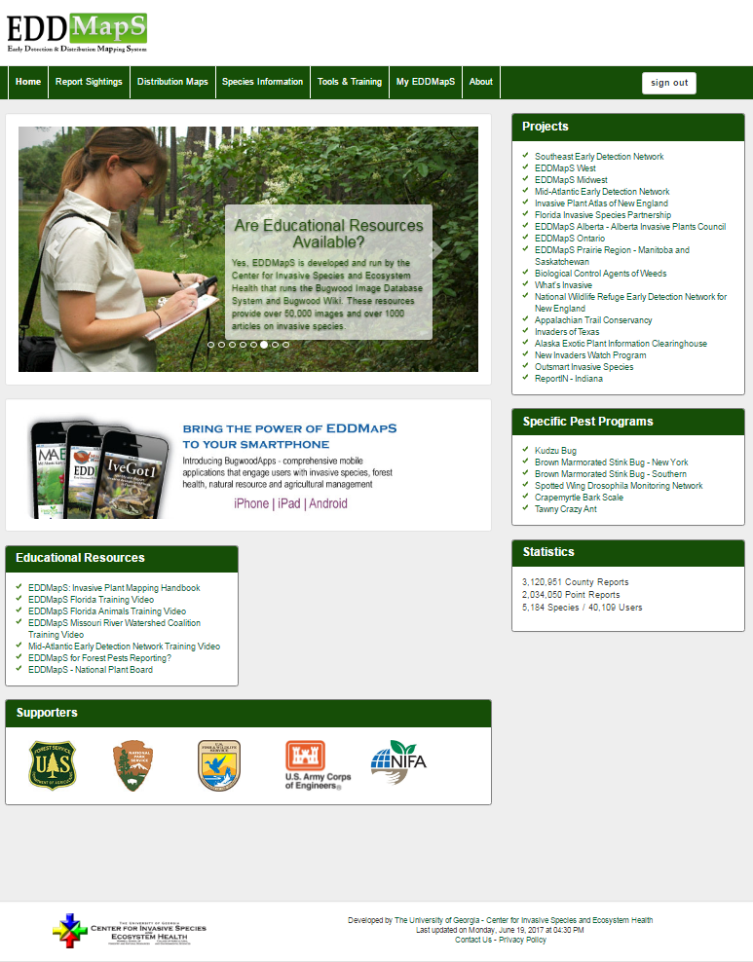
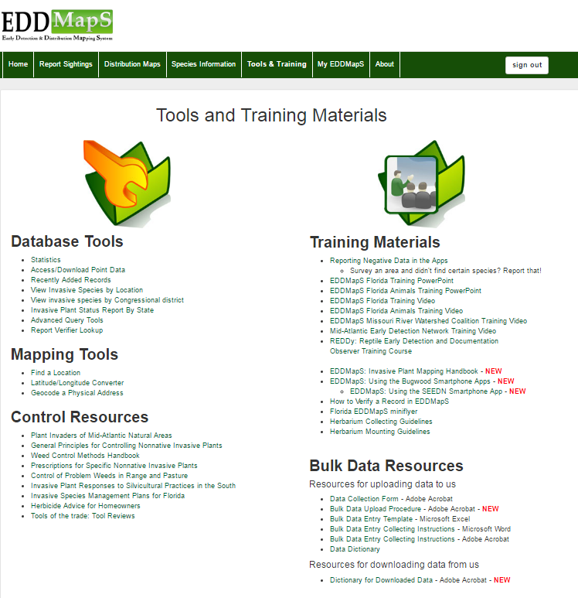
The resources we have been learning about in this Power Point are also available on the Tools and Training page
Notes:
The resources we have been learning about in this Power Point are also available on the Tools and Training page.

Slide 16
Thank you for participating in this EDDMapS training.
This and other trainings are available on the EDDMapS Website.
EDDMapS.org
For questions on uploading bulk data to EDDMapS contact
Rebekah Wallace at bekahwal@uga.edu
Notes:
Thank you for watching this EDDMapS Training Video. For questions on uploading bulk data to EDDMapS contact Rebekah Wallace at bekahwal@uga.edu

