Slide 1

Training
Using EDDMapS
Notes:
Hello, welcome to EDDMapS training video. This training will focus on entering data into the EDDMapS form on the website.

Slide 2
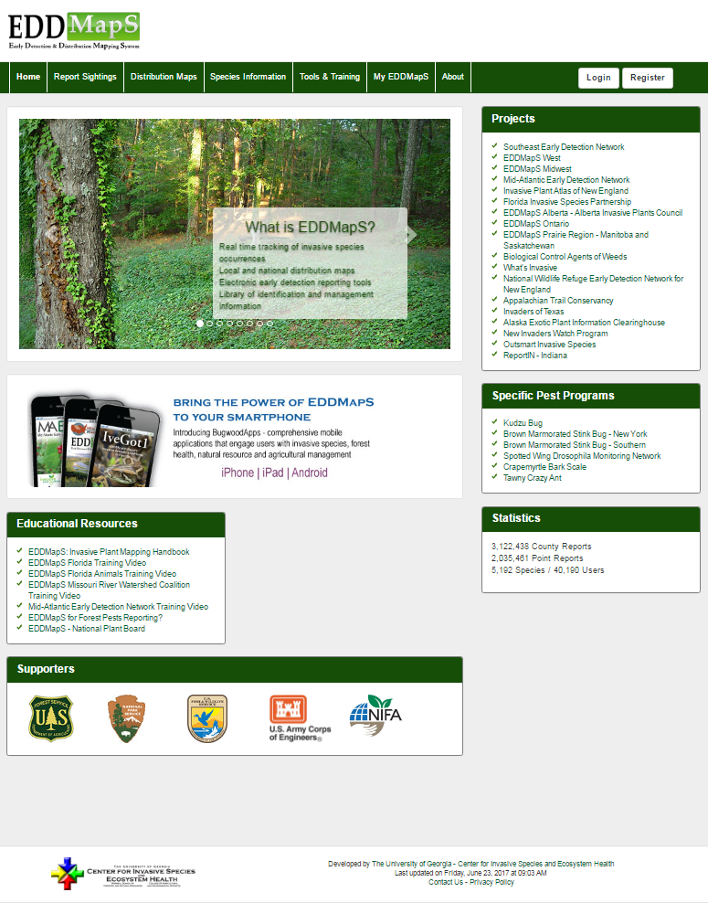
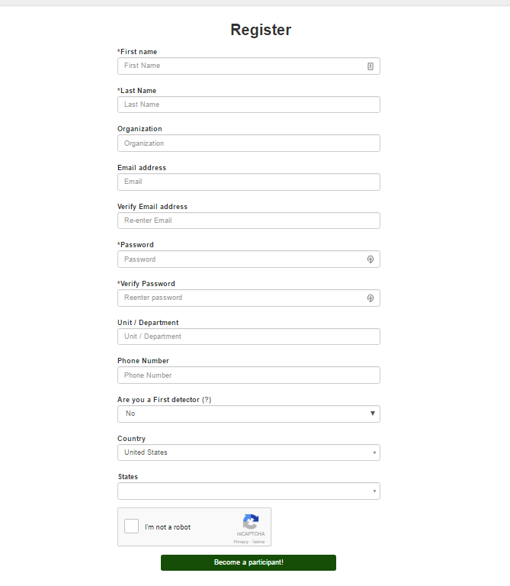

Register to create
a FREE account
Notes:
So, what is EDDMapS? EDDMapS is real time tracking of invasive species occurrences; local and national distribution maps; electronic early detection reporting tools; and a library of identification and management information. Register to create your free account.

Slide 3
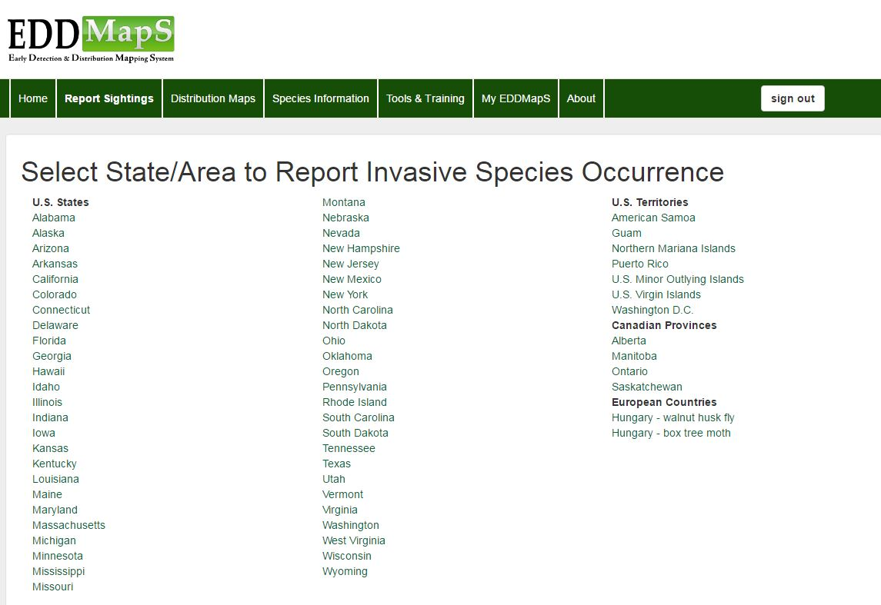
Choose the Location
Select State/Area to Report Invasive Species Occurrence
Choose the location of the Invasive species you are reporting.
Notes:
Choose the category of the invasive pest species you are reporting.

Slide 4
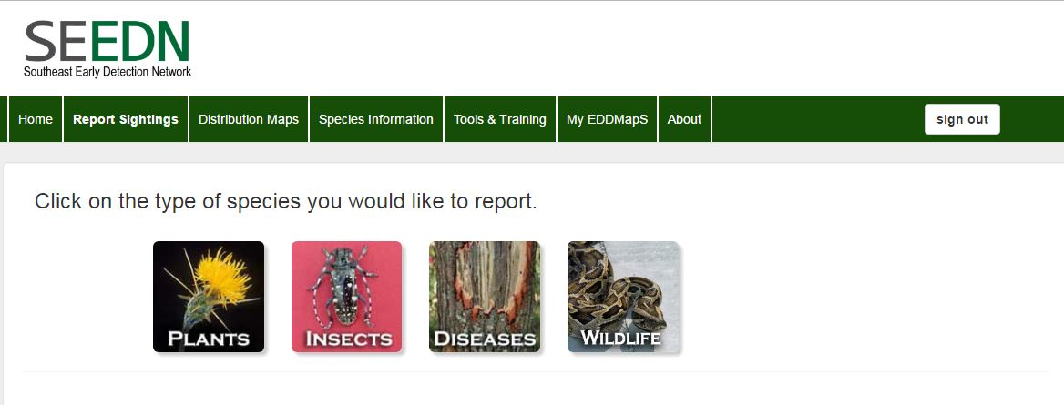
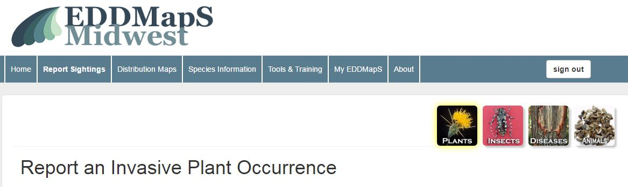
Choose the species
Choose the type of species you are reporting
For this training we will use Plants
Notes:
Choose the division of the invasive pest species you are reporting. For this training we will use plants, but the process is basically the same for all taxa.

Slide 5
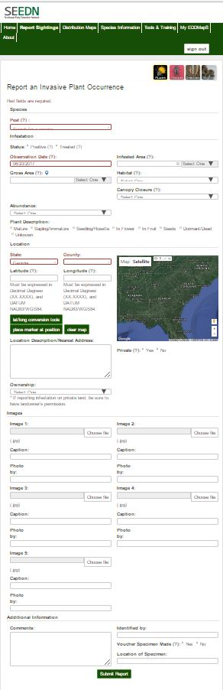
The Web form has
Four Sections
1-Species
Information on the Pest Species
Information on the Location
Images
Additional Notes
2-Location
3-Images
4-Additional Notes
Notes:
This is the reporting form or web form found on the EDDMapS website. The reporting form is based on the North American Invasive Species Management Association’s mapping standards. There are four sections to the web form. Each section focuses on a different aspect of your data. First, Information on the Pest species; second Information on the Location of the infestation; third, Images of the pest which help verify identification; and finally, a place for Additional Notes, if needed.

Slide 6
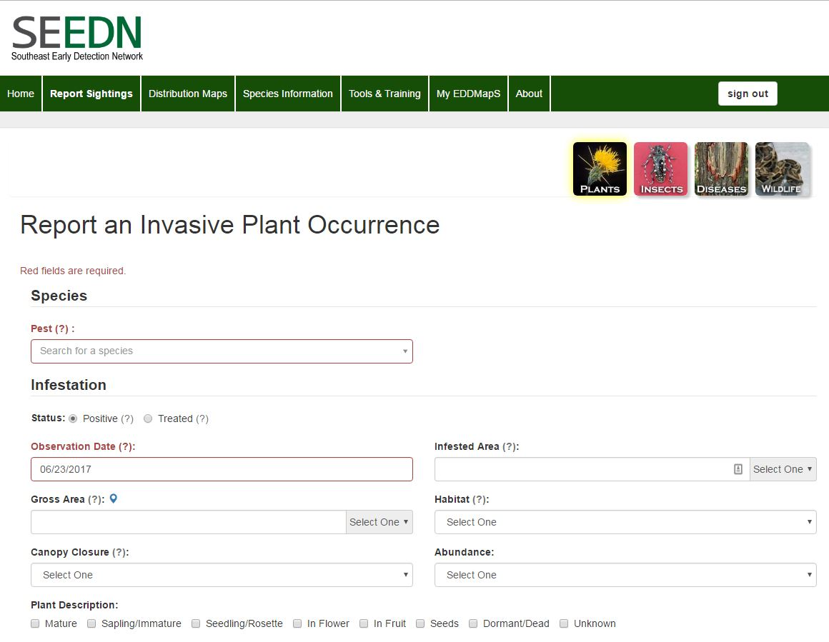
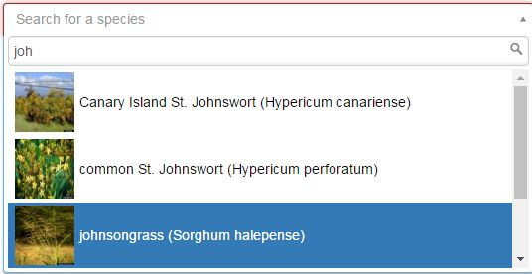
Species information
Begin typing the name of the pest
Choose your species from the dropdown box
Simply check any box you think applies at the time you collected the data.
Notes:
The first part of the forms is asking for information on the invasive species you are reporting. To choose the species name, begin typing the name of the pest, using either the scientific or common name. A drop down box will appear, and you can click on the species you want to report. In Plant Description, simply check any box you think applies at the time you collected the data.

Slide 7
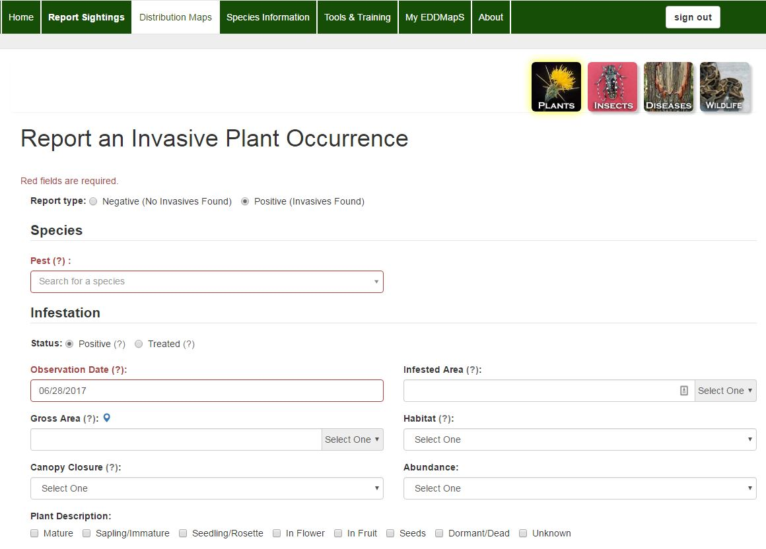
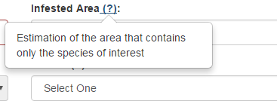
Species information – Add information on the invasive species
Check Treated if infestation has been treated (Default = Positive)
Date default is the date data is entered
Notes:
If you are reporting a site which has not been treated, choose Positive (Positive is the default). If you are submitting a report on a treated site, choose Treated. The Date default is the day on which you enter the data, but change it if you need to in order to show the actual date the information was collected. Hover your mouse over a ‘?’ for a popup box with more information about that field. You can report negative data which shows which invasive were NOT found in the surveyed area. Reporting Negative data will be addressed in a separate training power point.

Slide 8
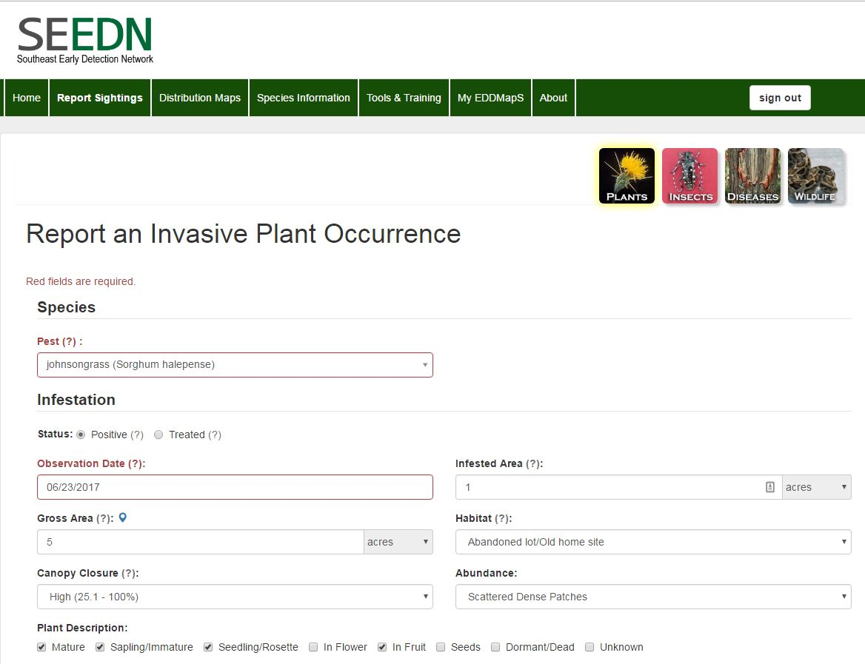
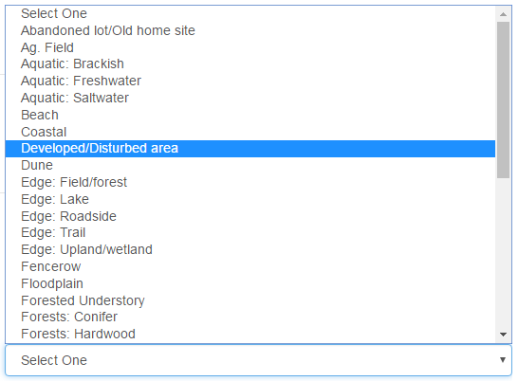
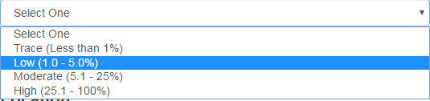
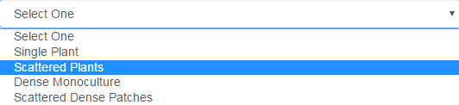
Species information
The drop down menus have choices for
Abundance, Canopy Closure, and Habitat
Habitat
Choose the closest match from the drop down menu
Canopy Closure Estimate percent of the ground covered by foliage of the invasive plant
Abundance
Choose the best description for the plants at the site
Notes:
Click in the field for a drop down menu to see choices for Abundance, Canopy Closure, or Habitat.
Abundance - Choose the best description for the plants at the site. Canopy Closure - Estimate percent of the ground covered by foliage of the invasive plant. Habitat - Choose the closest match from the drop down menu.

Slide 9
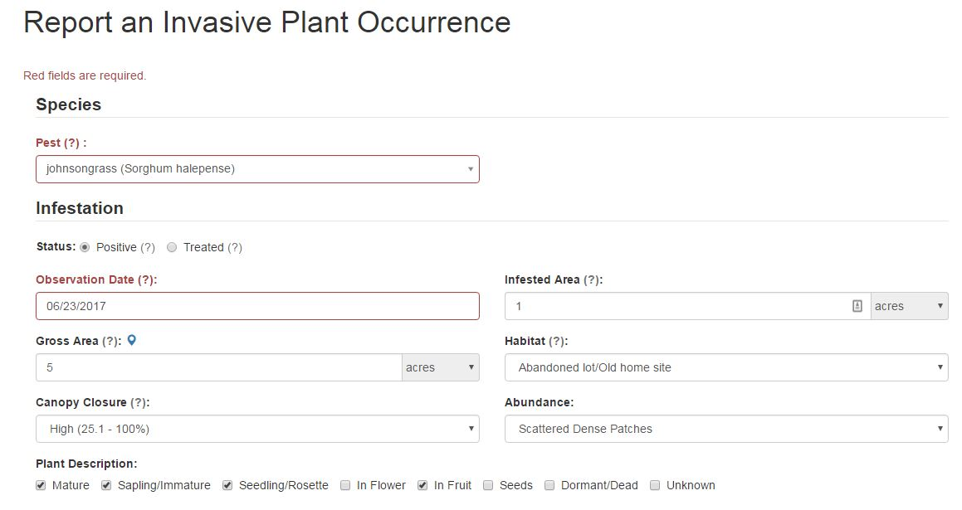
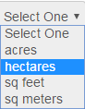
Species information
Gross area – Estimation of the general area of the infestation, but may include areas that are not actually occupied by the species of interest
Infested area – Estimation of the area that contains only the species of interest
Notes:
The definition for Gross Area is an estimate of the general area where the species was found, but may include areas that are not actually covered by the species of interest. The Infested Area is an estimate of the area that contains only the species reported. An example would be patches of tallowtree scattered across an old field. We would mark the entire field as the Gross Area, and then count the part of the field with tallowtrees as the Infested Area.
You can choose to report the site you are surveying as acres, hectares, square feet or square meters.

Slide 10

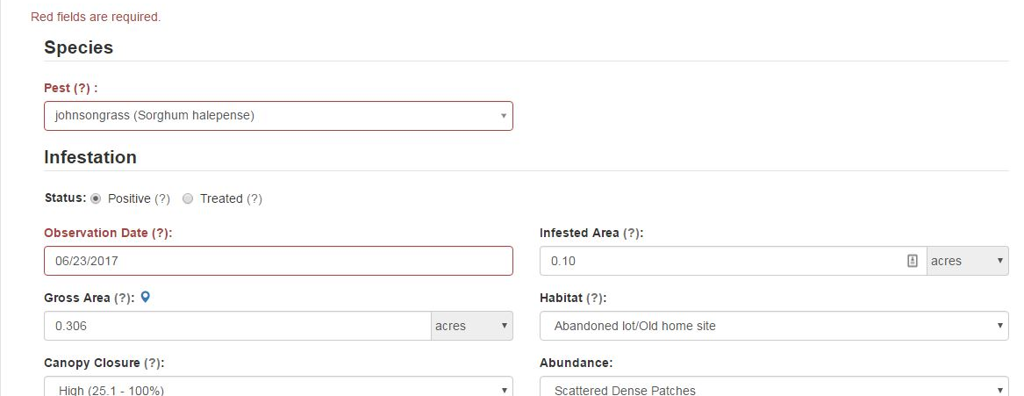
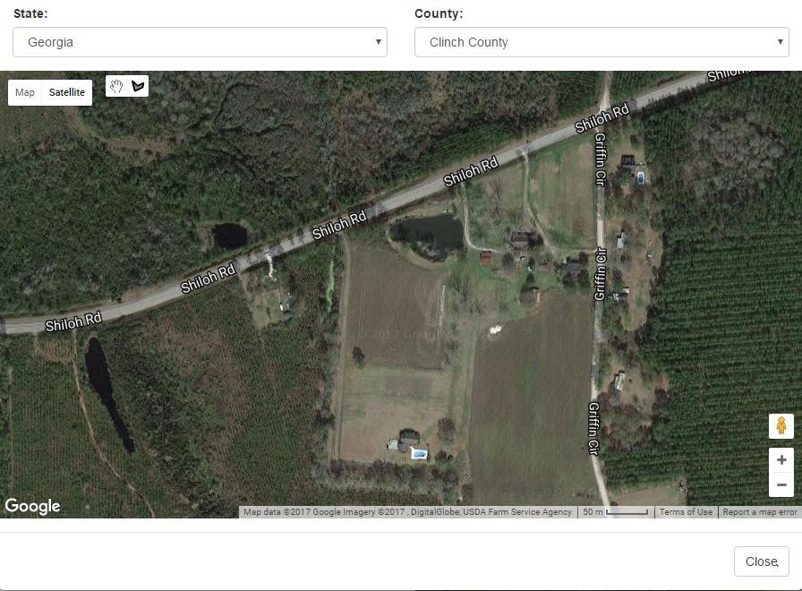
Species information
Want to draw a polygon of the Gross Area (entire site)?
  Click on the pin , a map will pop up
  Zoom in to the location
  Click on to draw the Gross Area of the site
  Gross area is then filled in automatically
Polygon icon
Map pin
Notes:
If you want to draw a polygon covering the entire site you are reporting, just click on the pin. Make sure State and County are filled in on the pop up map. That will zoom you the center of that county. Next zoom in to the location, then click on the Polygon icon to draw the gross area you have surveyed. The Gross Area field will be filled in on the form automatically.

Slide 11
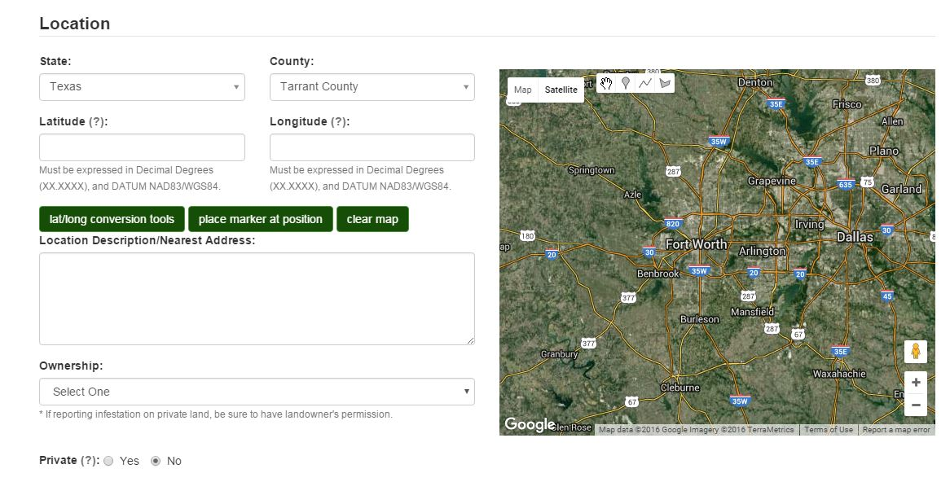
Location information
County automatically fills in based on the State you chose
Notes:
When the State is chosen, the dropdown will automatically update to list the Counties in that state.

Slide 12
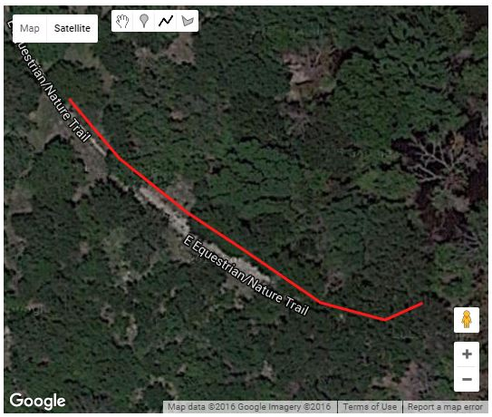
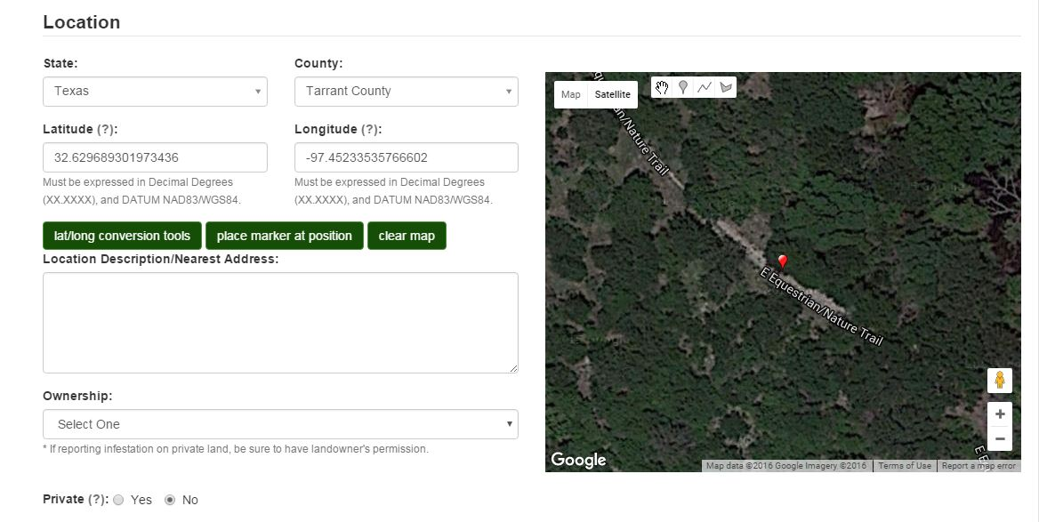
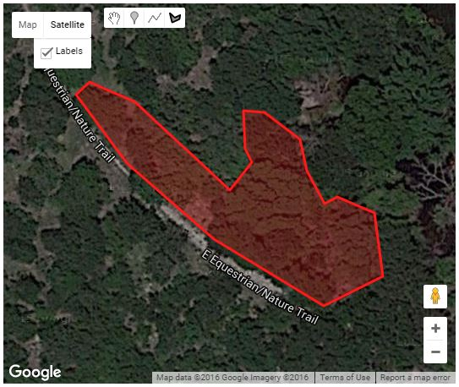
Location information - Three choices
Click on to show where an invasive is located
Click on to draw along a road or shoreline
Click on to create a site with three or more sides
Infested Area will automatically update
Linear
Point
Polygon
Notes:
For Site delineation you have Three choices. You can record the infestation as a point, for example when you are documenting a single tree or a very small area. Click on the pin and drop it on the map to mark the location of the invasive species. To record an infestation that follows a linear path, Click on the line icon to drop points along an infestation such as a roadway, fence line, river or shoreline. Click on the polygon icon to drop points and create a site with three or more sides, for example an abandoned field. Every click of the mouse drops a point on the map. You can click on the polygon again to create a second polygon on the map. For the linear and polygon shaped sites, double click the mouse to end the drawing, which will then be completed. If you make a mistake, just hit Clear Map to delete the drawing.

Slide 13
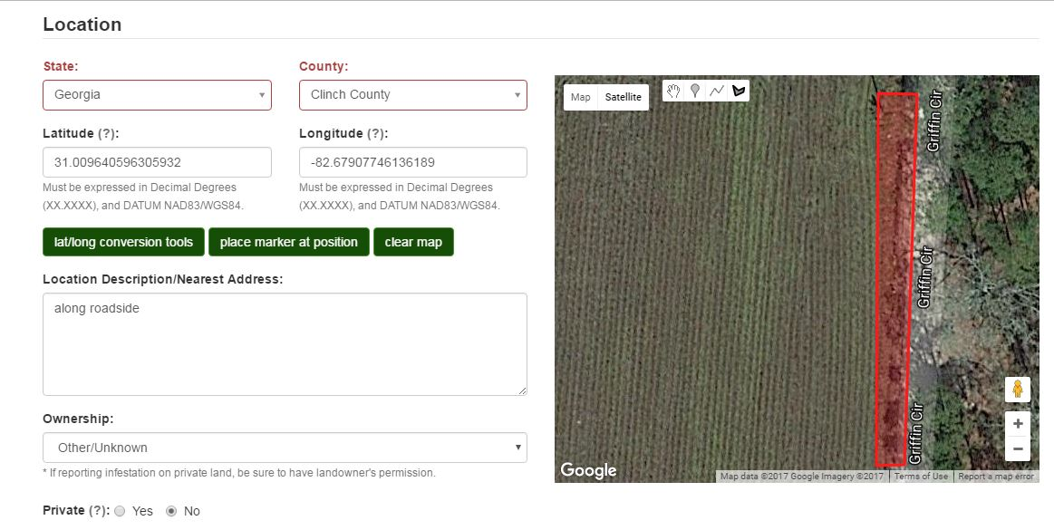
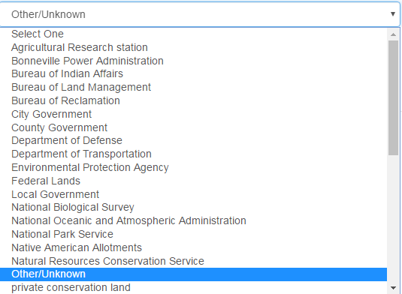
Location information
Location Description/Nearest Address is a text box for additional information
to help relocate an infestation
Choose Ownership from the dropdown box
Private
No = Default
Yes – Exact coordinates stay hidden, only county is shown, e.g.
  Landowner prefers the exact location stays hidden
  Sensitive restoration site
Reporting invasives on privately owned land?
Be sure to get the landowners permission
Notes:
Use the text box under “Location Description/Nearest Address” to add additional information necessary to help relocate an infestation. Choose Ownership from the dropdown box, in this case, Other/Unknown.
Click on Yes if the record should be private instead of public – No or public is the default setting. If you mark it as private, the infestation will show up only at the county level with no GPS coordinates displayed publically. Surveying on privately owned land? Be sure to get the landowners permission.

Slide 14
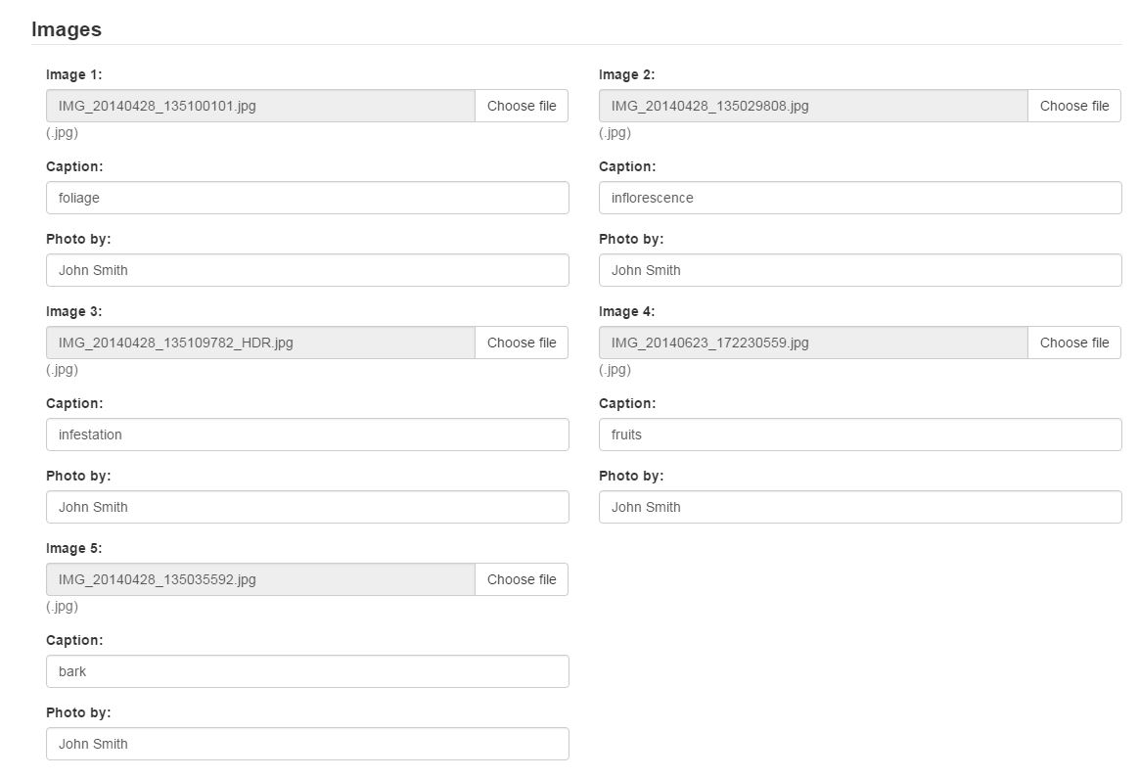
Add Images
Upload up to five images for each report
Caption: Identify the main feature in the image
Photo by: If someone else took the picture, add their name
Notes:
In the Third Section of the Web form you can add up to five images for each report. Use the “Caption” to Identify the main feature in the image, such as flower, vine, leaf, or fruit. If someone other than the reporter took the picture, then add their name in the field, “Photo by”.

Slide 15
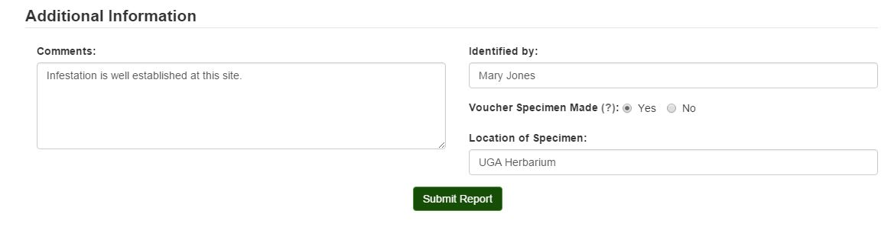
Additional Information
Comments: Add additional information needed in this text box
Identified by: Add name here if another expert identified the species
Click Yes and add the location if a specimen is taken (Default = No)
Click on Submit Report and you are done.
Notes:
In the last Section of the Webform there is a Comment text box for adding information on the infestation or site that would be helpful to someone following up later. In some cases the invasive species may be identification by a third party. Their name can be added under “Identified by”. If you collect a sample to send to an herbarium, Click Yes and add the name of the herbarium where the specimen is sent for identification. The Default for that field is No.
Click on Submit Report and you are done. Congratulations!

Slide 16
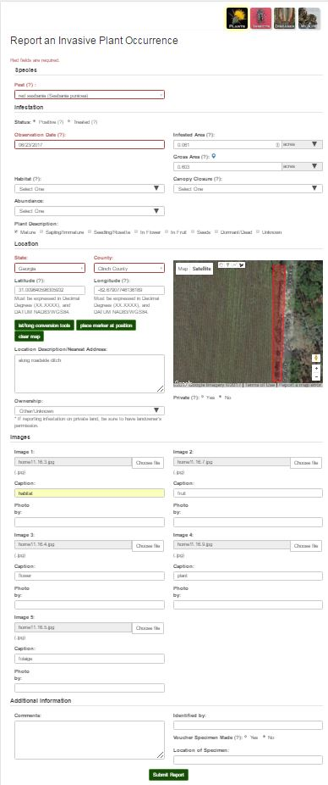
EDDMapS Web form is complete
Reports are automatically sent to be verified
Once verified, reports show on EDDMapS website
Trainings are available on EDDMapS.org
Notes:
Your Web form is now complete. Once submitted the Reports are automatically sent via email to Verifiers. Once verified, reports are available to be viewed, searched and downloaded from the EDDMapS website. This and other EDDMapS trainings are available through the Tools & Training tab on the EDDMapS homepage.

Slide 17
Thank you for participating in this EDDMapS training.
This and other trainings are available at EDDMapS.org
For Questions Contact
Rebekah Wallace at bekahwal@uga.edu
Or Karan Rawlins at krawlins@uga.edu
Notes:
Thank you for participating in this EDDMapS training. This and other trainings are available on the EDDMapS Website.

