Slide 1

Training
Reporting Negative Data
Notes:
EDDMapS Training for Reporting Negative data, both online and in the smartphone apps.

Slide 2
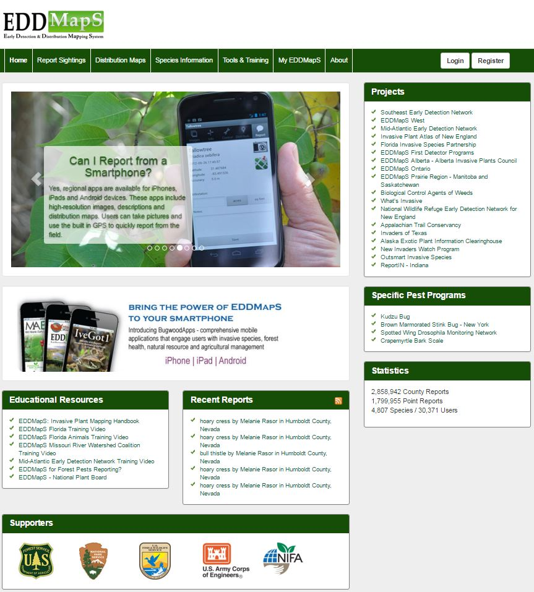
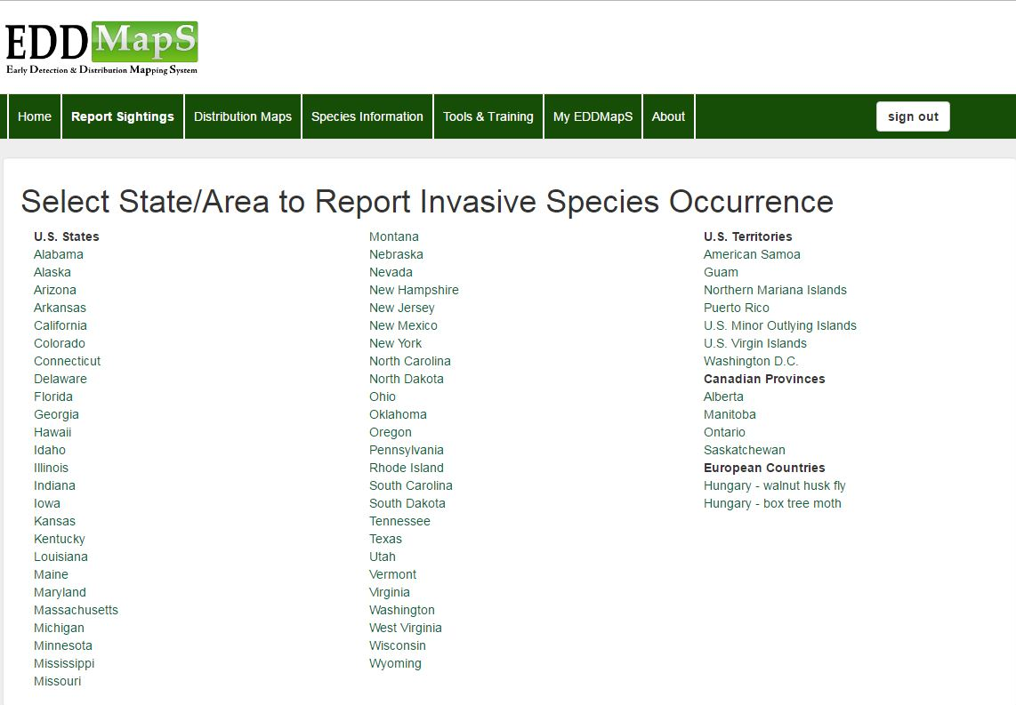

Reporting online
First – Login and click on Report Sightings
Choose the State/Area where you are conducting the survey
Notes:
First Login, click on Report sightings, then Choose the State/Area where you are conducting the survey.

Slide 3
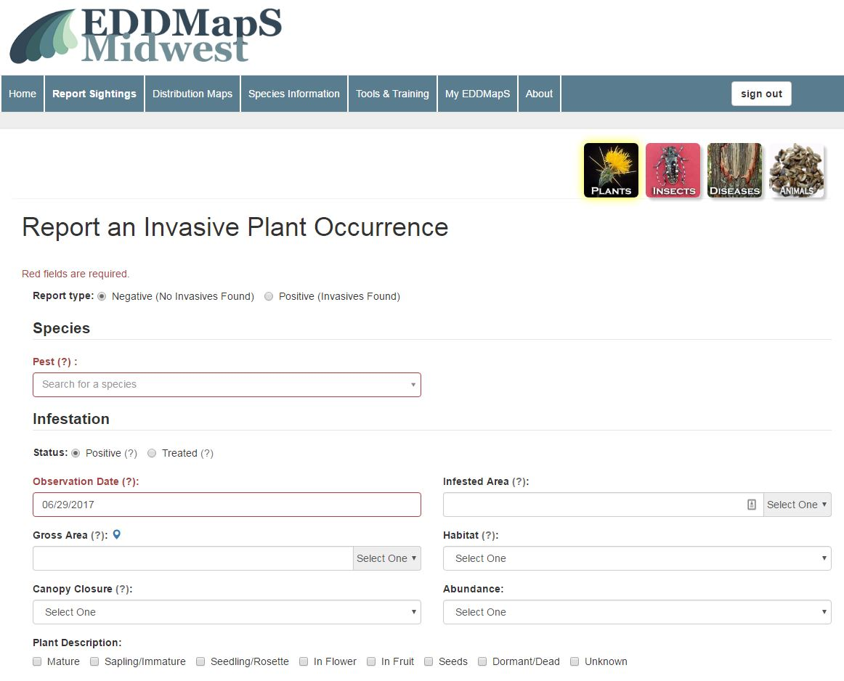
Choices in Status:
Positive
Treated
Negative
Choose Negative
Positive is the default
Negative (No Invasives Found)
.
Notes:
To report Negative data Choose the Status – Negative. Positive is the default.

Slide 4
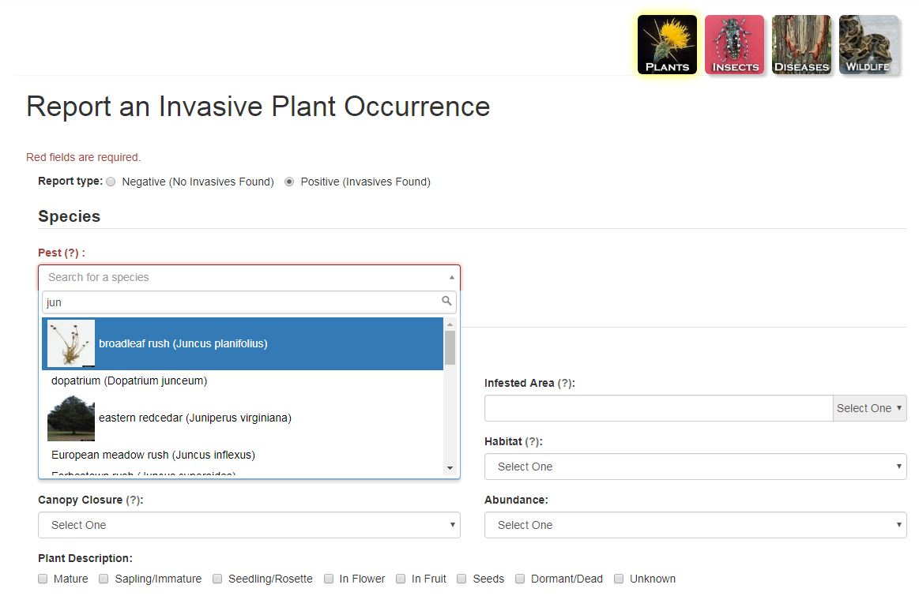
Species information
Begin typing the name of the pest
Choose your species from the dropdown box
You only need to fill in fields that apply to your negative data
Notes:
The first part of the forms is asking for information on the invasive species you are surveying for. To choose the species name, begin typing the name of the pest, using either the scientific or common name. A drop down box will appear, and you can click on the species you want to report.

Slide 5
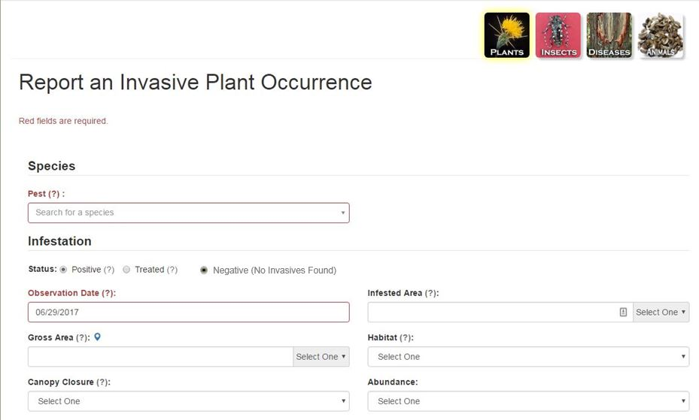
Record information for
Date
Gross Area (this is the area surveyed)
Habitat
The other fields will be used when reporting Positive data
Notes:
Record information for the Date; Gross Area (this is the area surveyed); and Habitat. The other fields will apply when you are reporting Positive data.

Slide 6
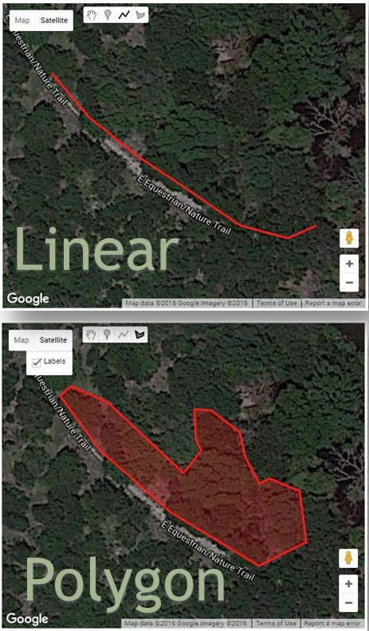
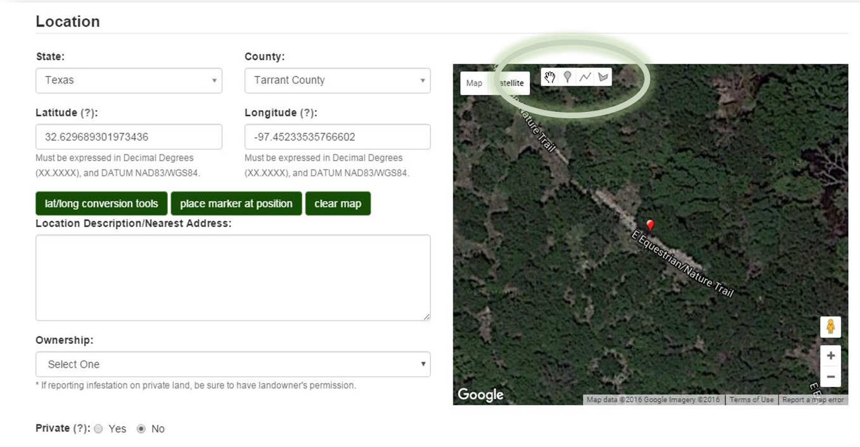
Survey Location
Click on to draw along a road or shoreline
Click on to create a site with three or more sides
Notes:
You can type in the GPS coordinates or use the Google map to zoom in to the infestation. If the state and county field are filled in, the map will zoom you to the center of the county. For Negative surveys, you will usually be surveying a site that is either linear or a polygon. To record an infestation that follows a linear path, Click on the line icon to drop points along an infestation such as a roadway, fence line, river or shoreline. Click on the polygon icon to drop points and create a site with three or more sides, for example an abandoned field. Every click of the mouse drops a point on the map. You can click on the polygon again to create a second polygon on the map. For the linear and polygon shaped sites, double click the mouse to end the drawing, which will then be completed. If you make a mistake, just hit Clear Map to delete the drawing.

Slide 7
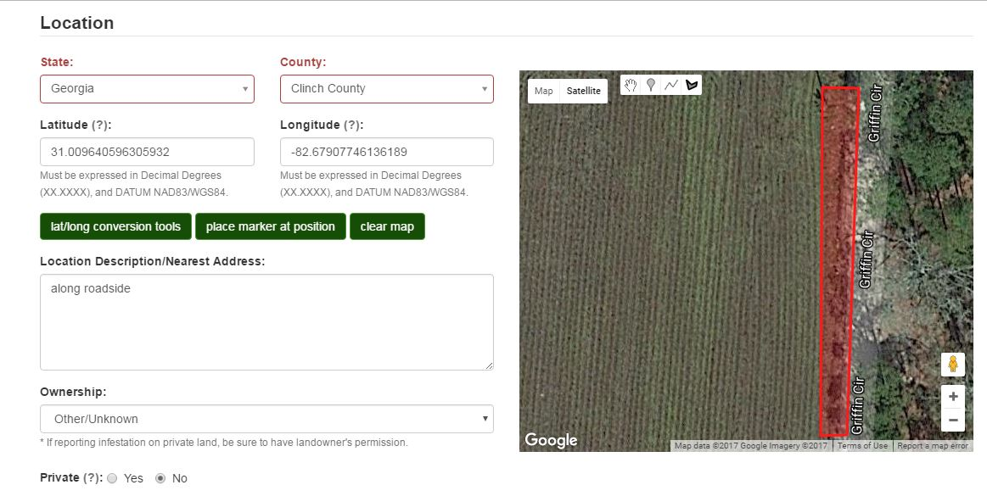
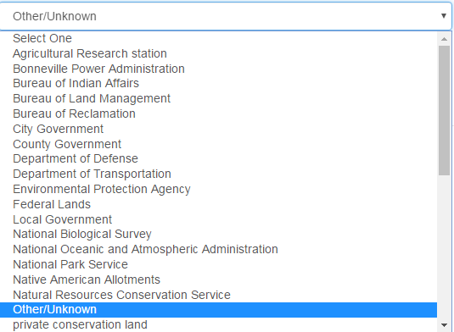
Location Description/Nearest Address is a text box for additional information to help relocate the survey site
Choose Ownership from the dropdown box
Private
No = Default
Yes – Exact coordinates stay hidden, only county is shown, e.g.
Landowner prefers the exact location stays hidden
Sensitive restoration site
Be sure to get the landowners permission before surveying
Notes:
Use the text box under “Location Description/Nearest Address” to add additional information necessary to help relocate a survey site. Choose Ownership from the dropdown box, in this case, Other/Unknown.
Click on Yes if the record should be private instead of public – No or public is the default setting. If you mark it as private, the infestation will show up only at the county level with no GPS coordinates displayed publically. Reporting invasives on privately owned land? Be sure to get the landowners permission.

Slide 8
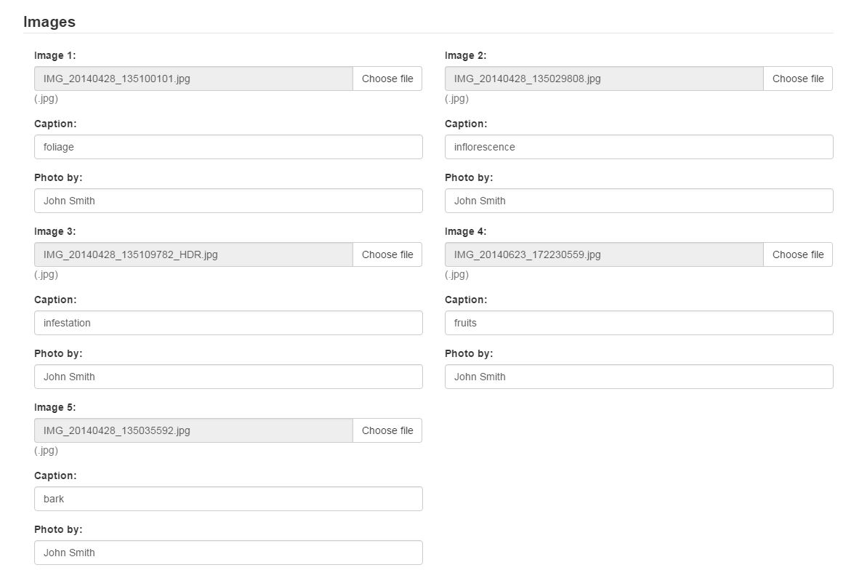
Images may not be needed for a Negative report, but that is available
Add Images
Upload up to five images for each report
Caption: Identify the main feature in the image
Photo by: If someone else took the picture, add their name
Notes:
Images may not be needed for a Negative report, but that is available. You can add up to five images for each report. Use the “Caption” to Identify the main feature in the image. If someone other than the reporter took the picture, then add their name in the field, “Photo by”.

Slide 9
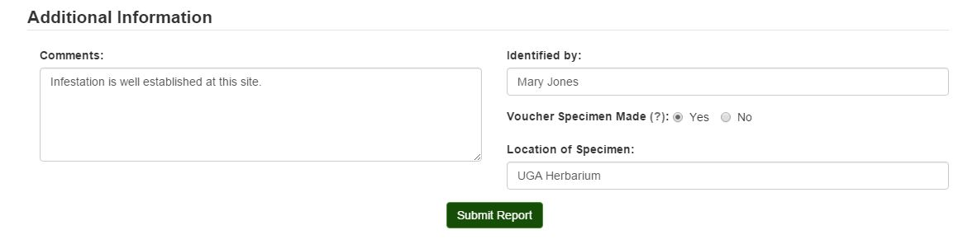
Additional Information
Comments: Add additional information if needed in this text box
Click on Submit Report and you are done.
Notes:
In the last Section of the Webform there is a Comment text box for adding information on the survey site that would be helpful to someone following up later. Click on Submit Report and you are done. Congratulations!

Slide 10
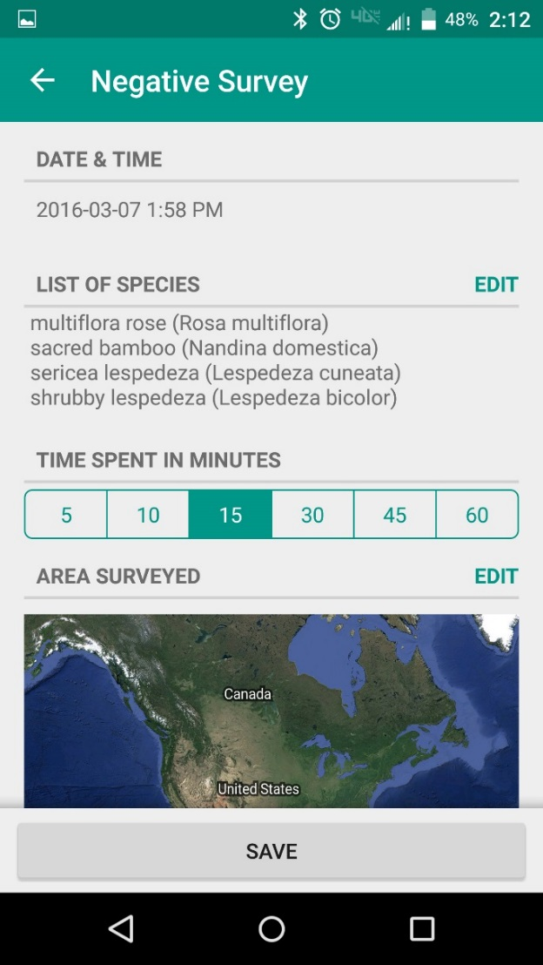
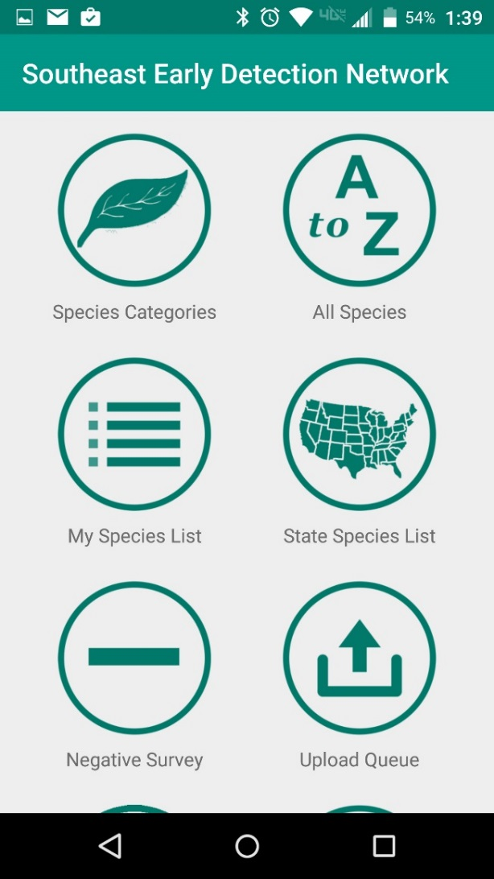
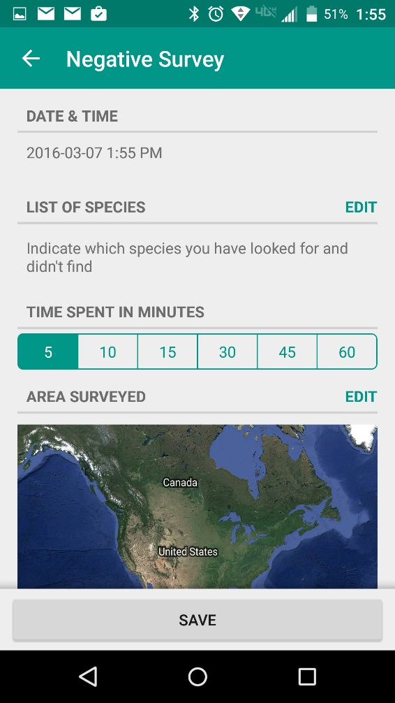
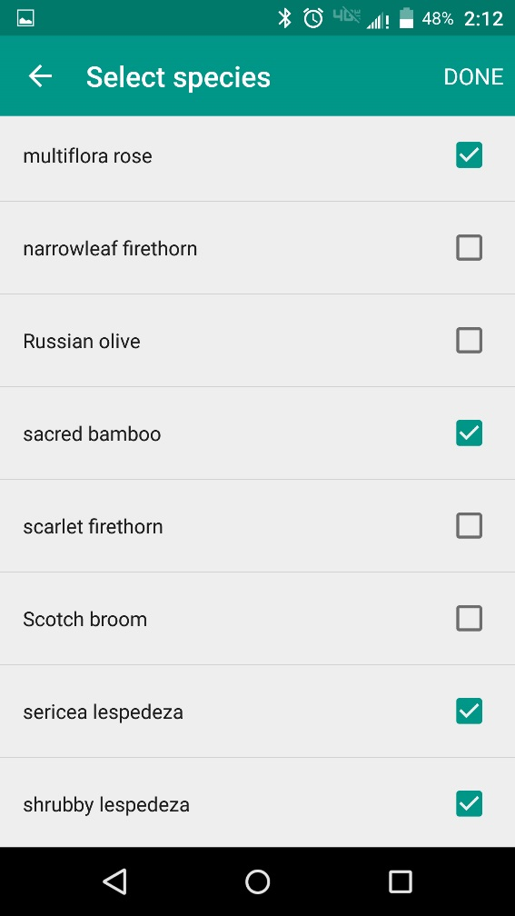
Reporting with the Smartphone App
Click Negative Survey in main menu
Click Edit to add all species surveyed
Click Edit in Area Surveyed to map it
Notes:
Click on Negative Survey in the main menu to bring up the negative survey reporting form. Click Edit next to List of species to add the species surveyed in this area. Then Click Edit next to Area Surveyed to map the area you are reporting on for this survey (there will be more information on mapping on the next slide). You can also document the time you spend for each survey and a text box to any notes that may be useful in locating or managing the surveyed area later.

Slide 11
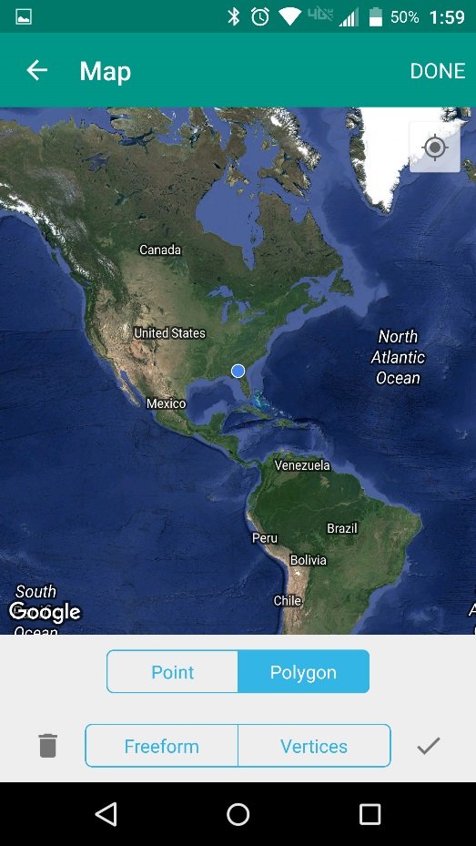
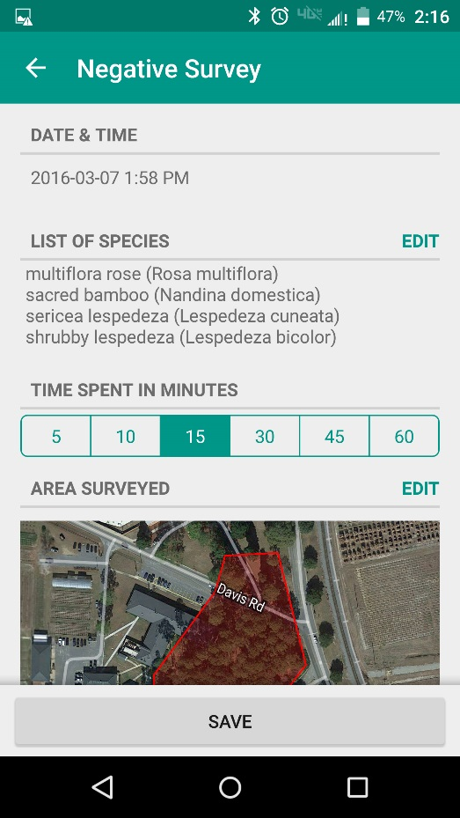
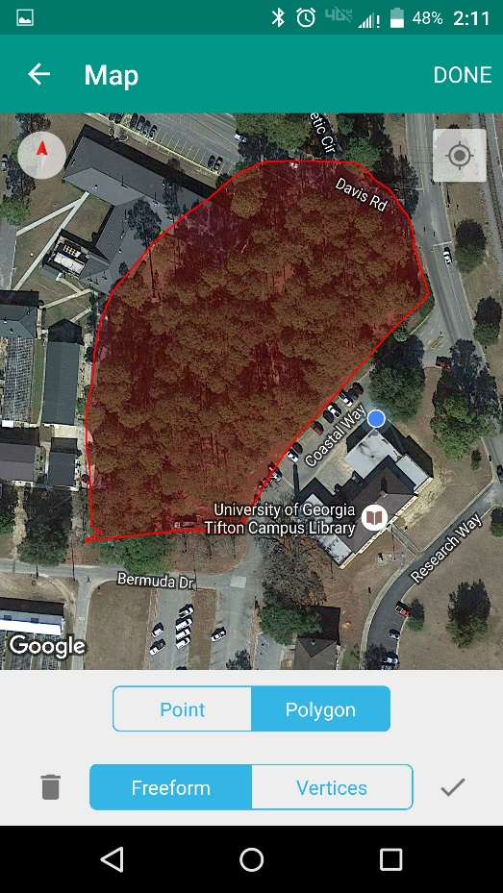
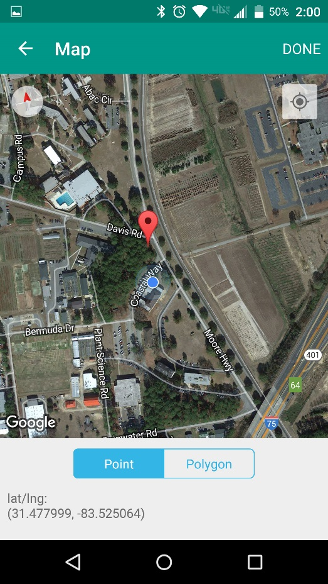
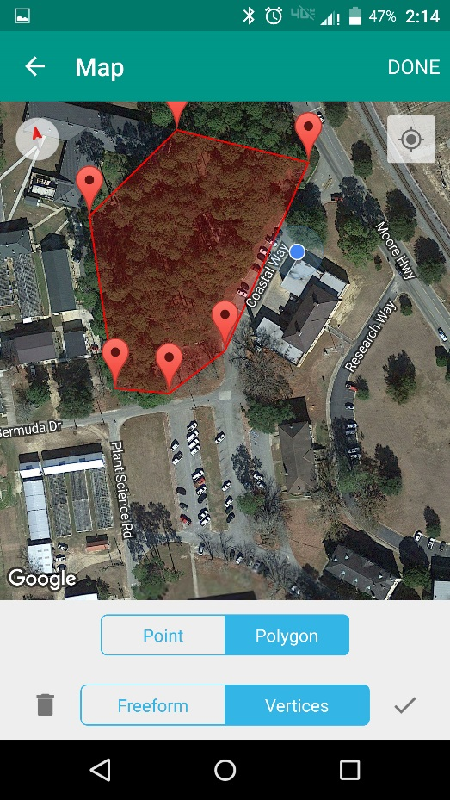
Reporting Forms - Negative Surveys - Mapping
Zoom In
Freeform
Point
Vertices
Notes:
Details for Mapping on the Negative Surveys reporting form. After you click on Edit, you will see a Western hemisphere map with your location highlighted. This is Google maps, which you are probably already familiar with, and works the same way as it does on your computer. Zoom in to your location and choose how you want to report. Choices are Point, Freeform polygon and , polygon drawn from Vertices. For a point, drop the marker on the correct location and click on Done. For a freeform polygon, simply draw the perimeter of the infestation on your device’s touch screen, then click on done. For a polygon from vertices, drop markers at the corners of the infestation and the device will draw the polygon for you, then click on done.

Slide 12
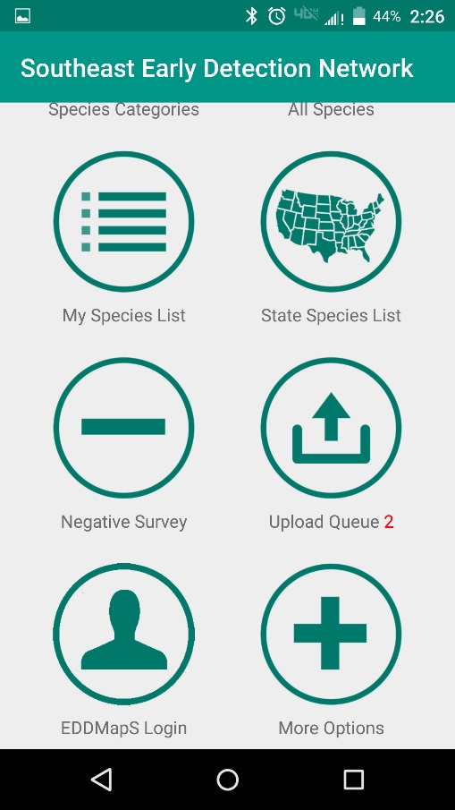
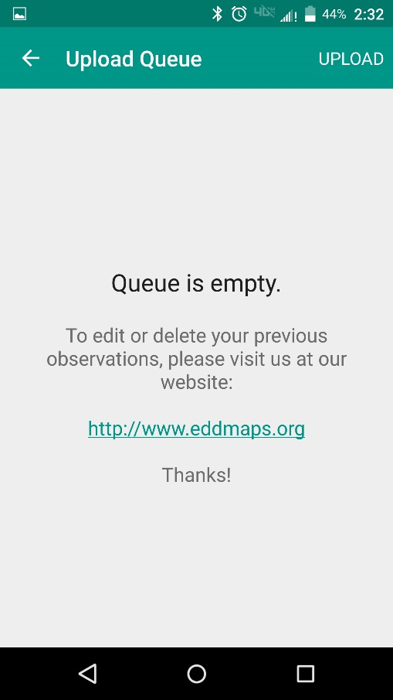
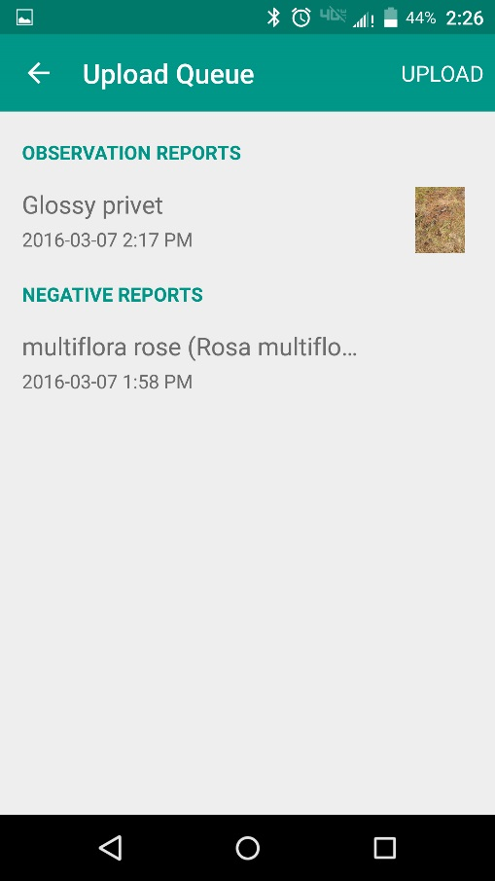
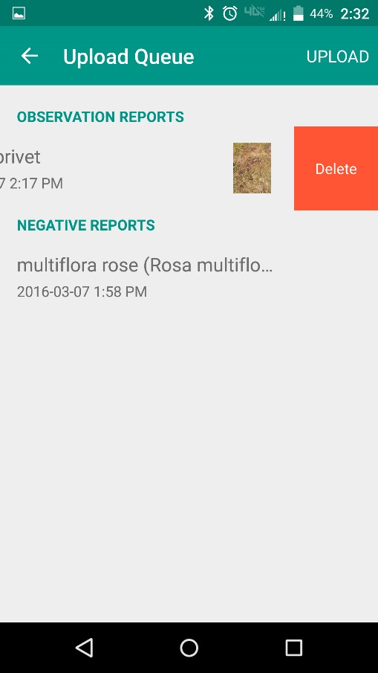
Upload Queue
Save all reports to your device
Upload after connecting to WiFi
Saves your data and your device’s battery
Shows # of reports in Queue
Swipe to edit or delete reports in Queue
Empty Queue
Reports in Queue
Notes:
Upload Queue. All reports are Saved to your device automatically. You can wait to Upload all your reports after connecting to WiFi. Saves your data and your device’s battery.

Slide 13
Thank you for participating in this EDDMapS training.
This and other trainings are available at EDDMapS.org
For Questions Contact Rebekah Wallace at bekahwal@uga.edu
Or Karan Rawlins at krawlins@uga.edu
Notes:
Thank you for participating in this EDDMapS training. This and other trainings are available at EDDMapS.org at the Tools & Training tab. For Questions Contact Rebekah Wallace at bekahwal@uga.edu Or Karan Rawlins at krawlins@uga.edu.

