Slide 1
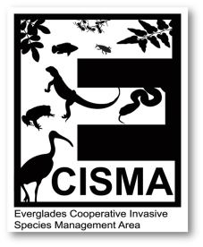
Invasive Plant Operations Overview
2015 Everglades Invasive Species Summit
LeRoy Rodgers, SFWMD

Slide 2

ECISMA Plant Monitoring:
2015 Update
Systematic Reconnaissance Flights
  Completed coast to coast mapping between Lake Okeechobee and Florida Bay
  Currently evaluating 20 year trends
Digital Aerial Sketch Mapping
  Detailed mapping in support of planned control efforts
    Loxahatchee National Wildlife Refuge
    Big Cypress National Preserve
    Water Conservation Area 2A

Slide 3
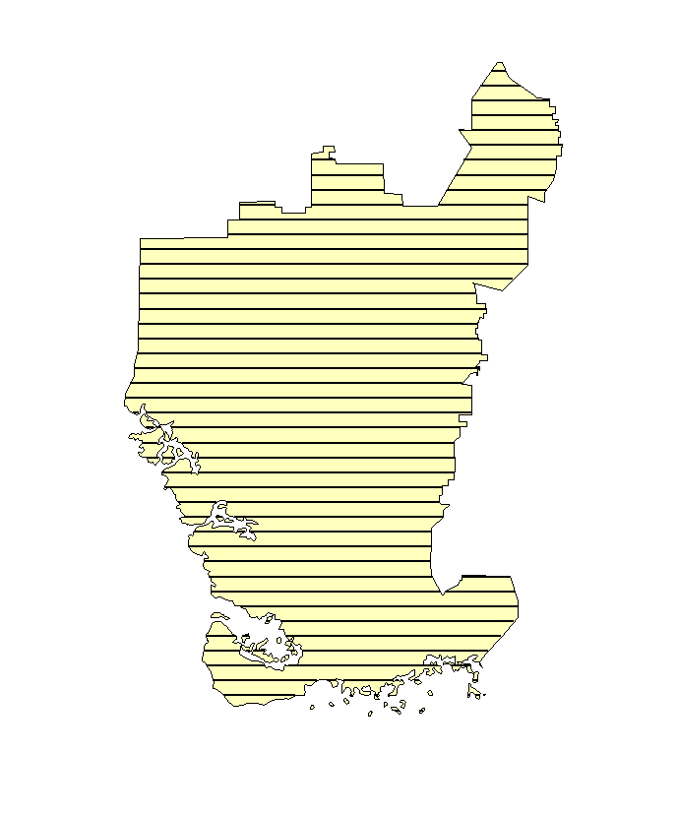
Systematic Reconnaissance Flights
Aerial regional assessment initiated in 1993
Objective: assess landscape level distribution and abundance of priority invasive plants
East-west transects on 4-km intervals

Slide 4
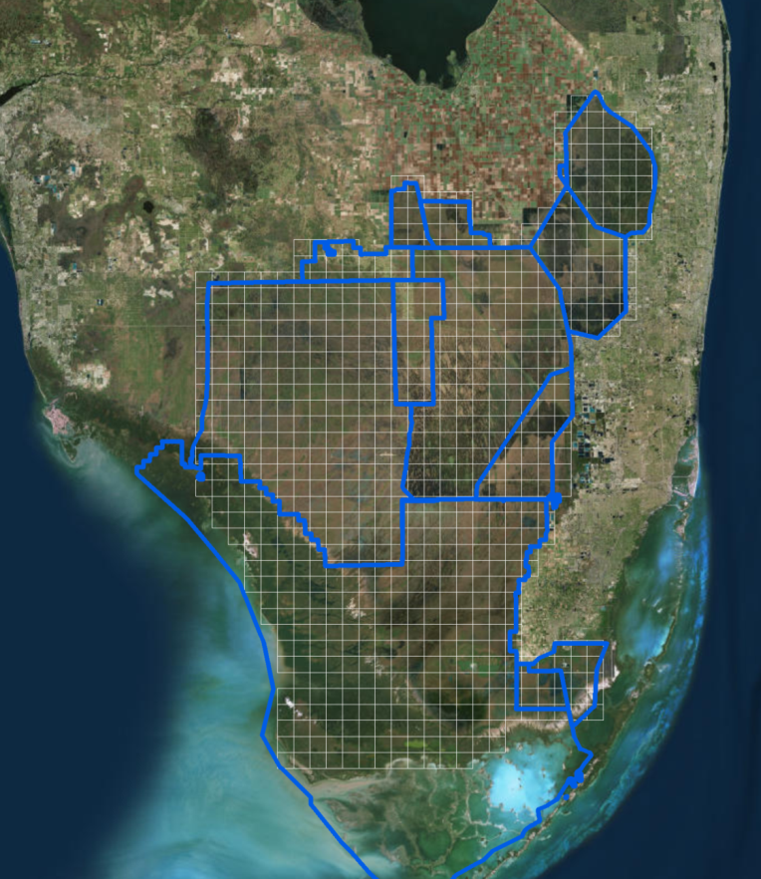
Everglades CISMA
4 kilometer grid
Cell = 4 km x 4 km
  3954 acres
1995 and 2015 results presented

Slide 5
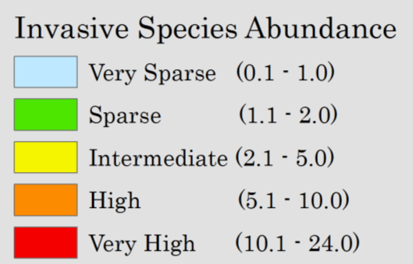
Grid Cell Abundance Classes
Index Value
Translation
Very rare (single tree) to “Maintenance control”
Widely scattered or some dense patches
Many dense infestations or scattered throughout

Slide 6
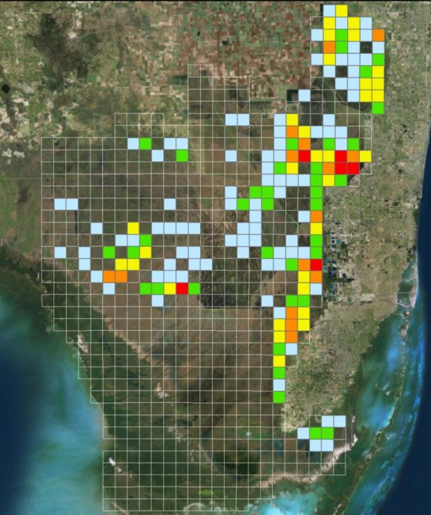
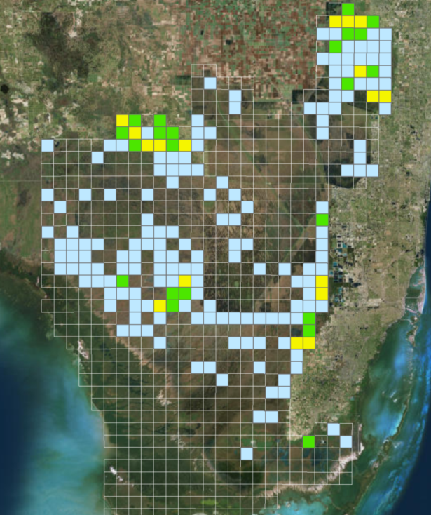

Melaleuca 1995 - 2015
1995
2015

Slide 7
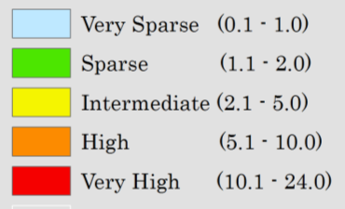
Melaleuca
-48%
-54%
}
}
6% increase in frequency (occupancy)
Frequency of cells with ≥intermediate abundance scores down 54%
Region-wide abundance down 48%

Slide 8
Melaleuca
1995-2015 Trend by Management Area
⬇-26%
⬇-37%
⬇-38%
⬇-88%
⬄0%
⬇-48%
⬇-58%
⬇-56%

Slide 9
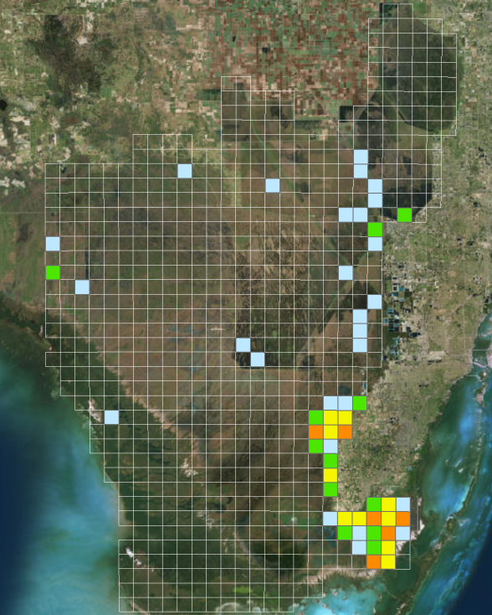
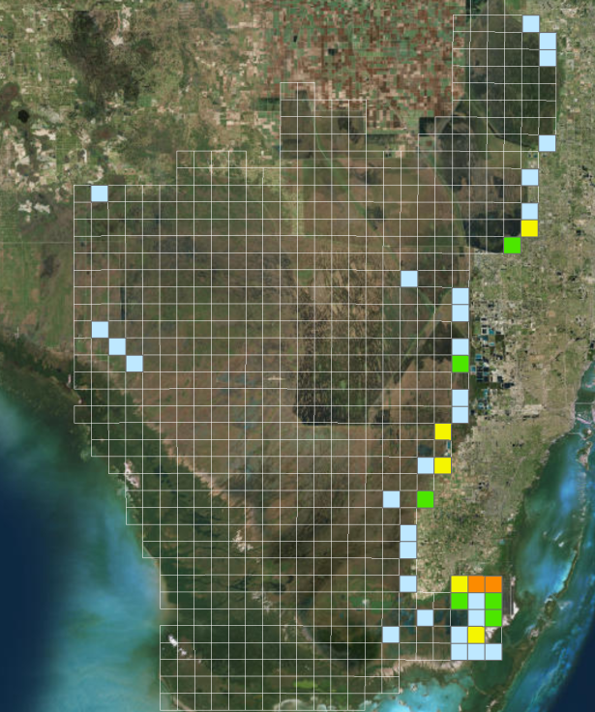
Australian Pine 1995 - 2015
1995
2015
Notes:
12% decrease in frequency (occupancy)
Frequency of cells with ≥intermediate abundance scores down 56%
Overall abundance (region-wide) down 53%

Slide 10
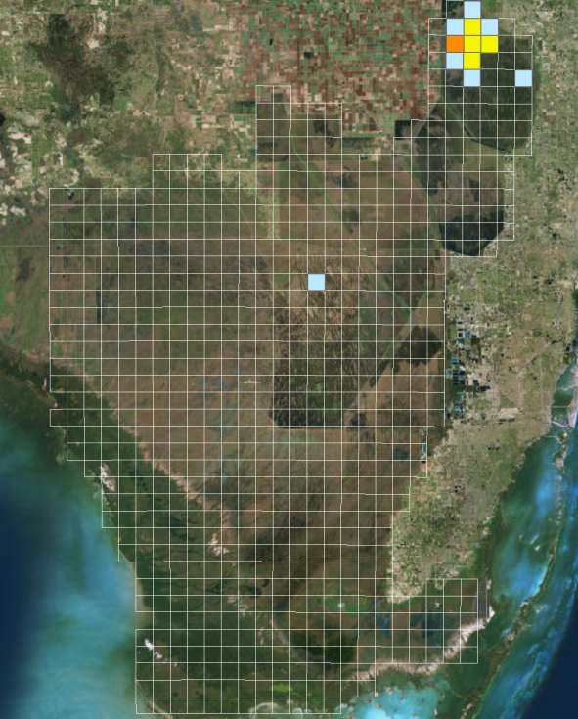
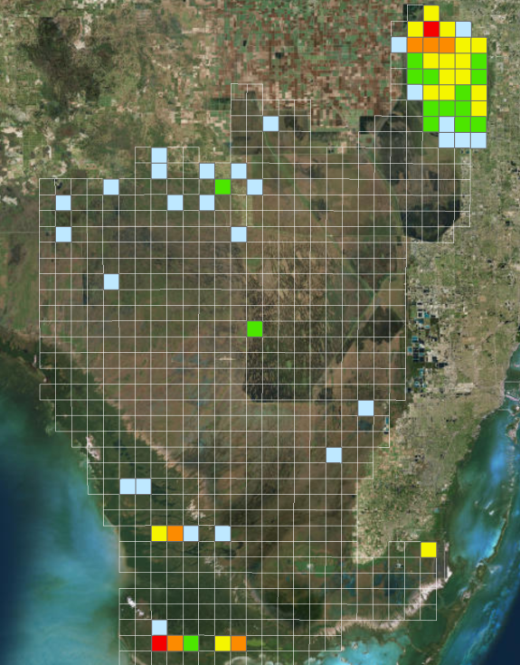
Old World Climbing Fern
1995 - 2015
1995
2015
Notes:
239% increase in frequency
Frequency of cells with ≥intermediate abundance scores up 400%
Overall abundance (region-wide) up 604%

Slide 11
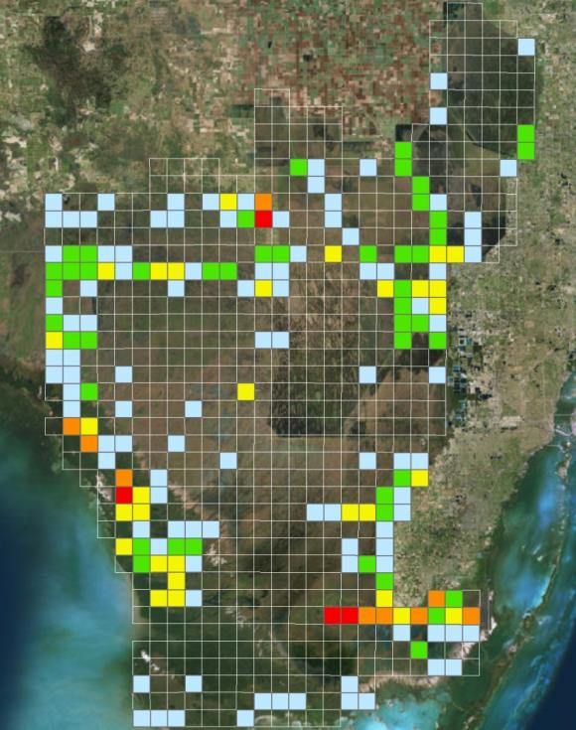
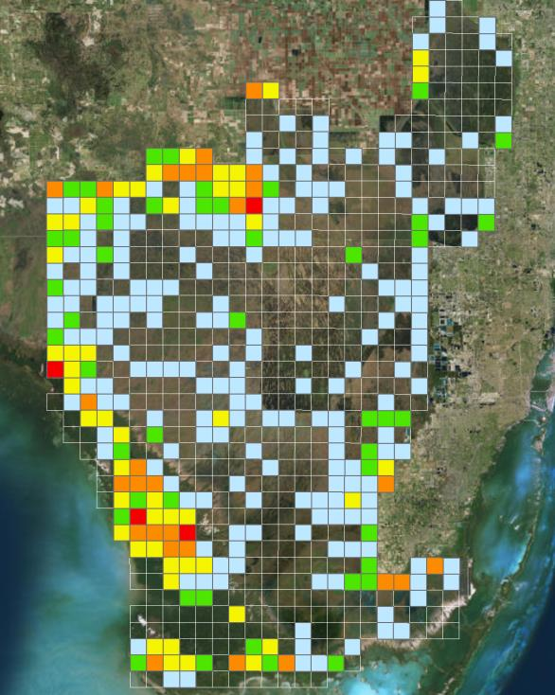
Brazilian Pepper 1995 - 2015
1995
2015
Notes:
37% increase in frequency (occupancy)
Frequency of cells with ≥intermediate abundance scores up 84%
Region-wide weighted abundance up 58%

Slide 12
ECISMA Trends

Slide 13
Summary of ECISMA Trends
Australian Pine and Melaleuca down roughly 50% within Everglades ECISMA
Melaleuca’s distribution range is static
Brazilian Pepper and Old World Climbing Fern increased in frequency, range is expanding, and number of high abundance cells increasing.

Slide 14
ECISMA Priority Plant Species
Agency/Tribe | Melaleuca | Lygodium | Brazilian Pepper | Australian Pine | Shoebutton Ardisia | Lather leaf | Portia Tree | Air Potato | Many Cat.1
Big Cypress NP
Biscayne Bay NP
Broward County
Everglades NP
FP&L
FWC
FWS (Lox Refuge)
Miami-Dade Co.
Palm Beach Co.
Seminole Tribe
SFWMD

Slide 15
New Species Observations
Species | Common Name | Mgmt Area | FLEPPC Category
Syngonium podophyllum | Arrowhead vine | WCA 3A South | Cat. I
Pteris vittata | Chinese brake fern | WCA 3A South | Cat. II
Pteris tripartita | Giant brake fern | WCA 3A South
Phoenix reclinata | Senegal date palm | WCA 3A South | Cat. II
Hyparrhenia hirta | Thatching Grass | Miami Dade
Lygodium japonicum | Japanese climbing fern | Southern Glades | Cat. I
Miscanthus sinensis | Chinese silver grass | 8.5 SMA
Spathoglottis plicata | Philippine ground orchid | East Coast Buffer
Eucalyptus deglupta | Rainbow eucalyptus | Biscayne Bay Coastal Wetlands

Slide 16
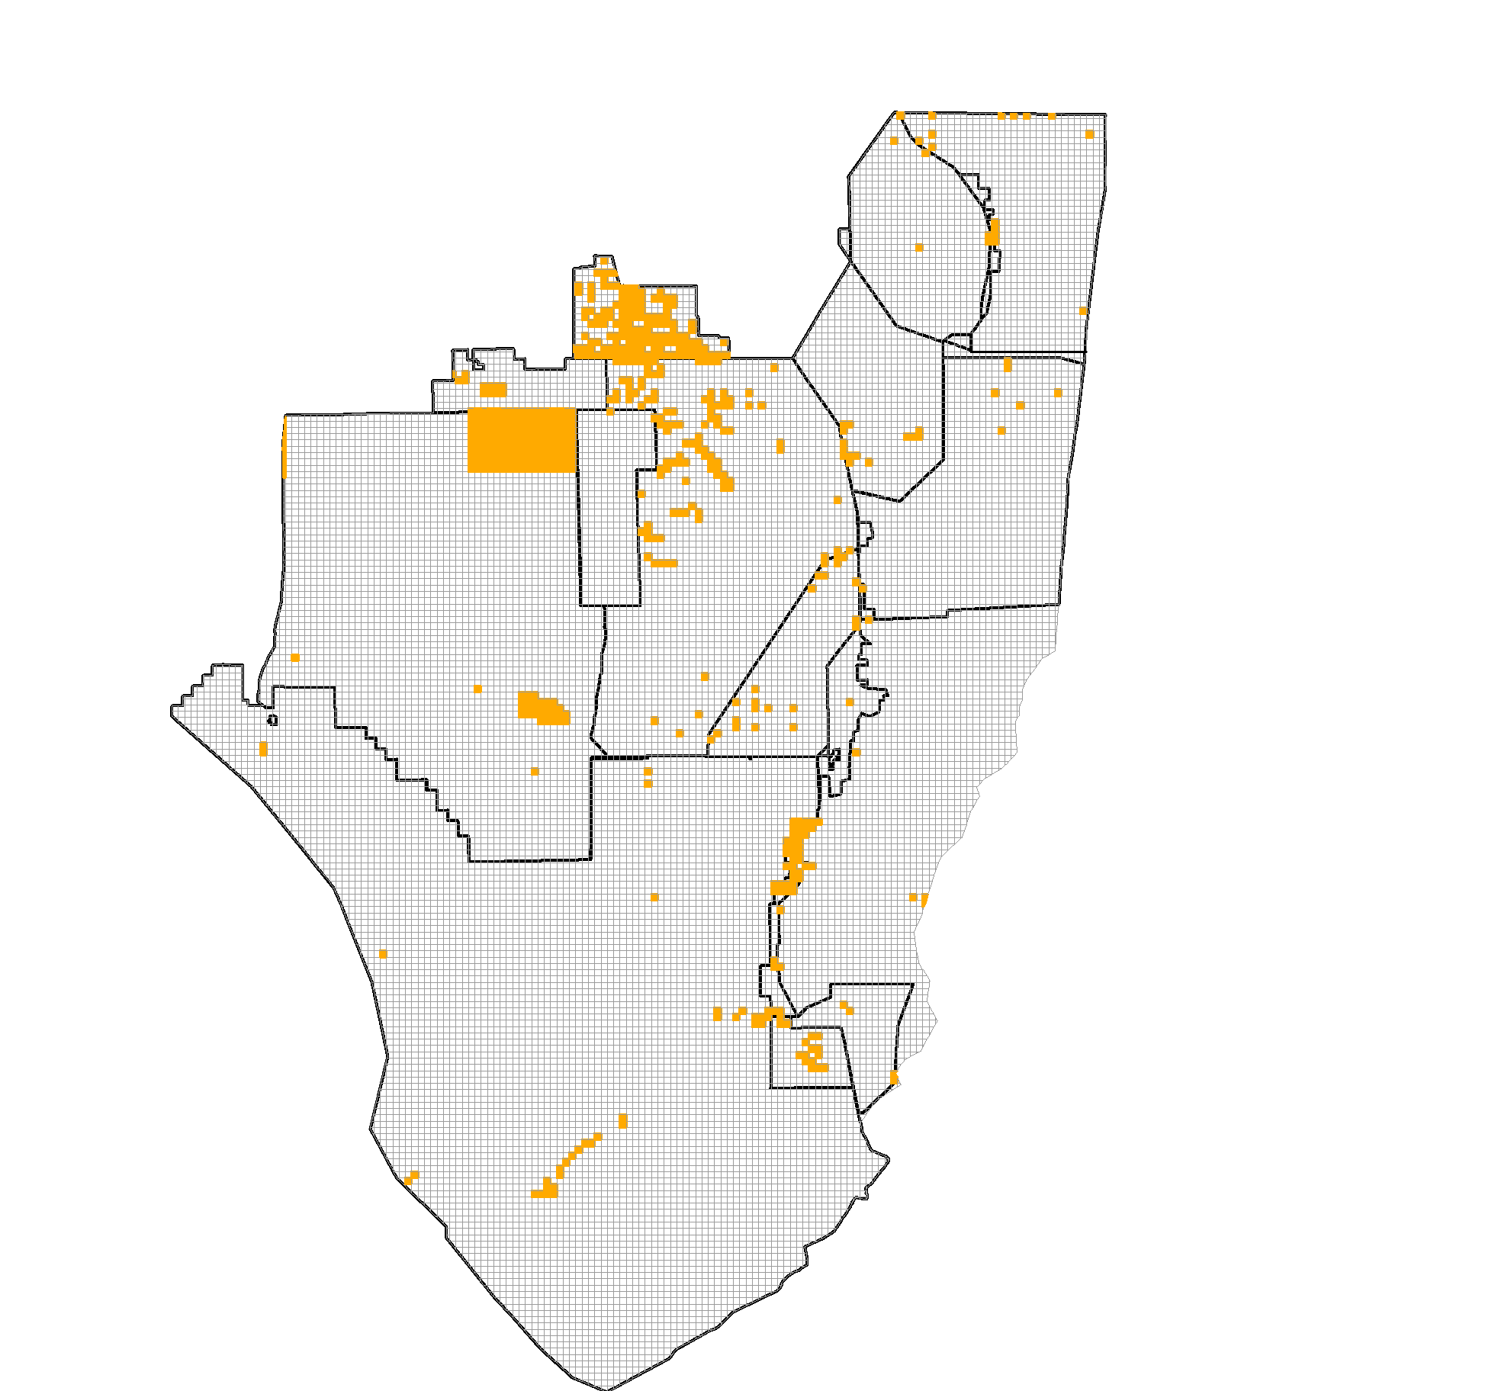
2014/15 Treatments: Brazilian Pepper
~83,000 acres swept for Brazilian Pepper
  Majority of effort in Big Cypress NP, FWC Wildlife Management Areas

Slide 17
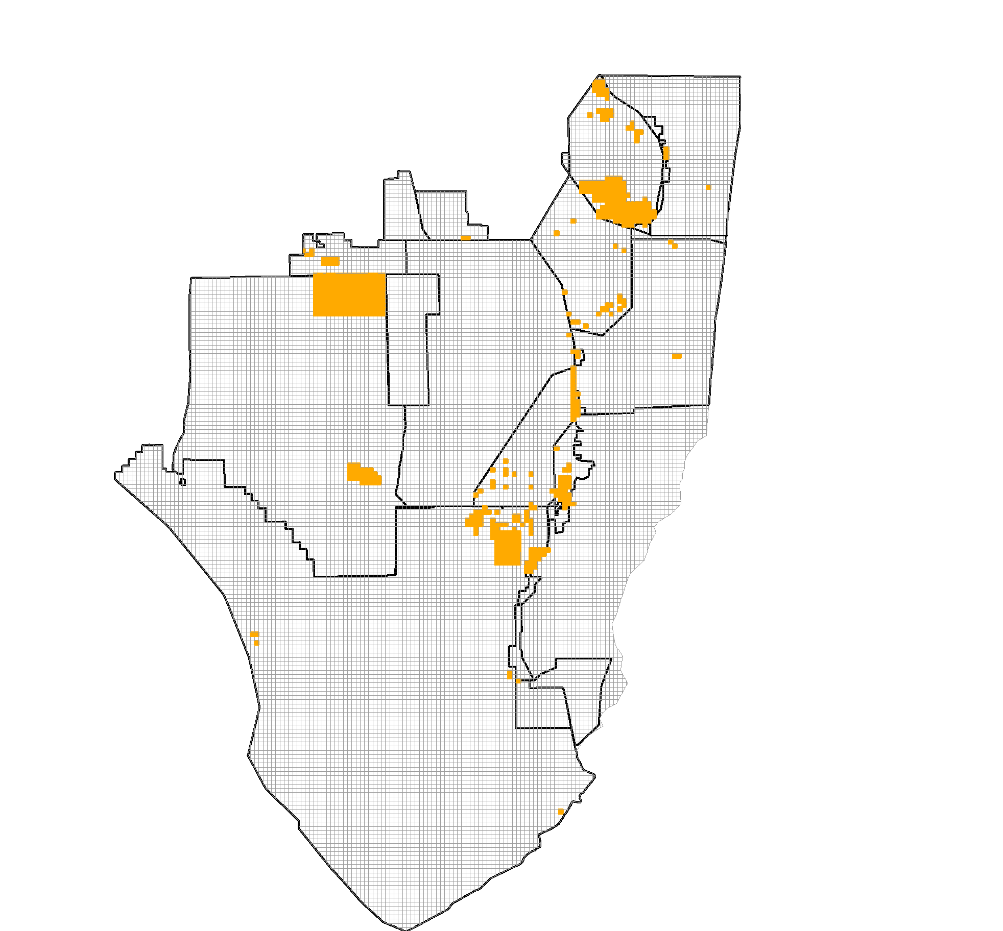
2014/15 Treatments: Melaleuca
~ 112,000 acres swept for melaleuca
  Predominantly maintenance control work in nearly all management areas

Slide 18
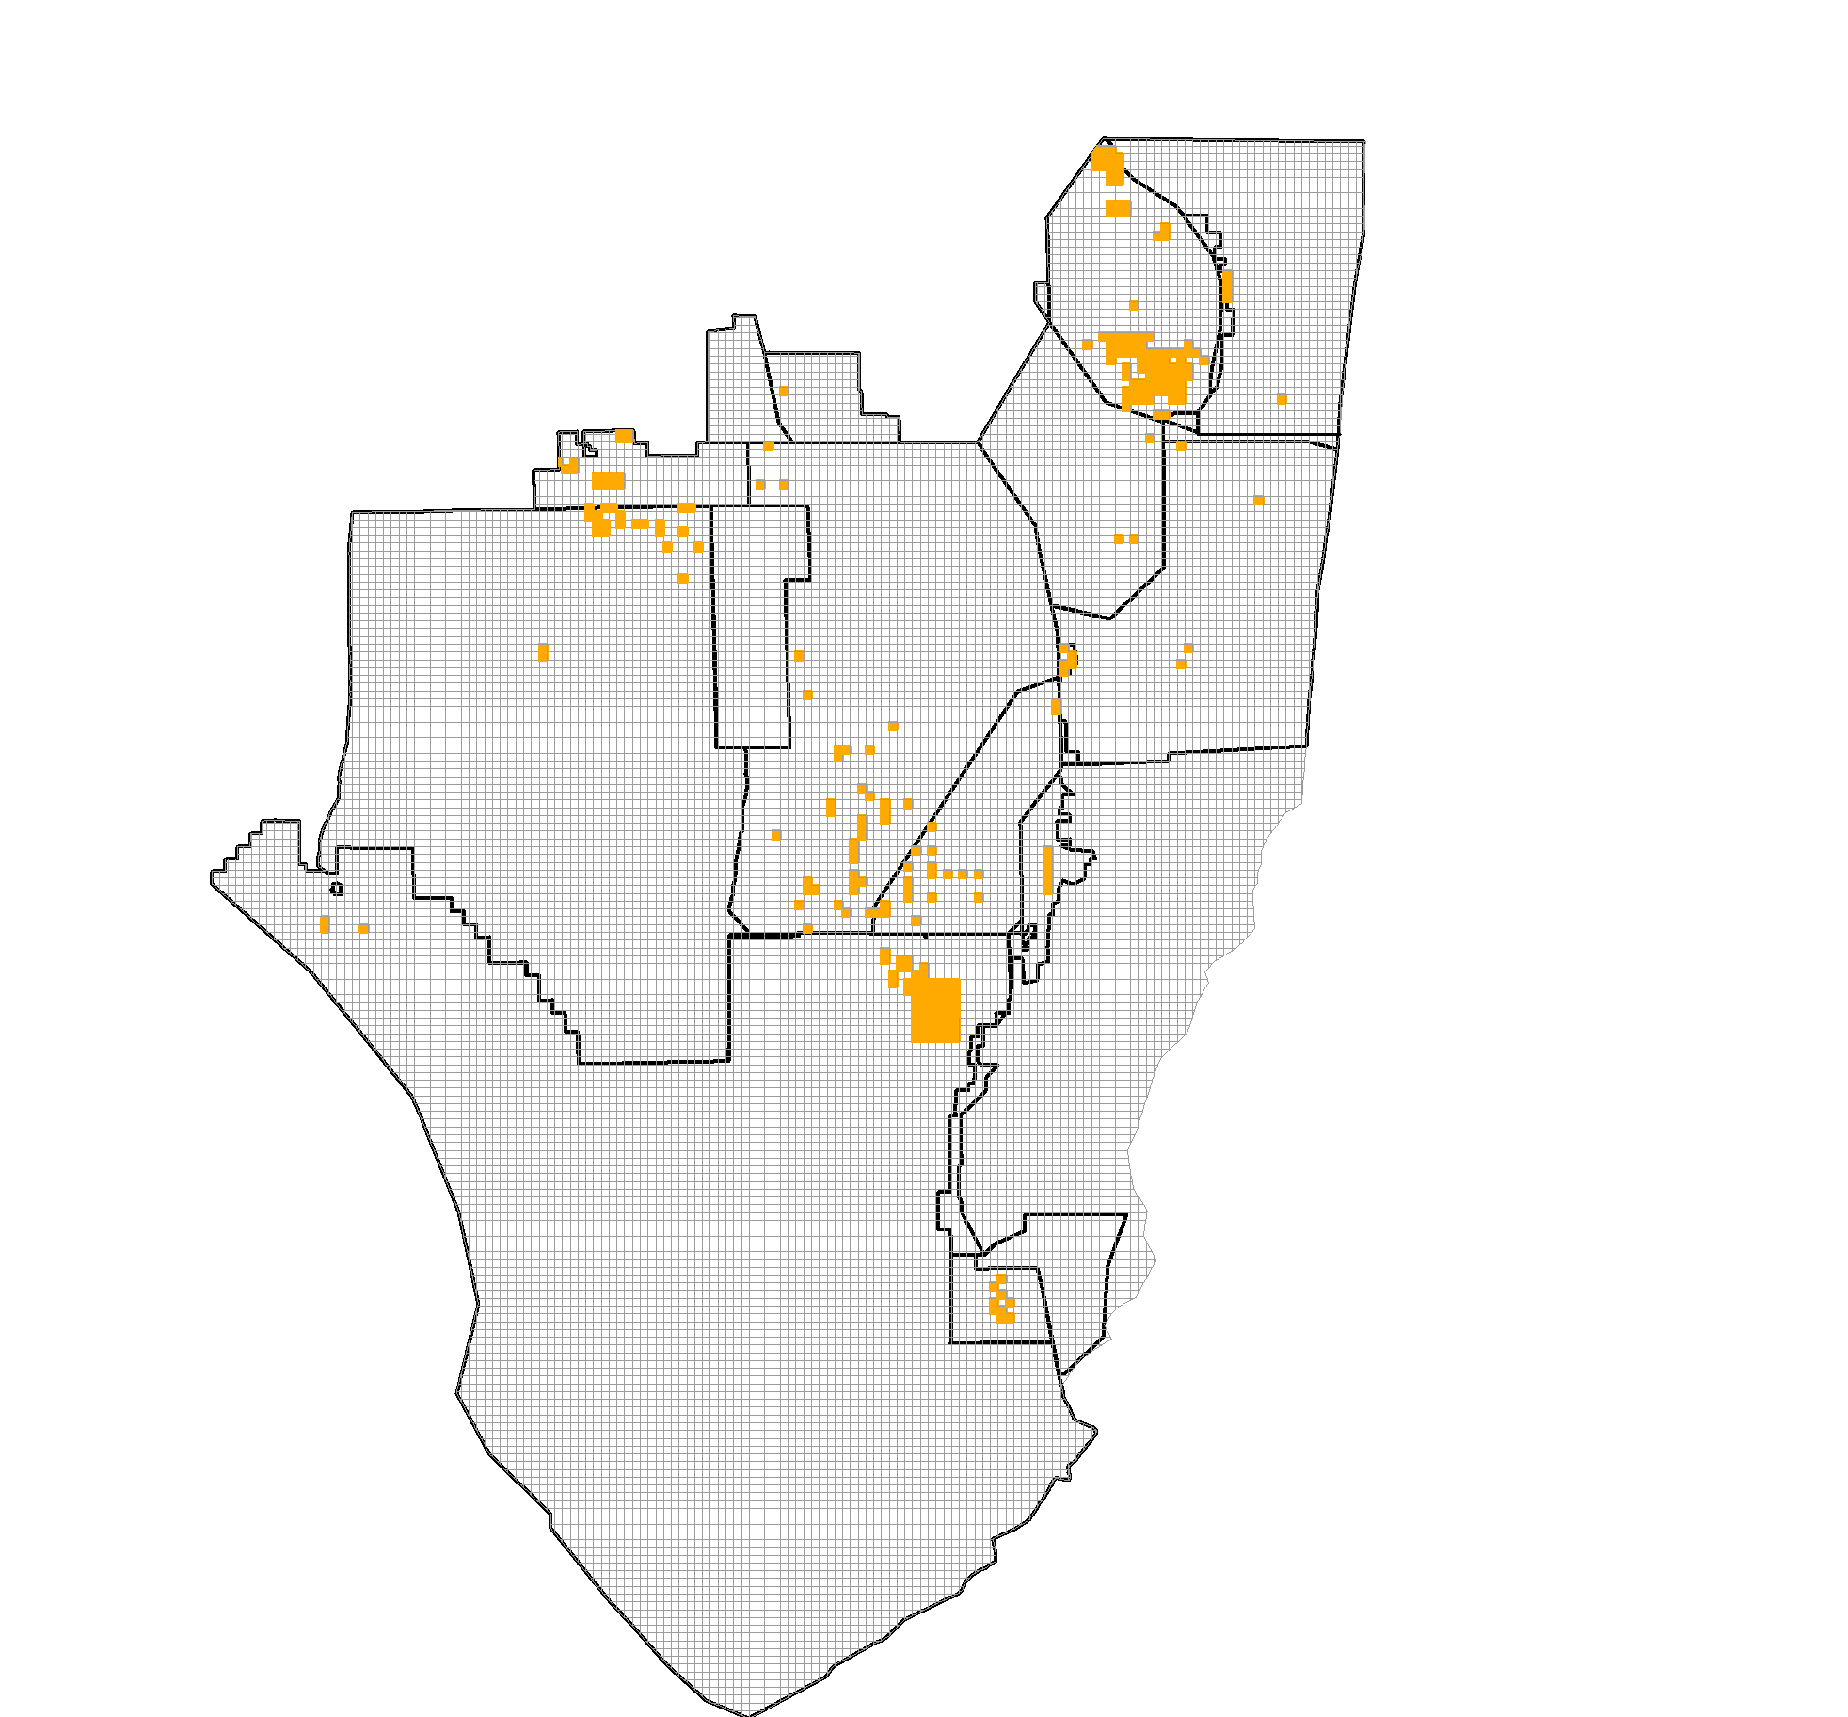
2014/15 Treatments:
Old World Climbing Fern
~ 54,000 acres swept for OWCF
  Tree islands and other forested wetlands in Southern Glades, Holey Land, and Rotenberger WMA’s
  Scattered OWCF in Loxahatchee NWR

Slide 19
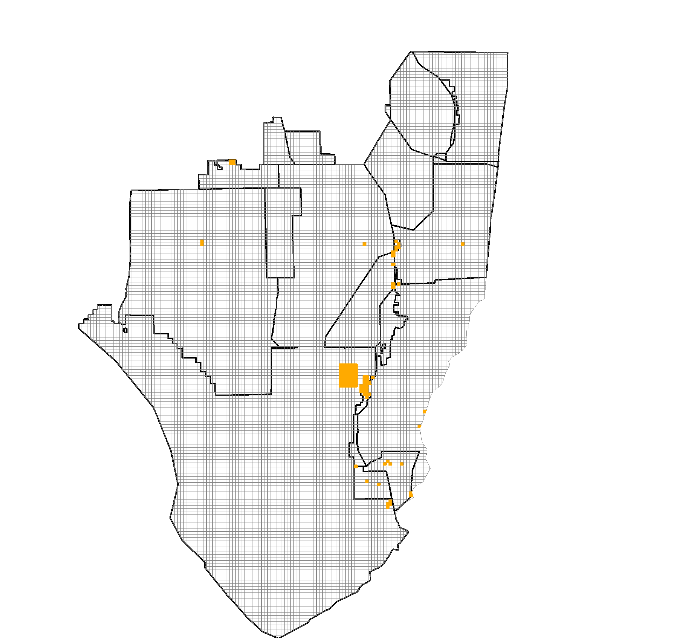
2014/15 Treatments: Australian Pine
~ 1,270 acres swept for Australian pine
  Most work in eastern ENP and Southern Glades

Slide 20
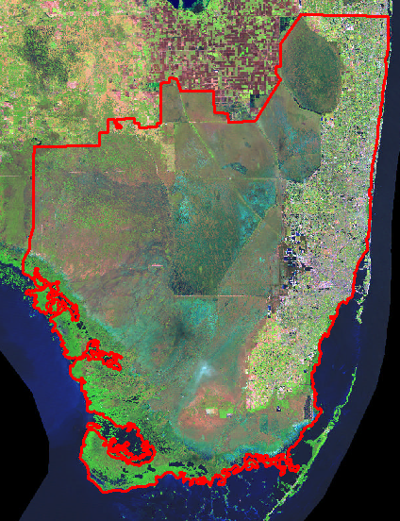
Other Managed Invasive Plant Species
Giant Brake Fern
(Pteris tripartita)
Day Jessamine
(Cestrum diurnum)
Bishopwood
(Bischofia javanica)
Arrowhead Vine
(Syngonium podophyllum)
Air Potato
(Dioscorea bulbifera)
Latherleaf
(Colubrina asiatica)
Portia Tree
(Thespesia populnea)
Shoebutton Ardisia
(Ardisia elliptica)

Slide 21
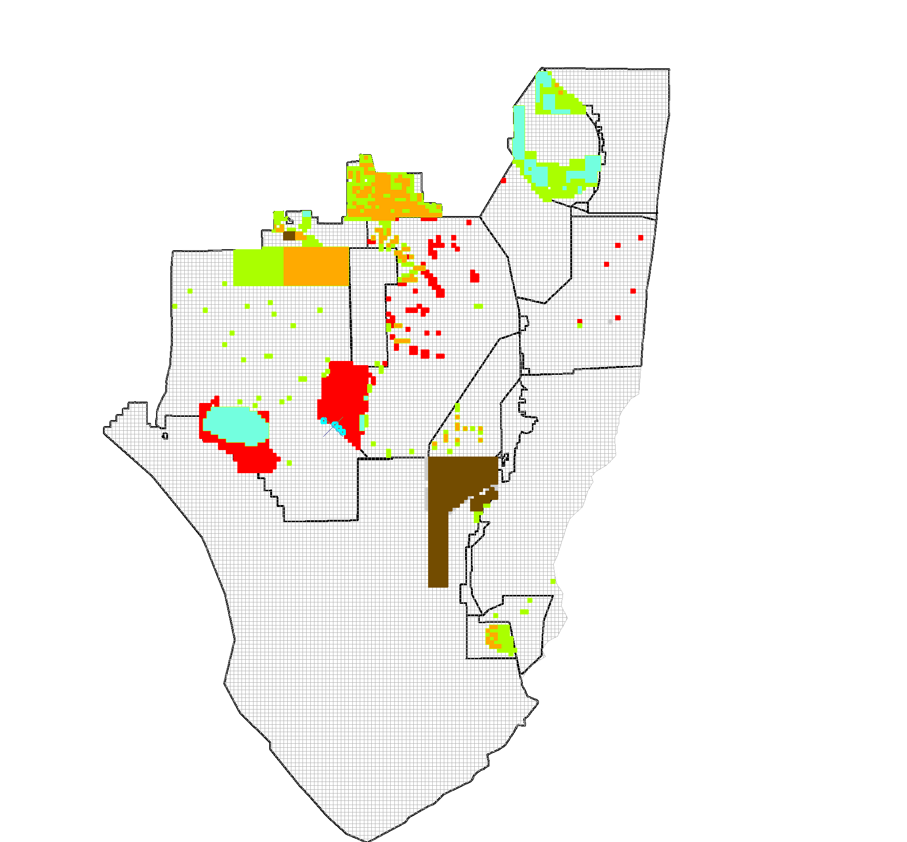
Planned Treatments FY15/16
Brazilian Pepper
Old World Climbing Fern
Old World Climbing Fern,
Brazilian Pepper
Old World Climbing Fern,
Melaleuca
Melaleuca, Brazilian Pepper,
Old World Climbing Fern,
Australian Pine
~490,000 acres planned for treatment coverage
Notes:
491181

Slide 22
Thanks
Presentation support from:
  Ellen Allen (SFWMD)
  Ryan Brown (SFWMD)
  Shea Bruscia (NPS)
  Hillary Cooley (Everglades NP)
  Jane Dozier (Miami-Dade Co.)
  Andrew Eastwick (USFWS, Loxahatchee NWR)
  Pat Howell (Broward Co.)
  Christen Mason (SFWMD)
  Vanessa McDonough (Biscayne Bay NP)
  Shelby Moneysmith (Biscayne Bay NP)
  Tony Pernas (NPS)
  Amy Peters (SFWMD)
  Jed Redwine (NPS)
  Whitney Sapeinca (Seminole Tribe of Indians)
  Billy Snyder (Big Cypress NP)

Slide 23
Foliar Aminocyclopyrachlor Trials
Christen Mason
South Florida Water Management District

Slide 24
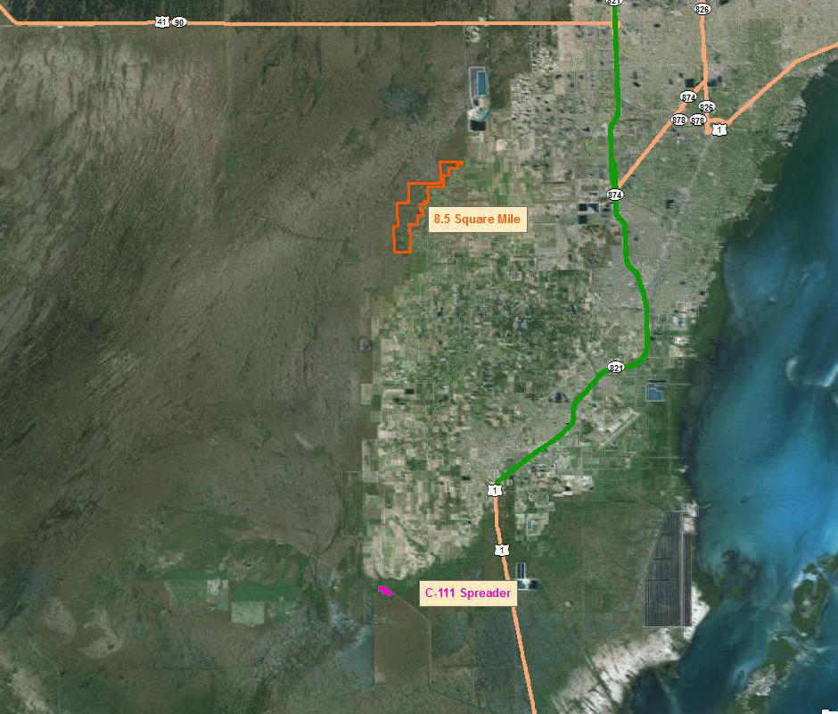
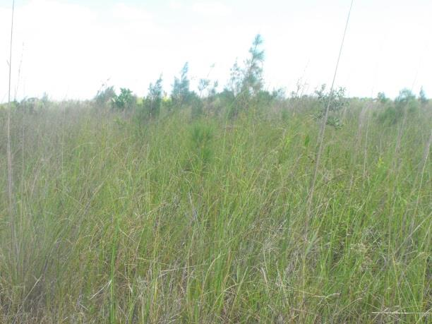
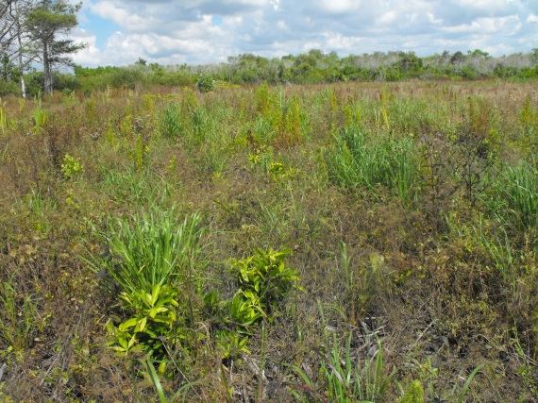
Notes:
The idea was to do a quick and dirty experiment to see if we could treat effectively, lower cost, minimal non-target damage

Slide 25

8.5 Square Mile
Objectives
Maintain prior work in sawgrass/muhlygrass prairies in the most cost-effective way.
Determine the rate of aminocyclopyr that is most effective across multiple species with the least amount of non-target damage
Notes:
Muhlygrass/sawgrass marsh. Follow-up on trials by Dan Mixson.

Slide 26
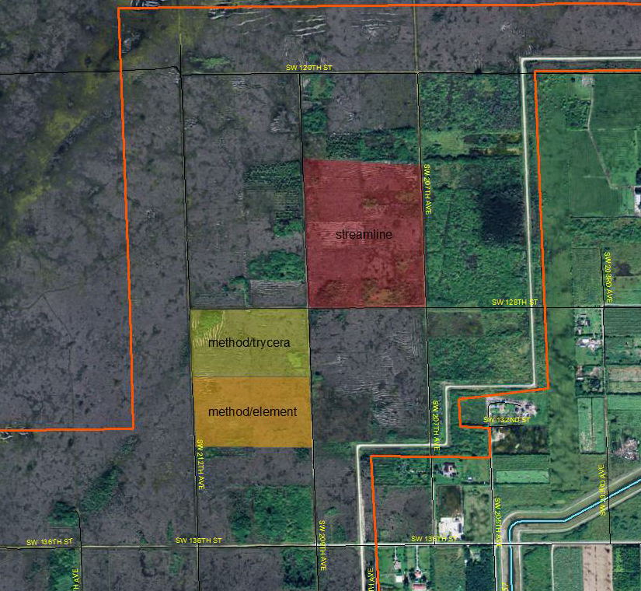
8.5 Square Mile
Streamline 9.5oz/acre
Method/Trycera 16oz/8oz
Method/Element 3A 16oz/16oz
Notes:
Dan Mixson ‘s work in the area. We tweaked it a bit and put it into operation. Argo used roads as access points. Visable trees treated but don’t use transect method. Method max label rate :18oz/acre

Slide 27
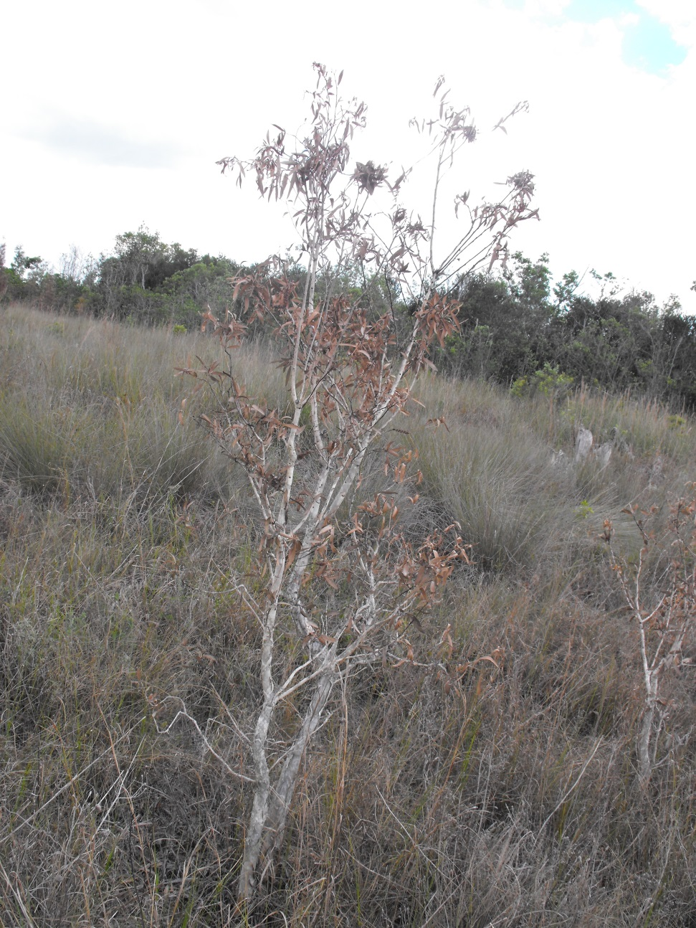
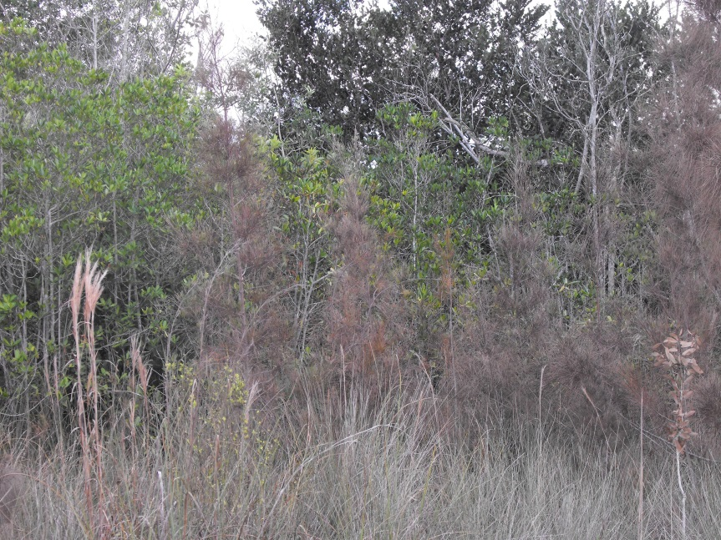
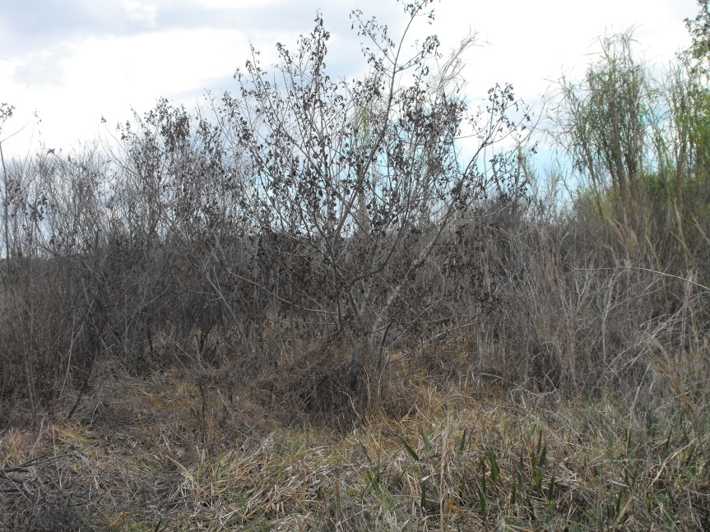
Streamline – 4 weeks
Notes:
Streamline treated 2/9-2/17

Slide 28
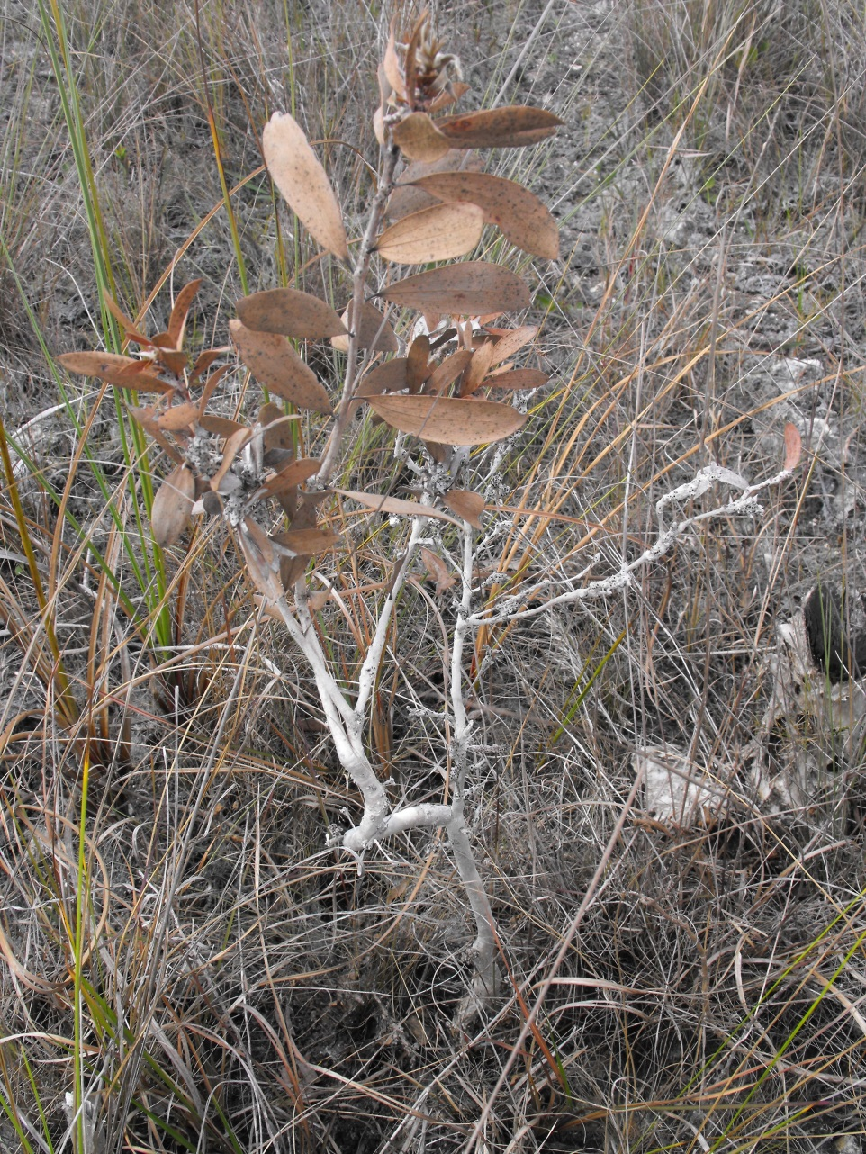
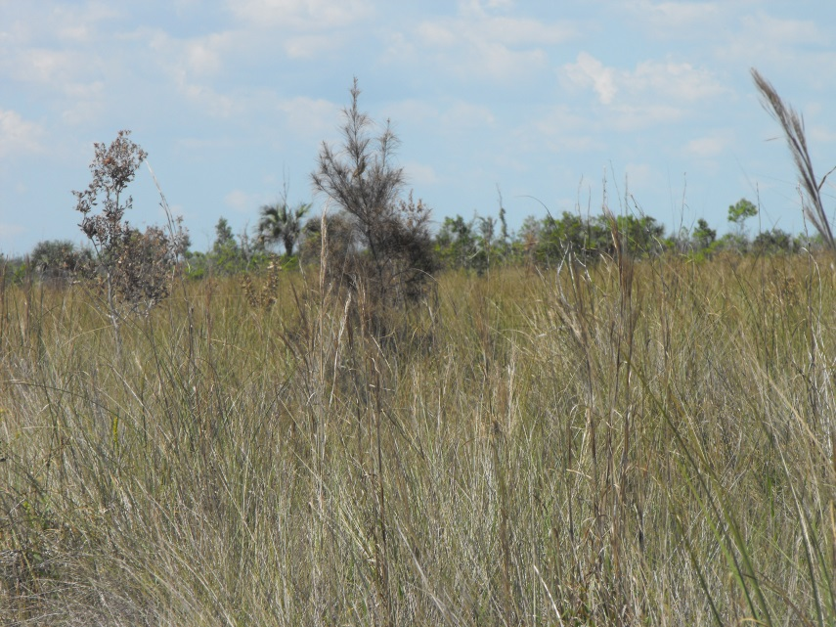
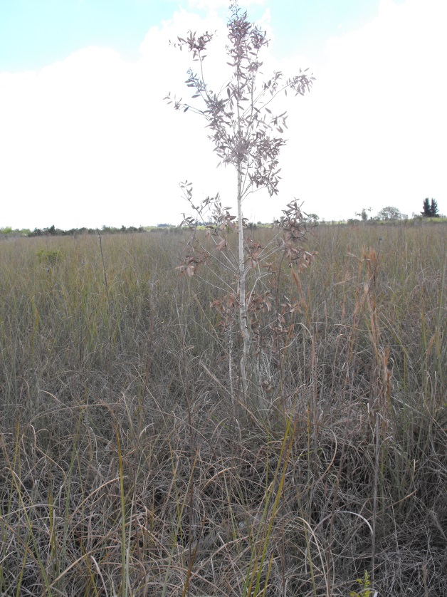
Method 240 SL/Trycera – 3 weeks

Slide 29
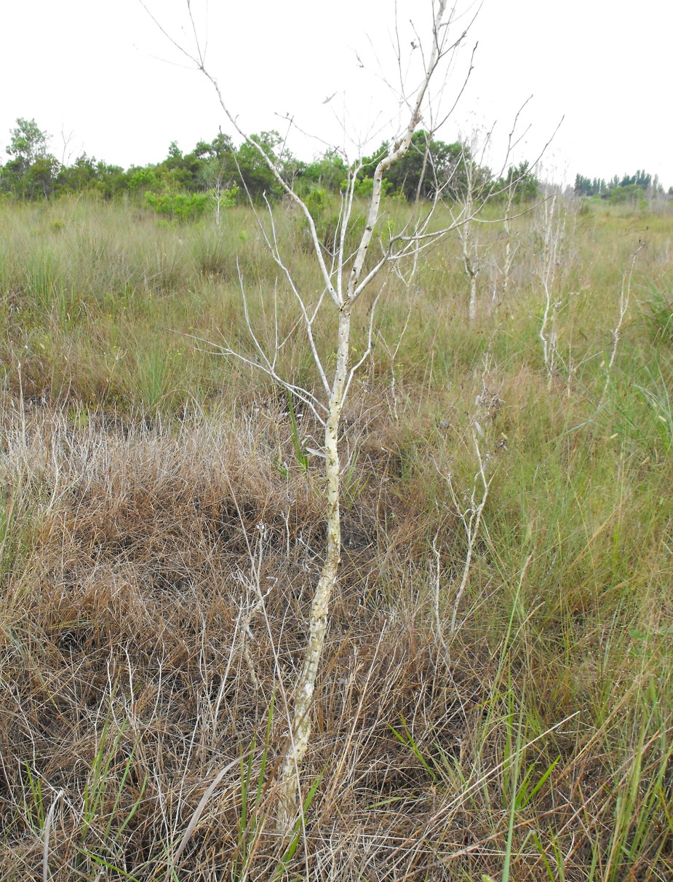
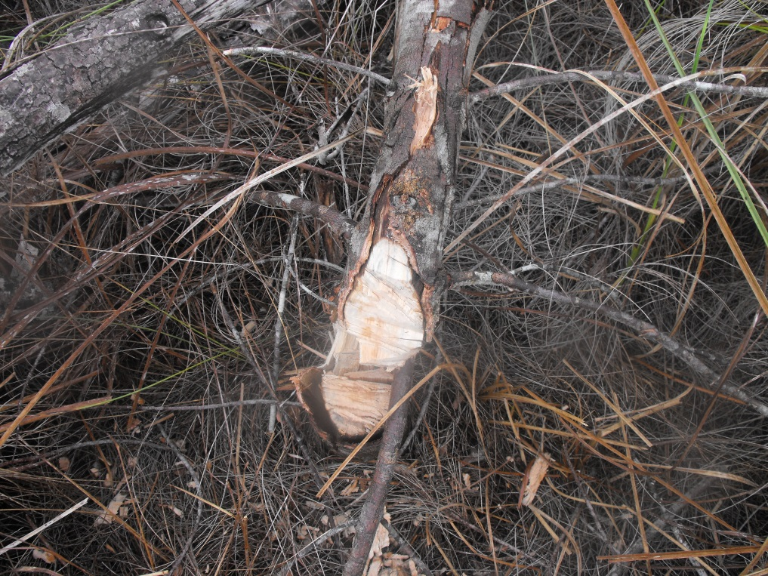
Streamline – 5 MAT
5’ trees

Slide 30
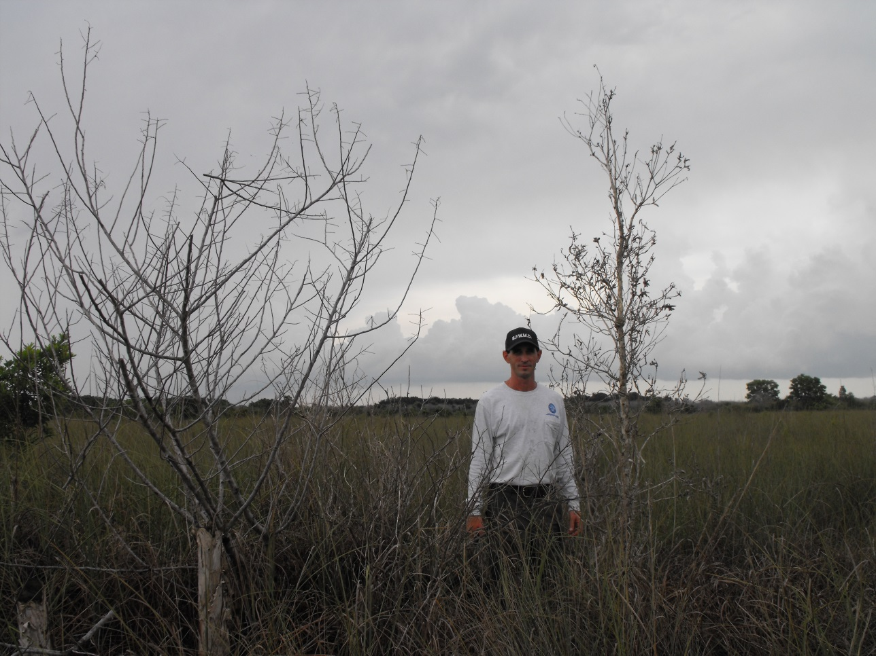
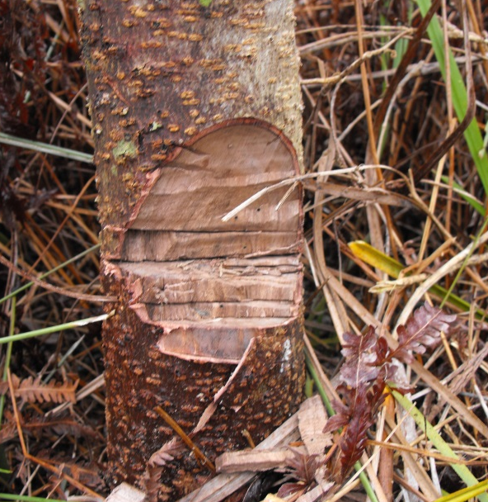
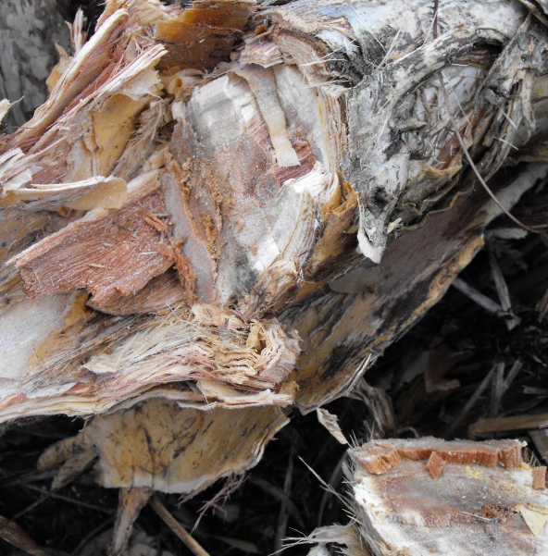
Streamline – 5 MAT
Almost
8’ trees

Slide 31
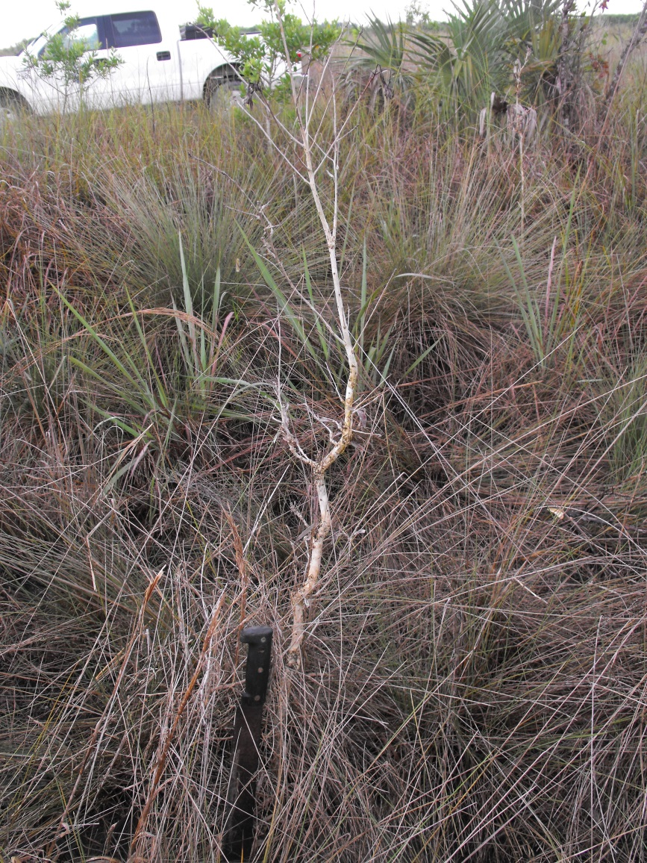
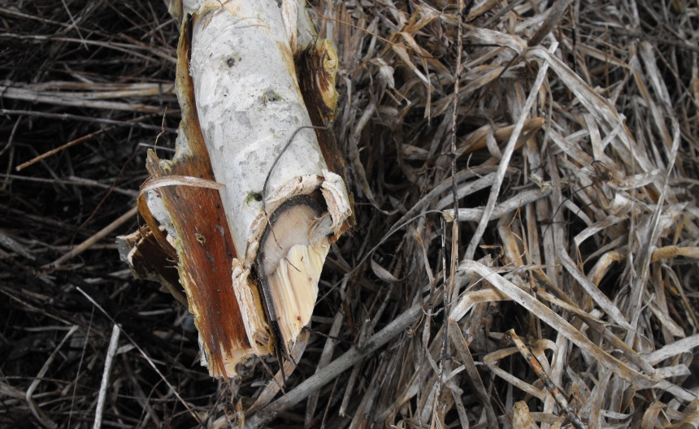
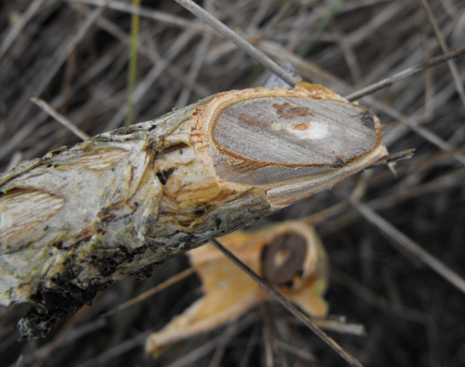
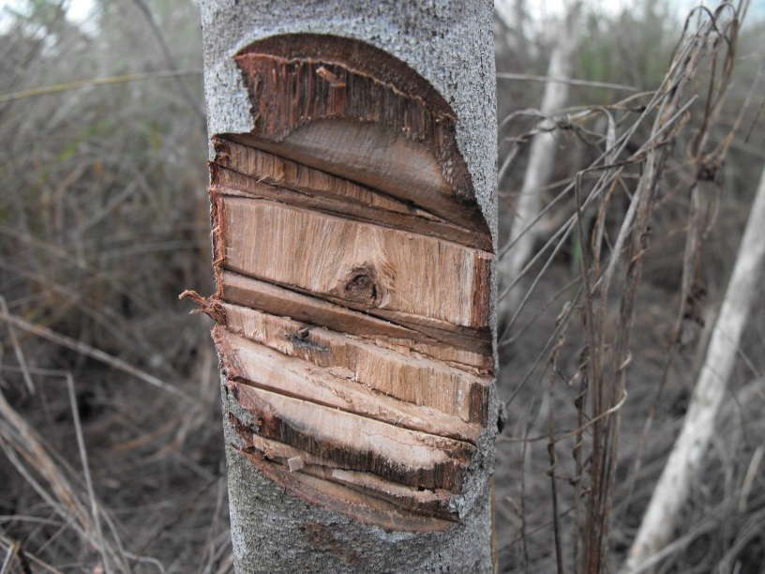
Method 240 SL/Trycera – 5 MAT
Not quite
8’ trees
5’ trees
Notes:
2/18-2/25

Slide 32
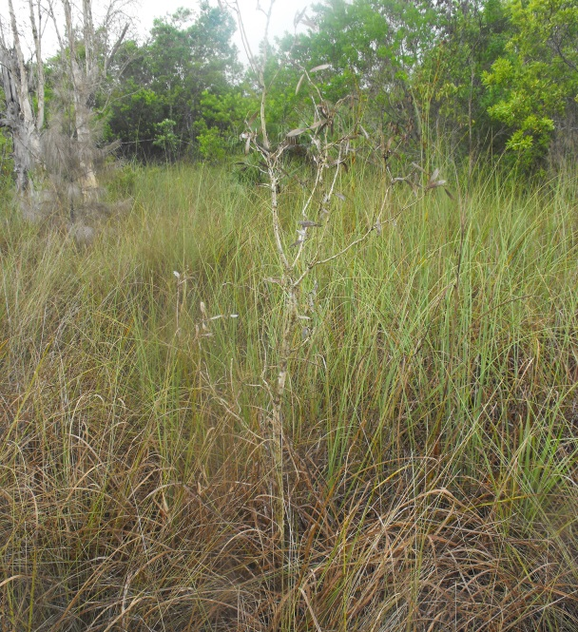
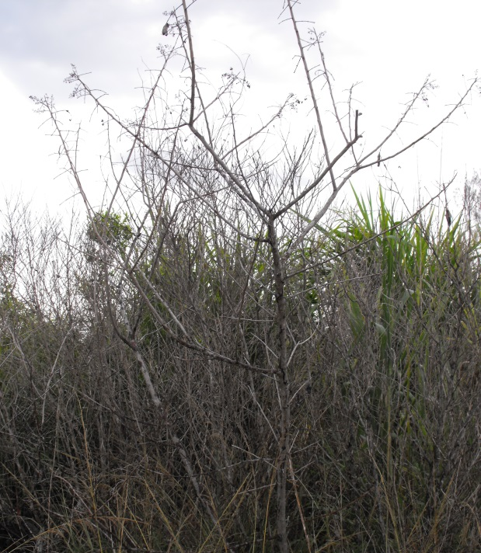
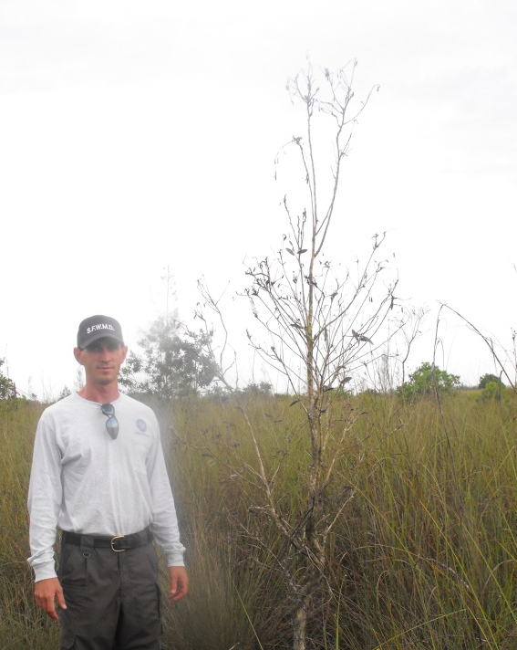
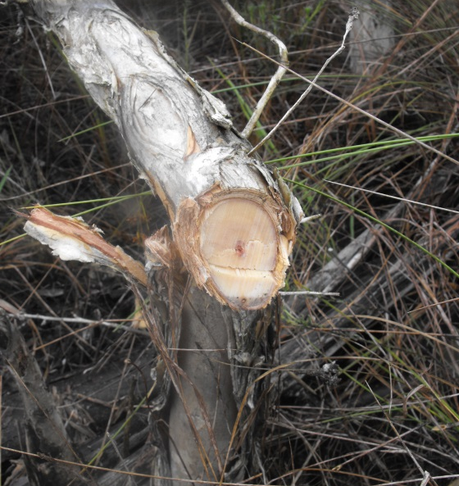
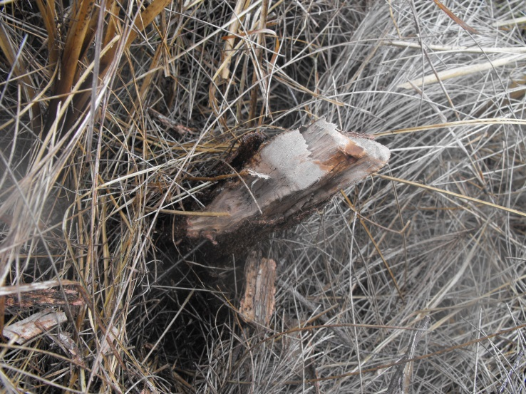
Method 240 SL/Element 3A – 4 MAT
6’ trees
8’ trees
Too soon
Notes:
3/3-3/11

Slide 33
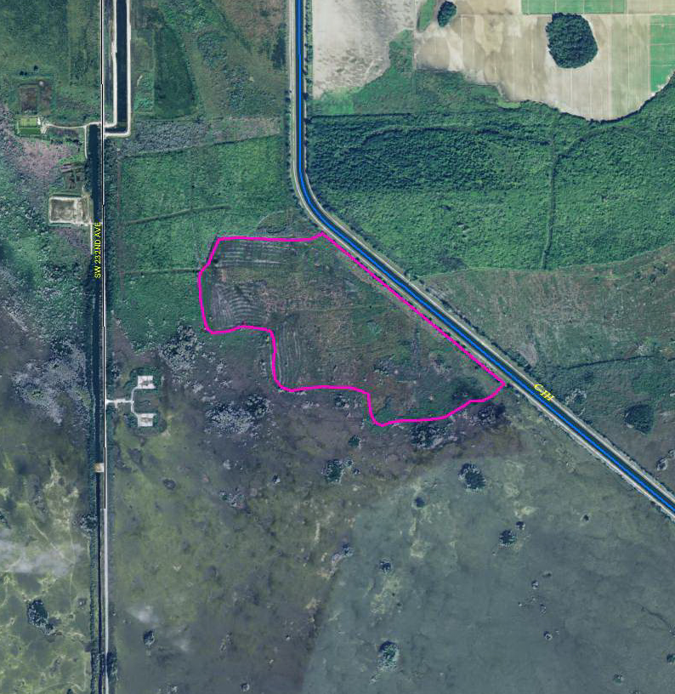
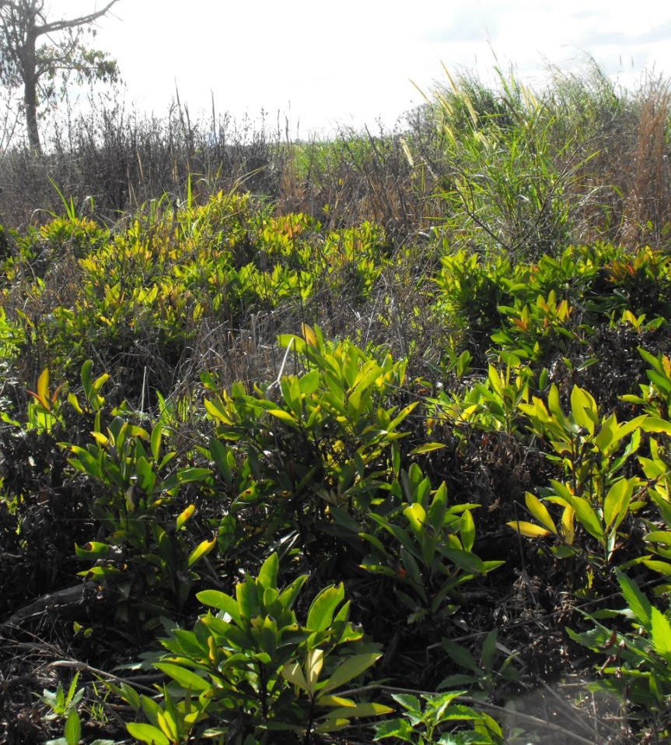
C-111 Spreader
Objective: Restore an invaded area by treating nuisance and exotic broadleaf vegetation to promote the return of the native, fire-adapted graminoid community.
Notes:
Mowed/shreaded. Herbicided. Follow up broadleaf control.

Slide 34
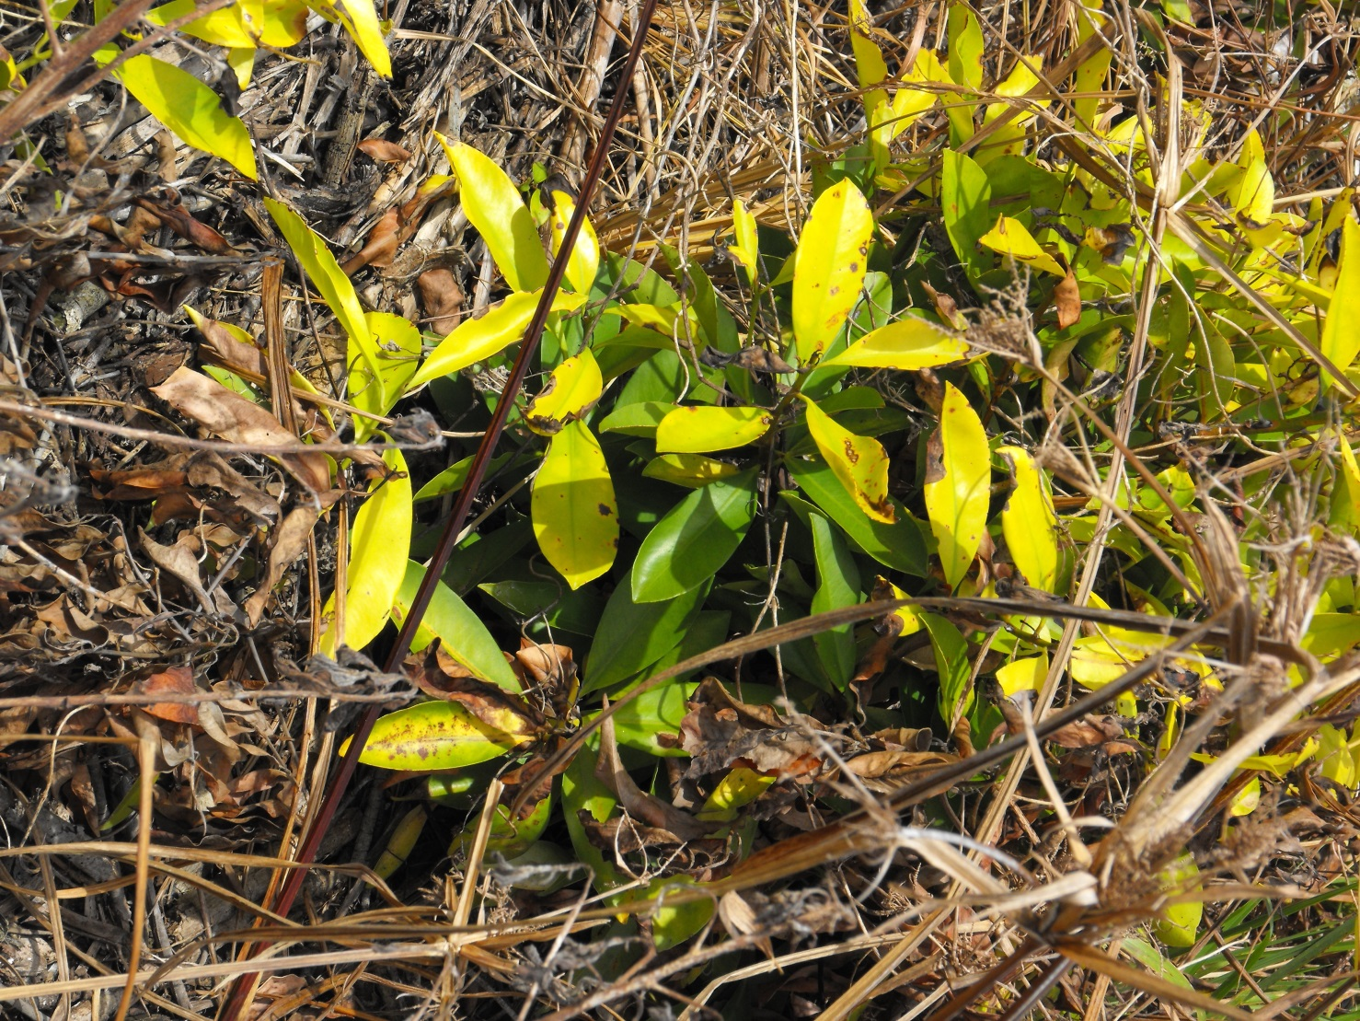
Foliar Streamline for Ardisia control
11.5 oz/acre
2 MAT
Notes:
2 MAT, ludwigia was barely visable.

Slide 35
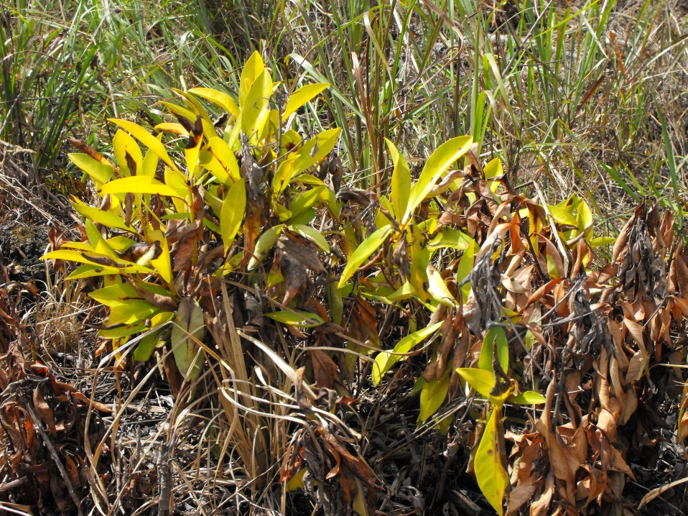
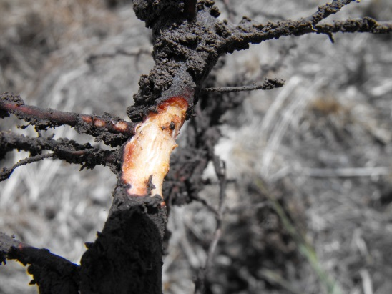
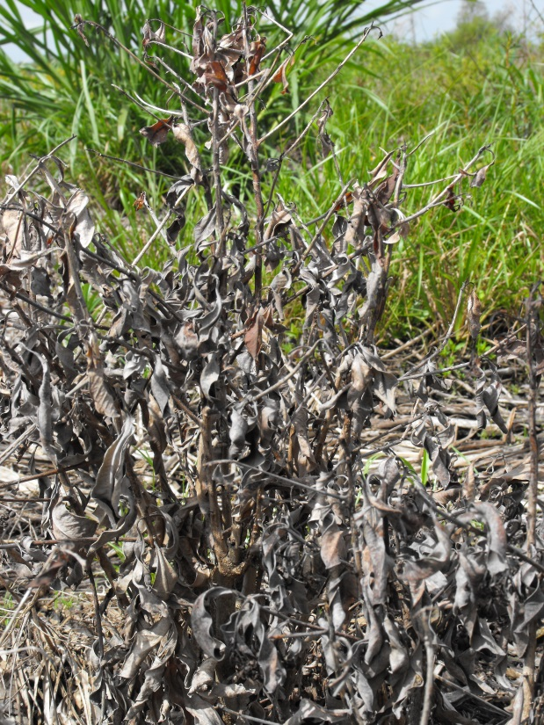
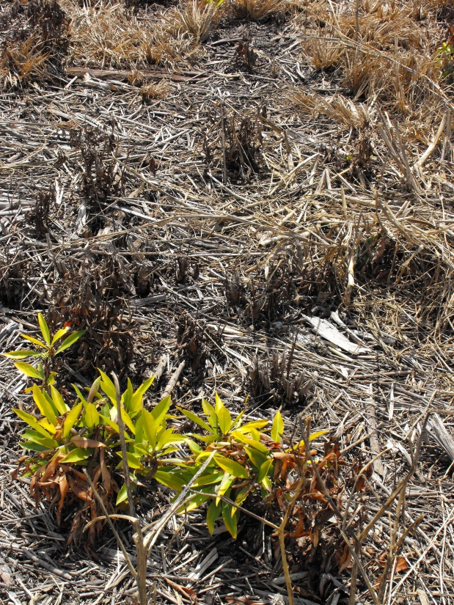


3 MAT

Slide 36

Initial thoughts Future plans
Aminocyclopyrachlor (ACP) at 9.5 oz/acre as a foliar application on BP and AP is effective.
Lower rates for BP and AP control
ACP is likely effective on melaleuca at 9.5 oz/acre
Lower rates for Melaleuca control
Streamline at 11.5oz/acre will likely control small ardisia.
Lower rates for ardisia control
Other ACP formulations
Sawgrass is sensitive to ACP
Nozzle type, application methods

Slide 37
Big Cypress NP Treatment History Analysis
Jed Redwine
Everglades National Park

Slide 38


Current coverage and historical treatment intensity

Slide 39
Four regions have evidence that exotic plants are spatially constrained.
The average frequency of treatments is 2.5-3.7 in these watershed units
Watershed Unit | Proportion of cells treated | mean treatment frequency | Proportion of 1km cells with exotic plants
1. Marshes, Sloughs, Strands, & Uplands | 34.5% | 1.2 | 63.4%
2. Northern Uplands | 13.8% | 1.2 | 46.9%
3. Strands, Sloughs, & Uplands | 39.8% | 2.1 | 58.4%
4. Strands & Prairies | 44.7% | 3.7 | 39.4%
5. Interior Uplands | 44.8% | 3.1 | 32.8%
6. Cypress Domes, Cypress Prairies, & Sloughs | 3.0% | 1.2 | 11.4%
7. Coastal | 7.1% | 1.9 | 25.4%
8. Southern Uplands | 36.2% | 3.1 | 31.2%
9. Dwarf Cypress | 59.9% | 2.5 | 50.3%
10. Everglades Marl Prairies | 7.4% | 1.8 | 9.1%
Average | 36.7% |  | 37.0%

Slide 40
Bottom line
Reducing and infestation is the most expensive form of exotic management (EDRR is much cheaper).
Analysis suggests that an average of 3 treatments per km² is threshold for constraining an infestation.
Land managers are best at identifying where treatments should occur (some areas treated much more frequently than 3 times), but 3-treatment threshold may be a general rule-of-thumb that helps budget forecasting

Slide 41
Cattail Management with Imazamox in Nutrient Enriched Everglades Wetlands
LeRoy Rodgers, SFWMD
Notes:
Good morning and thanks to Lyn and others for the invitation to come present at the short course
This presentation will be a review of cattail management activities in the Everglades by SFWMD over the last nine years
With an emphasis on more recent work using the herbicide imazamox
The cattail management work I will talk about is primarily aimed at wildlife habitat improvement in disturbed portions of the Everglades

Slide 42


The Everglades’ Phosphorus Problem
Increased phosphorus leads to cattail dominance
Notes:
Begin with a little back ground on why we are in the cattail management business in the first place
The Everglades has a nutrient problem. In particular, the Everglades has too much phosphorus.
The Everglades was historically an oligotrophic ecosystem– meaning that there are relatively low levels of nutrients
After the construction of the central and south Florida project for flood control and water supply, the Everglades experienced decades of nutrient rich surface water inflows from upstream agricultural and urban areas as well as periodic droughts which released nutrients from the deep organic Everglades soils.
The map on the left shows phosphorus hot spots across the everglades in 2004. And on the right you can see a close up view of WCA 2A. The yellow orange and red colors show the distribution and abundance of cattail between 1991 and 2003.
Cattail is expanding its range and abundance over time. Instead of being an occasional species at low densities, this native plant is now behaving like a weed and dominating large portions of WCA2.
This is directly related to the increased concentrations of phosphorus in the system

Slide 43


Cattail Encroachment Degrades Habitat
Current Conditions
Desired Conditions
Dense cattail stands
Low species diversity
Poor wading bird foraging habitat
Mosaic of sawgrass “ridge” and open water sloughs
Increased habitat complexity
Increased species diversity
Increased wildlife habitat
Notes:
As a result of these human activities, many parts of the Everglades have been transformed from the quintessential river of grass that features the mosaic of sawgrass “ridges” and open water sloughs to a sea of dense and nearly impenatrible stands of cattail.
We have found that despite improved water quality and quantity, these cattail marshes are quite resilient and resistant to change. Even if we get the water right, restoration of the ecosystem to its former condition may take a very long time, if ever.

Slide 44



Cattail Habitat Improvement Project
“CHIP”
Creating “open” habitat with herbicides and fire
Timeline
May 2006 – glyphosate (7.5 pts/ac AquaNeat™)
July 2006 – burn
Aug 2006 – glyphosate + imazapyr (7.5 pts/ac AquaNeat™ + 1 qt/ac Habitat™)
Mar 2007 – glyphosate + imazapyr
Nov 2007 – glyphosate + imazapyr
44
Notes:
In 2006, the SFWMD initiated a pilot project aimed at learning how to improve wildlife habitat in the cattail dominated portions of the WCA’s
The project is called CHIP Cattail Habitat Improvement Project
The objective was to open up habitat in the cattail dominated regions using herbicides and fire with the goal of restoring ecological functions such as aquatic productivity and wading bird habitat
We established three 15-acre plots and another three plots to use as untreated control plots for comparison
We began with a glyphosate treatment in May 2006 followed by a prescribed fire two months later.
Unfortunately, we did not get very good control – in hindsight, we believe this was due to the high abundance of cattail and spring season application
We then did fall application of glyphosate and imazapyr
Followed by two additional treatments of glyphosate and imazapyr in 2007

Slide 45


Succession of an Ecosystem
April 2006
May 2010
Herbicide + Burn treatments:
created open water habitat with submerged aquatic vegetation
increased productivity
reduced phosphorus levels
increased wading bird utilization
Notes:
The end result was complete control of cattail and other emergent vegetation and a transformation to open water habitat with dense submerged aquatic vegetation, primarily chara and ????
The photo on the left shows the dense cattail marsh in 2006 and on the right is the same plot 4 years later with dense SAV and no emergent vegetation
We observed substantial decreases in phosphorus and large increases in wading bird foraging

Slide 46


Increased Dissolved Oxygen
Enriched control
Algae and submerged vegetation
Oxygen concentration
(mg/L)
Enriched open
Oxygen concentration
(mg/L)
46

Slide 47



Wading bird usage greater in open versus control plots (WY2010 dry season)
 | Enriched Control | Enriched Open
Mean birds per week ± S.D. (all species pooled) | 0.5 ± 1.4 | 36 ± 36
Total # birds | 26 | 2,024
Total # species | 4 | 9
Number of weeks ≥1 bird observed | 6 | 17
47

Slide 48


Challenges
Glyphosate and imazapyr provided good, but non-selective control of cattail and other emergent vegetation.
Several treatments required
Did not achieve sawgrass ridge/slough landscape
?

Slide 49
Imazamox
EPA registration 2008
Belongs to the imidazolinone class of pesticides.
  Includes imazapic, imazapyr, imazaquin
Mode of action: inhibits acetohydroxyacid synthesis (ALS inhibitor)
Imidazolinone herbicides generally exhibit very little toxicity to mammals, birds, fish, or insects.
Approved for aquatic use
Notes:
Imi---DaZole---eh-KNOWN
Inhibits the plant enzyme acetolactate (ah-see-toe-lack-tate) synthase (ALS) thereby stopping cell division and causing plant death
Average half life in water of 14 days in Florida

Slide 50
Clearcast for Cattail Control
Recommended rate for cattail control
  32 - 64 oz/acre
BASF reported excellent control at 32 fl oz/acre
Recommended rates for some plants closely related to desired non-target Everglades species
  64 - 128 oz/acre
  e.g. smartweeds, floating heart, bulrushes, grasses
Can imazamox provide selective control of cattail in Everglades marsh?
Notes:
Also known to effectively control wild taro and chinese tallow

Slide 51

Initial Everglades Trials 2010 - 11
Clearcast
32 oz/ac
Aerial Application
Control

Slide 52
Clearcast Treatments 12 MAT
Cattail
Sawgrass
Percent change in cover
0 oz/ac
8 oz/ac
16 oz/ac
32 oz/ac
0 oz/ac
8 oz/ac
16 oz/ac
32 oz/ac
Excellent cattail control at 32 oz/ac; moderate control at 16 oz/ac
Minimal to no damage to sawgrass and other dominant species in all treatments

Slide 53

Back to CHIP
Switched to imazamox in 2011
Cattail very well controlled for three years
Habitat evolving into productive emergent marsh with bulrush and other species.
Bulrush and other emergent species now colonizing CHIP plots

Slide 54

Post-Imazamox Treatment 2015

Slide 55
Active Marsh Improvement Project
“AMI”
New trial in dense cattail areas in WCA 2A
Evaluated 32 oz/ac and 24 oz /ac
Results suggest that dense cattail requires no less than 32 oz/ac with follow up treatments
  More biomass to kill, interference from dense thatch probably limits uptake

Slide 56

Cattail Control – 12, 21, and 24 MAT

Slide 57
24 MAT Species Results
SPECIES |  | Alive |  |  | Resprout Injury |  |  | Dead
 |  | 0 oz | 24 oz | 32 oz | 0 oz | 24 oz | 32 oz | 0 oz | 24 oz | 32 oz
Chara sp. | Muskgrass | 100% | 100% | 80% |  |  |  |  |  | 20%
Cladium jamaicense | Sawgrass | 100% | 100% | 93% |  |  | 7%
Eleocharis cellulosa | Spikerush | 100% | 100% | 100%
Nymphea odorata | Fragrant Water Lily | 100% | 100% | 83% |  |  |  |  |  | 17%
Typha domingiensis | Cattial | 100% | 31% | 13% |  |  | 13% |  | 69% | 73%
Polygonum setaceum | Bog Smartweed | 100% | 100% | 100%
Utricularia foliosa | Bladderwort | 100% | 100% | 86% |  |  |  |  |  | 14%
Salix caroliniana | Carolina Willow | 100% | 100% | 100%
Sagittaria lancifolia | Duck Potato | 100% | 100% | 55% |  |  |  |  |  | 45%
Notes:
Some minor damage and/or stunted growth on some desirable species
While a second aerial application may be effective and necessary to get more complete control of cattail, it is an open question as to whether other species would tolerate a second treatment.

Slide 58

New Imazamox Trials in WCA 2A
Remnant sawgrass “ridge” persists after imazamox treatment
Sloughs opening up as cattail is selectively controlled
Notes:
140 acre plots
Landscape scale openings were created for the AMI-1 project using the CHIP approach.
Combination of herbicide and burning treatment, with the expectation that because imazamox was used, where CHIP initially used the broad spectrum combination of glyphosate and imazapyr, cattail will be disproportionately impacted allowing desirable vegetation recovery
and succession following the burn to occur sooner than observed in CHIP.
Plots were aerially sprayed in April 2011 with imazamox at a rate of 0.28 kg ae ha-1 and burned January 2012.

Slide 59
Next Steps
Assess impact of pre-herbicide burning to remove dense thatch
Evaluate ground-based cattail treatments using imazamox
Address resistance management concerns
Notes:
Resistance to ALS compounds confirmed in terrestrial species - none in aquatics

Slide 60


Acknowledgements
Sue Newman, SFWMD
Michael Manna , SFWMD
Mark Cook , SFWMD
David Black , SFWMD
Todd Horton, SeaPro Corp.
Bill Haller, UF/IFAS
Helicopter Applicators Inc.

