Slide 1
Invasive Plant Operations Overview
2014 Everglades Invasive Species Summit
LeRoy Rodgers, SFWMD

Slide 2
ECISMA Priority Plant Species
Agency/Tribe | Melaleuca | Lygodium | Brazilian Pepper | Australian Pine | Shoebutton Ardisia | Lather leaf | Portia Tree | Air Potato | Many Cat.1
Big Cypress NP
Biscayne Bay NP
Broward County
Everglades NP
FP&L
FWC
FWS (Lox Refuge)
Miami-Dade Co.
Palm Beach Co.
Seminole Tribe
SFWMD

Slide 3
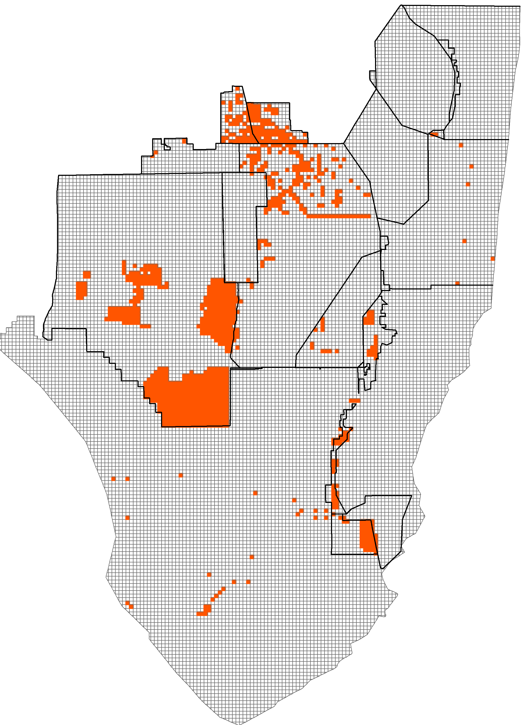
2013/14 Treatments: Brazilian Pepper
~128,550 acres swept for Brazilian Pepper
Majority of control effort in Big Cypress National Preserve and FWC Wildlife Management Areas

Slide 4
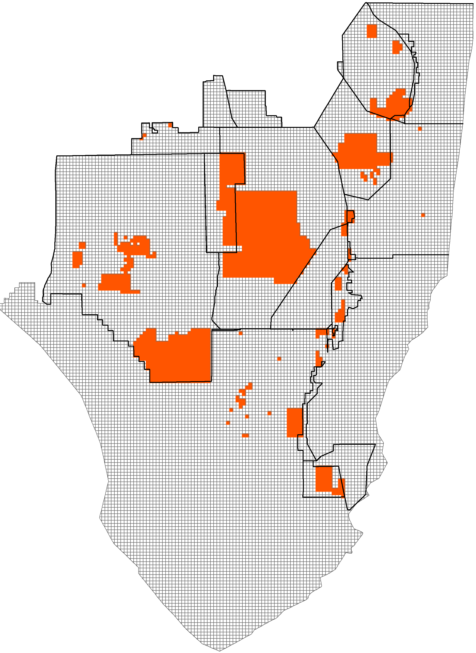
2013/14 Treatments: Melaleuca
~ 341,000 acres swept for melaleuca
Predominantly maintenance control work in nearly all management areas

Slide 5
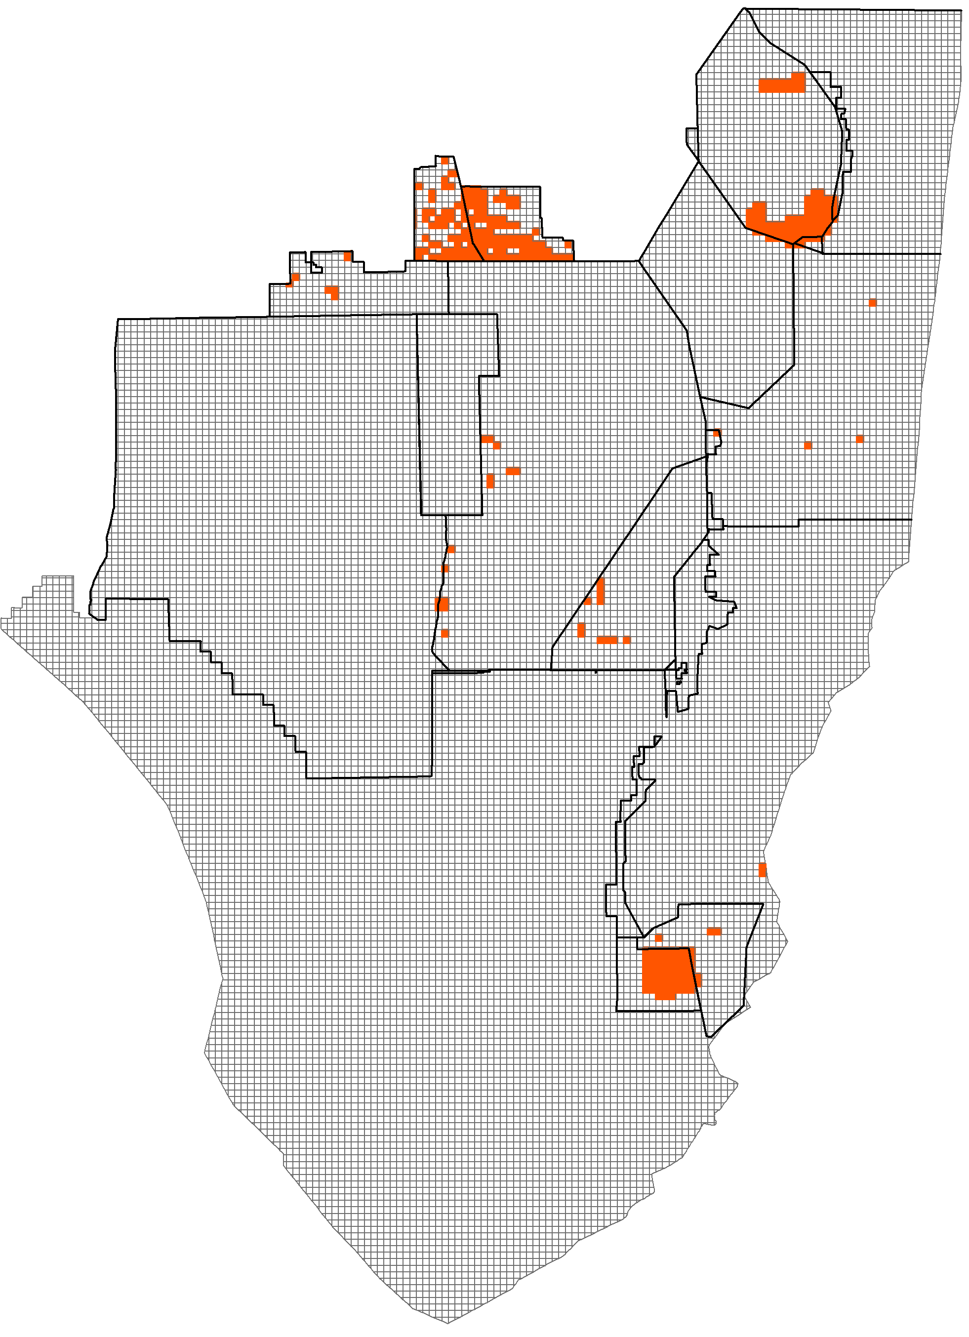
2013/14 Treatments: Old World Climbing Fern
~ 18,500 acres swept for OWCF
Tree islands and other forested wetlands in Southern Glades, Holey Land, and Rotenberger WMA’s
Follow up work (post-aerial) and foliar treatments of widely scattered OWCF in Loxahatchee NWR

Slide 6
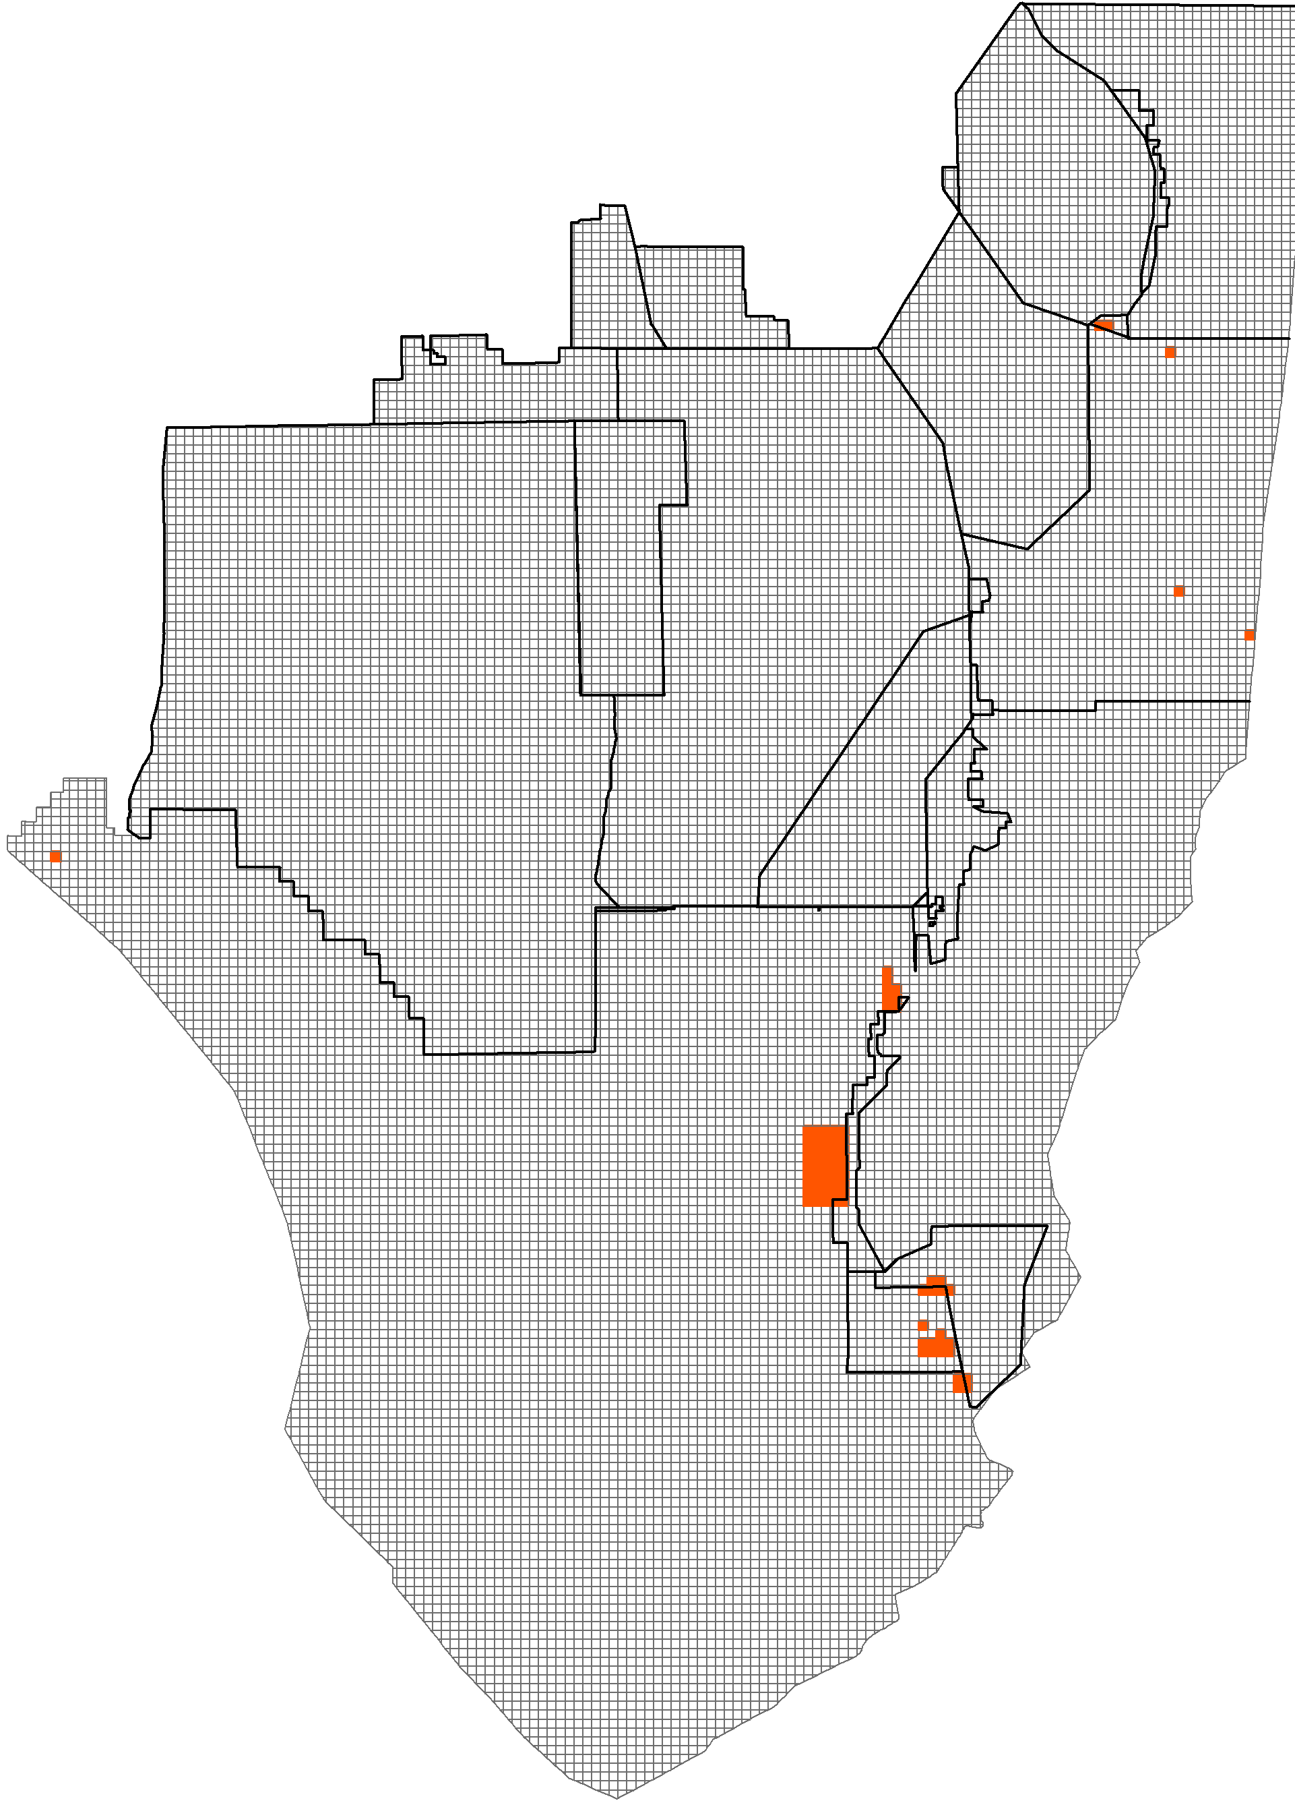
2013/14 Treatments: Australian Pine
~ 16,000 acres swept for Australian pine
Most work in eastern ENP and Southern Glades

Slide 7
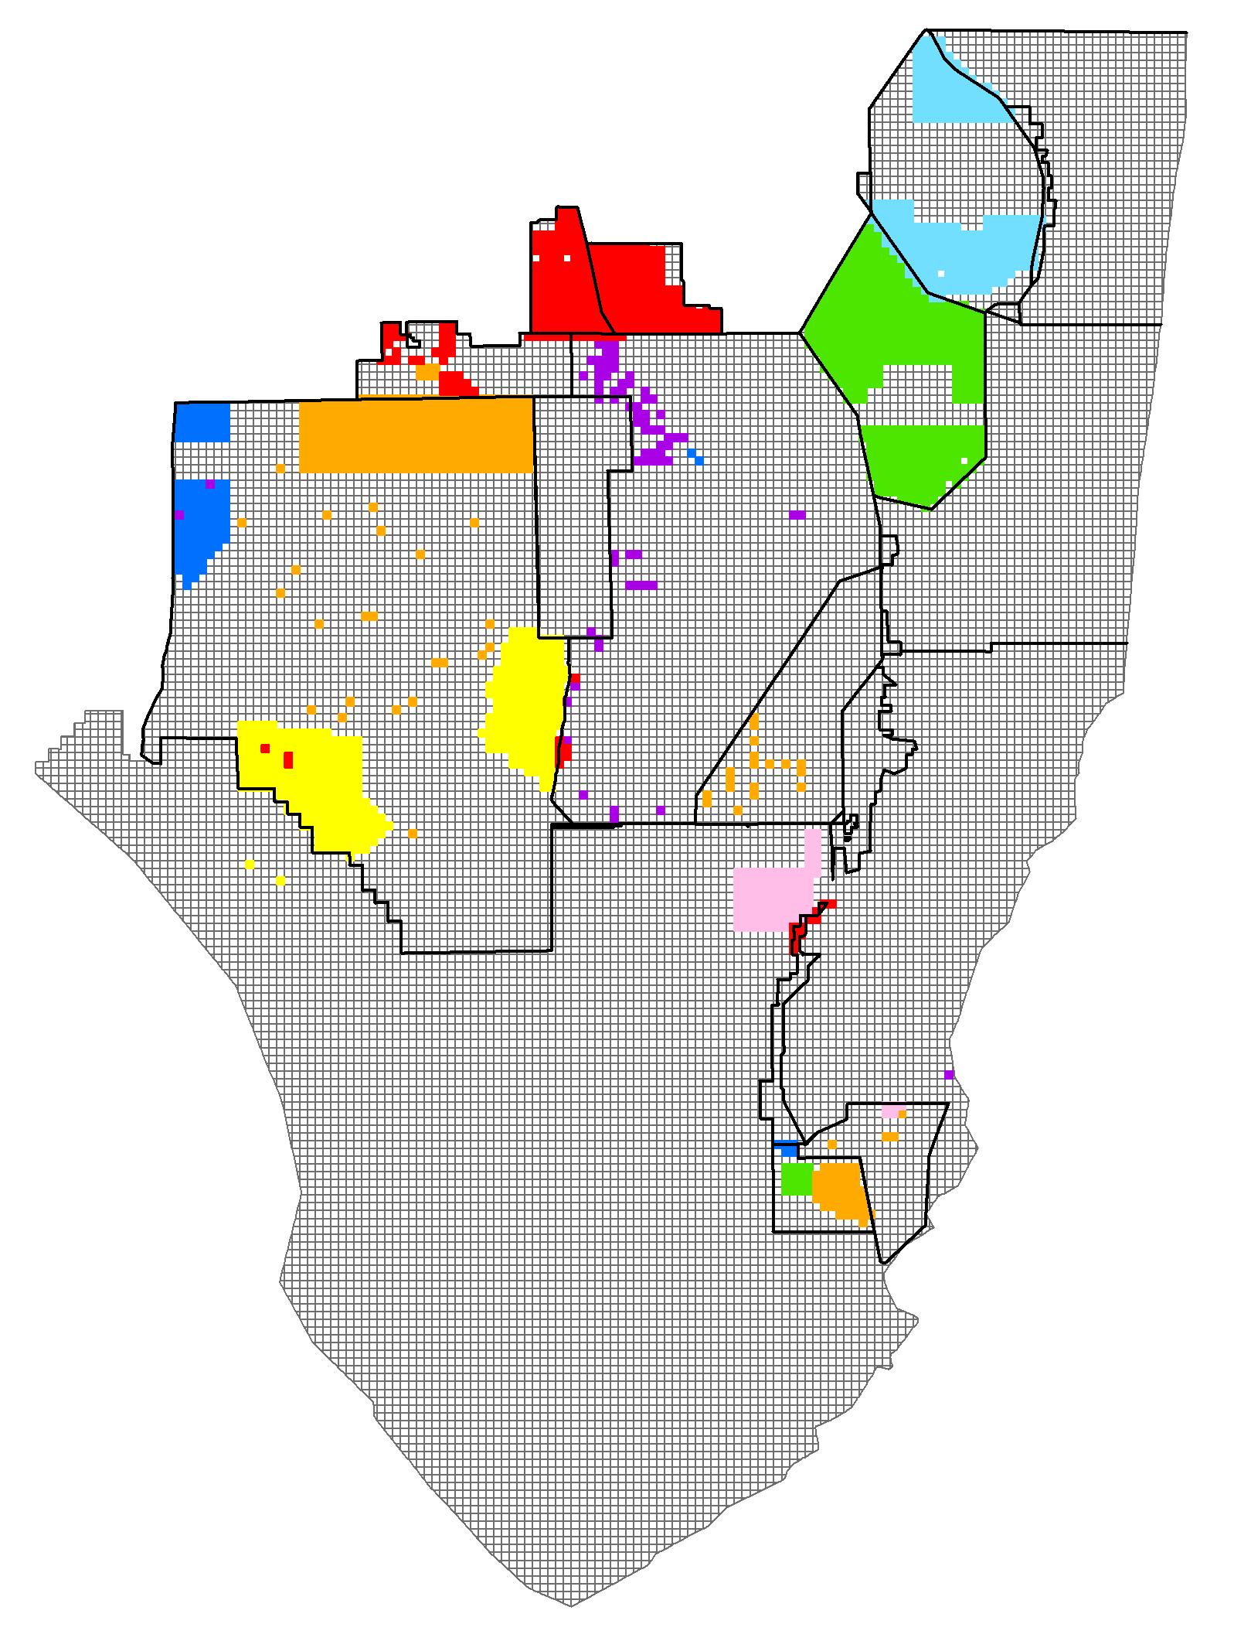
Planned Treatments FY14/15
Brazilian Pepper
Melaleuca
Melaleuca, Brazilian Pepper
Melaleuca, Australian Pine
Melaleuca, Lygodium
Lygodium, Brazilian Pepper
Lygodium

Slide 8
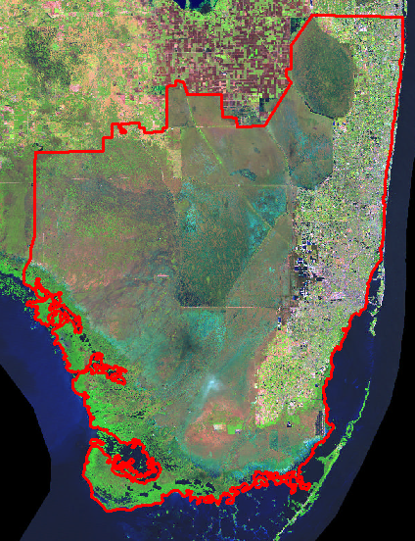
Other Managed Invasive Plant Species
Air Potato
(Dioscorea bulbifera)
Skunk Vine
(Paederia foetida)
Arrowhead Vine
(Syngonium podophyllum)
Latherleaf
(Colubrina asiatica)
Shoebutton Ardisia
(Ardisia elliptica)
Portia Tree
(Thespesia populnea)

Slide 9
Cost Summary*
Habitat | Habitat Cost/ac | Species | Species Cost/ac
Tree Island | $382 | Old World Climbing Fern | $280
 |  | Brazilian Pepper | $712
Cypress Swamp | $55 | Old World Climbing Fern | $255
 |  | Melaleuca/ Brazilian Pepper | $289
Marsh | $398 | Melaleuca | $415
 |  | Australian Pine | $351
Forested | $391 | Old World Climbing Fern | $392
 |  | Brazilian Pepper | $227
*Mean cost per acre from a selection of local, state, and federal projects during the reporting period. Costs include contractor services and materials only– contractor oversight not included.

Slide 10
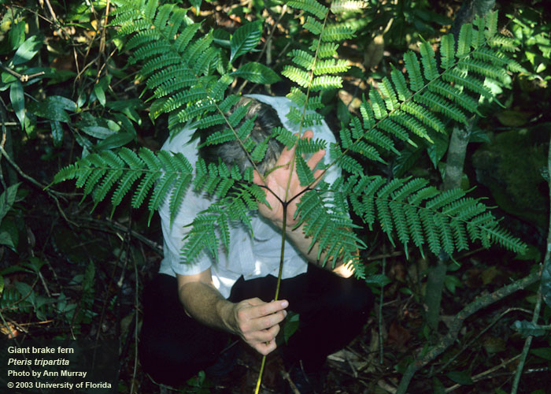
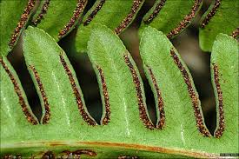
2014 Newly Detected Plant Species
Giant Brake Fern
(Pteris tripartita)
Giant Brake Fern
(Pteris tripartita)

Slide 11
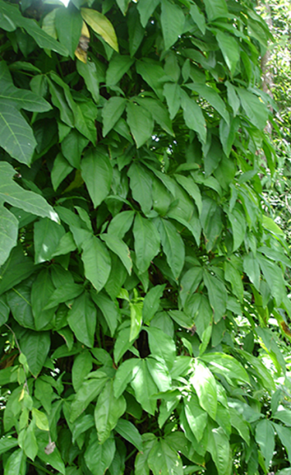
Invaders on the Move?
Arrowhead Vine
(Syngonium podophyllum)

Slide 12
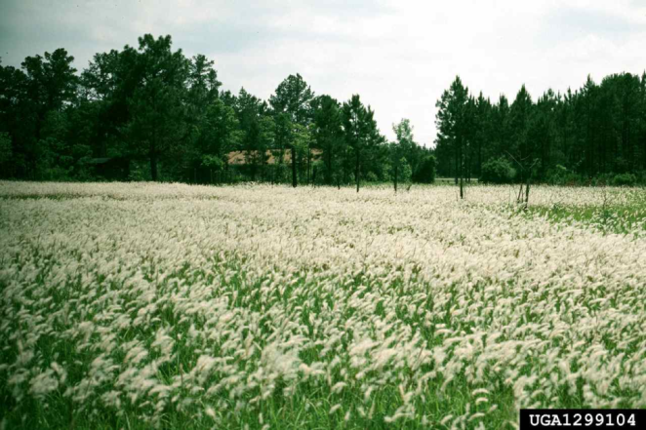
Invaders on the Move?
Cogongrass
(Imperata cylindrica)

Slide 13
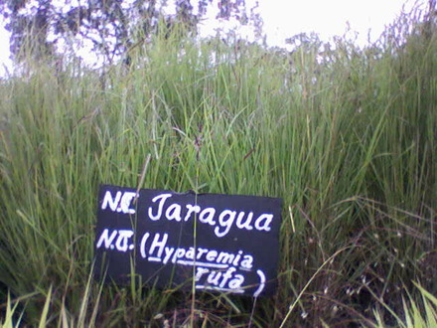
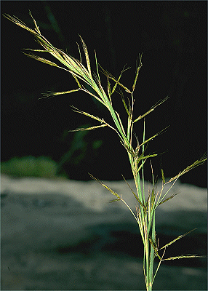
Invaders on the Move?
Jaragua
(Hyparrhenia rufa)

Slide 14



ECISMA Plant Monitoring
1993-2005 : Systematic Reconnaissance Flights
Point data collected on fixed transects
2008 –Present: Digital Aerial Sketch Mapping
Aerial mapping “on-the-fly”
Other monitoring activities
EddMaps
Invasion corridor monitoring
Ground-based monitoring by many partners
Notes:
Sustained funding for invasive plant monitoring
Tony Pernas
Also mention USDA
Systematic surveys from aircraft where biologists map plant infestations on-the-fly using GPS linked computers.

Slide 15
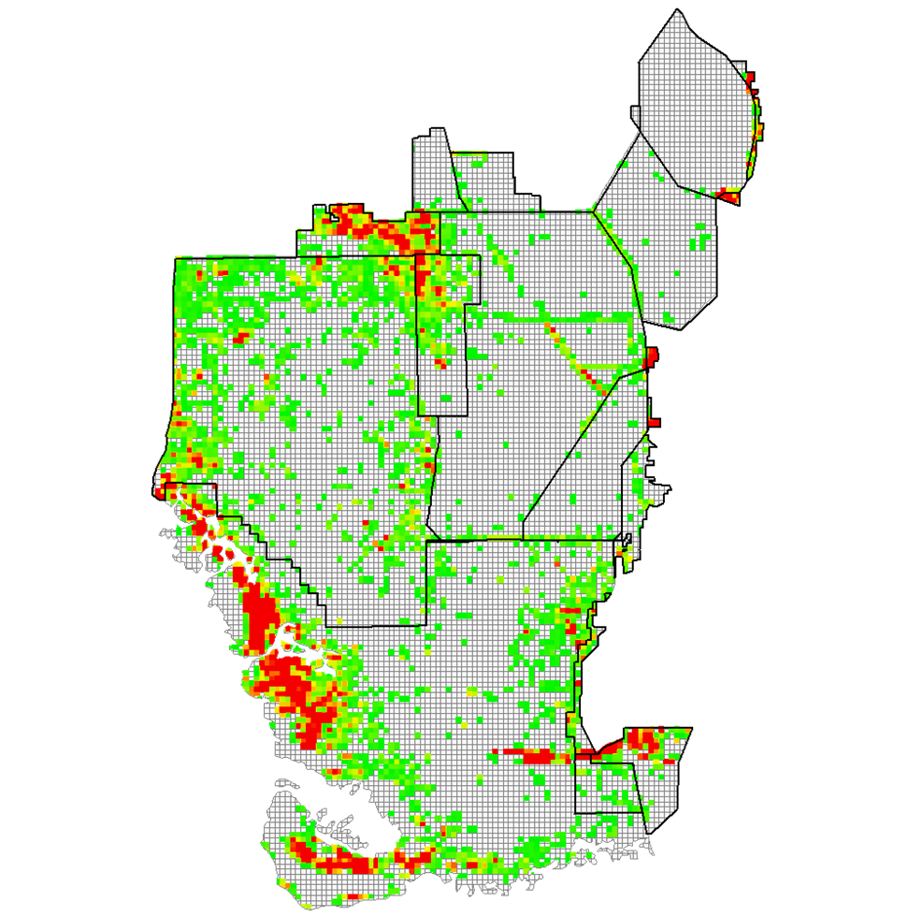
Digital Aerial Sketch Mapping
2012/2013
Landscape scale inventory of four detectable species
LeRoy Rodgers, Tony Pernas, and Steven D. Hill (2014) Invasive Plant Science and Management 7(2):360-374.

Slide 16
ECISMA Exotic Plant Monitoring Objectives
Assess Distribution & Abundance
Detect New Invasions
Measure Change over Time
?

Slide 17
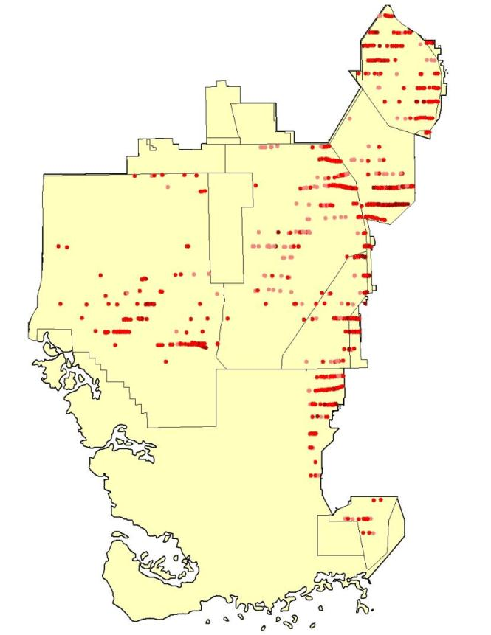
Landscape Assessments of Distribution & Abundance
Systematic Reconnaissance Flights
Landscape level assessment
Fixed transects (4 km interval)
Provides sample-based abundance estimates

Slide 18
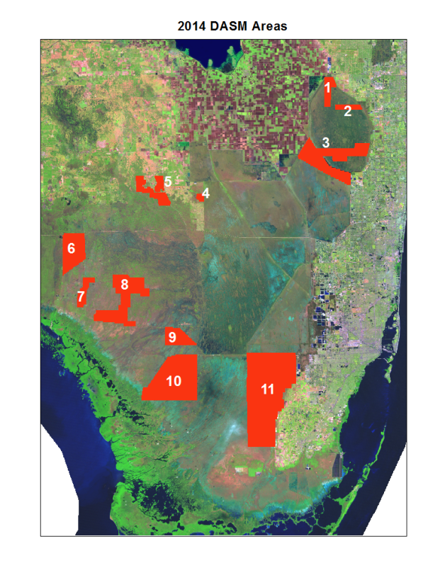
Detailed Mapping to Direct Planned Control Efforts
Utilizes sketch mapping and 250 m grid system.
Provides resource managers with more precise and up-to-date maps in planned work areas.

Slide 19
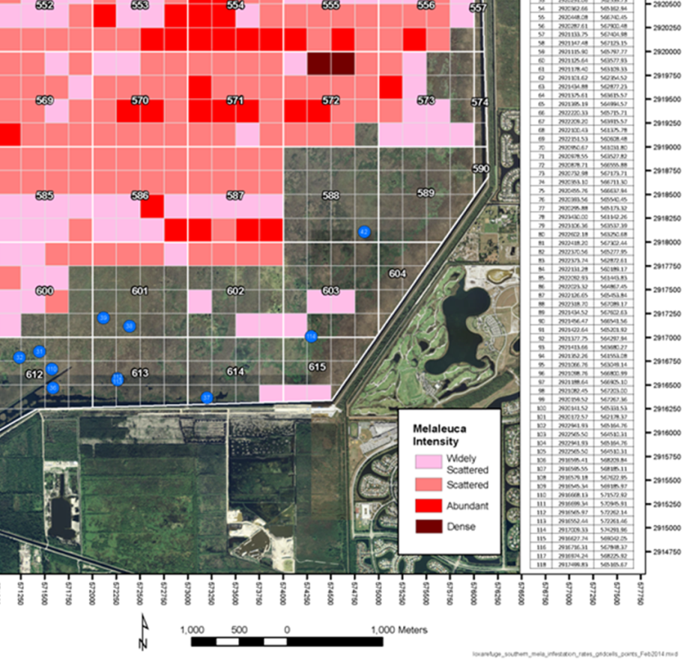
2014 Sample Data
250 m cells
Outlier points

Slide 20
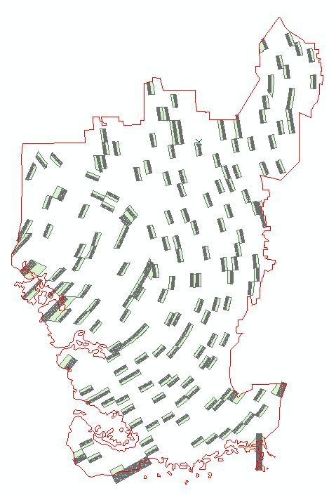
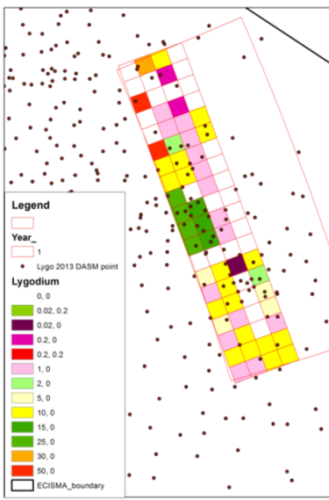
Measure Change Over Time
CERP Monitoring Design
Incorporating invasive plants
Expand to entire ECISMA
Enhance ability to detect change over time and make inferences at multiple scales

Slide 21
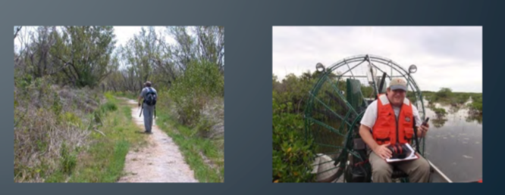

Detect New Invasions
NPS COORIDORS OF INVASIVENESS PROGRAM
Promote expansion of early detection monitoring programs and reporting networks.

Slide 22
ECISMA Exotic Plant Monitoring Objectives
Assess Distribution & Abundance
Detect New Invasions
Measure Change over Time
Digital Aerial Sketch Mapping
& SRF
CERP Landscape Panels
Corridor Monitoring, EddMaps

Slide 23
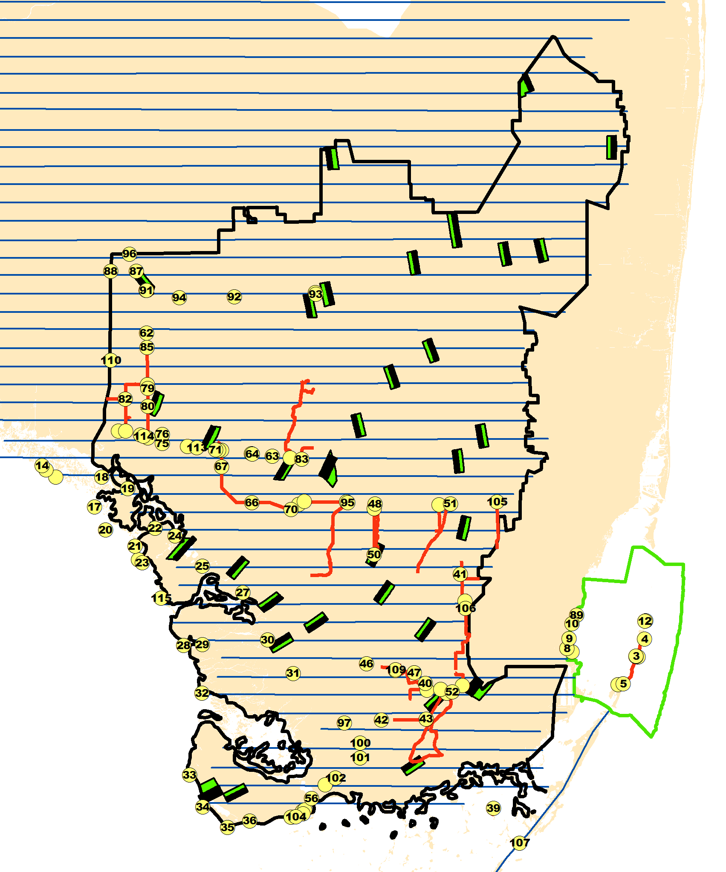
Multi-scale Approach for Multiple Objectives
Measure landscape distribution and abundance
Direct contractors
Detect new invasions
Detect change and
Assess impacts
5-yr Interval
Annual
Annual
Annual
0

Slide 24
Landscape Level Change in Distribution and Abundance Greater Everglades Module 2003 - 2013

Slide 25
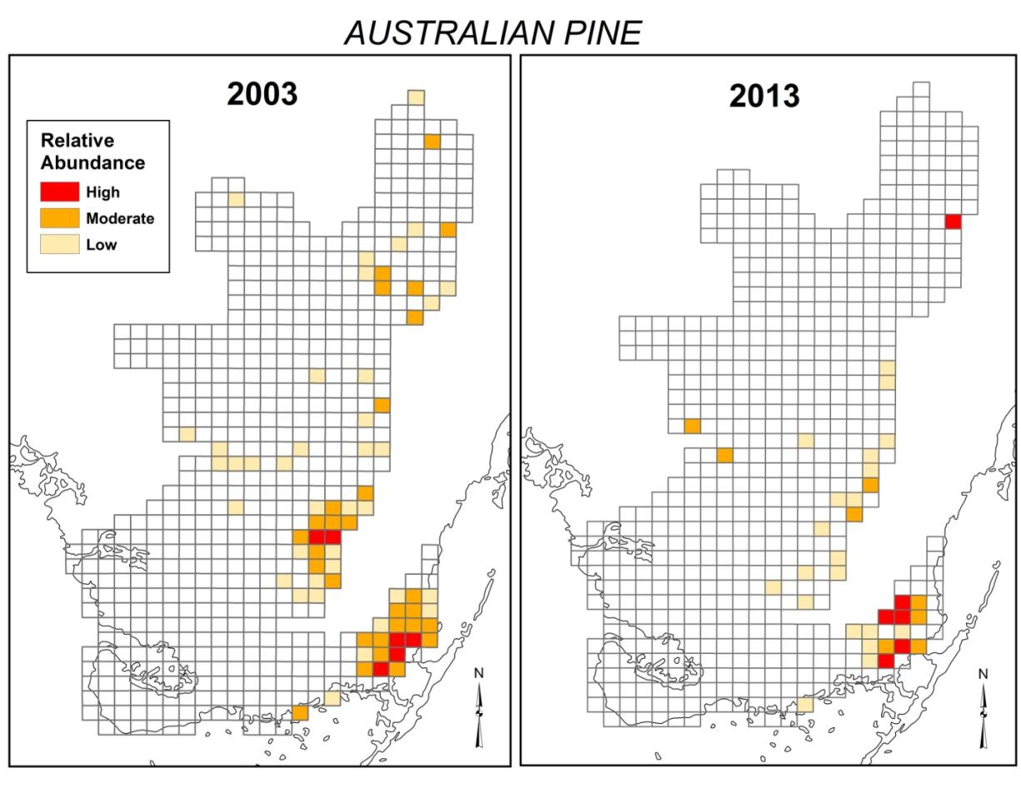
Australian Pine 2003-2013

Slide 26

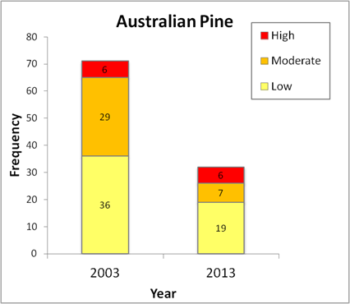
Australian Pine 2003-2013

Slide 27
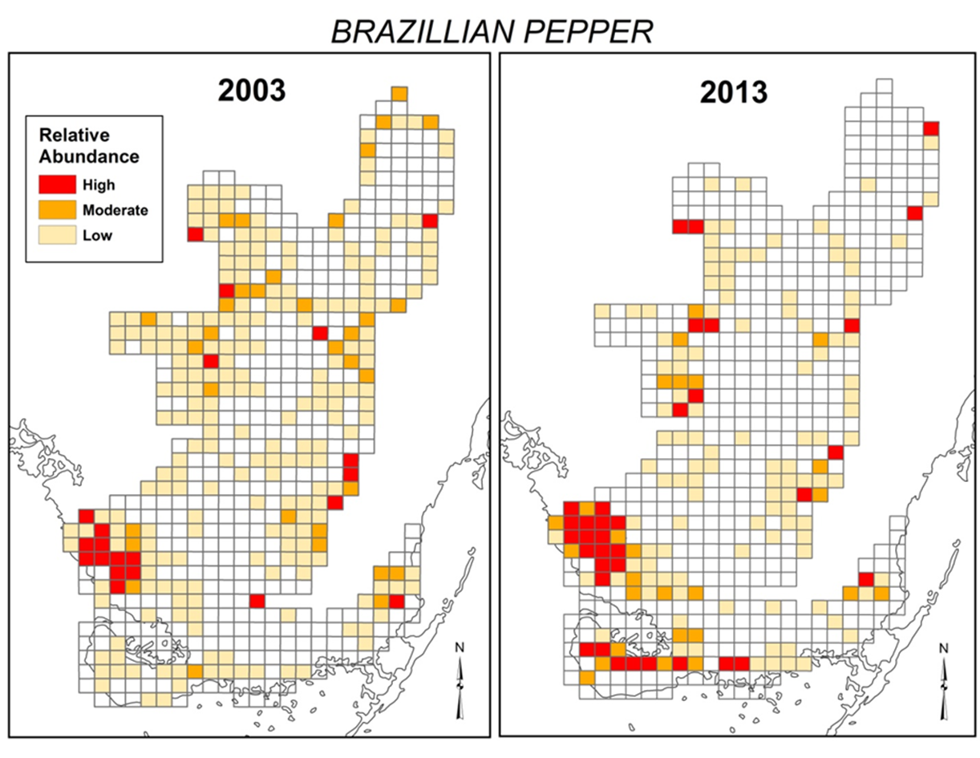
Brazilian Pepper 2003 -2013

Slide 28

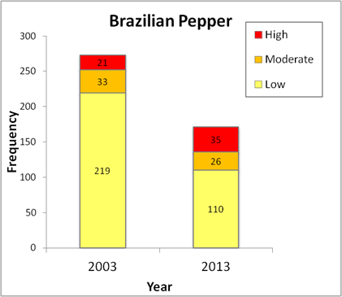
Brazilian Pepper 2003 -2013

Slide 29
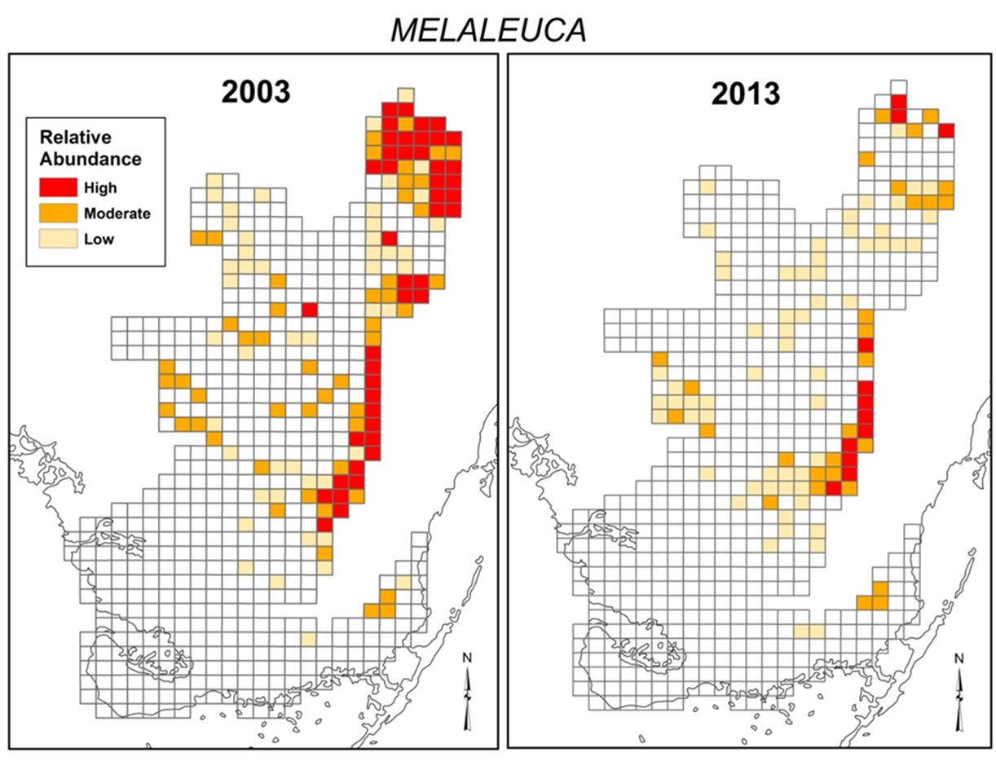
Melaleuca 2003 -2013

Slide 30

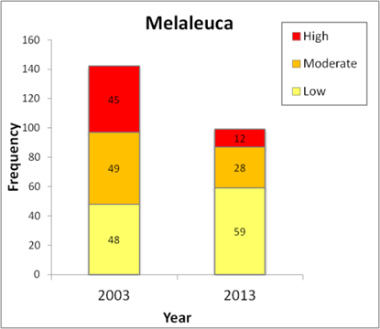
Melaleuca 2003 -2013

Slide 31
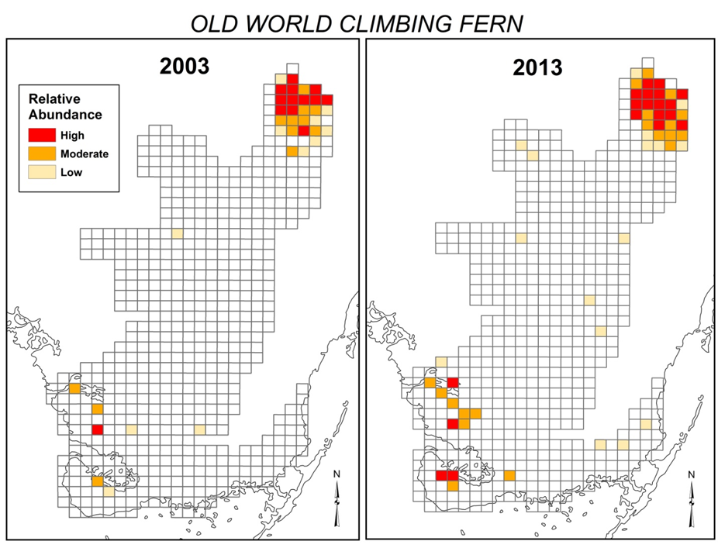
Old World Climbing Fern 2003-2013

Slide 32

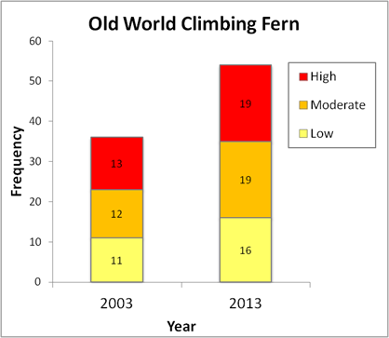
Old World Climbing Fern 2003-2013

Slide 33
It Takes A Village
Presentation support from:
Ellen Allen (SFWMD)
Terri Bennett (SFWMD)
Shea Bruscia (NPS)
Gwen Burzycki (Miami-Dade Co.)
Hillary Cooley (Everglades NP)
Jane Dozier (Miami-Dade Co.)
Pat Howell (Broward Co.)
Elizabeth Letts (Seminole Tribe of Indians)
Christen Mason (USFWS, Loxahatchee NWR)
Vanessa McDonough (Biscayne Bay NP)
Shelby Moneysmith (Biscayne Bay NP)
Tony Pernas (NPS)
Jed Redwine (NPS)
Billy Snyder (Big Cypress NP)

