Slide 1
2014 Everglades Invasive Species Summit
Hillary Cooley (ENP) and Jed Redwine (USNPS)

Slide 2
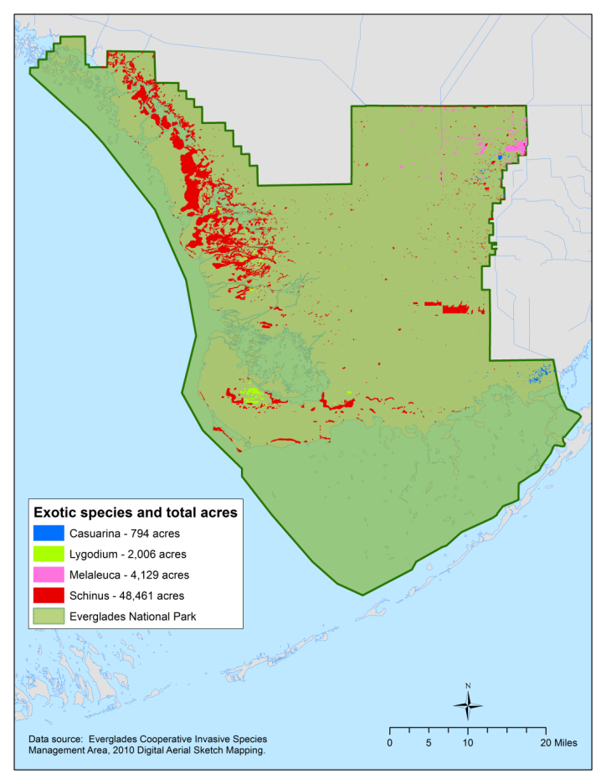
Digital Area Sketch Mapping
Conducted by SFWMD and NPS Every 2 Years
2010
2013

Slide 3
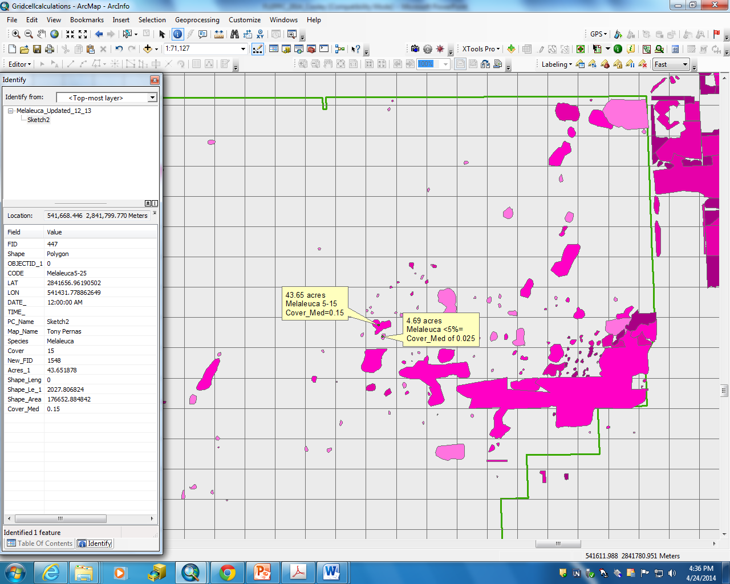
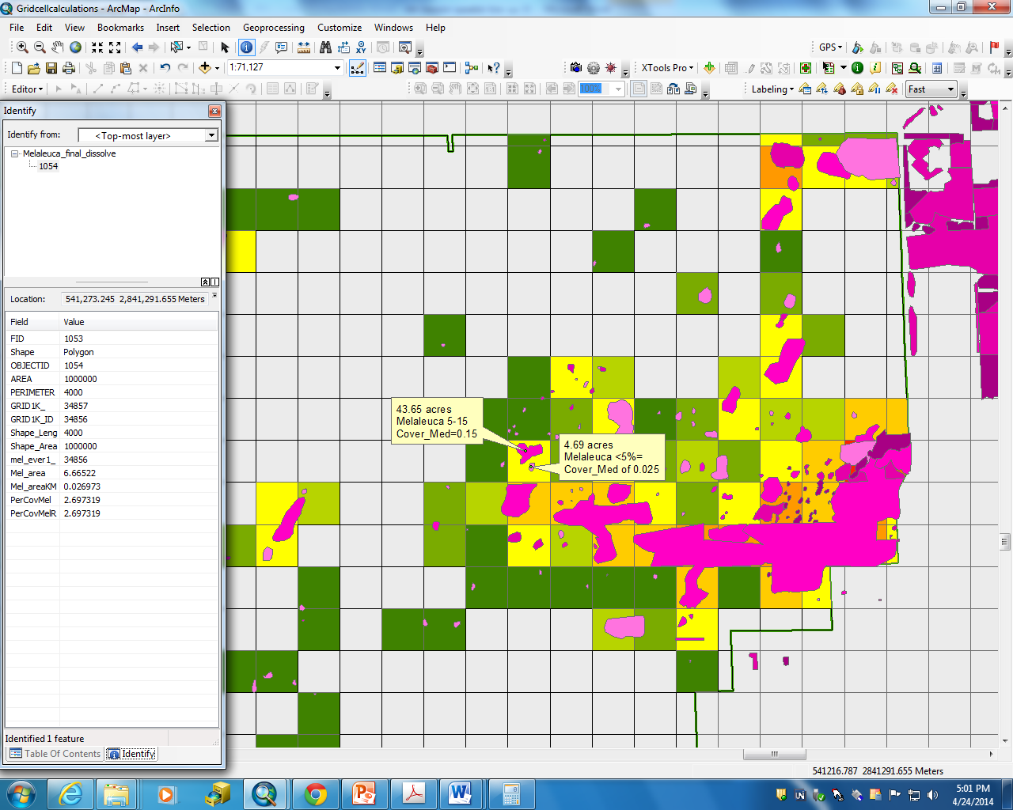
How we did the calculations
Canopy Cover=
((43.65 acres x0.15)+(4.69 acres x 0.025))
247.105 acres X 100
=2.698%
247.015= ~1 km²
2

Slide 4
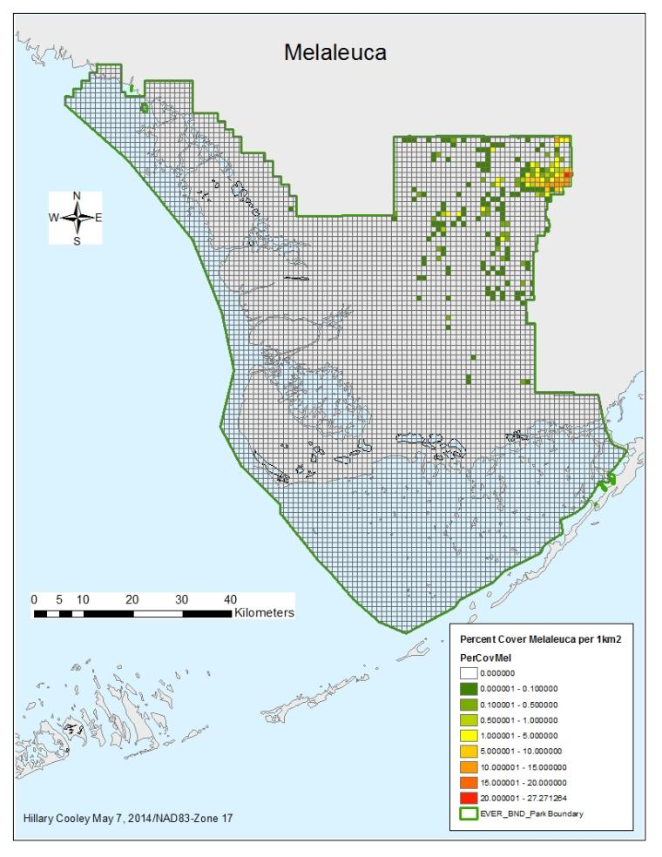
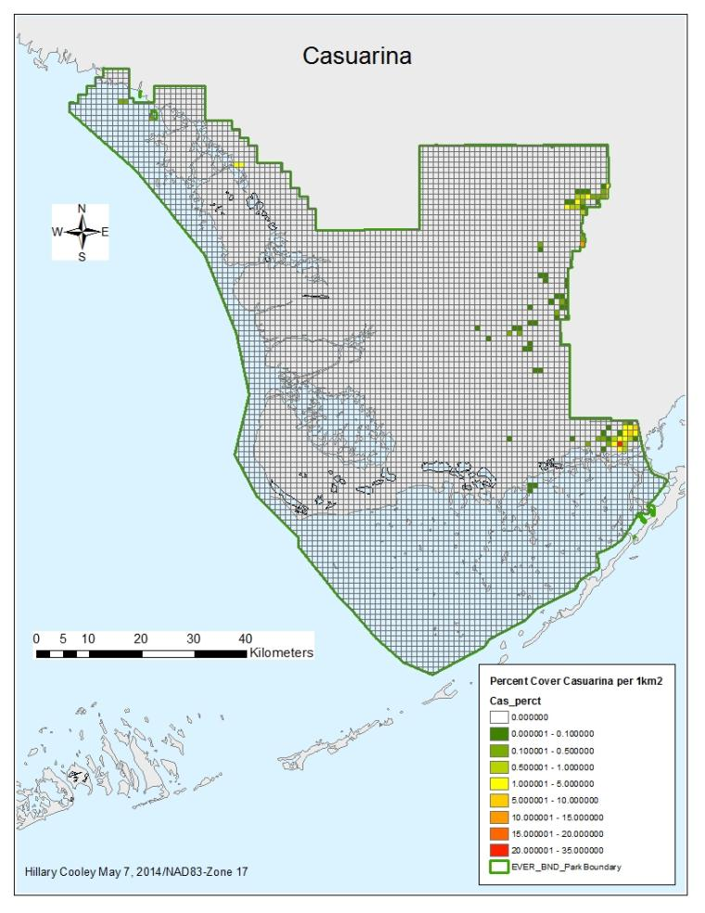
Performance of the Exotic Vegetation Management Program
1% cover per Km ²
^{Green Meets Criteria}
1% cover per Km ²
^{Green Meets Criteria}

Slide 5
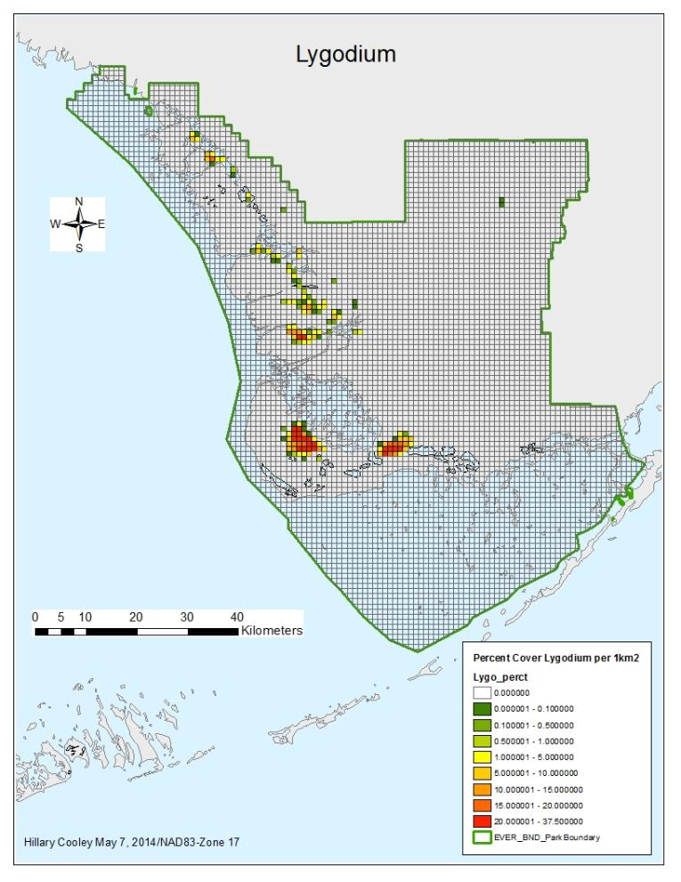
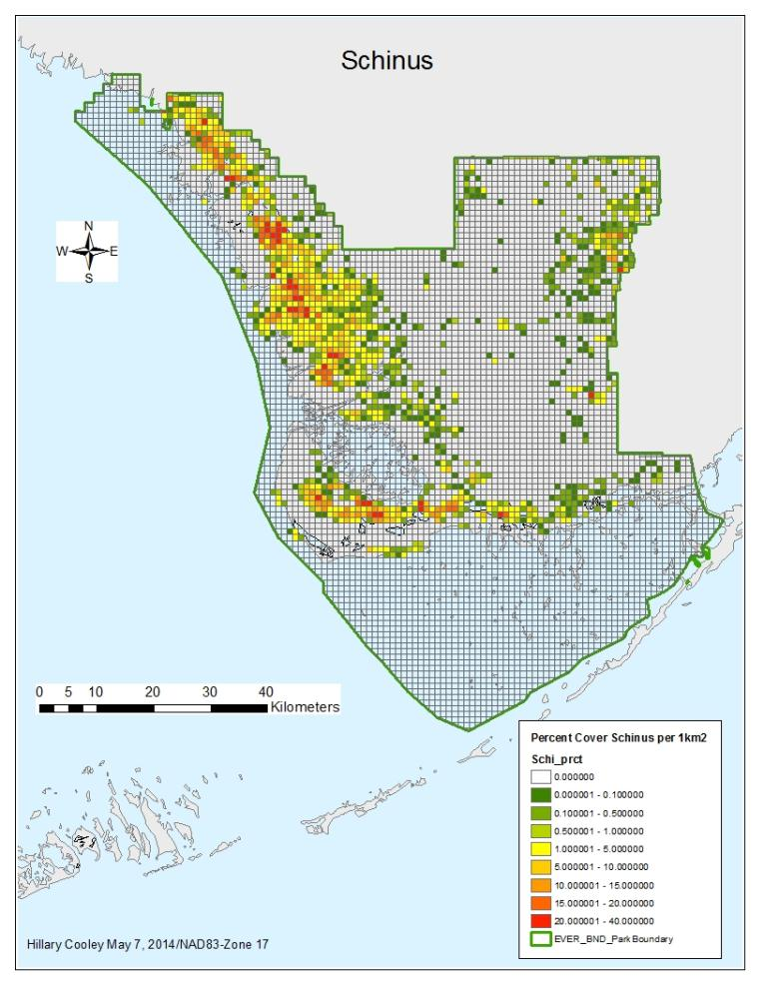
Performance of the Exotic Vegetation Management Program
5% cover per Km ²
Green and Yellow Meets Criteria
5% cover per Km ²
Green and Yellow Meets Criteria

Slide 6
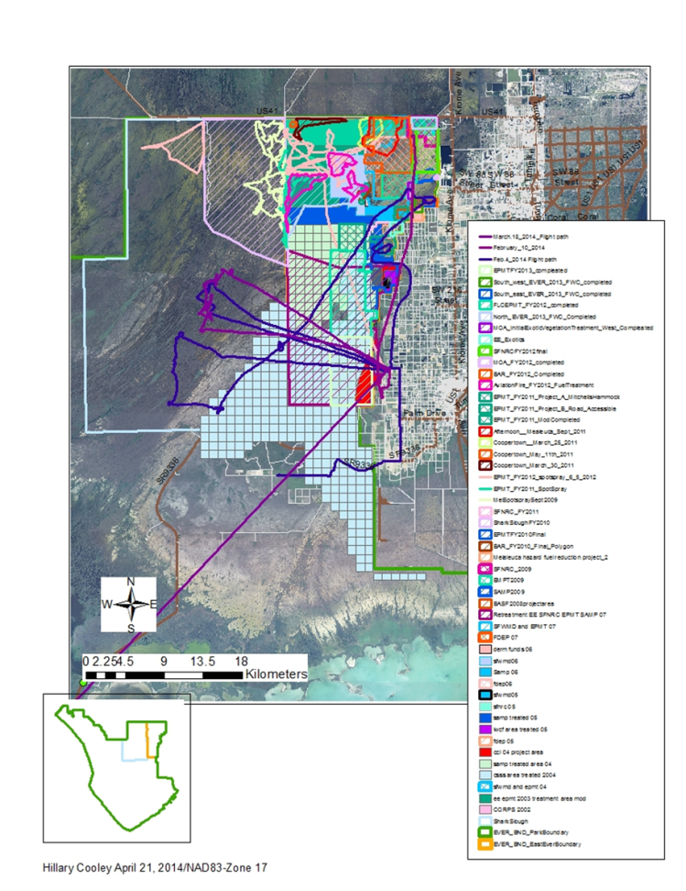
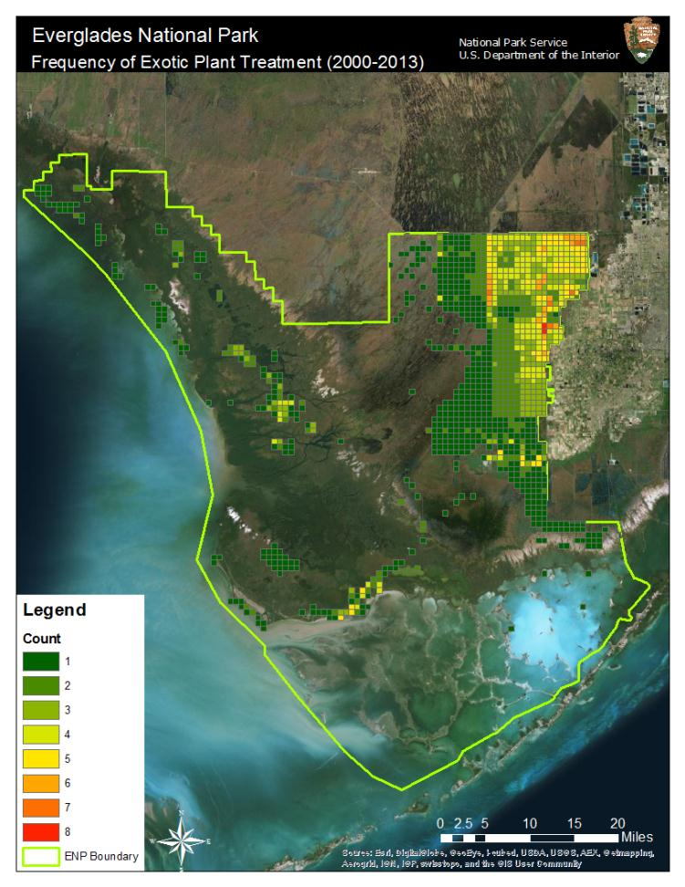

Slide 7
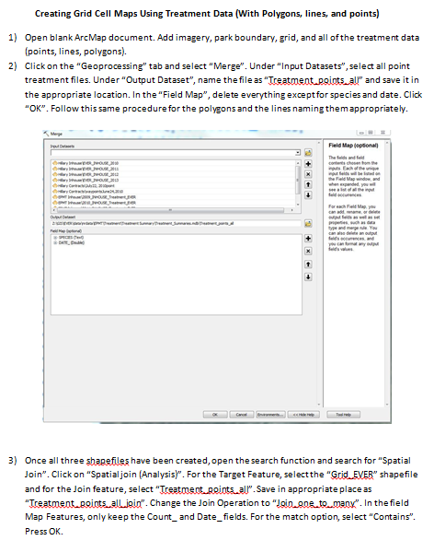
SOP for making gridded maps using treatment data
Developed by EPMT intern Shea Bruscia
7 pgs using lines, points, or polygons for EVER
8 pgs using points only for BICY
Key issues:
Data organization – folder and file naming process matters for facilitating quick results.
  Program for writing filepath to all shapefiles in a directory: AddPopulatePathField.py
Metadata – provides insight into shapefiles for data users that are external to the program.
  https://edg.epa.gov/EME/ - source of metadata editor

Slide 8

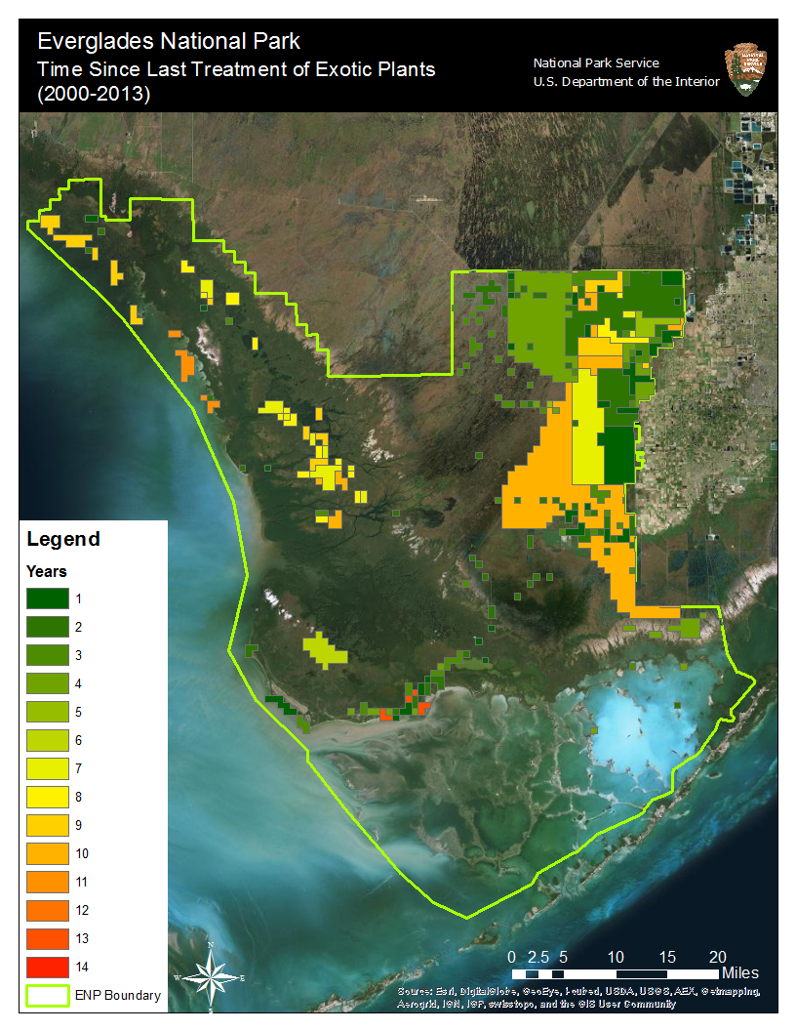

Slide 9
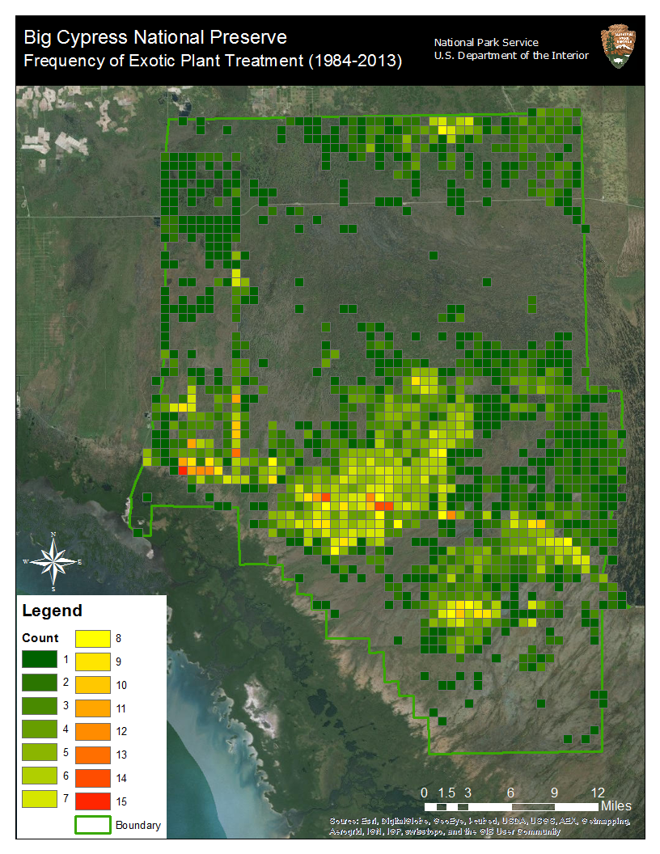
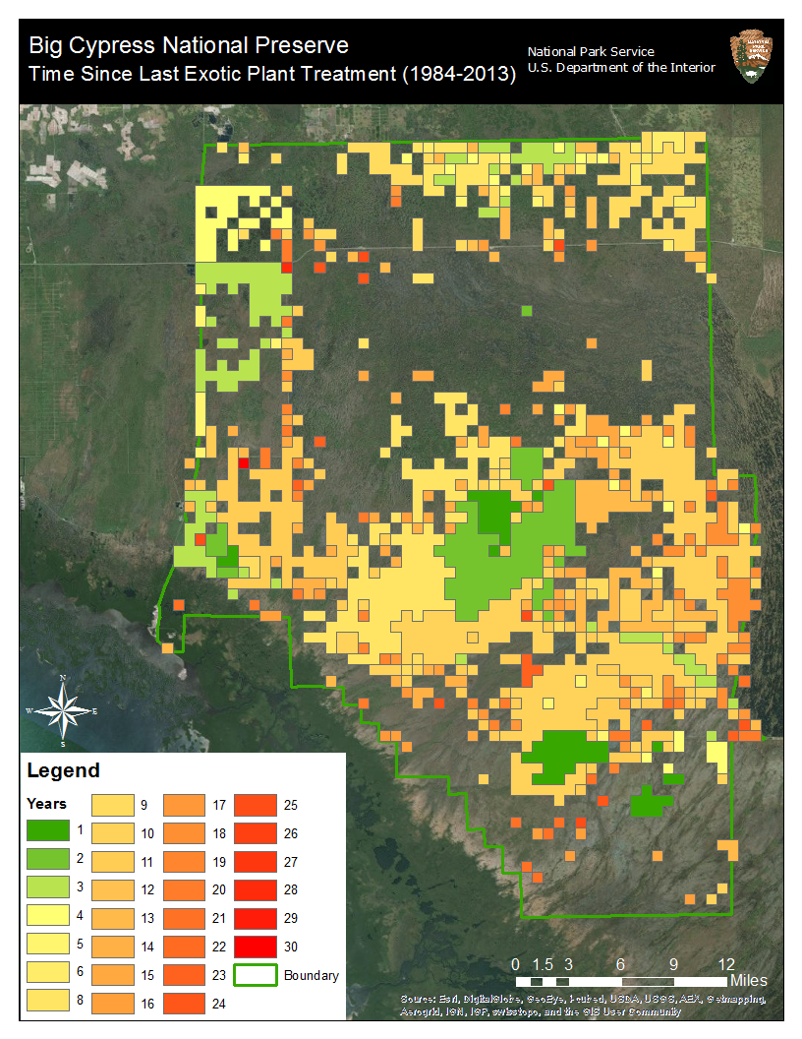

Slide 10
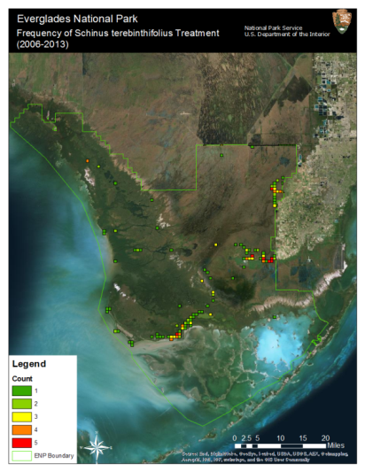
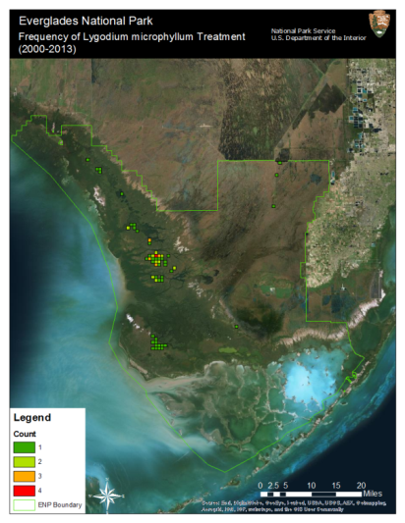
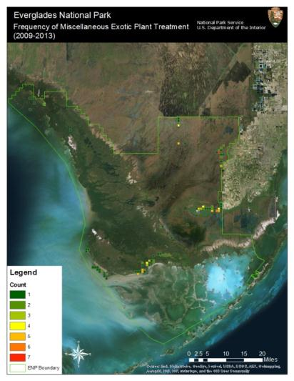
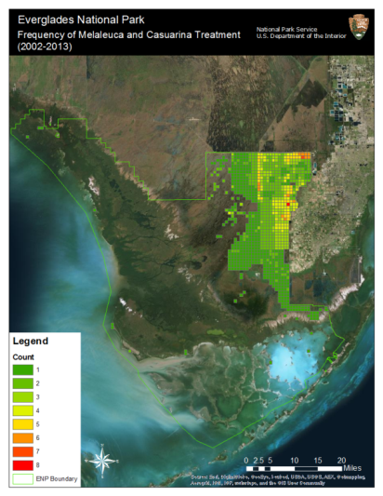

Slide 11
Developing subjects
Relating treatment return intervals with change in exotic abundance
cell | 1984 | 1985 | 1986 | 1987 | 1988 | 1989 | 1990 | 1991 | 1992 | 1993 | 1994 | 1995 | 1996 | 1997 | 1998 | 1999 | 2000
1 | 0 | 1 | 0 | 0 | 0 | 0 | 1 | 0 | 0 | 1 | 0 | 1 | 1 | 0 | 0 | 1 | 0
2 | 0 | 0 | 0 | 0 | 0 | 0 | 0 | 0 | 0 | 0 | 0 | 0 | 0 | 0 | 0 | 0 | 0
3 | 0 | 0 | 0 | 0 | 0 | 0 | 0 | 0 | 0 | 0 | 0 | 0 | 0 | 0 | 0 | 0 | 0
4 | 0 | 0 | 0 | 0 | 0 | 0 | 0 | 0 | 0 | 0 | 0 | 0 | 0 | 0 | 0 | 0 | 0
5 | 1 | 1 | 0 | 0 | 1 | 0 | 0 | 0 | 1 | 0 | 1 | 1 | 1 | 0 | 1 | 1 | 0
6 | 0 | 1 | 0 | 1 | 0 | 0 | 1 | 1 | 0 | 1 | 0 | 1 | 0 | 0 | 0 | 1 | 0
7 | 0 | 0 | 0 | 0 | 0 | 0 | 0 | 0 | 0 | 0 | 0 | 0 | 0 | 0 | 1 | 0 | 1
8 | 0 | 0 | 0 | 0 | 0 | 0 | 0 | 0 | 1 | 0 | 0 | 0 | 0 | 0 | 0 | 0 | 0
9 | 0 | 1 | 0 | 0 | 0 | 0 | 0 | 0 | 0 | 0 | 0 | 0 | 1 | 0 | 0 | 0 | 0
10 | 0 | 0 | 0 | 0 | 0 | 1 | 1 | 0 | 0 | 0 | 0 | 0 | 0 | 0 | 0 | 0 | 0
11 | 0 | 0 | 0 | 0 | 0 | 0 | 1 | 0 | 0 | 0 | 0 | 0 | 0 | 1 | 1 | 1 | 1
Understanding the strengths and weaknesses of current monitoring approaches through comparison and (hopefully) ground truthing
Species | Total number of 250 x 250 m cells observed | Total number of exotic occupied cells | Number of occupied cells seen by both | Average count of % Cover agreed | Average Count % Cover disagreed | Total Count of cells expected to be occupied (based on DASM) | Total Count of cells where DASM expectation was confirmed | expected confirmed / expected occupied
Casuarina | 3128 | 29 | 6 | 0.8 | 0.2 | 9 | 5 | 0.556
Lygodium | 3128 | 56 | 3 | 0.667 | 0.33 | 42 | 30 | 0.714
Melaleuca | 3128 | 208 | 68 | 0.826 | 0.17 | 113 | 63 | 0.558
Schinus | 3128 | 221 | 134 | 0.552 | 0.48 | 123 | 85 | 0.691

Slide 12
Lessons learned
The format of data storage is important! Specific attributes of file names, folder names, column fields can make synthesis much easier (or much harder).
Patience – learning as a group can be a delicate process. Although over time, the learning/synthesis process is very useful.

