Slide 1
Report on Operational Activities for Nonnative Wildlife
Jenny Ketterlin Eckles
Florida Fish and Wildlife Conservation Commission

Slide 2
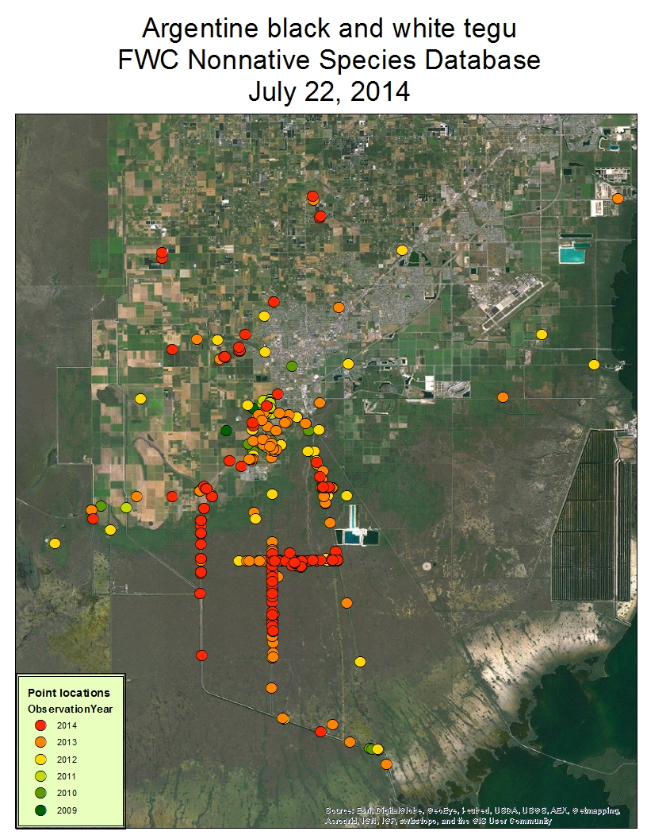
Argentine black and white tegus (Salvator merianae)
FWC/UF/Zoo Miami coordinating trapping efforts in natural areas with NPS/USGS
FWC and Venom One responding in urban areas
180+ trapped during last season
UF/FWC/M-D County efforts:
30-32 live traps
17-22 camera traps
252 removed
Trap lines = 162
Residential trapping = 59
Other = 31
Three females tracked by UF
Moving to dispersal mode

Slide 3
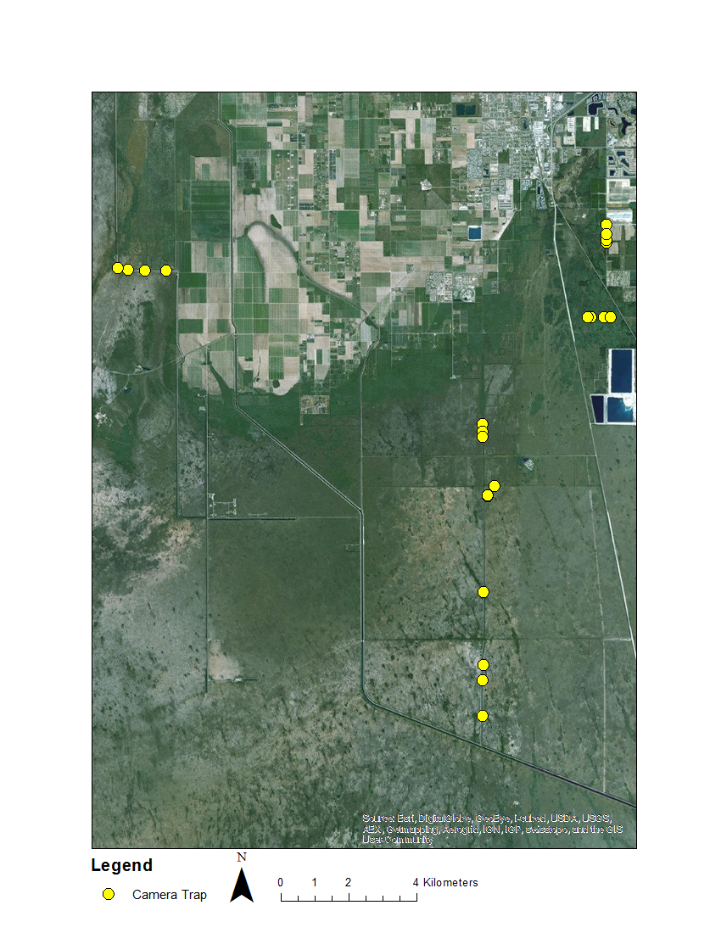
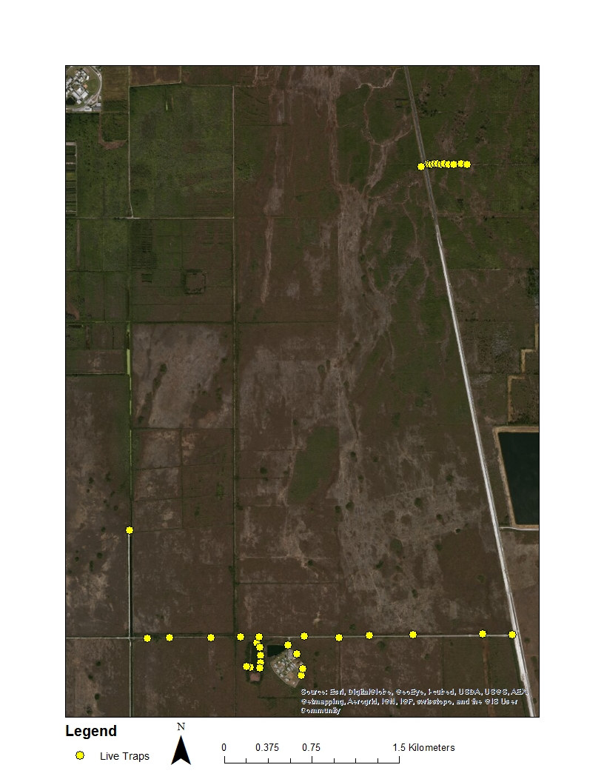
Camera traps
Live traps
20+
0
0
1
1
2
0
130+

Slide 4
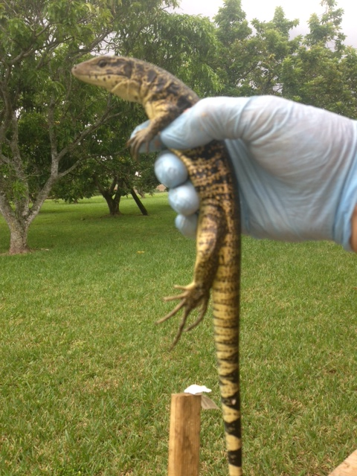
Gold tegus (Tupinambis teguixin)
Three gold tegus removed prior to 2013
Six gold tegus removed in 2013
Four gold tegus removed in 2014
Two YOY or yearlings from 2013
All from private trappers on private property

Slide 5
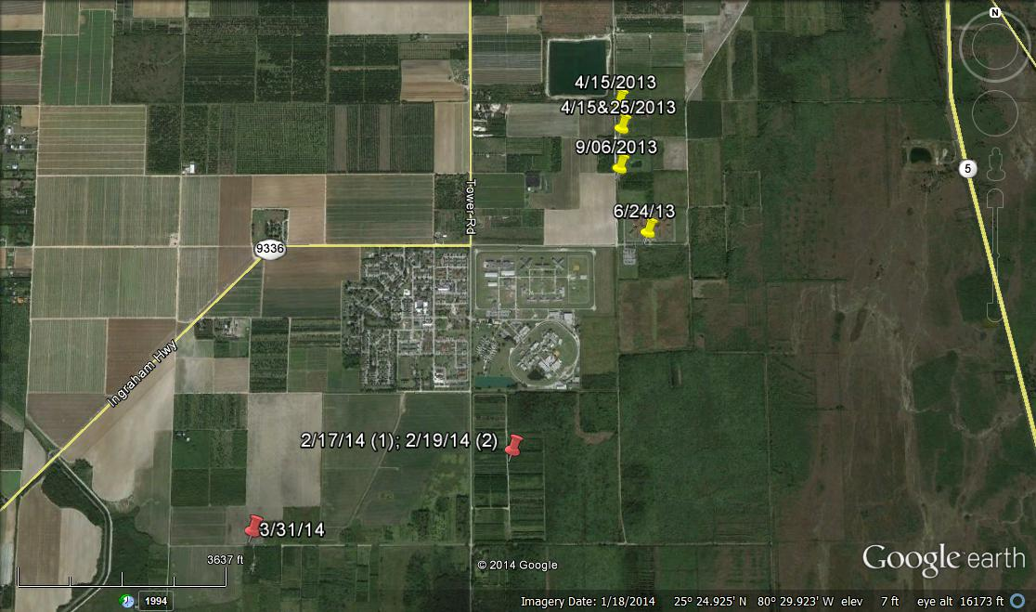
Recent gold tegu locations

Slide 6
Nile monitor surveys from August 2013 through June 2014
 | Number of surveys | Number of observations | Number removed | Sex ratio M:F
C-51 Canal east of SR7/441 | 15 | 10 | 7 | 3:4
C-51 Canal west of SR7/441 | 7 | 4 | 2 | 0:2
Total | 22 | 14 | 9 | 3:6

Slide 7
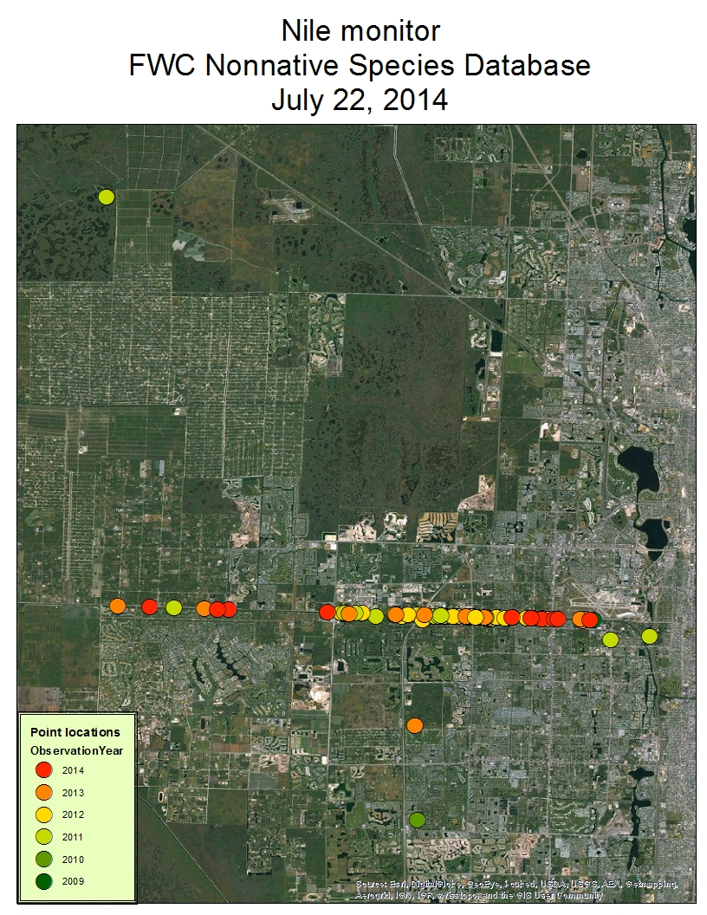
Nile monitors, cont.
Overall sex ration is 15:16
Gravid female and one that had recently laid eggs collected in June
Average clutch size likely 15-20
Continued confirmed sightings in western Broward
Efforts will increase in Palm Beach and Broward

Slide 8
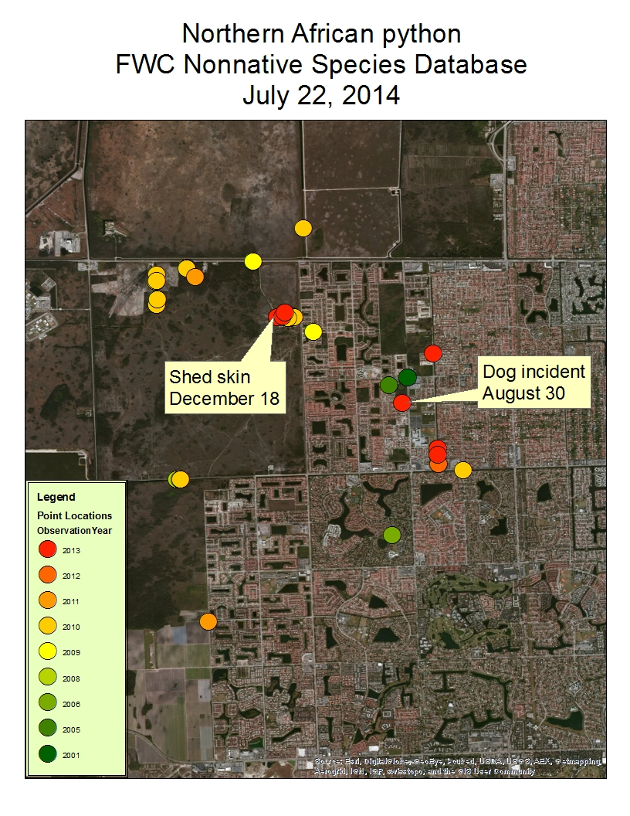
Northern African pythons
Dog incident
Outreach efforts
Three large surveys conducted over 2013-14 dry season
Shed skin at the rock pit
Increasing efforts dramatically in 2014-15

Slide 9
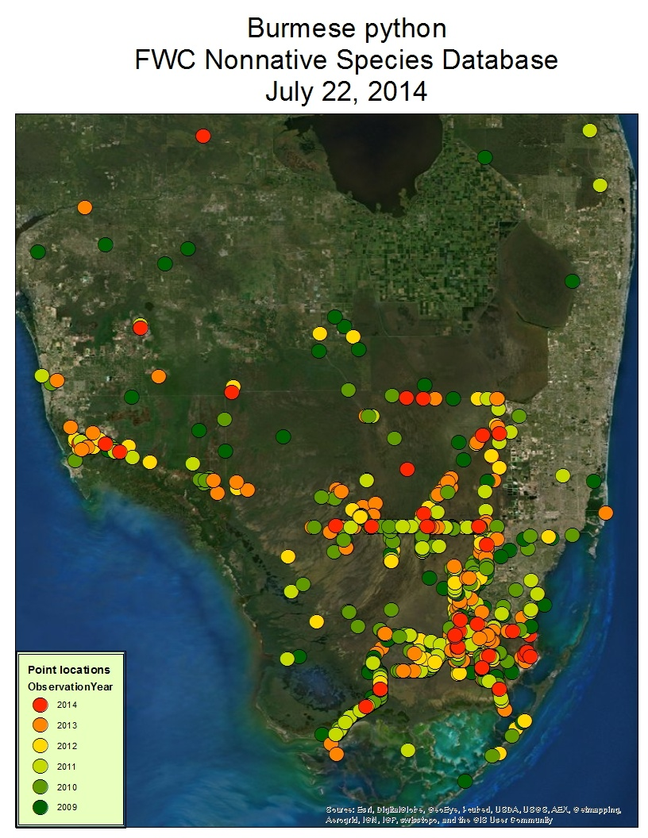
Burmese pythons
Number removed on Everglades WMA = 16
Number removed from District lands = 14
Other = 74
Seven permittees removed 32
Swamp Apes removed 56
Four sightings along Alligator Alley
Two removed from tree islands in WCA 3AS

Slide 10
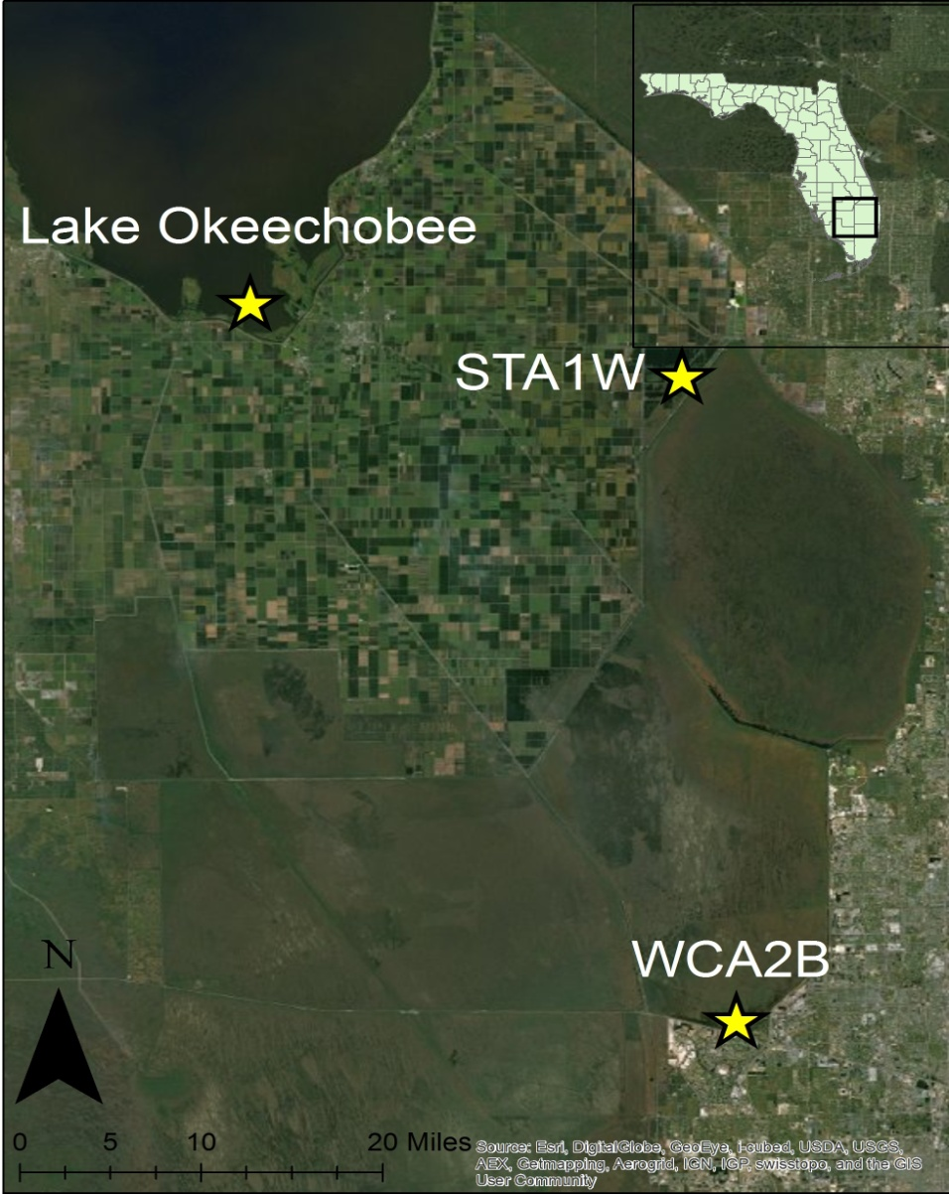
Purple swamphens
FAU completed diet analysis for 83 swamphens, three different locations
Most common food item is Eleocharis cellulosa (spikerush)
Some inverts found
Larger birds in STA1W

Slide 11
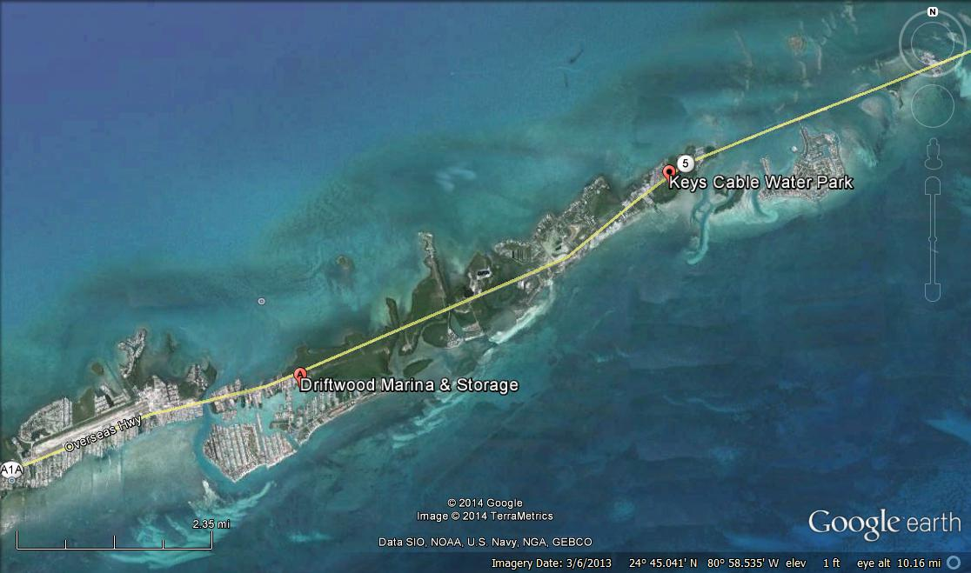
Gambian pouched rats
Two small-scale trapping events over past year
Mailing conducted last month → No reports in core
Observations from marina and water park
Increased trapping in next year using USDA

Slide 12
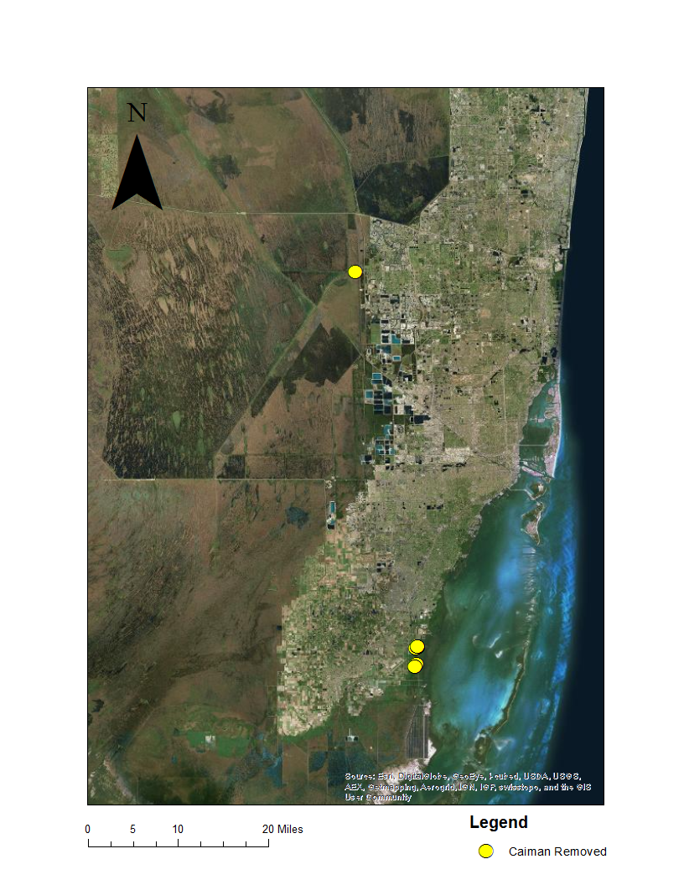
Caimans
8 surveys
Locations: Near L-31E in Miami-Dade Co., Holiday Park in Broward County
27 removed
Odd singletons in Broward and Palm Beach Counties
Map

Slide 13
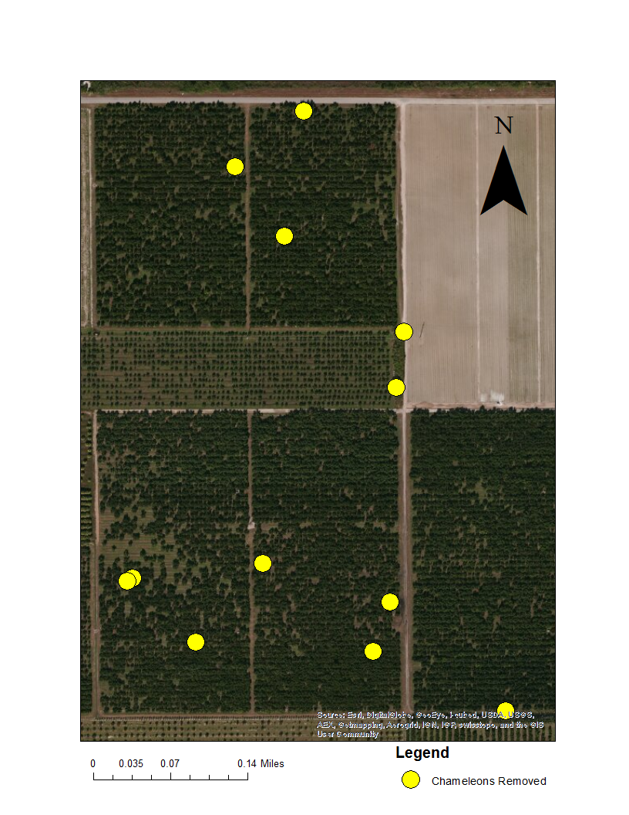
Oustalet’s chameleons
6 surveys
12 removed
1 hatchling found this year
Will decrease surveys to target hatchlings and months when most have been found
map

Slide 14
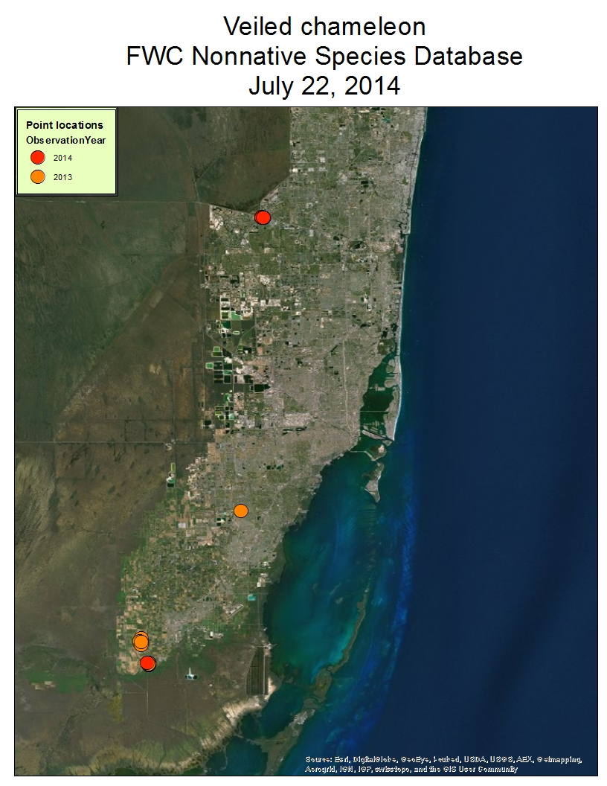
Veiled and panther chameleons
New veiled locations in Dade and Broward
Property ownership issues hinders removal of veileds
No panther chameleons found in follow-up surveys since last July

Slide 15
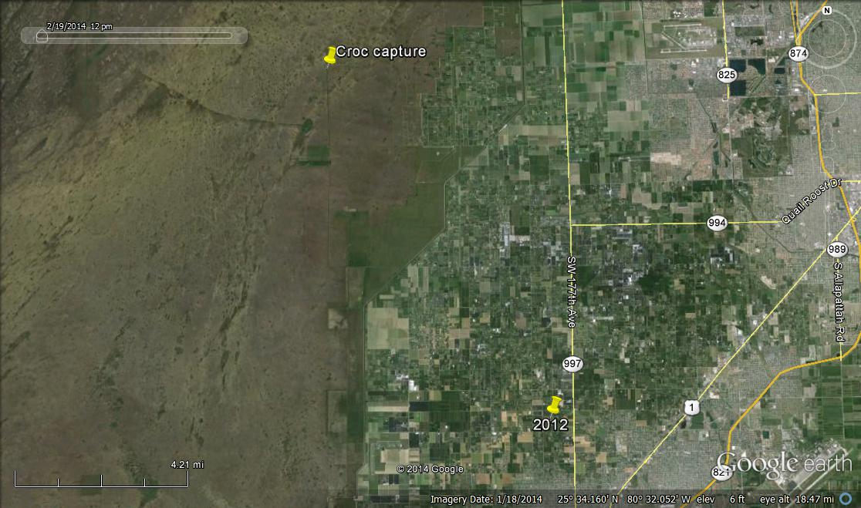
Nile crocodile
Notes:
2012—previous sighting of croc

Slide 16
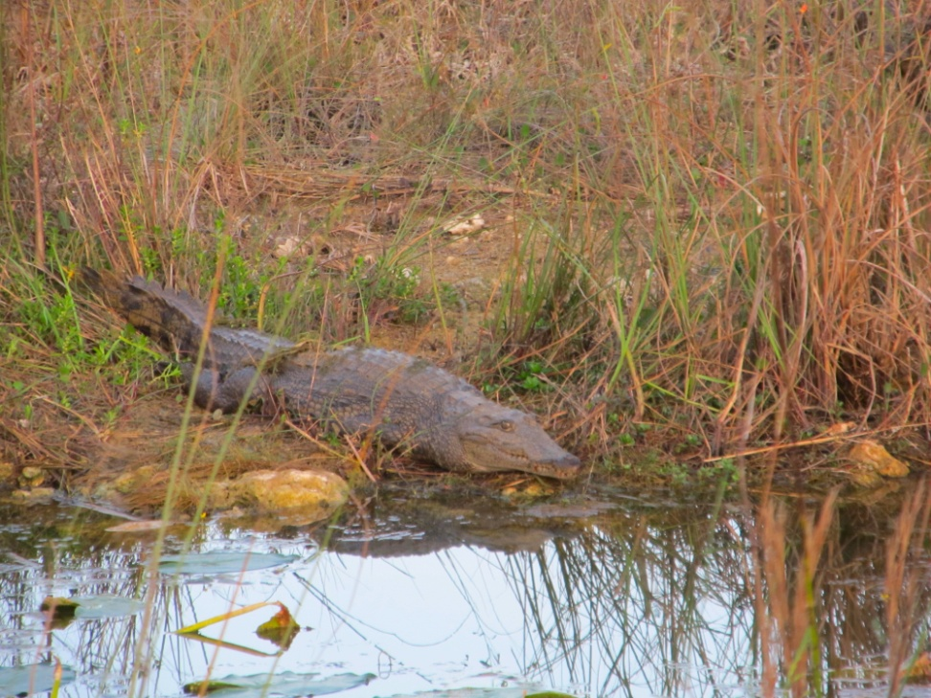
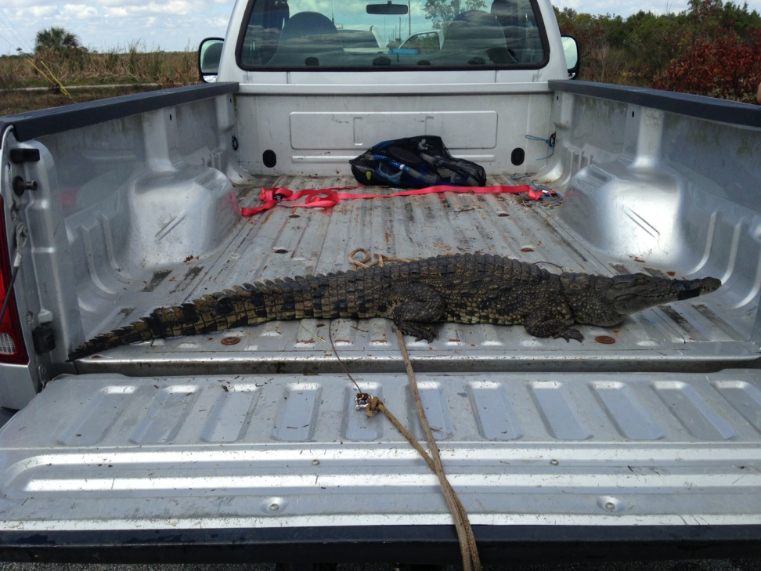

Chekika, Everglades National Park
February 22, 2014
March 9, 2014
Notes:
Crocodile reported by park python volunteer group, the Swamp Apes
Animal could not be positively identified by photos
University of Florida staff attempted to ID and capture croc on March 5th
Confirmed it to be a Nile crocodile which limited capture options due to its status as a Threatened Species under ESA
ENP worked with FWS to gain authorization to use lethal take, if possible
Interagency team of ENP rangers, UF and FWC staff, two members of the Swamp Apes planned a take or capture operation on March 9
Animal was corralled into smaller and smaller section of the canal using gill and block nets
Once its location was limited to a very small area, it was harpooned by UF volunteer and taken live
Swamp Apes vet attended to injury and it was transported to FWC Captive Wildlife officer

Slide 17
Thank you!
Mike Rochford (UF)
Joy Vinci (UF)
Michiko Squires (UF)
Michelle Curtis (UF)
Larry Connor (FWC)
Jake Edwards (FWC)
...and many more…
Jenny Ketterlin Eckles
University of Florida Fort Lauderdale Research and Education Center
Davie, Florida
954-577-6408
Jennifer.Eckles@myfwc.com
http://www.myfwc.com/wildlifehabitats/nonnatives/

