Slide 1
Boa Constrictor at the Charles Deering Estate at Cutler
Jessica Fiallo, Dallas Hazelton, Elias Horna, Frank Ridgley DVM, Karen Solms, Dustin Smith, Carolina Segarra

Slide 2
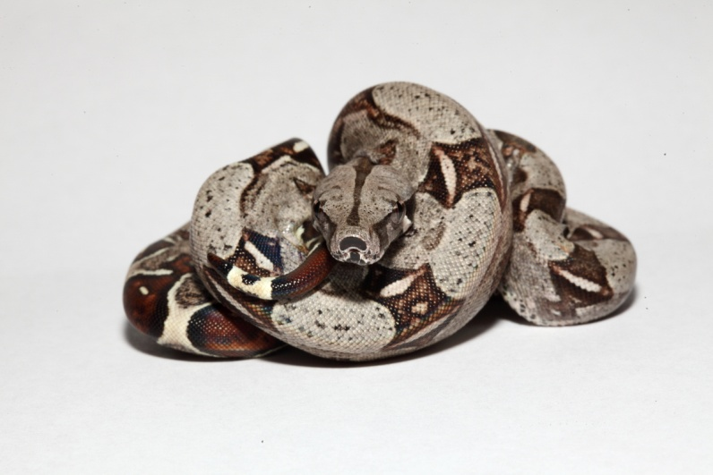
History
Snow reported in 2007 that likely present since the 1970’s
Juveniles and adults found in 1990 after a burn
Reported possibly breeding in 1992
164 removed since 1989 – 58 (35%) of which were YOY

Slide 3
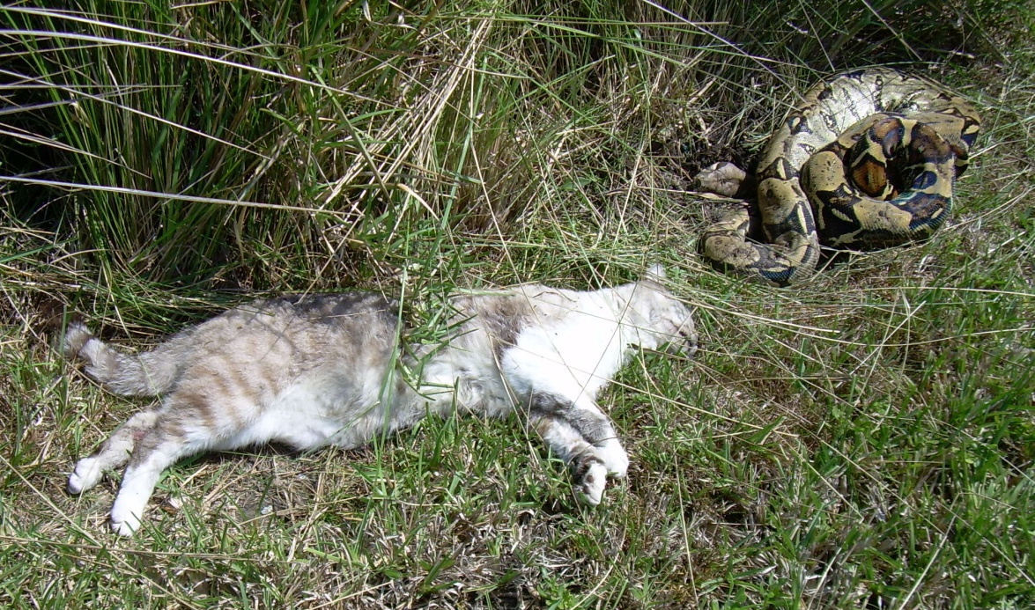
History
Adjacent resident’s cat killed by boa
  Outcry and website resulted
FWC surveyed area 12 times with no captures
Captures appear to be random and by chance
  Guests, employees,
  NAM plant crews

Slide 4
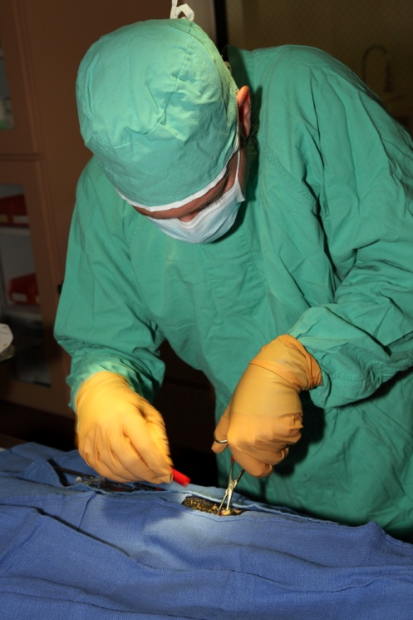
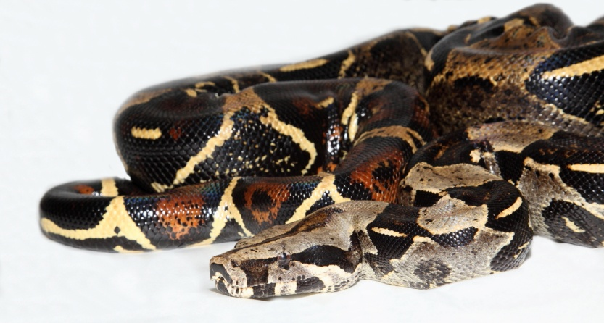
Objectives
Determine the potential impact on the ecosystems
Use radiotelemetry and visual surveys to determine habitat preference (2.2.2)
Suggest a management strategy for this species
Collect genetic samples to potentially determine the origin for the introduced population
  Develop a reference genetic profile for the population that will allow identification of individuals found outside the site as dispersers or unrelated releases.
Analyze gut contents and fecal samples to learn about its prey base, possible impacts on the local wildlife populations, and possible implications if the population were to ever disperse to other natural areas.
Discover any pathology, viruses or parasites that are endemic in the population that may pose a risk to native wildlife.

Slide 5
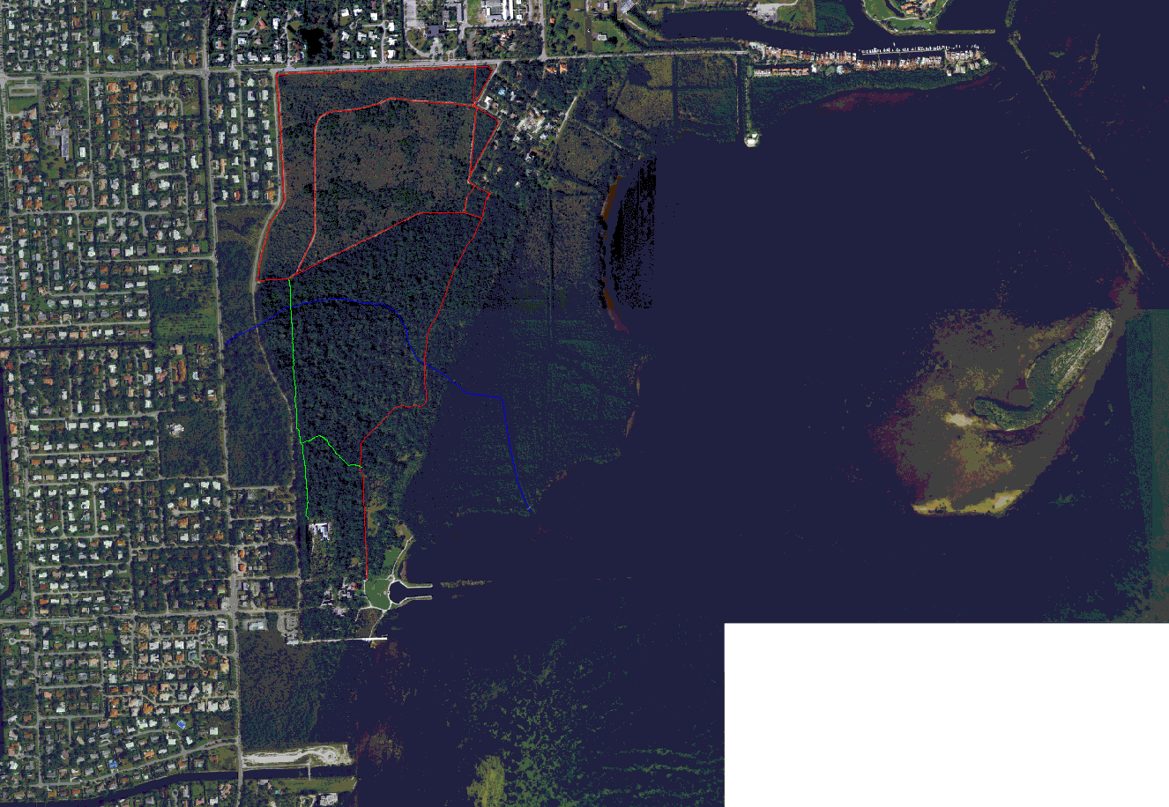
Slide text
444 acres

Slide 6
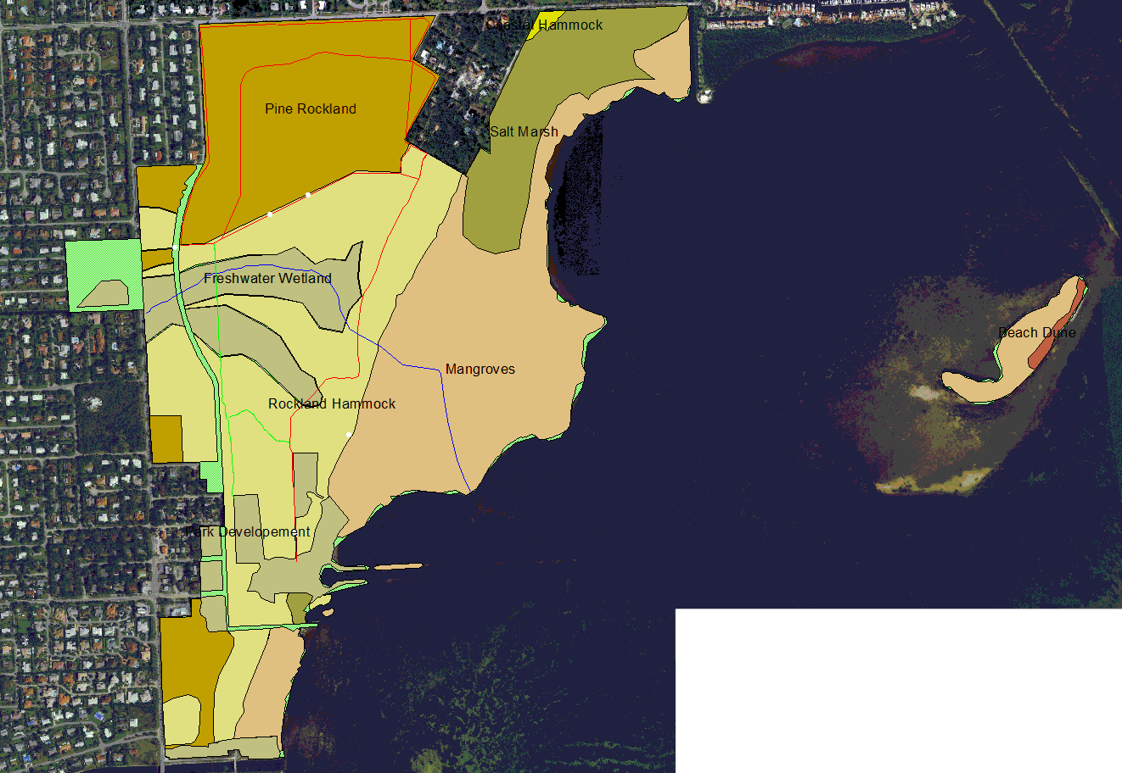
Slide text
104 Pine Rockland
116 Hammock
160 Coastal
33Wetland

Slide 7

DB-1, 3, 8, 10, & 12
DB1
  SV/ST - 223.4/244.5
  8.61 kg
DB8
  SV/ST - 163.7/183.0
  3.5 kg
DB10
  SV/ST - 160.7/179.1
  2.58 kg
DB12
  SV/ST - 181.2/207.0
  7.4 kg

Slide 8
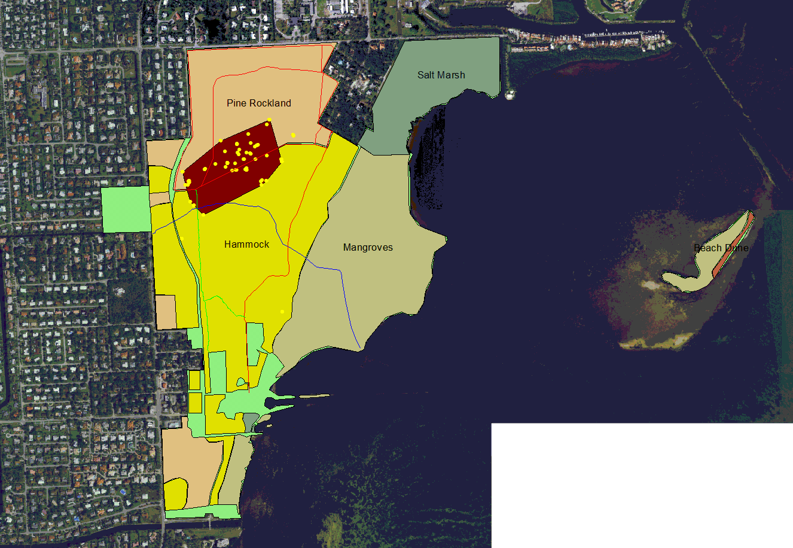
DB1 MCP
Slide text
Area = 104,135 m²
25.7 acres

Slide 9
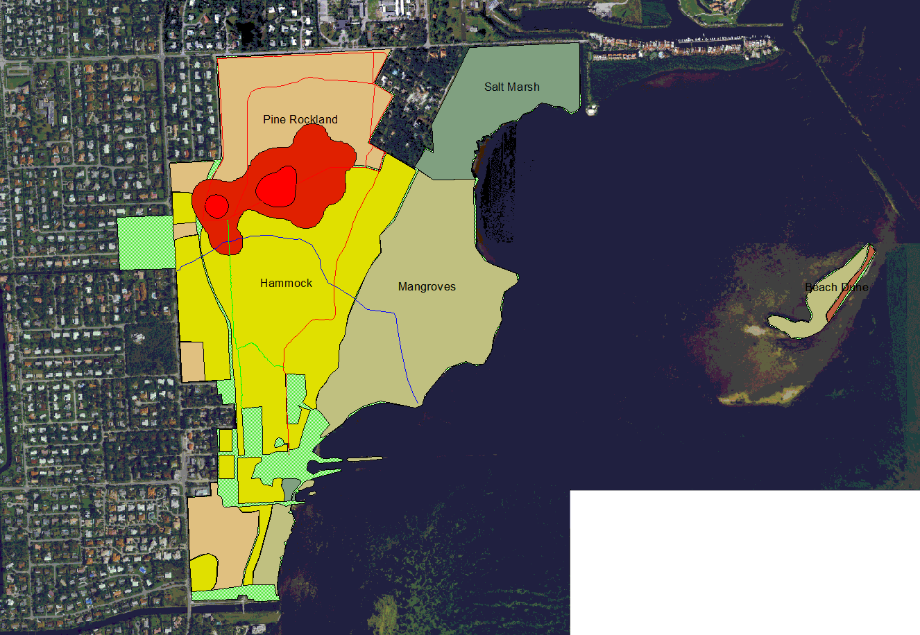
DB1 Kernal - female
Slide text
157,901/24,631 m²
39/6 acres
SF = 100

Slide 10
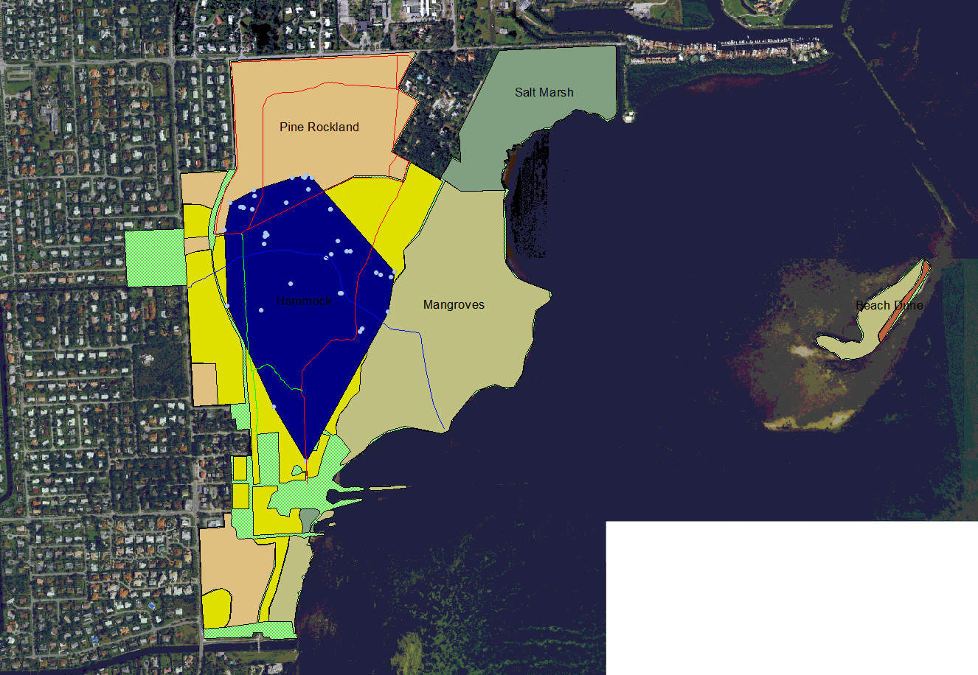
DB8 MCP
Slide text
Area = 388,317 m²
96.0 acres

Slide 11
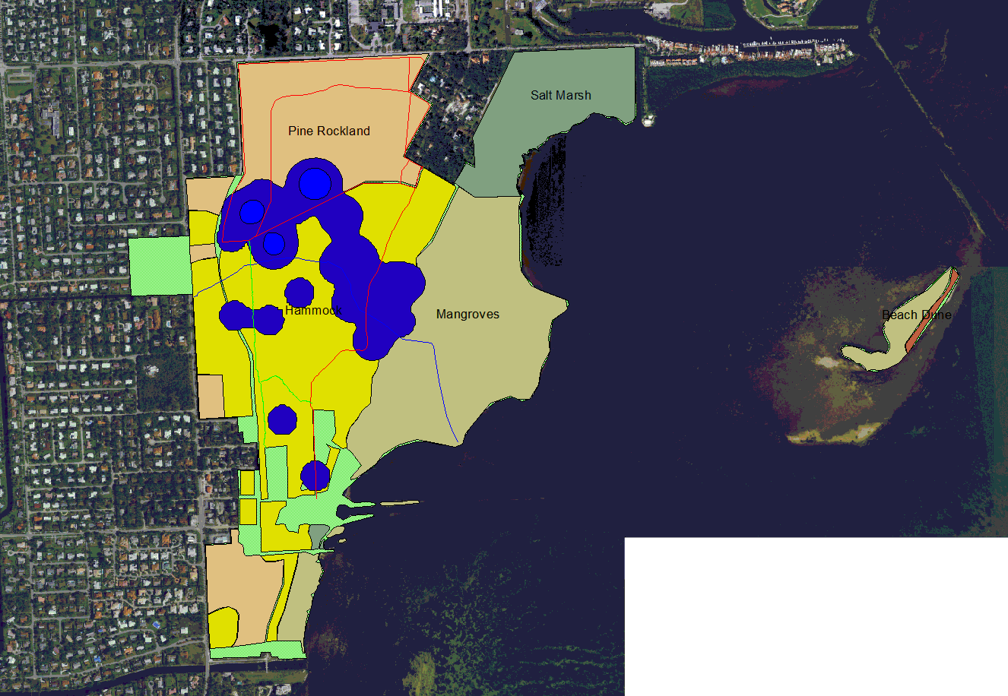
DB8 Kernal - male
Slide text
256,431/ 20,014 m²
63.3/4.9 acres
SF = 100

Slide 12
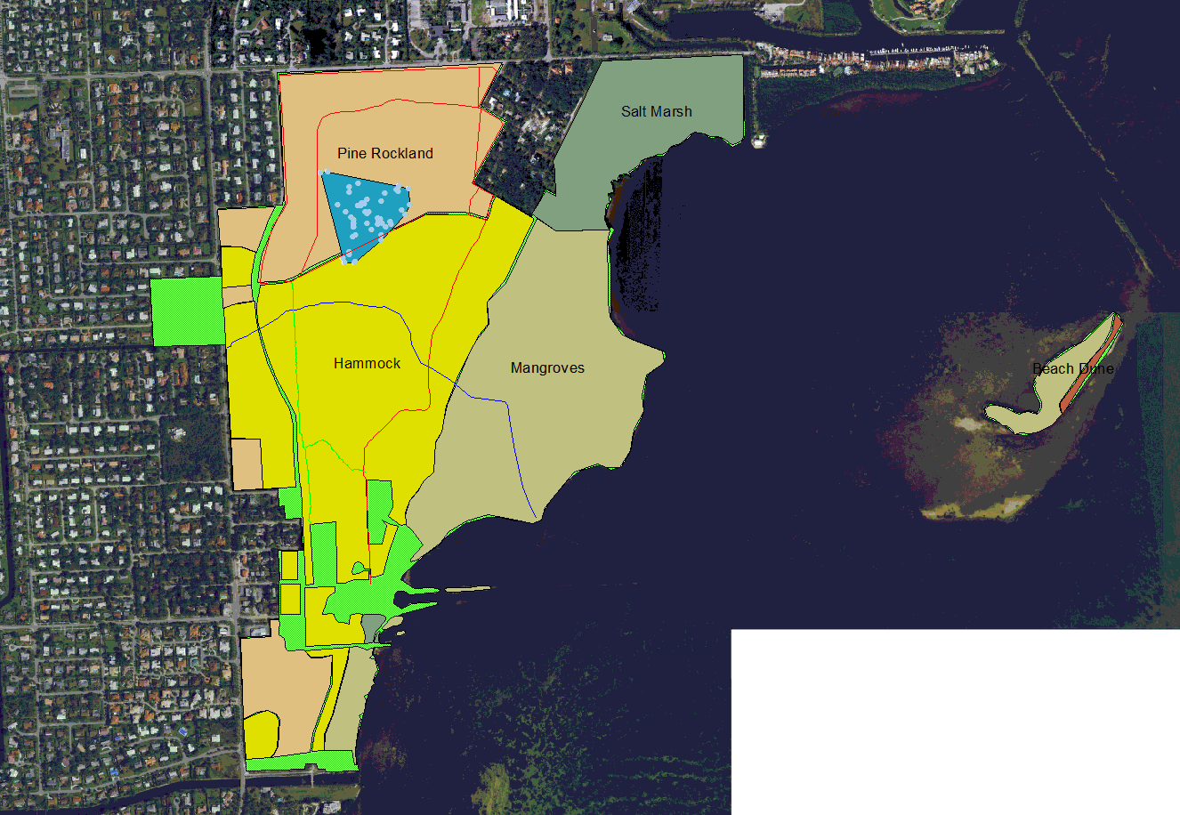
DB10 MCP
Slide text
Area = 44,551 m²
11.0 acres

Slide 13
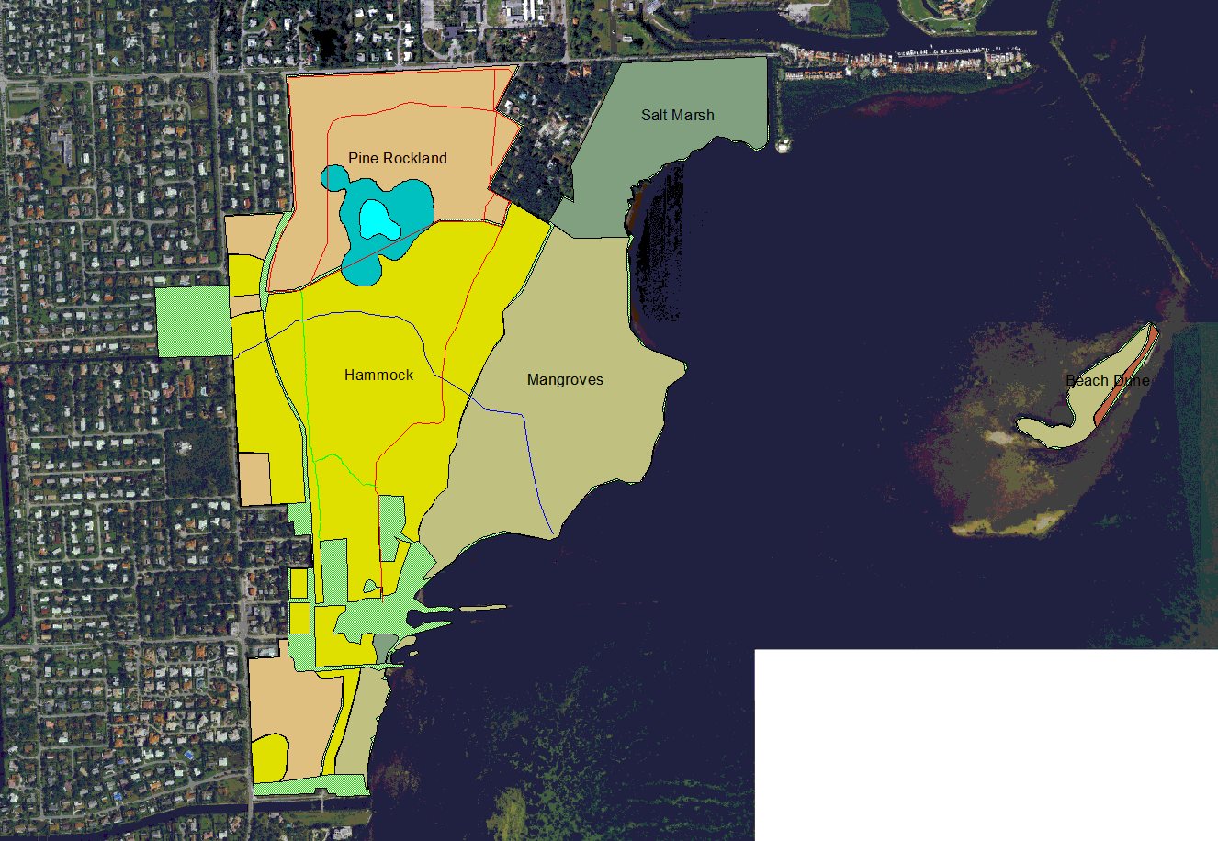
DB 10 Kernal - female
Slide text
62,859 / 9,662 m²
15.5/2.4 acres
SF = 100

Slide 14
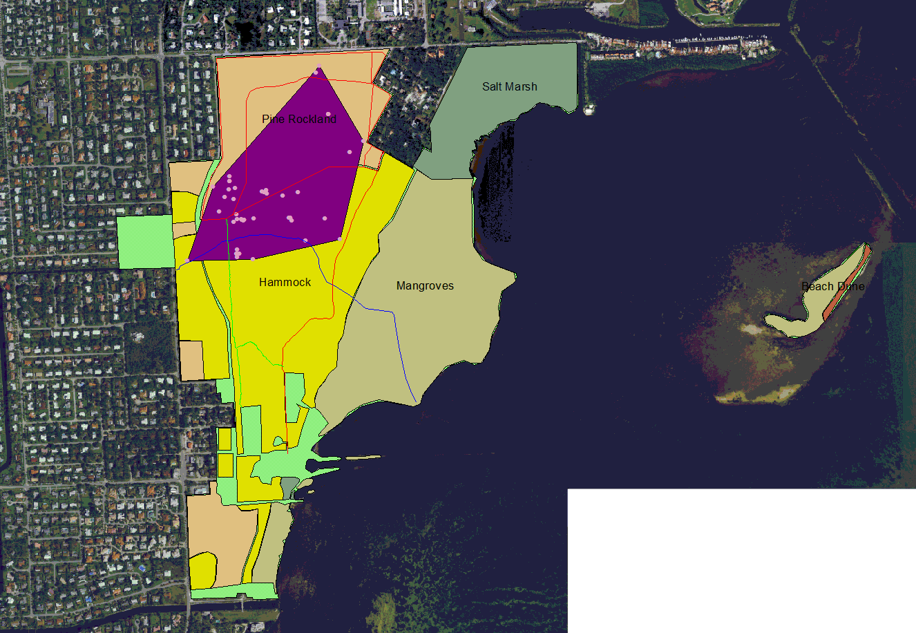
DB12 MCP
Slide text
Area = 288,092 m²
71.2 acres

Slide 15
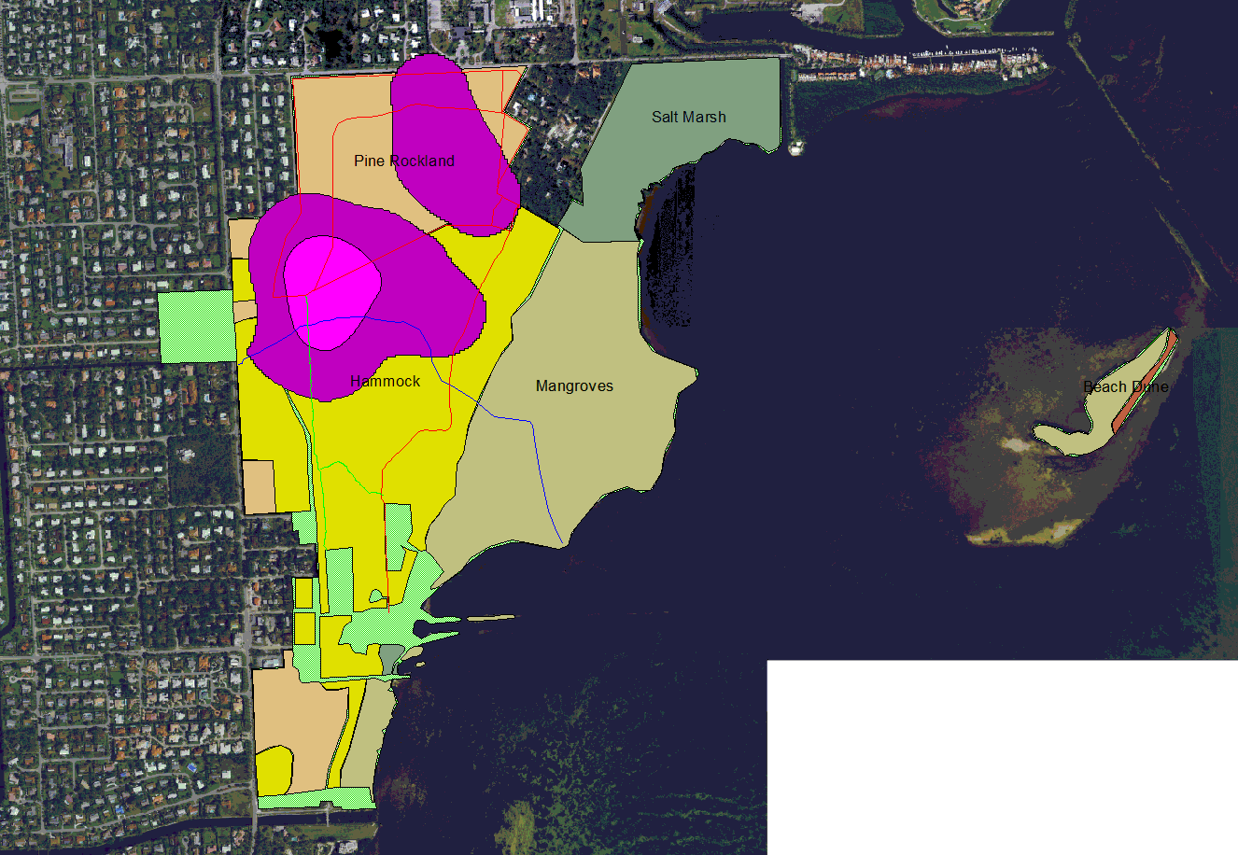
DB12 Kernal - male
Slide text
413,028 / 66,731 m²
102/16.5 acres
SF = 100

Slide 16
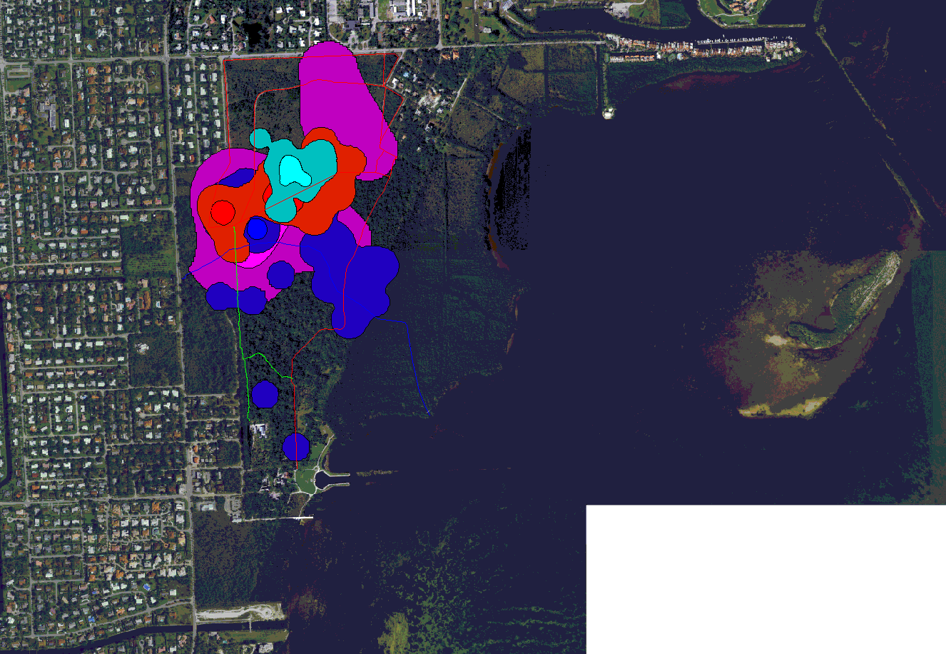
Combined Kernals
Slide text

Slide 17
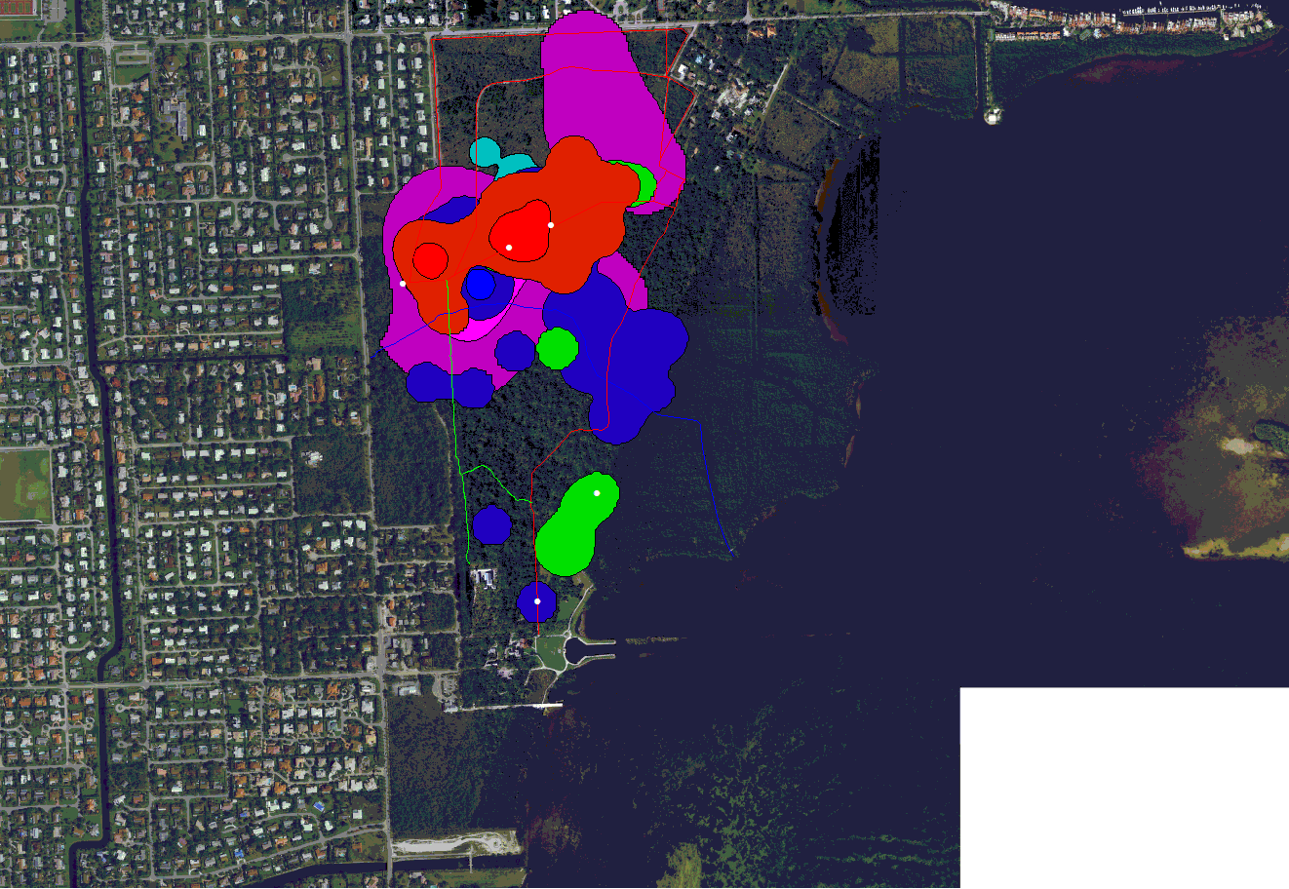
Capture Points

Slide 18
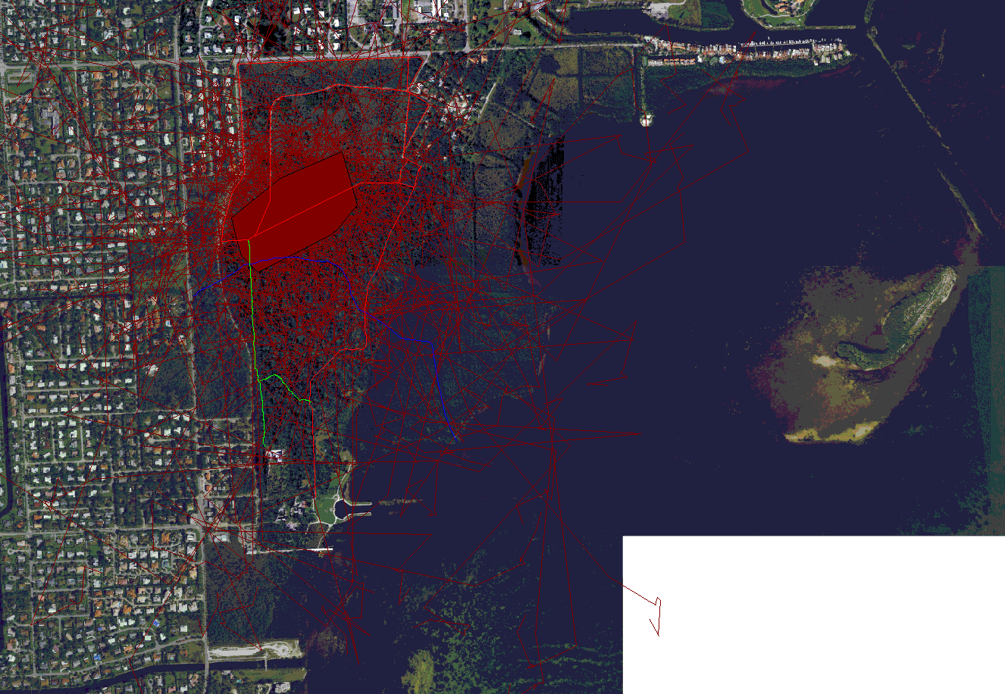
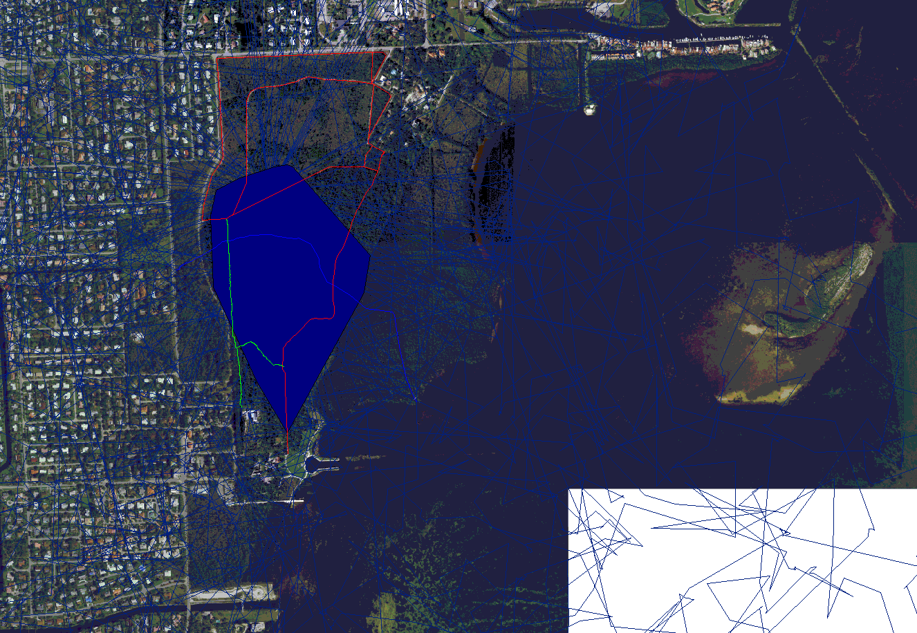
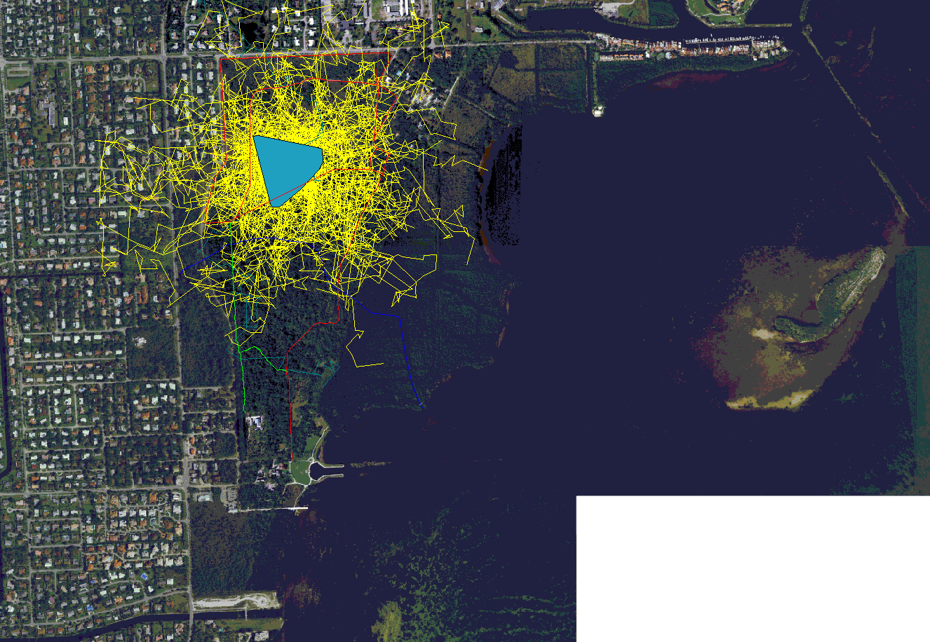
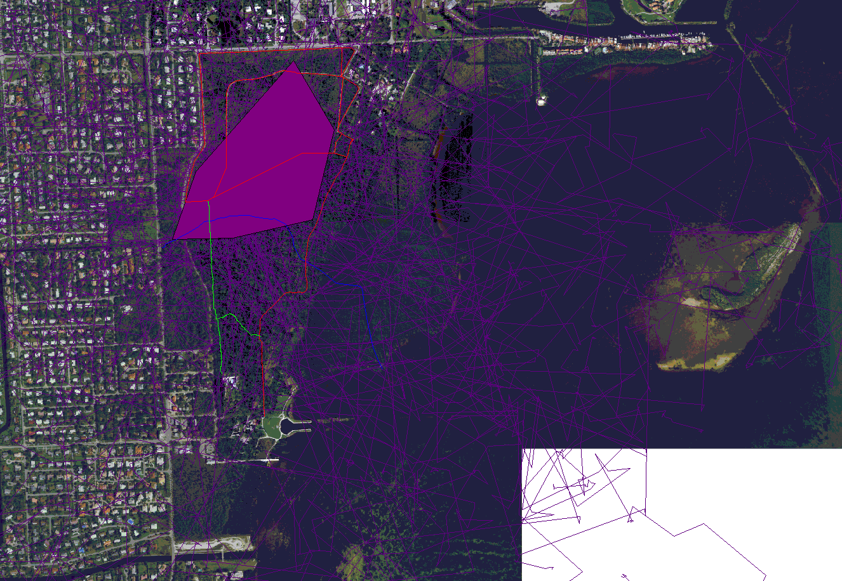
Site Fidelity
Slide text

Slide 19
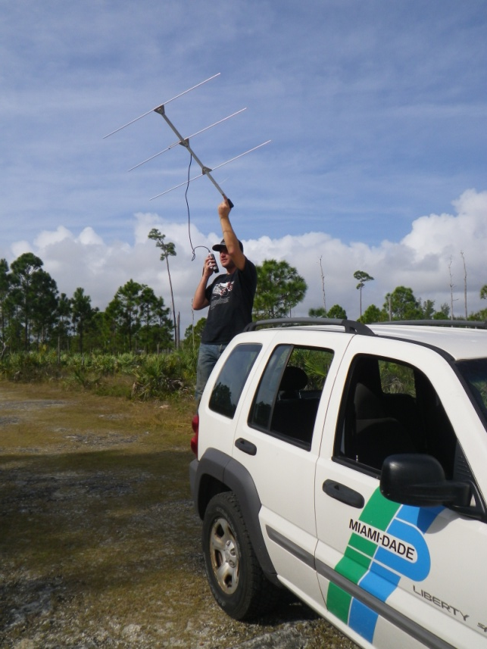
Timeframe and Points
DB1- Dec 10, 2012 to Nov 13, 2013 – 102 points
DB3- Aug 28, 2013 to Nov 1, 2013 – 18 points
DB8- Oct 28, 2013 – still tracking – 53 points
DB10- Nov 12, 2013 – still tracking – 58 points
DB12- Nov 26, 2013 – still tracking – 49 points
DB13 & 17 juveniles currently tracking

Slide 20
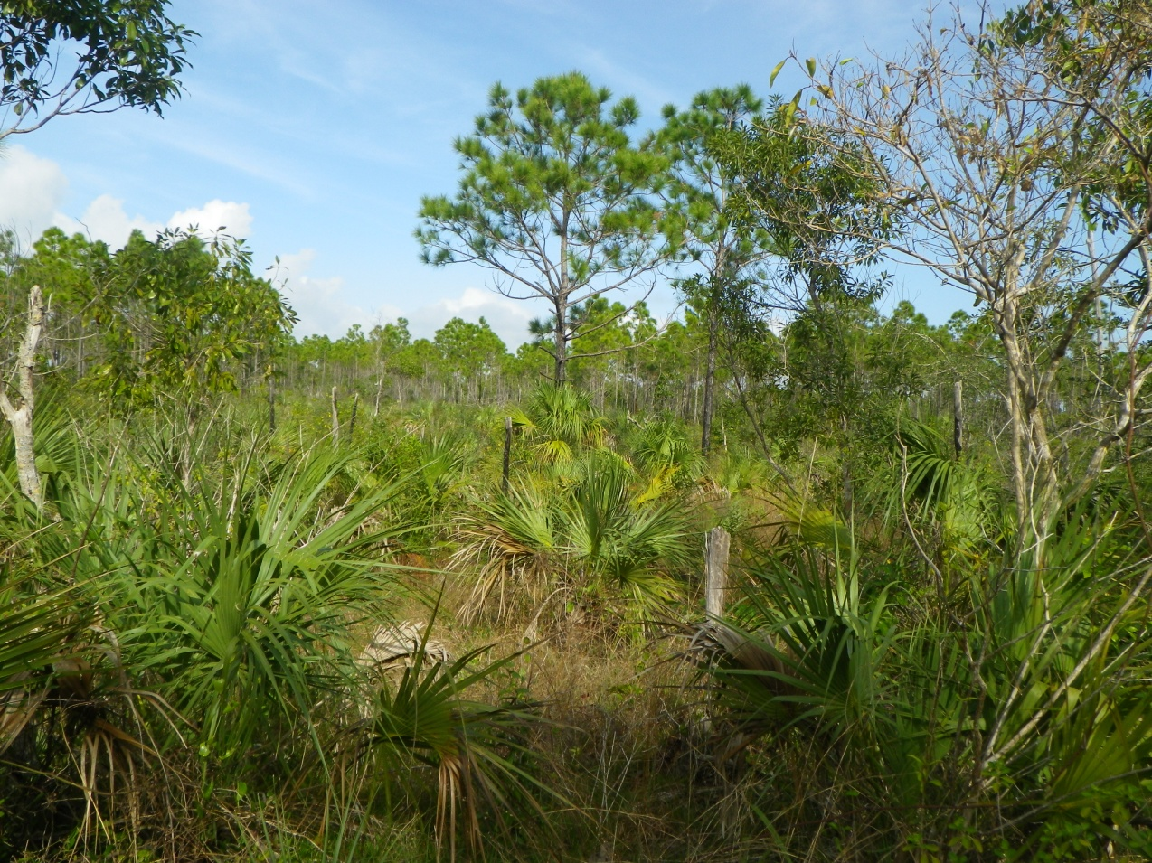
Macrohabitat Usage
Pine Rockland – 62.5%
Rockland Hammock – 35.7%
Mangroves – 1.8%

Slide 21
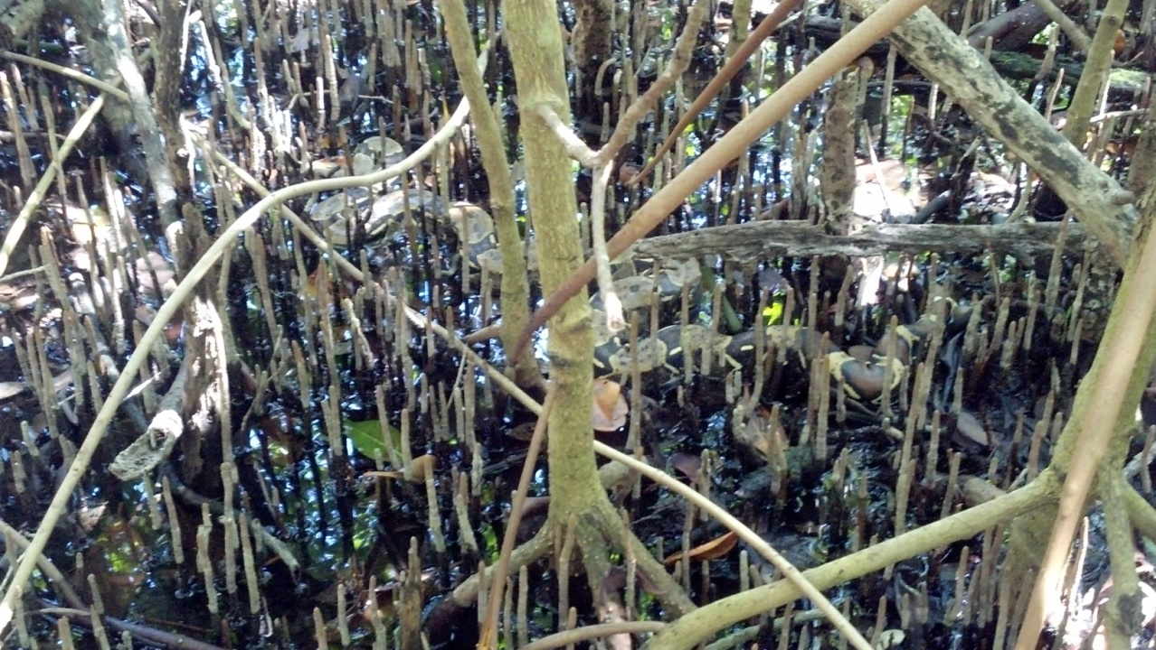
Microhabitat
Underground – 59.6%
Filtering Canopy – 18.2%
Under cover – 9.6%
Fully exposed – 4.6%
Tree – 2.9%
Water – 1.8%
Unknown – 3.2%

Slide 22
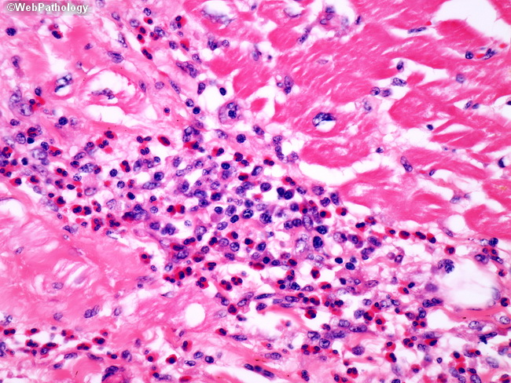
Histopathology
Evidence of parasite migration in tissues but no actual parasites have been seen in slide sections
Some parasites found in the lungs but have not been submitted yet for identification
No evidence of IBD
Most were remarked to be in good health and physical condition based on tissue samples

Slide 23
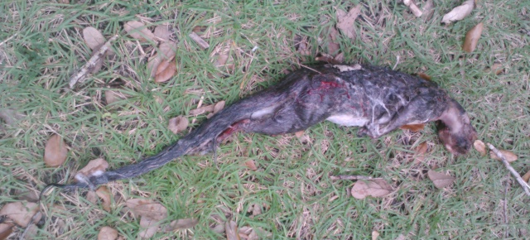
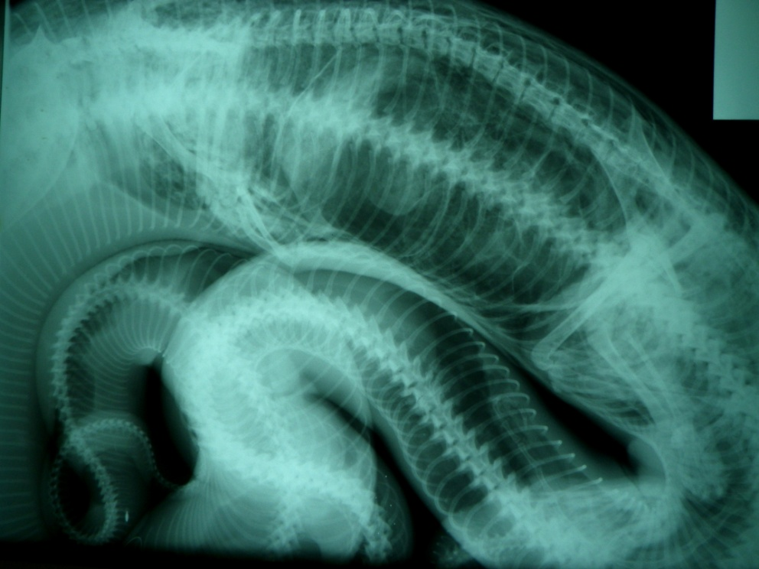
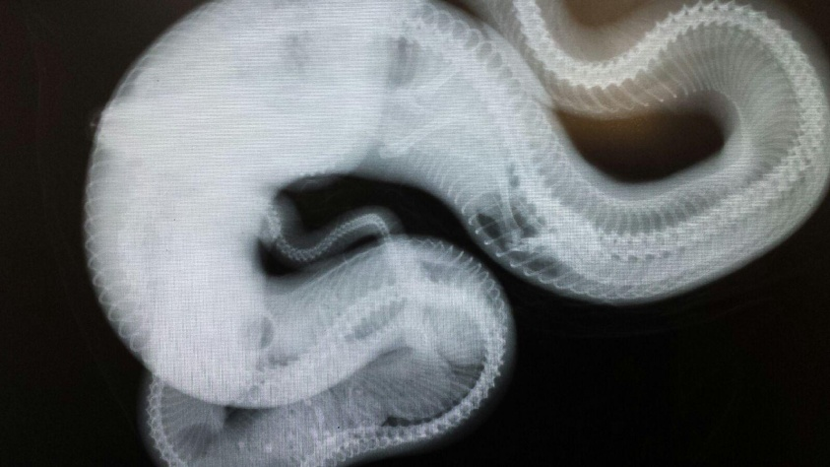
Diet
Virginia Opossum
Grey Squirrel
Feral Cat
Rat
Otter?

Slide 24
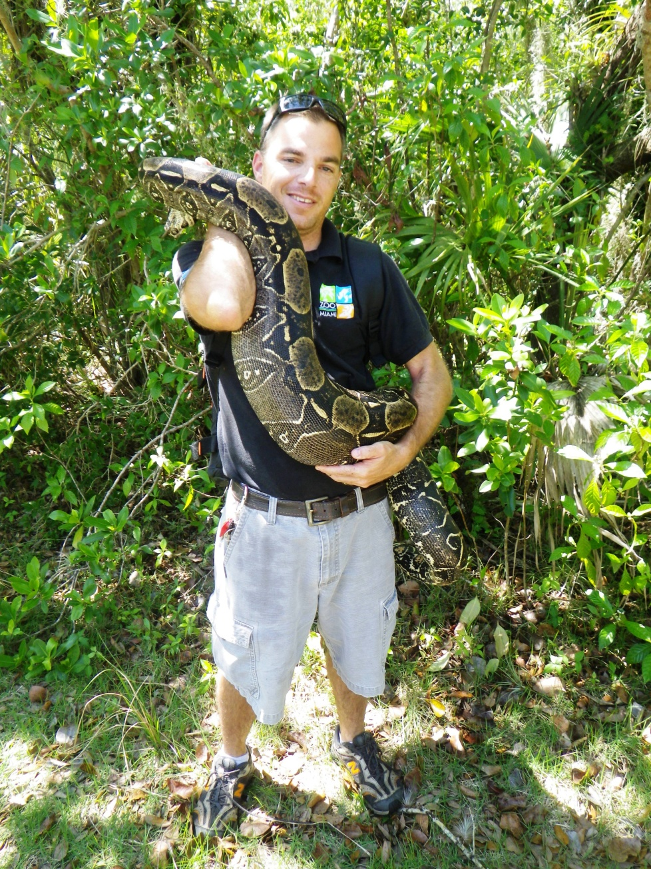
Management Suggestions
Still preliminary results
  small sample size
Map out burrows/solution holes in pine rockland and monitor
Maintain adults with transmitters near breeding season and monitor closely ~Oct-Nov
  November 1st
Search areas immediately around where neonates are found – May-Sept

