Slide 1
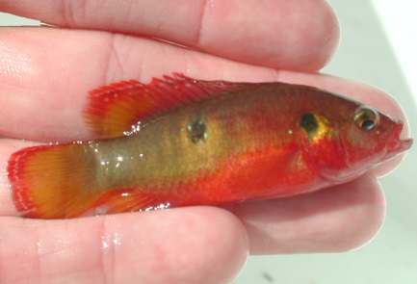
ECISMA Partner Non-native Fish Survey Jeff Kline-Everglades National Park 23 July 2014 Survey Participants: Everglades National Park Florida Fish and Wildlife Conservation Commission Miccosukee Tribe of Indians of Florida US Fish and Wildlife Service

Slide 2
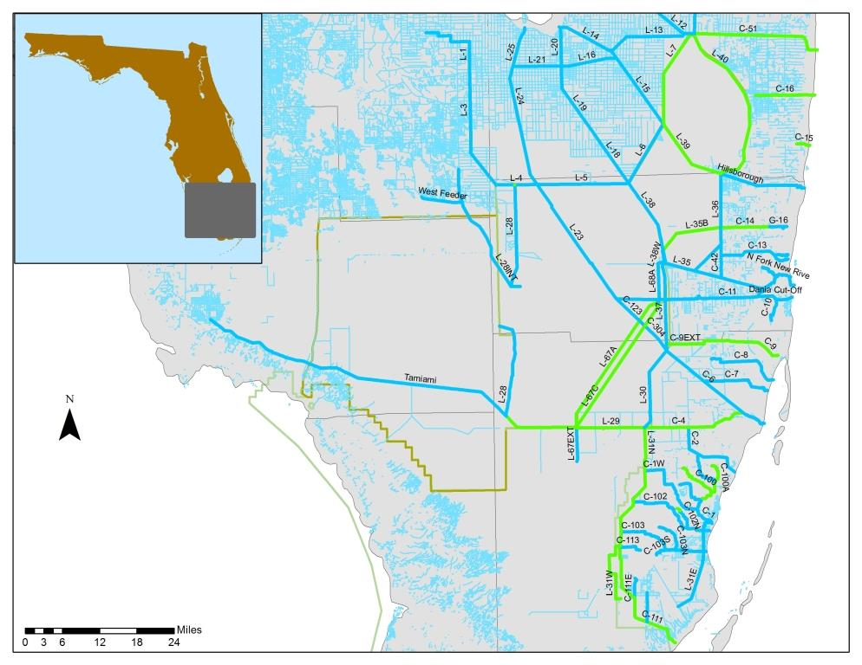
Lox.
WCA 2
BICY
WCA 3
Summit Breakout 2013
not sampled recently
ENP
sampled recently

Slide 3
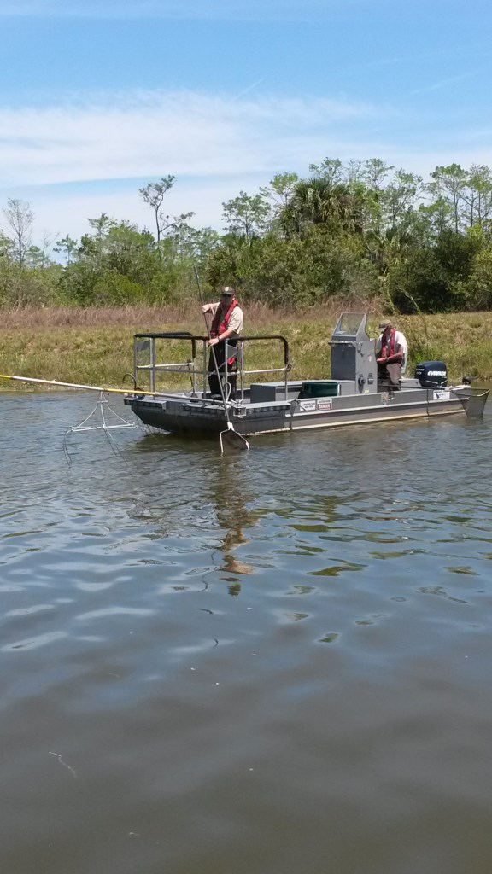
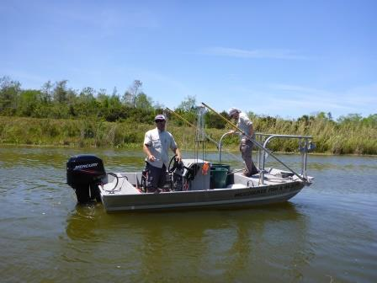
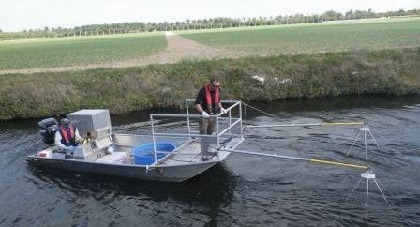

Slide 4
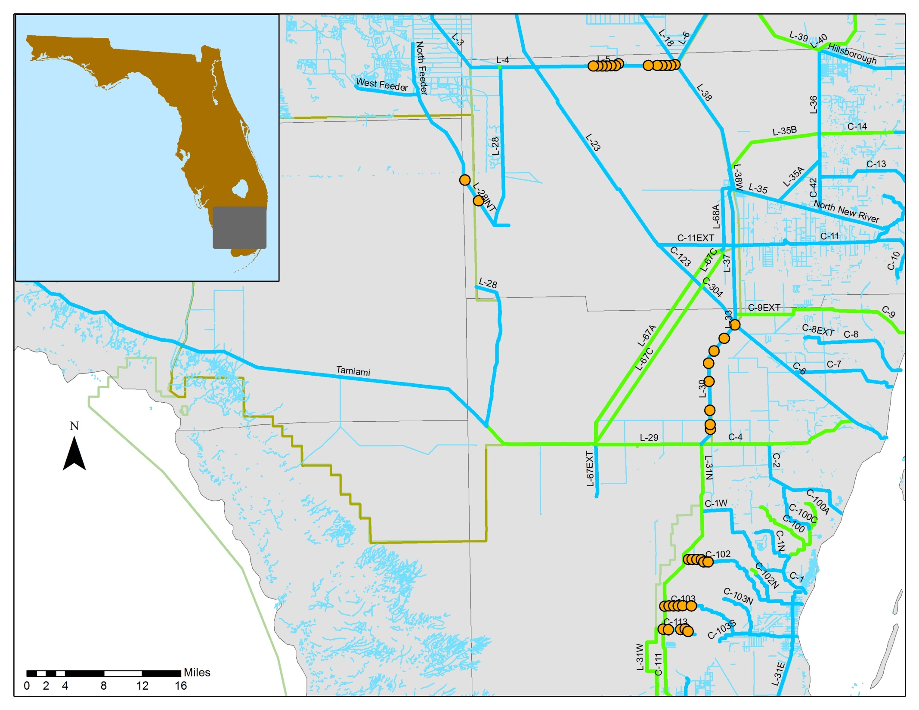
WCA 2
WCA 3
BICY
ENP
Electrofishing transects

Slide 5
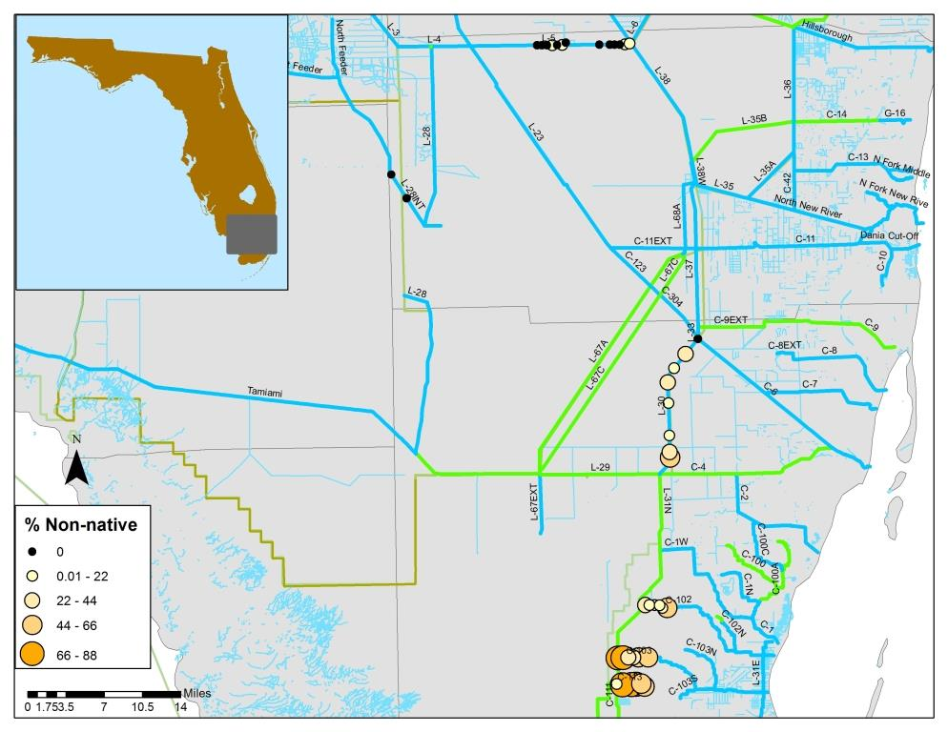
WCA 3
BICY
ENP

Slide 6
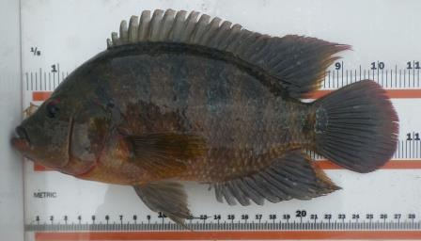
L-5 Canal
5.18 Fish/min
0.04 Non-native/min
0.7 % Non-native
3 Species

Slide 7
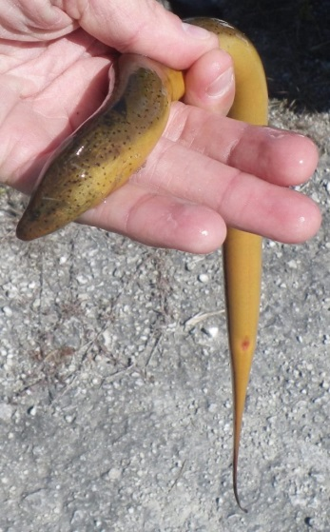
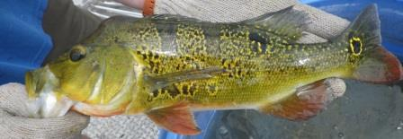
L-5 Canal
5.18 Fish/min
0.04 Non-native/min
0.7 % Non-native
L-30 Canal
1.6 Fish/min
0.3 Non-native/min
19.6 % Non-native
8 Species

Slide 8
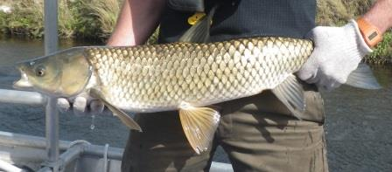
L-5 Canal
5.18 Fish/min
0.04 Non-native/min
0.7 % Non-native
L-30 Canal
1.6 Fish/min
0.3 Non-native/min
19.6 % Non-native
C-102 Canal
2.4 Fish/min
0.4 Non-native/min
18.9 % Non-native
6 Species

Slide 9

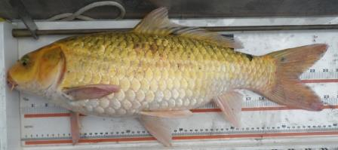
L-5 Canal
5.18 Fish/min
0.04 Non-native/min
0.7 % Non-native
L-30 Canal
1.6 Fish/min
0.3 Non-native/min
19.6 % Non-native
C-103 Canal
1.0 Fish/min
0.6 Non-native/min
59 % Non-native
7 Species
C-102 Canal
2.4 Fish/min
0.4 Non-native/min
18.9 % Non-native

Slide 10

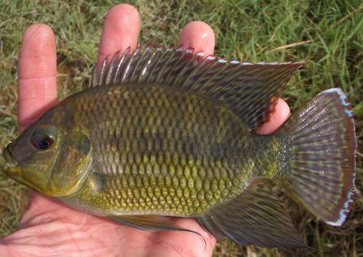
L-5 Canal
5.18 Fish/min
0.04 Non-native/min
0.7 % Non-native
L-30 Canal
1.6 Fish/min
0.3 Non-native/min
19.6 % Non-native
C-113 Canal
2.7 Fish/min
1.2 Non-native/min
45 % Non-native
7 Species
C-102 Canal
2.4 Fish/min
0.4 Non-native/min
18.9 % Non-native
C-103 Canal
1.0 Fish/min
0.6 Non-native/min
59 % Non-native

Slide 11
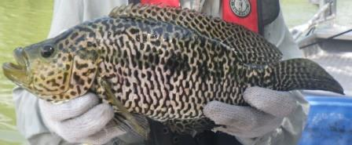
L-5 Canal
5.18 Fish/min
0.04 Non-native/min
0.7 % Non-native
L-30 Canal
1.6 Fish/min
0.3 Non-native/min
19.6 % Non-native
L-28INT Canal
No total fish/min available
0.2 Non-native/min
4 Species
C-102 Canal
2.4 Fish/min
0.4 Non-native/min
18.9 % Non-native
C-103 Canal
1.0 Fish/min
0.6 Non-native/min
59 % Non-native
C-113 Canal
2.7 Fish/min
1.2 Non-native/min
45 % Non-native

Slide 12
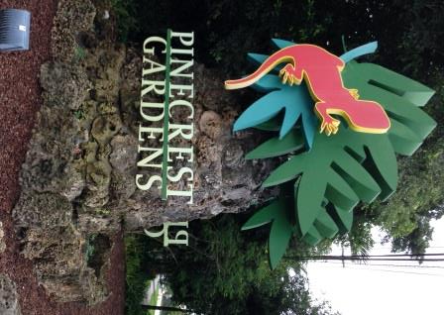
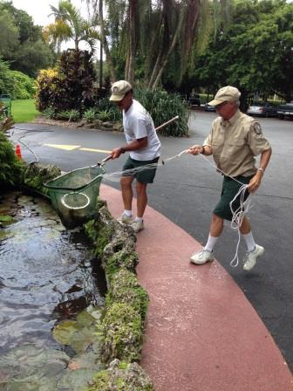
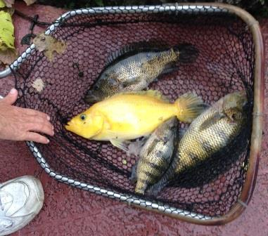
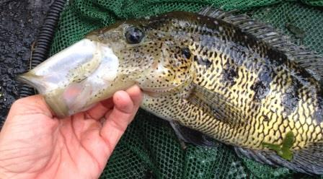
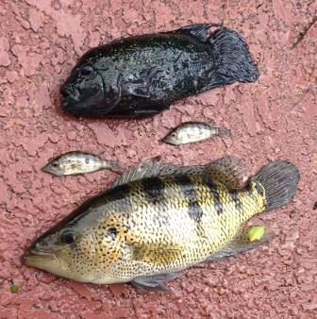
Pinecrest Gardens

Slide 13
ECISMA Nonnative Fish Roundup Results and
FWC exotic fish activities
Kelly Gestring and Murray Stanford
Nonnative Fish and Wildlife Program
Florida Fish and Wildlife Conservation Commission

Slide 14

Most successful to date (55 registrants in Dade, Broward, and Collier counties; 26 weighed in fish)
Weighed in 580 pounds of fish, 18 different species
Slam winner caught 13 species
Bullseye Snakehead in separate category due to large size
Mayans caught by the most anglers
Mayans, Midas, Sailfin Catfish by weight; Mayans, Midas and Spotted tilapia by numbers
More results and pictures at: evergladescisma.org/
Big thanks to Tony Pernas, Shea Bruscia, Ian Bartoszek, Rory Feeney, Murray Stanford, and ??

Slide 15
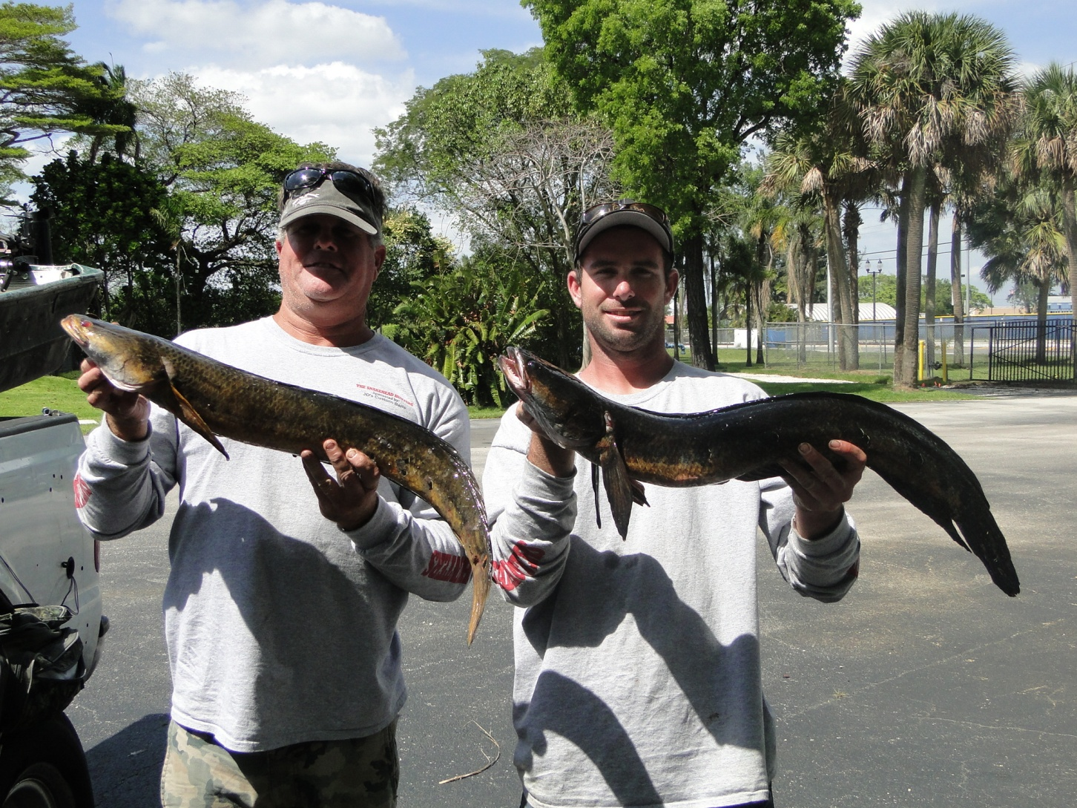
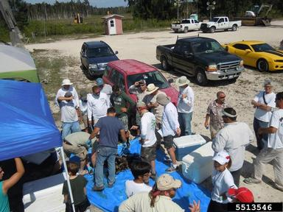
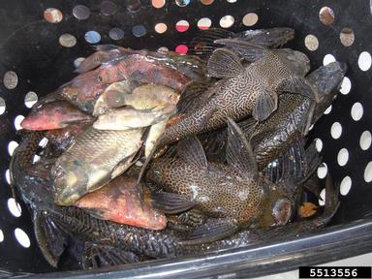
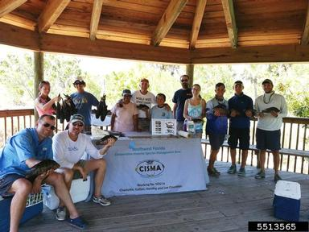

Slide 16
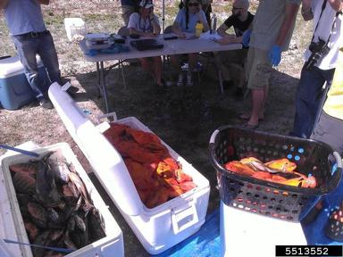
Nonnative Fish Round Up Challenges
What to do with unwanted fish?
If event takes off, how to handle
increased administration and logistics
Boy Scout leaders and fishing club member
expressed interest in next year’s event

Slide 17
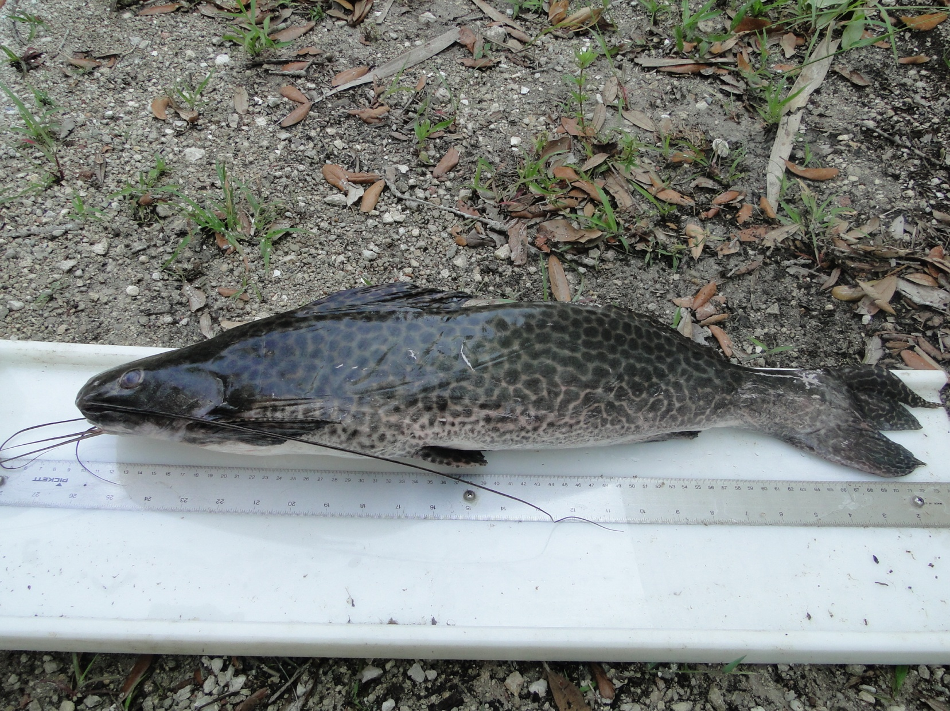
Marbled Pim (Leiarus marmoratus)
South American pimelodid catfish
Freshwater lakes and rivers
Piscivorous
In ornamental fish trade
Max 36 inches, 25#

Slide 18
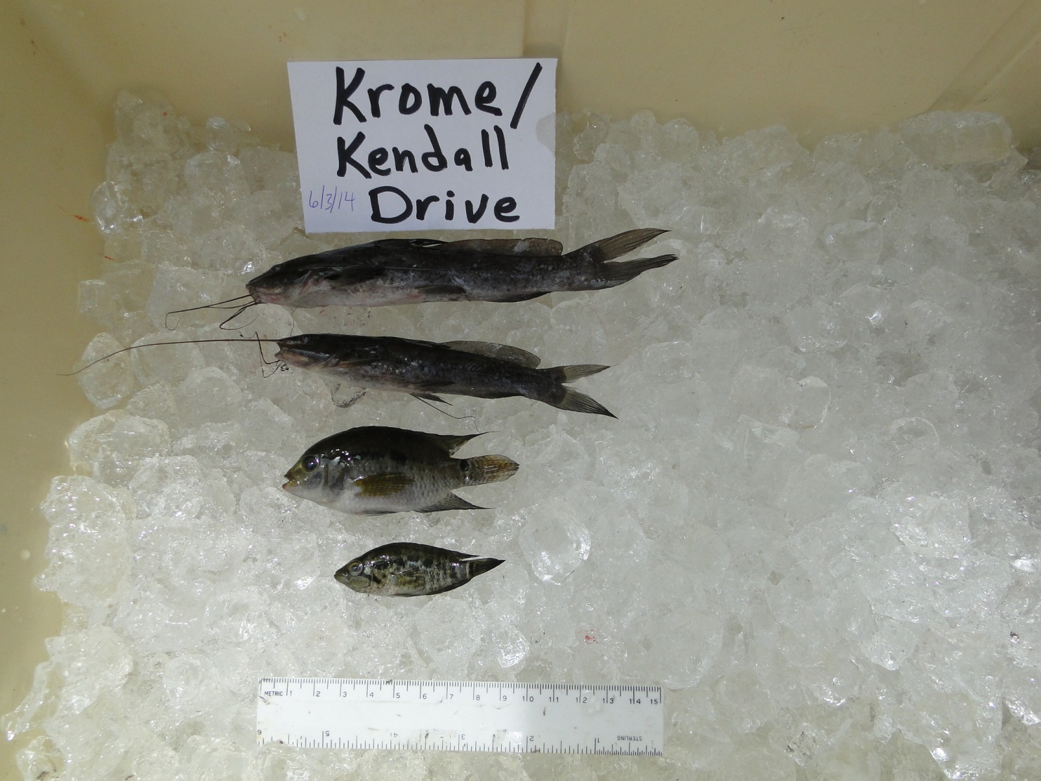
Silver Catfish (Rhamdia quelens)
-Central and South America
-Creeks, slow moving rivers, lakes
-Prefer muddy bottom with decaying wood and leaves to hide in
-Omnivorous
-Mainly nocturnal
-Some aquaculture
Black Acara
Jaguar guapote

Slide 19
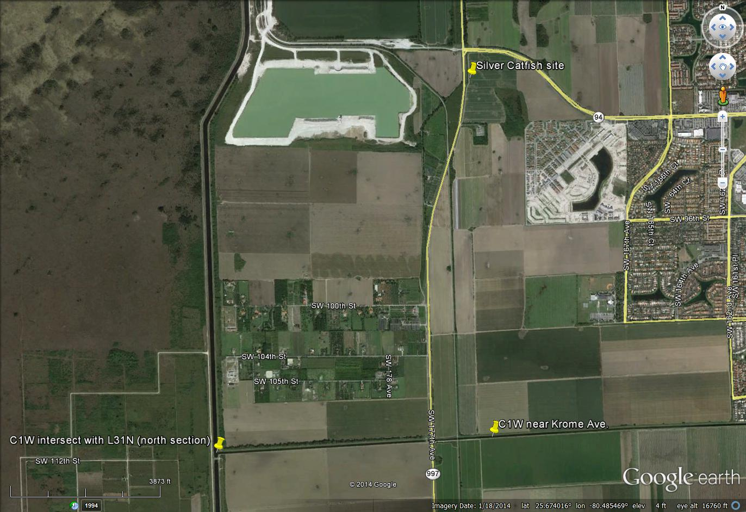
Silver Catfish Site;
Kendall Drive and
Krome Avenue

Slide 20
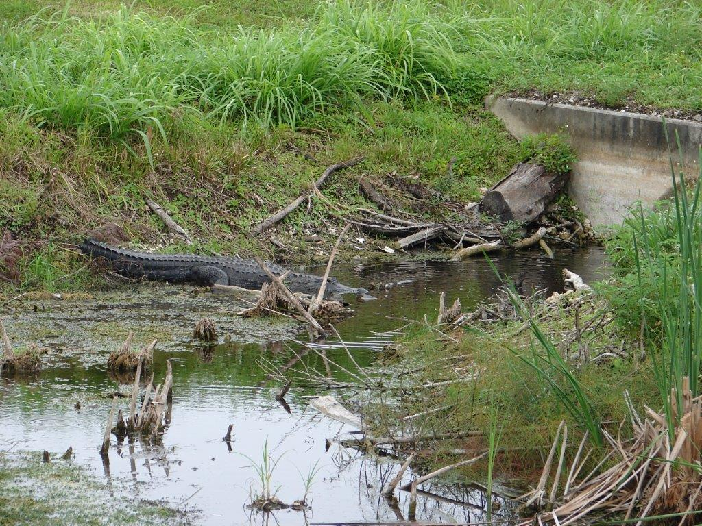

Slide 21
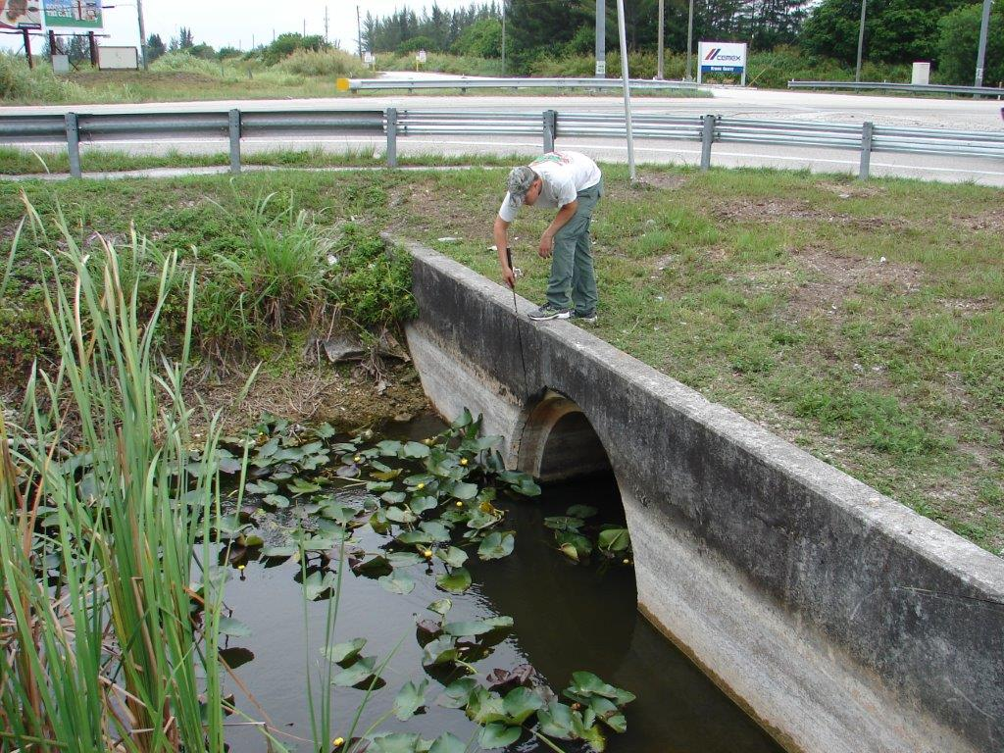

Slide 22
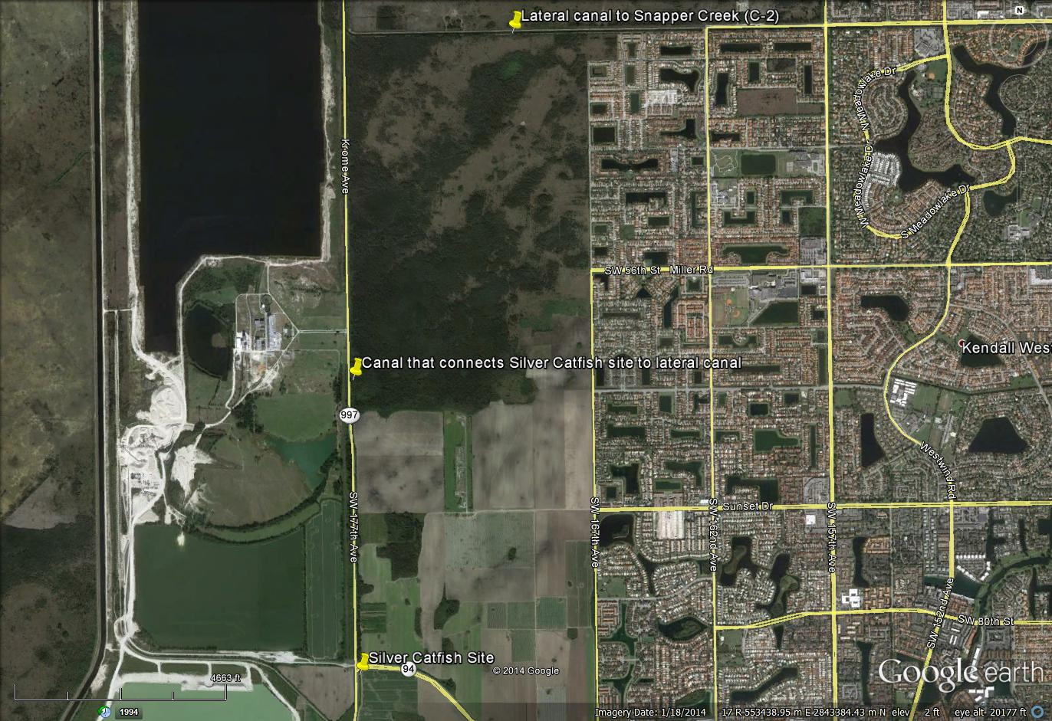
Silver catfish canal connections
Snapper Creek Canal

Slide 23
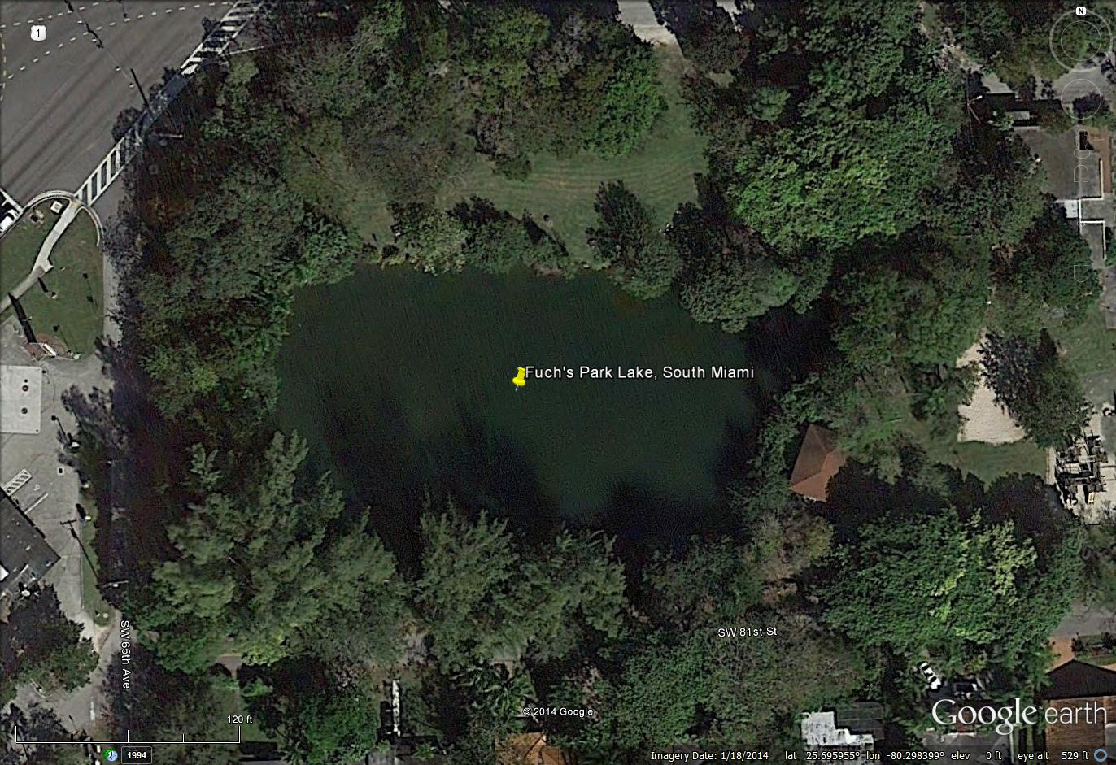
Fuch’s Park Lake; site of Marbled Pim collection
Reportedly a popular drop-off spot for unwanted terrestrial and aquatic nonnatives. Anglers were targeting pacus.
Connected to Snapper Creek (C-2) Canal

Slide 24
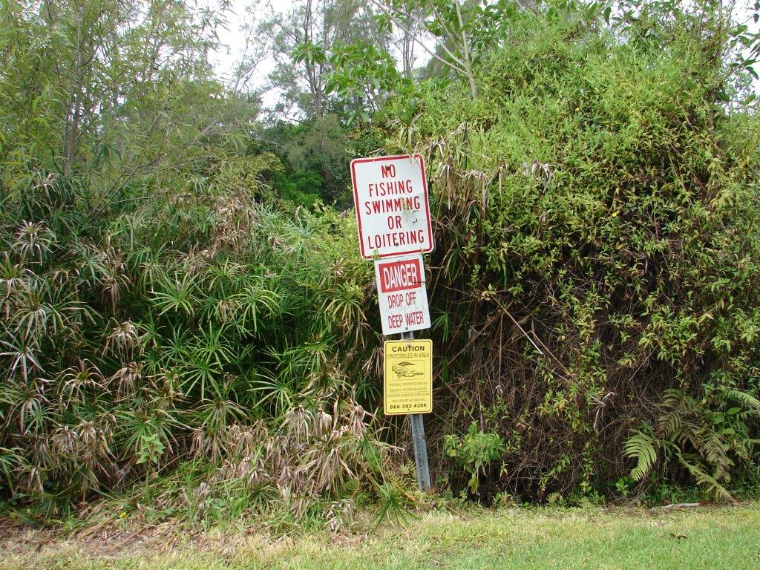

Slide 25
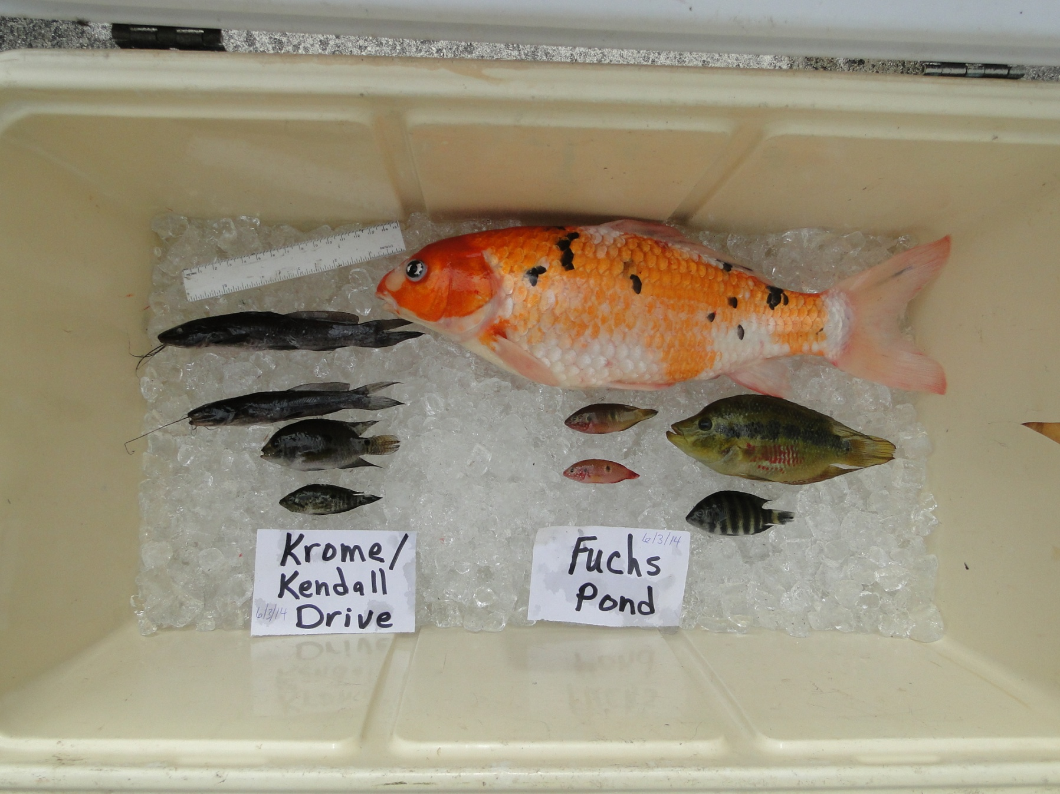

Slide 26
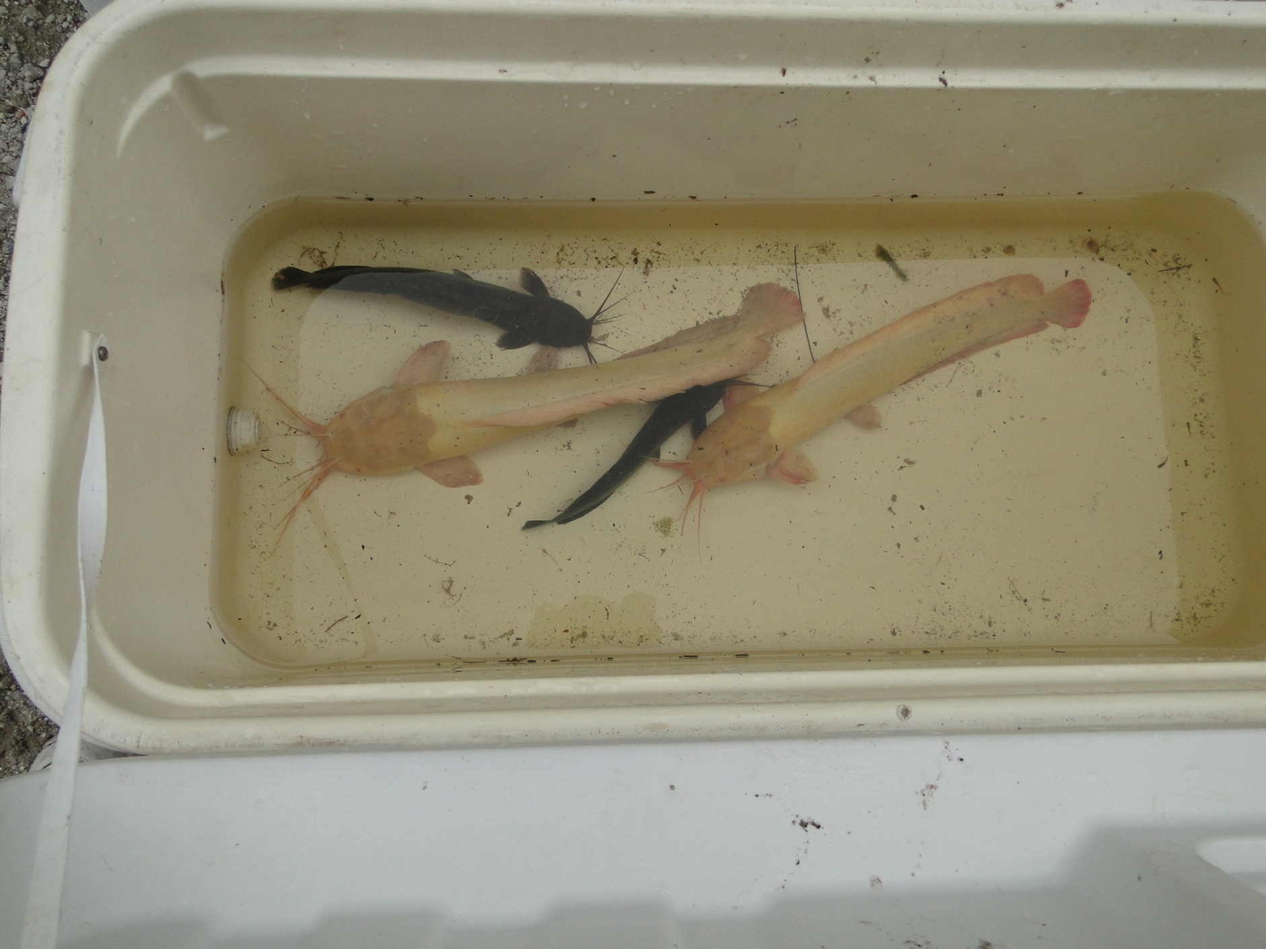

Slide 27
AskFWC question of the day:
“I'M CLOSING DOWN MY FISH POND, HAVE ABOUT 100 CYCLETS , I CAN’T FIND ANYONE TO TAKE CARE OF THEM AND NOT EVEN THE PET STORE THAT I BOUGHT THEM FROM WANTS THEM, CAN I RELEASE THEM IN A NEAR BY FRESH WATER CANAL ? PLS. LET ME KNOW .”

Slide 28
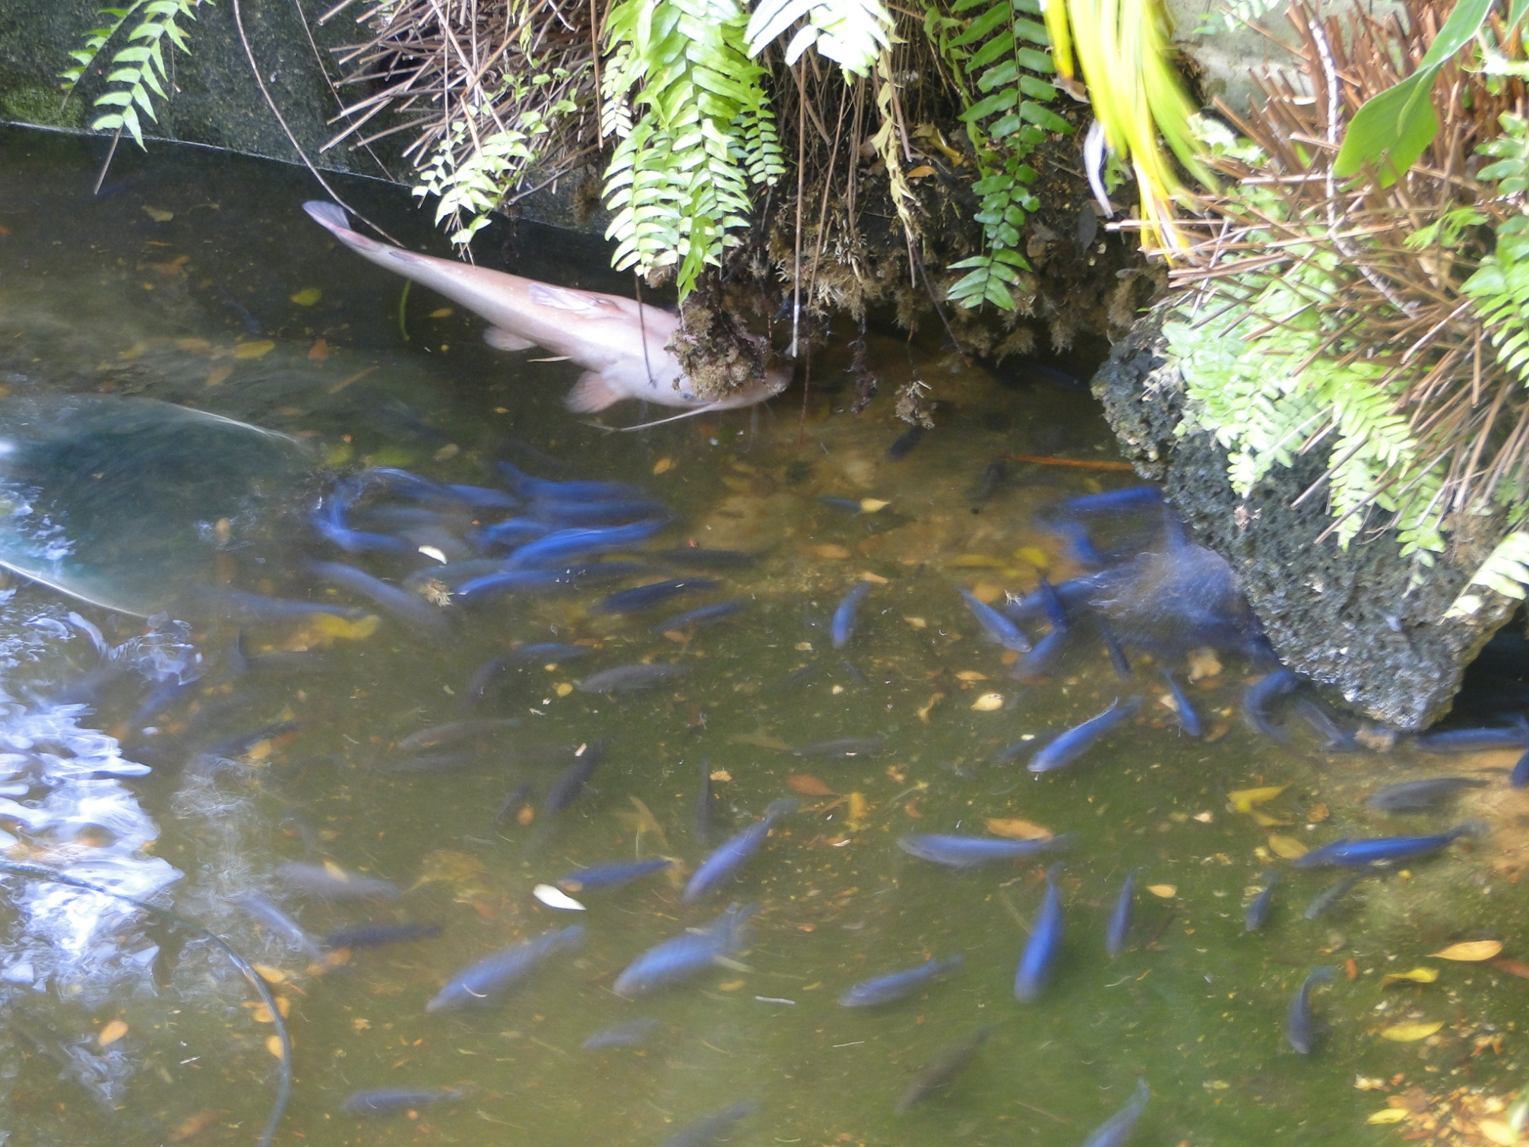

Slide 29
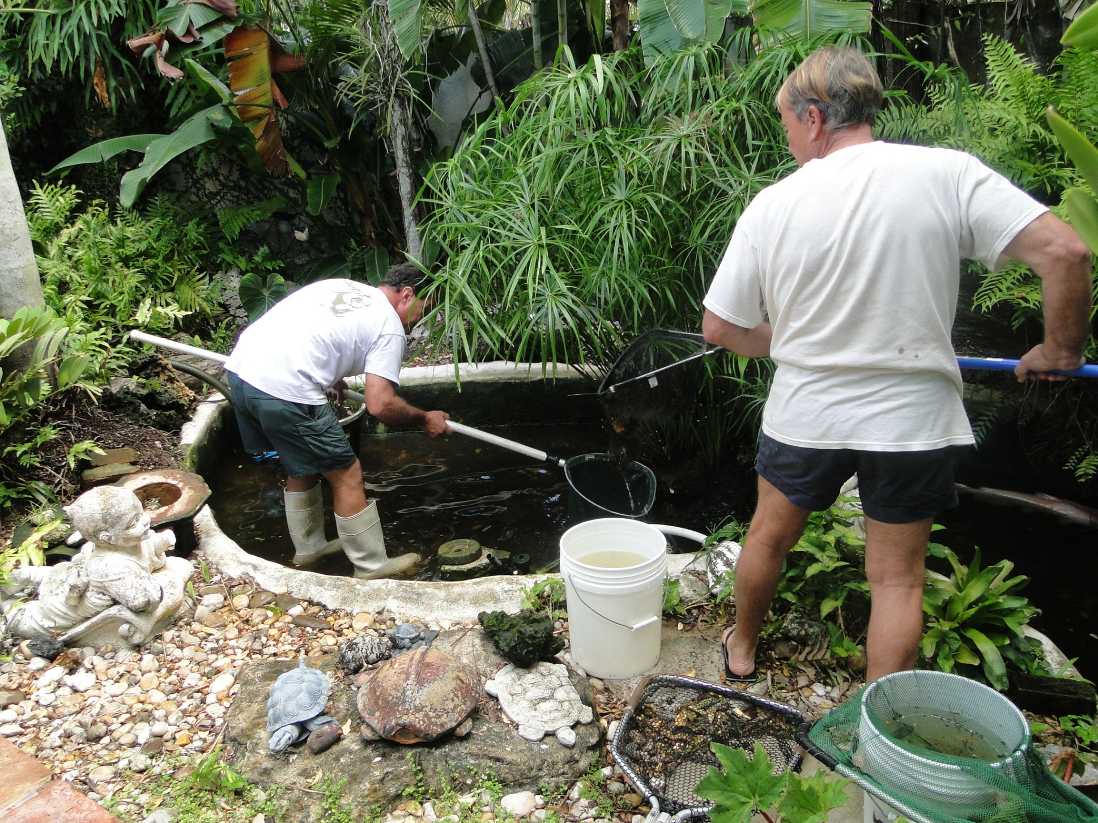

Slide 30
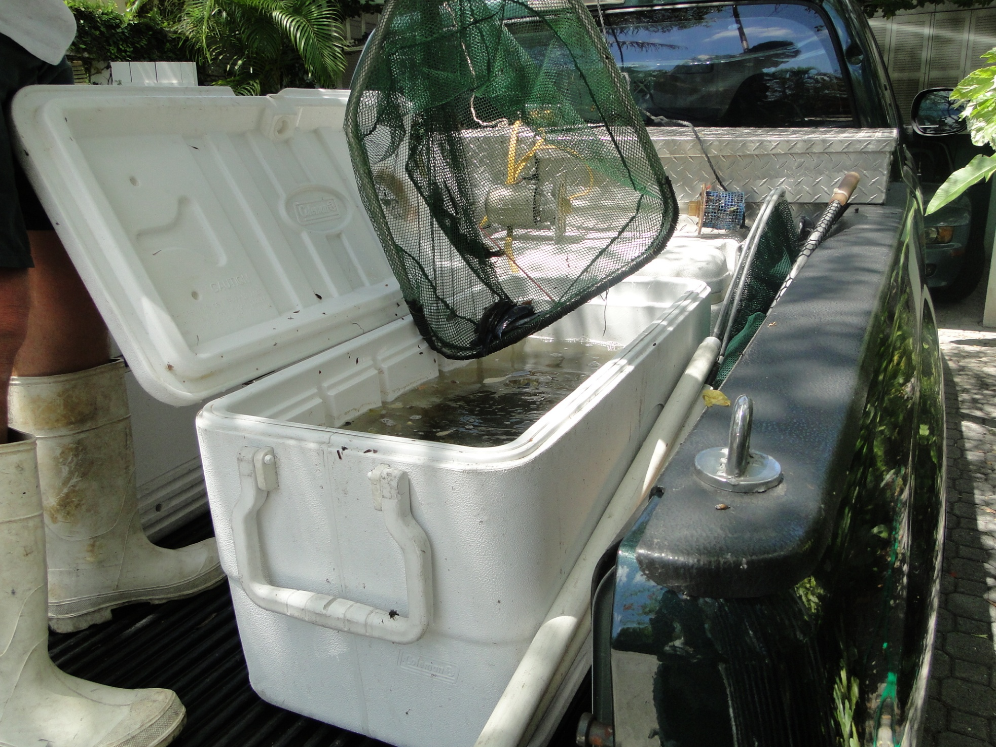

Slide 31
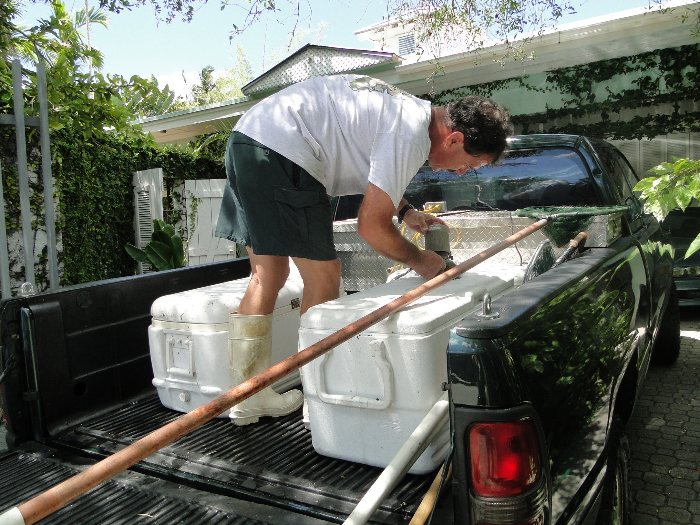

Slide 32
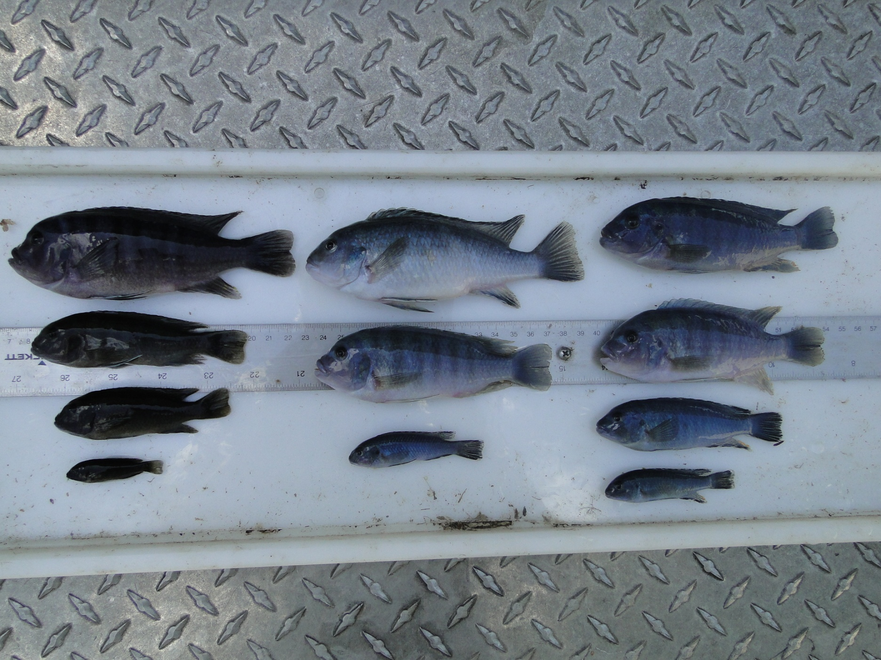
Blue Zebra (Blue Mbuna) rock cichlids from Lake Malawi
N = 501 Collected
Tony Pernas adopted 12, we kept 11 for
identification, remainder were destroyed

Slide 33
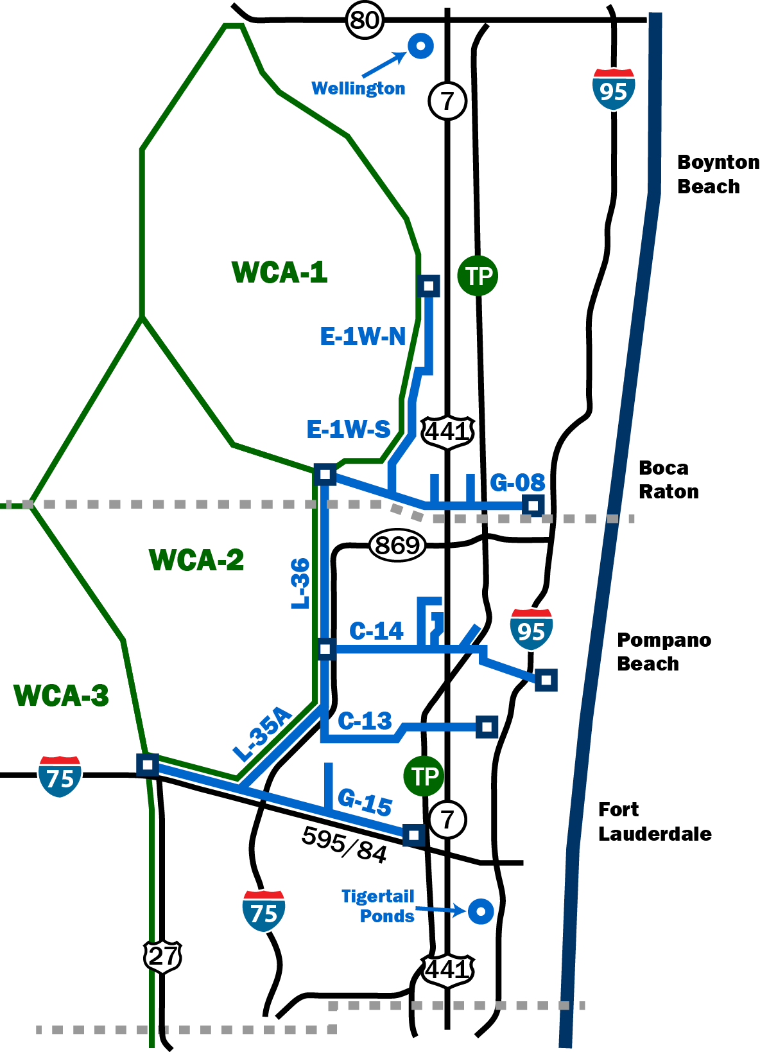
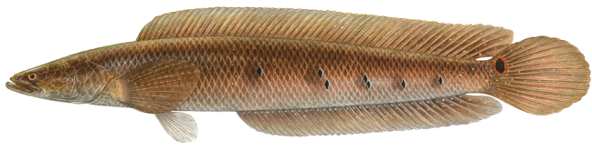
Bullseye Snakehead Range Expansion
First documented in 2000 in
Tamarac, slowly moving north
Angler caught fish from Wellington represents a 12 mile jump from northernmost location
Likely the result of illegal bucket biology
Wellington canal system drains into
C-51W Canal with access to Lake Okeechobee and west coast

Slide 34
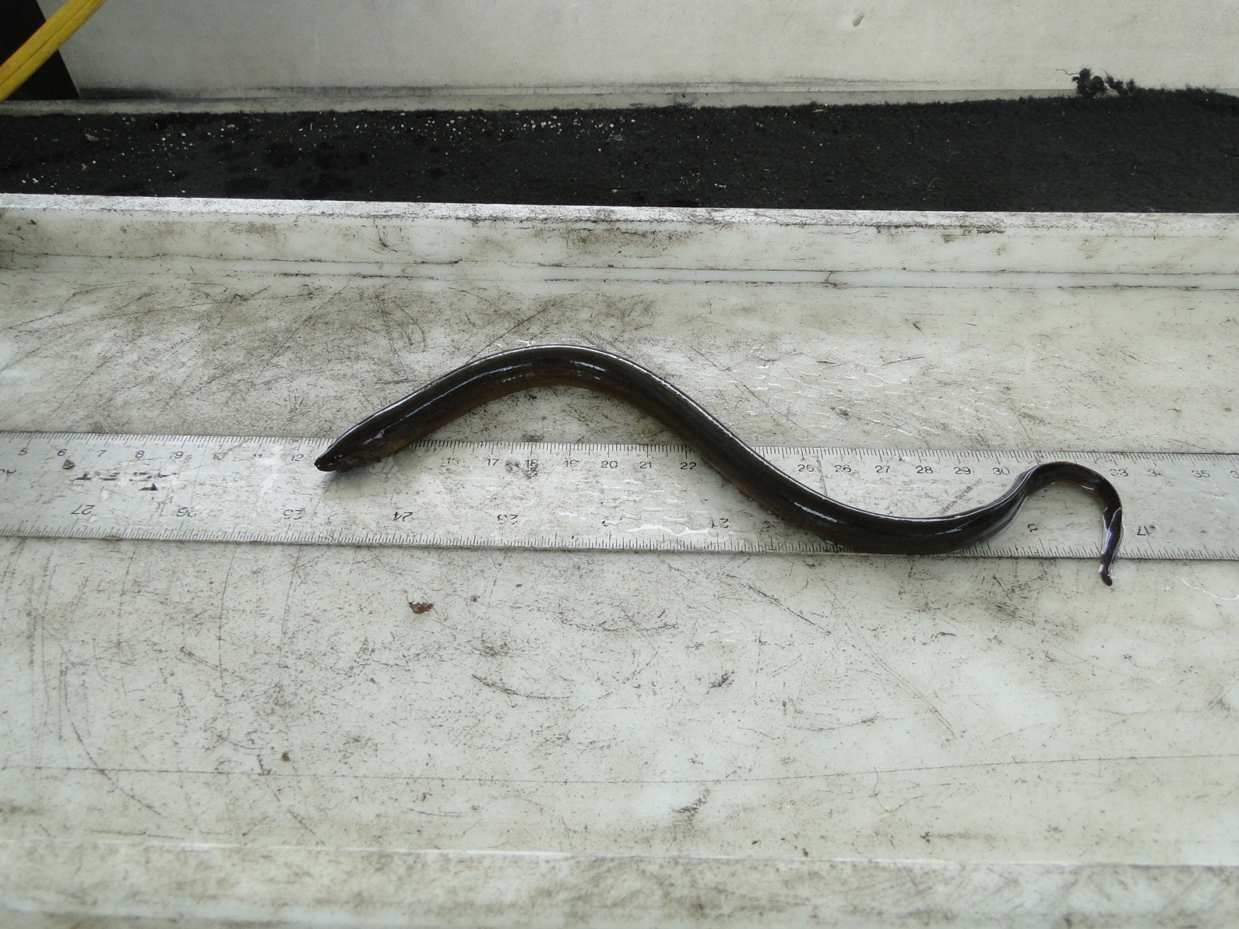
Asian Swamp Eel (Monopterus albus)
C-51W is approx. 45 miles north of
Snake Creek (C-9) Canal (formerly the
Northernmost collection site)
SWEE not strong upstream swimmers, not caught by anglers,
not a popular aquarium fish
How did they get here? Live fish market release?
Run DNA to determine if from one of three known Florida
populations

Slide 35
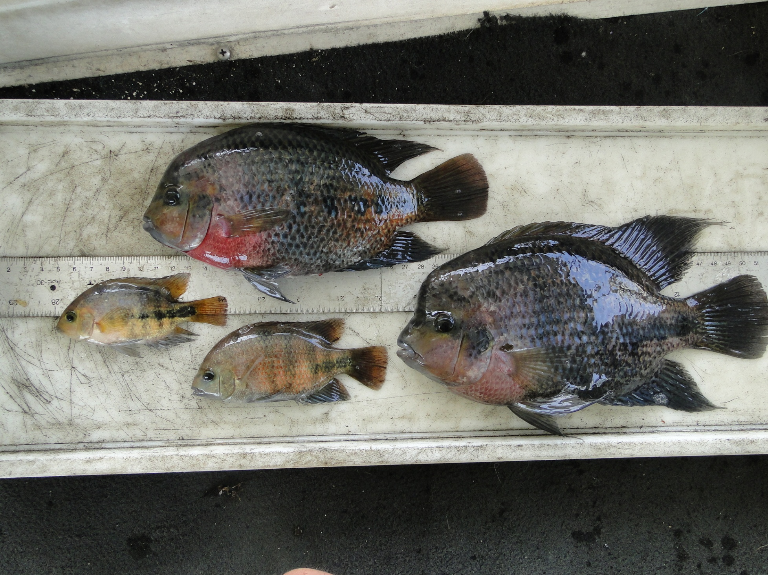
Paraneeotroplus sp. (Blackbelt cichlid)
First discovered in Biscayne Canal (C-8) in 2001 but present in low numbers.
Occasionally caught by anglers
C-51W site is approx. 50 miles from C-8 Canal

Slide 36
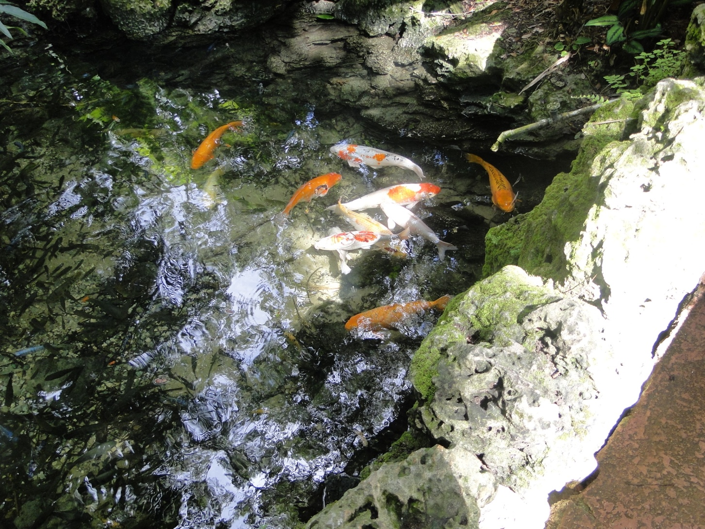
Pinecrest Gardens (formerly Parrot Jungle)
Site has long history of illegal terrestrial and aquatic nonnative species releases

Slide 37
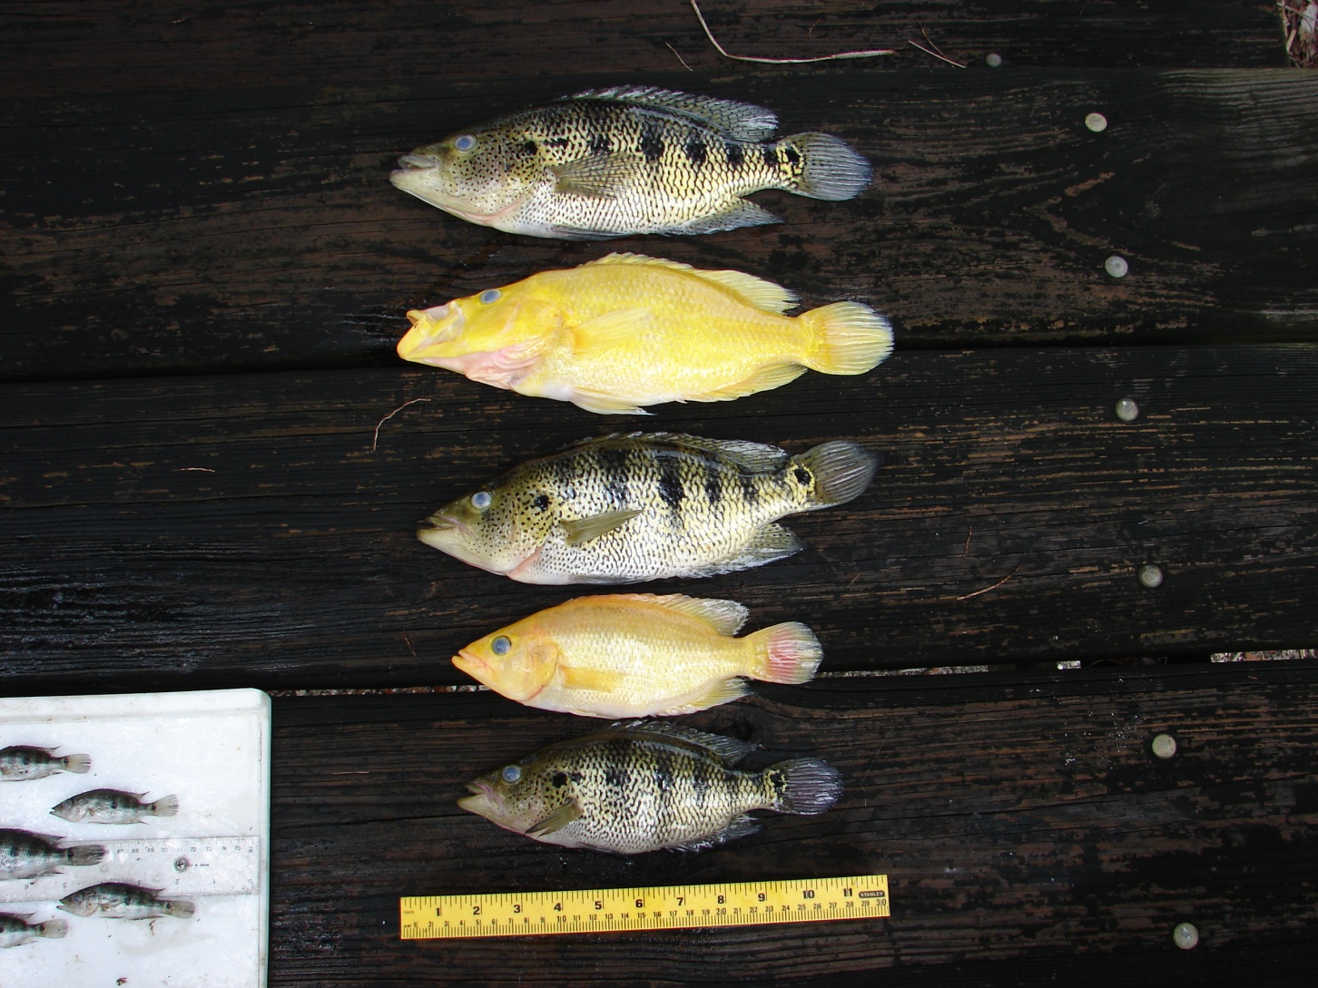
Petenia splendida (bay snook)
Central American cichlid
Freshwater lakes and rivers
Piscivorous
Max TL = 20 inches
Survived 2010 cold front
Salinity tolerance = ??
Brought to our attention by Jeff Kline (ENP)

Slide 38
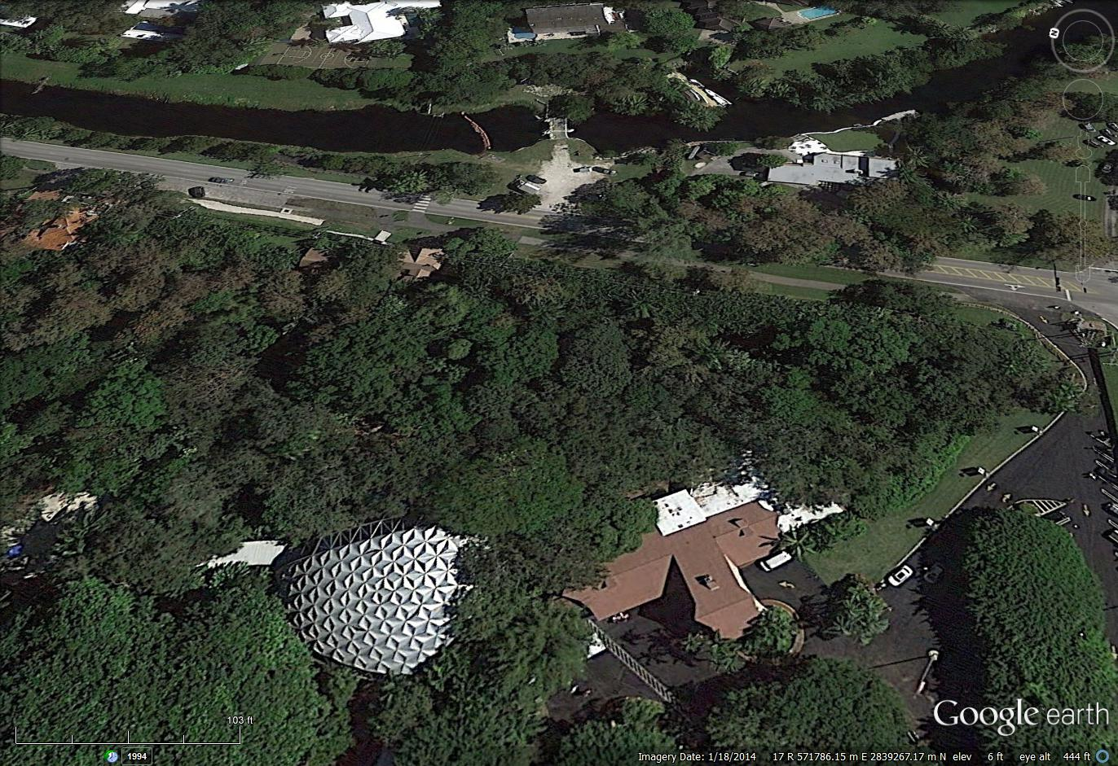
Pinecrest Gardens = former site of Parrot Jungle
Bay snook in Turtle Pond
Bay snook in entrance pond

Slide 39
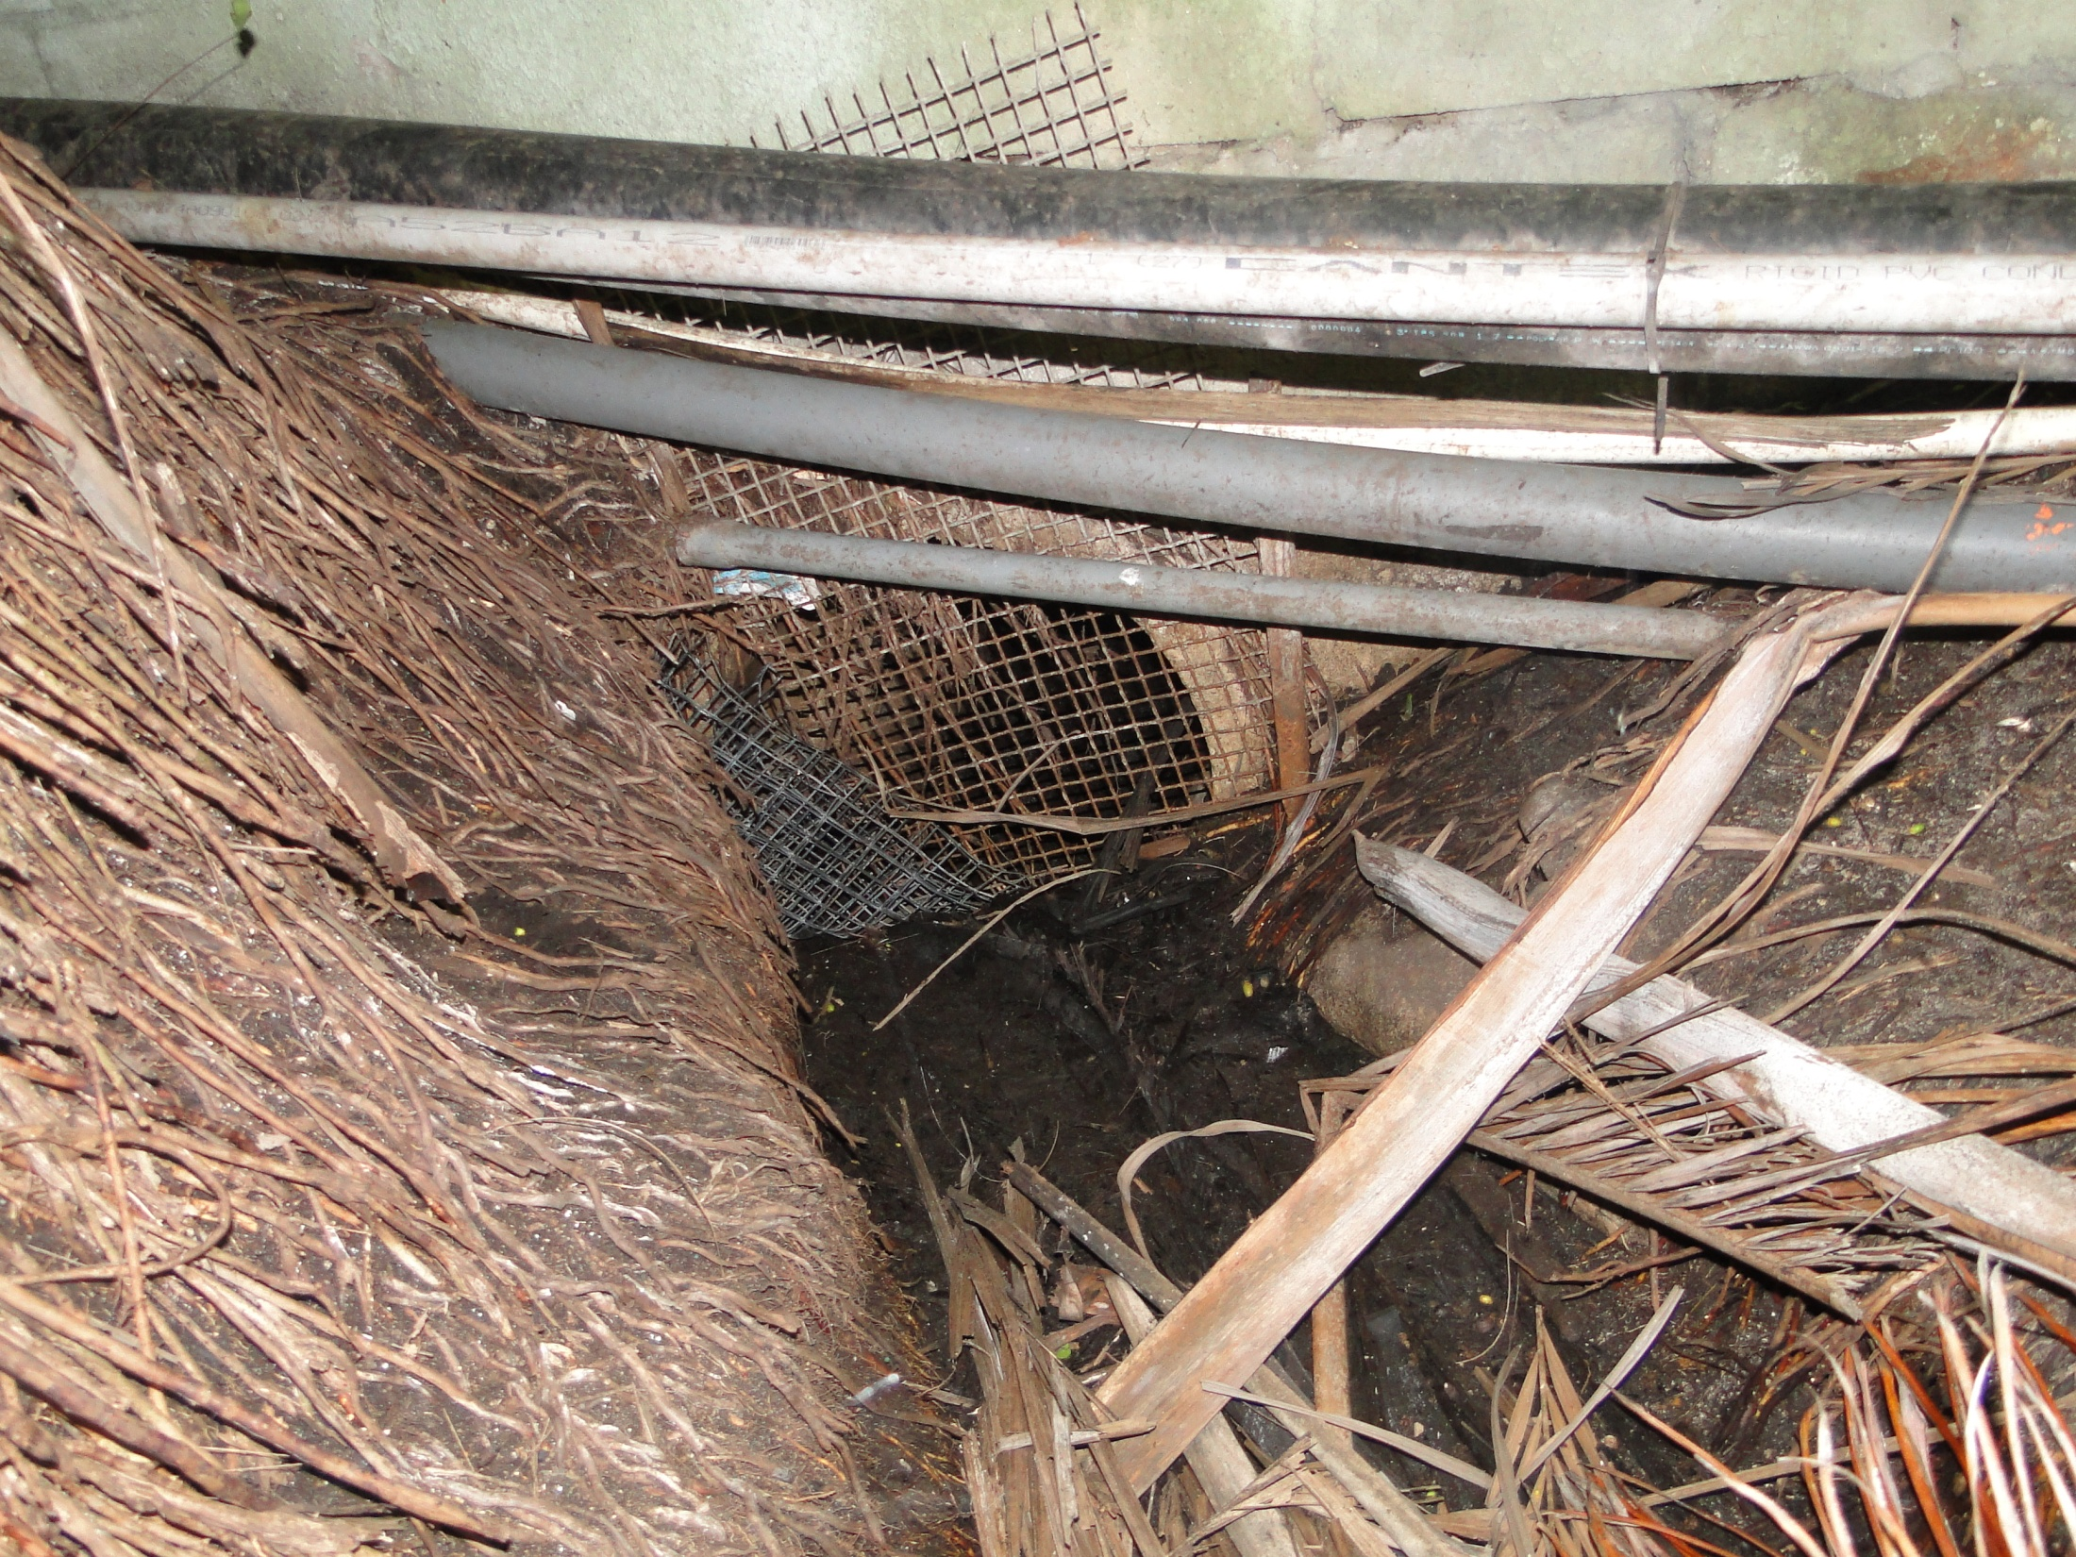
Pinecrest Gardens High Water Outflow

Slide 40
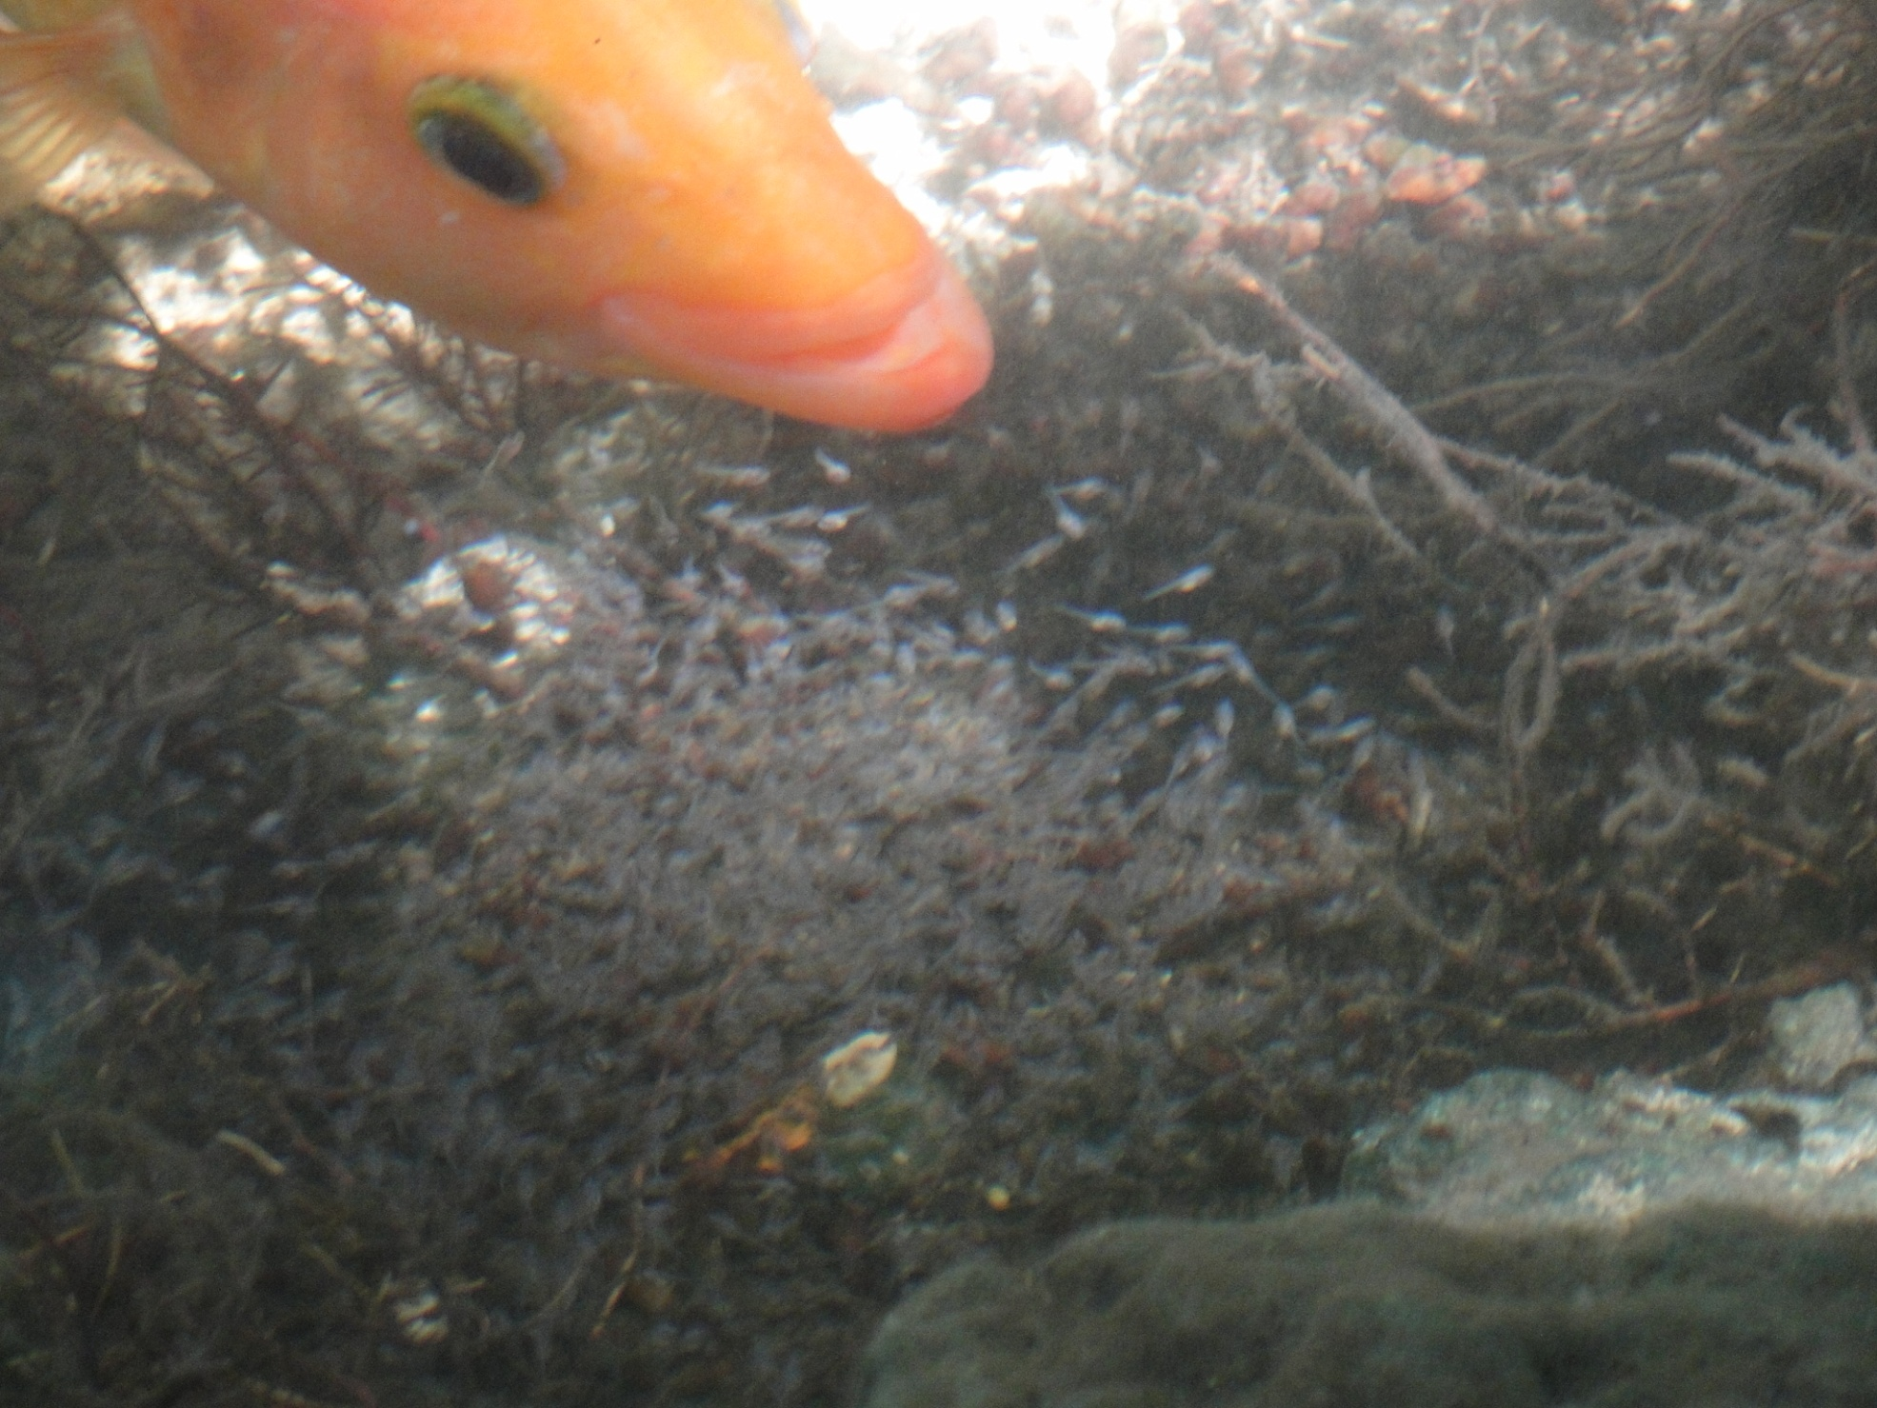

Slide 41
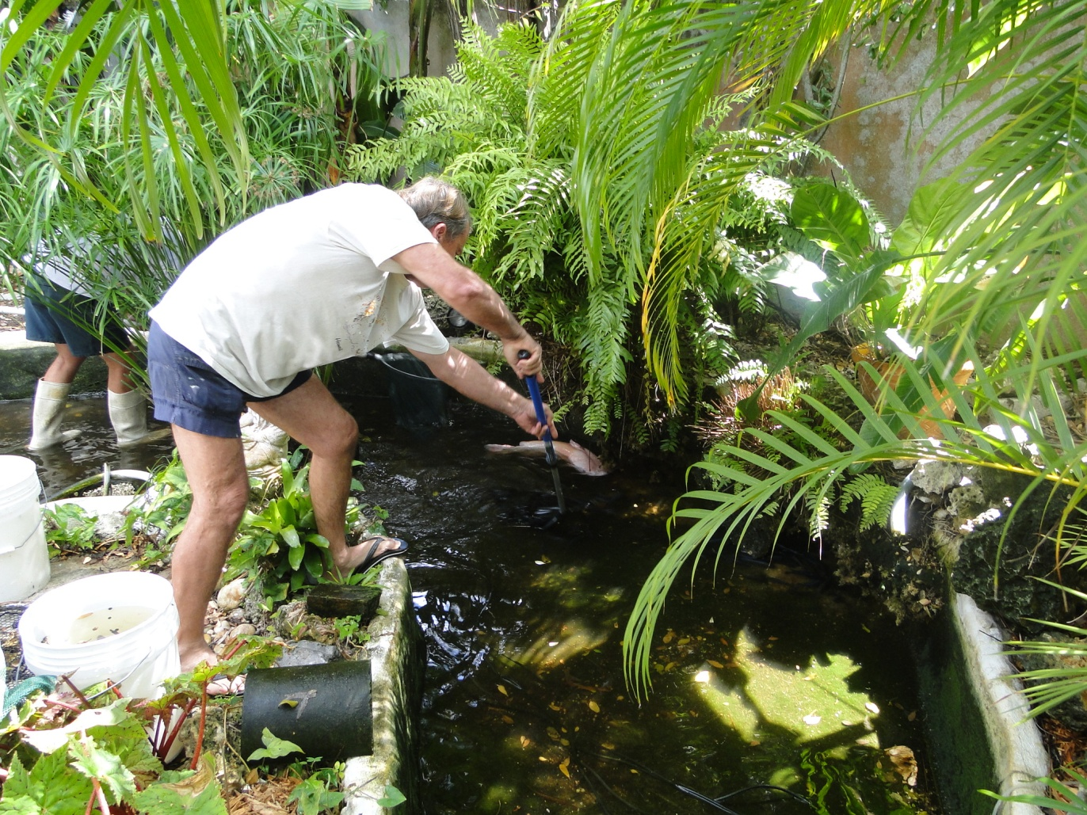
ECISMA Nonnative Fish Workday?
Objectives:
Remove as many Bay Snook as possible in 1-day effort.
Reduce biomass of unwanted nonnative fish, primarily spotted tilapia.

