Slide 1

Miccosukee Tribe of Indians of Florida
Rory Feeney
Fish and Wildlife Director

Slide 2
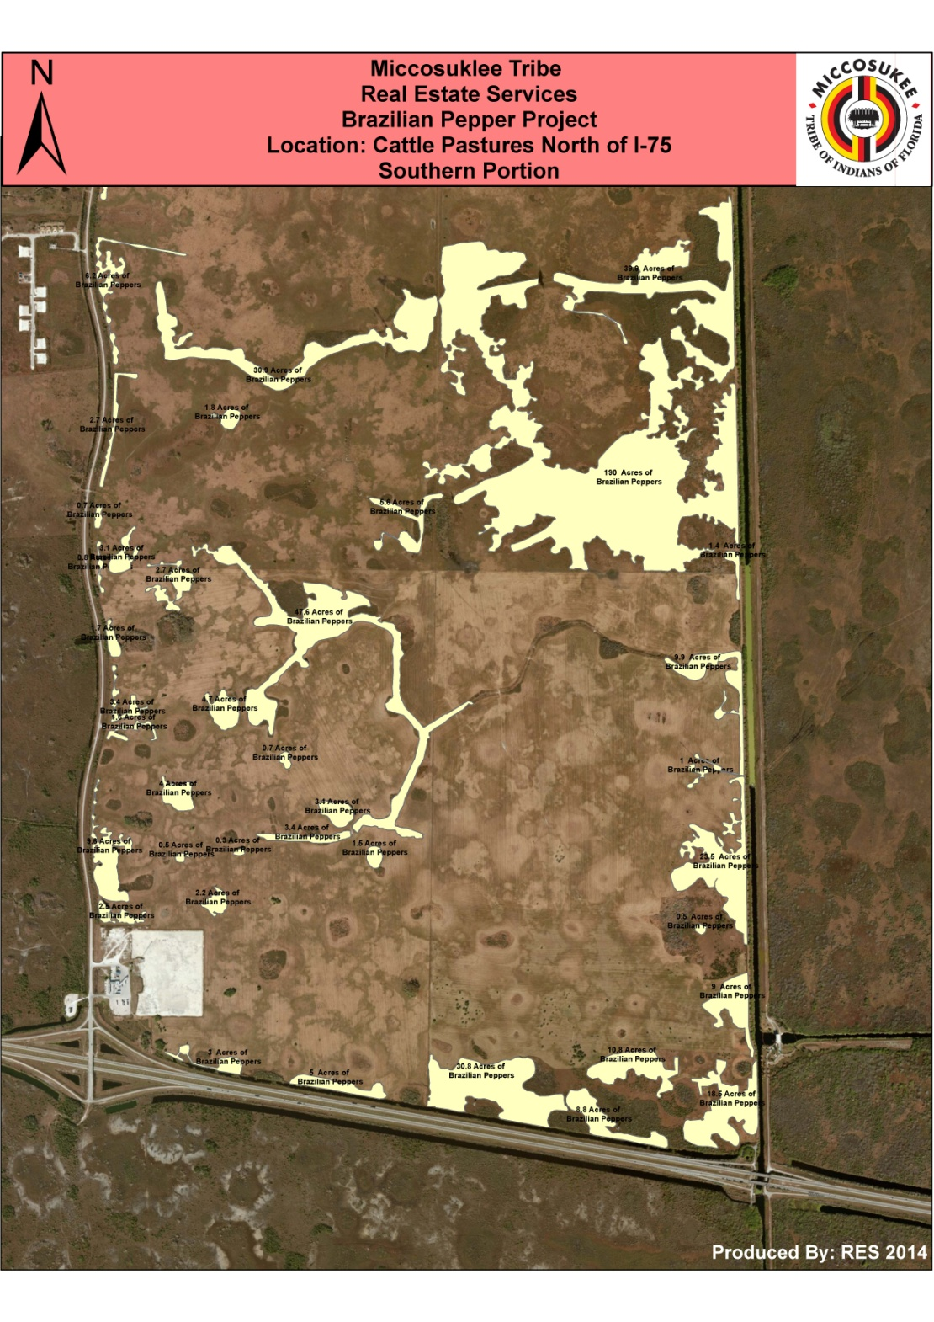
Brazilian Pepper Project on the Miccosukee Tribe’s Cattle Pastures treated approximately 560 acres of Schinus funded through Natural Resources Conservation Services.
BIA and Seminole Forestry conducted nearly 500 acres of Rx Fire.
Future plans to begin treating western side of Cattle Pastures.

Slide 3
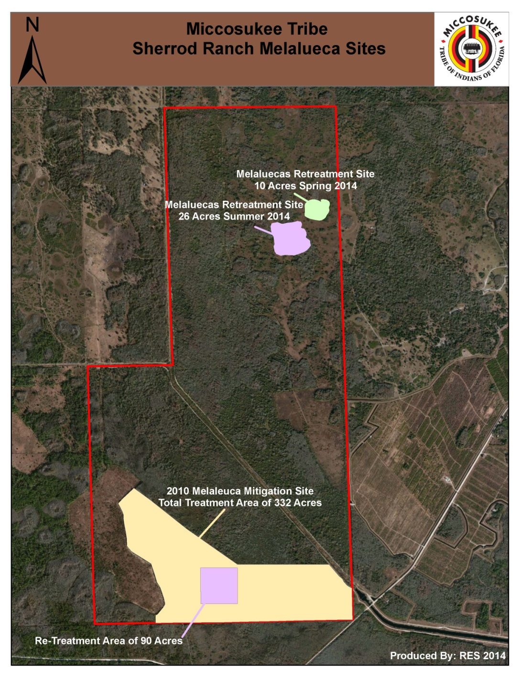
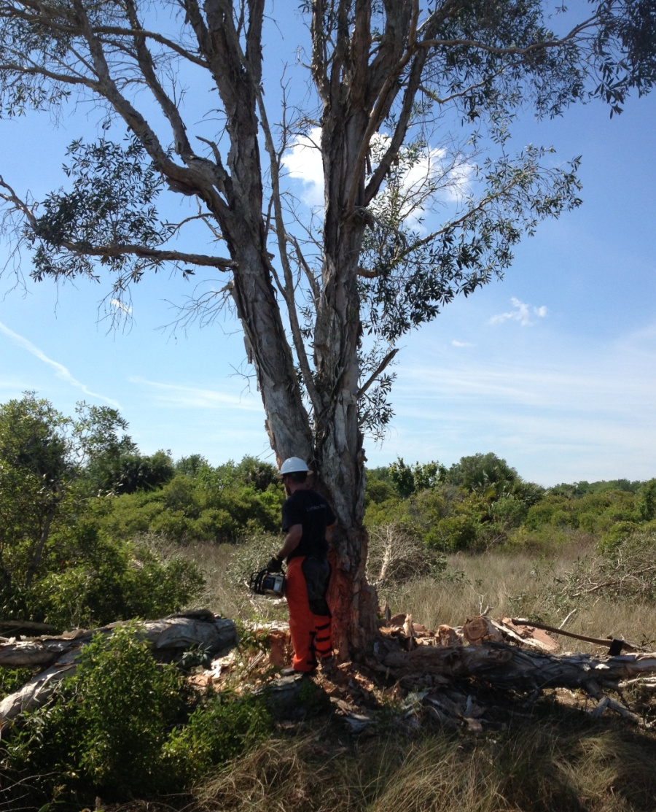
10 Acres of Melalueca were treated at Sherrod Ranch Reservation.
~116 Acres scheduled for retreatment this coming year.

Slide 4
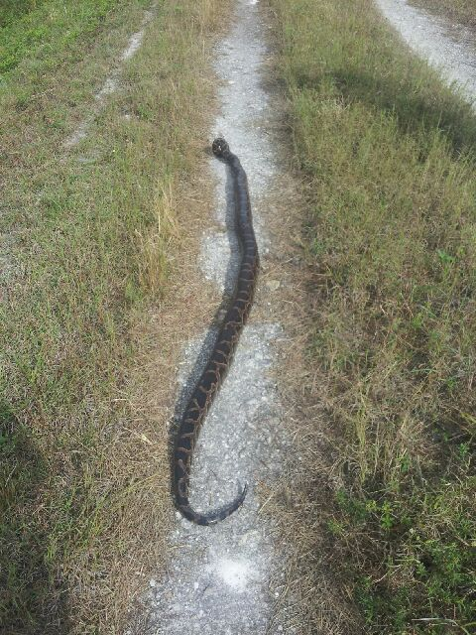
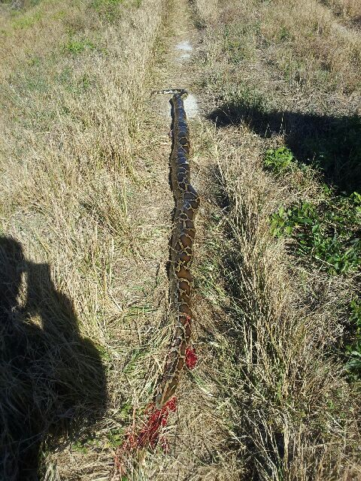
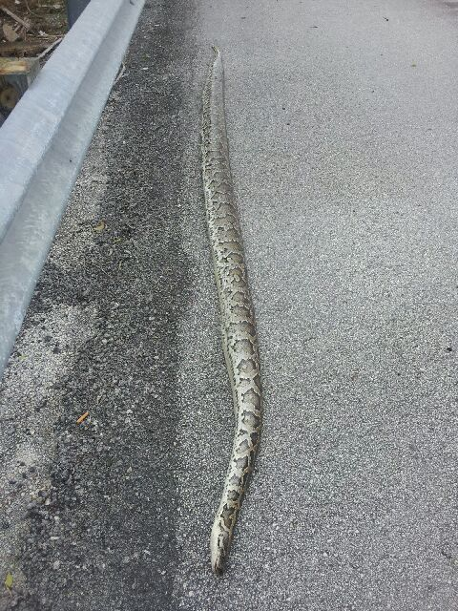
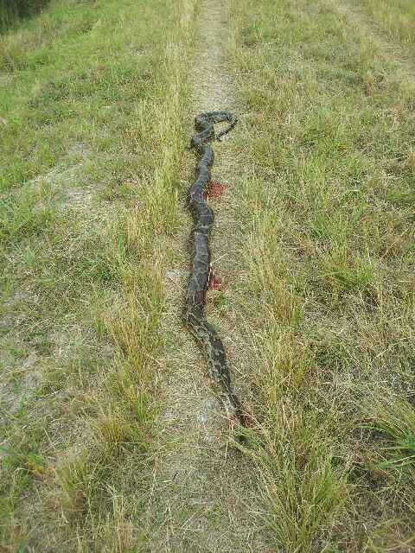
Pythons still a persistent problem…

Slide 5
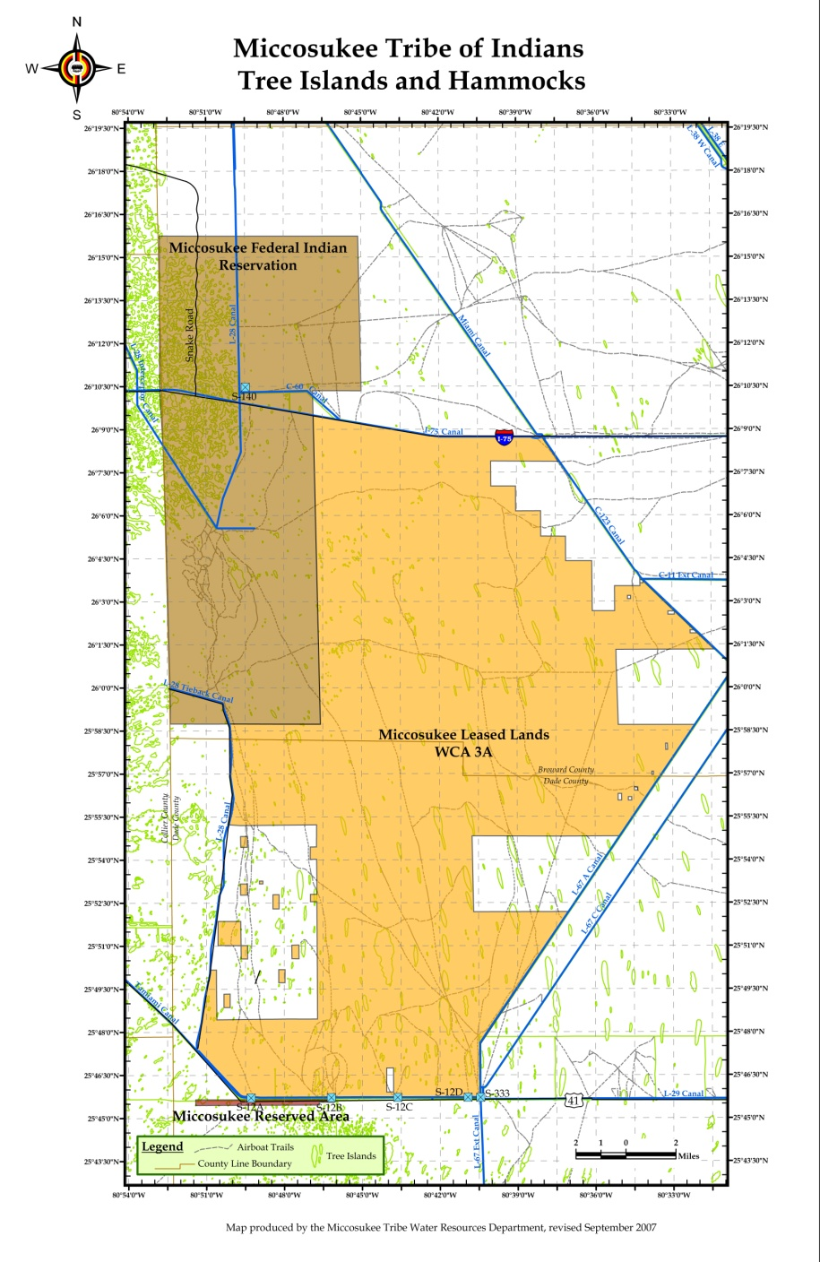
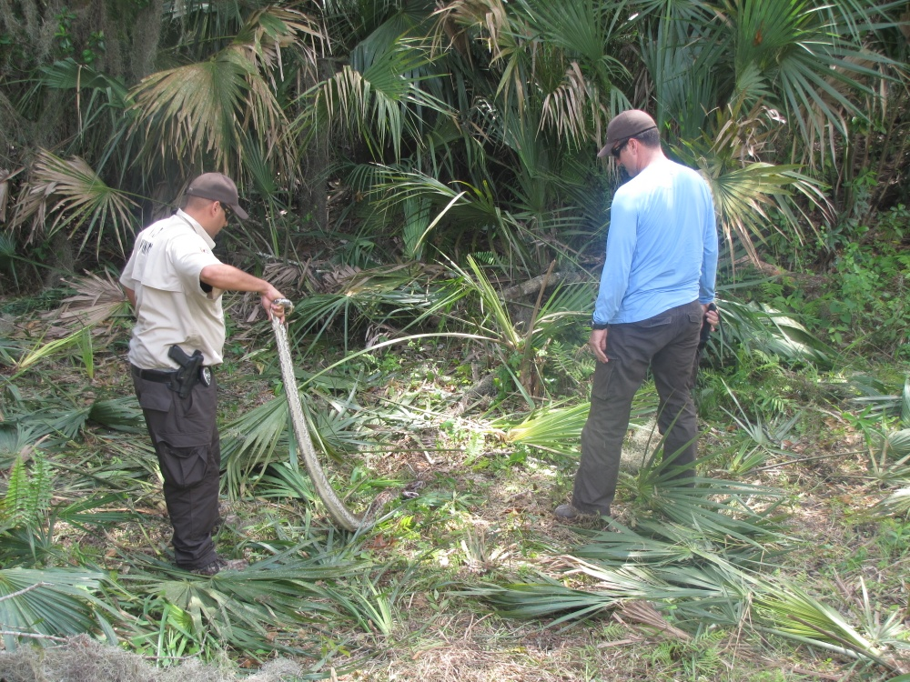
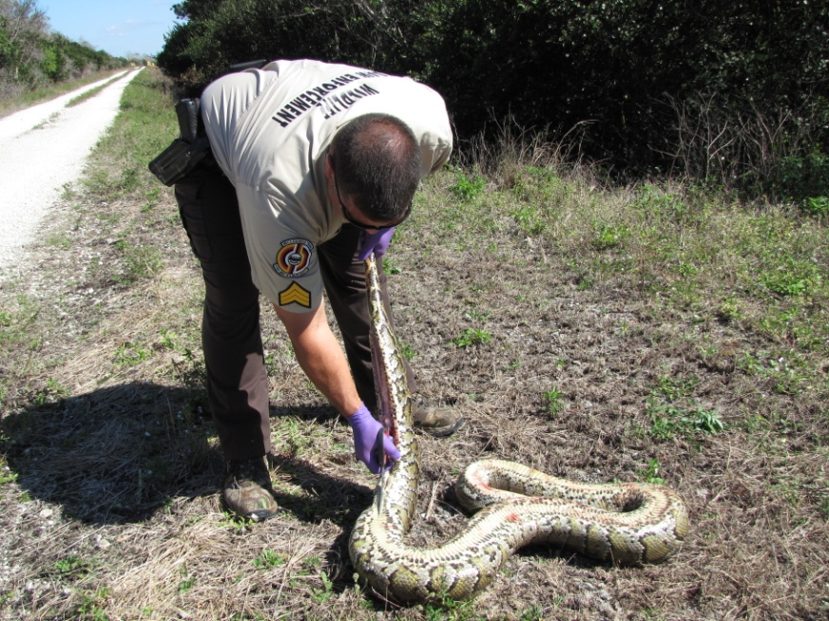

Slide 6
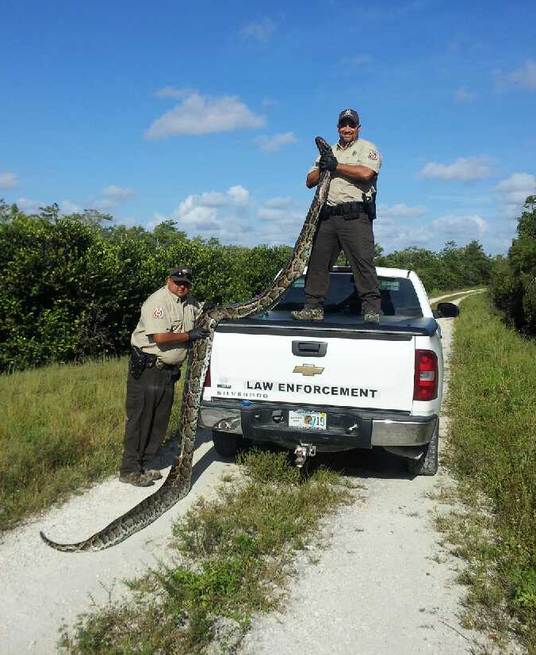
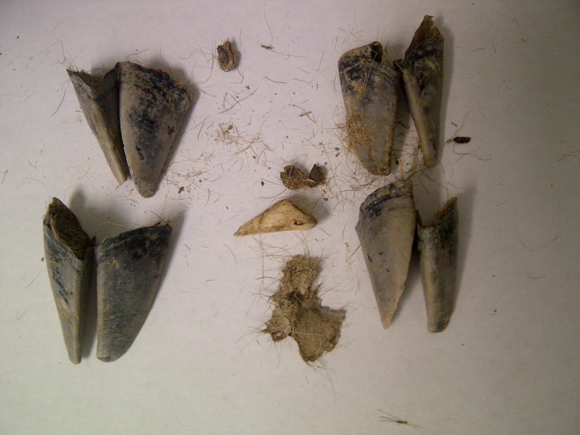
Seventeen+ foot Burmese Python
with remains of white tail deer found in stomach.

Slide 7
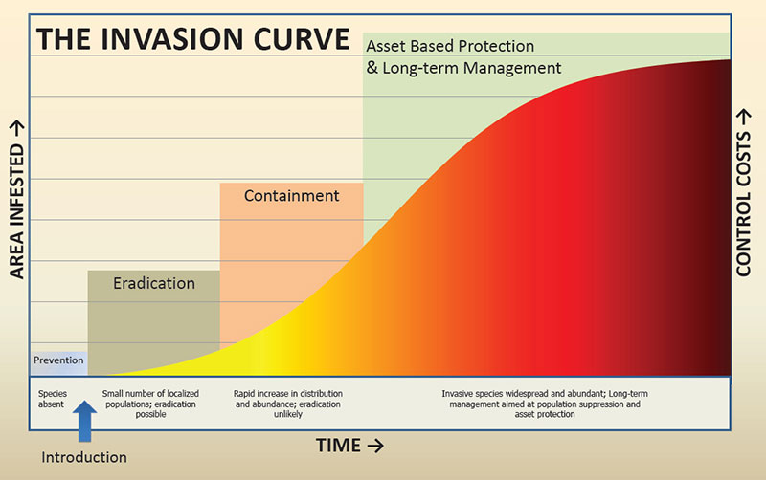
Cultural resources are in jeopardy
(for example: Swamp Bay/Laurel Wilt Disease)
Cultural resources

Slide 8
Bureau of Indian Affairs (BIA) steps up!
BIA has many programs and funds to support Indian Tribes across the country (i.e. Indian Housing, Health Care, Education, Law Enforcement and even Noxious Weeds) but nothing exists for Invasive Wildlife. So…lets start rockin’ the boat!
September 2011 discussions began with BIA to highlight the need for dedicated funding on the invasive exotic animal species issue in the Florida Everglades. The partnerships exist, but Tribes lack the capacity.
The Miccosukee Tribe has been the center of most of the invasive exotic species problems over the past decade. It is directly impacting their cultural way of life and is an epidemic they live with everyday.
The Miccosukee Tribe Fish and Wildlife staff emphasized the need for tools to manage the invasion from the inside out as well as containment on the periphery; while pushing for stronger legislation.
December 2012 after many talks regarding the Miccosukee’s needs for immediate funding on this issue as well as the greater lack of Federal Funding across Indian County, the Chief of Fish and Wildlife for the BIA out of Washington, DC arrived at the Miccosukee Reservation to meet with the elected officials to see and hear first hand the impacts to the Tribe’s way of life.
April 2013 the Bureau of Indian Affairs submits their Fiscal Year 2014 Budget to Congress with a $3 million line item dealing specifically with “Invasive Wildlife”.
February 2014 after a lengthy Continuing Resolution, Congress approves the additional funding to support all of Indian Country with their fight on Invasive Wildlife through a competitive grant process.
April 2014 the Miccosukee Tribe Business Council approves the submission of the Fish and Wildlife Department’s Invasive Species Action Plan and Initiatives (baseline data, boots on the ground, capacity).
June 2014 the BIA approves the Miccosukee Tribe’s application for Invasive Wildlife Funding ~$600k.
The check is in the mail. Lets get to work!!

Slide 9
Invasive Species Management – Methods Development and Application
Michael L. Avery and John S. Humphrey
USDA Wildlife Services
National Wildlife Research Center

Slide 10
Application of eDNA for Invasive Reptile Management
Burmese python methodology published (Piaggio et al. 2014. Molecular Ecology Resources 14:374-380).
Application began in May 2014.
Surveys follow EIRAMP routes; 25-km transects along Tamiami Trail and the L-5 Canal (near Loxahatchee NWR).
Repeat the sampling every 3 months.
Water samples to be analyzed at UF wildlife genetics lab, FL Museum of Natural History (Dr. Kenney Krysko).
Nile Monitor eDNA method development underway.

Slide 11
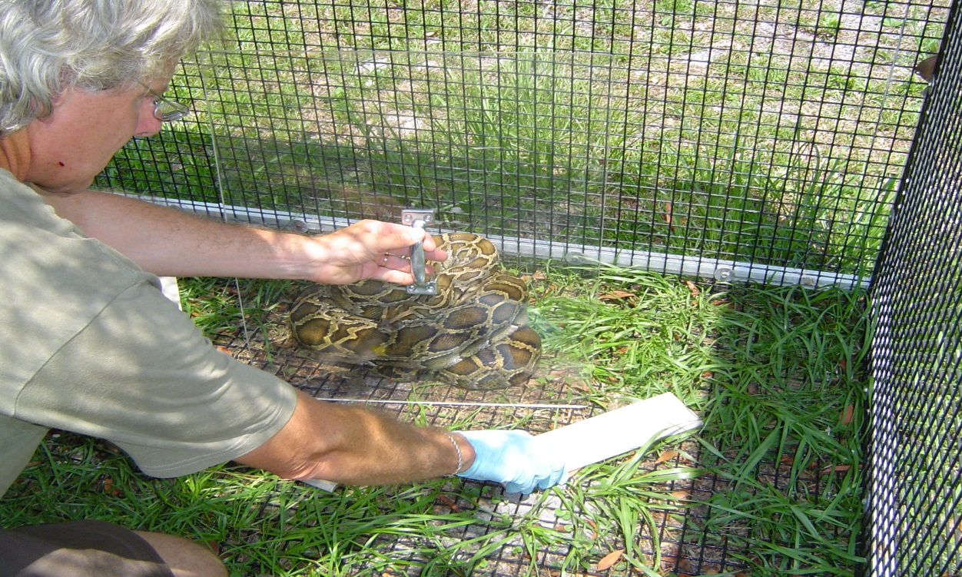
Chemical Communication in Pythons
Multi-year collaborative project with Dr. Rocky Parker (Washington & Lee University).
Extract, characterize python skin lipids in both sexes.
Identify distinct female compounds – pheromone.
Stimulate production of female compounds by implanting male snakes with estrogen.
Conduct bioassays to
document responses .
Eventually, field
evaluation.

Slide 12
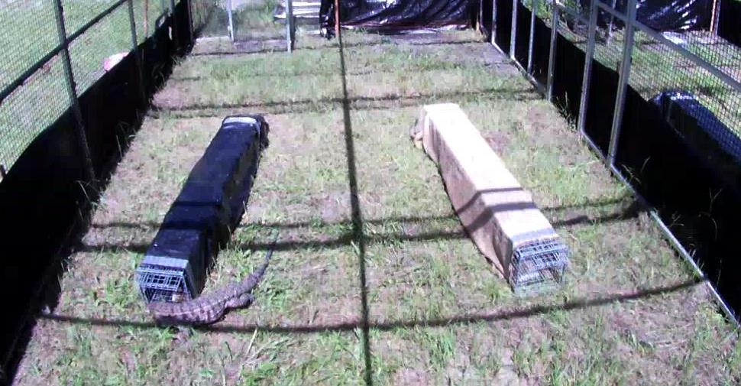
Black and White Tegu – Trap Tests and Seasonal Activity
Alternative trap and lure combinations compared to “standard” live trap/chicken egg method.
Too early to say if anything
will be more effective than
the standard approach.
Tegu movements in and out of burrows are also recorded to determine correlates of their activity with ambient environmental conditions and burrow temperature.

Slide 13
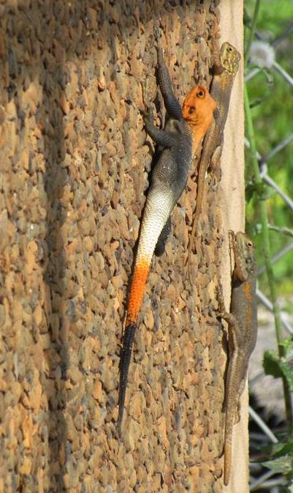
Genetic Analyses of Invasive Florida Reptile Populations
Cooperative agreement with UF Museum of Natural History (Dr. Kenney Krysko and grad student Leroy Nuñez) supporting three investigations:
Genetics of the FL Ctenosaura similis
populations to understand invasion
pathways and sources.
Similar analysis of Agama agama
populations.
Analyses of 12 unknown tissue samples
(sheds, eggs, bones) of large constrictors to
determine species; so far 8 are P. sebae,
1 is P. bivittatus, 3 TBD.

Slide 14
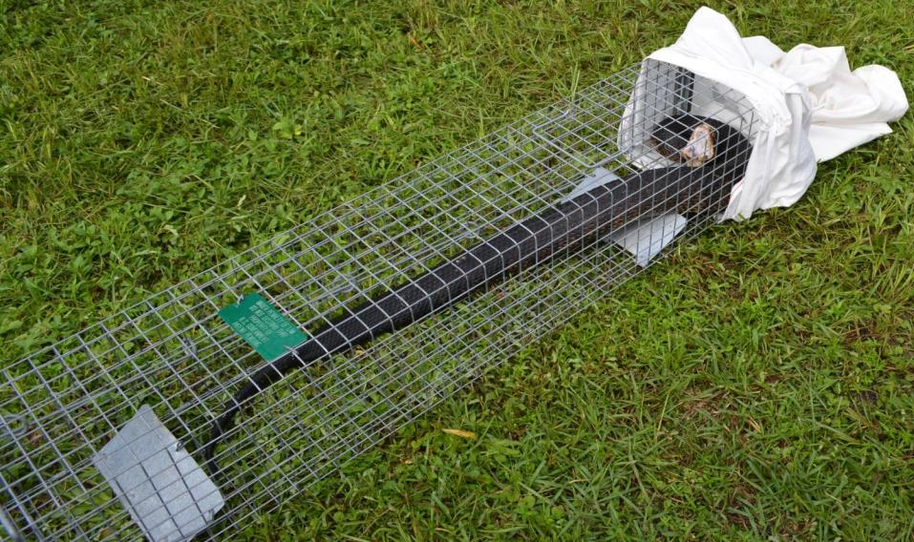
Python Trap Testing
Continuation of pen trials to identify more efficient, cost-effective trap methods.
Evaluation of attractants.
Evaluation of traps as refugia; not baited.
Verification of non-target exclusion when using new, patented large snake
trap design.

Slide 15
Metagenomics – Everglades Water
Metagenomics uses genome sequencing to identify all fragments of DNA in a single environmental sample.
Potentially powerful tool for detecting species that are found in low numbers and/or are difficult to detect through traditional field methods.
Water samples from 4 locations were analyzed using the Titan supercomputer at Oak Ridge National Laboratory.
Tentative identifications were made on thousands of taxa from viruses to birds and mammals. These include many disease organisms and invasive species.
Positive taxonomic identifications require specific genetic verifications which have yet to be performed.

