Slide 1
INVASIVE ANIMAL OPERATIONS UPDATES
Invertebrates: Laurel Wilt and Giant African Snails
Andrew Derksen
FDACS
Andrew Derksen, FDACS 2014

Slide 2
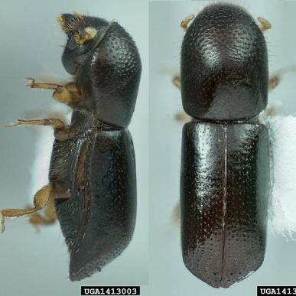
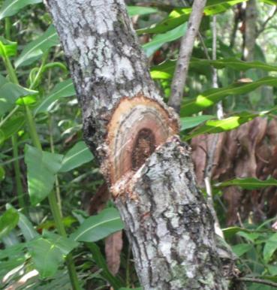
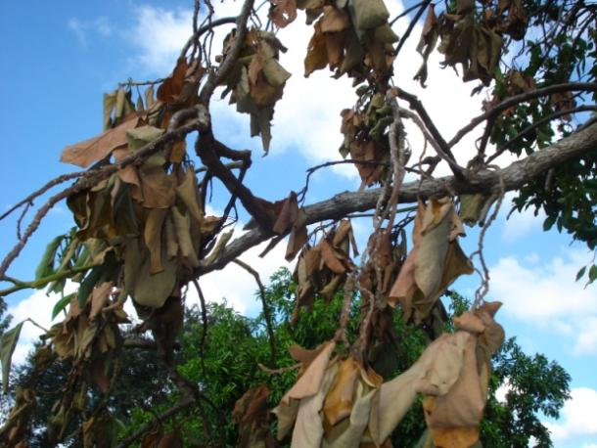
Laurel Wilt (Raffaelea lauricola)
Vascular fungus
Primary vector is
redbay ambrosia beetle (Xyleborus glabratus)
Lethal to Lauraceae
Redbay (Persea borbonia)
Swampbay (Persea palustris)
Avocado (Persea americana)
(Clockwise from left)
Mike Thomas, FDACS 2008
LeRoy Rodgers, SFWMD 2013
Andrew Derksen, FDACS 2010

Slide 3
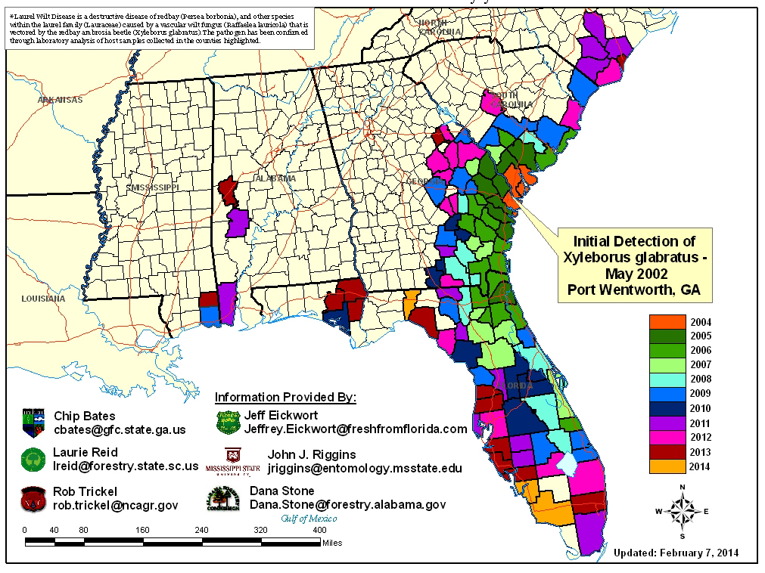
Laurel Wilt

Slide 4
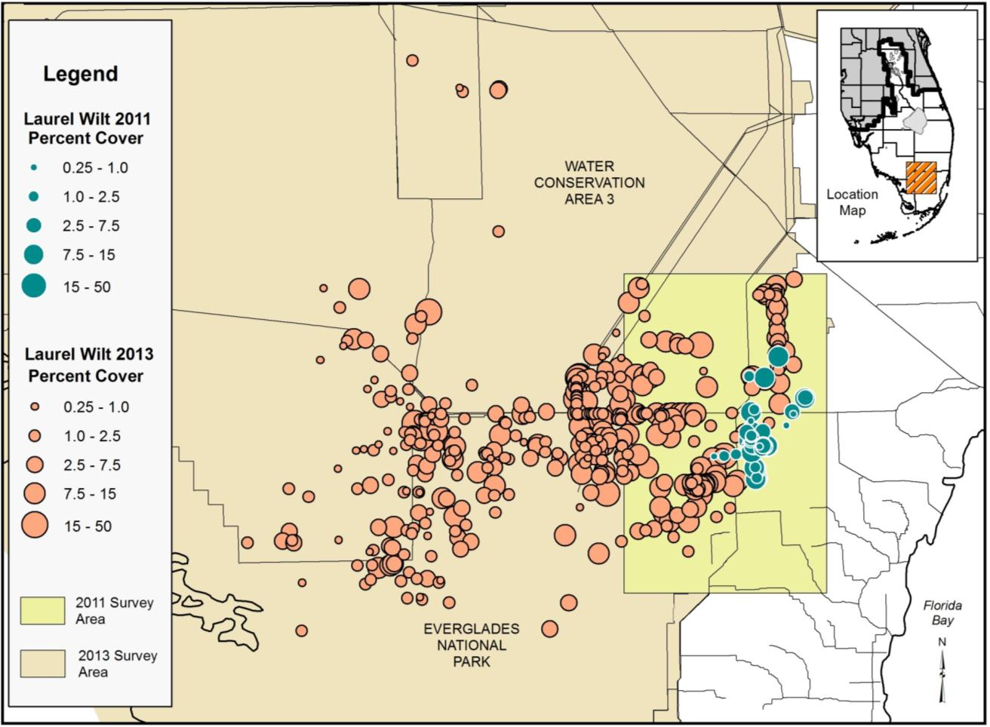
Distribution of Laurel Wilt in 2011 and 2013
~133,740+ ha
LeRoy Rodgers, SFWMD 2014

Slide 5
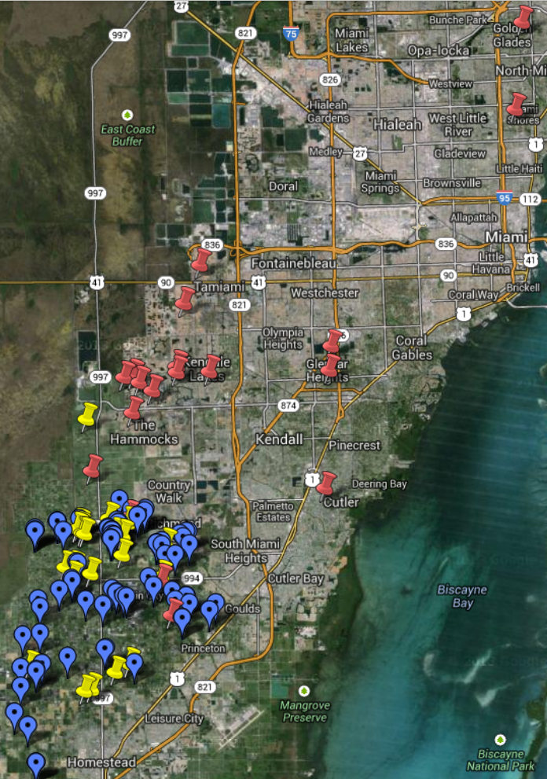
Laurel Wilt
FEB 2014
Commercial
3000+ avocado trees removed
Residential
200+ symptomatic avocado or bay trees
Don Pybas, FLAC 2014

Slide 6

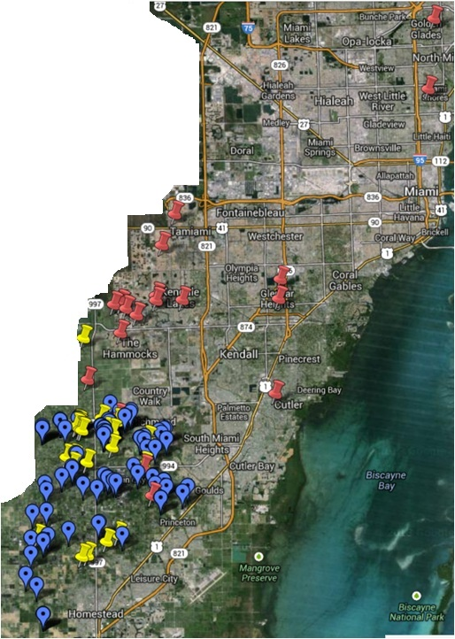

Slide 7
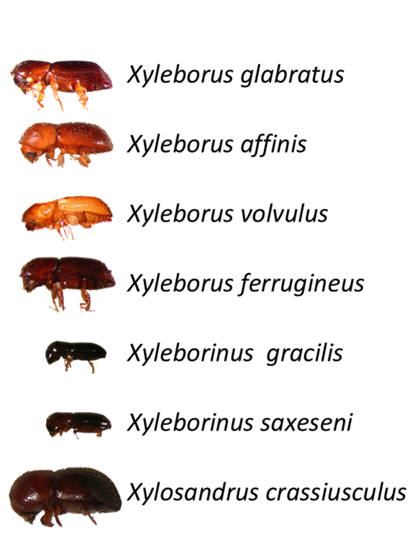
Laurel Wilt
Daniel Carrillo, UFlorida 2013
Seven vector species
Low rate of transmission
May have different hosts
Unknown what f/x this will have on other hosts
Watch for surprises

Slide 8
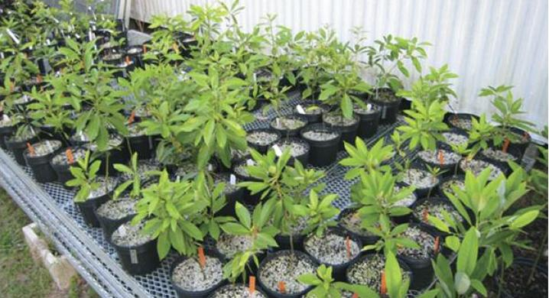
Laurel Wilt
Marc Hughes, UFlorida 2014
Searching for resistant strains of redbay
Survivors taken from twelve field sites in FL, GA, SC
Method for propagation as cuttings developed

Slide 9
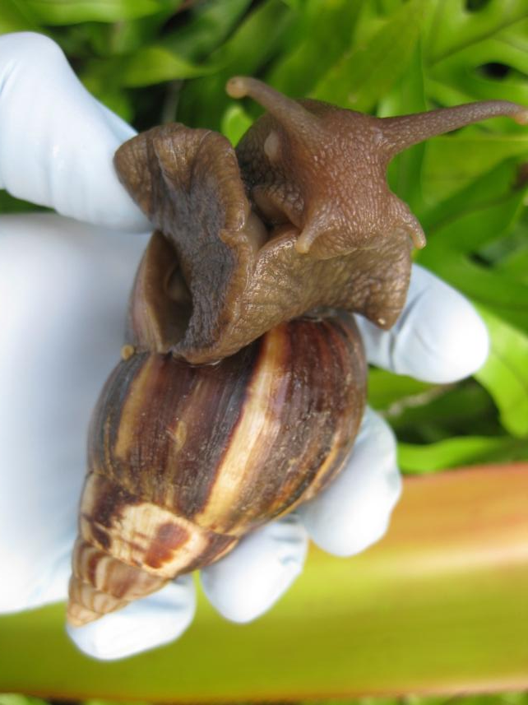
Giant African Snail (Lissachatina fulica)
Broadly polyphagous
Rapid developmental cycle
Sexual maturity in six months
45 viable eggs per month
Vectors rat lungworm (Angiostrongylus spp.)
Andrew Derksen, FDACS 2011

Slide 10
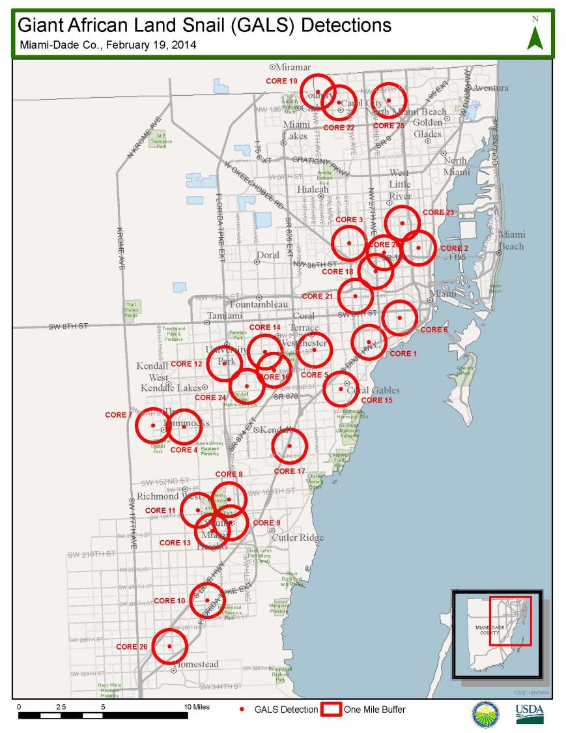
Giant African Snail
Holding at 26 cores
No new detections since February 2014
643 properties (13%) remaining with positive detections within the last nine months
4,304 properties (87%) surveyed have not had a detection for more than nine months
2,523 (51%) clean for two years or more

Slide 11
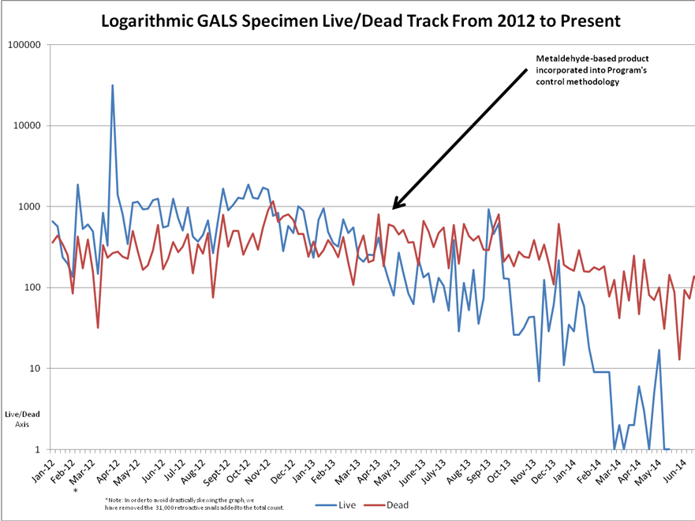
Overall collections are down
Dead collections exceed live collections
Most recovered are small juveniles
Julio Rodriguez, FDACS 2014

Slide 12
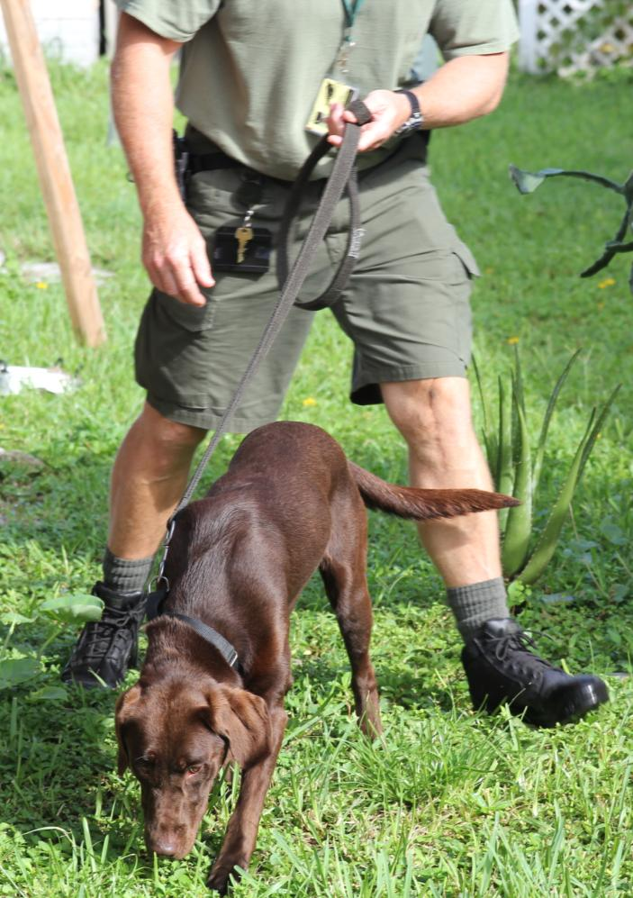
Giant African Snail
Two detector dogs have been added to program
Detect Lissachatina
At low frequencies
Underground
Allows for
Targeted application of force
Higher confidence in negative results on helpline calls
Julio Rodriguez, FDACS 2014

Slide 13
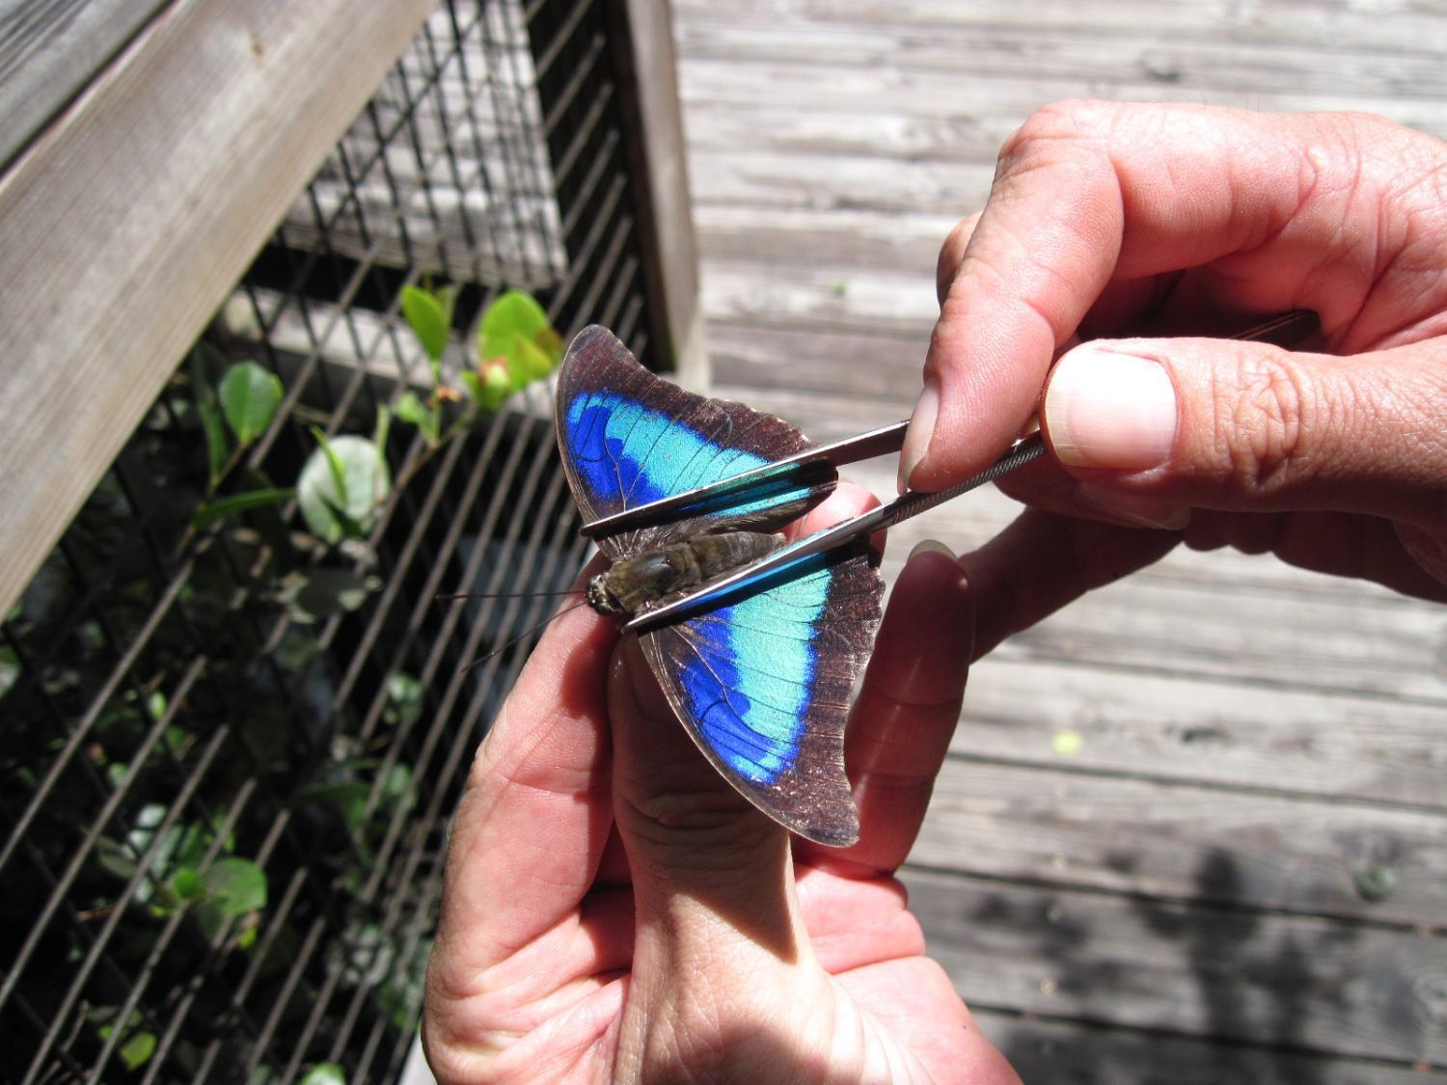
Questions?
Michelle DaCosta, FDACS 2013

