Slide 1
ECISMA Outreach 2013 – 2014
Erica Skolte, U.S. Army Corps of Engineers
Jenny Novak, Florida Fish and Wildlife Conservation Commission

Slide 2
New Outreach Committee Chair
Erica Skolte
Public Affairs Specialist
U.S. Army Corps of Engineers, West Palm Beach
561-472-8893
Erica.A.Skolte@usace.army.mil

Slide 3
Innovations and Successes
Fabulous new handouts
Python Patrol grant for snake boxes
Direct door mailing for Gambian pouched rats
Snazzy skin for Exotic Pet Amnesty trailer
Plans to create Python Patrol responders, complete with Google map
Plans to automate exotic pet adoption process

Slide 4
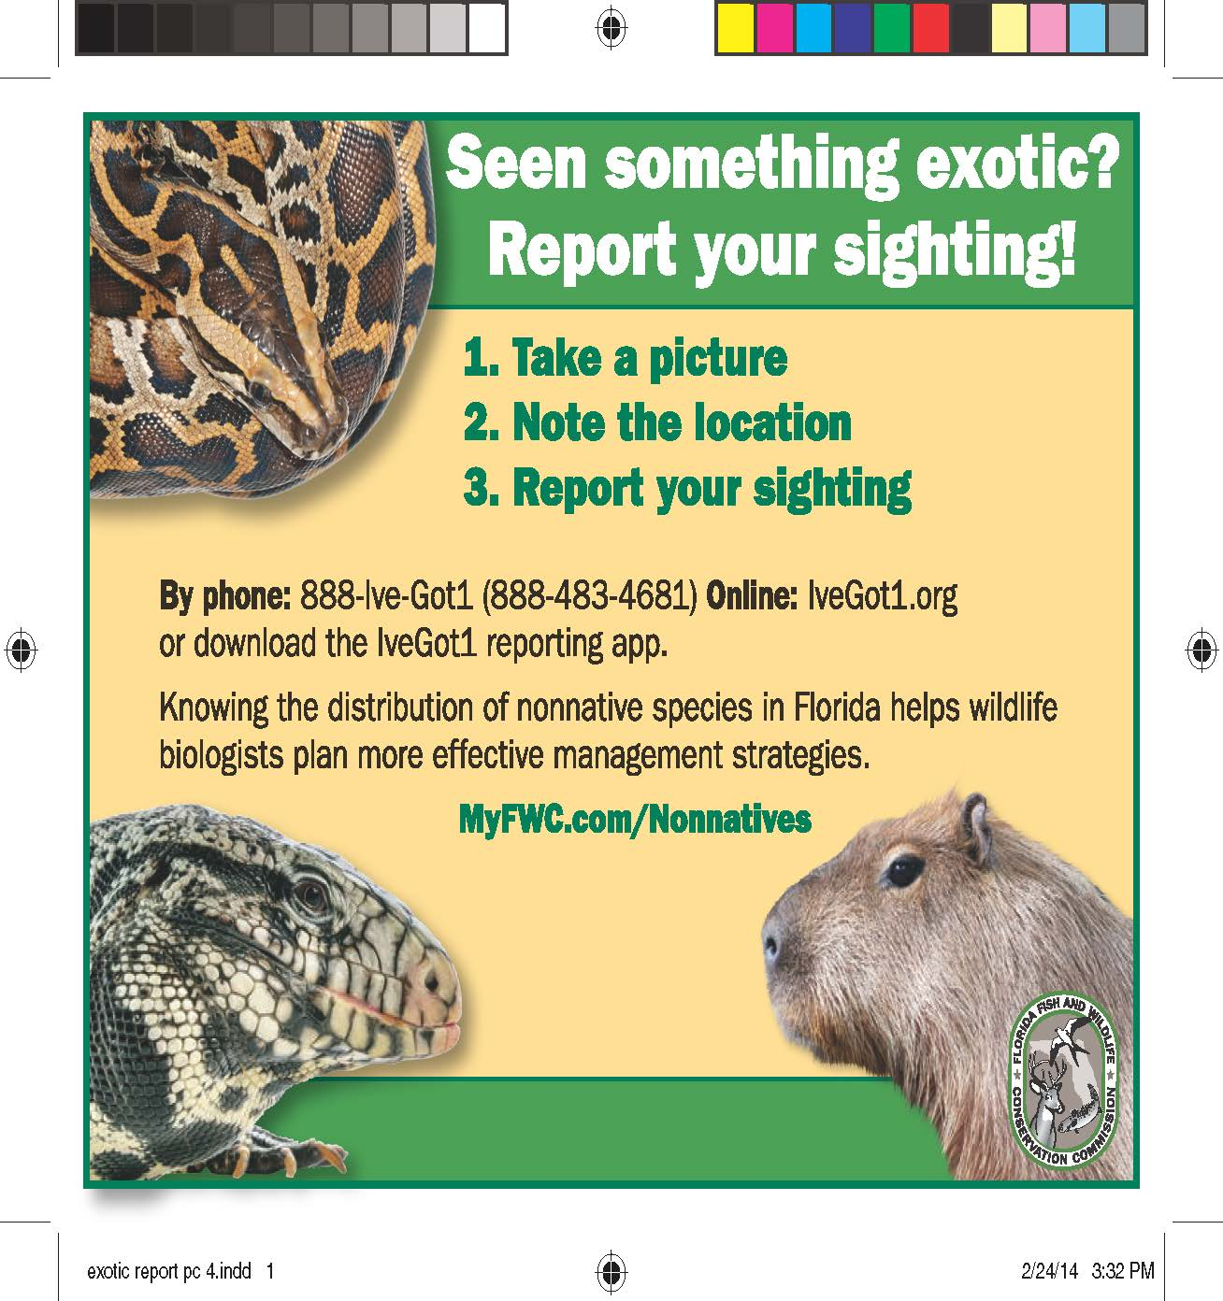
Publications and Products
Outreach postcard created mainly for dispatch and call centers, with information on how to make useful and credible exotic species reports
Notes:
This outreach ‘postcard’ was created to be used as a easy reference for dispatch and call centers as well as being a simple, eye-catching handout which features specific information on how to make a credible and useful report.

Slide 5
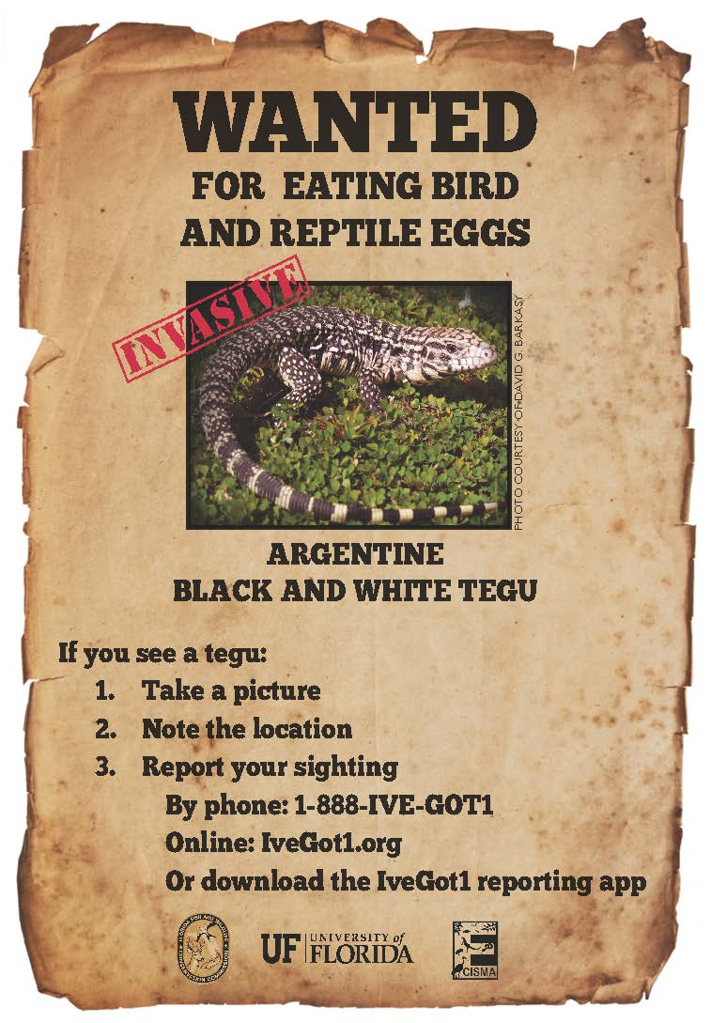
Tegu poster designed to be posted in areas where tegus are established, with information on making useful tegu reports
Notes:
This poster was created with the intention of having them displayed in some key areas where tegus are established, such as restaurants, gas stations, toll booths, etc. Like many of our outreach items. The purpose of this poster is to generate more useful, credible sighting reports.

Slide 6

Gambian rat poster designed for an Every Door Direct Mailing on Grassy Key that was used to raise awareness and increase verifiable reports
Notes:
This handout was created specifically for an Every Door Direct Mailing on Grassy Key. The intention of this flyer and the mailing was to raise awareness in the area on what people should be looking out for and to increase verifiable reports in the area.

Slide 7
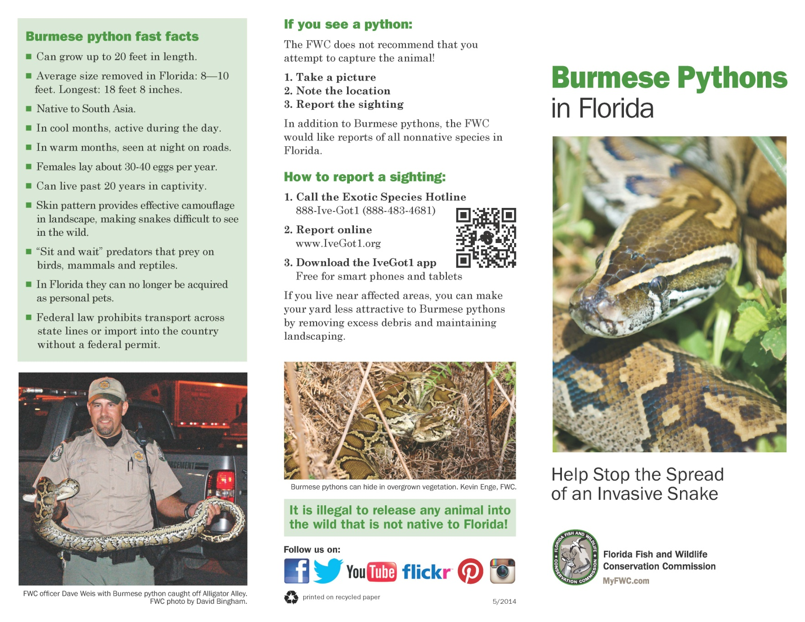
Burmese python brochure that consolidates
information into one handout
Notes:
This outreach item was created to consolidate information on Burmese pythons into one ‘easy to reference’ brochure. This item should assist in outreach events where the general public is interested in learning information specific to the ‘python problem’ in Florida.

Slide 8
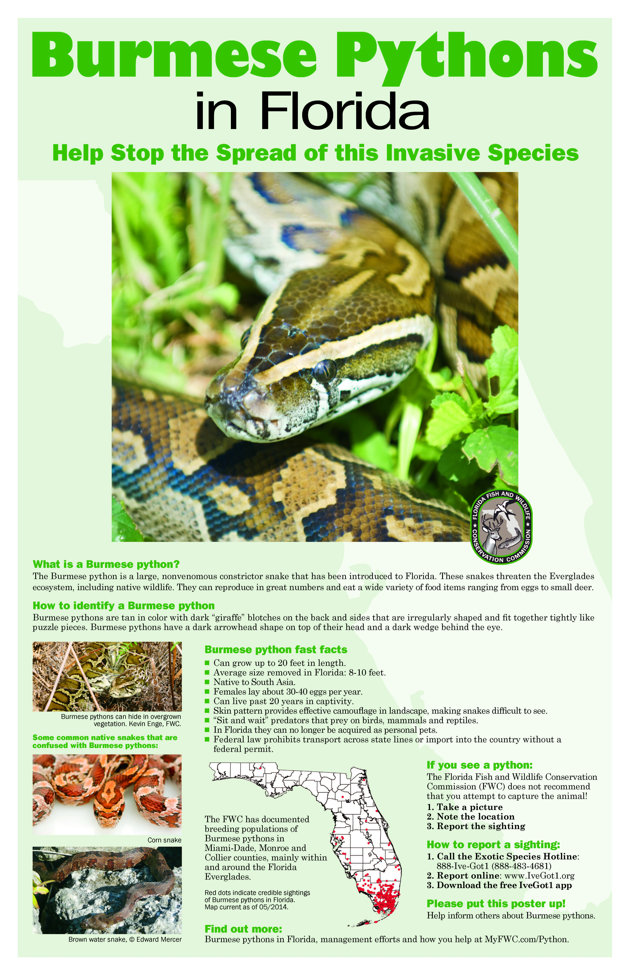
Burmese python poster, developed from the brochure, designed as an 11” x 17” newsletter poster and available to print from the FWC web site
Notes:
Using information from the python brochure (previously shown) this poster was created to be printed as an 11 * 17 poster in a newsletter. In addition to its use in the newsletter, this poster will be available for print off of our webpage.

Slide 9

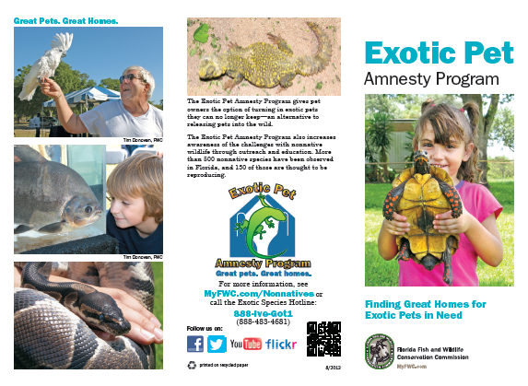
Exotic Pet Amnesty Program brochures to promote the program and help recruit adopters
Notes:
Two brochures highlighting the Exotic Pet Amnesty Program were completed. One brochure contains general information about the program and the other focuses on recruiting new adopters to the program. These brochures are intended for use in outreach events and display at veterinary offices and clinics.

Slide 10
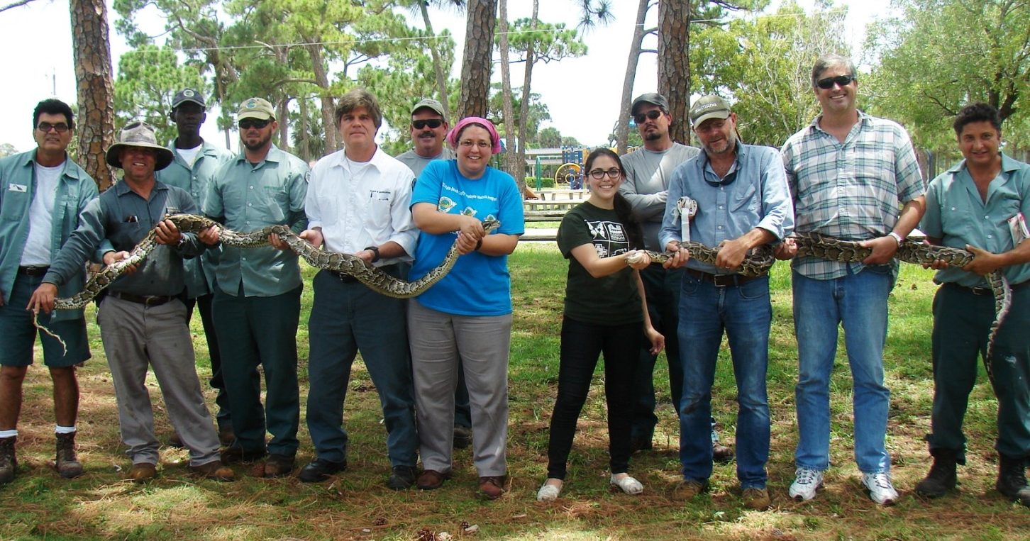
Python Patrol
Since November 2013, 20 training workshops
have been held for over 350 participants
Notes:
Since November 2013, 20 training workshops and 346 participants

Slide 11
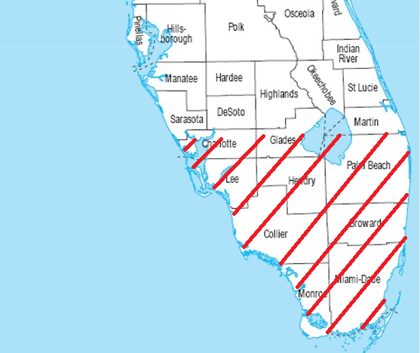
Python Patrol is building an EDRR network
of trained participants throughout south Florida
Notes:
Program is working towards building an EDRR network of trained participants throughout south and southwest Florida

Slide 12
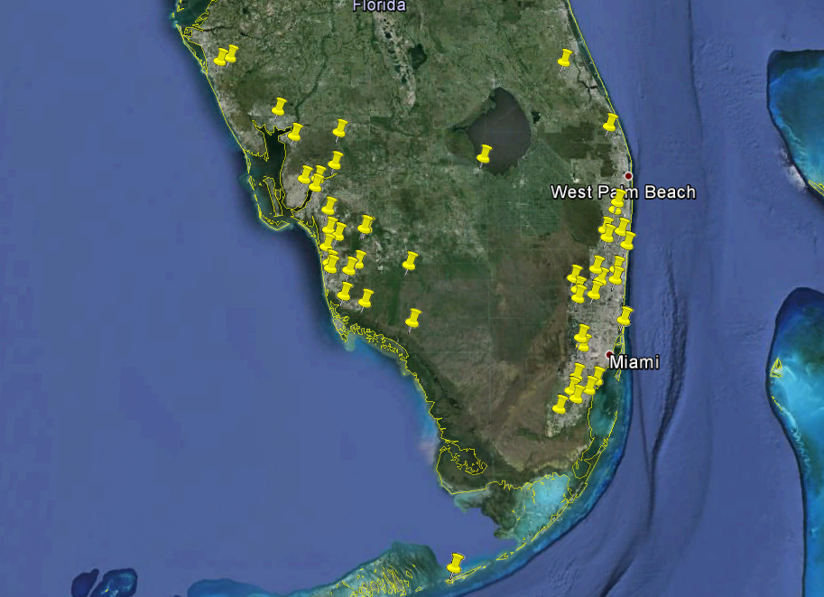
Python Patrol is also working to create a subgroup of trained FWC Hotline responders
Notes:
Working to create a subgroup of trained FWC Hotline responders

Slide 13

Python Patrol has received a grant from the MN Zoo; funds will be used to purchase transport boxes for pythons
Notes:
Python patrol has received a grant from the MN Zoo; funds will be used to purchase transport boxes for pythons

Slide 14
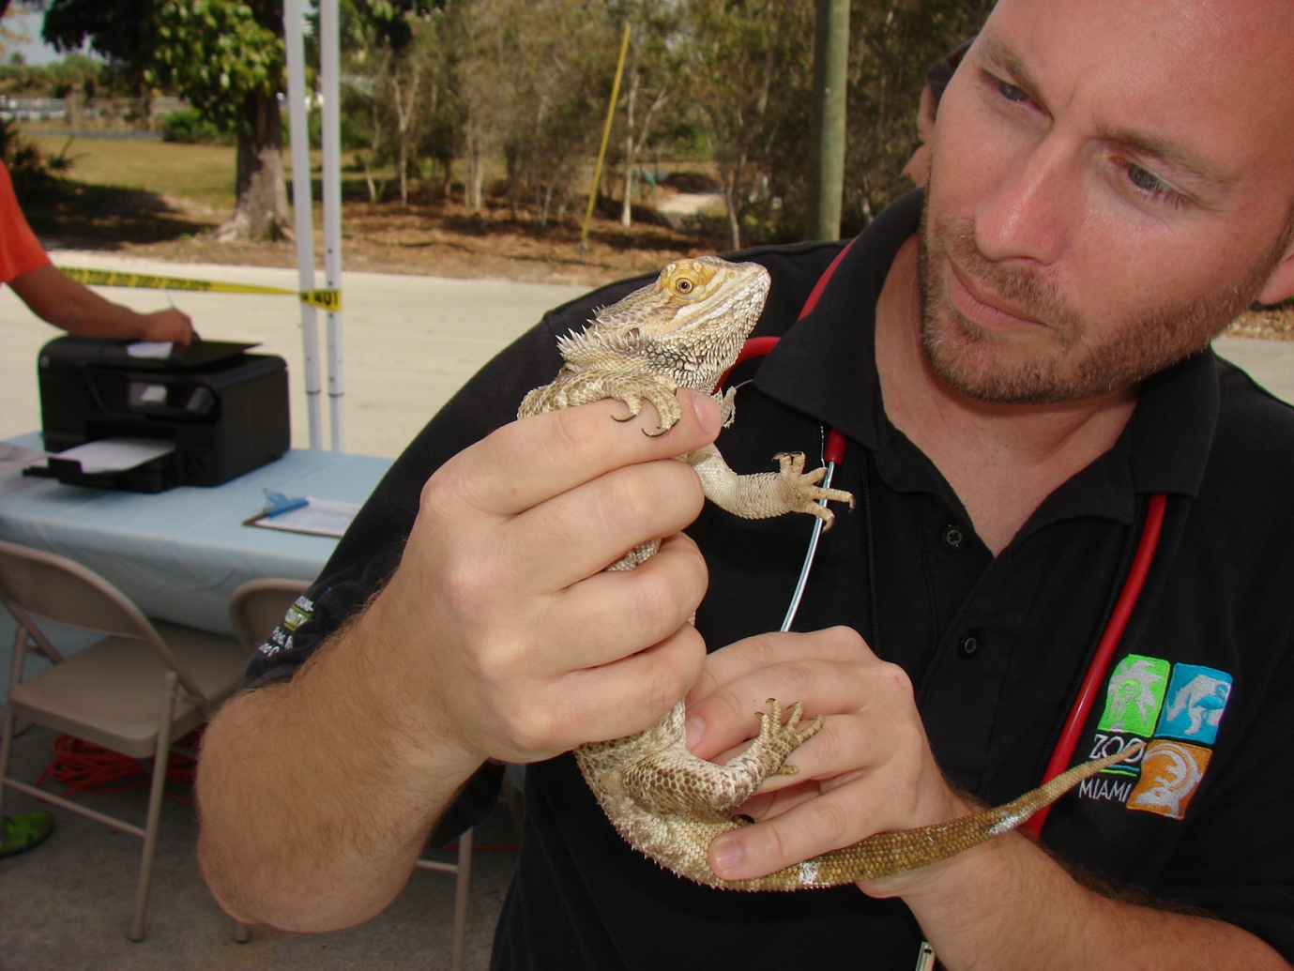
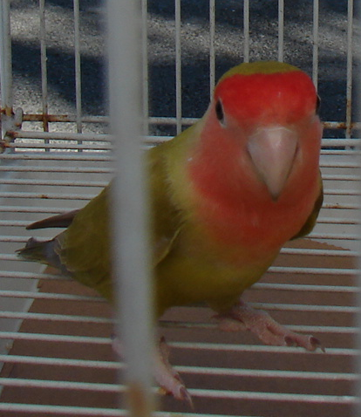
Exotic Pet Amnesty Day Events
Year | Month | County | Animals Surrendered
2013 | September | Broward | 70
2014 | January | Broward | 32
2014 | March | Miami | 40
 |  | Total = | 142 animals
Notes:
2013 Broward: Sawgrass nature center (you were present…)
2014 Broward: FLREC open house (funny story)
2014 Miami (Telemundo feature resulted in some animal surrenders)

Slide 15
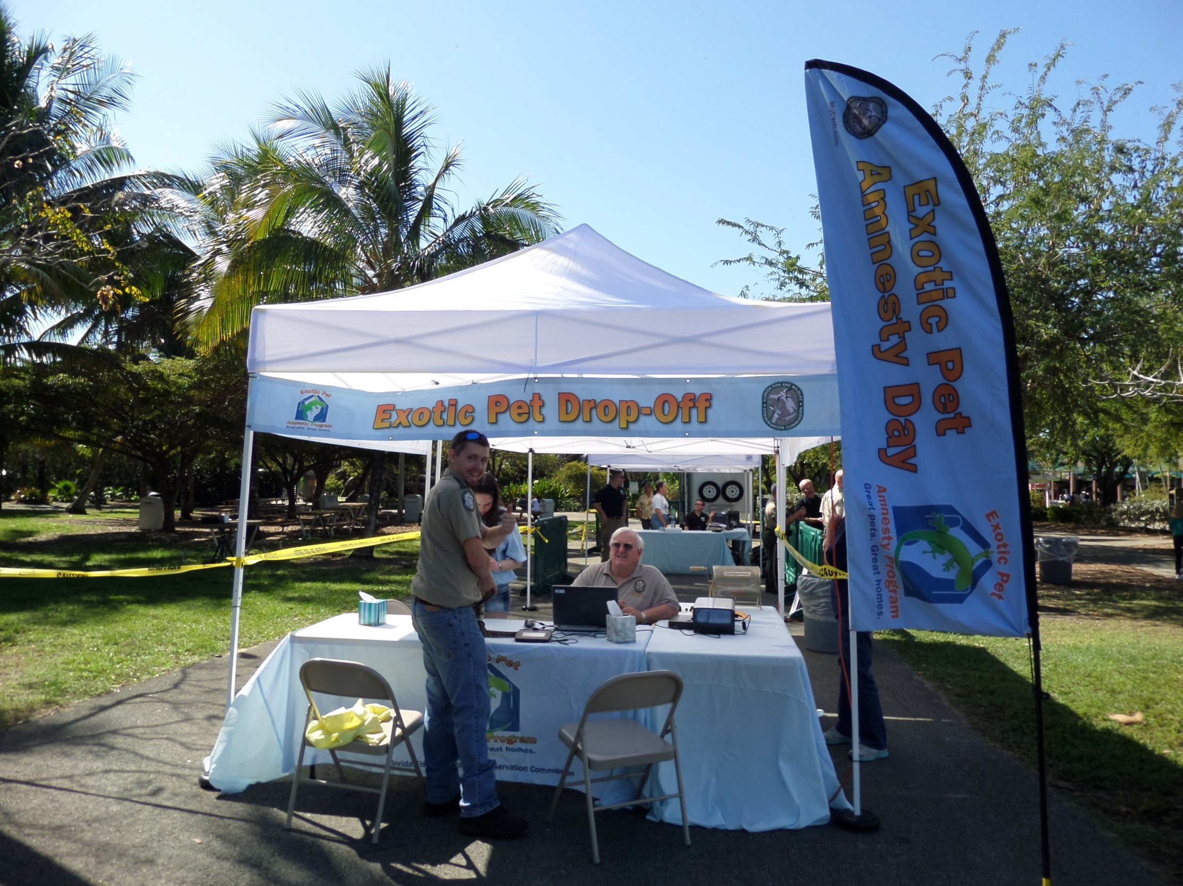
Upcoming Exotic Pet Amnesty Events
Year | Month | County | Location
2014 | October | Broward | Palm Beach Zoo
2014 | November | Palm Beach | Flamingo Gardens
2015 | March | Miami | TBD
Notes:
Palm Beach: Will be reuniting with partners from last event, hoping for great turnout.
Broward: Will be trying a new location..some reasons being actual location, being able to join with current event (Swamp Fest), able to have event without park entry fees, etc. Also, should be very visible from road.
Miami: Will likely need new location as Zoo Miami is undergoing improvements and promenade area is no longer available.

Slide 16
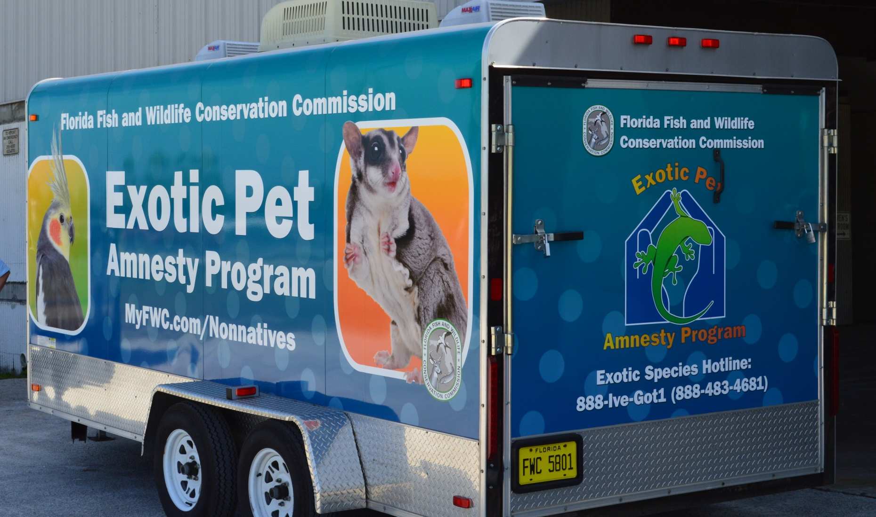
The Exotic Pet Amnesty Program is working to schedule repeating events in certain counties, automate the adoption process, and recruit new adopters
Notes:
Overall, the Exotic Pet Amnesty Program has seen many improvements, including an eye-catching new skin on the trailer. We are moving forward with trying to have dependable events in certain counties that will repeat every year in the same month. As always, a priority for the program is finding more adopters to join and be available as potential new homes for surrendered animals. Additionally, we are moving forward with automating the adoption process outside of events so that people can more easily search for a new home for their animal online.

Slide 17
ECISMA Outreach Events
Everglades Coalition Conference Jan. 2014 in Naples by South Florida Ecosystem Restoration Task Force (SFERTF) Department of the Interior (DOI) Office of Everglades Restoration Initiatives (OERI) (Carrie Beeler)
Career Day at Oliver Hoover Elementary School on Invasive Exotic Species (Carrie Beeler)

Slide 18
ECISMA Outreach Events
Zoo Miami Pet Amnesty Day (Carrie Beeler)
American Farm Bureau (presentations in Everglades and Everglades Agricultural Area by LeRoy Rodgers)
WRAC (presentation to Water Resources Advisory Commission by Dan Thayer)
2014 Educational Forum at Olsen Middle School in Dania Beach May 8, 2014

Slide 19
ECISMA Outreach Events
Party for the Planet at Zoo Miami April 26 and 27, 2014 (Dustin Smith, Sara Williams, Andrew Derksen)
Parkland Environmental Expo July 19, 2014 (Liz Barraco, Brenda Garza, Jake Edwards)
“Working together to combat invasive species” by Erica Skolte highlighting CISMAS was published in April 2014 JaxStrong newsletter by U.S. Army Corps of Engineers, Jacksonville District

Slide 20
ECISMA Outreach Events
Miami-Dade County Parks, Recreation and Open Spaces Department, Natural Areas Management Division
Outreach is conducted through the Volunteer Workday program, which engages citizens in projects at our nature preserves, such as invasive plant removal, native plantings, and litter removal
Everyone is welcome, school-age kids are the target audience
During this year's volunteer season, they conducted 26 events at various nature preserves, with 833 volunteers who logged a total of 2,600 hours
In addition, Dallas Hazelton assisted in one of the Pet Amnesty days in Broward.

Slide 21

ECISMA Outreach Events

Slide 22
ECISMA Outreach Events
5th Annual Non-Native Fish Round Up on May 17, 2014 was the most successful year ever.
55 people registered across three counties
580 pounds of invasive fish were caught
A new exotic fish called the Marbled-Pin Catfish (Leiarius marmoratus) was caught by Nick Valderrama.

Slide 23
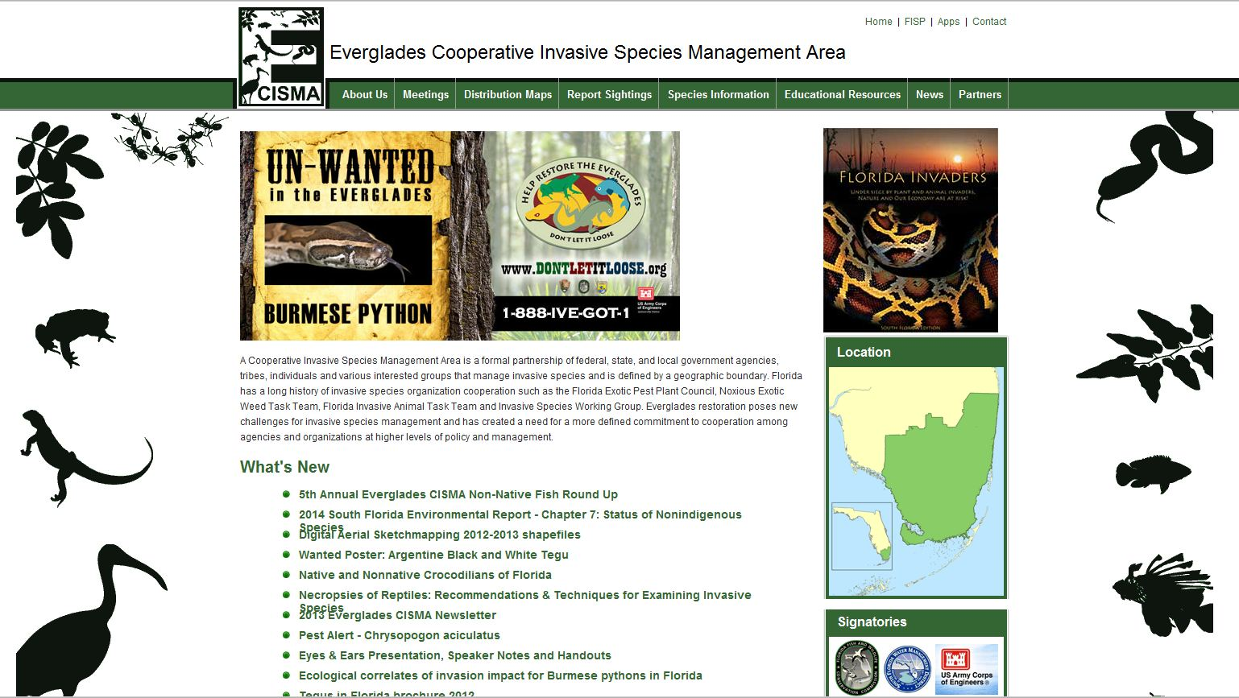
ECISMA Website
http://evergladescisma.org

Slide 24
ECISMA Website
University of Florida received $5,000 from the University of Georgia and a $7,500 grant from the Munson Foundation to redesign and develop content for the Everglades CISMA website http://evergladescisma.org
UF (Rebecca Harvey) is working on the redesign
UF will seek input from the ECISMA steering committee on the revised website this fall, with the aim of launching the new site in early 2015
UF continuing to look for funds to develop additional products, including a Traveling Trunk of outreach materials.

Slide 25
ECISMA Website
The website and other materials produced by UF will be organized around the concept of the "Everglades Dangerous Dozen," a list of 12 invasive animal and plant species on which we will focus outreach.
The list will be developed with your input and updated on a yearly basis.
Criteria for inclusion in the "Dangerous Dozen" and nominations will be one of the topics for discussed during the outreach breakout session tomorrow.

Slide 26

Social Media

Slide 27
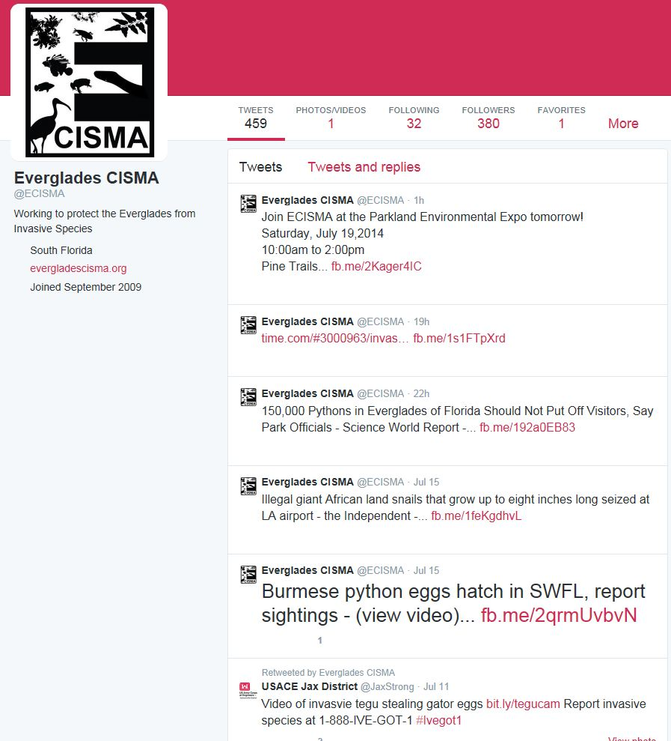
Social Media
Twitter
380 followers

Slide 28

Social Media
Facebook
222 followers
Looking for suggestions for a good cover photo

Slide 29
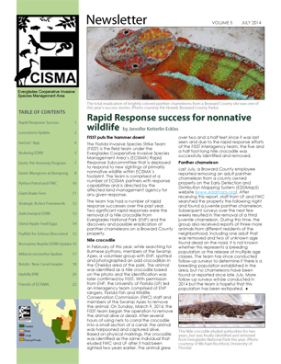
2014 ECISMA Newsletter
17 outstanding articles!
download the whole newsletter OR
download individual articles
http://bit.ly/ECIS14

Slide 30
2014 ECISMA Newsletter
Topics include:
Rapid Response Success
Luminitzera Update
IveGot1 App
Redwing EDRR
Exotic Pet Amnesty Program
Exotic Mangrove at Kampong
Python Patrol and FWC
Giant Brake Fern

Slide 31
2014 ECISMA Newsletter
Strategic Action Framework
Dalechampia EDRR
Island Apple Snail Eggs
Psyllids for Schinus Biocontrol
Nonnative Reptile EDRR Update
Mikania micrantha Update
Rotala: New Canal Invader
Hydrilla IPM
Friends of ECISMA

Slide 32
What Can I Do to Help?
SOCIAL MEDIA
“Like” ECISMA Facebook page
Follow ECISMA on Twitter
Share ECISMA Facebook posts and retweet to publicize the event on agency and personal social media
Send photos and items to outreach chair, Erica Skolte at erica.a.skolte@usace.army.mil for various uses

Slide 33
What Can I Do to Help?
EVENTS
Volunteer to help out at the event
Share ECISMA Facebook posts and retweet to publicize the event on agency and personal social media
Take photos at the event
Send photos to outreach chair, Erica Skolte at erica.a.skolte@usace.army.mil

Slide 34
Thank you! ECISMA Outreach Volunteers and Collaborators

