Slide 1
Current Python Science USGS and Collaborators
Brian J. Smith
Contracted to USGS

Slide 2
3 Updates
USGS in Davie
USGS in Everglades National Park
Collaborators in SW Florida

Slide 3
USGS in Davie
Kristen Hart, Mike Cherkiss, Brian Smith, Thomas Selby, Andrew Crowder, Hayley Crowell
Summer interns Devon Nemire-Pepe and Luke Stevens

Slide 4
Current Projects
Telemetry and “Judas” Snakes
Diet
Impacts to Native Fauna
eDNA
Testing New Biologging Tools
Python Facility in Davie

Slide 5
Telemetry and “Judas” Snakes
Translocation Paper
published
Telemetry Paper
in revision
Breeding Aggregation Note
in press
“Judas” Technique Paper
in prep

Slide 6
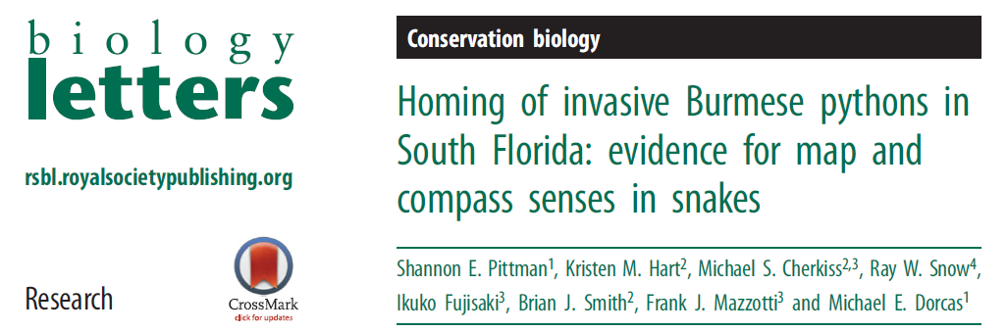
Translocation Paper Published!

Slide 7
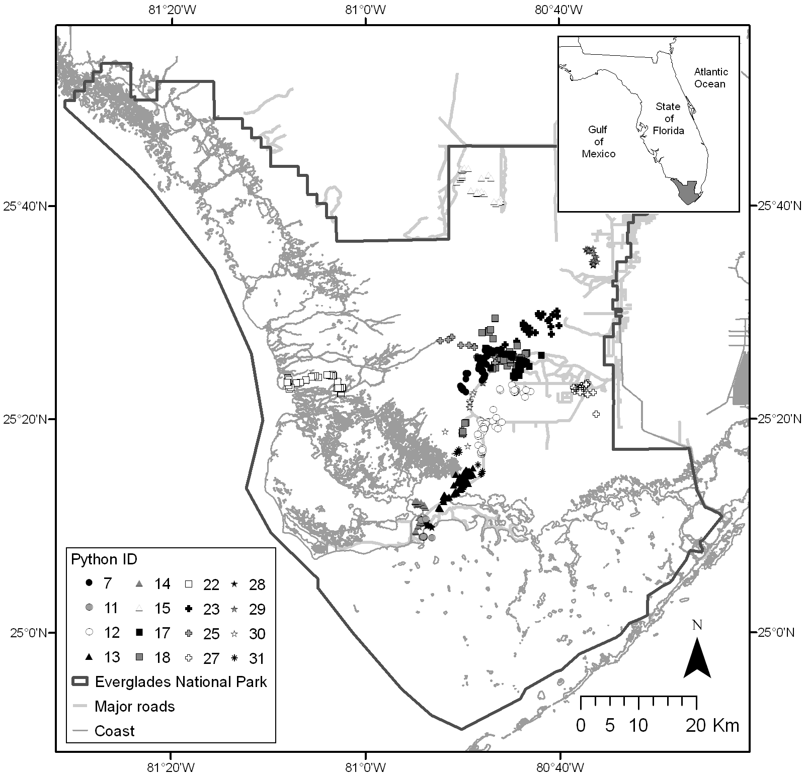
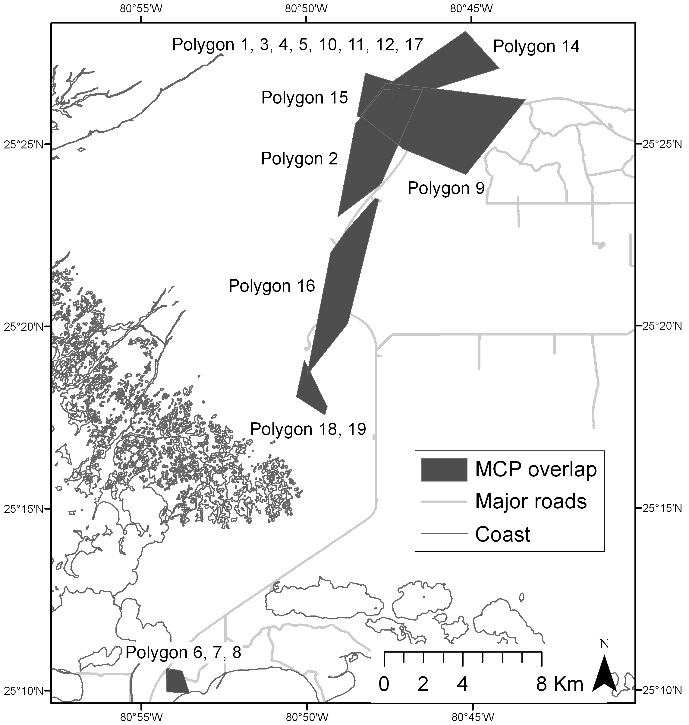
Telemetry Paper In revision

Slide 8
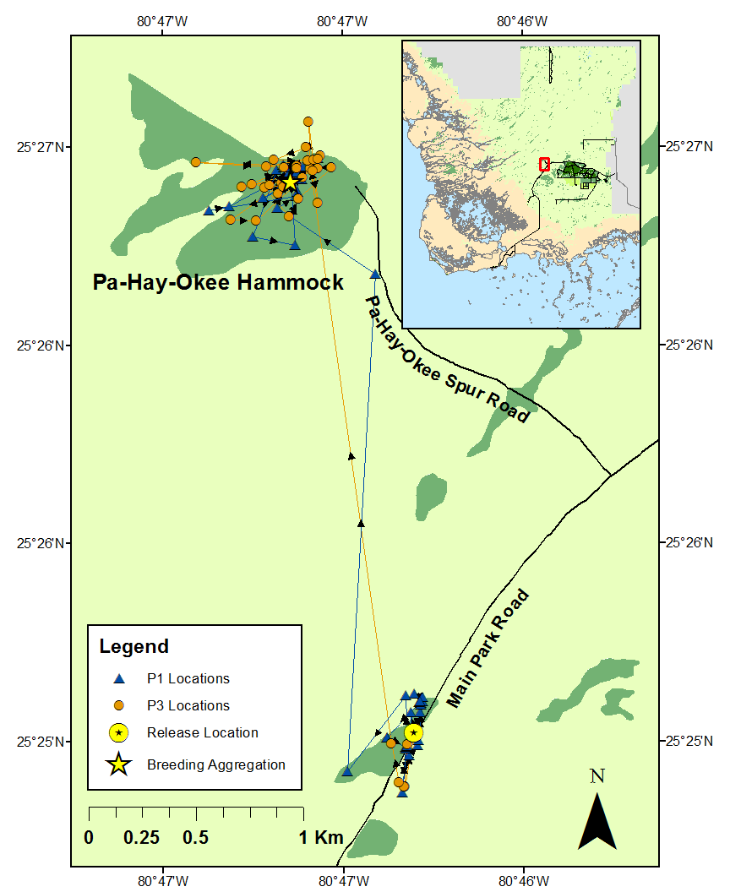
Breeding Aggregation Note In press (Southeastern Naturalist)

Slide 9
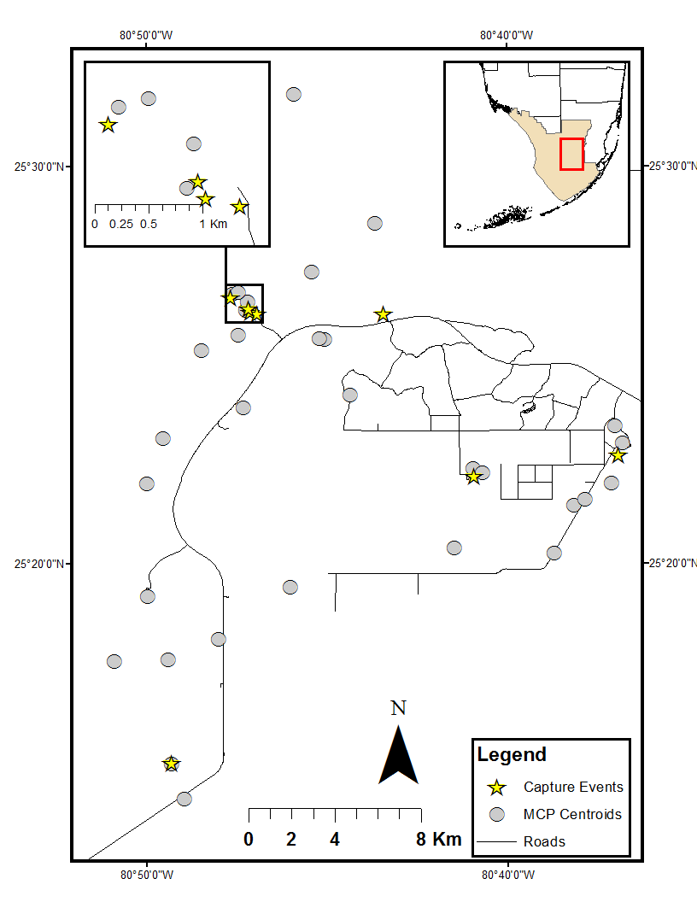
“Judas” Technique Paper In prep

Slide 10
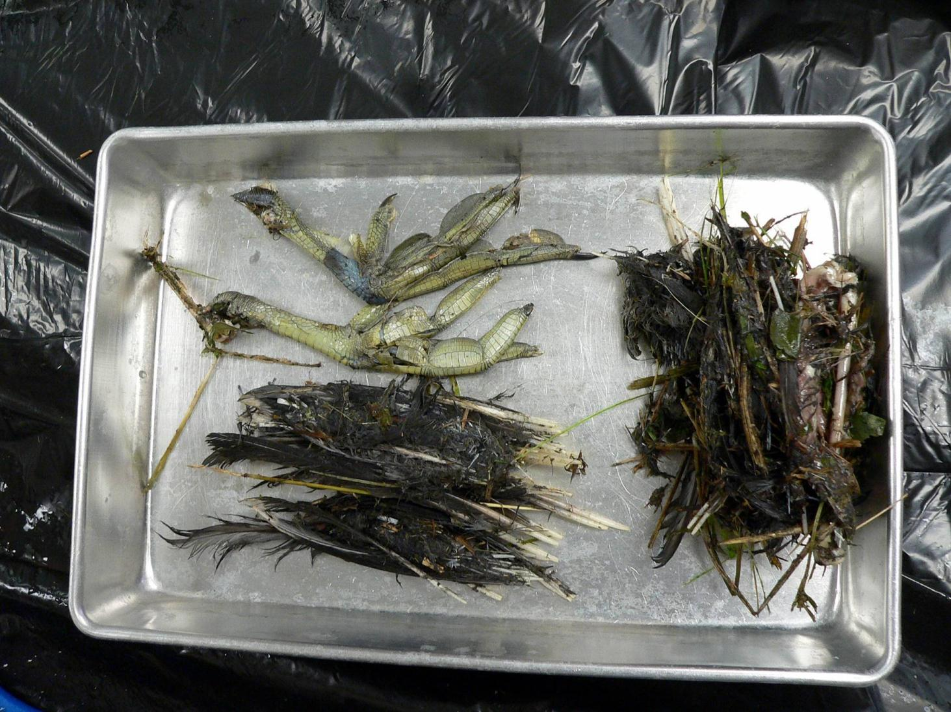
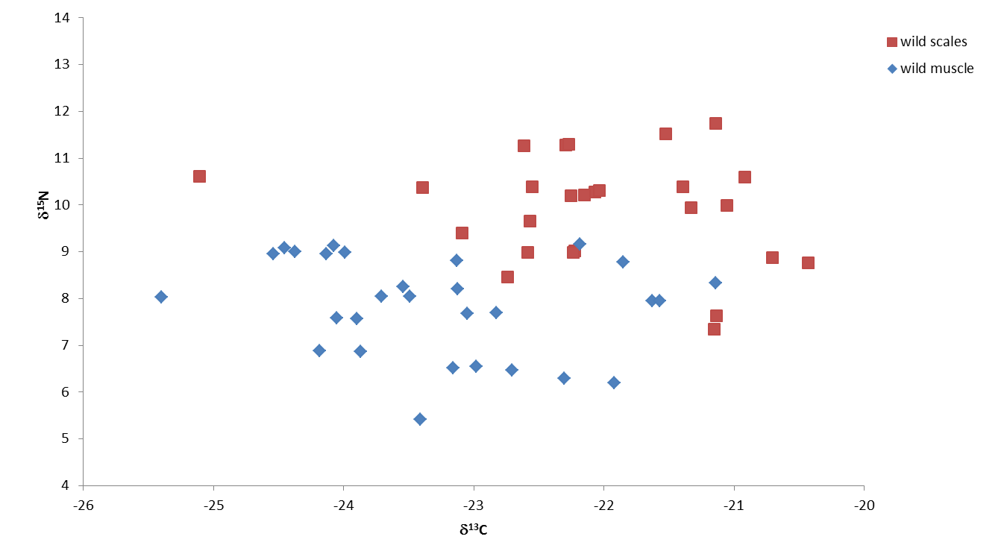
Diet Gut contents, stable isotopes, genetics
Diet Paper, in prep, Cherkiss & Mazzotti
Proposal in for genetic ID of gut contents (Hunter & Hart)
Notes:
Collaborative w/ Amanda Demopoulos, multiple tissue types, C and N,
Long-term Everglades residents w/ varied diet vs. possible new releases that were pets

Slide 11
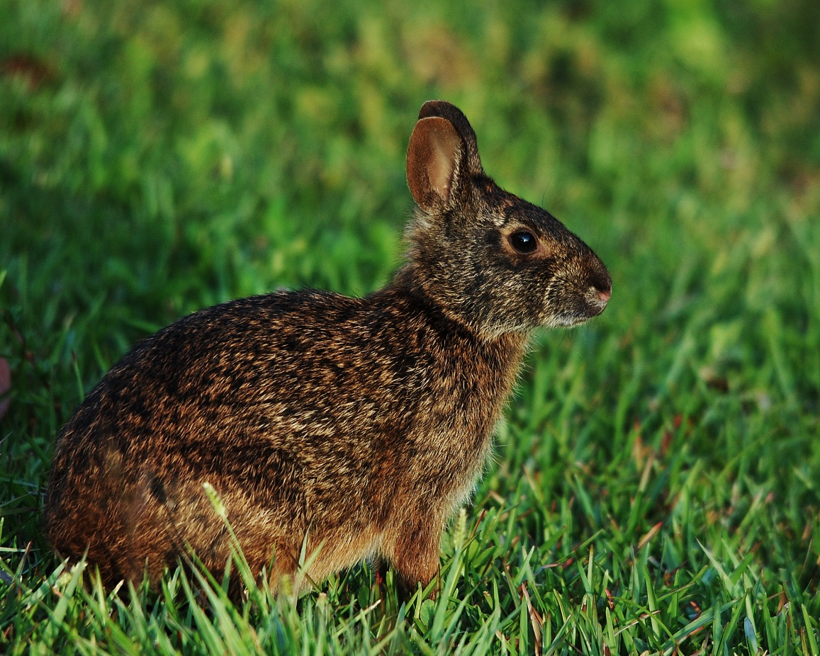
Impacts to Native Fauna Marsh Rabbit Study
Notes:
Bob McCleery

Slide 12
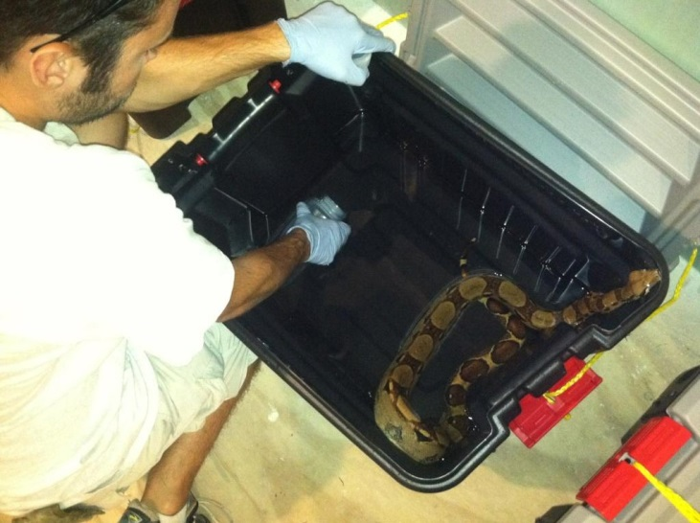
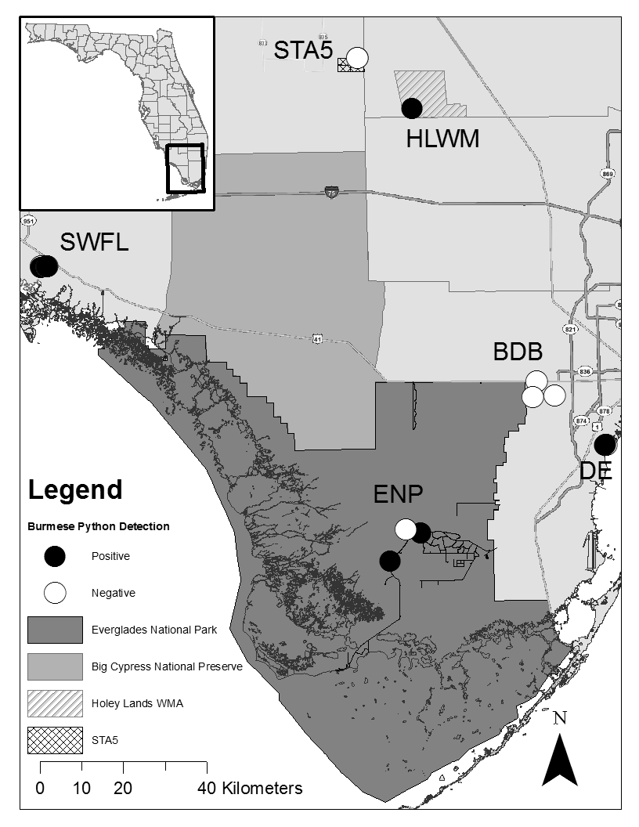
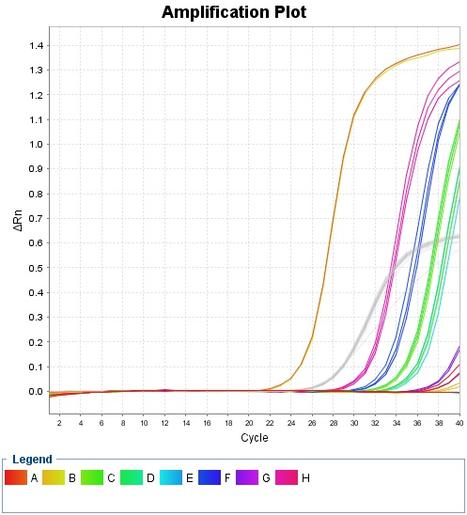
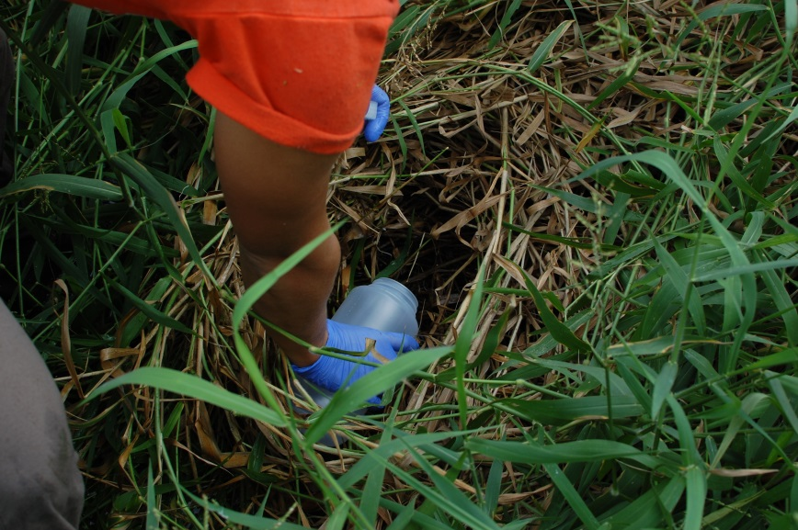
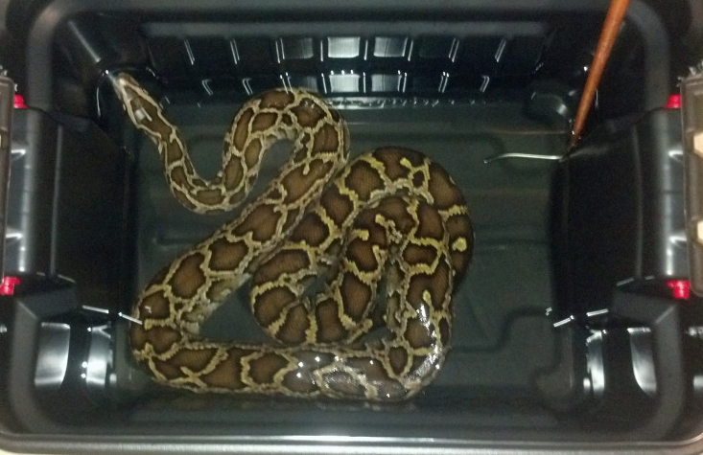
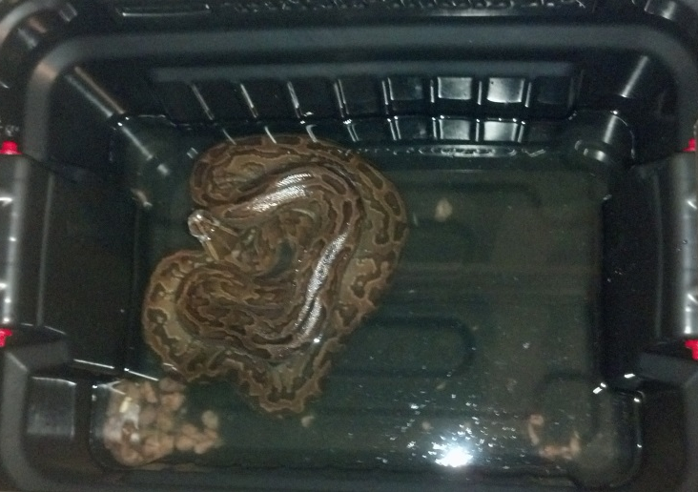
eDNA Lab & Field Trials

Slide 13
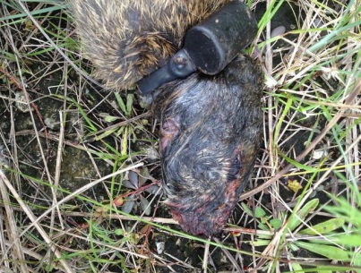
eDNA Determining Predation
Log transformed DNA concentration (ng/ul)
Notes:
Used on other types of samples, besides water, including soil, and saliva or excrement.
To test the hypothesis that the lack of mammals in the Everglades is associated with python predation.
Two rabbits potential prey items
Tested the saliva present on the fur. Next slide please
I was able to separate rabbit from python DNA and confirm that the DNA from the fur was python

Slide 14
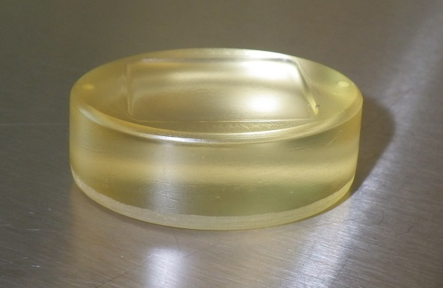
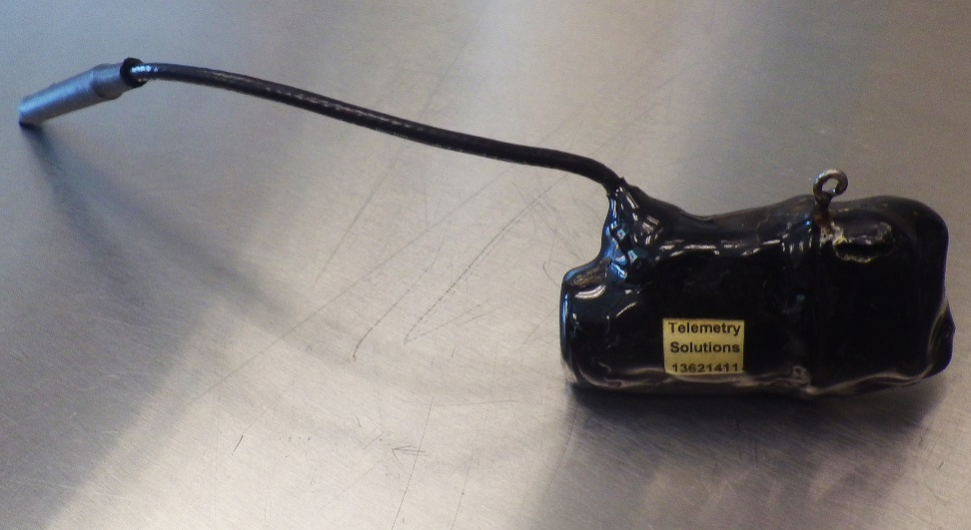
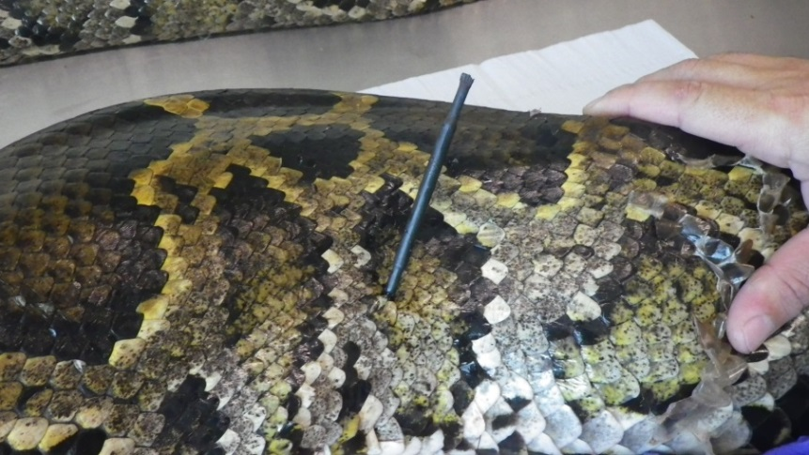
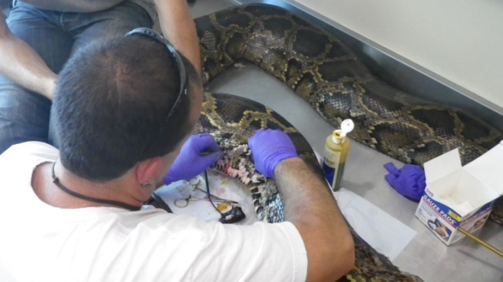
Testing New ‘Biologging’ Tools
GPS Tag
Accelerometer

Slide 15
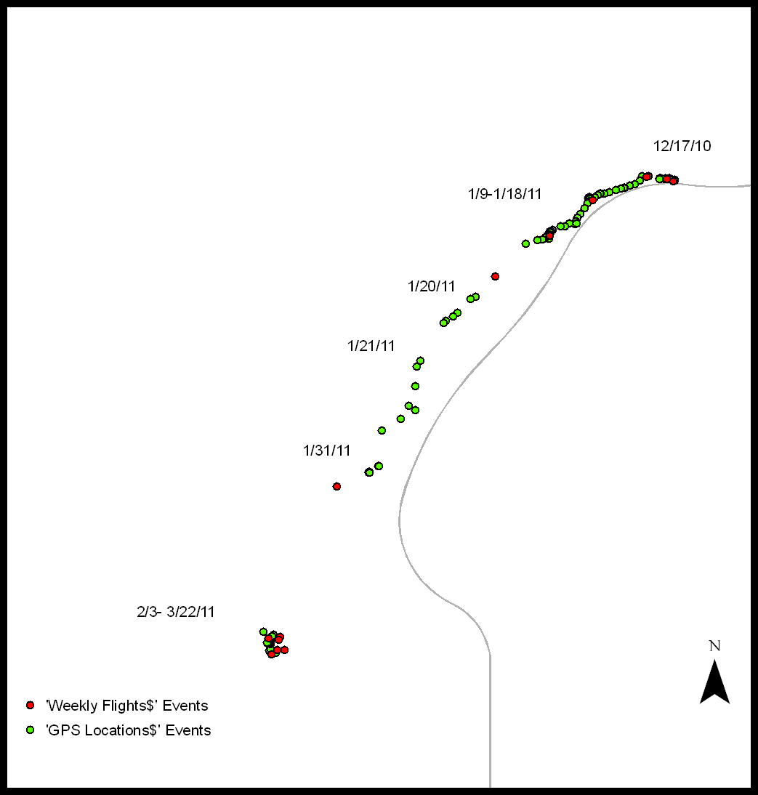
GPS Tags

Slide 16
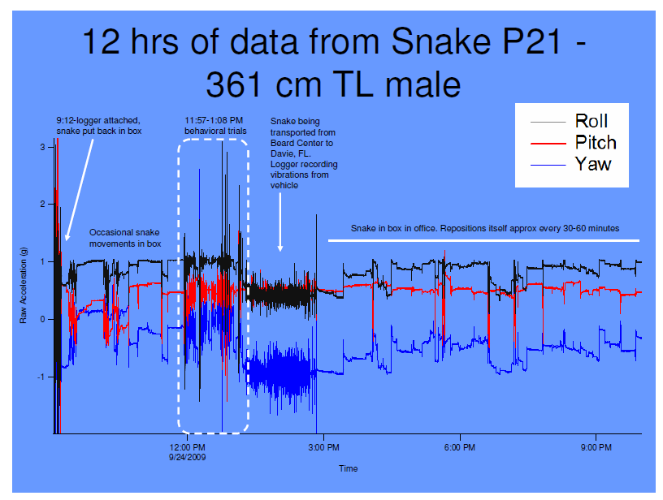
Accelerometers

Slide 17
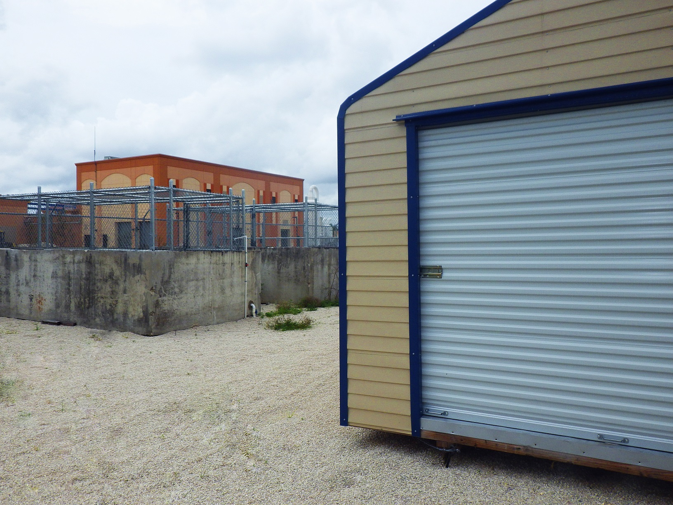
Python Facility in Davie

Slide 18
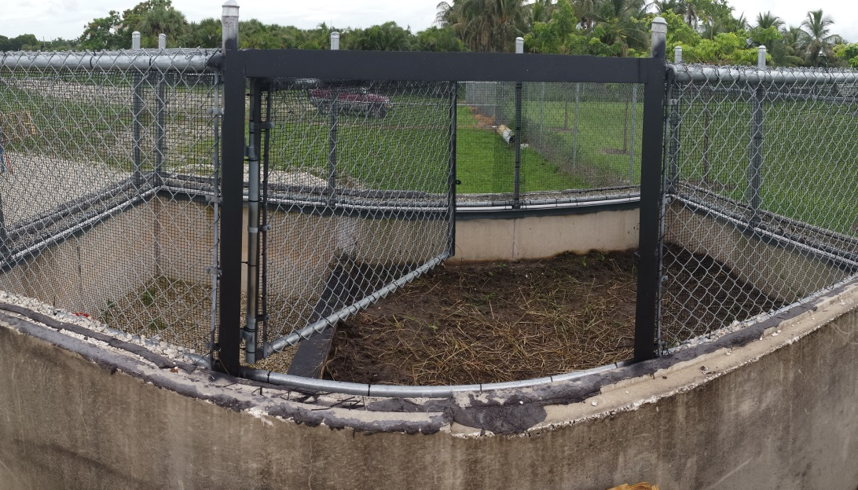
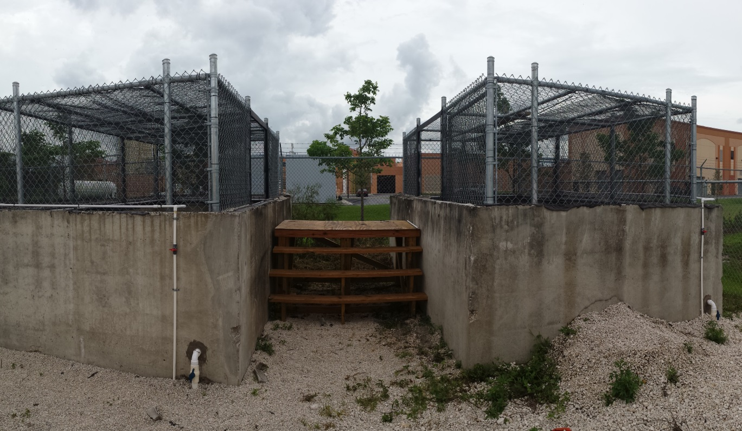
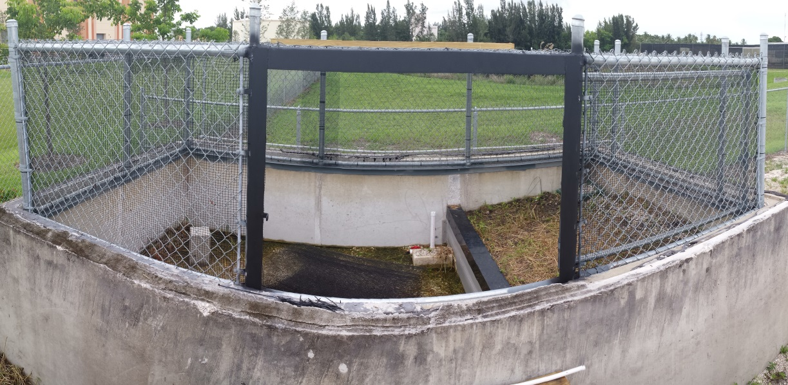
Python Facility in Davie

Slide 19
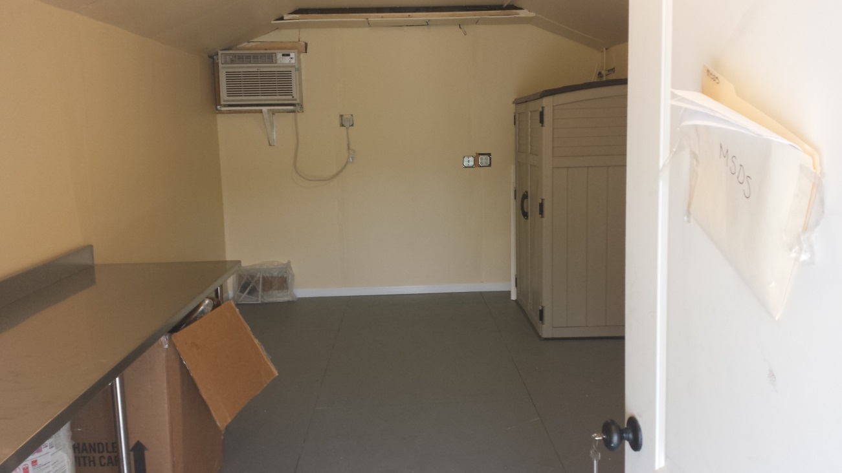

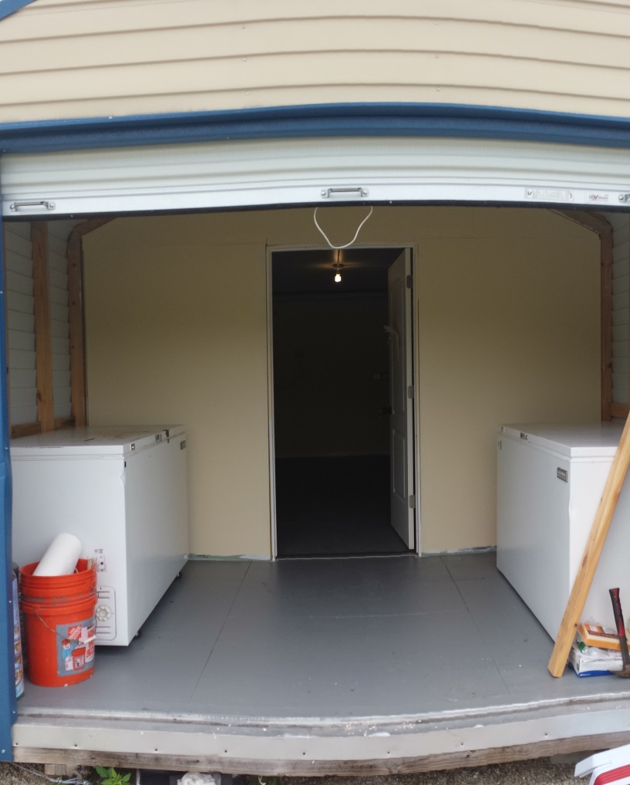
Python Facility in Davie
12 ft
30 ft
7.5 ft

Slide 20
USGS in ENP
Bob Reed (Ft. Collins)
Bryan Falk, Michelle McEachern

Slide 21
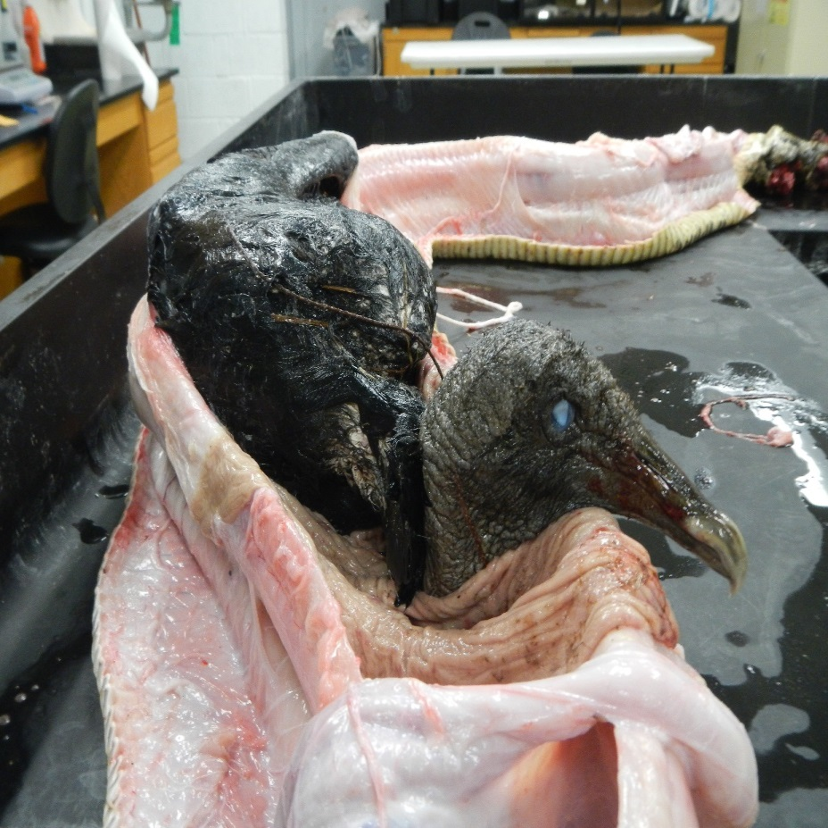
Transition year – USGS/NPS
Interagency agreement
USGS personnel stationed in Everglades NP (Bryan Falk)
Continuing python work by Skip Snow:
Necropsies
Data/specimen management
Research
Authorized Agent Program
Black vulture in python gut – Pa-hay-okee

Slide 22
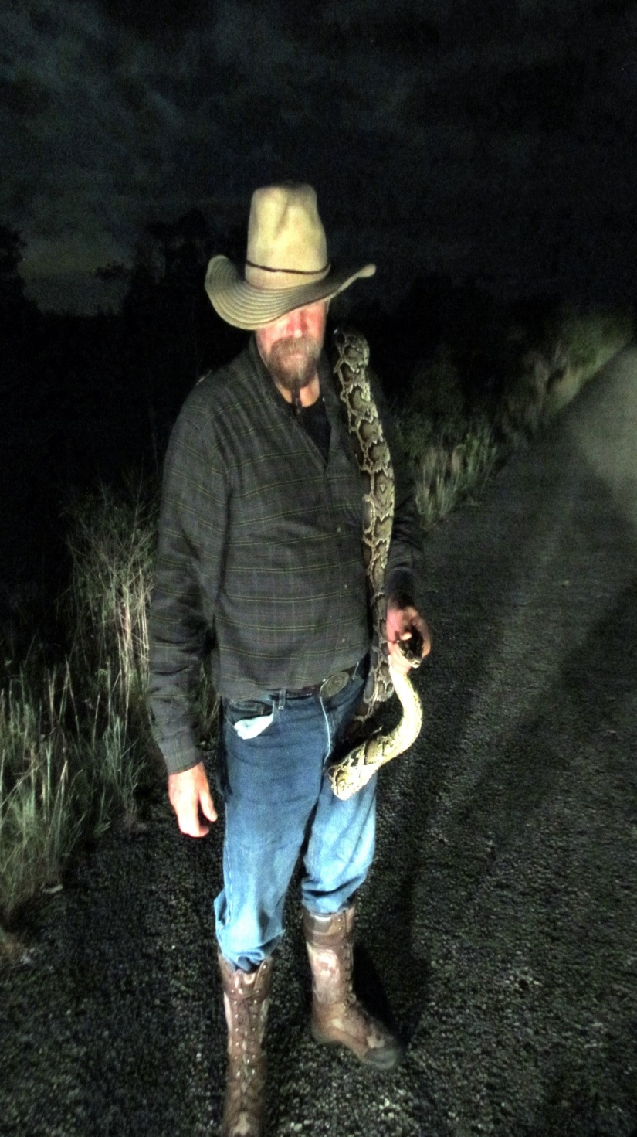
Authorized Agent Program
Volunteers authorized to remove pythons in Everglades NP
Created in 2011
Up to 30 agents authorized at one time
Primary function is python removal

Slide 23
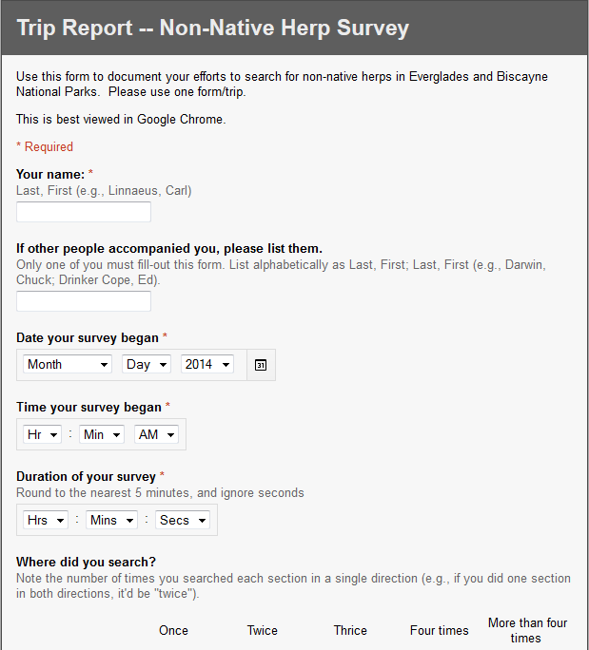
Authorized Agent Program Changes in 2014
Managed by Bryan Falk (USGS) with oversight by Tylan Dean(NPS)
Renewed 19, recruited 7 (26 total agents currently)
Increased EDRR capacity:
Expanded to Biscayne, pending expansion to Big Cypress
Authorized to remove all non-native herps (not just pythons)
Greater emphasis on data collection and reporting – online form
Online trip report form

Slide 24
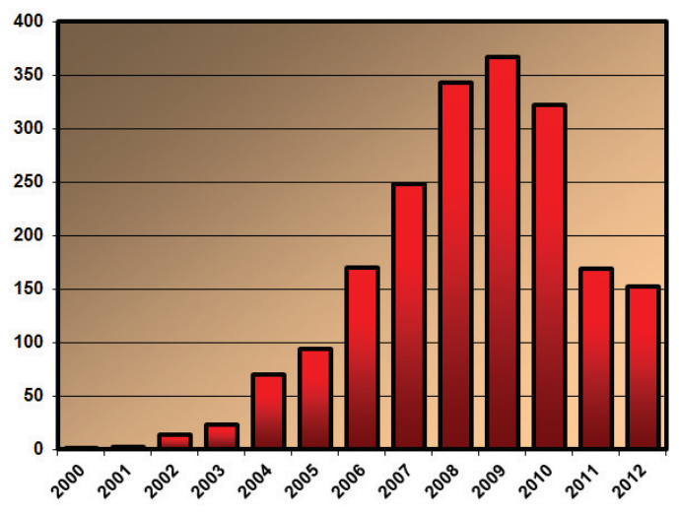
Authorized Agent Program Current Issues
5 no-python online trip reports since June 1st:
Overall search effort is low – or –
Agents don’t submit effort data, especially for negative searches
Haphazard search times and routes make meaningful analysis difficult
Moving towards a more structured program for 2015:
Scheduled, predefined routes
Standardized data collection
What do these trends in python removal actually mean?
Can’t answer with current data collection protocols

Slide 25
July numbers through July 15th

Slide 26
Agent program started March 19

Slide 28
Collaborators in SW Florida
Paul Andreadis (Denison University)
Ian Bartosek (Conservancy of SW Florida)

Slide 29
Questions?

Slide 30
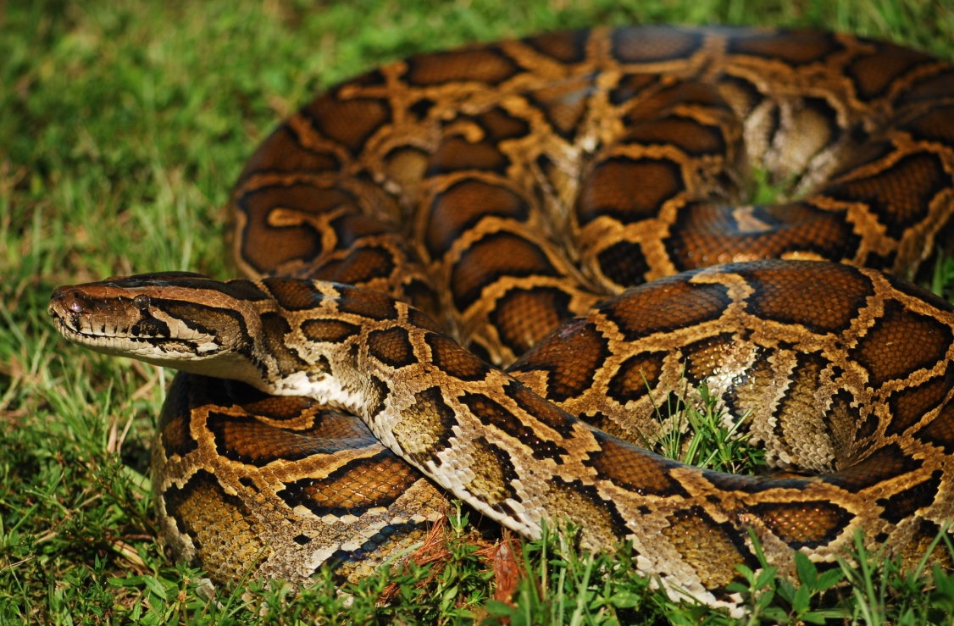




An Integrated Approach to Adaptive Management of Invasive Reptiles: the Burmese Python Lesson

Slide 31
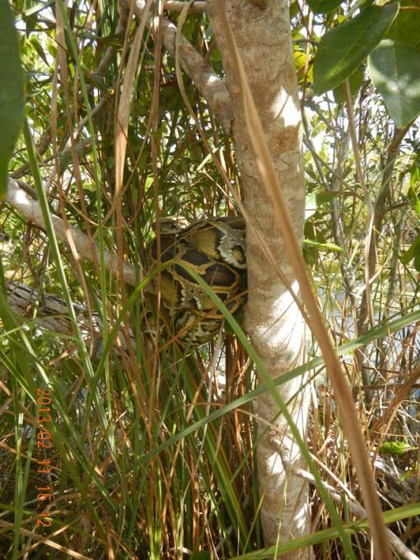
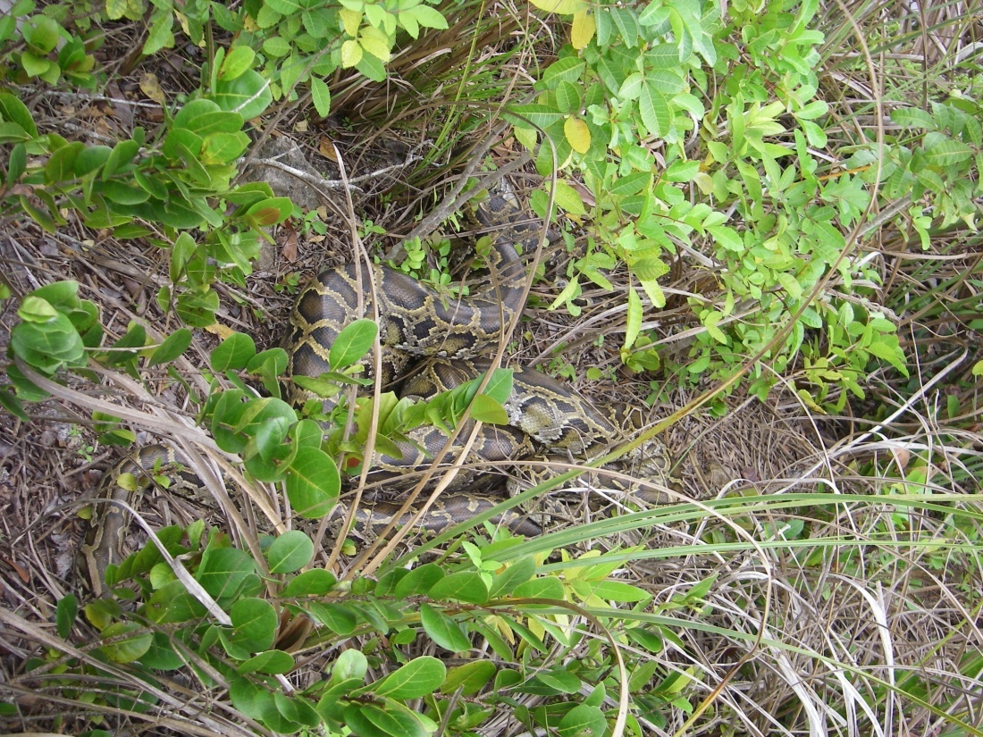
The Detection Dilemma: What happens when you can’t find the needle in the haystack?

Slide 32
What is detection? Why is it important? Can we estimate it? How can we use it and improve it? What do we do next?

Slide 33
What is detection = detectability = probability of detection = Pdetect?
Pdetect = the probability of seeing a python on the condition that one is present
Pdetect is a function of habitat, behavior, and observer method and skill

Slide 34
Why is Pdetect important?
Measures of abundance, density, and occupancy require an estimate of Pdetect to be reliable
If you know what (and how) factors affect Pdetect you might be able to improve it
Low Pdetect may give an impression of a small population
Ability to remove (or model) pythons (any invasive species) can be limited by low Pdetect;
Pcatch = Pthere x Pdetect x Pseize

Slide 35
Estimating Pdetect
Empirical – repeated surveys along C110 with telemetered snakes
Model – as part of analysis of occupancy of pythons in ENP using weekly surveys
Application
Improvement

Slide 36
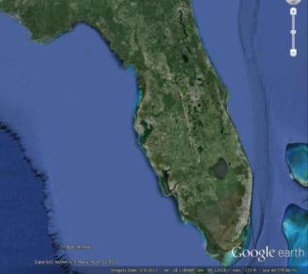
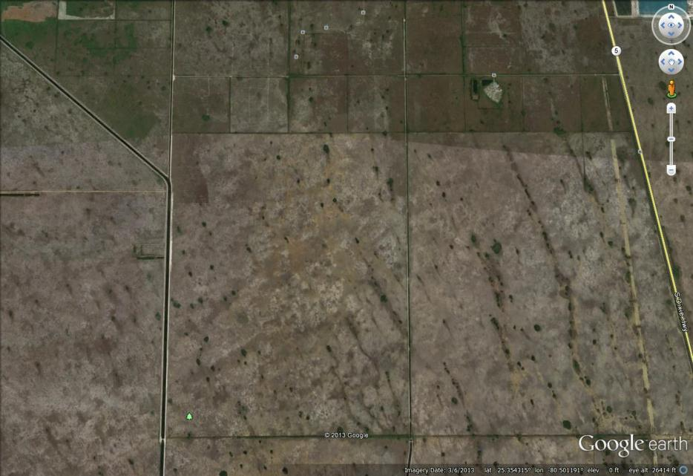
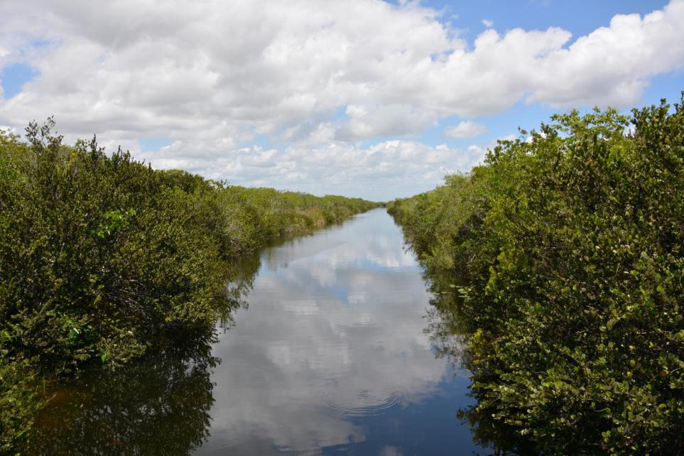
2013 Intensive surveys, UF/USGS
C-110 canal surveyed on foot 3x/week
≥2 independent observers/survey
Round trip (both sides, ~8 km total)

Slide 37
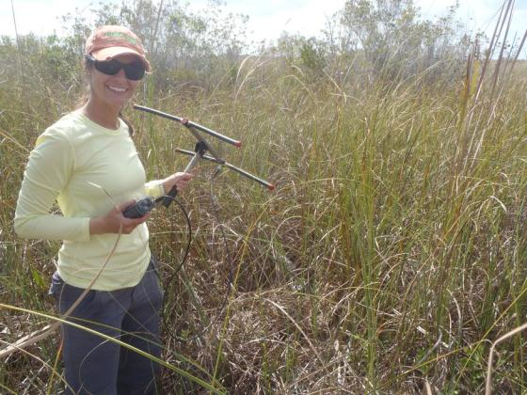
3 adult male pythons captured on C110 received transmitters
ID SVL (cm) Dates tracked
PyMo27 171 16 Jan – 02 Jun 2013
PyMo32 215 16 Jan – 11 Apr 2013
PyMo60 293 01 Feb – 18 Mar2013

Slide 38
Results
62 locations of 3 telemetered pythons, 16 Jan – 02 July
One or more pythons on canal or levee on 51 of 62 days
198 person-opportunities to see a telemetered python
Number of times pythons detected during visual searches = 0

Slide 39
Results
However….PyMo32 was spotted once. Pretend it was found by one of us…..
Raw detection probability of PyMo32:
1/80 opportunities = 0.0125
Raw detection probability across all opportunities:
1/198 = 0.005

Slide 40
Application

Slide 41
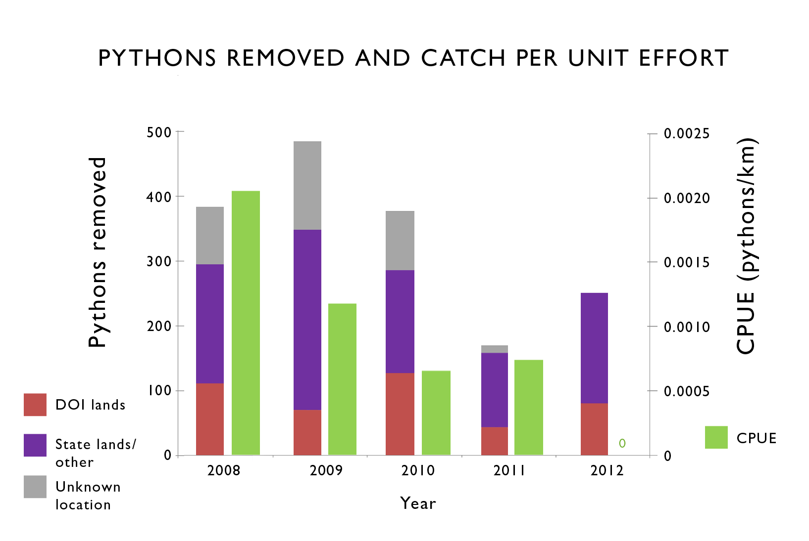

Slide 42
EIRAMP Occupancy Modeling – UF/USGS
Weekly surveys main ENP road at dusk were conducted 2008 – 2011
To model detection we held occupancy constant and modeled detection as a function of temperature and time of day
Pdetect averaged 0.0054 (0.0030-0.0096)
Does this mean that Pdetect for python is 0.005? NO! It does mean that Pdetect is very low (<0.01). So low that we need to be concerned about bias in our results.

Slide 43
Findings and Next Steps
Just because you can estimate Pdetect doesn’t mean you can use it to model abundance, density, or occupancy
We need to improve Pdetect for pythons for modeling, management, and monitoring
More than just doing more surveys – refine surveys by location, season, time, weather, and method, under natural conditions

Slide 44
Findings and Next Steps
We don't have a model to deal adequately with low Pdetect
We need a new model, a new sampling method, or both
We need to do comparative studies with other invasive reptiles. Tegus are more detectable. What does this mean for modeling, management, and monitoring?
What happens when you can find the needle in the haystack?

Slide 45
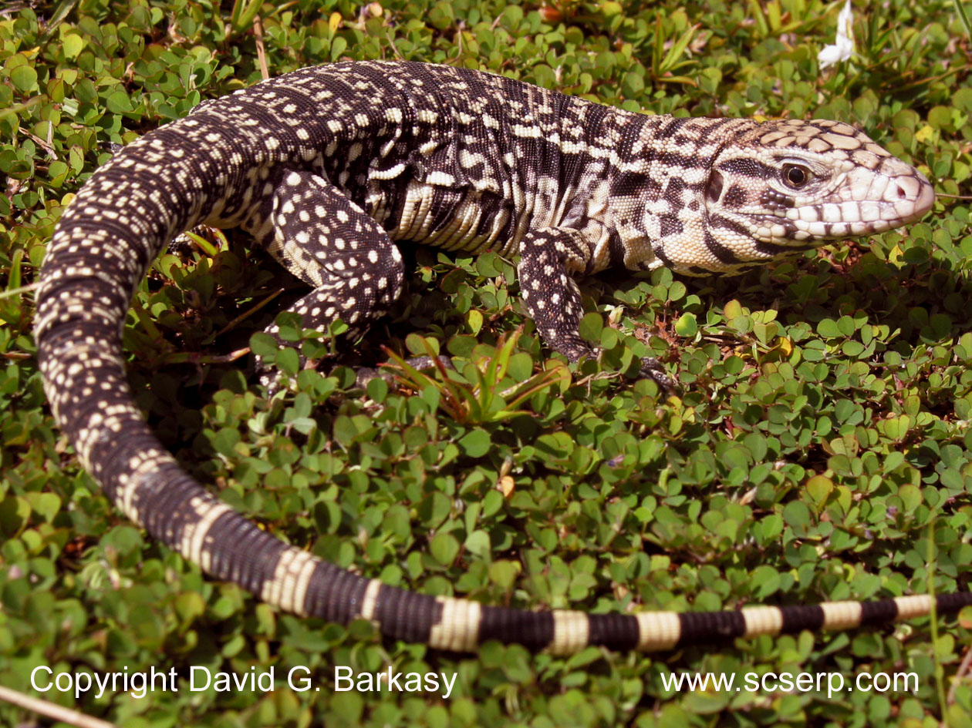
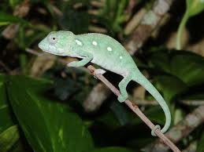
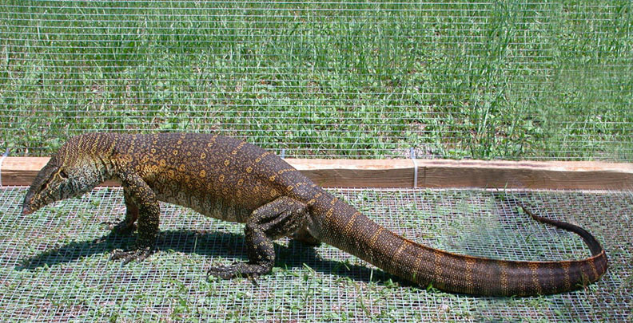
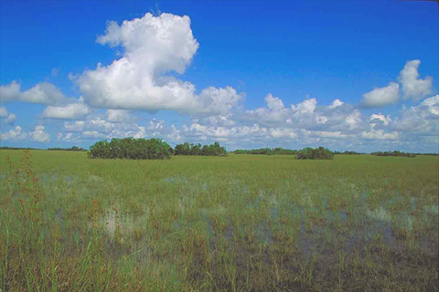
This is Not The End
?

