Slide 1
Updates on Current Research:
Tegus and Nile Monitors
Liz Barraco
Florida Fish and Wildlife Conservation Commission

Slide 2
Research Updates
Nile monitor diet study (UF)
Tegu telemetry study (UF)
Tegu diet study (FWC)

Slide 3
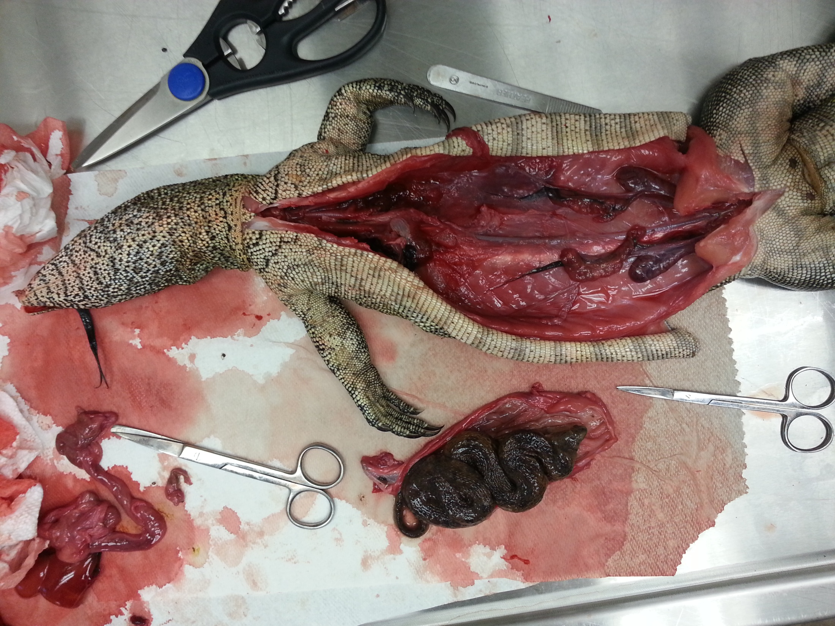
Nile Monitor Gut Content Analysis
19 specimens (18 had contents, 16 >1 prey item)
Amphibians:
  Marine Toad (Rhinella marina),
  Southern Leopard Frogs (Lithobates sphenocephalus),
Reptiles:
  Brown Basilisk (Basiliscus vittatus)
  Eastern Glass Lizard (Ophisaurus ventralis)
  Brown Watersnake (Nerodia taxispilota)
  Banded Watersnake (Nerodia fasciata)
  Corn Snake (Pantherophis guttatus),
  Three-striped Mud Turtle (Kinosternon baurii).
Mammals:
  Hispid Cotton Rat (Sigmodon hispidus),
Other:
  crustaceans, spiders, snails, parasites (Acanthocephalans, Nematode, and unknown), reptile eggs, insects (Formicidae, Pentatomidae, Coleoptera, Blattidae, Lepidoptera, Hemiptera, Curculionidae, Scarabaeoidea, Elateroidea, and Orthoptera), a fish, and plastic objects

Slide 4
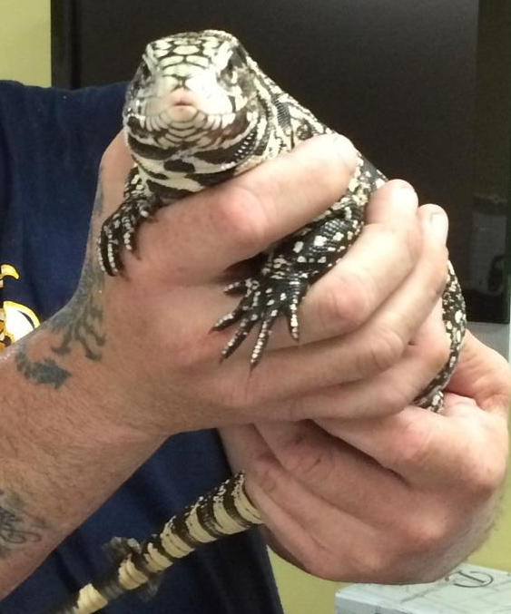

Tegu Telemetry
Female tegu behavior
  Nesting
  Sex ratio of clutch

Slide 5
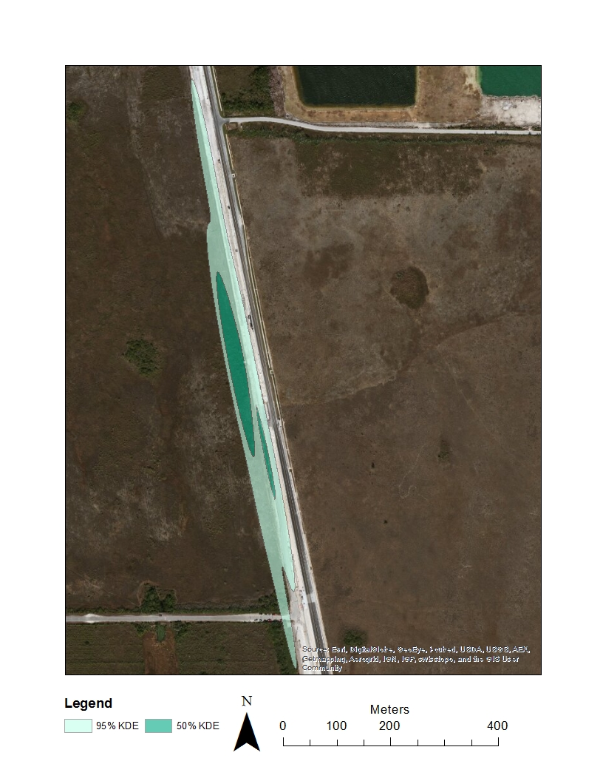
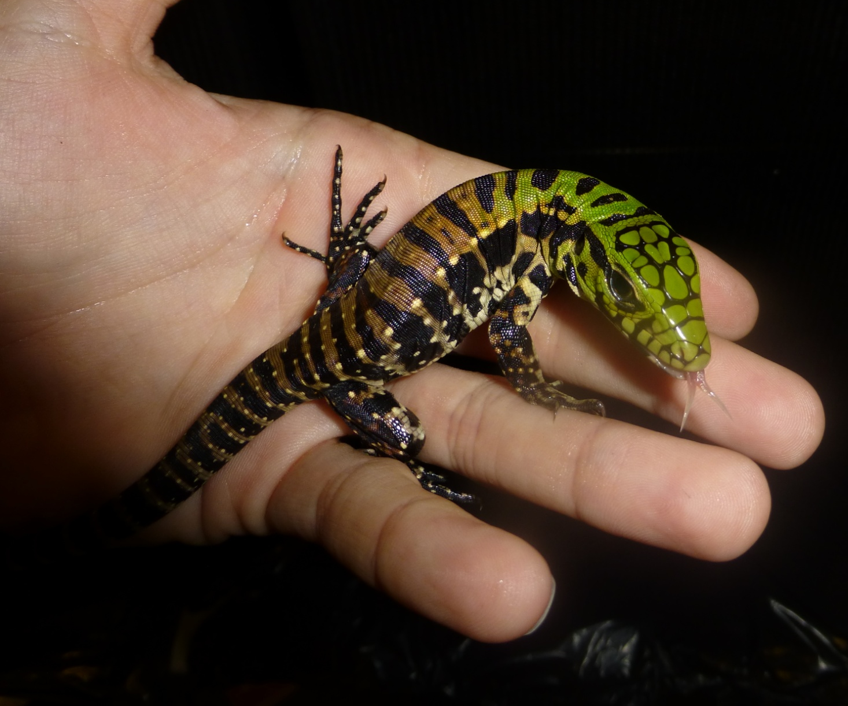
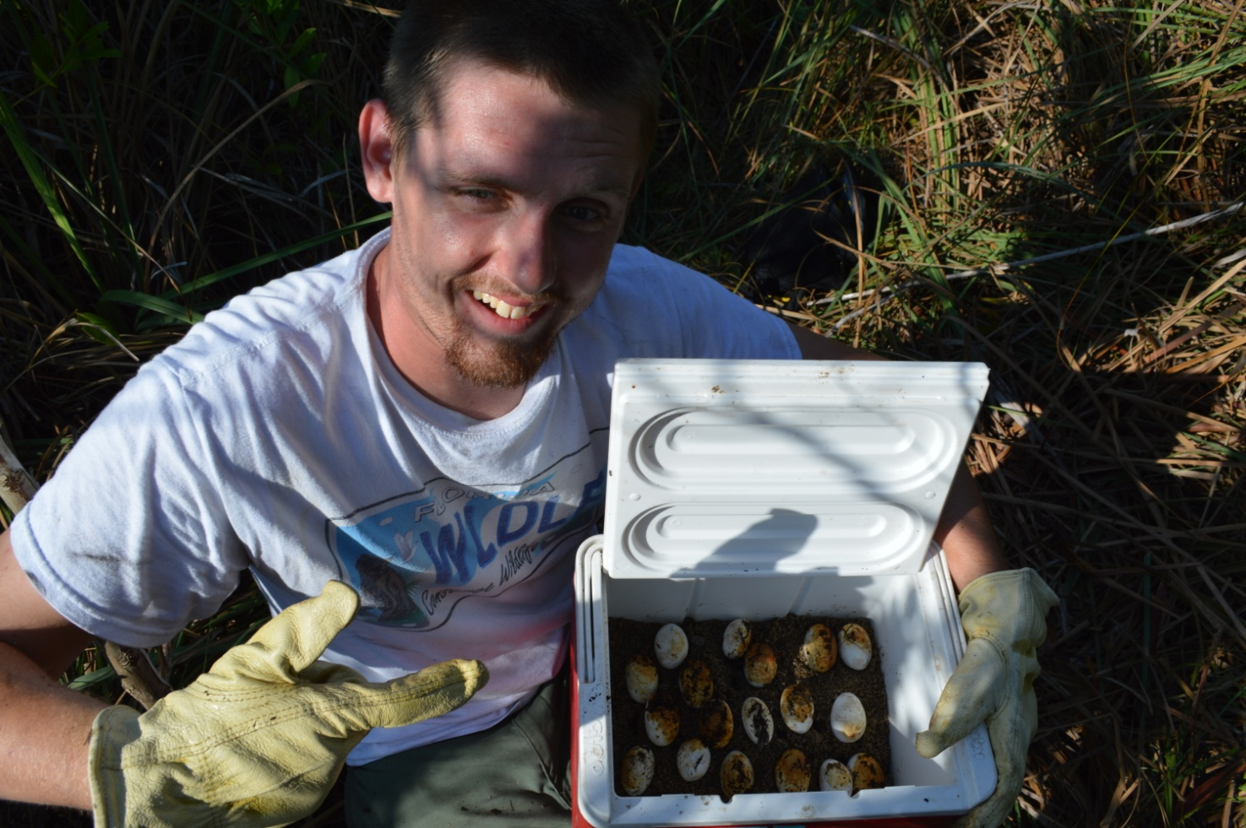
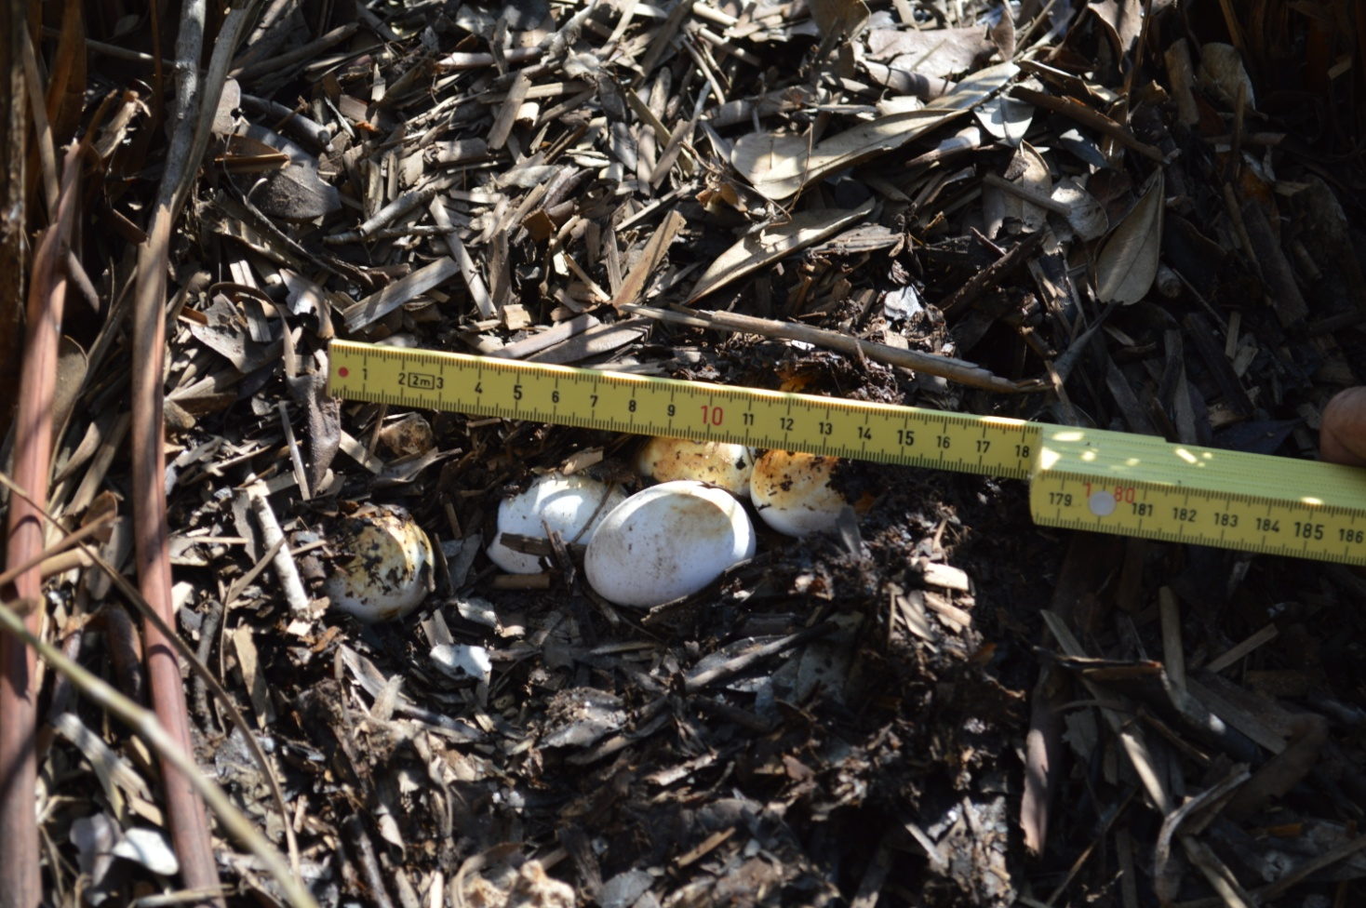
`
TuMe380
  7 April 2014 – 18 June 2014
  23 May 2014
    18 eggs
  18 June 2014
    14 viable

Slide 6
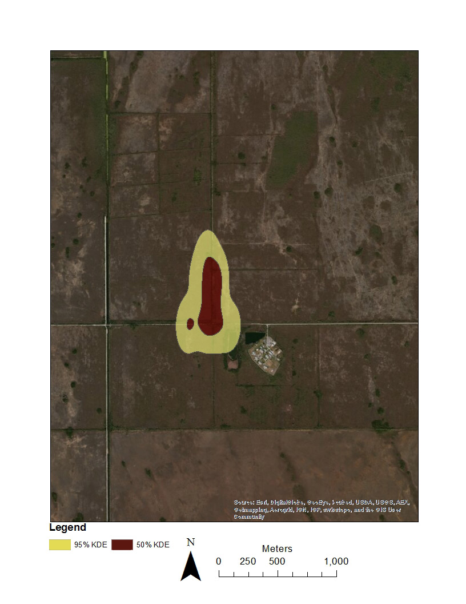
TuMe409
  21 April 2014 – 11 June 2014

Slide 7
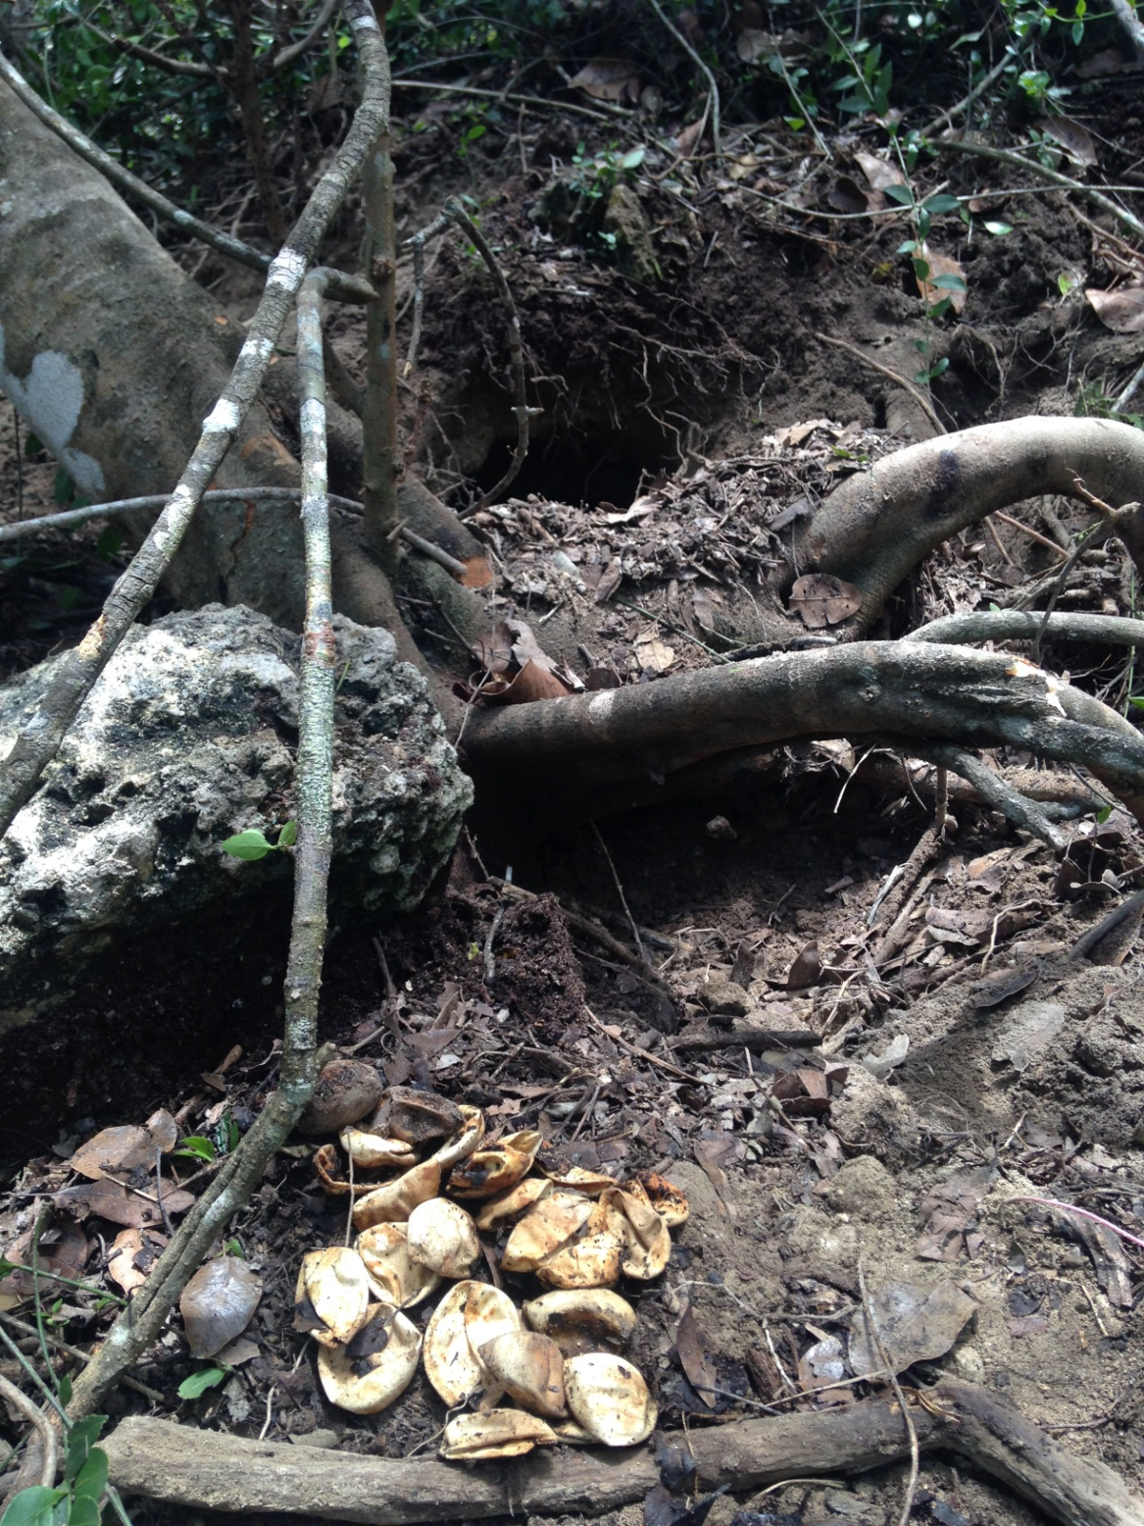
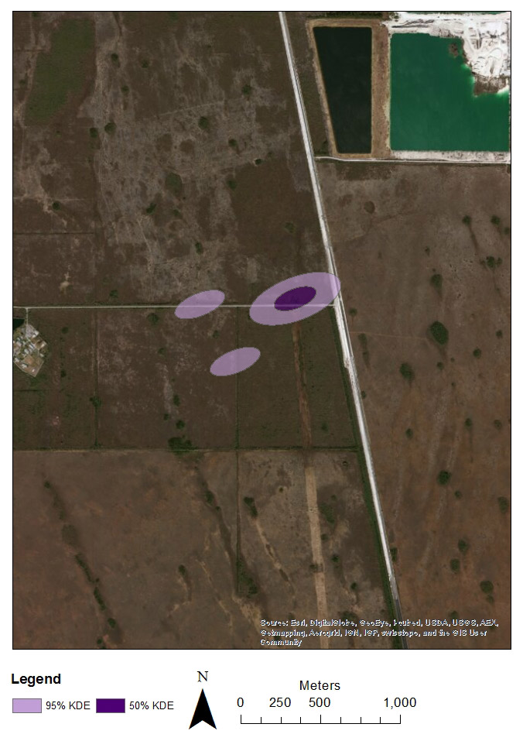
TuMe440
  5 May 2014 – 18 June 2014
  Tracked to multiple locations
  25 June 2014
    27 eggs
    25 hatched

Slide 8
Tegu Telemetry
Tegu ID | SVL (cm) | Mass (kg) | Monitoring period (days) | Number of locations | Mean daily distance moved (m) | 95% KDE (m2) | 50% KDE (m2)
TuMe380 | 33.5 | 1.16 | 72 | 29 | 2 | 34,238 | 6,991
TuMe409 | 31.5 | 1.16 | 51 | 20 | 17 | 325,648 | 89,753
TuMe440 | 35.5 | 1.2 | 44 | 18 | 9 | 165,605 | 22,014

Slide 9
Tegu Telemetry
Female tegu behavior
  Nesting
    Two different nest structures
  Sex ratio of clutches
    Upcoming

Slide 10
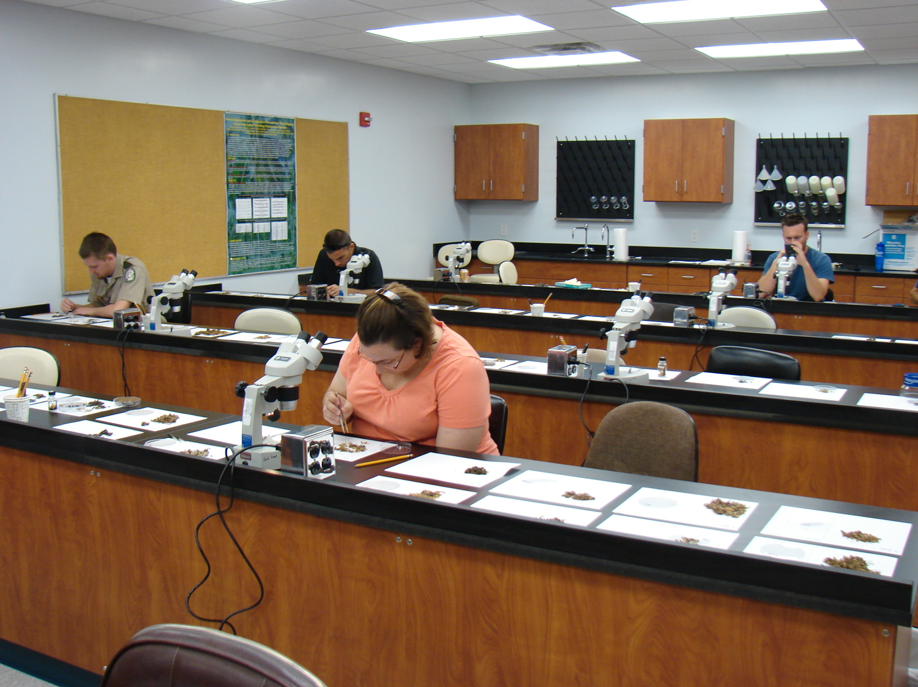
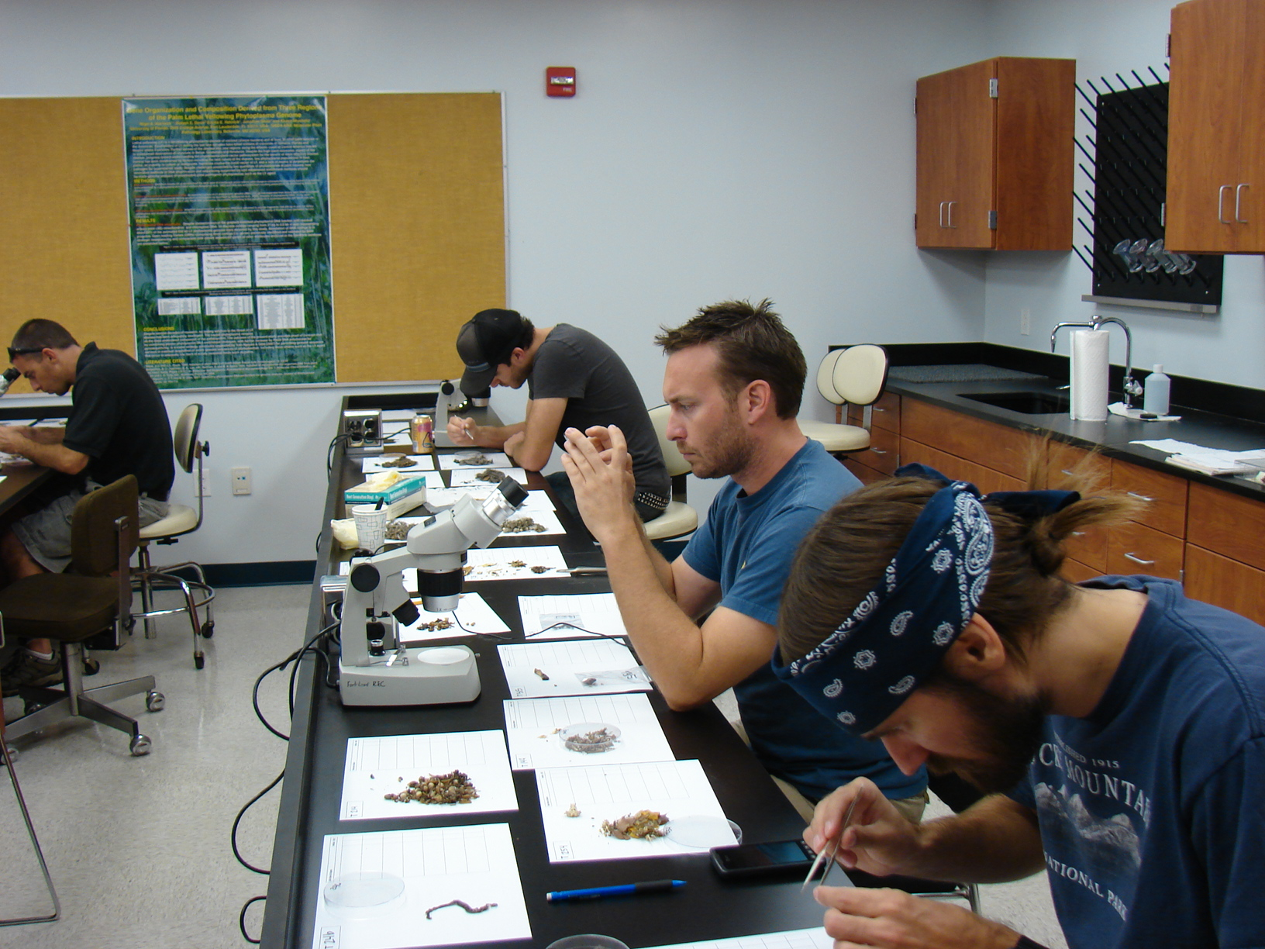
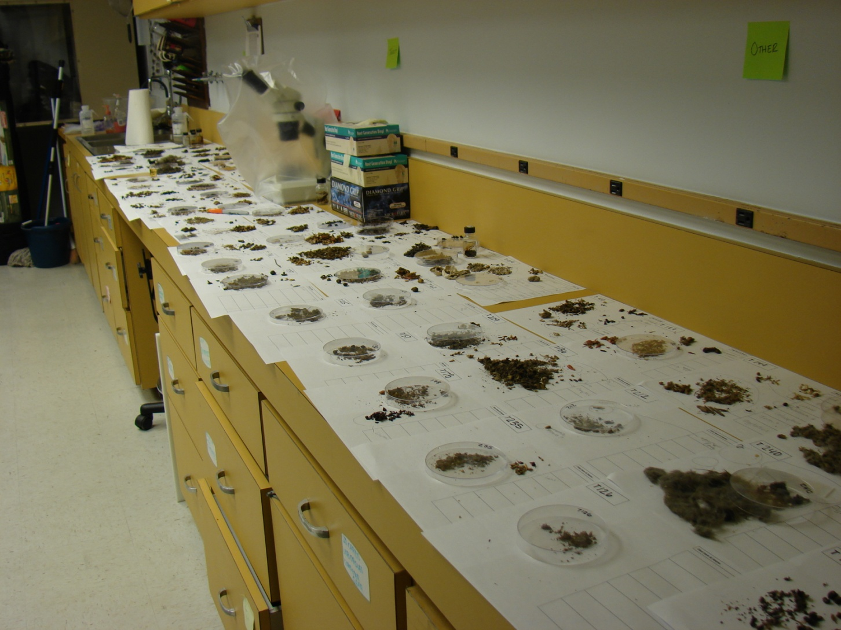
Tegu Gut Contents Analysis

Slide 11
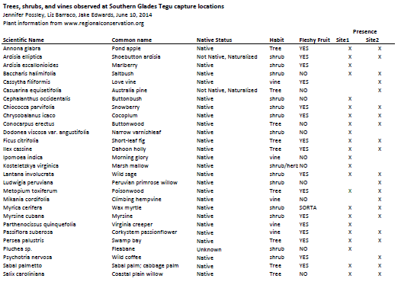
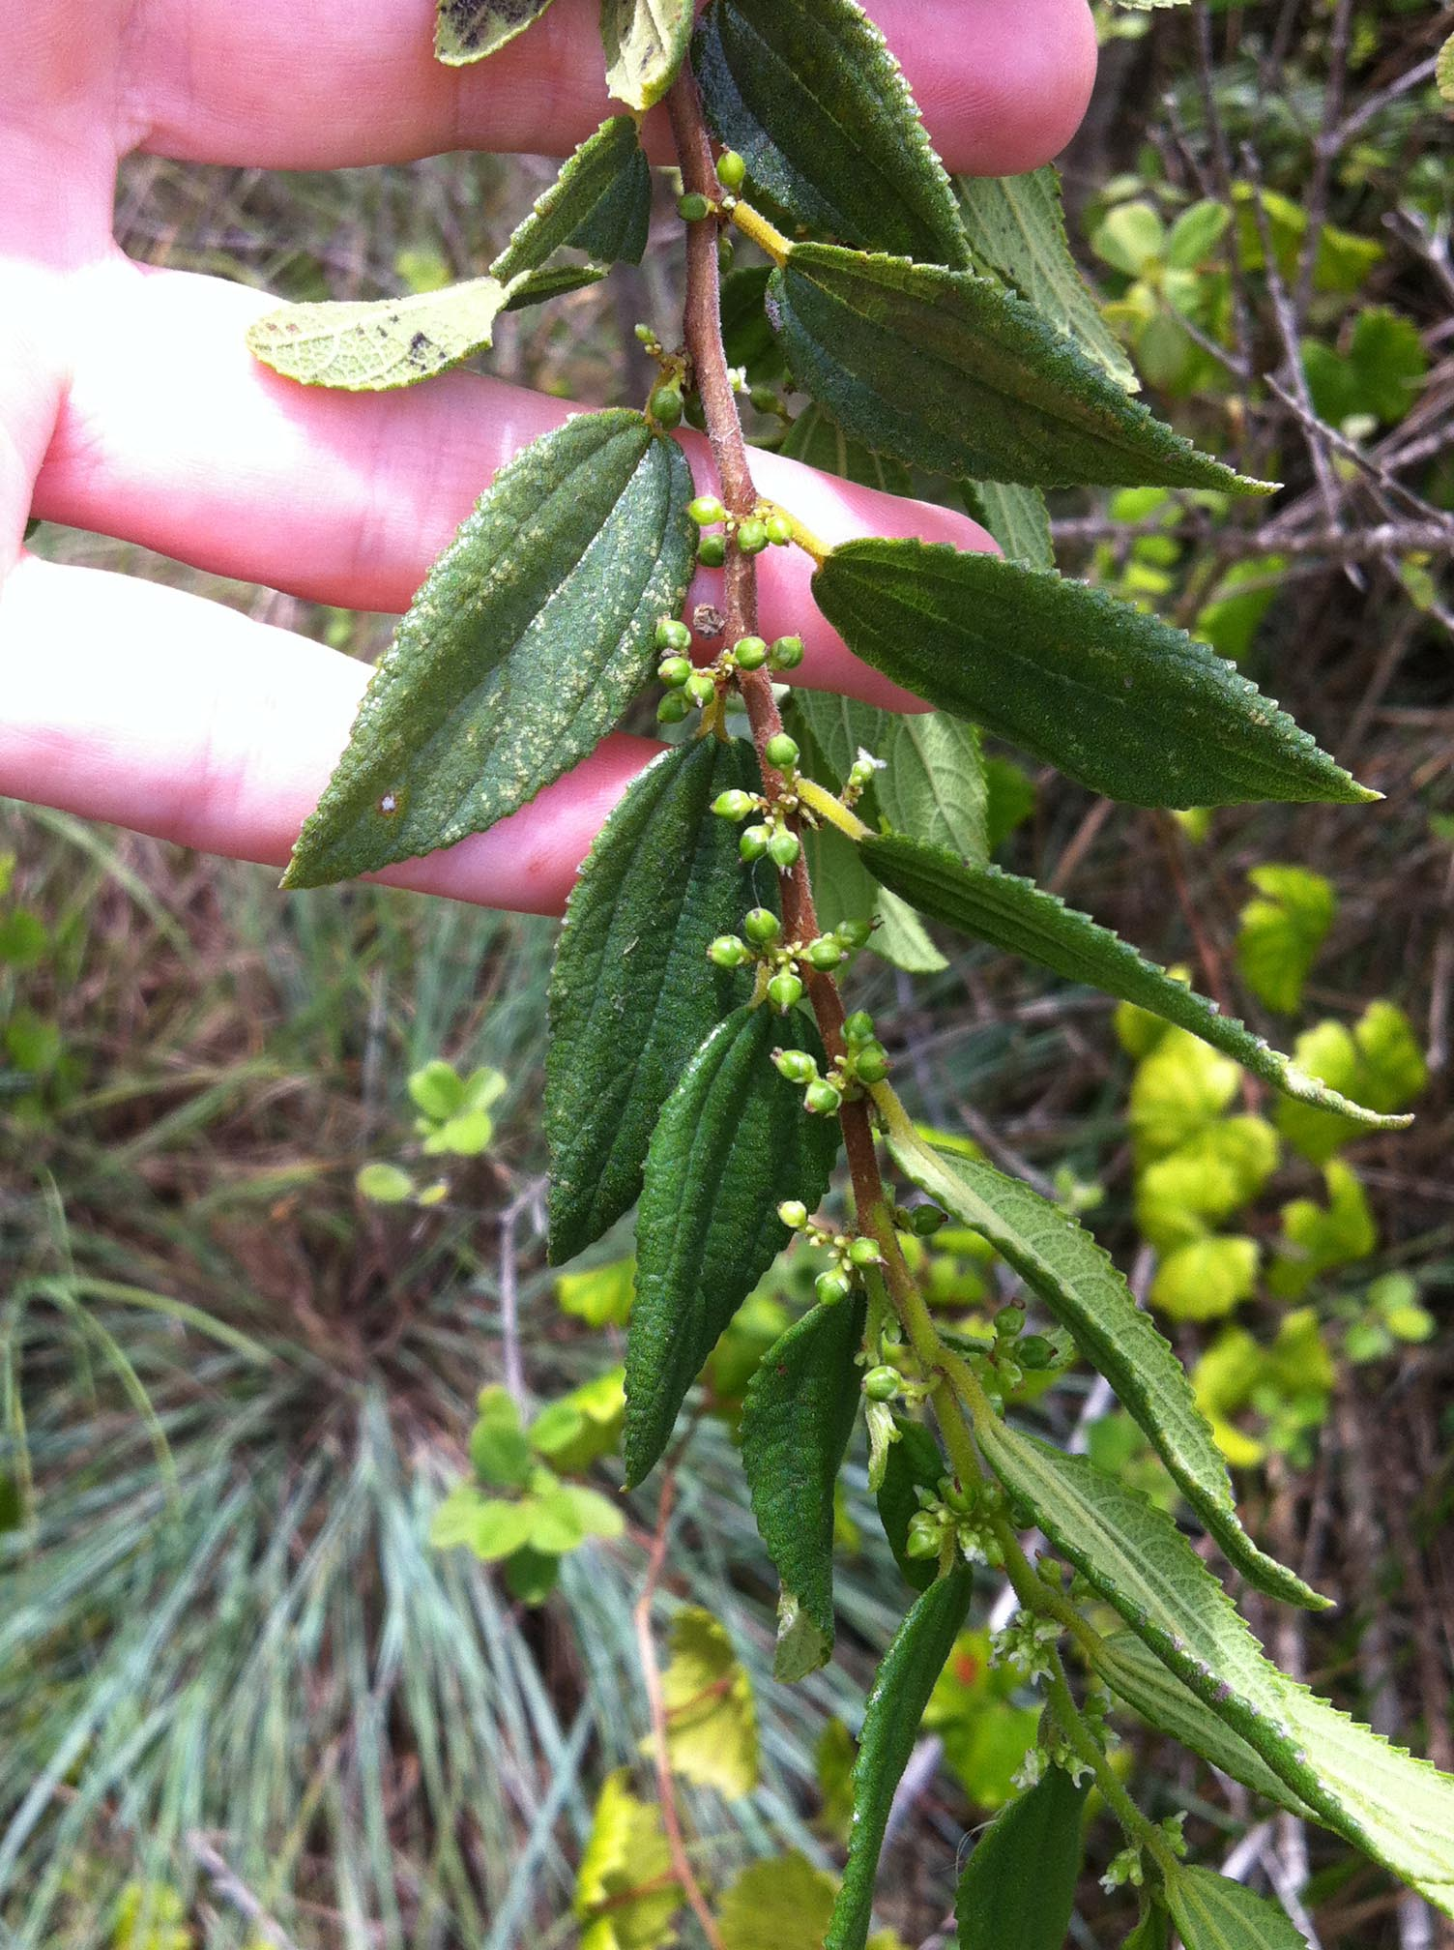
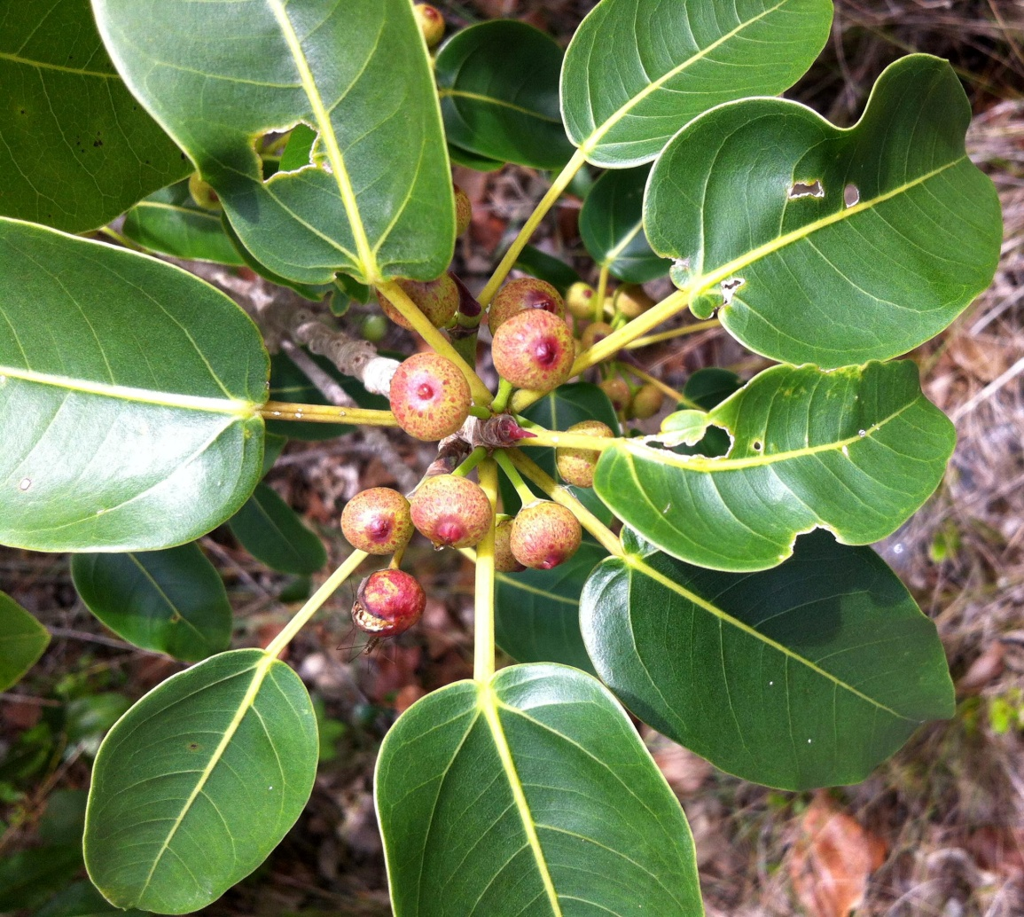
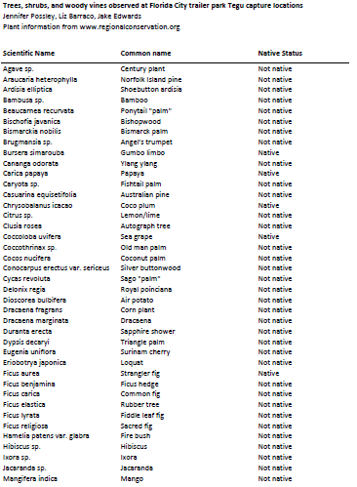
Tegu Gut Contents Analysis

Slide 12
Tegu Gut Contents Analysis
Category | Frequency of Occurrence
Crustacea | 8%
Gastropoda | 26%
Insecta | 71%
Plantae | 60%
Vertebrates | 39%
Eggs | 8%

Slide 13
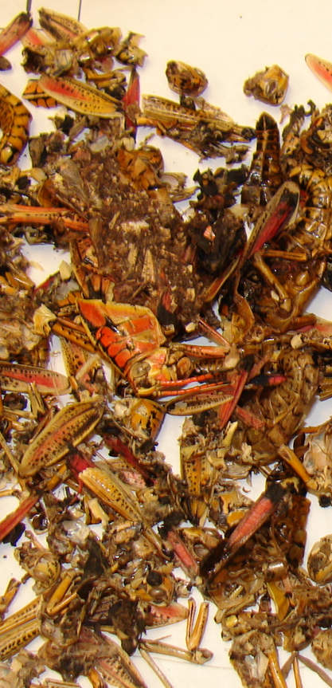
Tegu Gut Contents Analysis
Insecta (89; 71%)
24 families
  Romaleidae (60; 67%)
    Lubber grasshopper, Romalea guttata
  Carabidae (17; 19%)
  Scarabidae (11; 12%)

Slide 14
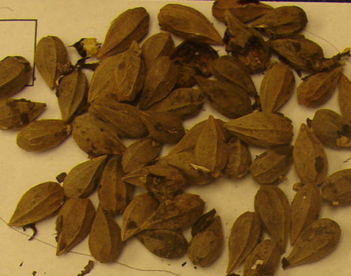
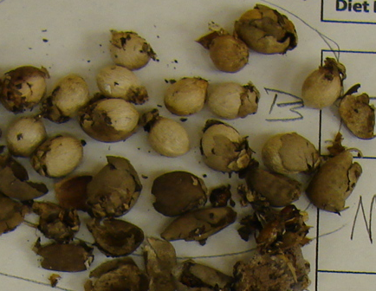
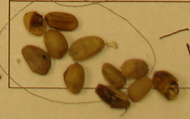
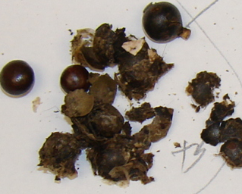
Tegu Gut Contents Analysis
Plantae (76; 60%)
17 families, 26 species
  Chrysobalanaceae (20; 26%)
    Cocoplum, Chrysobalanaus icaco
  Arecaceae (20; 26%)
  Anacardiaceae (16; 21%)
    Poisonwood, Metopium toxiferum

Slide 15
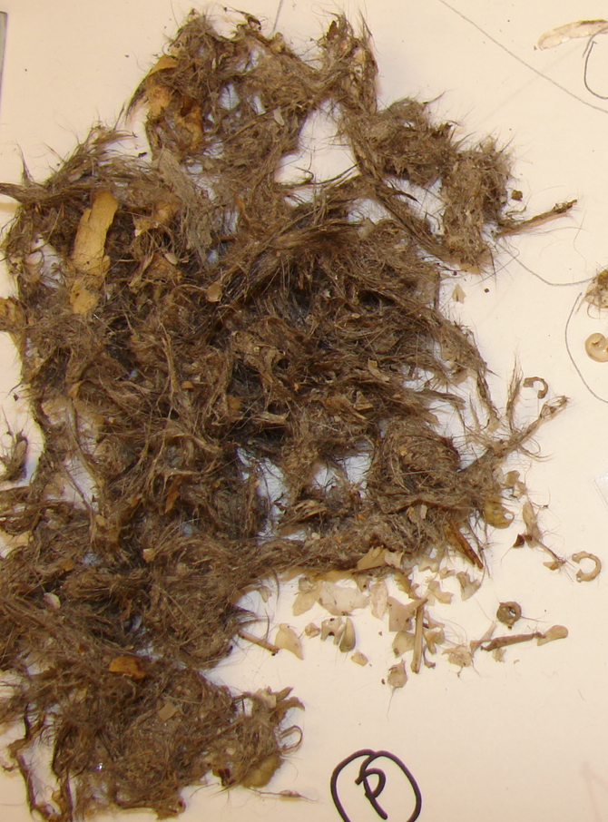
Tegu Gut Contents Analysis
Vertebrates (49; 39%)
Mammalia (28; 57%)
  Cricetidae (16; 57%)
    Cotton rat, Sigmodon hispidus
  Opossum, black rat, cat
Repitilia (9; 18%)
  Snakes (4; 45%)
  Lizards, turtles

Slide 16
Tegu Gut Contents Analysis
Varied diet
75% had multiple diet items
Where are the eggs?
Statistical analysis
  Size class
  Gender
  Collection location
  Collection date
  Body condition

Slide 17
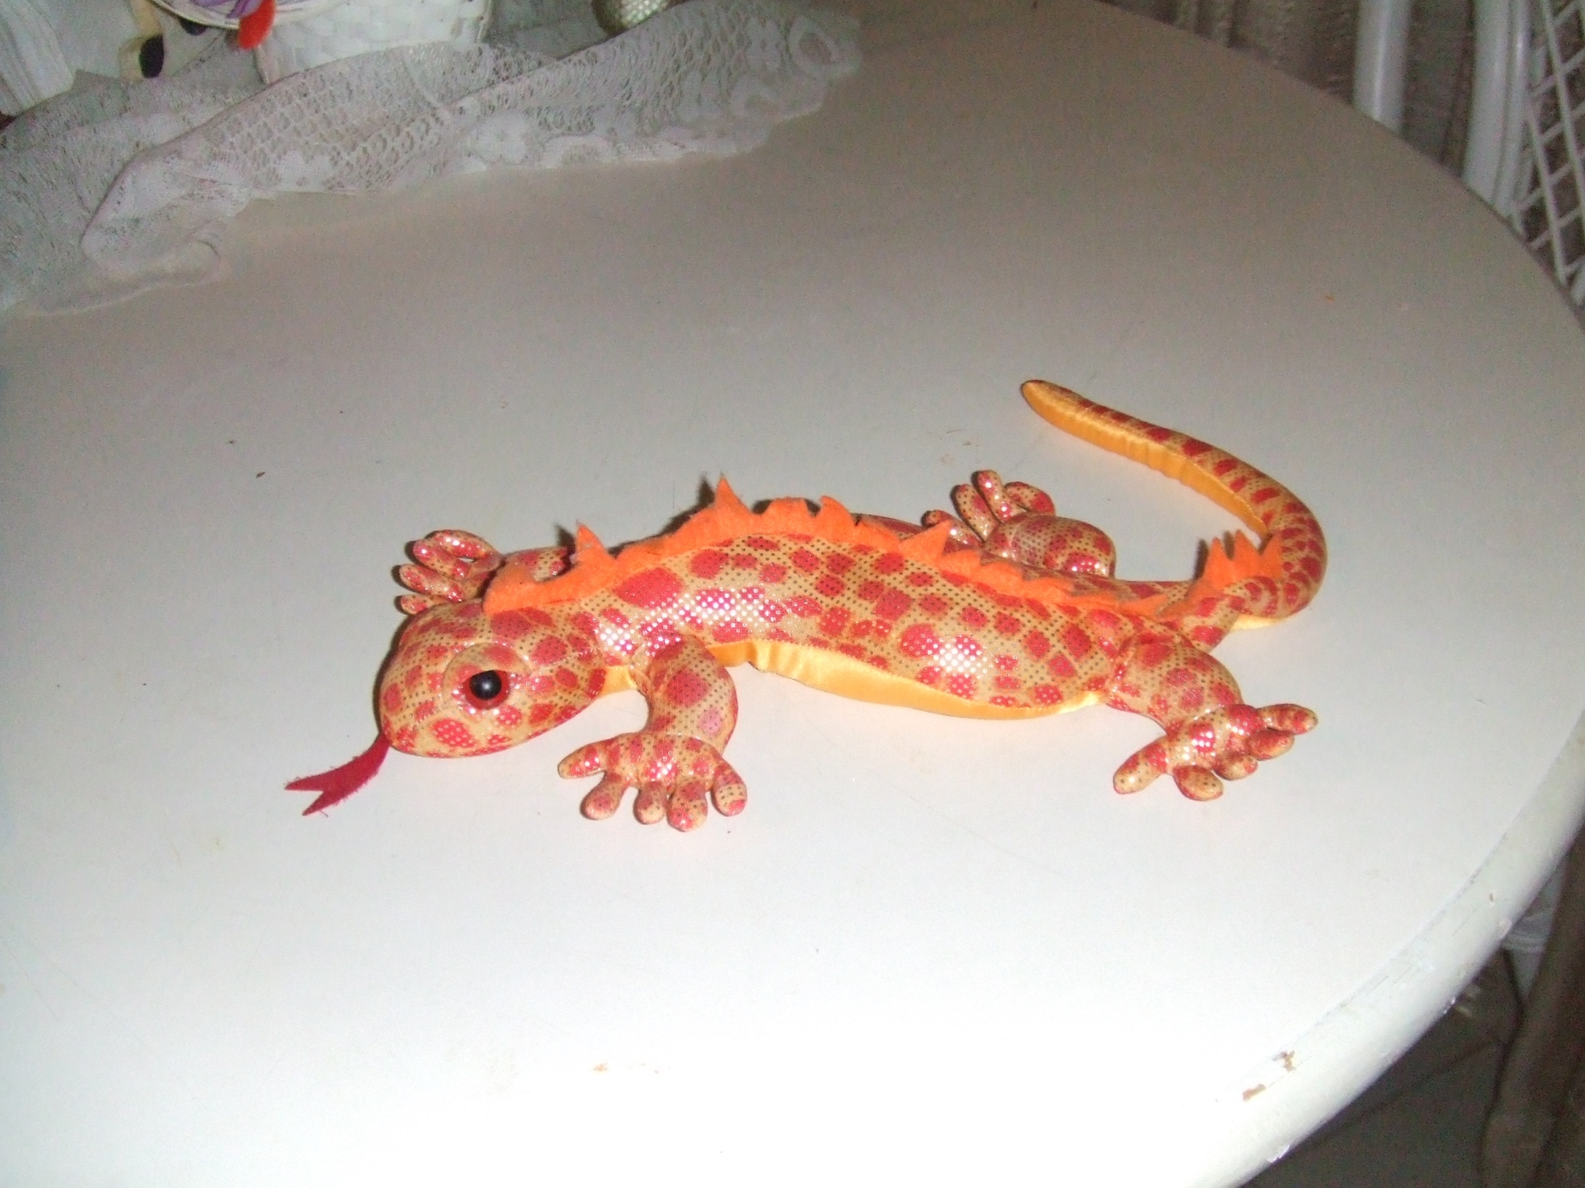
I hope you have enjoyed your lizard update!

