Slide 1
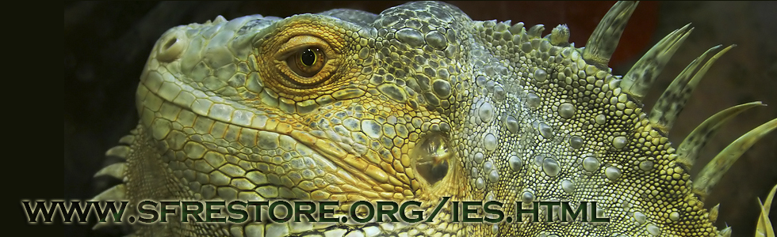
Invasive Exotic Species Strategic Action Framework Carrie Beeler U.S. DOI Office of Everglades Restoration Initiatives South Florida Ecosystem Restoration Task Force
July 24, 2014

Slide 2
The South Florida Ecosystem Restoration Task Force
Established by the Water Resources Development Act of 1996 and includes 14 top level policy makers from four sovereign entities:
7 federal, 2 tribal, 5 state and local government representatives
Duties:
Coordinates the development of consistent policies, strategies, plans, programs, projects, activities, and priorities addressing the restoration, preservation, and protection of the South Florida ecosystem.
South Florida Ecosystem =
Natural and Built environments within SFWMD boundary +
Coastal/Marine systems that are ecologically connected to the mainland
Florida-based Working Group and Science Coordination Group
Office of Everglades Restoration Initiatives
Notes:
The South Florida Ecosystem Restoration Task Force (Task Force) was established by section 528(f) of the Water Resources Development Act of 1996. The Task Force consists of 14 members from four sovereign entities. There are seven federal, two tribal, and five state and local government representatives. The duties of the Task Force are to:
Coordinate the development of consistent policies, strategies, plans, programs, projects, activities, and priorities addressing the restoration, preservation, and protection of the South Florida ecosystem; Exchange information regarding programs, projects and activities of the agencies and entities represented on the Task Force to promote ecosystem restoration and maintenance; Facilitate the resolution of interagency and intergovernmental conflicts associated with the restoration of the South Florida ecosystem among the agencies and entities represented on the Task Force; Coordinate scientific and other research associated with the restoration of the South Florida ecosystem; Provide assistance and support to agencies and entities represented on the Task Force in their restoration activities.

Slide 3
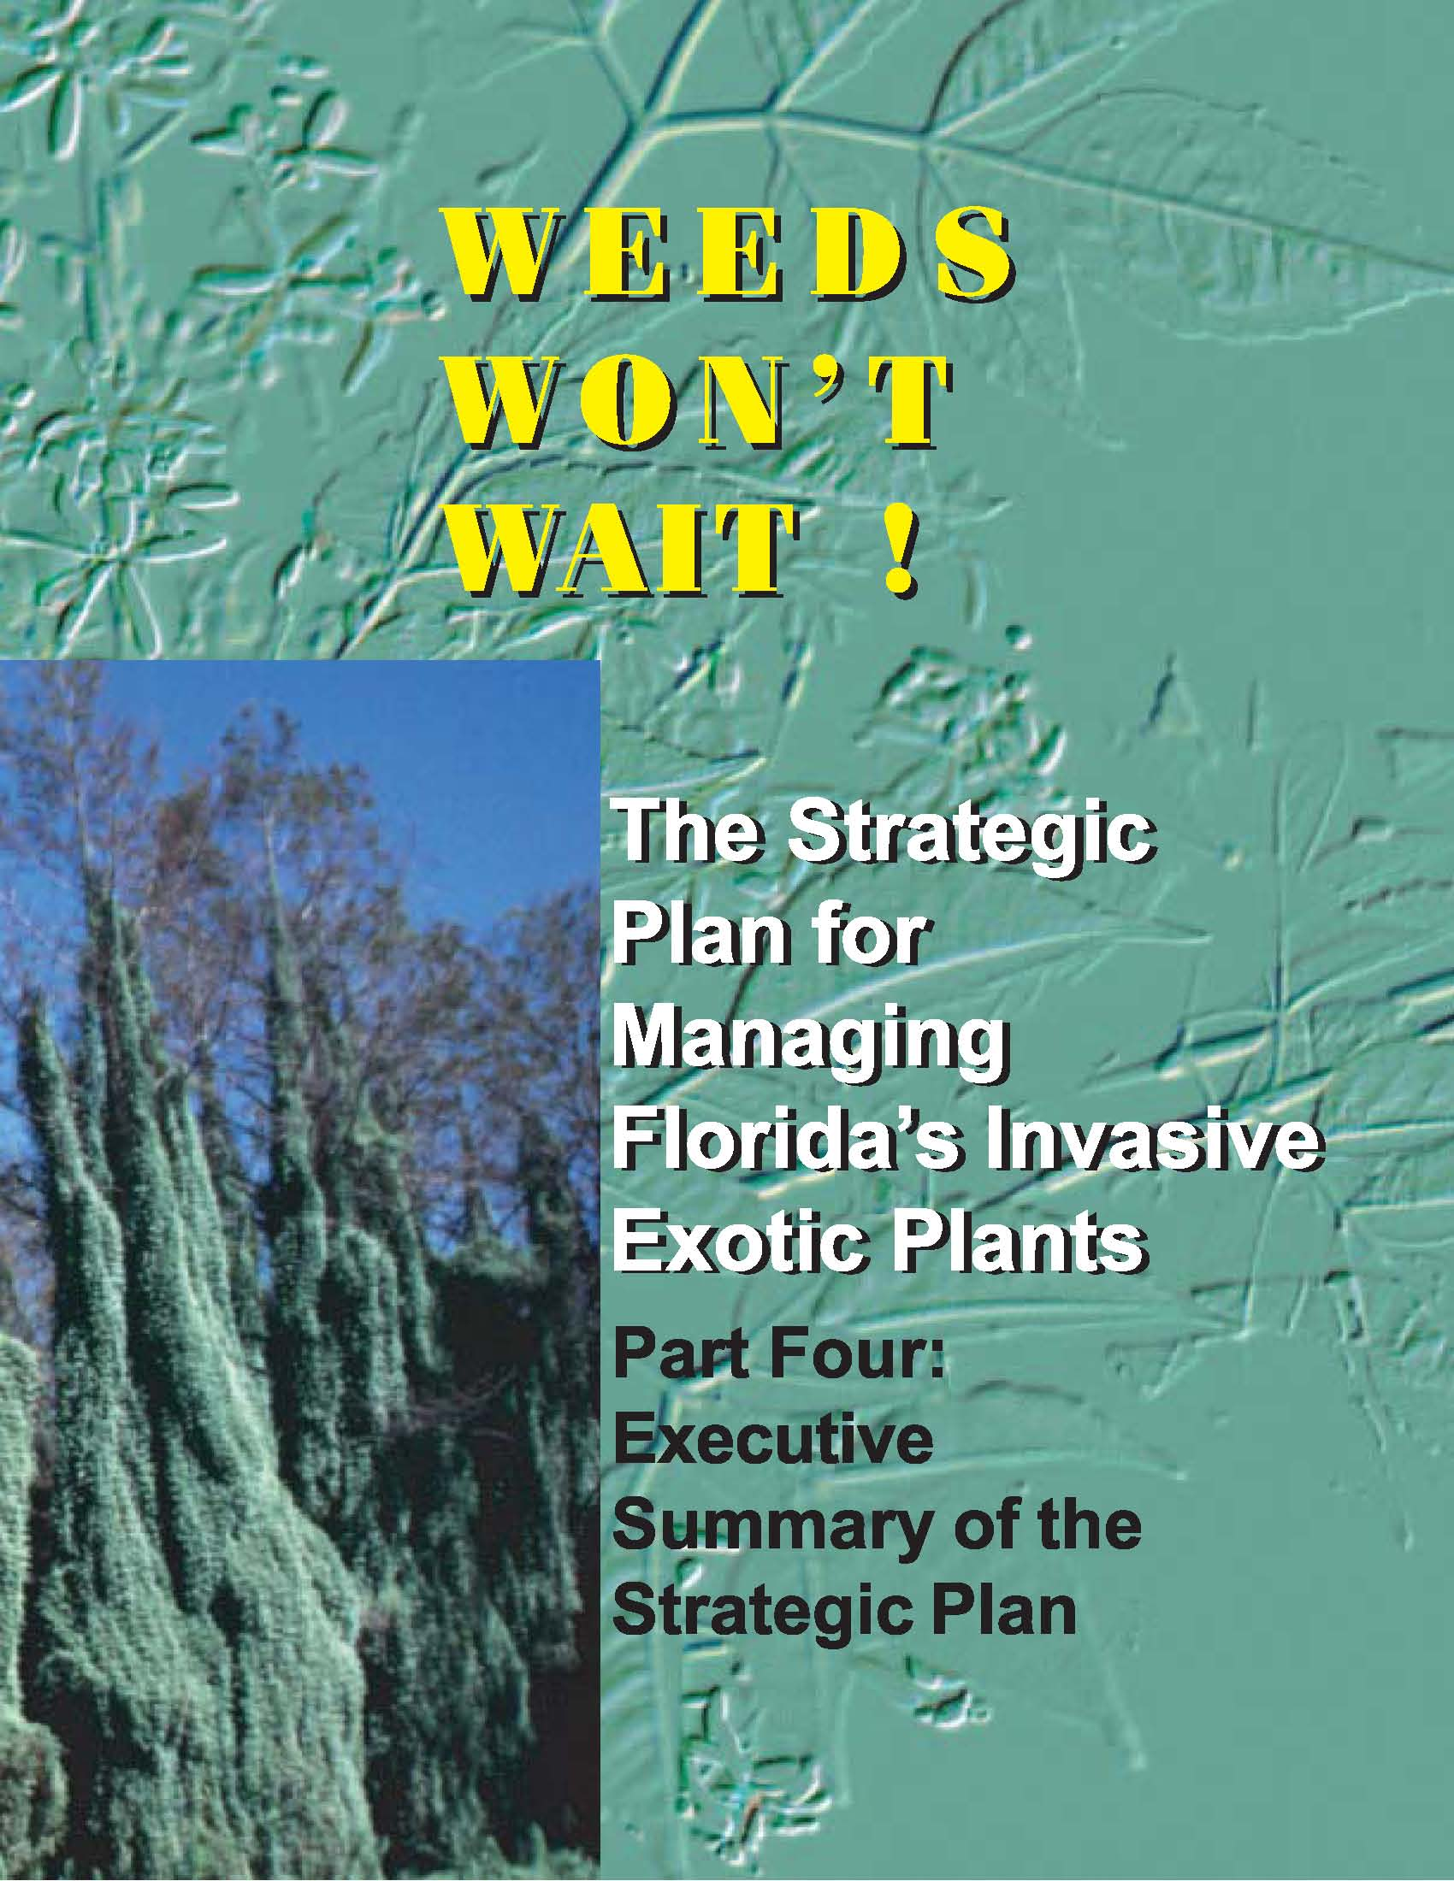
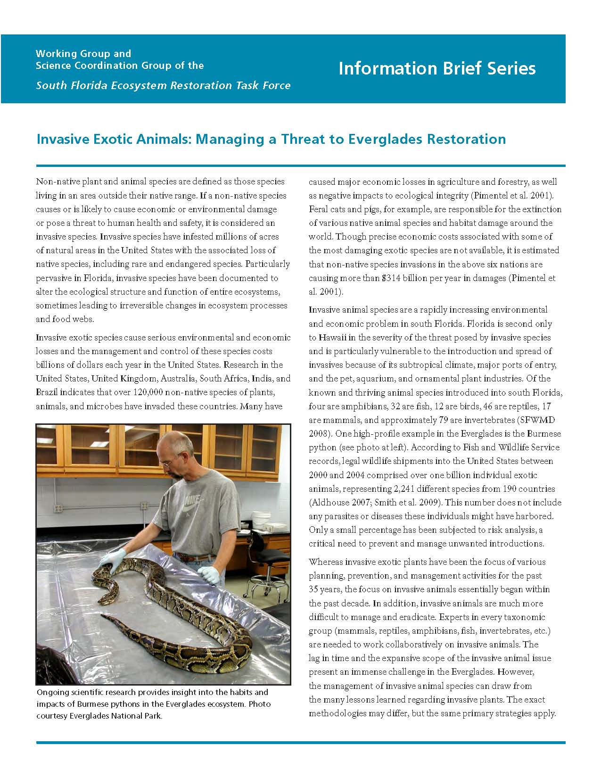
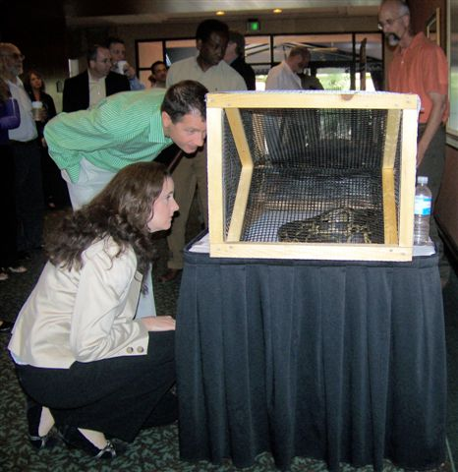
Brief History of Task Force/ Working Group Invasive Efforts
1997: NEWTT
2000: Weeds Won’t Wait
2004: FIATT
2008: FIATT Draft
2010: Information Brief
2012: TF Direction:
Review current efforts and provide updated recommendations

Slide 4
What we Learned
That we know what it takes to solve this problem
Effective invasive exotic species management requires an integrated approach with sustained resources
July 9, 2013 Task Force direction
Develop a comprehensive Invasive Exotic Species (IES) Strategic Action Framework that includes a cross cut budget tool

Slide 5
Why a Strategic Action Framework?
Help decision-makers understand the connections between goals, strategies, and tactics;
Maximize the extent to which the current capacity for partnership is leveraged to meet common goals;
Help decision-makers make wise and timely investment decisions in the battle against invasive exotics; and
Define success and provide for accountability.

Slide 6
Current Status
More than 25 agencies, tribal governments, academic institutions, and NGOs are simultaneously developing under the coordination of OERI:
Printable Framework document
Web-based Framework
Suite of case studies
Cross-cut budget tool
Consistent IES goals included in reporting requirements to Congress, Task Force members, and the public (Strategy and Biennial Report 2014)
Notes:
Easily digestible, short, printable framework
Further layers of details available on the web
2-pager case studies
Next meeting will be having the SW CISMA join us

Slide 7
Science, Coordination, Outreach, and Funding are Vital
Science forms the foundation for the strategies within every goal area.
Success will require interagency cooperation, innovative partnerships, and an informed, involved public.
A successful invasive exotic species program requires long-term commitment of resources.
Notes:
Science, outreach, coordination, and funding are addressed within every goal.

Slide 8
The Invasion Curve
How we assess the challenges, establish our goals, and formulate our strategies

Slide 9
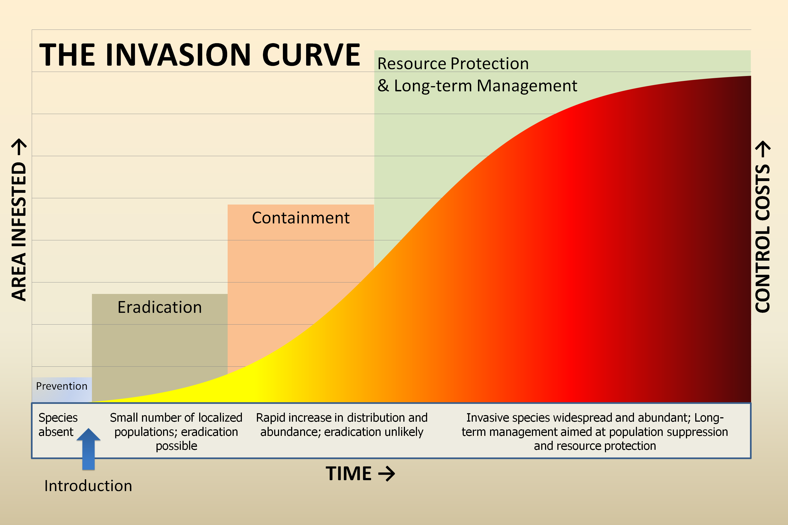
Notes:
COST BENEFIT (BANG FOR THE BUCK)

Slide 10
Goal 1: Prevent the introduction of invasive exotic species.

Slide 11
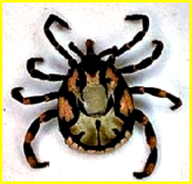
Goal 1: Prevent introduction of invasive exotic species
Preventing introductions of new invasive exotic species is the most cost effective strategy and can yield benefits provided funding and current barriers are addressed up front.
Objectives:
Prepare & Prioritize: Prepare for and prioritize prevention efforts.
Prevent: Prevent entry of invasive exotic species.
Examples:
Lacey Act Authority
Don’t Pack a Pest
Case Studies:
Heartwater Diseases
Tropical Bont Tick
Photo: USFWS Law Enforcement
Notes:
Prepare & Prioritize:
Identify pathways and prioritize potential threats;
Engage stakeholders and public
Prevent:
Enhance and improve pathway inspection/screening process
Develop new/utilize existing voluntary and regulatory tools
Improve pathway awareness and engage public

Slide 12
Goal 2: Eradicate invasive exotic species by implementing Early Detection and Rapid Response (EDRR).

Slide 13
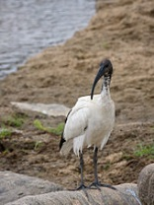
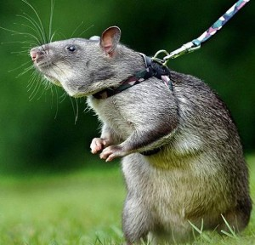
Goal 2: Eradicate invasive exotic species by implementing EDRR
Successful eradication of newly established invaders through EDRR requires formal collaboration and dedicated staff and funding.
Objectives:
Prepare & Monitor: Prepare and monitor to enhance early detection.
Assess: Ensure rapid assessment of newly detected species.
Respond: Rapidly respond to identified threats.
Case Studies:
Gambian Pouched Rats
Sacred Ibis
Tephritid fruit flies
Sacred Ibis
Gambian Pouch Rat
By: Poskan Komentar
Notes:
Prepare & Monitor:
Implement multi-species monitoring/inventory plan
Utilize existing network to increase likelihood of detection
Employ science and technology for development of early detection tools
Engage public and provide reporting mechanisms
Establish rapid assessment and response programs, etc.
Asses:
Rapidly assess status/threat of newly detected species (EDRR Plan)
Respond:
Initiate rapid response based upon plan of action developed during the assessment phase (Strike teams, etc.)

Slide 14
Goal 3: Contain the spread of invasive exotic species.

Slide 15
Goal 3: Contain the spread of invasive exotic species
Consistent resources to address containment, resource protection, and long-term management are needed.
Objectives:
Contain: Utilize existing control tools to contain invasive exotic species.
Improve: Improve effectiveness of containment efforts on invasive exotic species populations.
Notes:
Contain:
Implement BMPs.
Control efforts at containment boundaries and known pathways.
Retreat or reassess to ensure containment
Eliminate incipient populations
Enforce existing laws regarding transporting/releasing IES
Improve:
Invest in science-based containment methods
Assess effectiveness of containment efforts and adapt to improve success
Standardize efforts through enhanced coordination
Improve public awareness of need for ongoing containment efforts

Slide 16
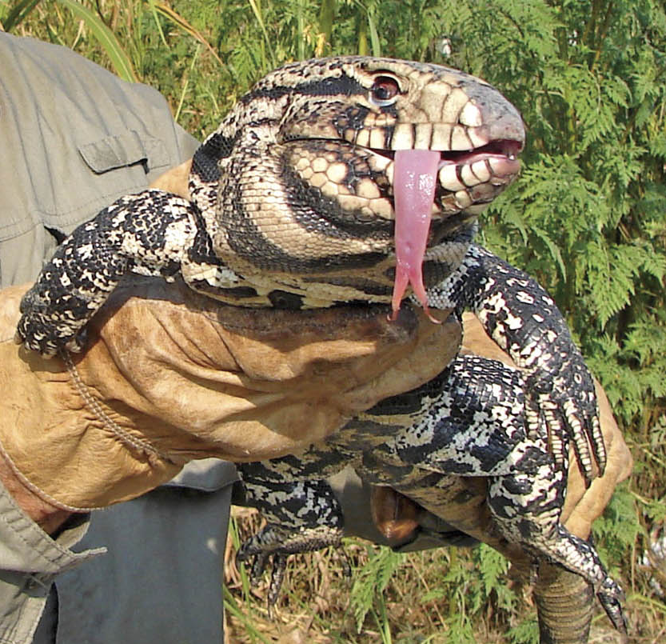
Goal 3: Contain the spread of invasive exotic species
Argentine Black and White Tegu
Case Studies:
Argentine black and white tegu
Examples:
Lacey Act Authorities
Photo: Dennis Giardina, FWC

Slide 17
Goal 4: Reduce the populations of widely established invasive exotic species and maintain at lowest feasible levels.

Slide 18
Goal 4: Reduce the populations of widely established invasive exotic species and maintain at lowest feasible levels.
Consistent resources to address population reduction, resource protection, and long-term management are needed.
Objectives:
Combat: Reduce population and extent of established invasive exotic species through Integrated Pest Management approaches.
Restore & Recover: Reduce impacts of invasive exotic species through restoration of native habitats and species.
Improve: Improve effectiveness of long-term management efforts on invasive exotic species populations.
Notes:
Combat:
Strive to eliminate the impact of IES on natural areas by implementing Integrated Pest Management approach
Conduct routine surveys to determine populations
Restore and Recover:
Support efforts to increase total spatial extent of natural areas and restore natural hydrology
Coordinate IES management with restoration activities to prevent degradation of habitat.
Reintroduce extirpated/rare species and augment existing populations to improve native species abundance/diversity
Recover ecological functions and ecosystem services.
Improve:
Assess effectiveness and adapt to improve success.
Conduct inventory/monitoring to improve understanding of IES population growth in order to develop better control methods.
Develop/improve tools
Integrate efforts across agencies

Slide 19
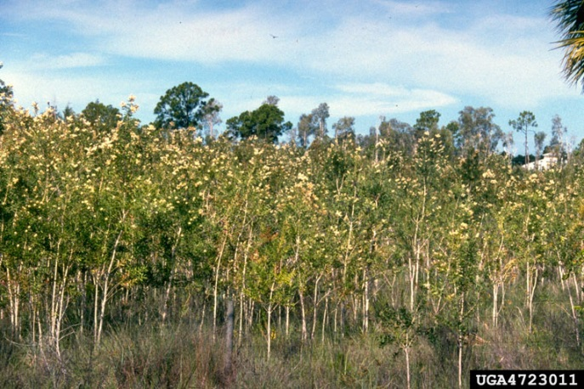
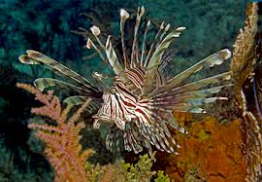
Goal 4: Reduce the populations of widely established invasive exotic species and maintain at lowest feasible levels.
Case Studies:
Shoebutton Ardisia
Ambrosia beetle/laurel wilt disease
Lionfish
Burmese python
Melaleuca
Melaleuca
By: Min B Rayamajhi
Lion Fish
By: Reef.org
Notes:
Chose from long list, including lygodium

Slide 20
Invasive Exotic Species Strategic Action Framework
Next Steps

Slide 21
Schedule
August 27: IES Working Meeting (@MODS)
September 16: Draft IES Strategic Action Framework presented to Working Group/Science Coordination Group (@SFWMD)
October 2: IES Working Meeting
October 23: Final IES Strategic Action Framework presented to Working Group/Science Coordination Group (@SFWMD)
November 18: Final IES Strategic Action Framework presented to Task Force (@SFWMD)

Slide 22
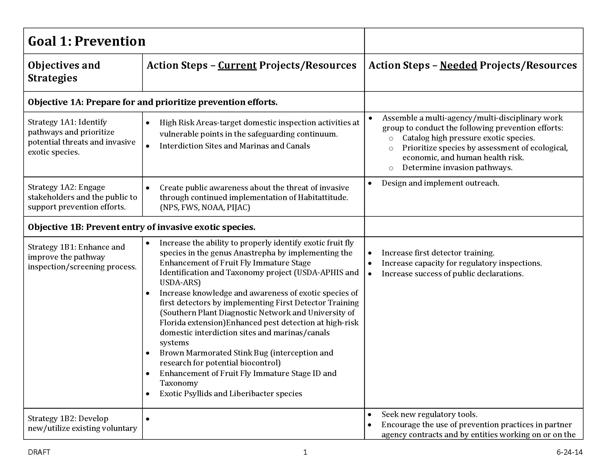
Schedule – DUE July 25th ☺

