Slide 1
IveGot1 and EDDMapS Update
Chuck Bargeron
The University of Georgia

Slide 2
Overview
Website Update
EDDMapS Florida Update
IveGot1 Smartphone Apps
IPCConnect

Slide 3
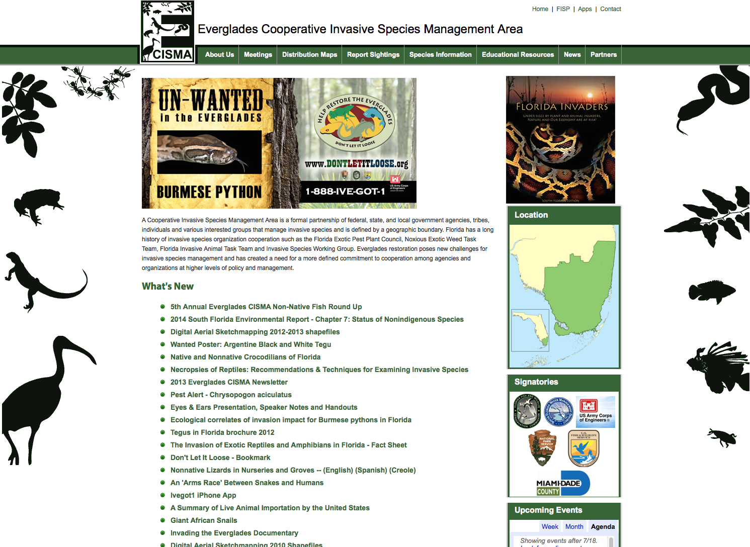
WeBSITE UPDATE

Slide 4
ECISMA - Web Traffic

Slide 5
Overall Traffic
554,210 Page Views
319,102 Visitors
2,548,550 Hits

Slide 6
Popular Pages
Species Info page (all species)
Home Page
Fish Roundup
About ECISMA
Don’t let it loose
Educational Resources
Reptile Card Deck
The Invasion of Exotic Reptiles and Amphibians in Florida
2013 ECISMA Newsletter

Slide 7


Social Media
222 likes
380 Followers
458 Tweets

Slide 8
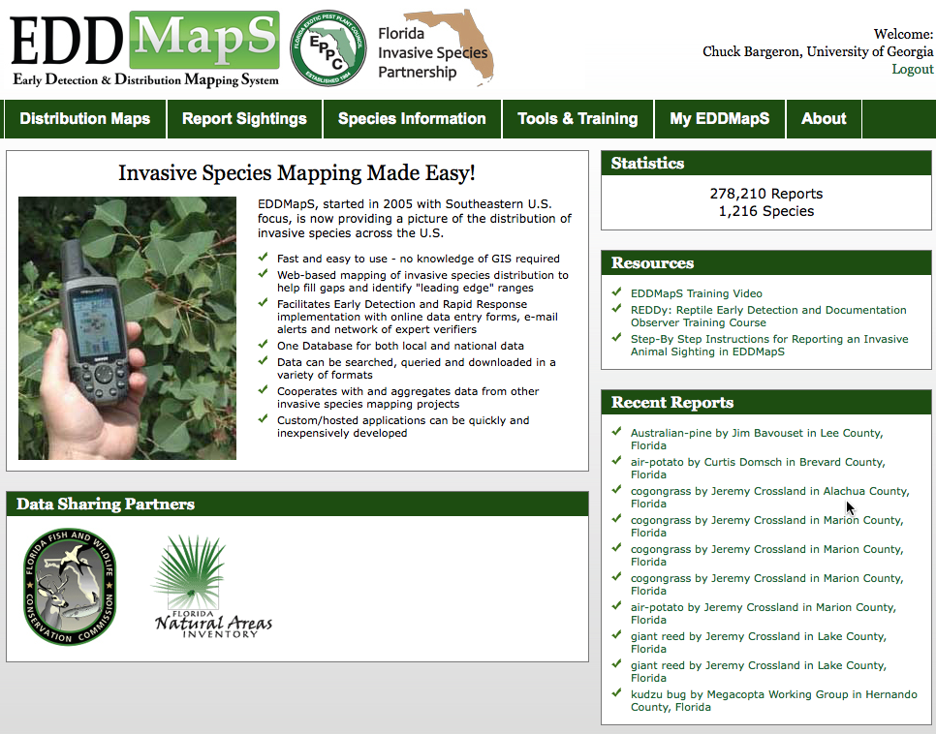
EDDMaPS Florida UPDATE

Slide 9
Statistics - Overall
278,211 Reports
1,216 Species
1,376 Reporters
3,083 Web Reports
416 iPhone Reports
315 Android Reports

Slide 10
Statistics – Last Year
7,630 Reports
1,216 Species
382 Reporters
277 Web Reports
142 iPhone Reports
170 Android Reports

Slide 11
EDDMapS Florida Statistics
Of the 985 reports from smartphones in Florida, there were 230 unique reporters.
111 of these reporters only submitted one record.
37 of these reporters only submitted 2 records
The most records reported by a single reporter were 99 and second most was 72 both from professionals.

Slide 12
EDDMapS Florida Statistics
What were the reports?
Overall

Slide 13
EDDMapS Florida Statistics
What were the reports?
Smartphones

Slide 14
EDDMapS Coming Soon Live as of Yesterday

Slide 15
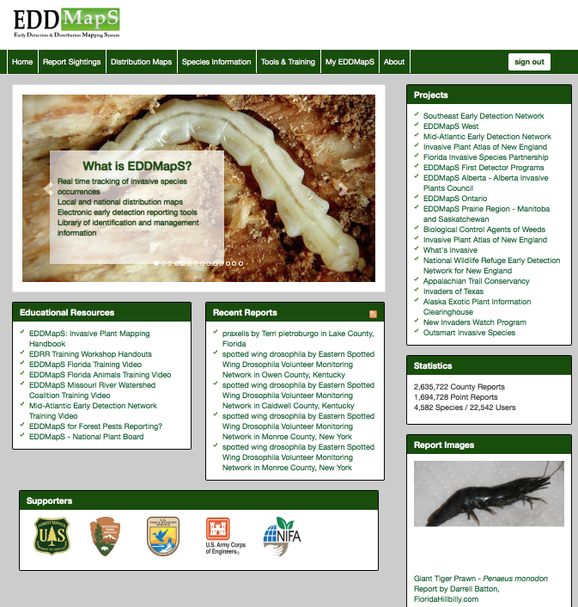

Slide 16
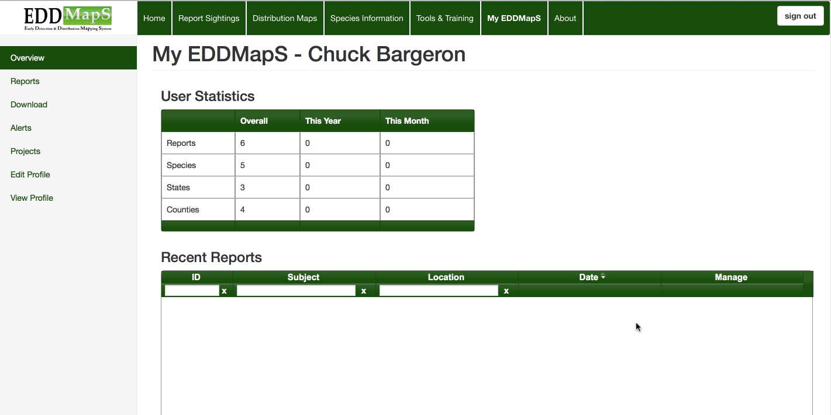
New My EDDMapS with New Features Under Development

Slide 17
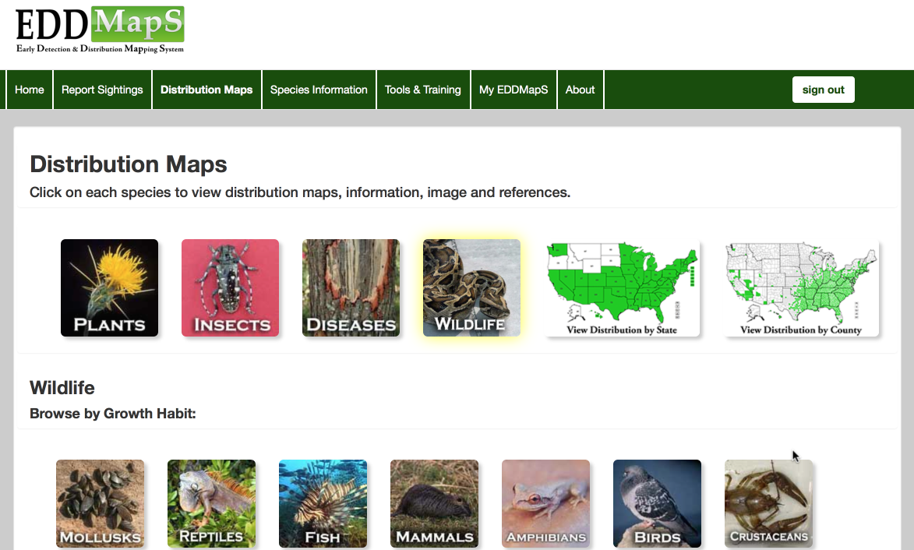
All Taxa from EDDMapS Home

Slide 18
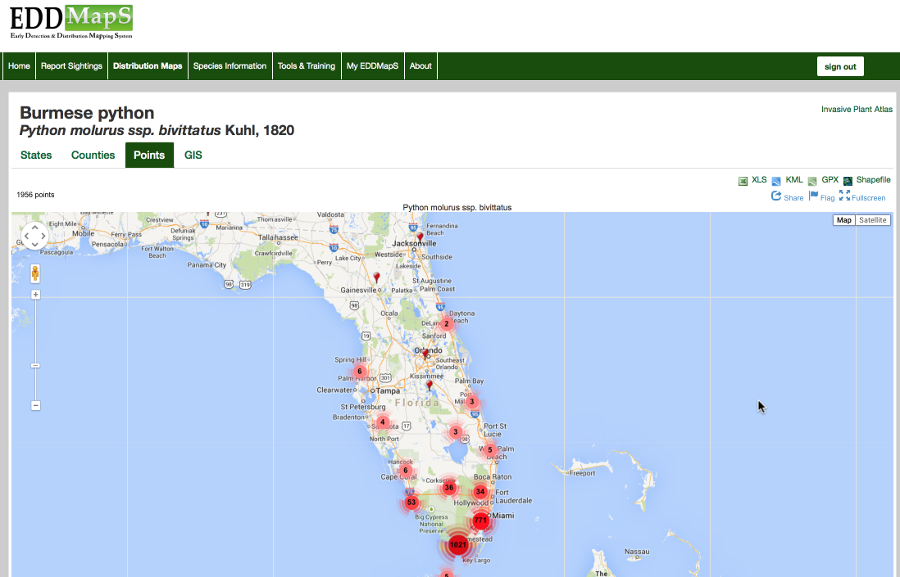

Slide 19
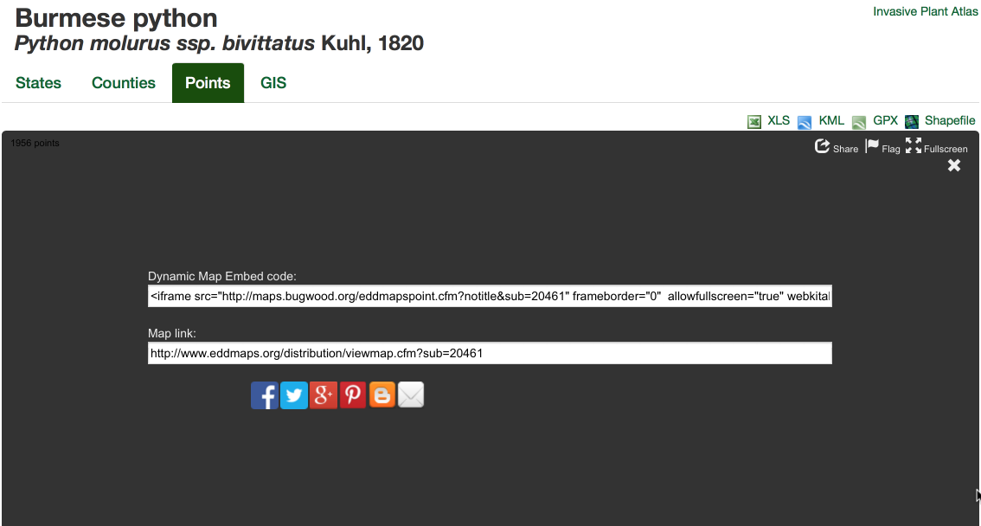

Slide 20
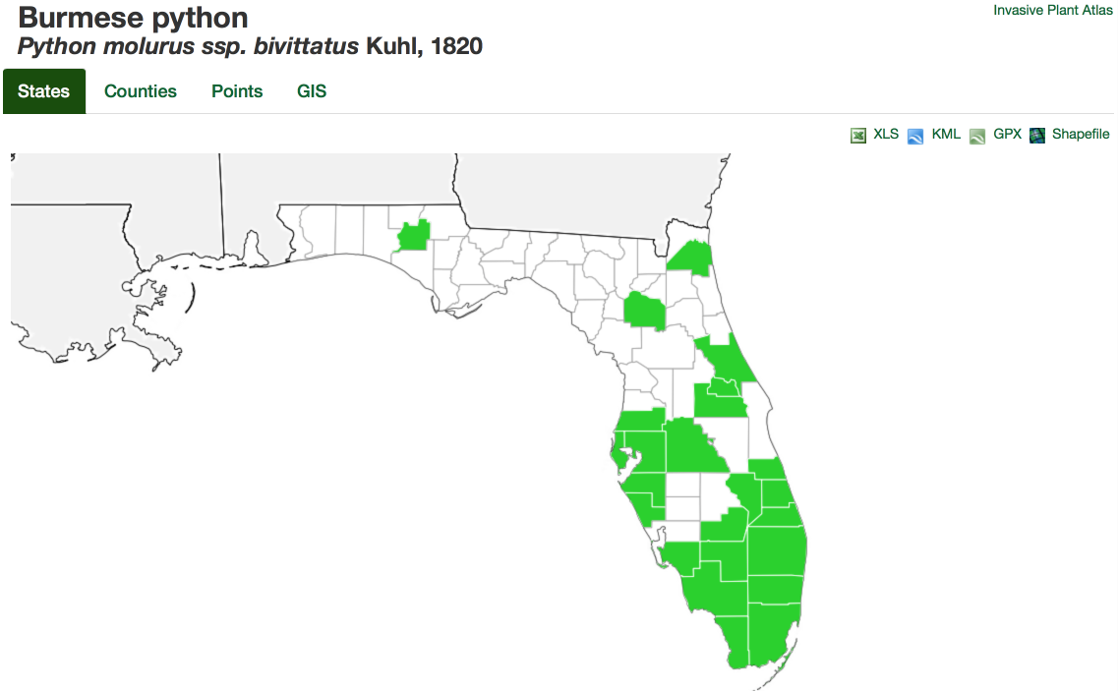

Slide 21
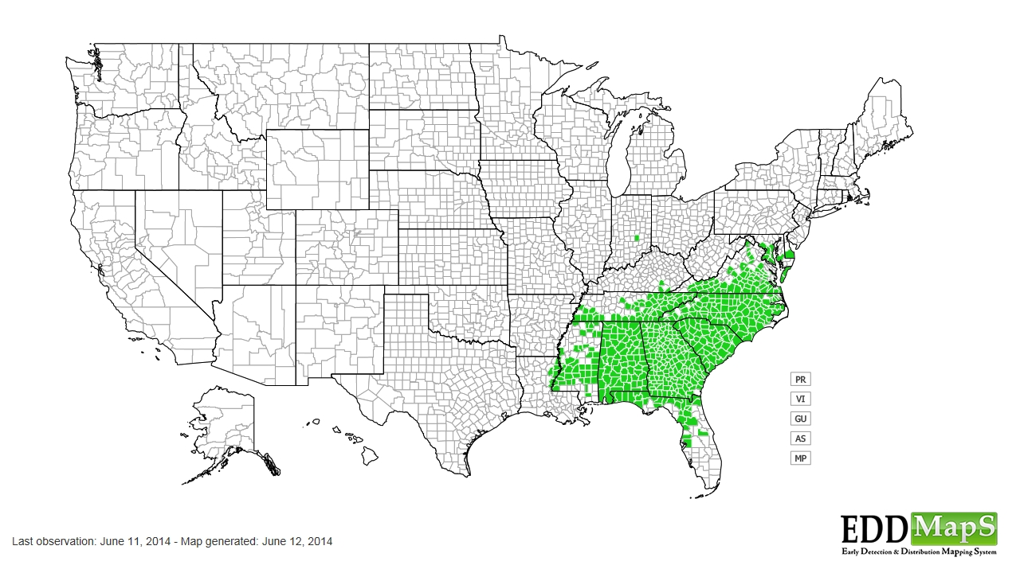
JPEGs Generated of Maps for Easy Download
Kudzu Bug Distribution

Slide 22
EDDMapS 3.0
Unified Interface, Maps and Reporting Forms
Responsive Design (works great on all platforms)
Once Implemented of Sub-sites (EDDMapS Florida) – Changes will be Global (less bugs)
All Modules on Sub-sites (no more bouncing between EDDMapS Home and Sub-sites)

Slide 23
EDDMapS 3.0 Coming Soon
Polygon support
Negative data support
Better clustering on point maps
Color coding – historic records (herbarium) vs recent reports
Color coding – positive, negative, eradicated, under treatment?
Better error checking on report forms
Email validation
Finally, follow-ups with users after reports and after review

Slide 24
EDDMapS GIS
http://gis.eddmaps.org/apps/eddmapsflorida/
Still in “beta” testing
EDDMapS data running on ArcGIS server
Can connect via ArcGIS Desktop
Speed enhancements over Google Maps for polygons, but has some limitations

Slide 25
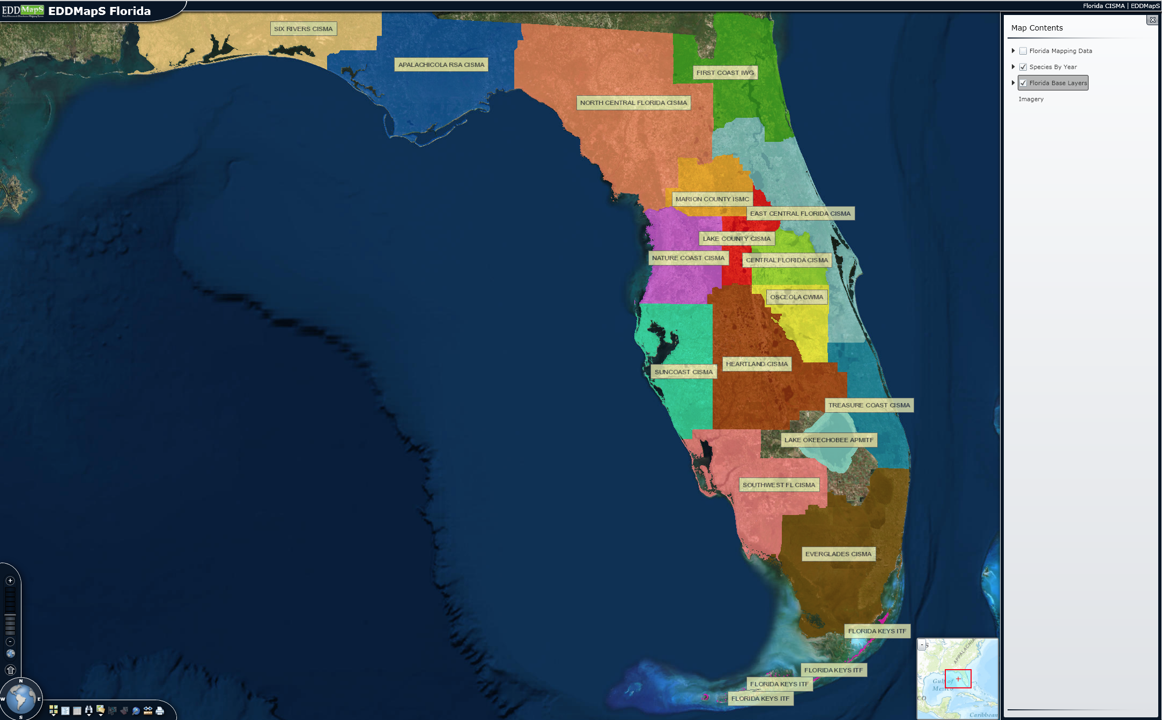

Slide 26
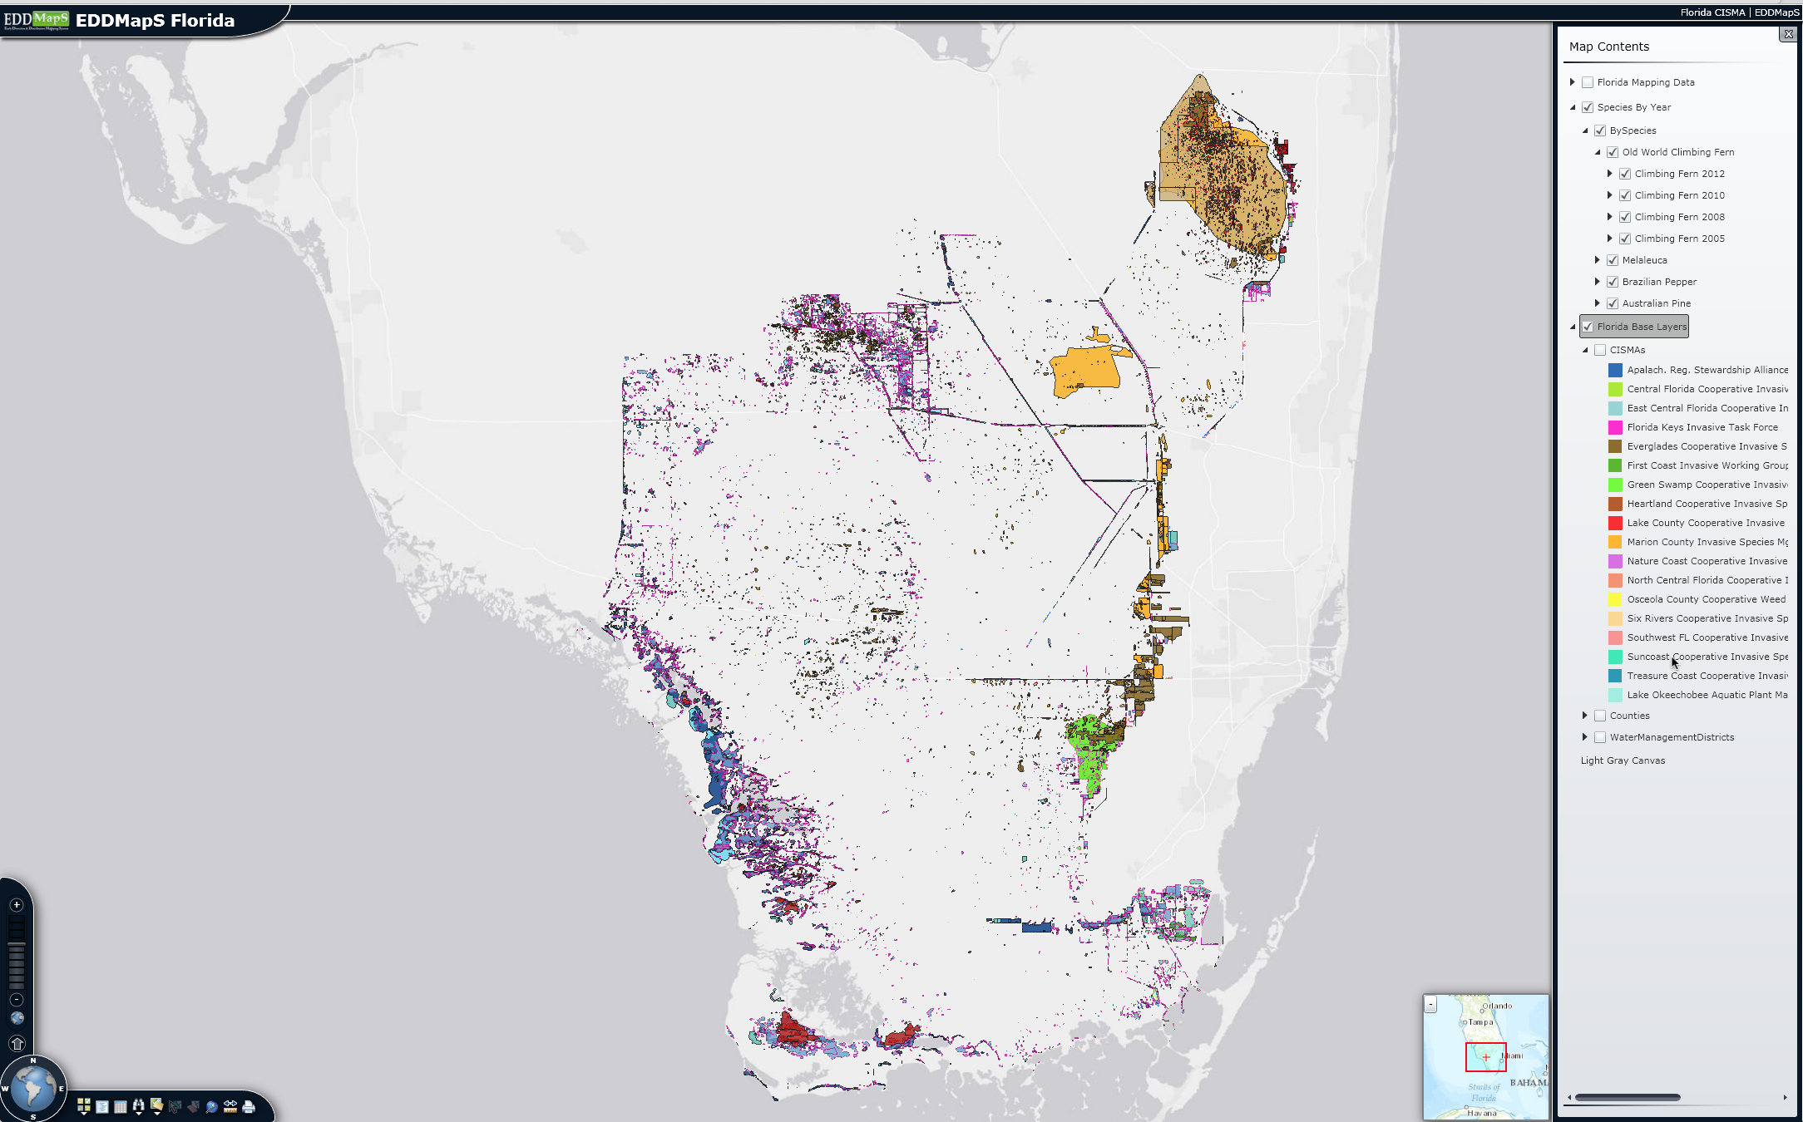

Slide 27
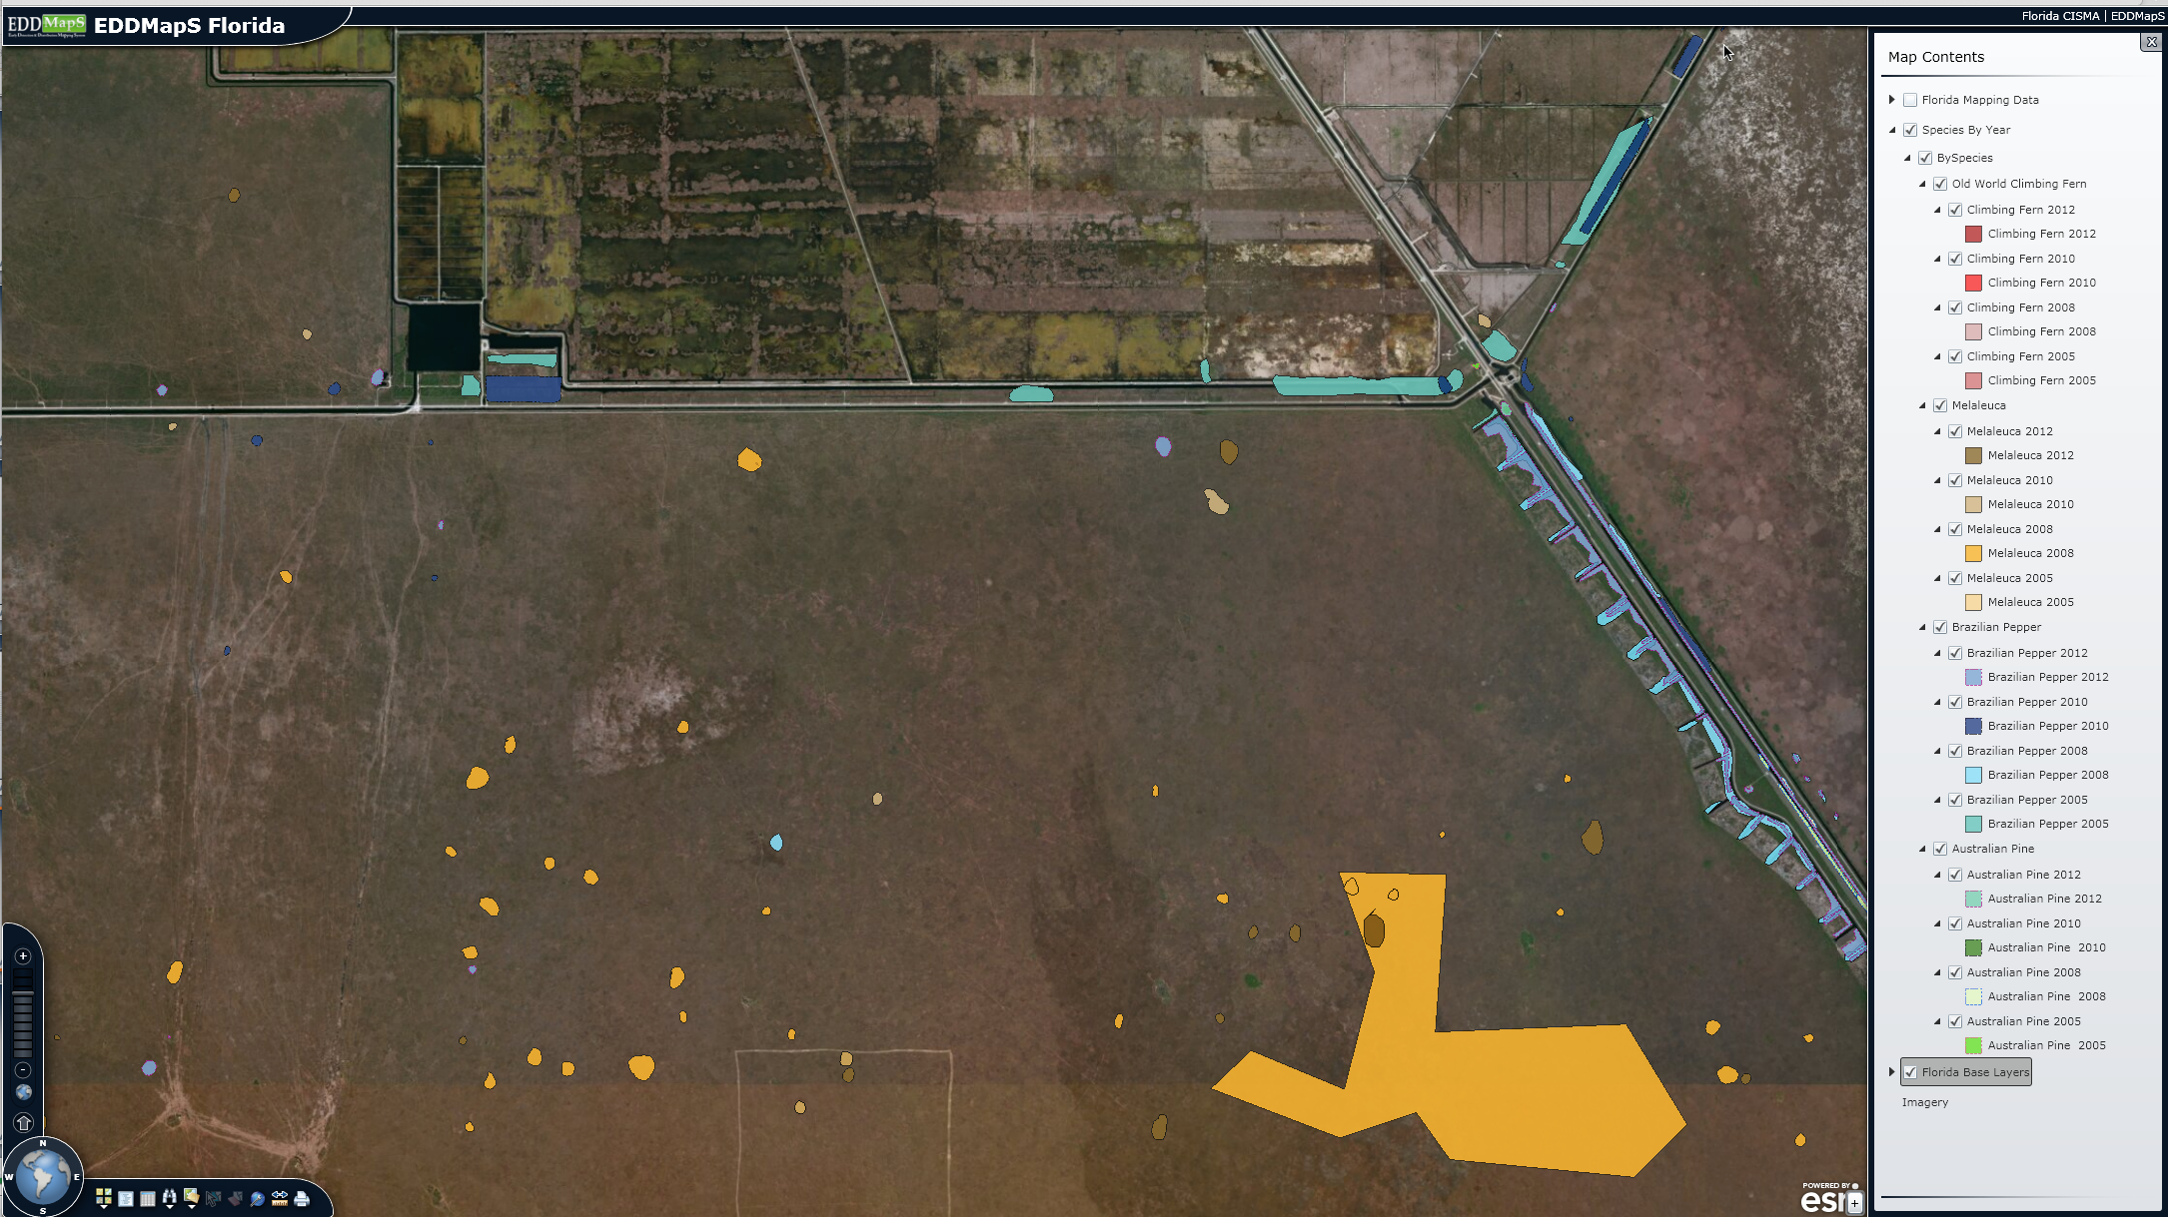

Slide 28
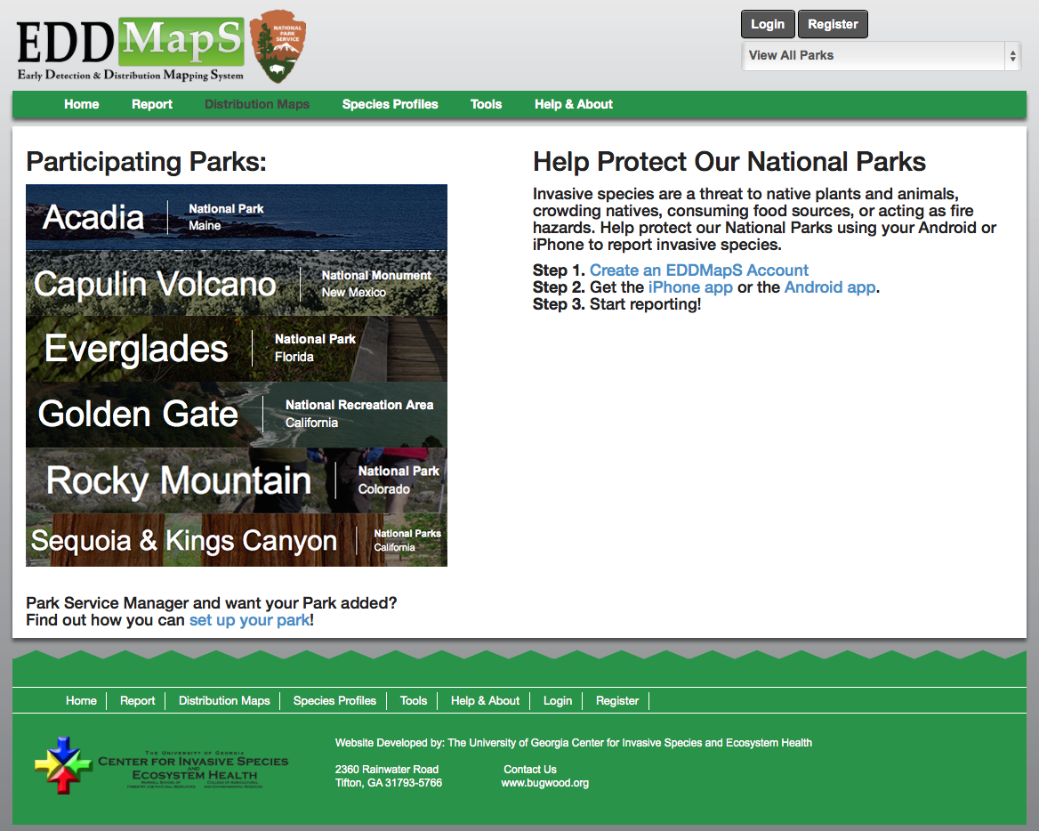

Slide 29
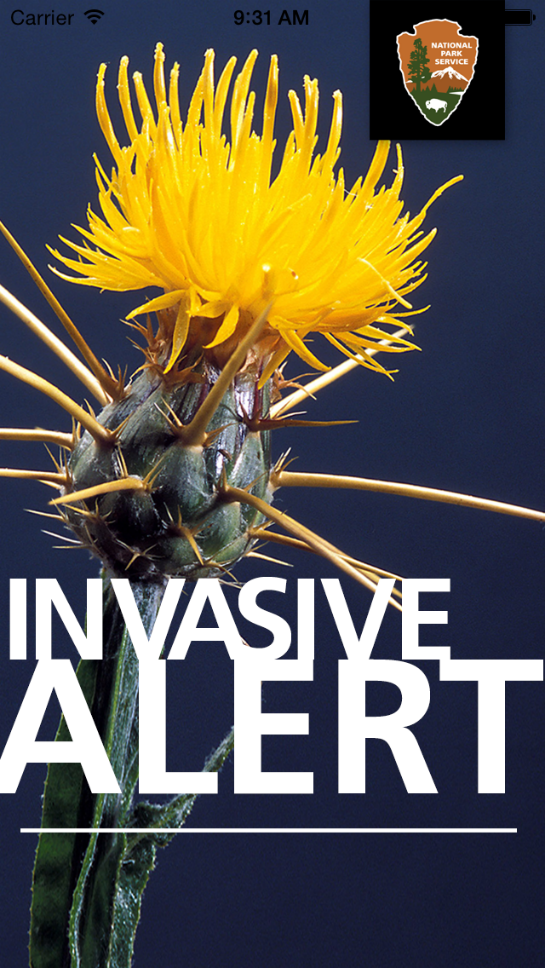
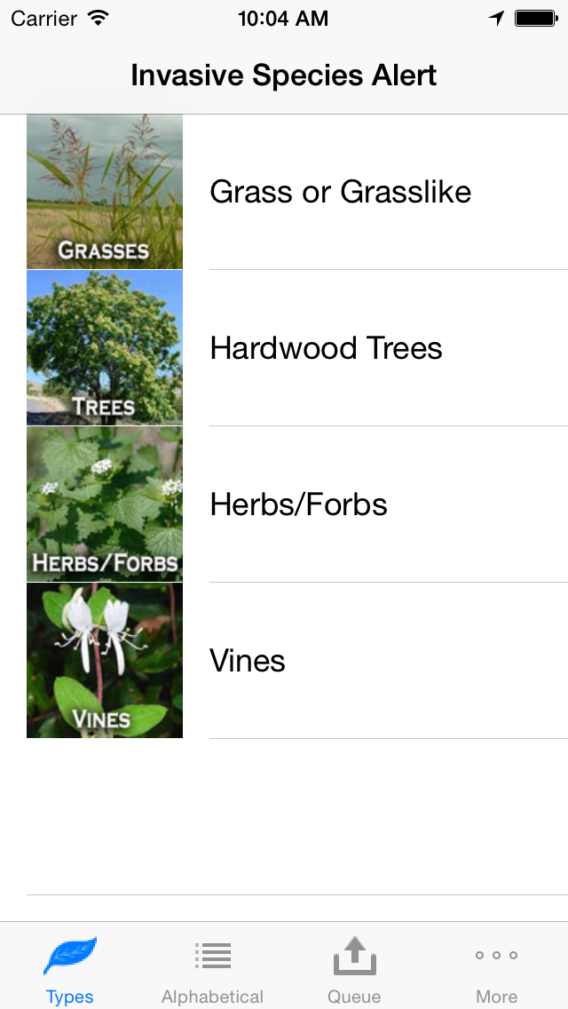

Slide 30


Interface to view distribution by project (all data)
Report infestations by project but with points
Report treatments
Tie treatments to infestations
Under Development Now!

Slide 31

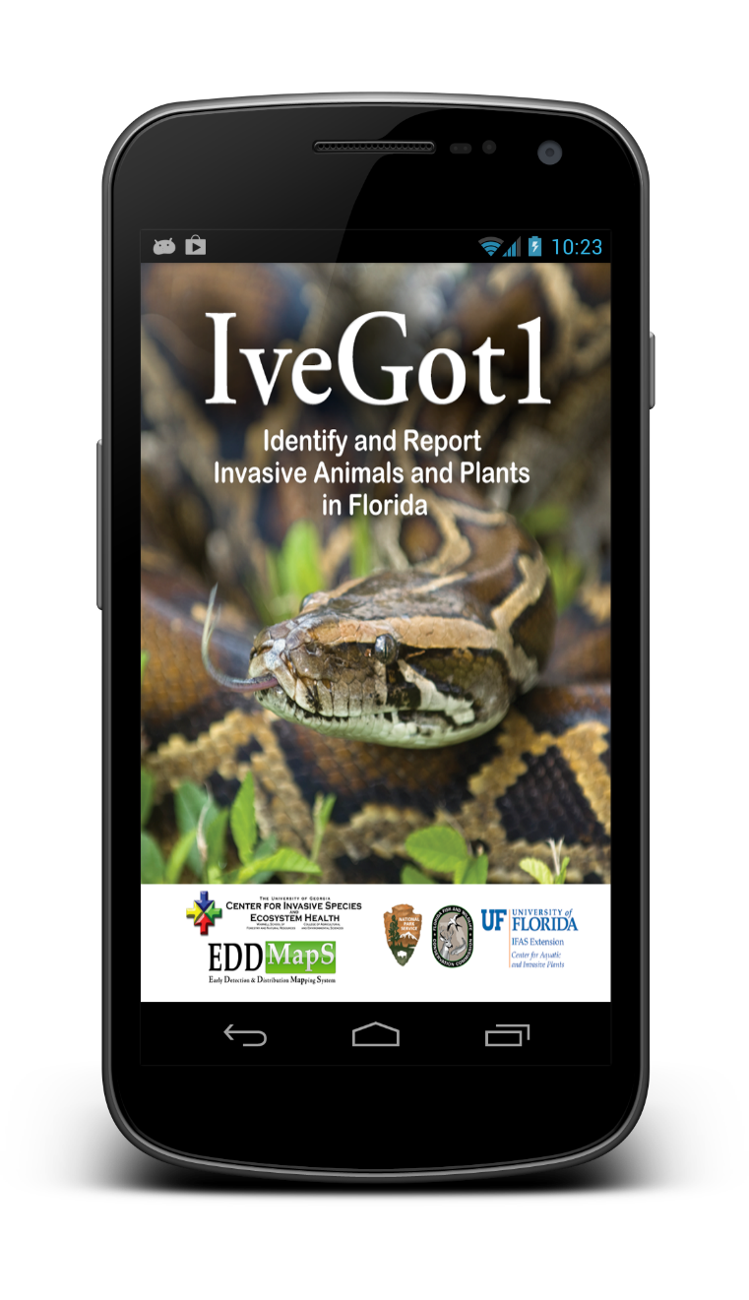

Smartphone Apps UPDATE

Slide 32
Statistics
iOS
20,107 downloads
22,677 upgrades
4 stars with 12 reviews
Android
1,849 installs – 693 current
4.78 stars with 9 reviews

Slide 33
IPHONE

Slide 34
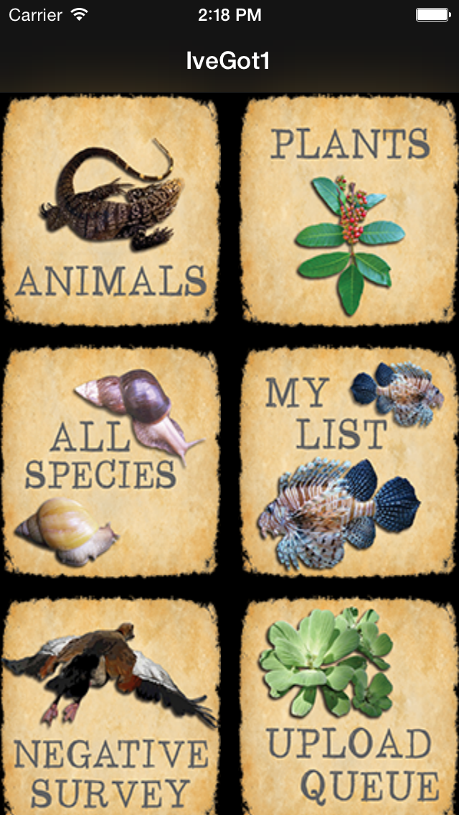
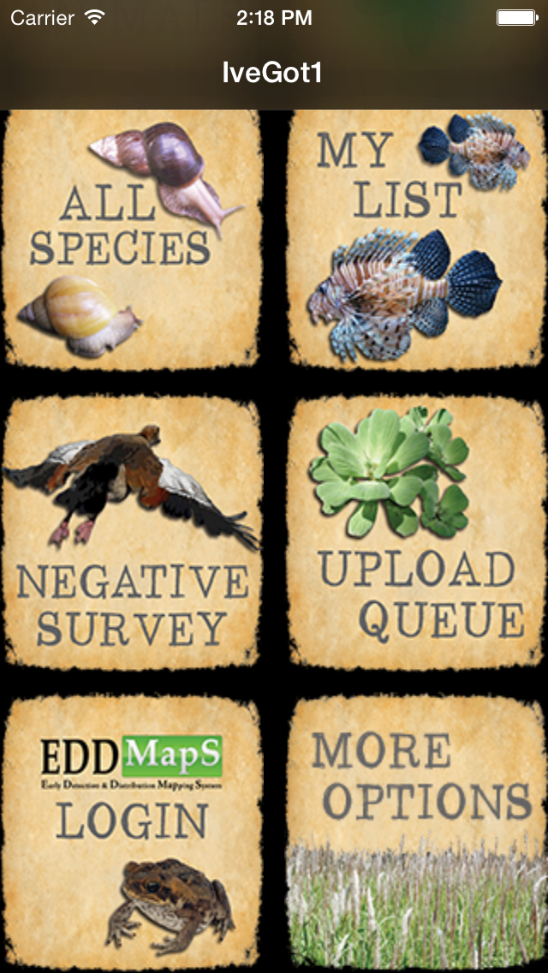

Slide 35
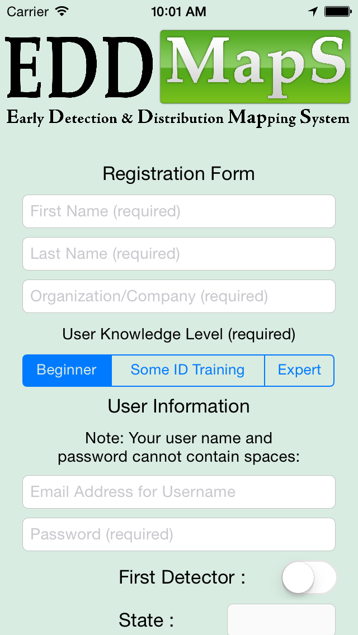
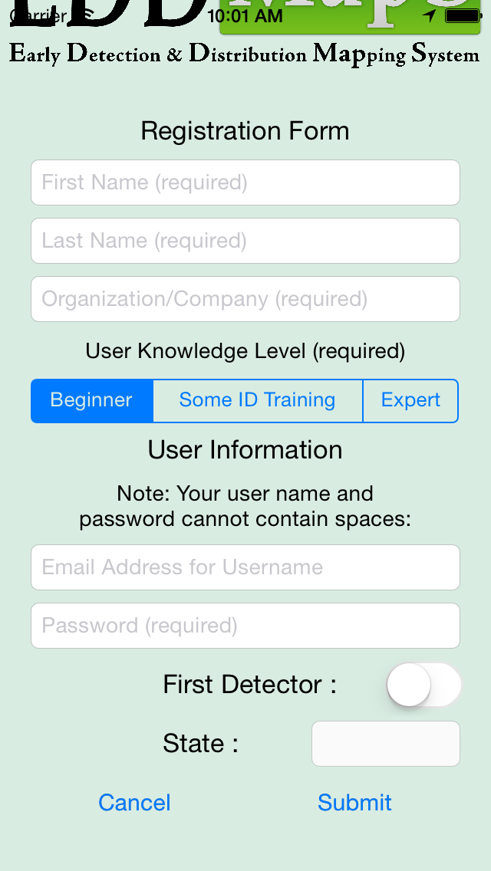

Slide 36
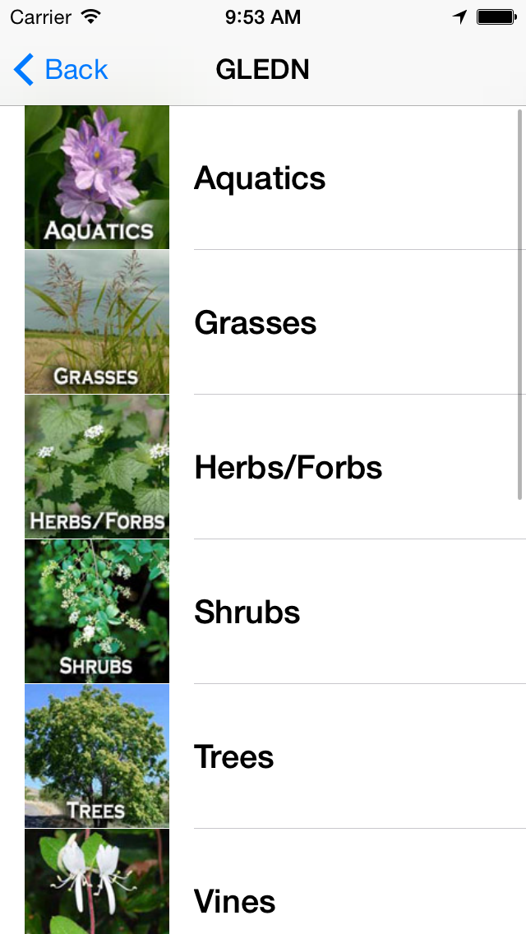
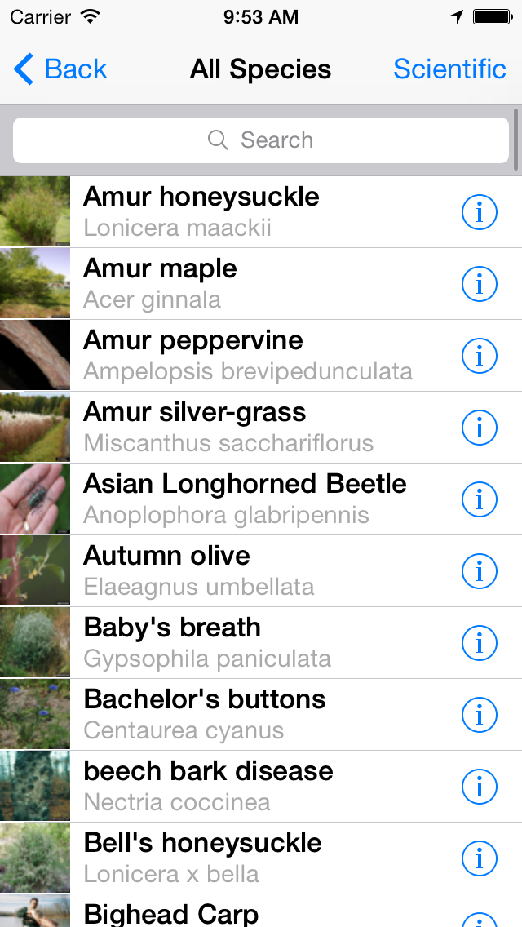

Slide 37
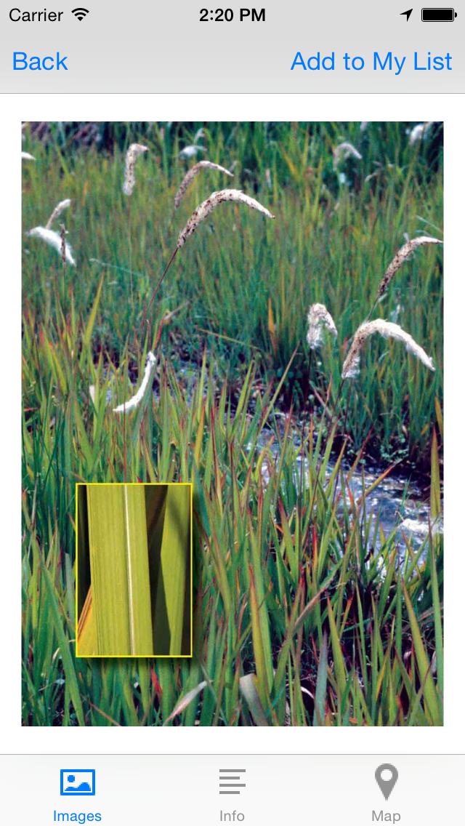
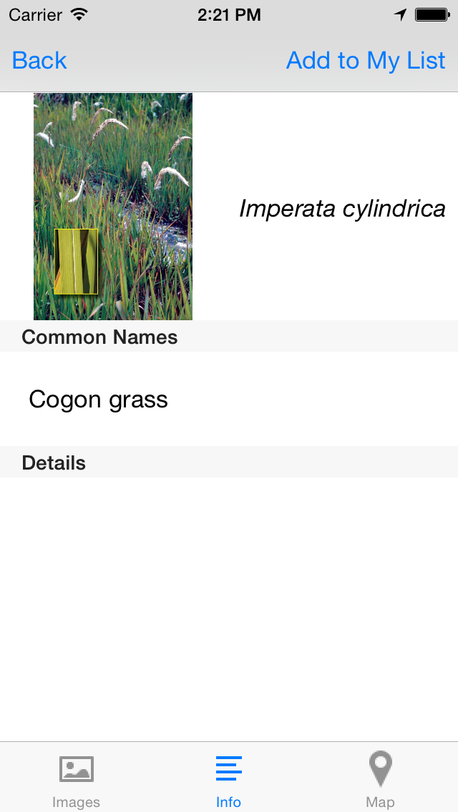

Slide 38
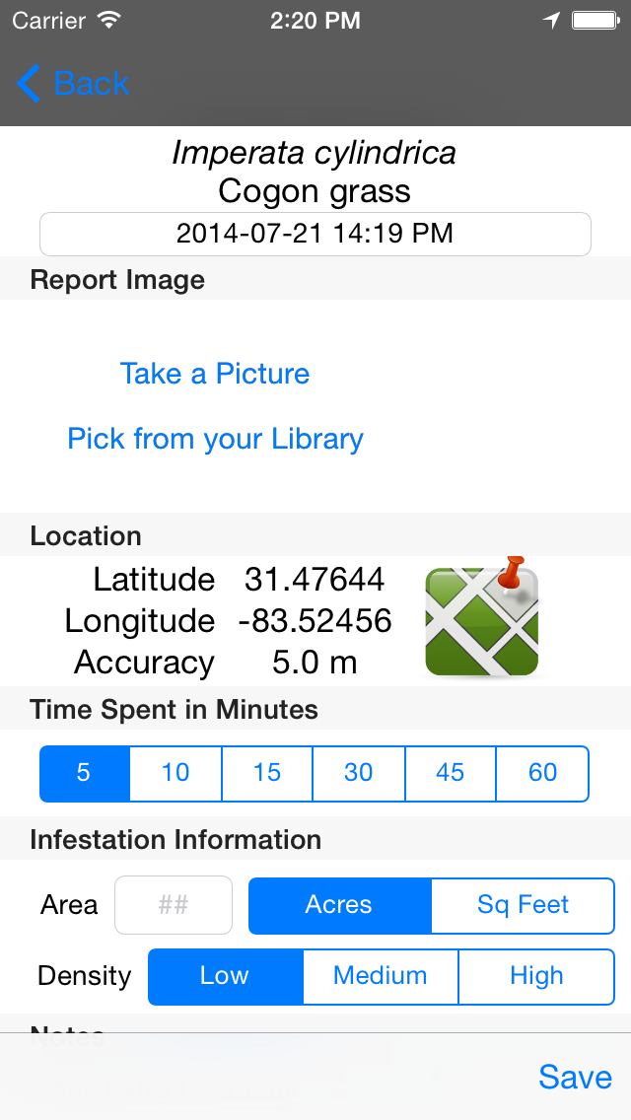
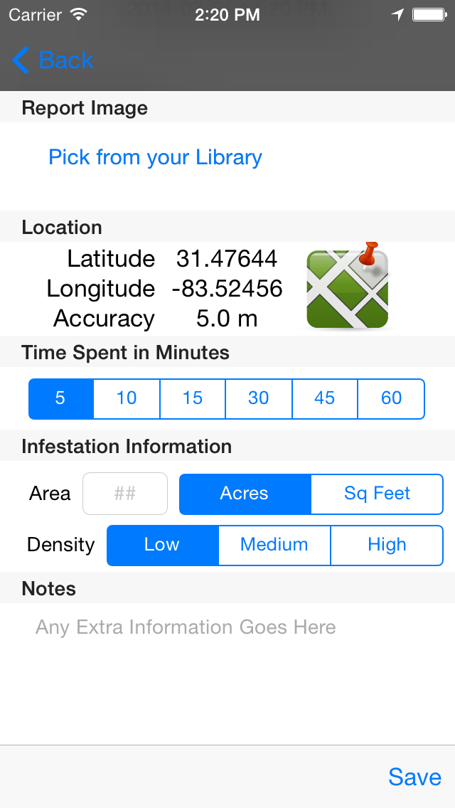

Slide 39
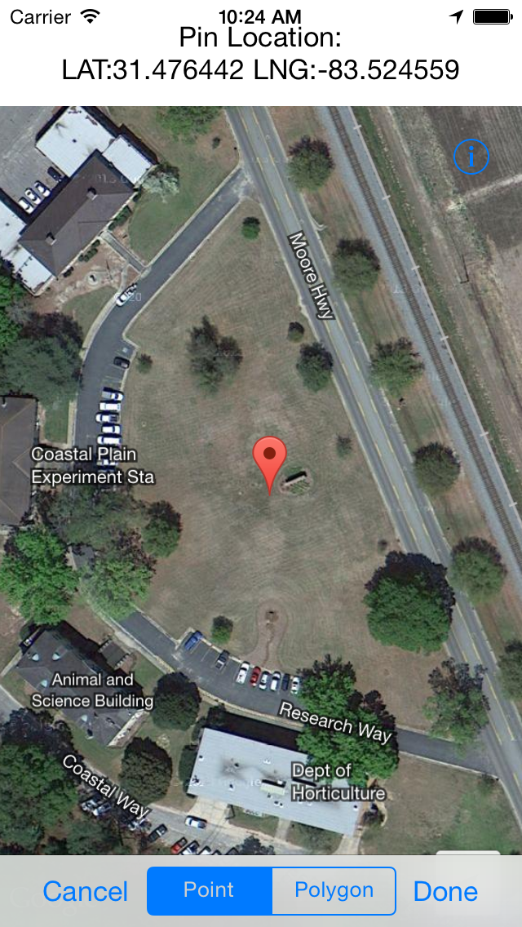
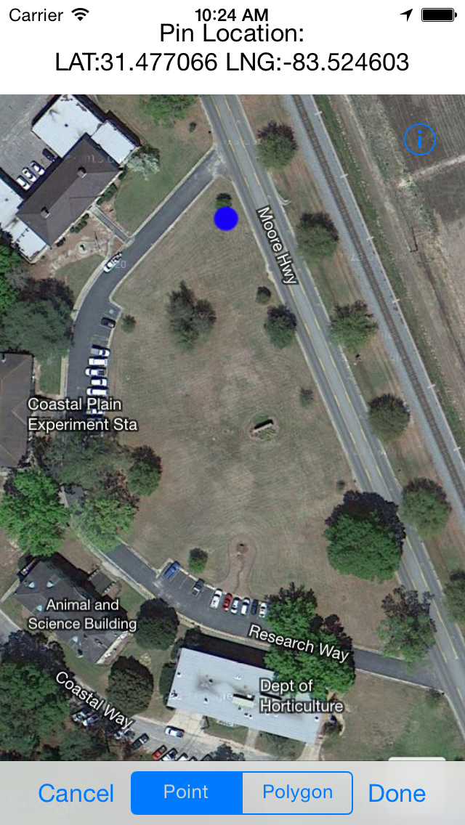

Slide 40
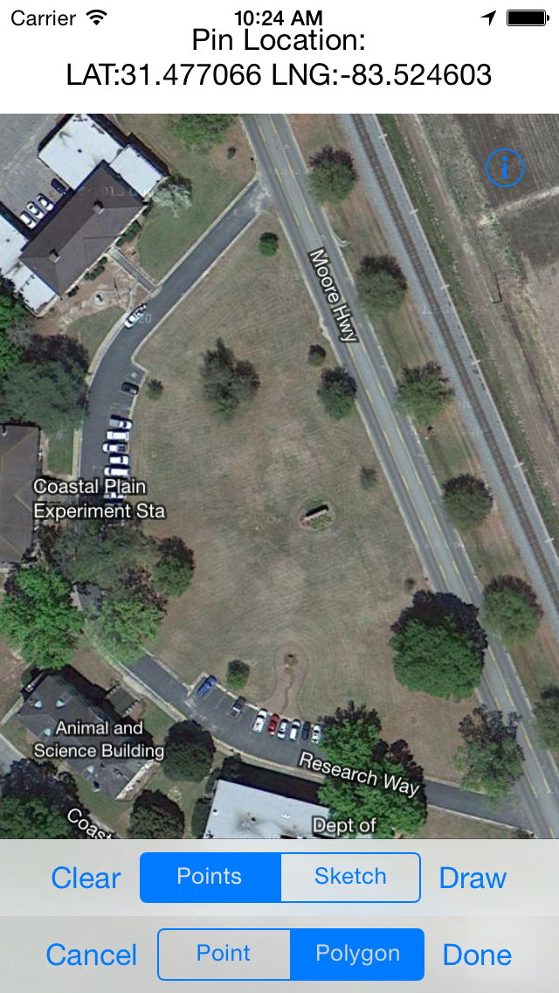
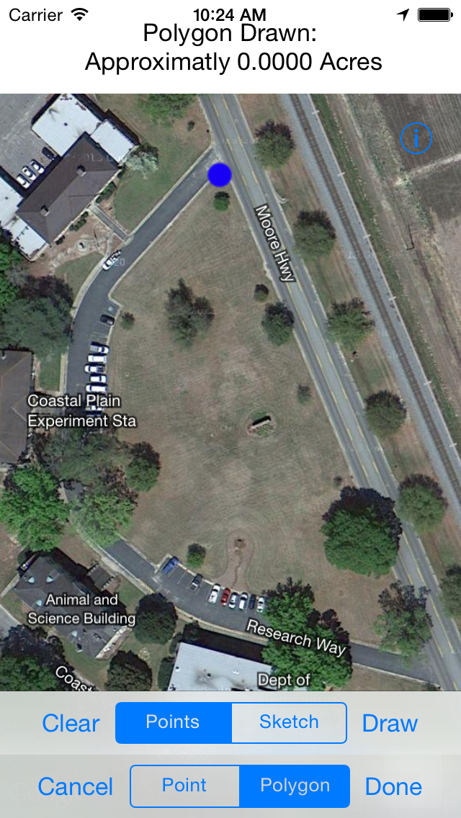

Slide 41
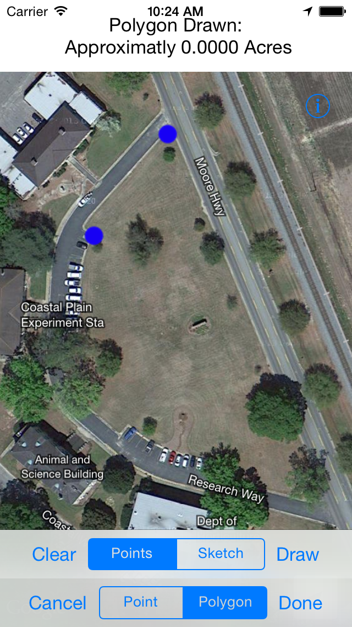
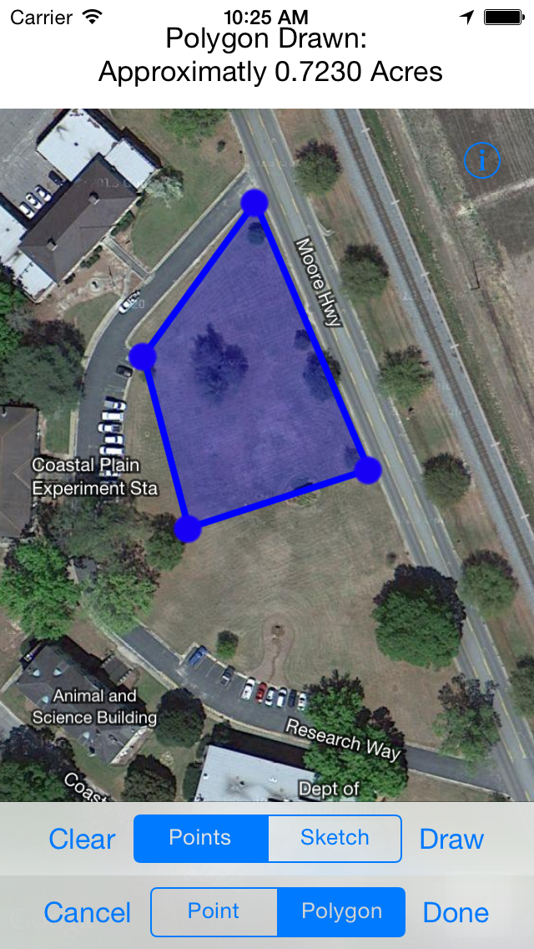

Slide 42
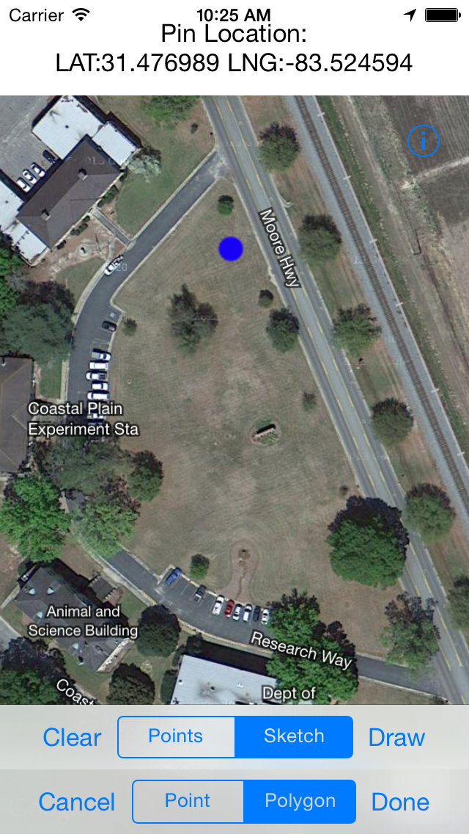
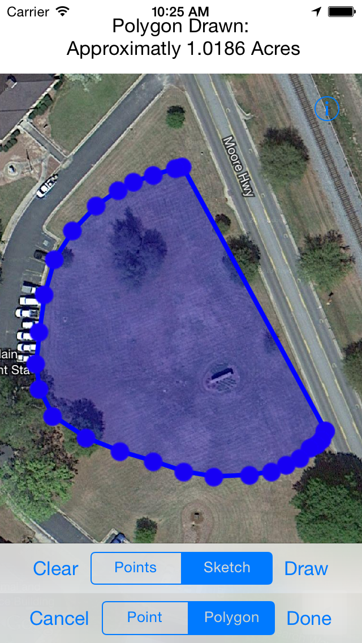

Slide 43
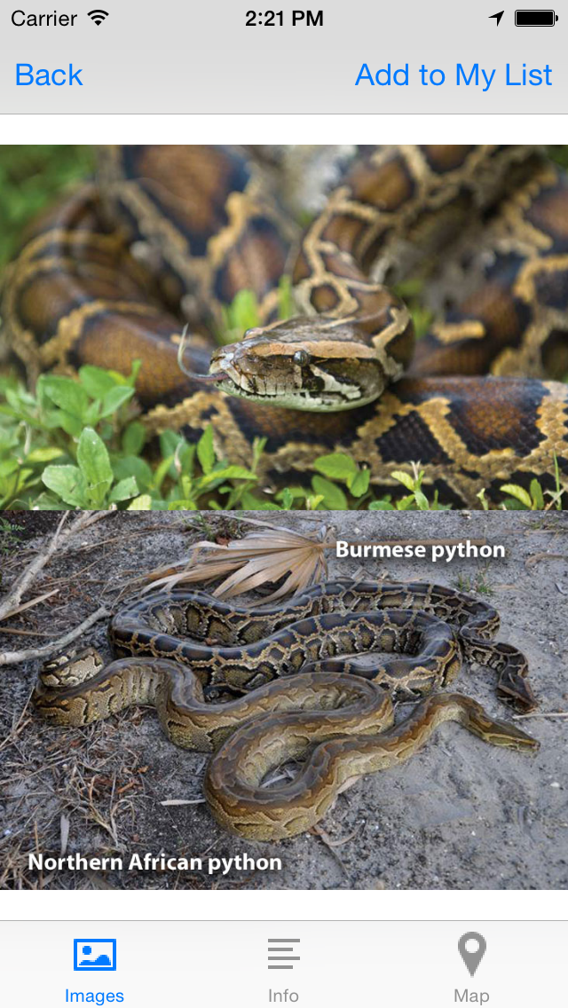
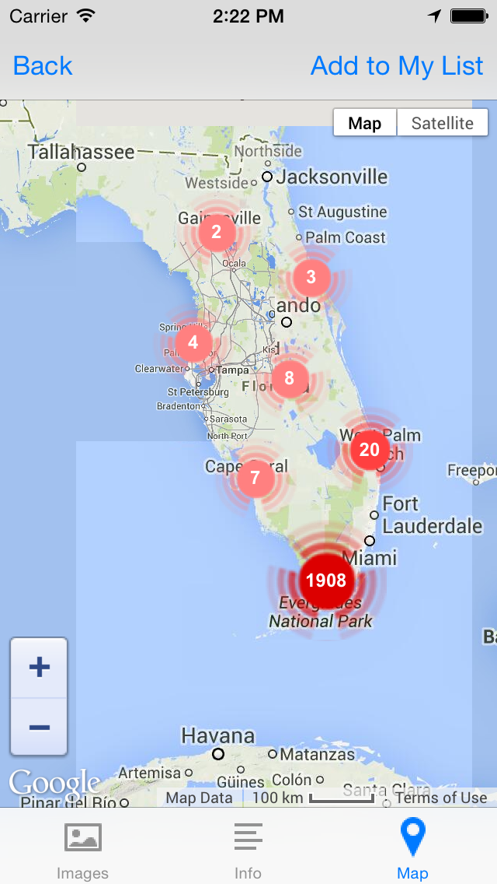

Slide 44
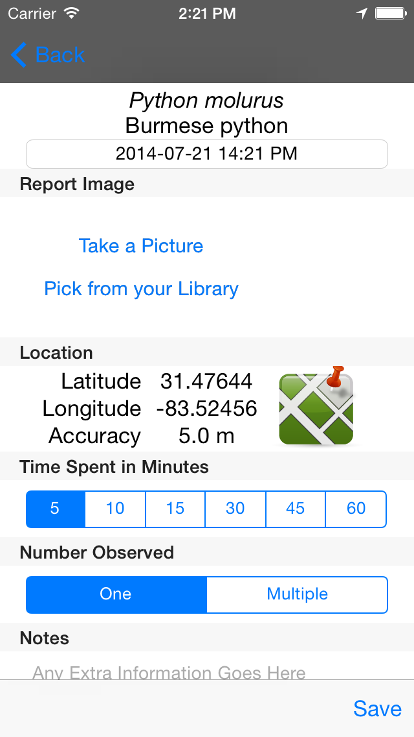

Slide 45
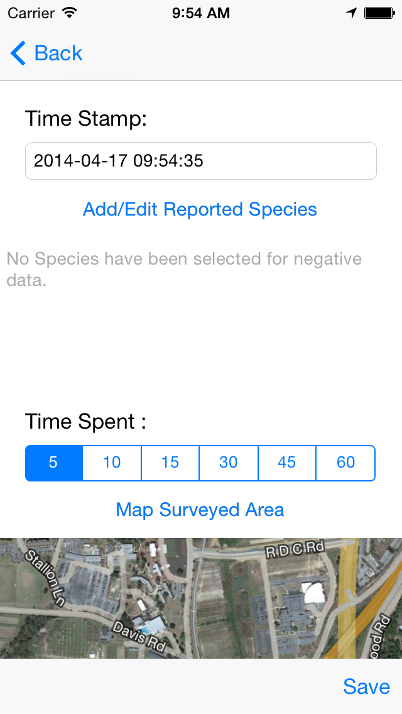
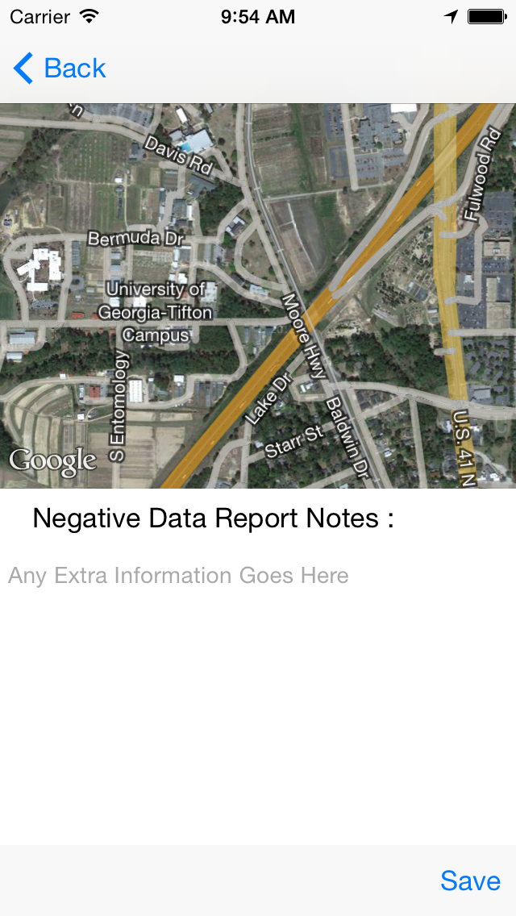

Slide 46
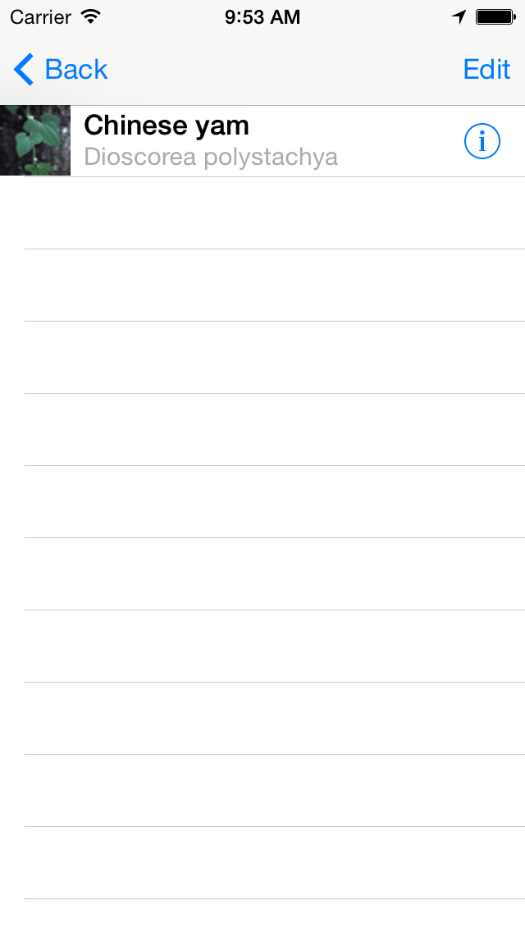
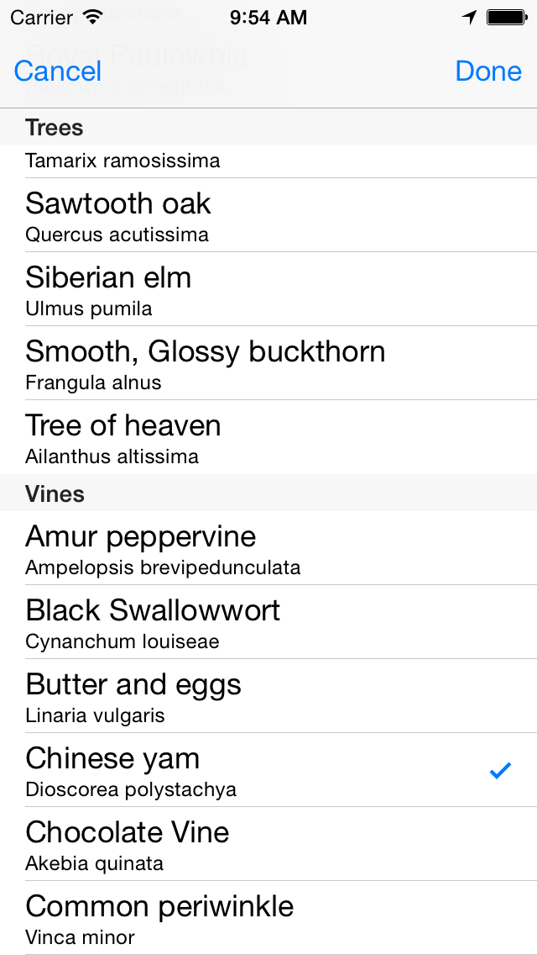

Slide 47
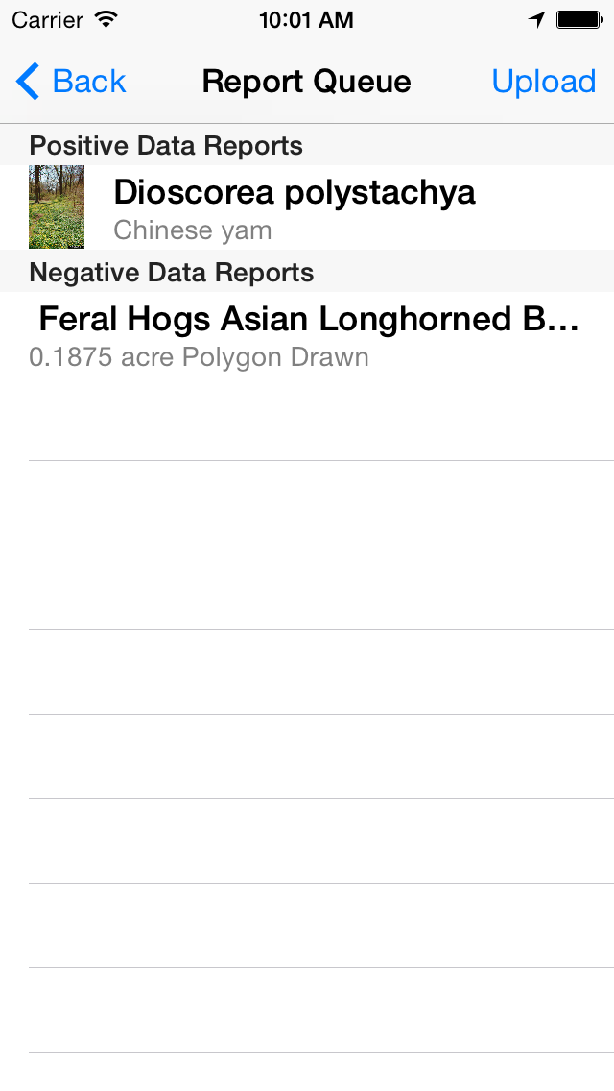
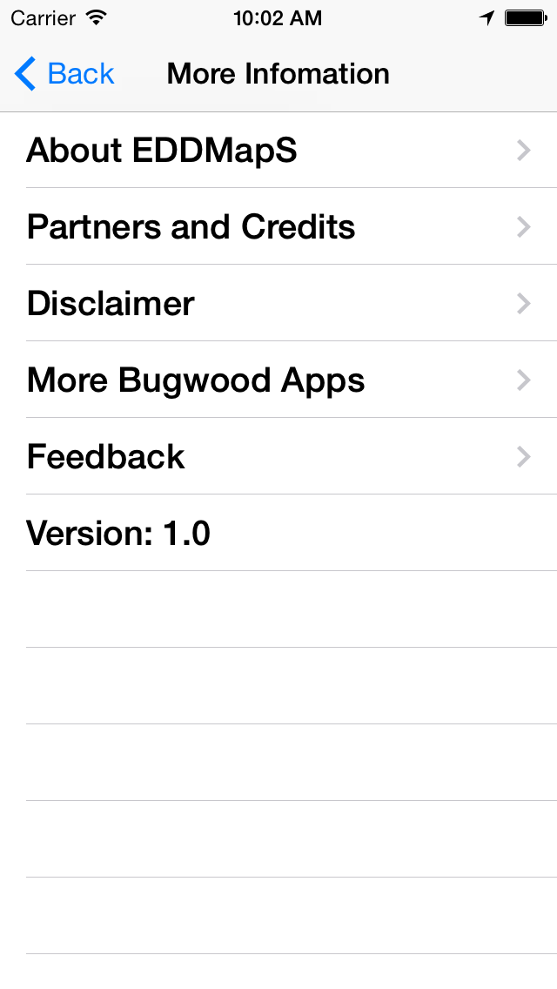

Slide 48



IPCCOnnect Integration

Slide 49
IPCConnect Overview
Fourth season in production for Invasive Plant Control, Inc. crews
Tracks photo points and polygons
Tracks chemical use, travel and hours
Combines power of EDDMapS with treatment knowledge of IPC
Implemented Solution for New Jersey Invasive Species Strike Team that is built on EDDMapS reports
Work has started for a similar interface for Wisconsin

Slide 50
Other Projects of Interest
iBiocontrol App for Western States
iBiocontrol Website
Decision Support Apps – Insecticide Recommendations for Stink Bugs in Cotton
Identification Key Apps – Stink Bugs, Noxious Weeds in Montana, Invasive Plants in Alaska

Slide 51
THANKS
Try out the new apps,
Send us feedback
cbargero@uga.edu

