Slide 1
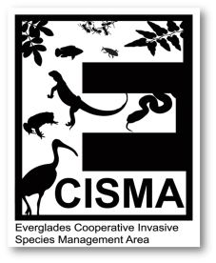
Biological Control of Weeds
Operational and Research Report
Carey Minteer
USDA-ARS
Invasive Plant Research Laboratory
Ft. Lauderdale

Slide 2
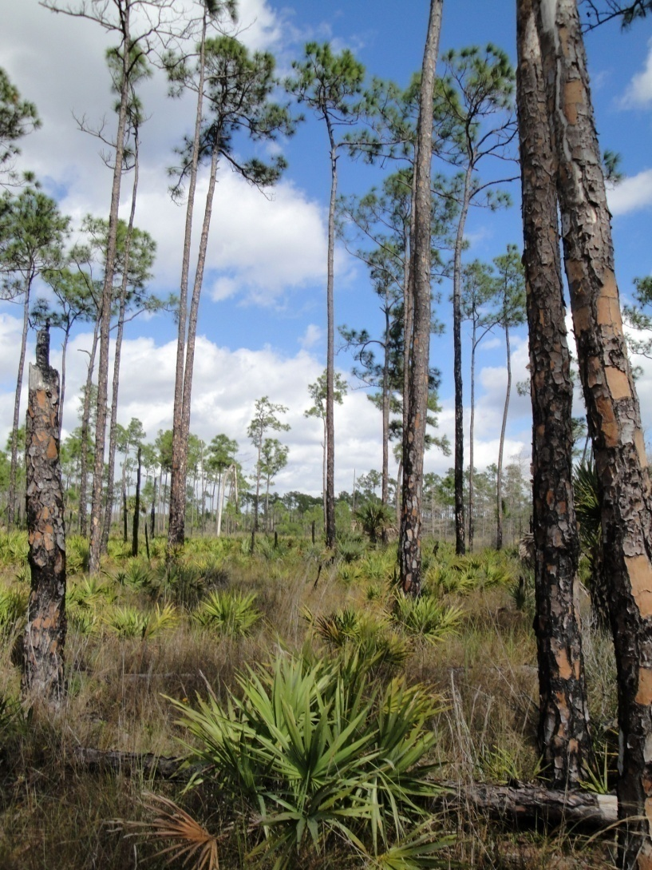
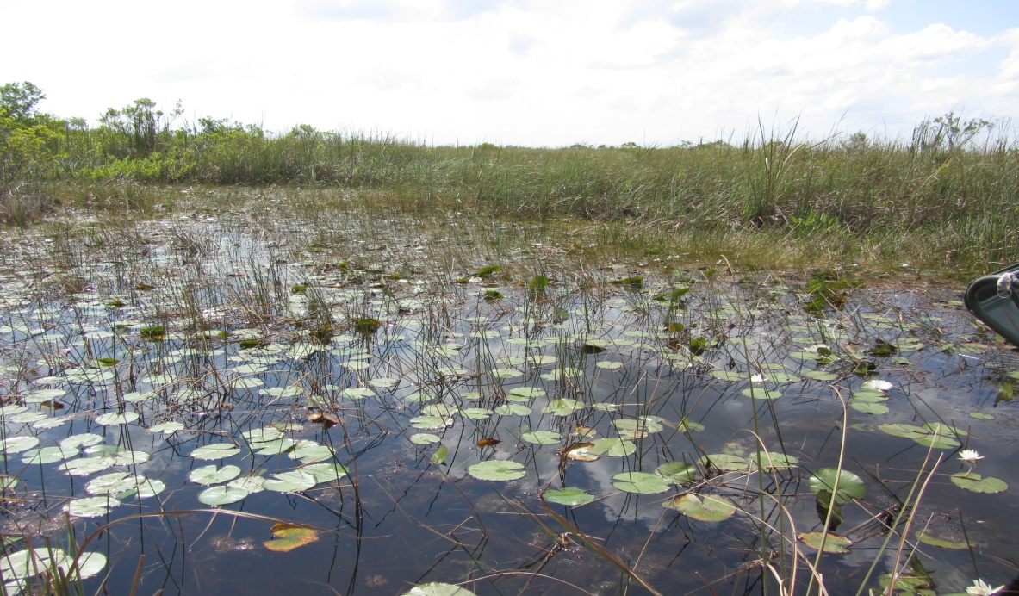
Presentation Topics
Insect Releases, Research, and Quarantine Agent Development for:
  Lygodium
  Air Potato
  Melaleuca
  Brazilian Pepper
  Waterhyacinth
  Waterlettuce
  Downy Rose Myrtle

Slide 3
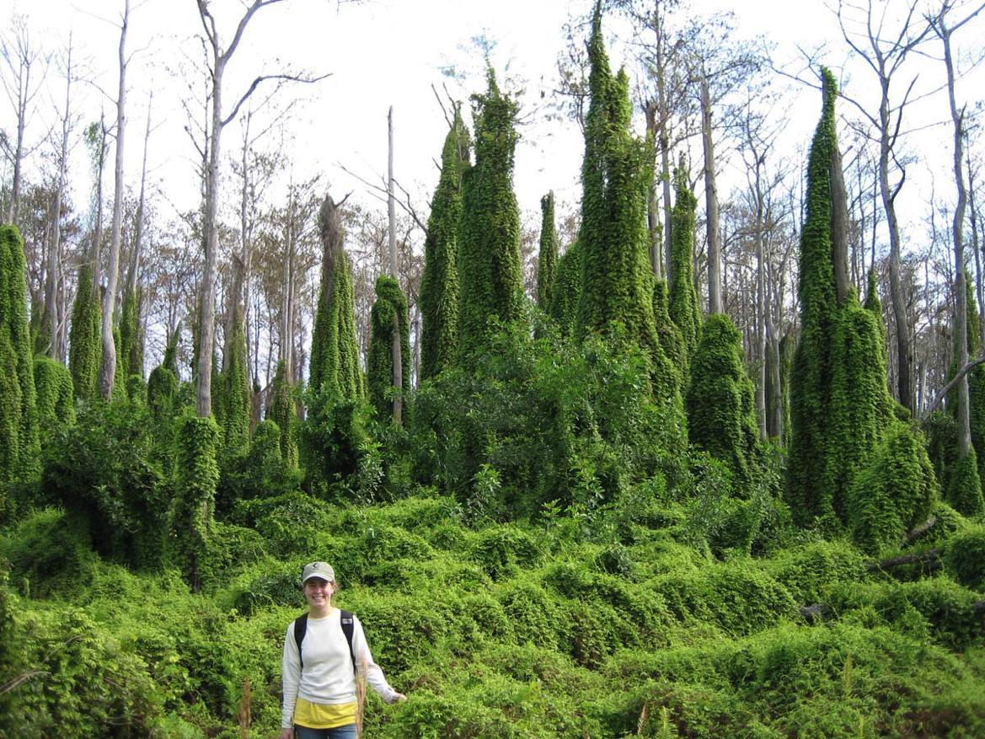
Lygodium microphyllum
Old World climbing fern

Slide 4
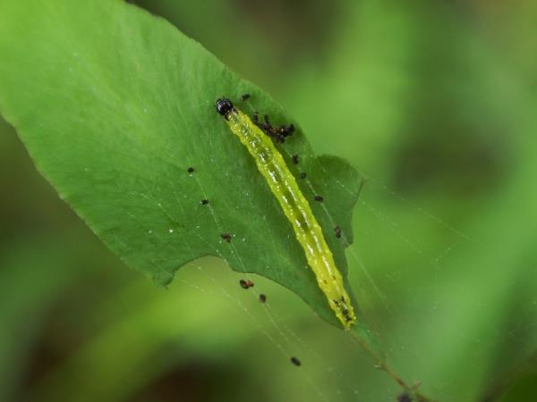
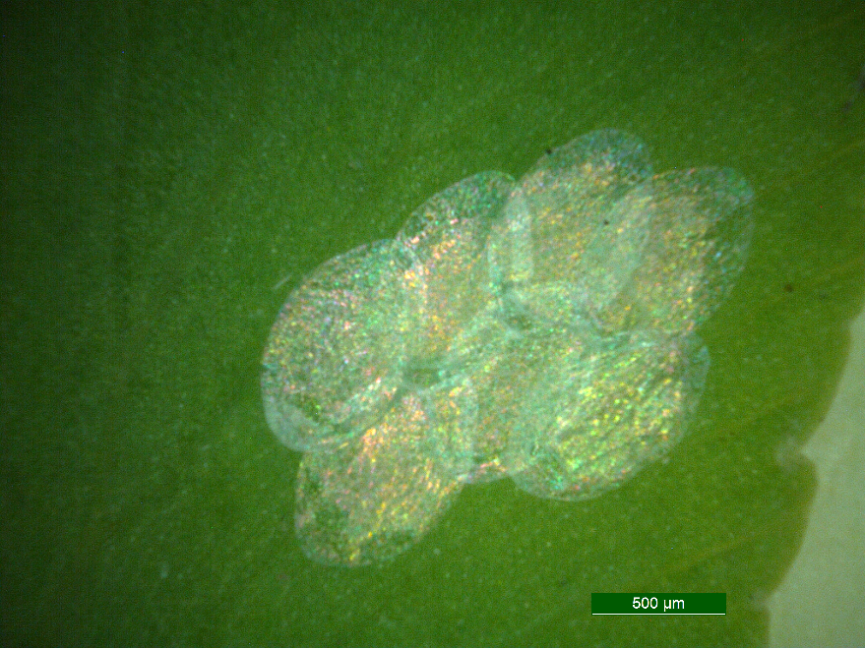
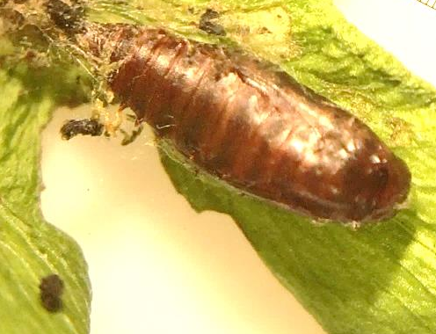
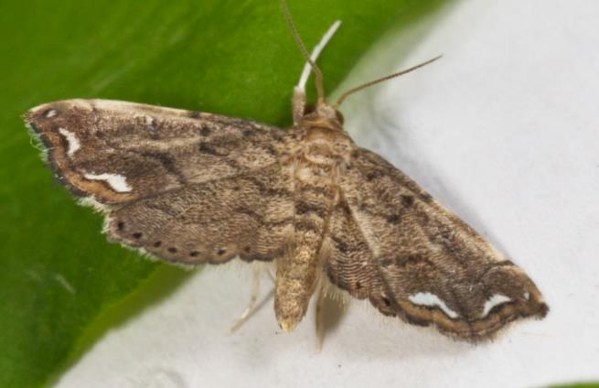
Neomusotima conspurcatalis, the brown lygodium moth
211,322 released to date in FY 2016
Larva
Pupa
Adult
Egg
~ 28 days
Notes:
Life cycle ~28 days. Larvae are leaf feeders. Active in the field year round but populations decrease in the peak summer heat.

Slide 5
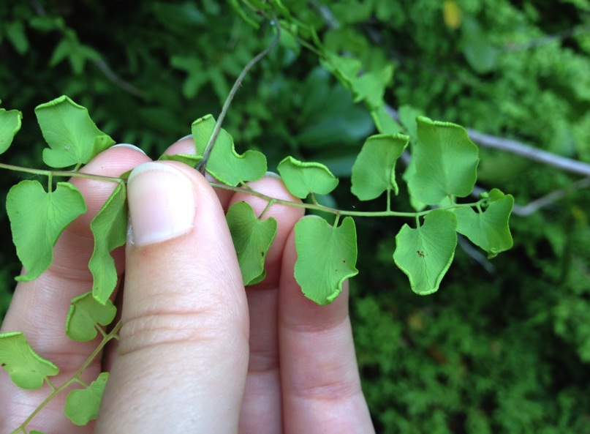
Floracarus perrepae
Freeman et al. 2005
Very low establishment success measured in 2011 after initial field releases
Agent is more widely distributed than originally thought
56,475 released to date in FY 2016
Notes:
The mite causes leaf roll galls. These galls are necessary for the mites to reproduce. Life cycle ~9 days. Populations decrease in peak heat

Slide 6
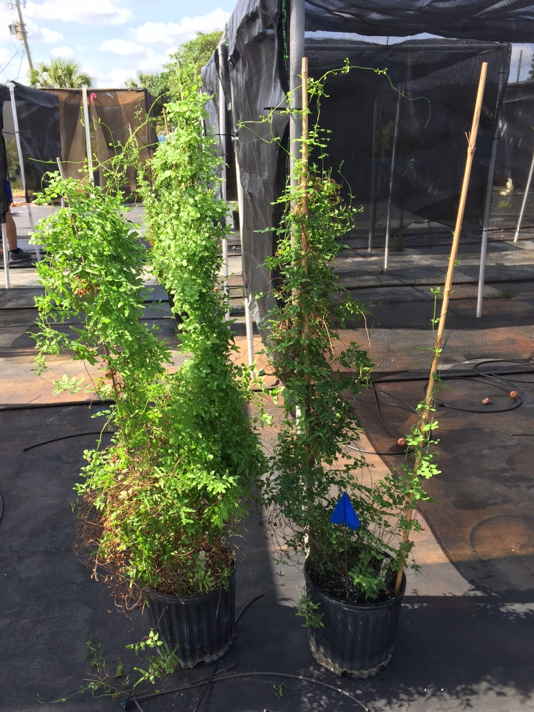
Floracarus perrepae impact
Goolsby et al. (2004) potted plant study
  Reduced aboveground biomass by 49% and belowground biomass by 35%
Notes:
Both pots started with 3 sporelings and are the same age. The plant on the left is not gallable, the one on the right has been attacked by mites

Slide 7
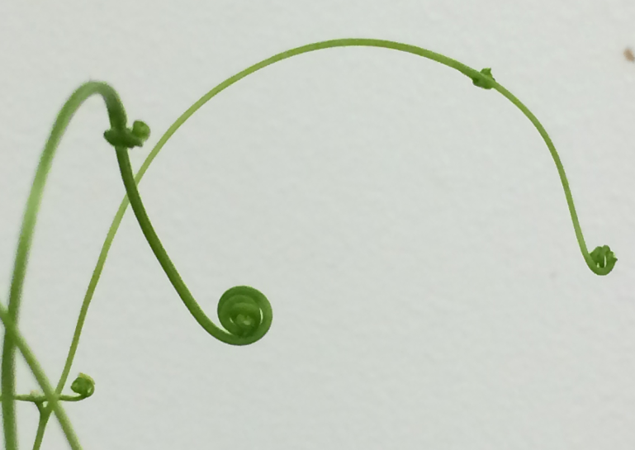
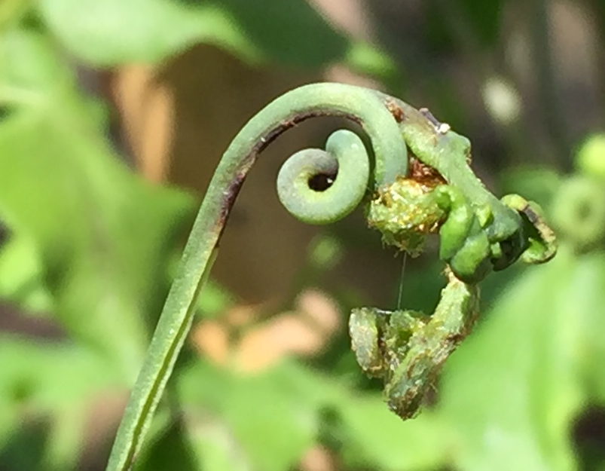
Can F. perrepae reduce Lygodium’s ability to climb? recover from herbicide or prescribed burns?
Notes:
Normal lygodium ‘fiddlehead’ left. Galled and deformed fiddlehead right. These deformed apical meristems are unable to continue to grow and therefore limit vine elongation. Many of these deformed fiddleheads become necrotic and die.

Slide 8
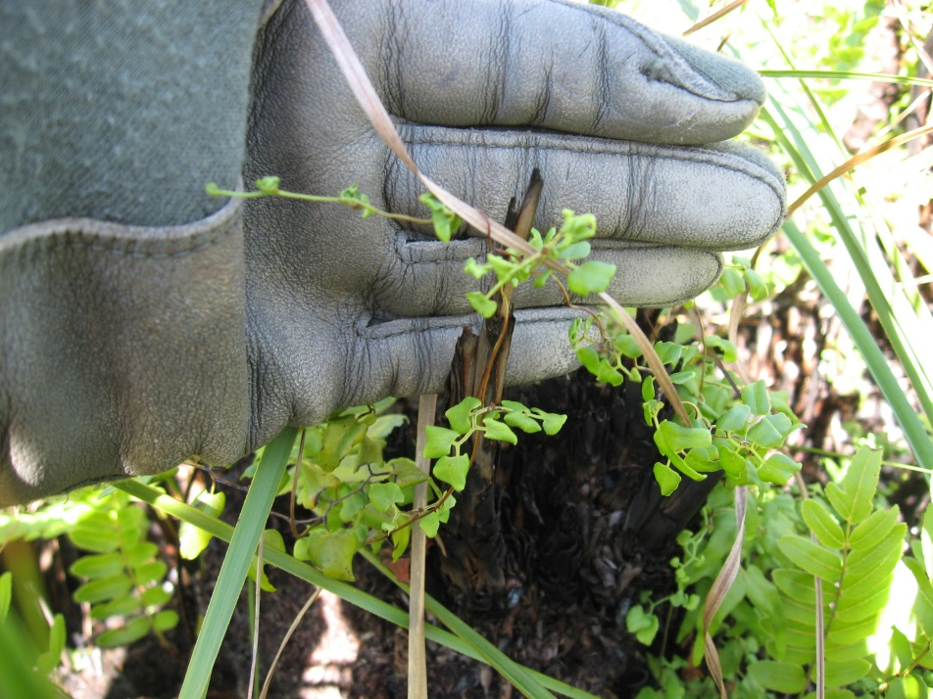
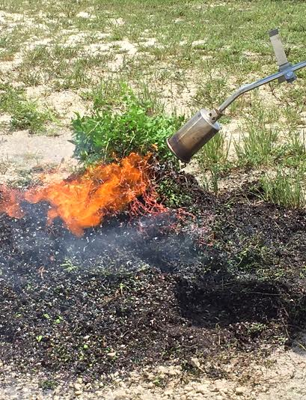
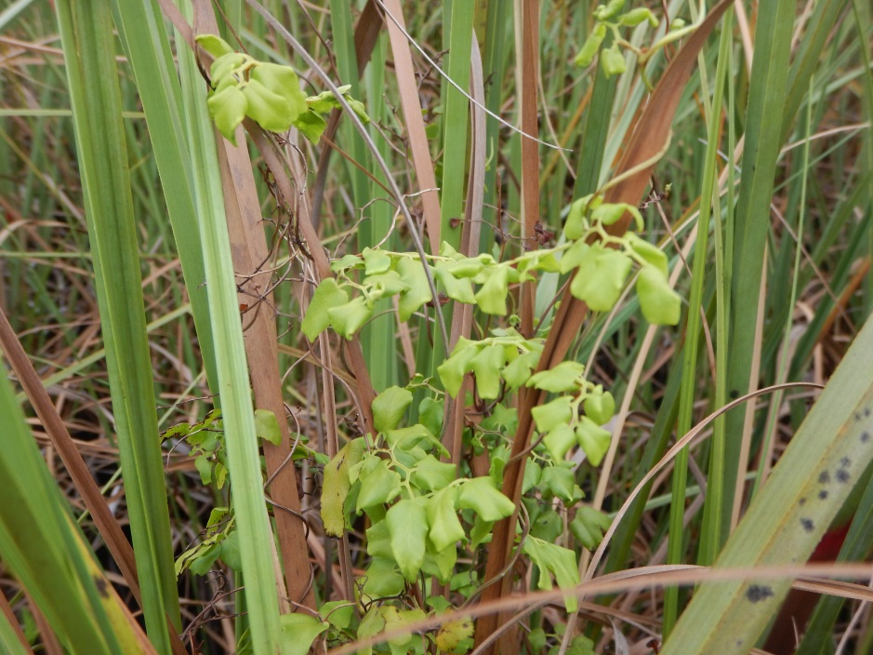
Mites, fire, and Everglades National Park
ENP Feb 2015
ENP April 2016
Notes:
A site colonized by the mites in ENP was subjected to a prescribed burn in fall 2014. The mites colonized the regrowth post burn and this lygodium remains low-growing and unable to reach the sawgrass canopy ~18 months post burn. A new experiment is being piloted with potted plants at IPRL to quantify the role of the mite in limiting lygodium regrowth post herbicide spray or burn to develop an integrated weed management plan.

Slide 9
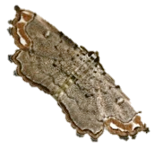
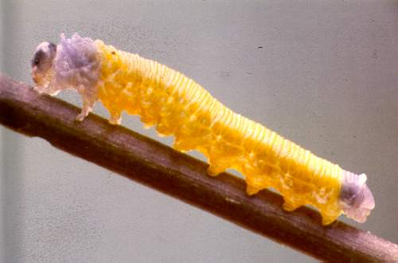
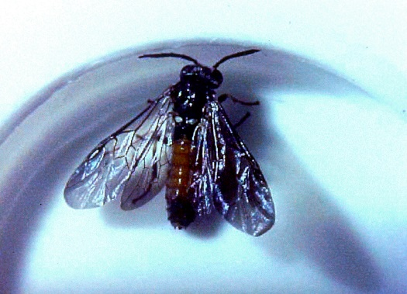
Lygodium microphyllum agents under development
Lygomusotima stria
(Lepidoptera: Crambidae)
Larvae defoliate plants (~2 yrs)
Neostrombocerus albicomus
(Hymenoptera: Tenthredinidae)
Sawfly larvae defoliate plants
(~2 yrs)

Slide 10
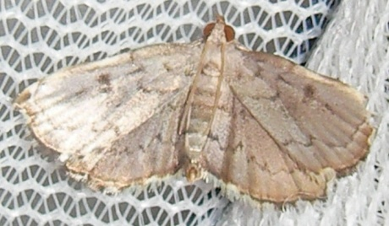
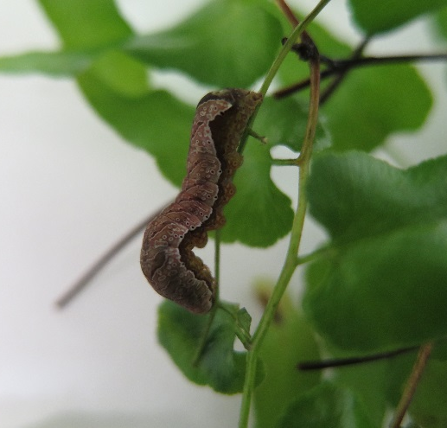
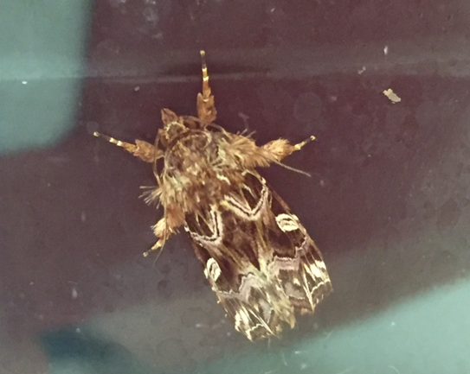
Lygodium microphyllum agents under development
Stem boring moths (4 species)
Larvae bore low on rachis and may kill all growth above the feeding point
Extremely difficult to colonize
(4-5 yrs)
Callopistria sp.
Just colonized at IPRL Spring 2016
Larvae defoliate plants (3-5 yrs)

Slide 11
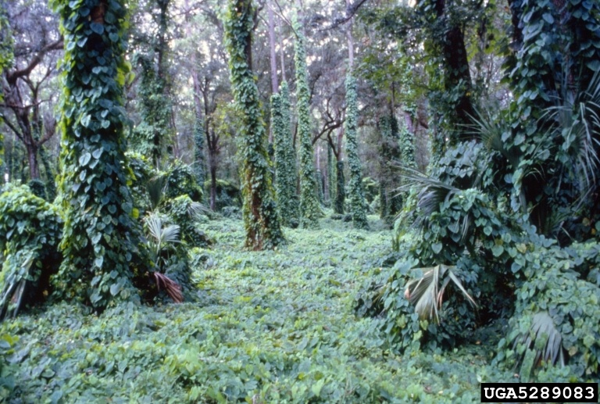
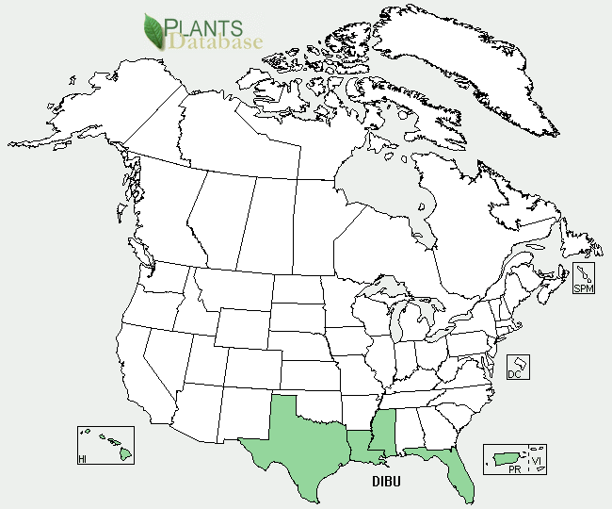
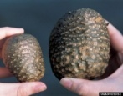
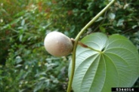
Dioscorea bulbifera (Air Potato)

Slide 12
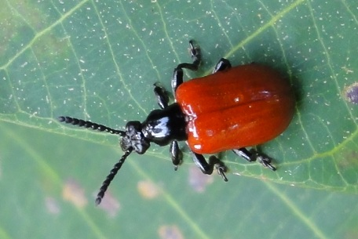
Air Potato Biological Control Program:
Agent Discovery and Importation
Lilioceris cheni first discovered in Central Nepal in 2002 and imported to IPRL in 2004
Permit for field-release of beetle was approved in 2009
Chinese biotypes were imported later in 2010
Began initial releases in late summer of 2011

Slide 13
Air Potato Leaf Eating Beetle Releases by Year

Slide 14
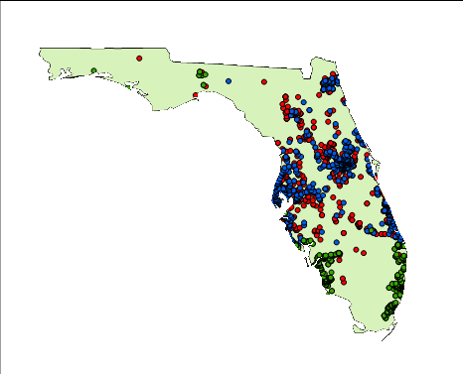
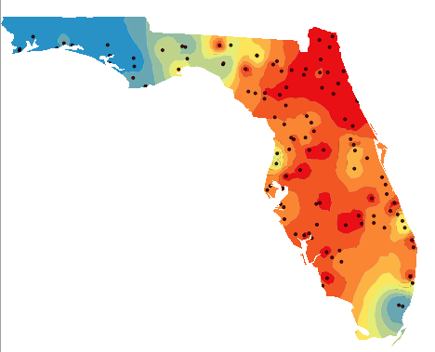
Beetle Releases and Overwintering Surveys
Beetle releases:
435,507 individuals
Surveys:
113 sites were surveyed in 47 counties
Beetles were found in 75% sites
Leaf feeding damage in 86% sites

Slide 15
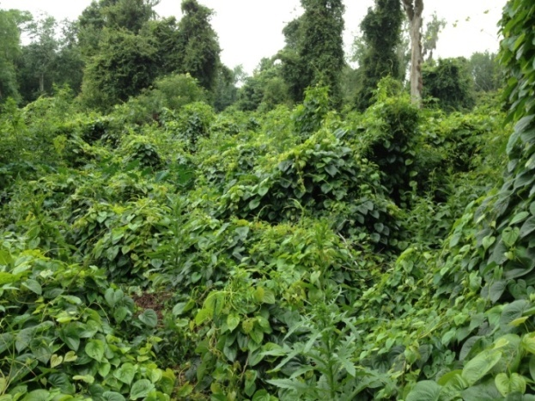
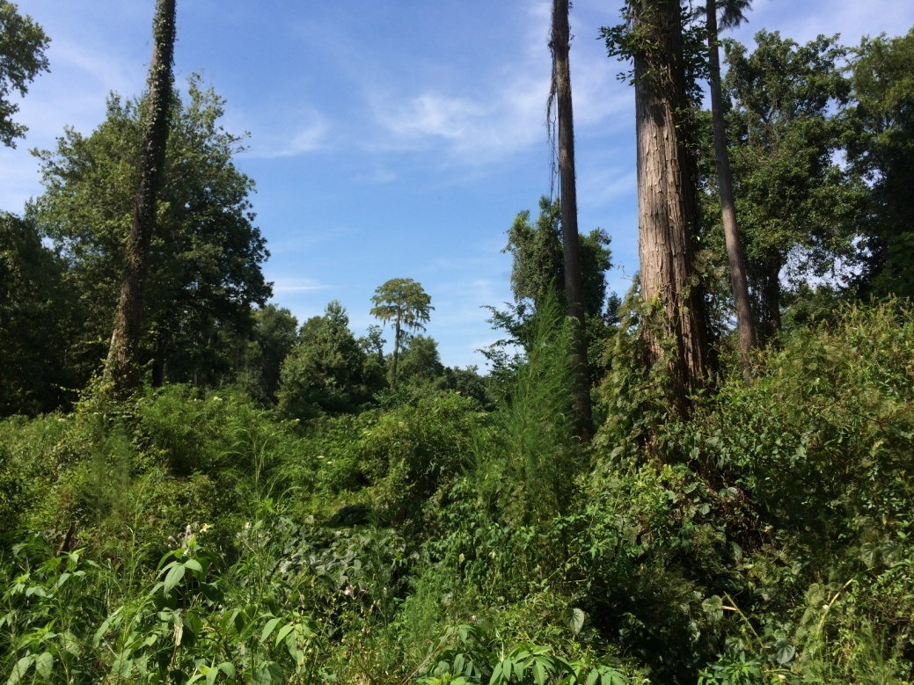
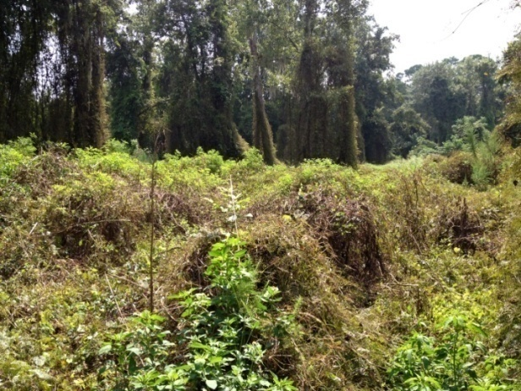
Landscape Level Changes Following Biological Control Impact
June 2012
August 2013
August 2014

Slide 16
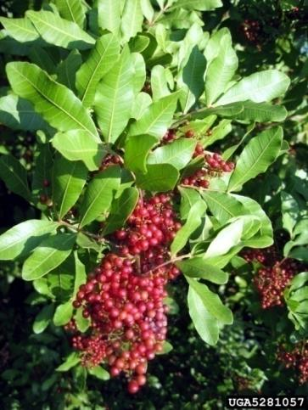
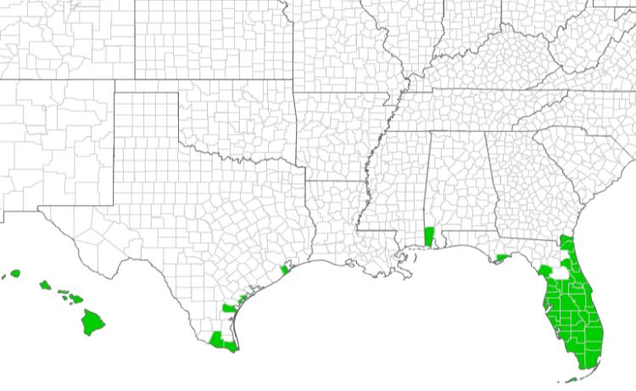
Brazilian pepper, Schinus terebinthifolia
  Bird dispersed
  In FL & HI one of our most invasive spp.
  Invades more ECISMA area than Lygodium, Melaleuca, Casuarina spp. combined
Notes:
Brazilian pepper was introduced from South America over 150 years ago for it’s attractive red berries. This species occupies more area than any other invasive species in Florida.

Slide 17
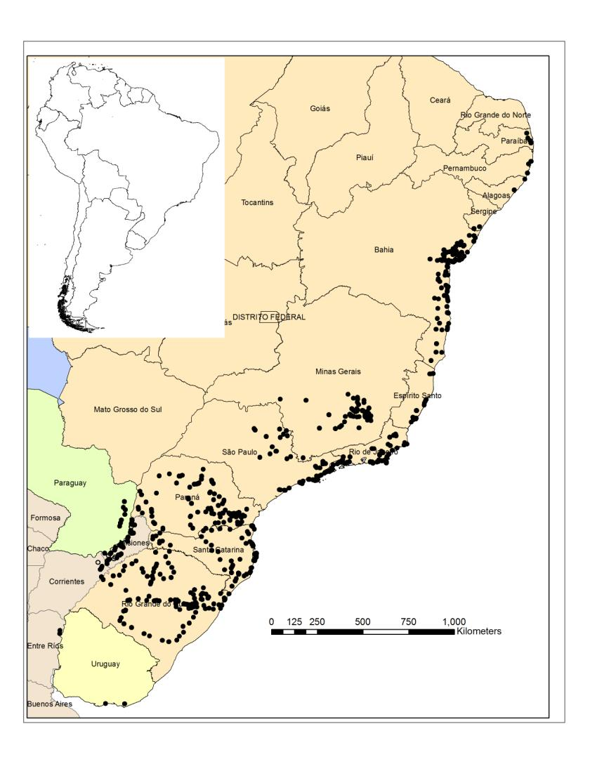
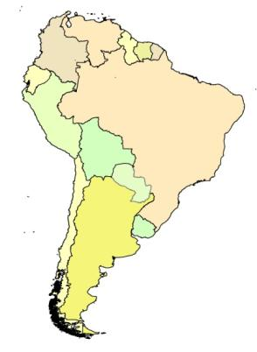
Search for biological control agents Brazil
Surveys of South America, 2005 to June 2015
20 + trips; > 900 sites
> 125 potential agents found
Paraguay
Argentina
Uruguay

Slide 18
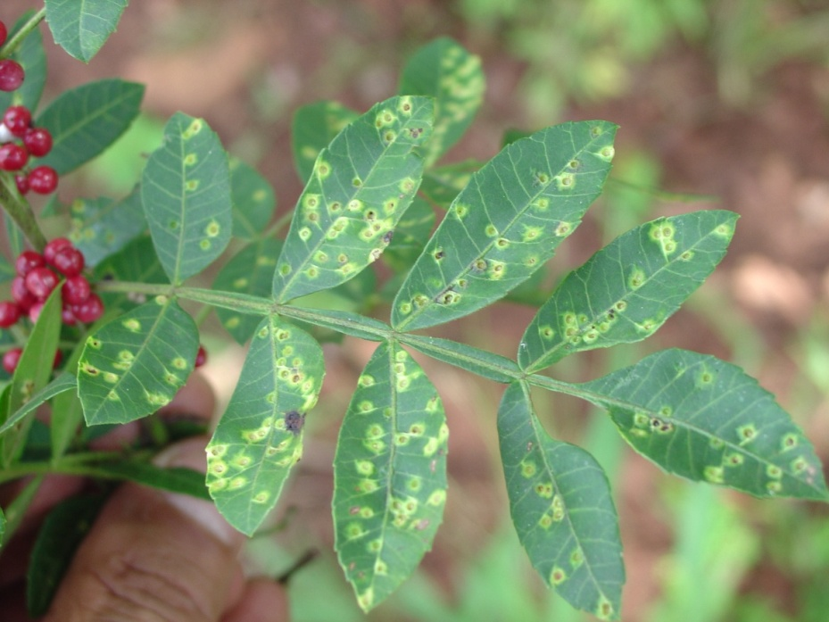
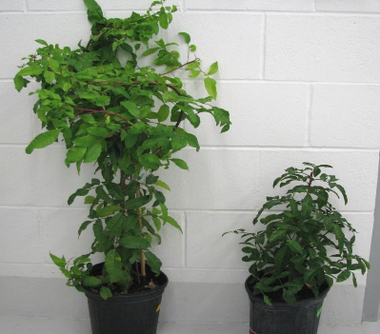
Two Brazilian pepper biocontrol agents now recommended for release by USDA/APHIS TAG
Pseudophilothrips ichini
Thrips
Calophya latiforceps
Forms leaf galls
Both stunt plant
growth and kill tips
More information: Greg Wheeler
Greg.wheeler@ars.usda.gov

Slide 19
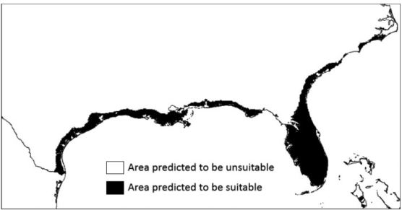
Potential distribution of the thrips?
Thrips should spread throughout invaded range
Southern Fla
Gulf coast
Predicted range
of thrips
Present range
of Brazilian pepper
Manrique et al. ‘2014

Slide 20
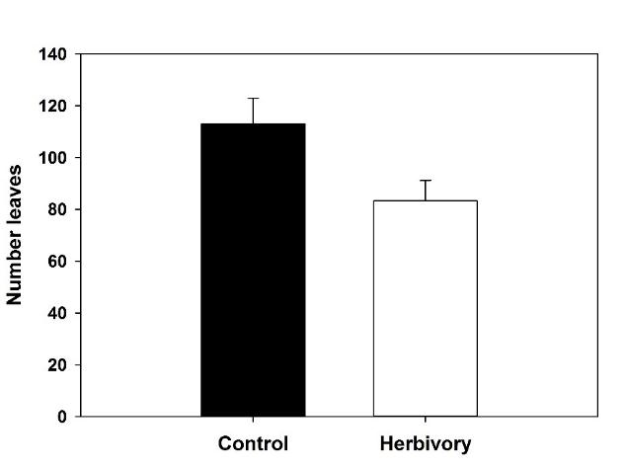
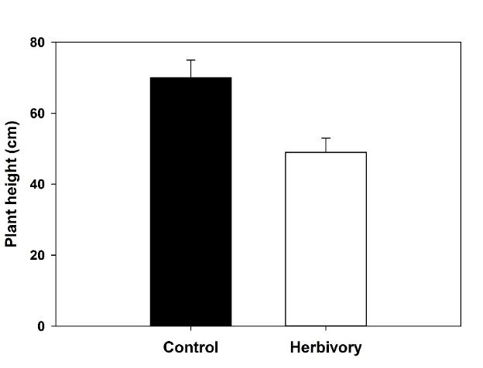
Impact of thrips feeding
Impact of 30 days thrips feeding 30% reduction in:
number of leaves
plant height

Slide 21
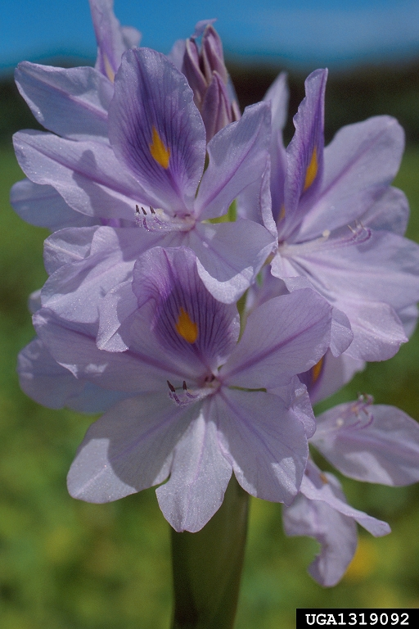
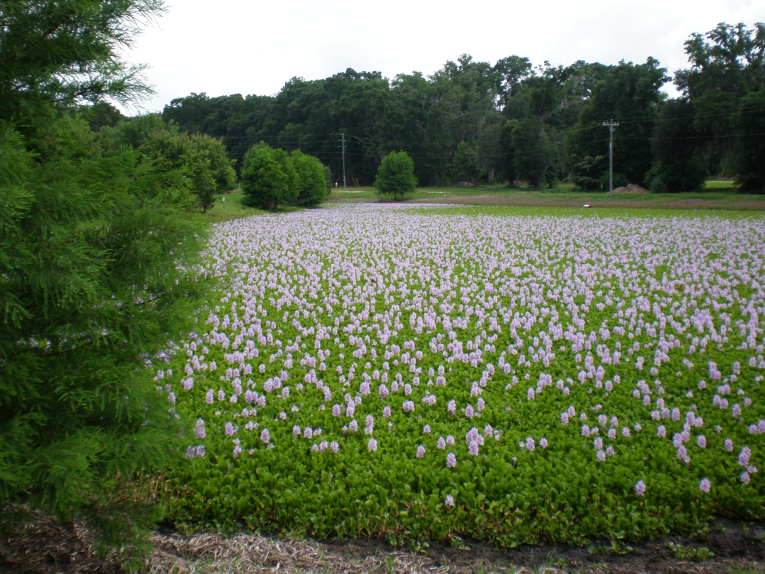
Waterhyacinth
More information: Phil Tipping, Lyn Gettys, Carey Minteer
Willey Durden

Slide 22
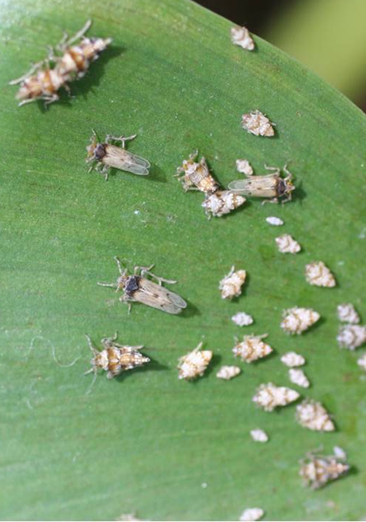
Waterhyacinth
Current Biocontrol
Plant hopper
  Megamelus scutellaris
  S. America (2010)
  Feeds externally
  More compatible with
  herbicides

Slide 23
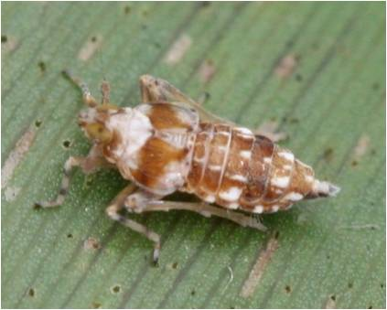
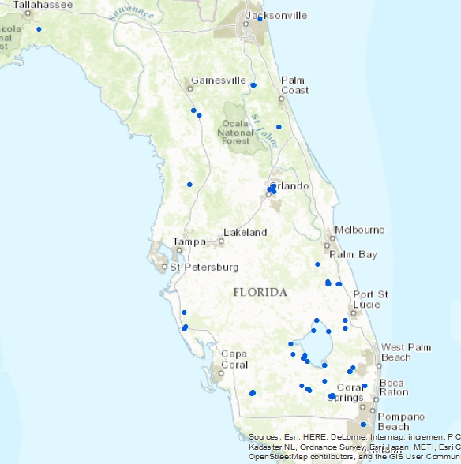
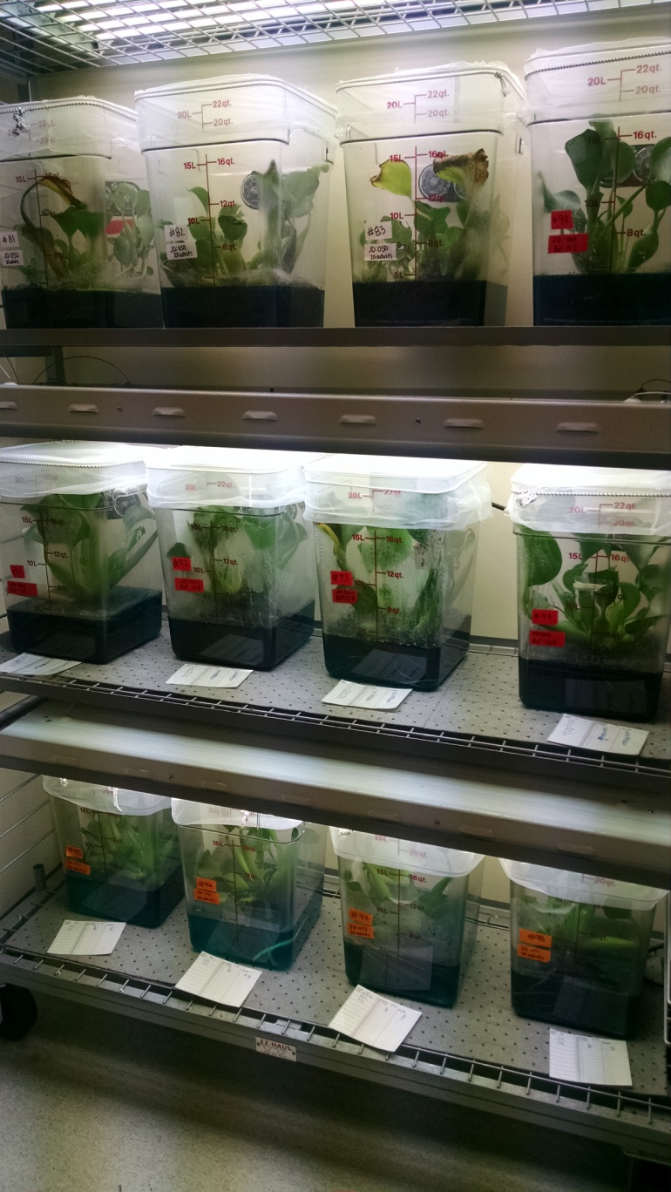
Mass rearing and release
> 1,080,000 since 2010
> 580,000- FY 2016
Notes:
Make sure to mention how we increased rearing efficiency since I have started. Optimization.

Slide 24
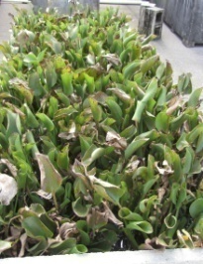
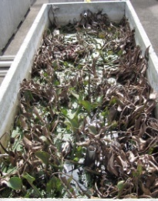
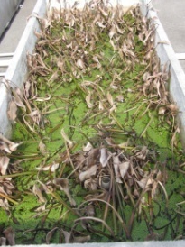
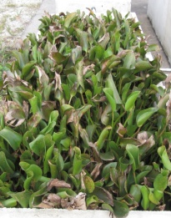


Waterhyacinth Research
Potential for Active Integration of Chemical and Biological Control
Biocontrol
Control
2 qts/A
4 qts/A
No
Biocontrol

Slide 25



Field IPM

Slide 26


Waterlettuce
Leslie Merhoff, U. of Conn.

Slide 27

Development of new biocontrol agents
Lepidelphax pistiae (Hemiptera: Delphacidae)
Leslie Merhoff, U. of Conn.

Slide 28

Host range testing
65 plant species tested (no choice)
No feeding or oviposition on any plant other than the target

Slide 29



Impact
*
* P < 0.0001

Slide 30


Rhodomyrtus tomentosa
Native to Asia
Fire resilient
High affinity for poor soils
Highly problematic in Naples and Cypress Creek, among other areas
Understory invader, especially in Pinelands
Source: Melissa Smith (Hong Kong)
Source: USDA-ARS (Florida)

Slide 31
Rhodomyrtus biological control
Fruit feeder, Mesophleps albinella, currently in quarantine

Slide 32

Rhodomyrtus biological control
Stem-boring moth, Casmara subagronoma

Slide 33

Melaleuca quinquenervia
20 years of biological control
Significant control achieved
Still need more control, especially in perennially inundated areas (e.g. Loxahatchee)
Source: USDA-ARS (M. quinquenervia with biological control)

Slide 34

Melaleuca biological control
Lophidiplosis indentata with galls (galling midge)
~2 years, More information: Melissa Smith
Notes:
Leaf gall midge (Lophidiplosis indentata)

Slide 35












Acknowledgements

