Slide 1


Midwest
Training
Maps and Advanced Query Tools
Notes:
Welcome to the EDDMapS Midwest Training on Distribution Maps and Advanced Query Tools.

Slide 2
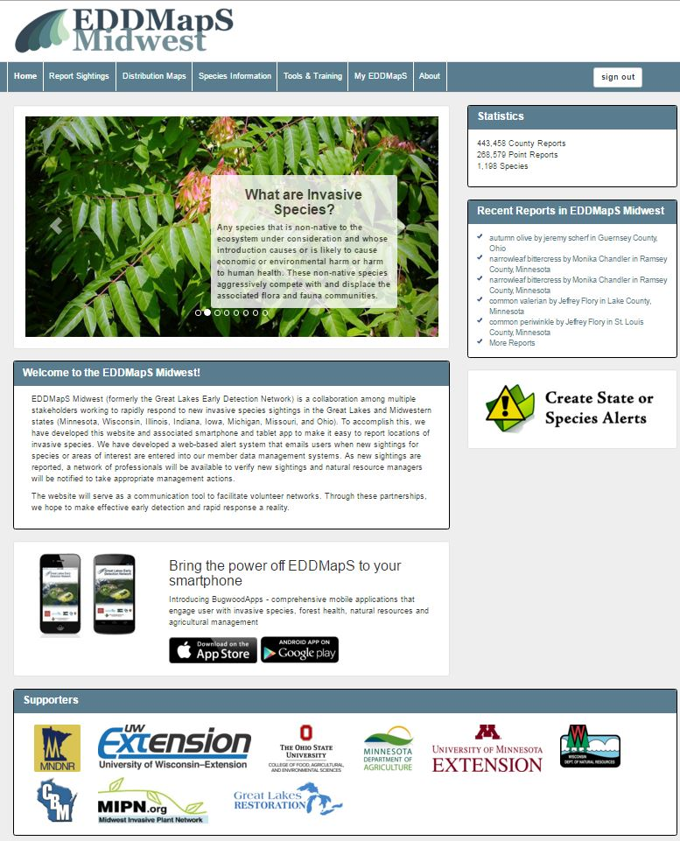

Begin by Signing In
You can always view the data in EDDMapS without signing in
Notes:
Begin by signing in. You can always view the data on EDDMapS without signing in, but to request downloads or to work with the data such as adding revisits to your own or someone else’s records you will need to be signed in.

Slide 3
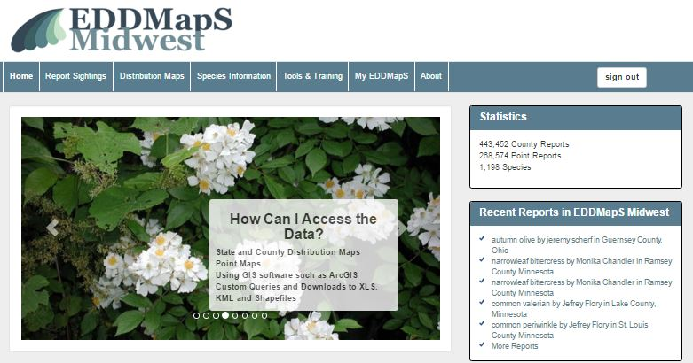
Distribution Maps
To see Distribution Maps and Project Maps click on Distribution Maps
Notes:
To see Distribution Maps or Project Maps click on Distribution Maps

Slide 4
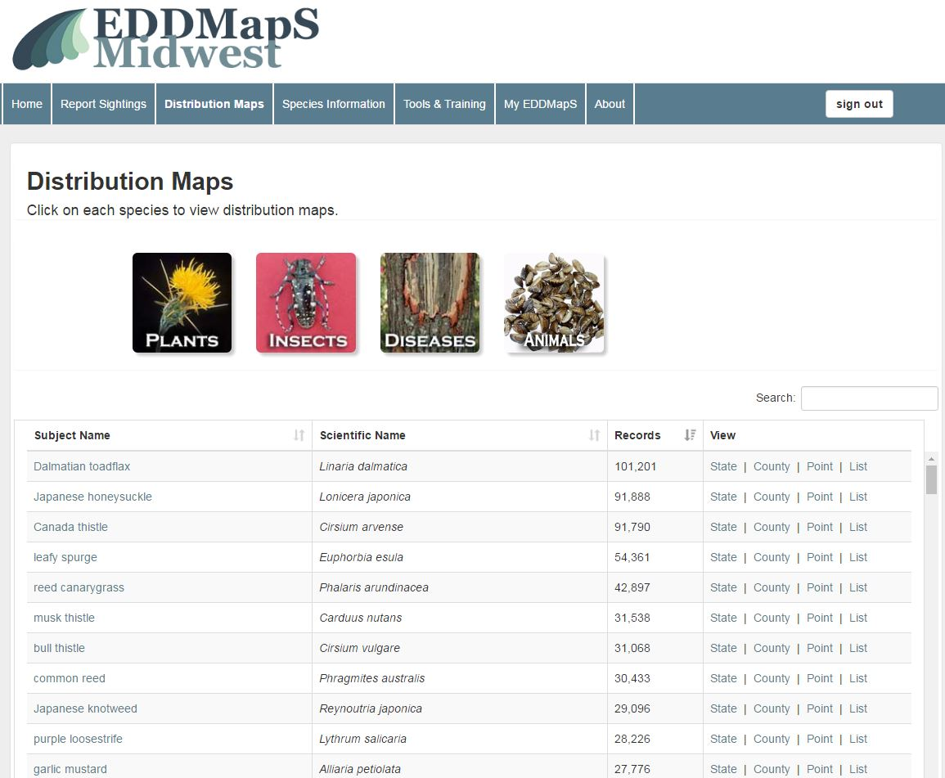
Distribution Maps
Choose the species
Species
Notes:
You can view distribution maps by Individual species or by a specific Project

Slide 5
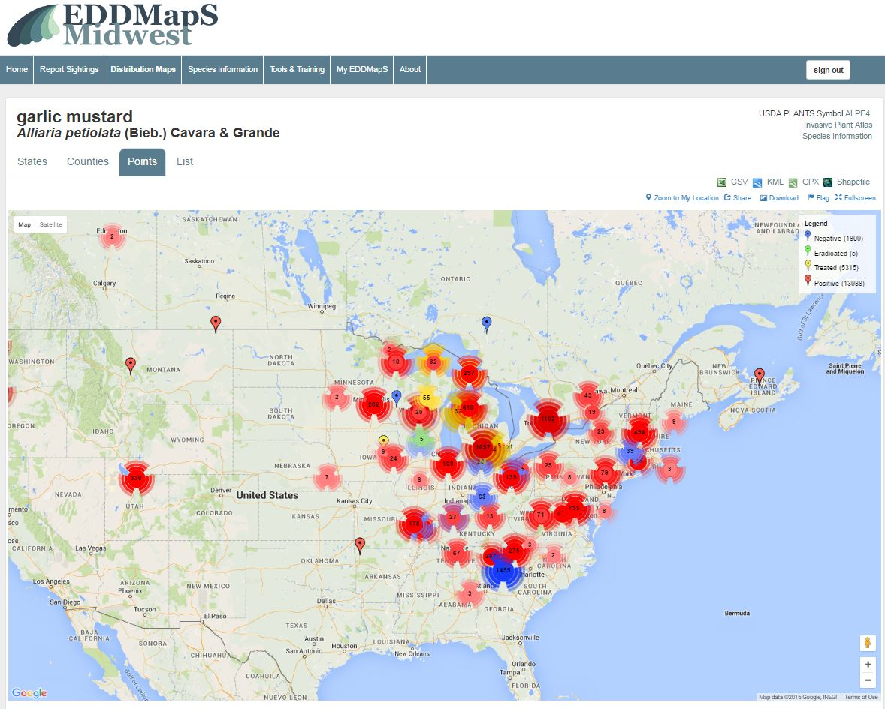
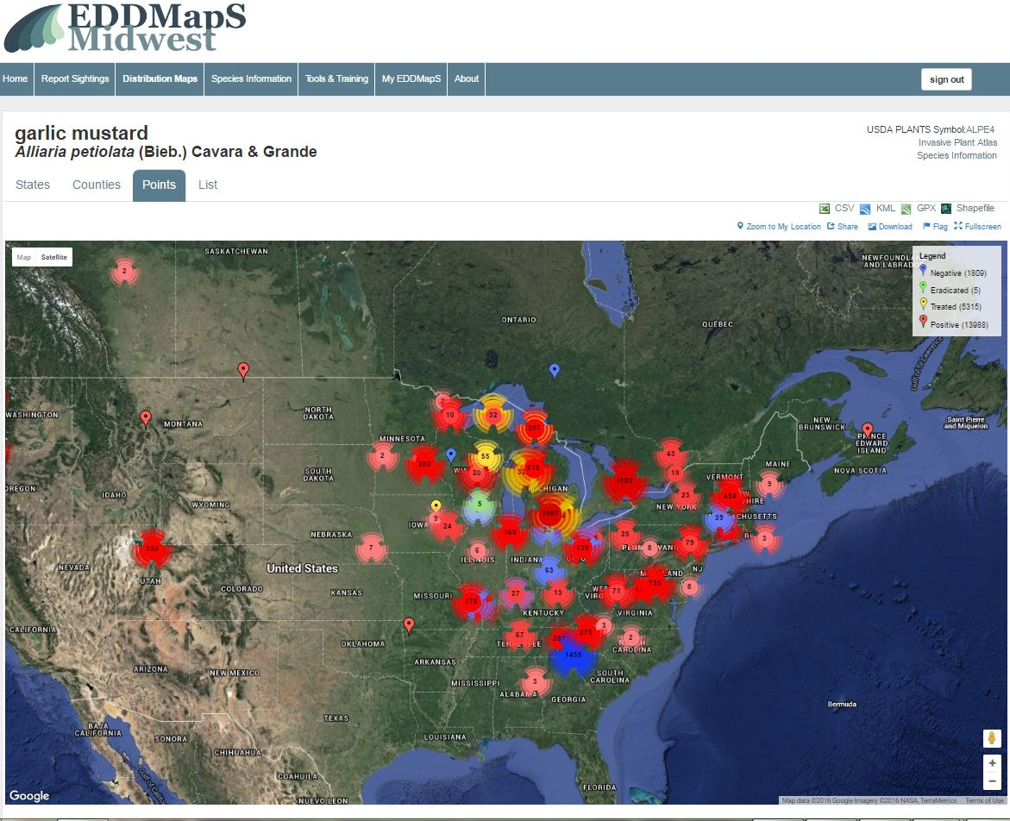
Distribution Maps by Species
View data as Points
Click on
Map
Or Satellite
Notes:
In distribution maps, you can view the data in a variety of ways. Here you can see the data as individual points on the map. You can also choose whether you see the data in map or satellite view.

Slide 6
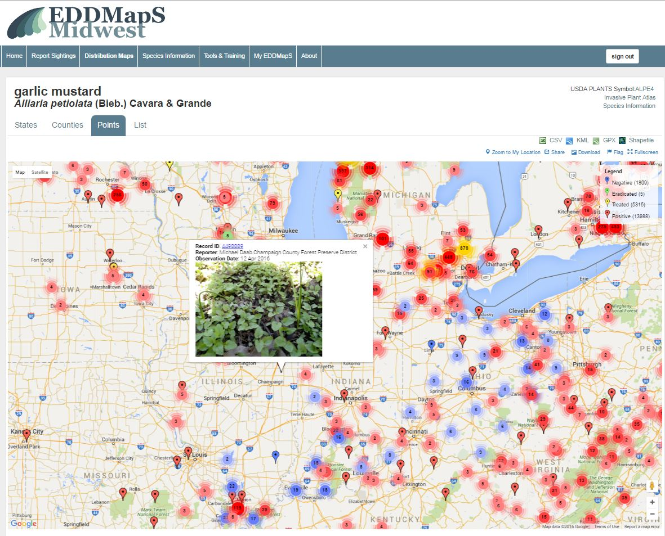
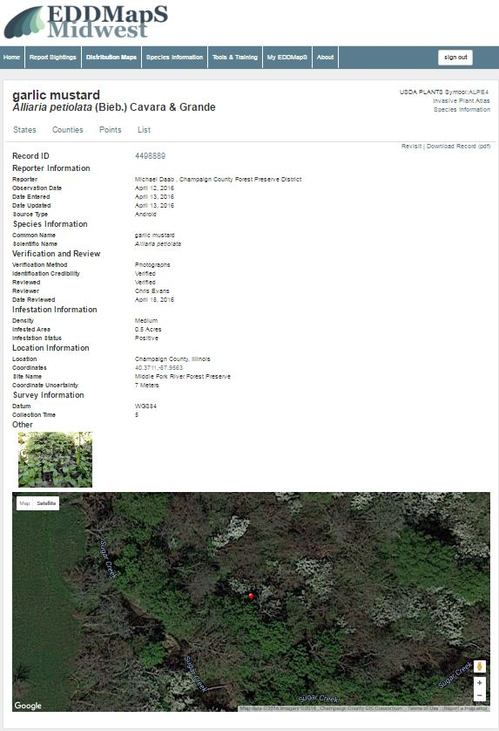
Distribution Maps – by Species
Zoom in to see details
Click on record to pull it up
Notes:
This works on Goggle Maps so you can Zoom in to see details. Each marker represents a report so you can click on the marker to select that record to open.

Slide 7
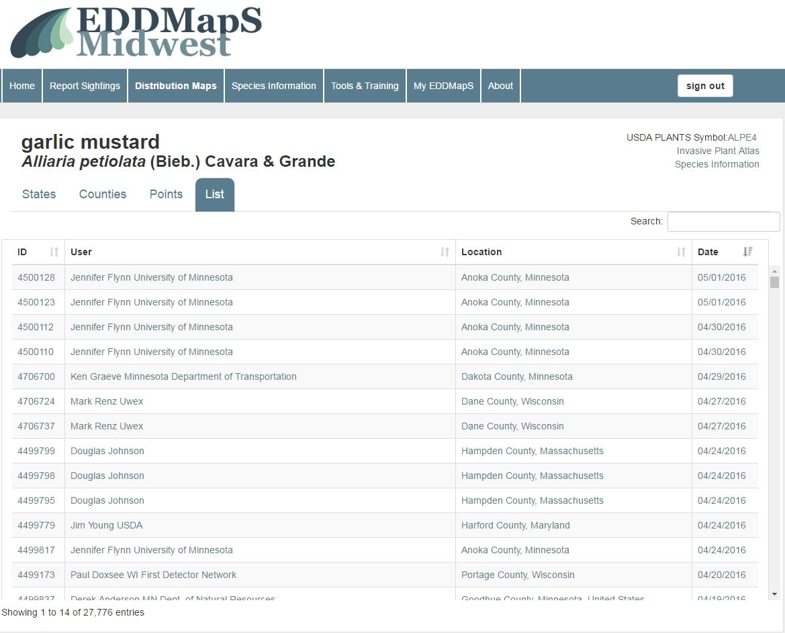
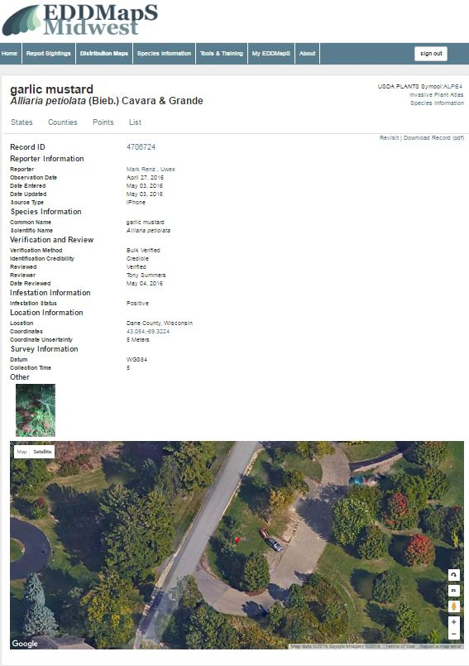
Distribution Maps – by Species
View data as a List
Click on record to pull it up
Click on
Notes:
View data as a List and click on any individual record you need to open it

Slide 8
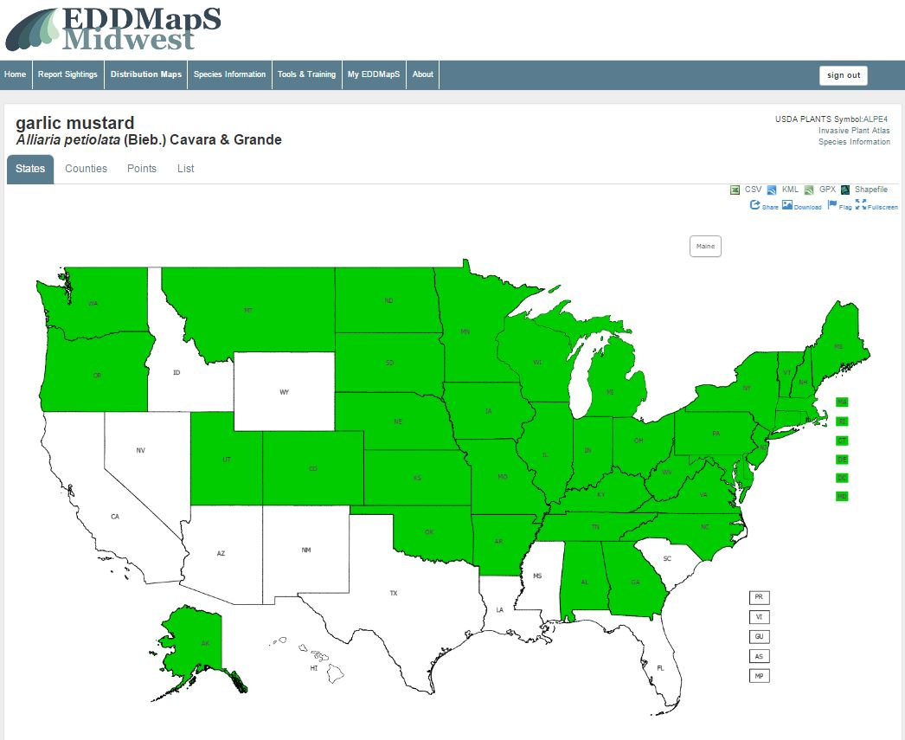
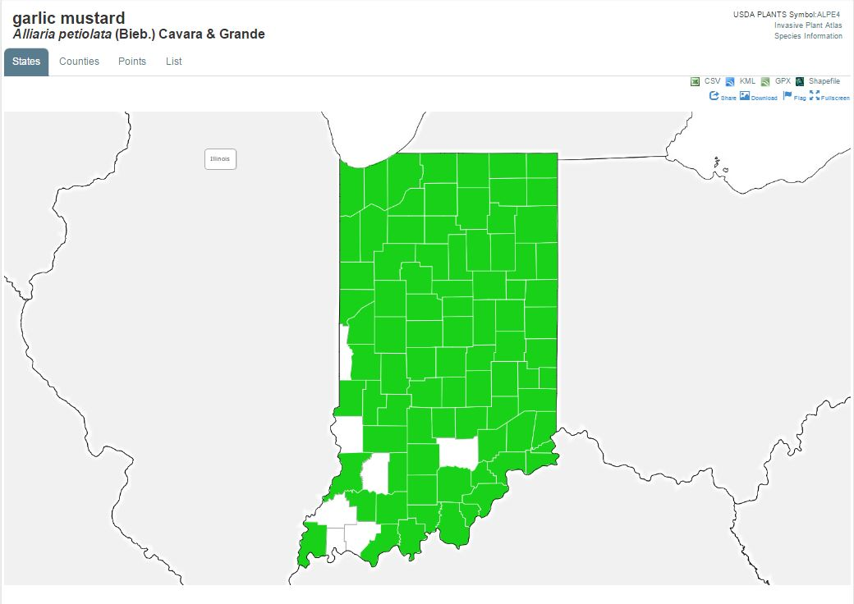
Distribution Maps – by Species
View data at the State level
Click on a state to view
it’s county level data
Click on
Click on
Notes:
You can view distribution of the pest species at the State level. If you click on a state you can view the county level data for that state.

Slide 9
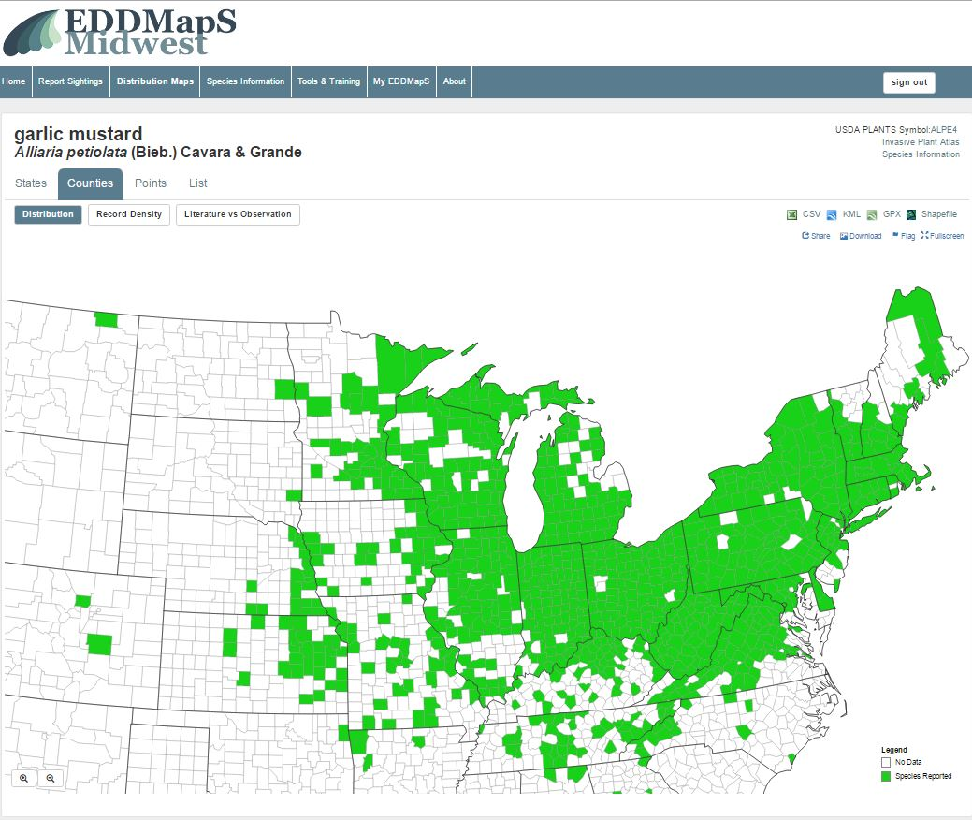
Distribution Maps – by Species
Click on
View data at
County level by clicking Distribution
Click on
Notes:
There are three ways to view county level data. You can View the data on the pest species at the County level by Distribution.

Slide 10
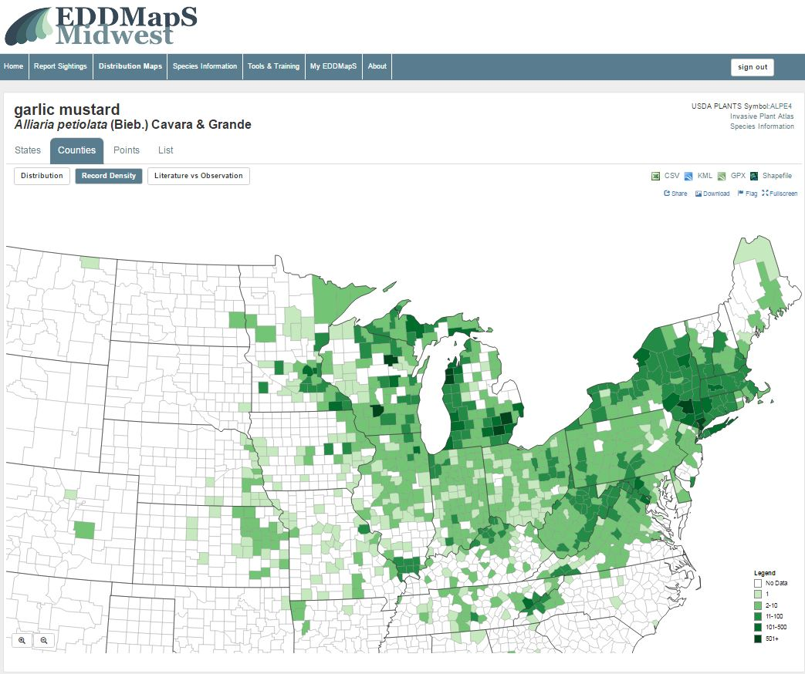
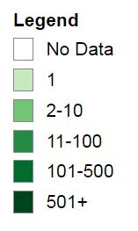
Distribution Maps – by Species
View data at
County level
by clicking
Record Density
Click on
Notes:
You can View the data on the pest species at the County level by Record density. The more infestations reported in a county, the darker the map color

Slide 11
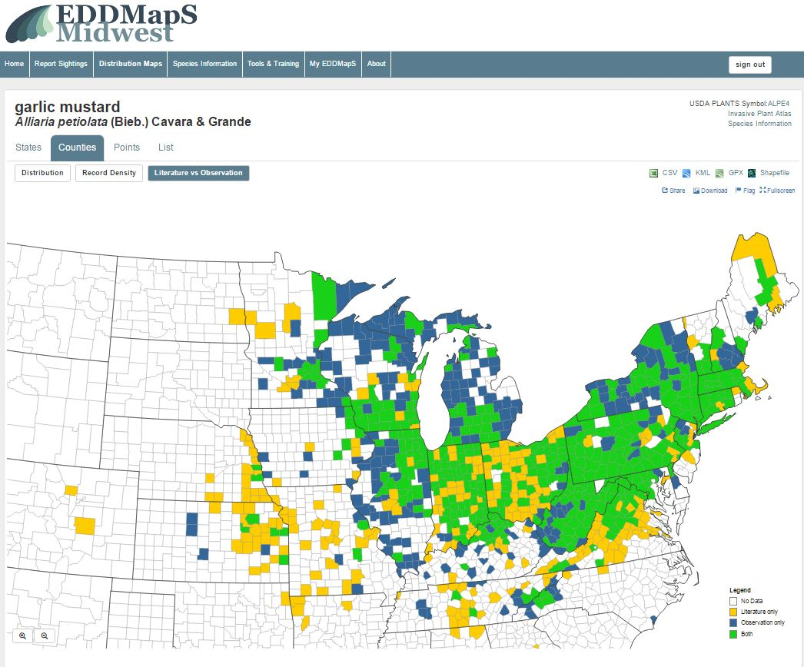
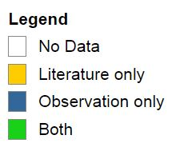
Distribution Maps – by Species
View data at
County level
by clicking
Literature vs Observation
Click on
Notes:
You can View the data on the pest species at the County level by Literature vs Observation. So literature only comes from herbarium, BIOTA of North America, USDA Plants or other published records. Observation only are records submitted by groups or individuals from a survey they conducted.

Slide 12
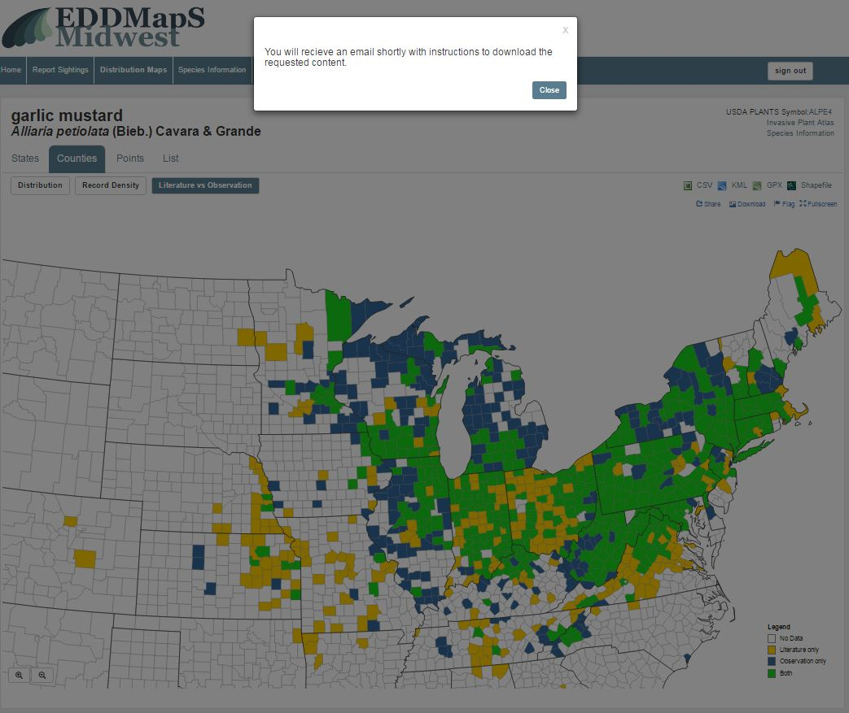
Distribution Maps – by Species
Download the data as
  CVS file
  KML file
  GPX file
  Shapefile
You will receive an email shortly with instructions to download the requested content
Notes:
You can choose to Download the data as CVS file, KML file , GPX file, or Shapefiles. You will receive an email shortly with a link to download the information you requested.

Slide 13
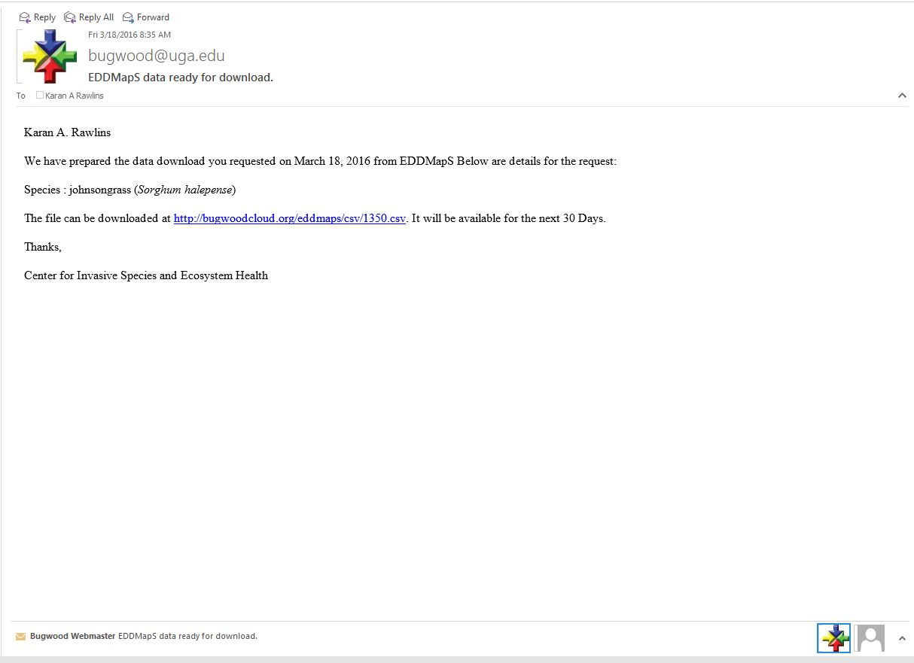
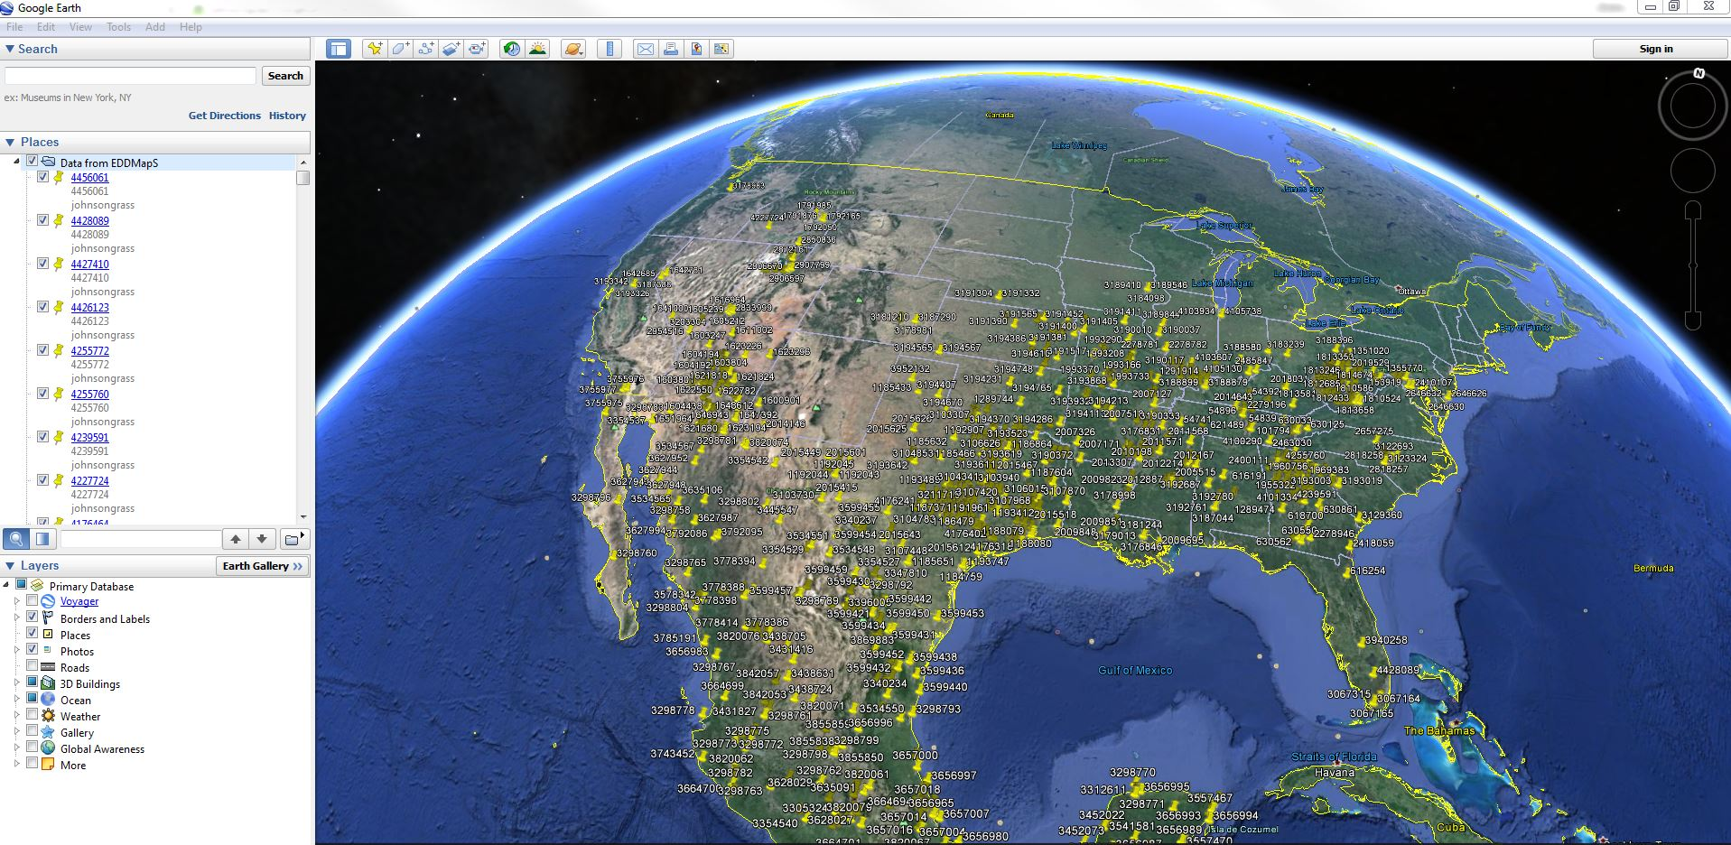
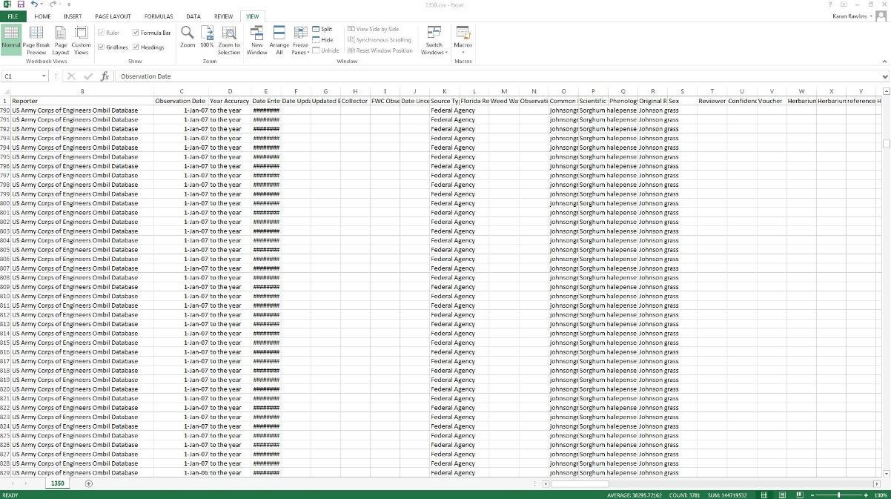
Distribution Maps – by Species
Email with link to data requested
Click on
Google earth – KML File
CVS file
Notes:
You receive an Email with link to data requested. That link will be available to you for 30 days. Here are examples of a cvs file and a KML or Goggle earth file that you can download. You will need to have the relevant software on your computer to open files such as KML, GPX or Shapefiles after they are downloaded.

Slide 14
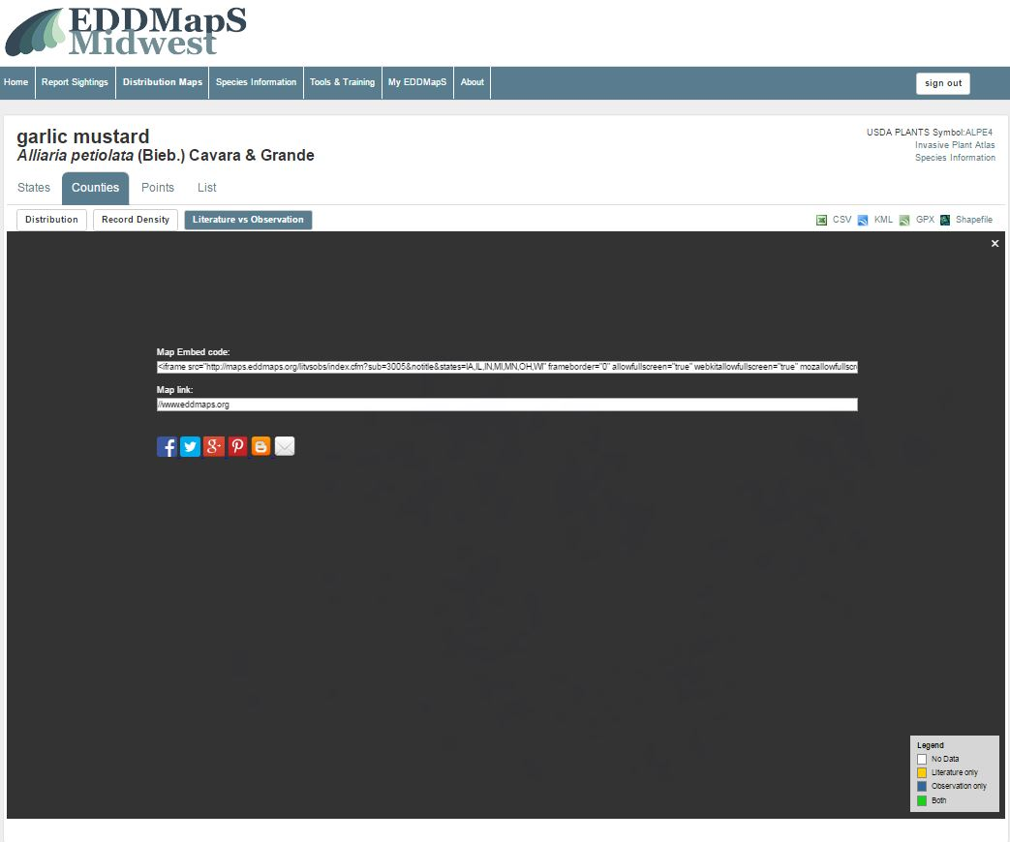
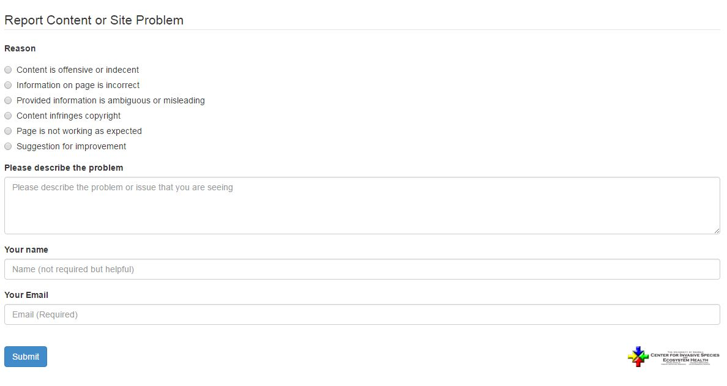
Distribution Maps – by Species
Click on Share
to get the url
Click on Flag to report a problem
Notes:
If you want to share a map, for example on a blog, click on share. The url will pop up for you to copy into your blog or to a website. If you are having any type of problem with the distribution maps, click on Flag to report a problem to our tech department.

Slide 15
Advanced Query Tools - Maps
Click on
Tools & Training
Notes:
To get to Advanced Query Tools, click on the Tools & Training tab

Slide 16
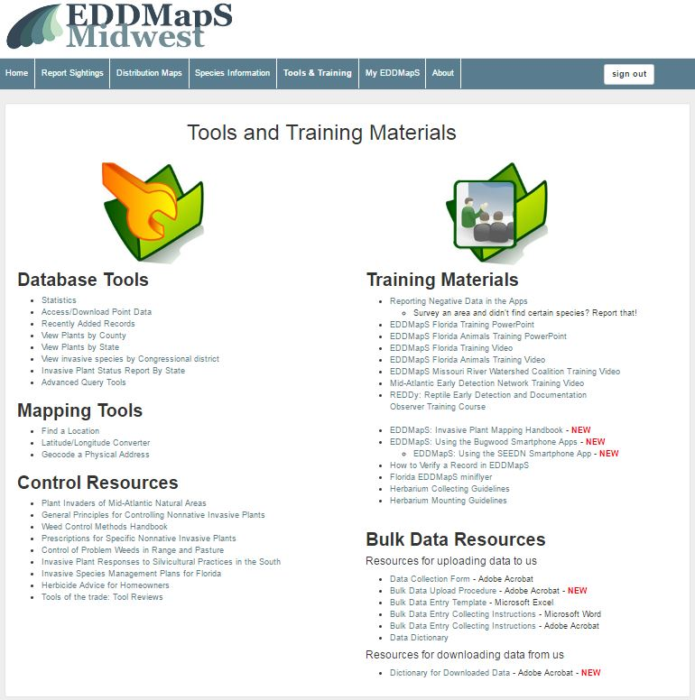
Advanced Query Tools - Maps
Click on
Advanced Query Tools
Notes:
Under database tools on the left hand side of the screen, click on Advanced Query Tools

Slide 17
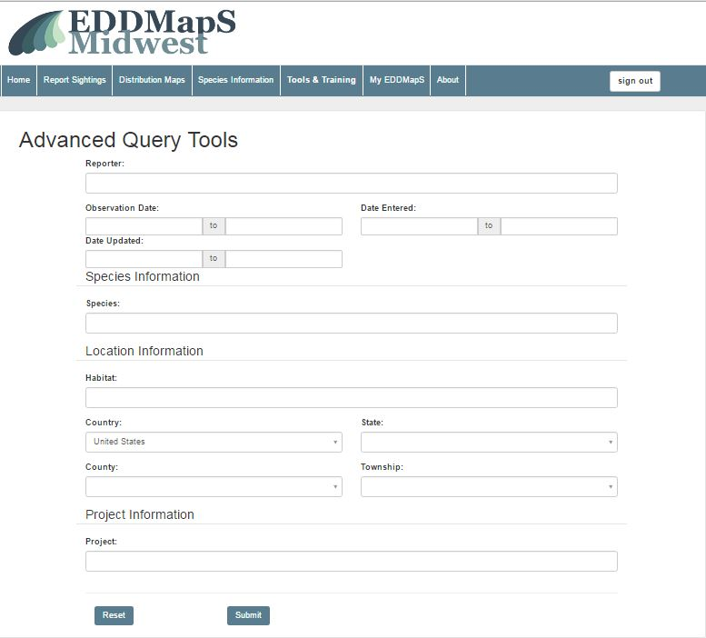
Advanced Query Tools - Maps
You can set the criteria for the search to be as general or as specific as you need
Notes:
You can set the criteria for the search to be as general or as specific as you need

Slide 18
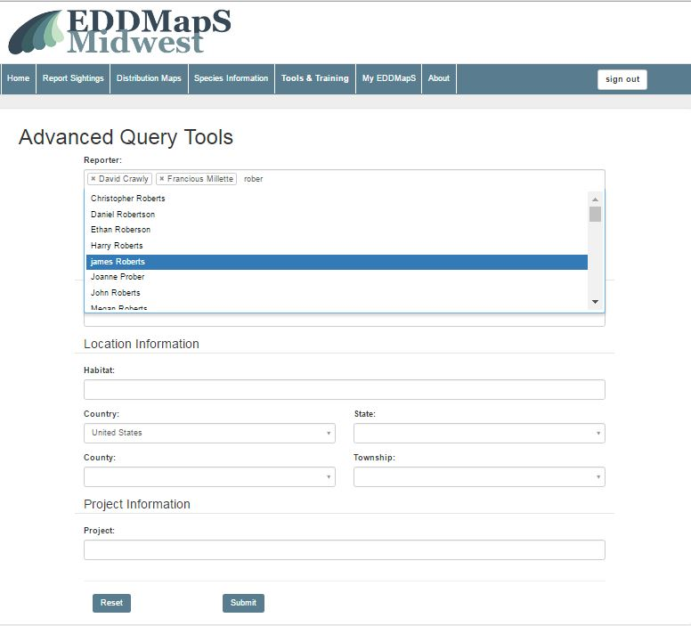
Advanced Query Tools - Maps
Choose one or multiple reporters
Begin typing in a name and then choose from the drop down list
To remove a name from the list you have chosen, click on the x next to that person’s name
Notes:
To Choose one or multiple reporters, Begin typing in a name and then choose from the drop down list.

Slide 19
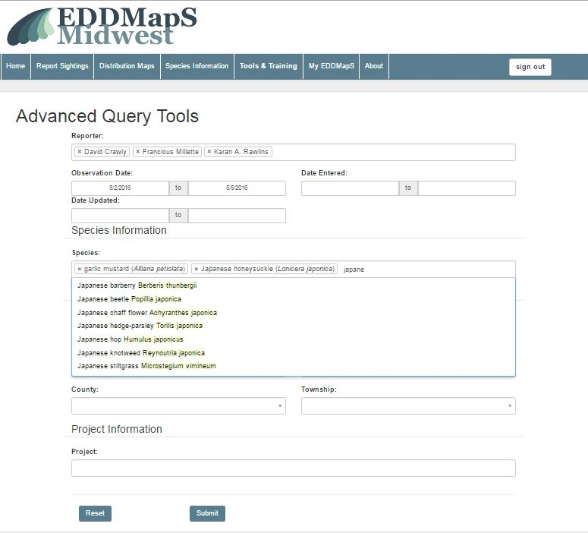
Advanced Query Tools - Maps
Choose one or multiple Species
Begin typing in a name and then choose from the drop down list
To remove a name from the list you have chosen, click on the x next to that species name
Notes:
To Choose one or multiple invasive Species, Begin typing in either the scientific or common name and then choose from the drop down list. To remove a name from the list you have chosen, click on the x next to that species name

Slide 20
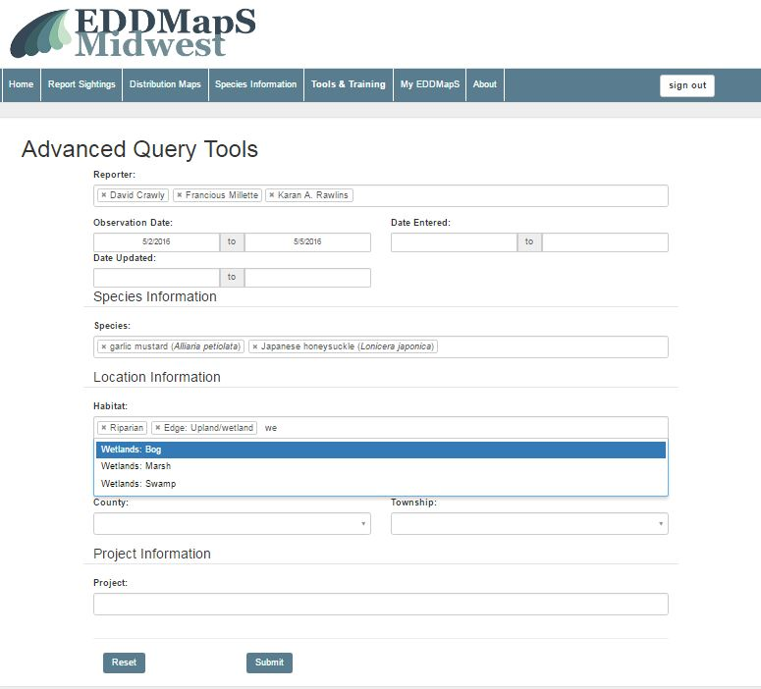
Advanced Query Tools - Maps
Choose one or multiple Habitat types
Begin typing in a habitat type and then choose from the drop down list
To remove a habitat from the list you have chosen, click on the x next to that habitat name
Notes:
To Choose one or multiple habitat types, Begin typing in the habitat name and then choose from the drop down list. To remove a name from the list you have chosen, click on the x next to that habitat name

Slide 21
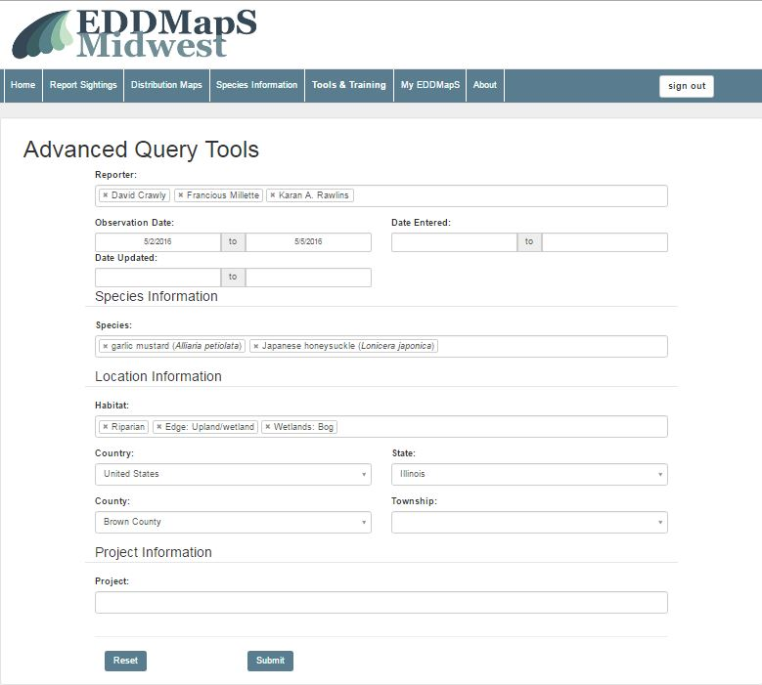
Advanced Query Tools - Maps
Click on Submit
to run the search
Notes:
Click on Submit to run the search.

Slide 22
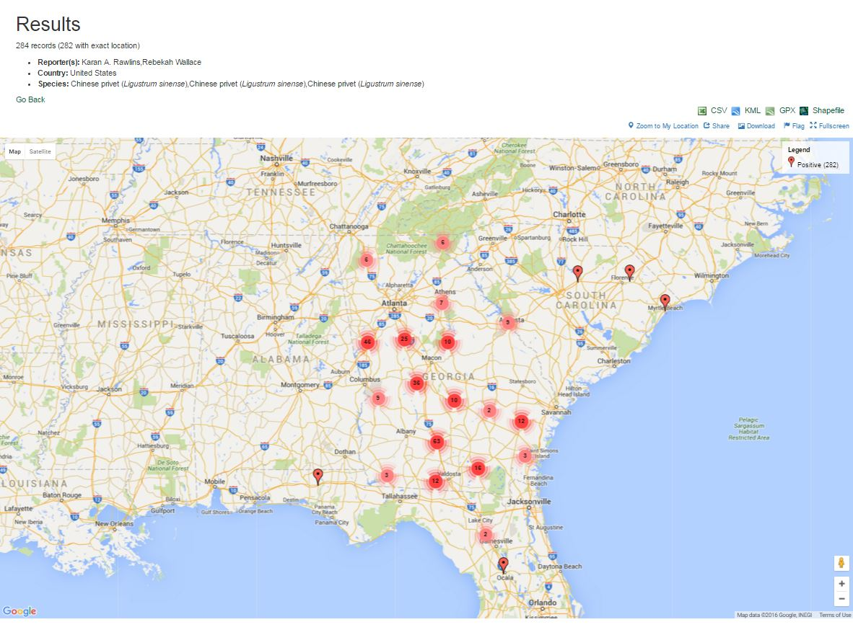
Advanced Query Tools - Maps
Downloads work the same way as they do for Distribution Maps
You can Share the map in the same way as Distribution Maps
Notes:
Downloads work the same way as they do for Distribution Maps. You can also Share the maps in the same way as you do for distribution maps.

Slide 23
Thank you for participating in this EDDMapS Midwest training.
This and other trainings are available on the EDDMapS Midwest Website.
For any questions contact us at
Bugwood@uga.edu
Notes:
Thank you for participating in this EDDMapS Midwest training. This and other trainings are available on the EDDMapS Midwest Website. For any questions contact us at Bugwood@uga.edu

