Slide 1
Inventory of IPM tools and resources: Connect database
Joe LaForest
National IPM Coordinating Committee
Federal IPM Coordinating Committee
March 25, 2025

Slide 2
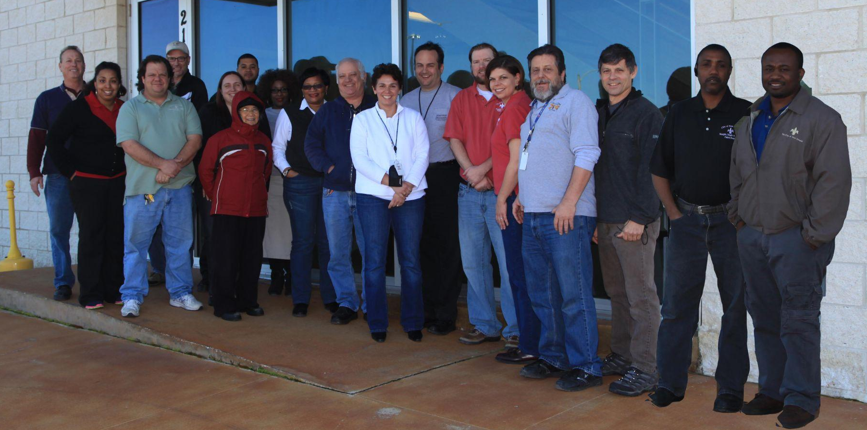
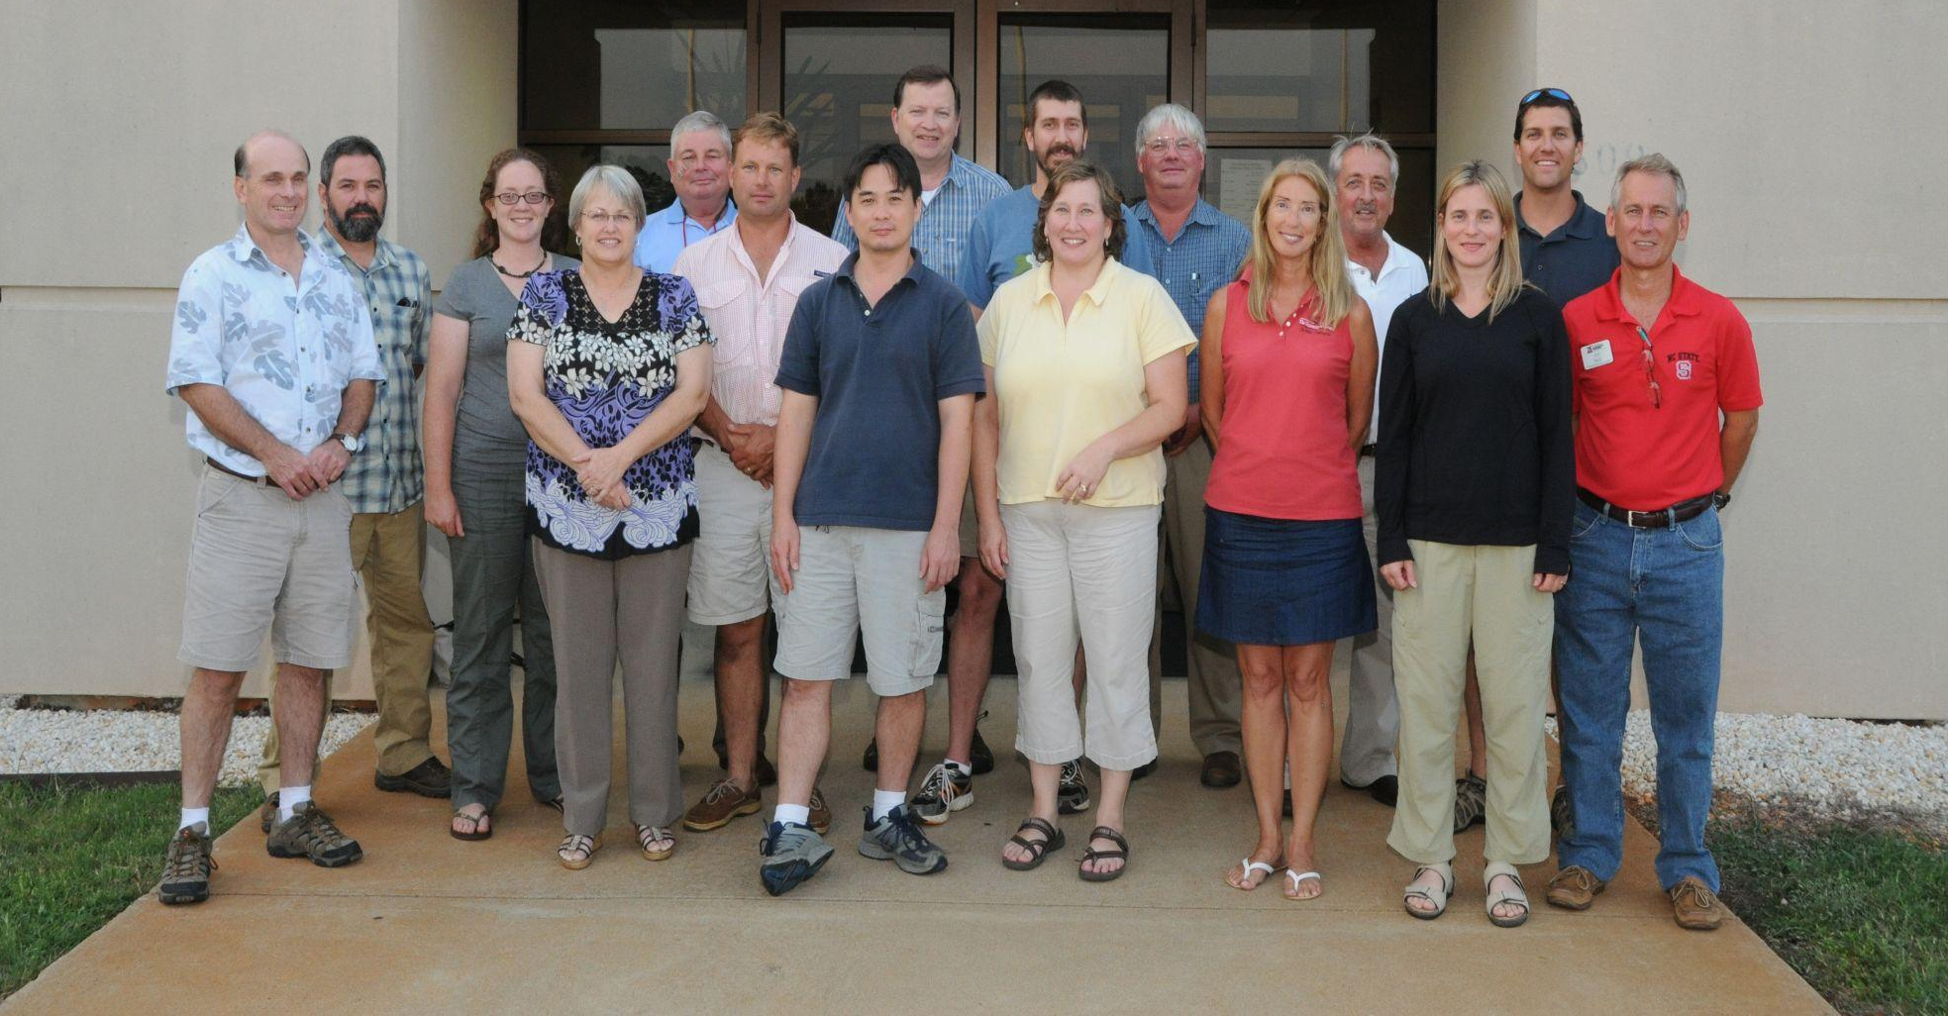
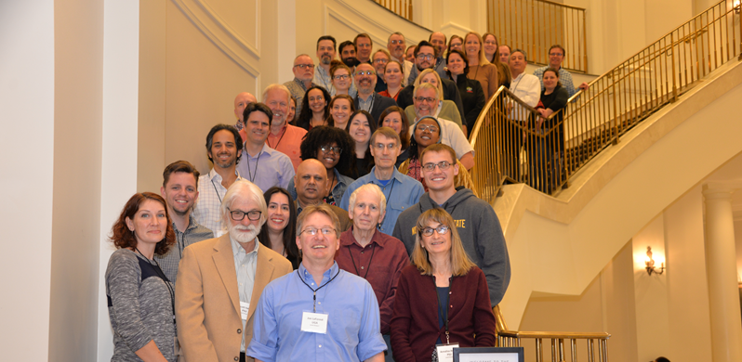
Goal 3
Enhance Engagement and Collaboration
People matter.
Yes, I mean you.
Notes:
Stronger internal and external collaborations are necessary to maximize the impact of IPM programs.
Expanding the Connect database will improve networking and collaboration among IPM professionals, facilitating better coordination within the Crop Protection and Pest Management Program.
Additionally, strategic partnerships with allied programs such as SARE, IR-4 and NPDN will enhance IPM outreach and implementation.
Strengthening communication pathways between research, extension and industry professionals will ensure IPM remains responsive to evolving challenges.

Slide 3
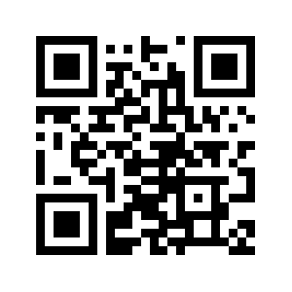
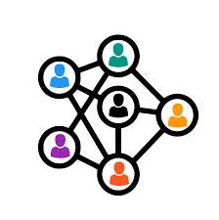

Define and clarify connections within the IPM Enterprise
Who’s here? Who works with whom?
What commodities and settings are people working in?
Where is there interest to build collaborations?
What efforts already exist?
Are there similar efforts in other areas of IPM?
What disciplines and expertise do we have? Who’s missing?
https://connect.bugwood.org

Slide 4
Improve coordination and integration within Crop Protection and Pest Management (CPPM) aligning on priorities and actions
Applied Research & Development Program
Extension implementation forgram
Hatch Multistate Working Groups
IPM Centers
Only starting here since these are the folks driving this forward. ALL ARE WELCOME!

Slide 5
Strengthen partnerships with allied programs
A nation where everyone can access the IPM information, tools and services they need to protect their health, home, and livelihood
Sustainable Agriculture Research and Education (SARE)
Inter-regional Research Project No. 4 (IR-4)
National Plant Diagnostic Network (NPDN)
Pesticide Safety Education Programs (PSEP)
National Animal Health Laboratory Network (NAHLN)
Minor Use Animal Drug Program (MUADP)
Food Animal Residue Avoidance Databank (FARAD)
Extension Disaster Education Network (EDEN)
Are you part of the solution? Want to be?

Slide 6
Improve communication & collaboration among
federal, state & university-led IPM-related entities s
Federal IPM Coordinating Committee
USDA Office of Pest Management Policy
State Plant Boards and Departments of Agriculture
State Associations of County and City Health Officials
State commodity checkoff programs
State experiment stations and extension services
IPM-related is a HUGE area! Help us build the network!

Slide 7
Improve networking and collaboration among IPM professionals and working groups
Innovation doesn’t happen in a vacuum
Pest specific working groups
Vector borne diseases
Pollinator protection
Specialty Crop Research Initiative projects
AFRI Sustainable Agricultural Systems projects
Are you recruiting? Building a new collaboration? Looking to get engaged?

Slide 8
Expand community engagement by increasing participation from others in IPM initiatives
Responding to evolving challenges requires strong roots in the community
Master Gardeners & Naturalists
Certified Crop Advisors
Pesticide Applicators
Grower Associations & Cooperatives
Community Health Departments
County Weed Management programs
Who else is on the ground?

Slide 9
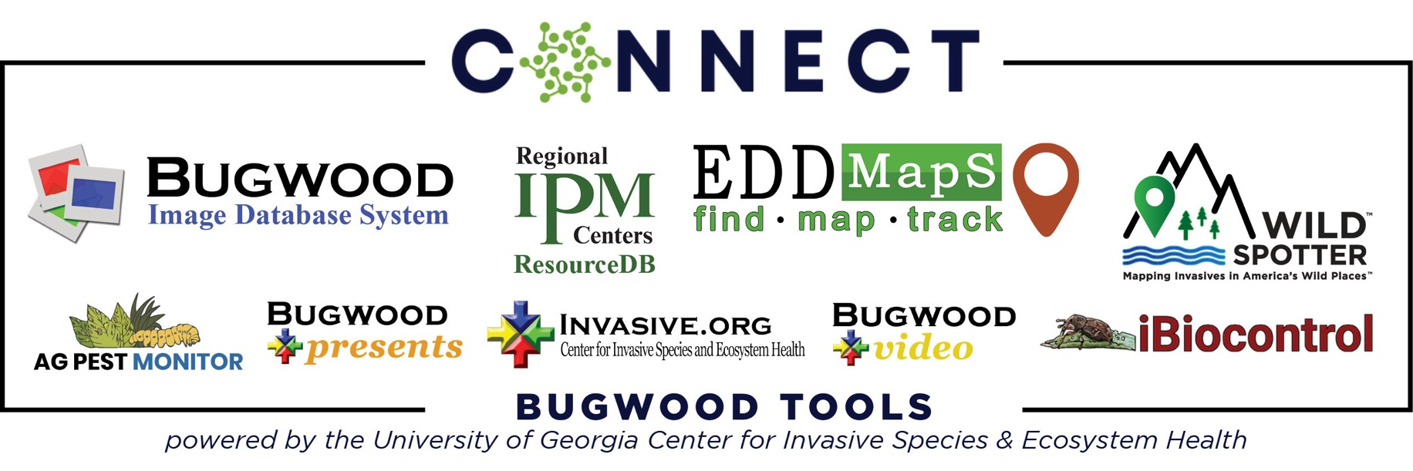
https://connect.bugwood.org/

Slide 10
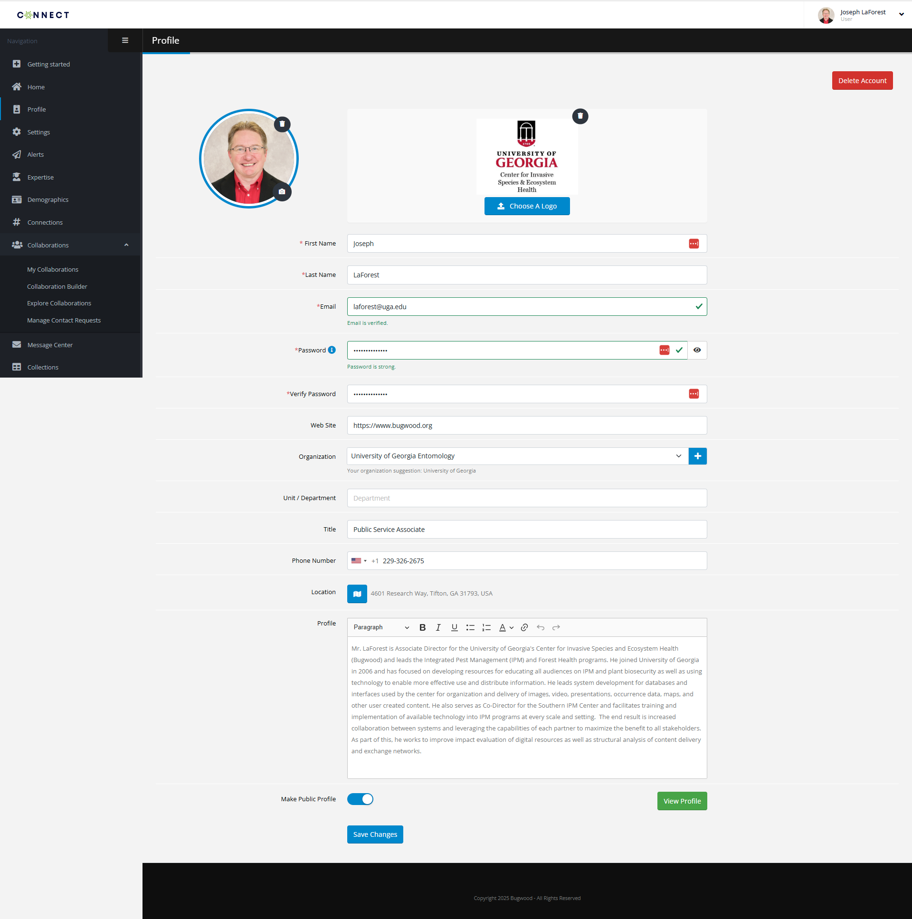

Slide 11
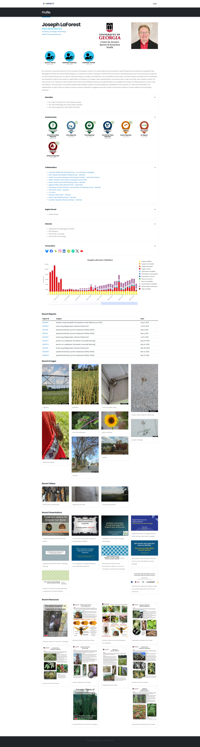


Slide 12
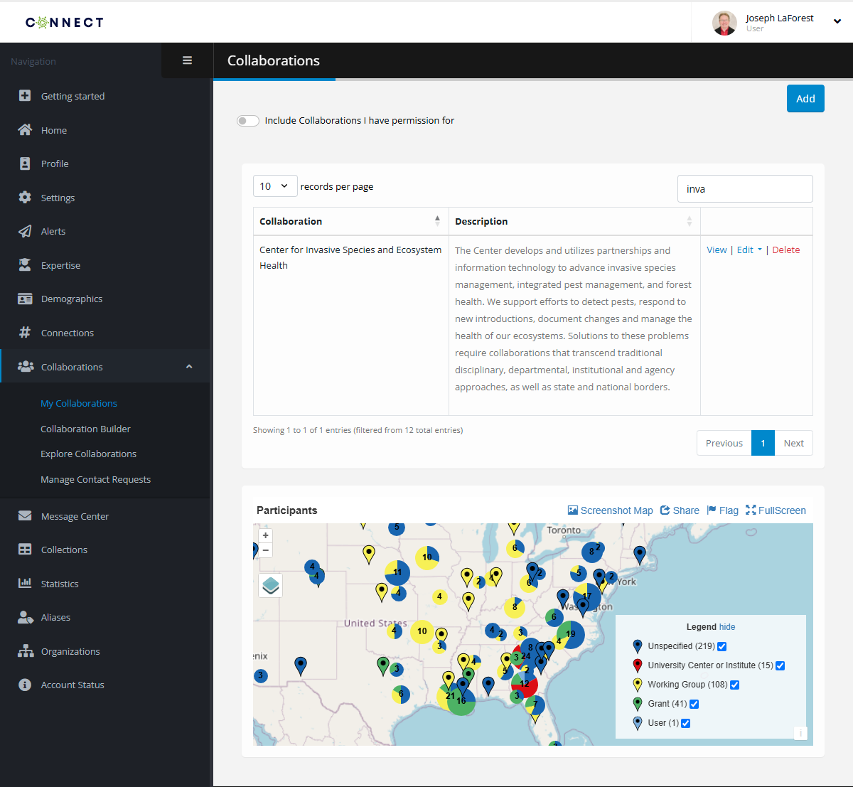
Connect - Collaborations
Current features:
  List of members and their roles
  Message/Email members
  Track group composition
  Track resource contribution and usage/access
  Group finder
  Group builder
https://connect.bugwood.org

Slide 13
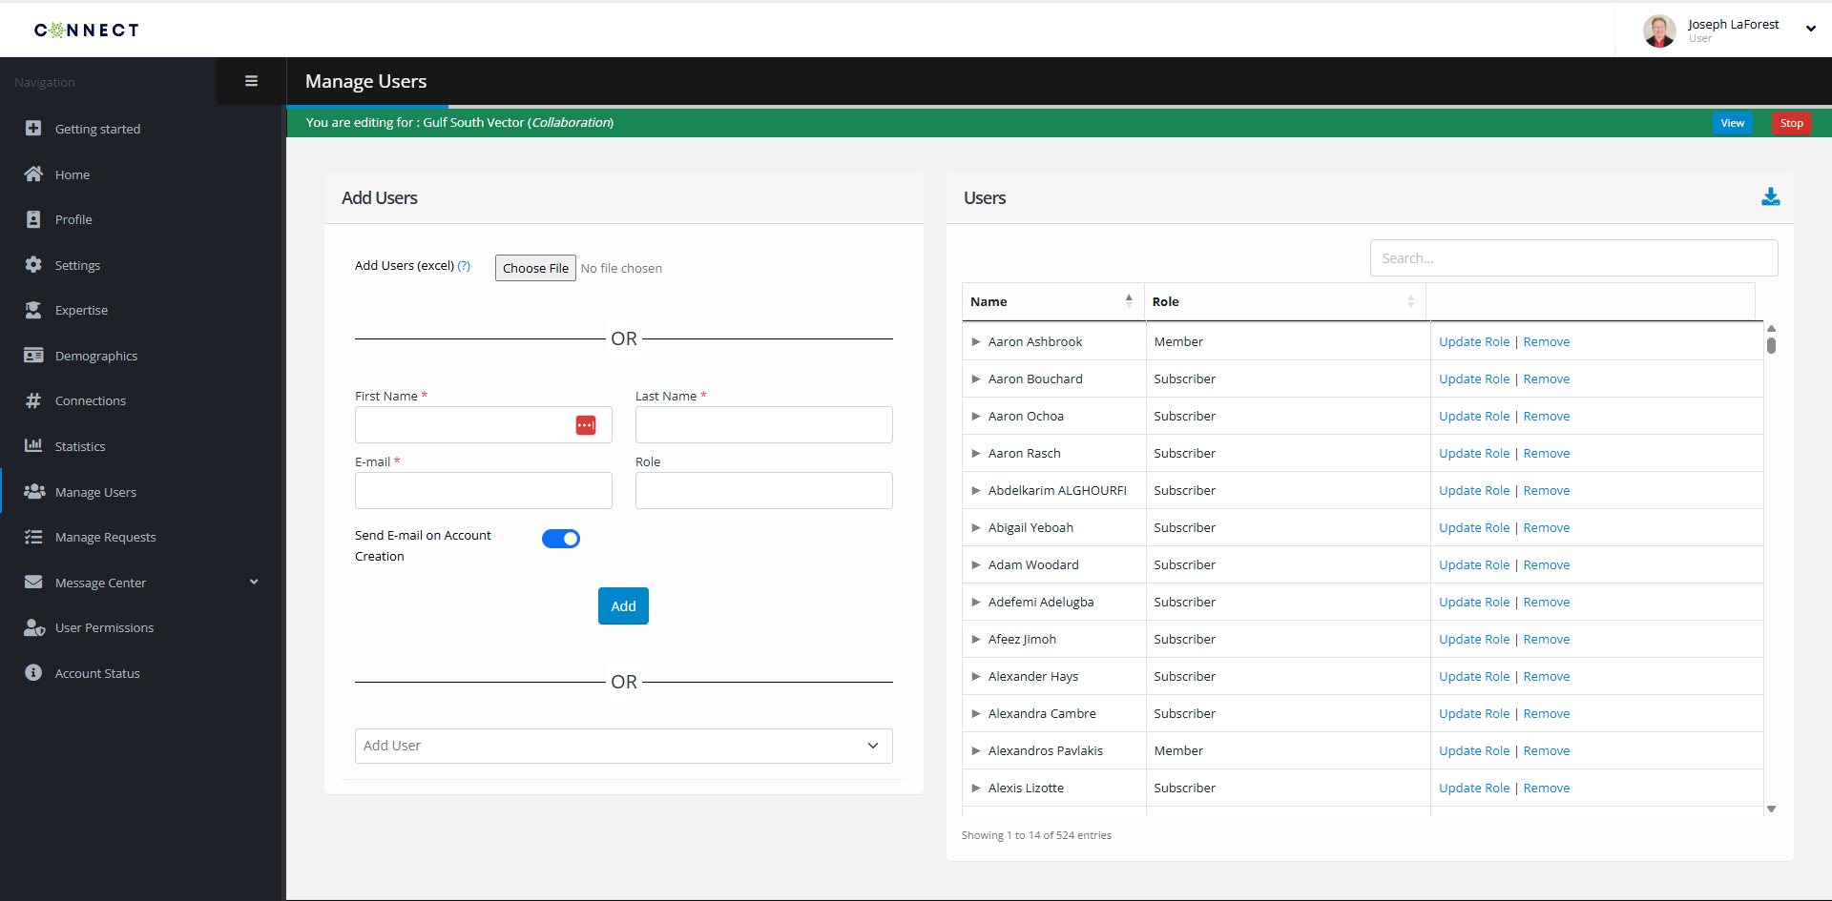
Connect – Collaborate: Users
https://connect.bugwood.org

Slide 14
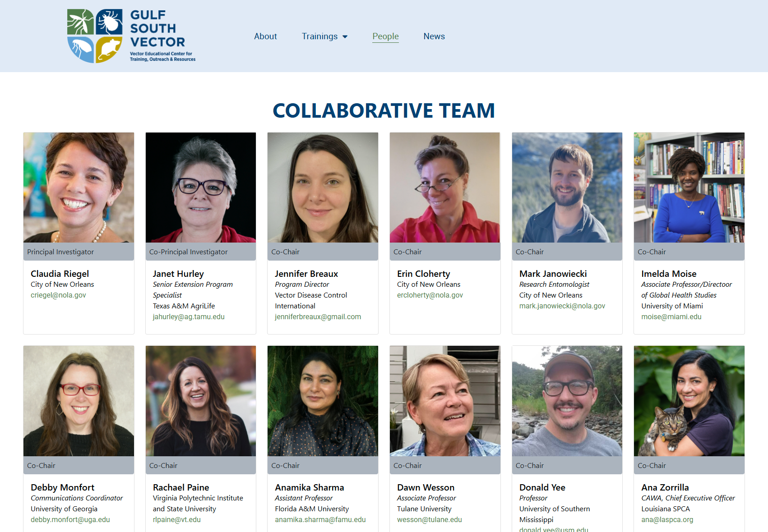
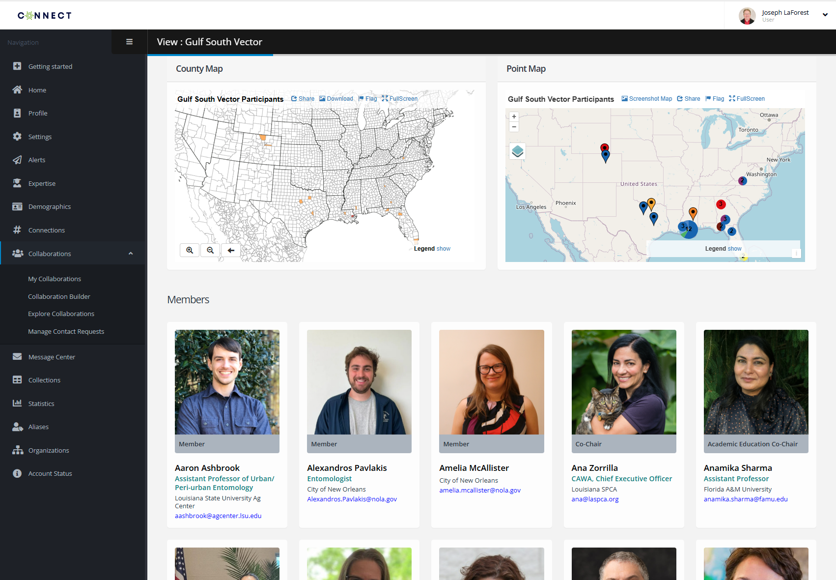
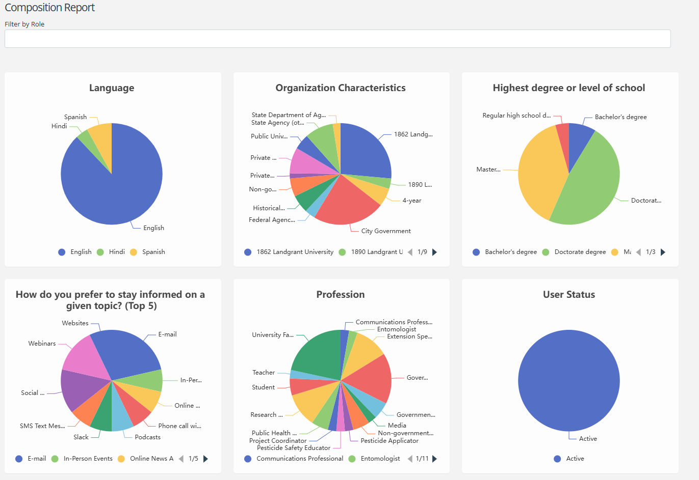
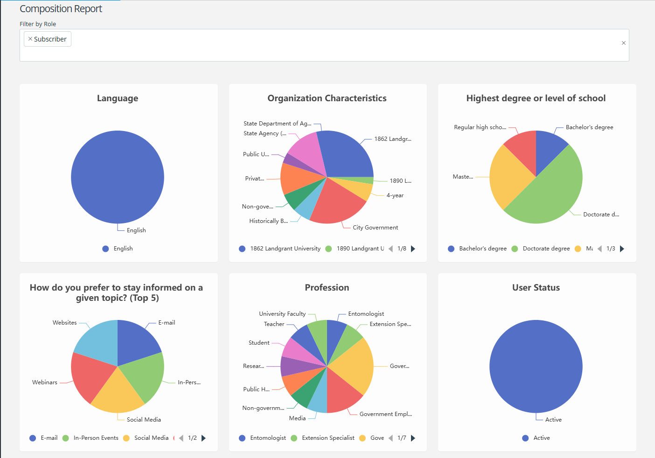
Connect – Collaborations: Users
Notes:
Typical user can see the Collaboration View page, Admins can Edit/Manage

Slide 15
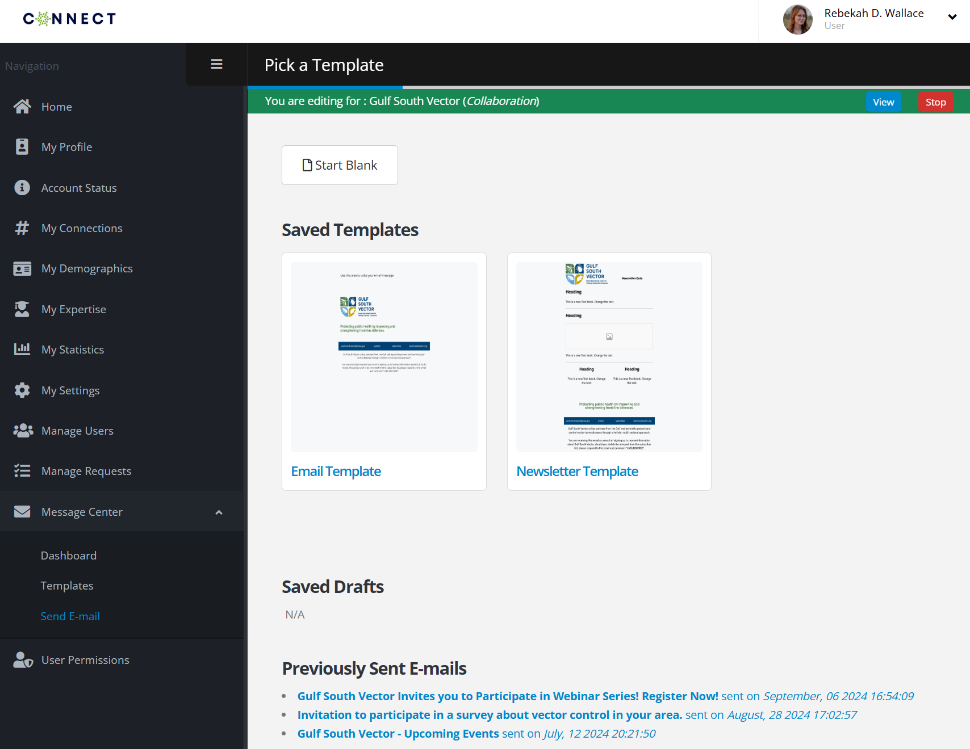
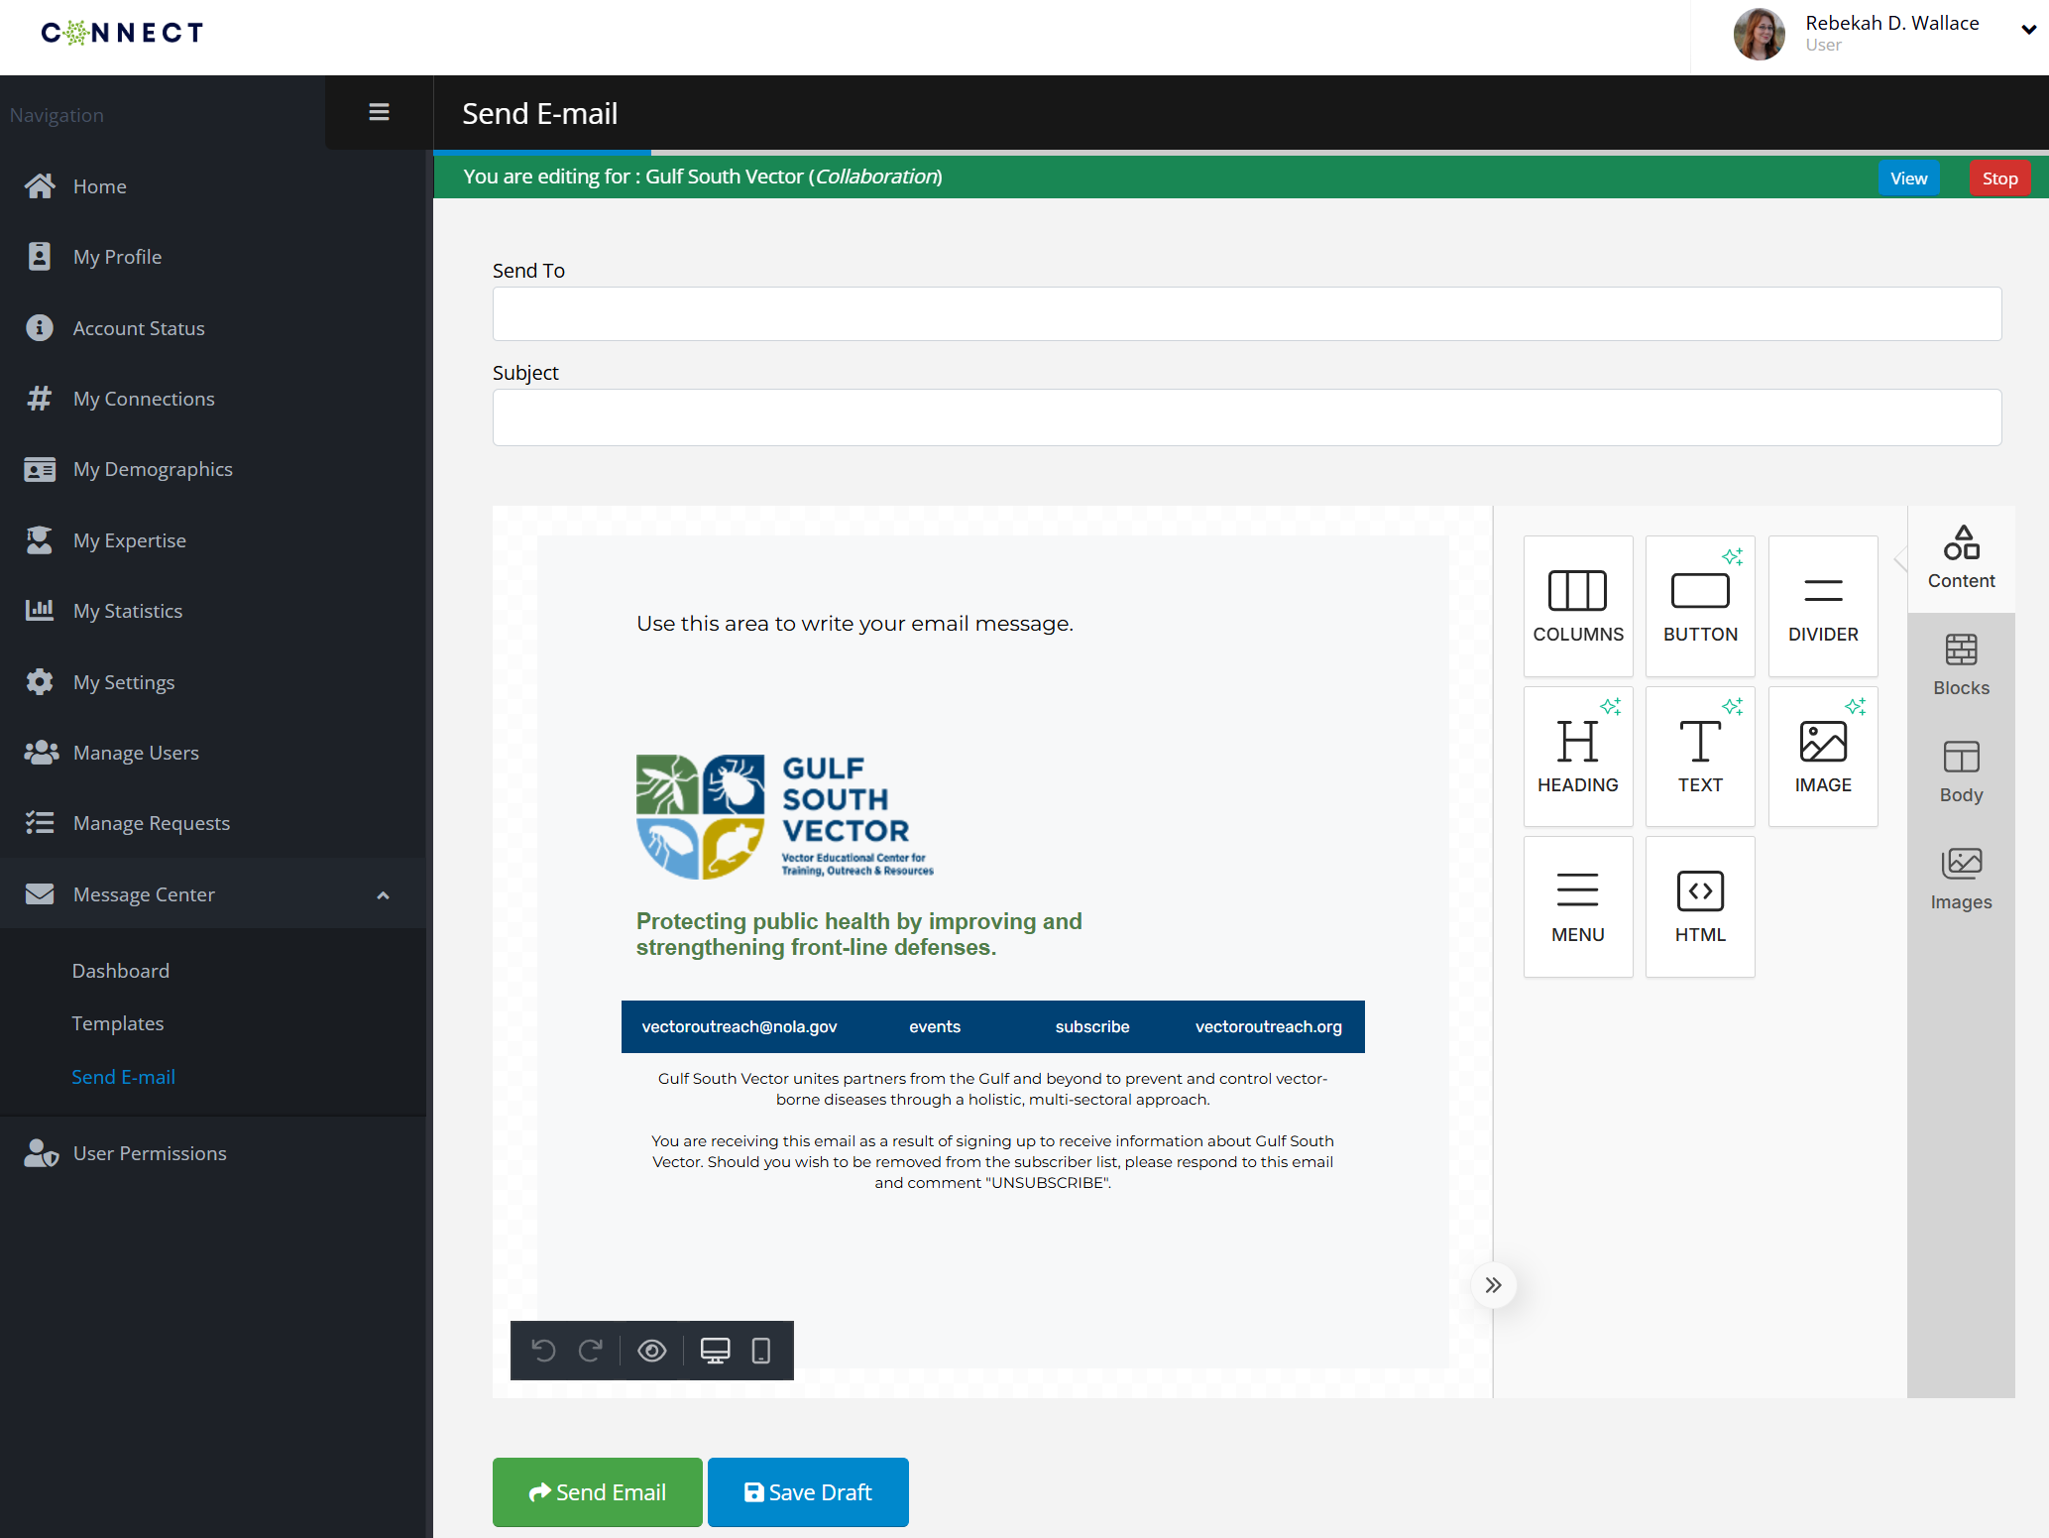
Connect – Collaborate: Messaging
https://connect.bugwood.org
Notes:
Create templates to email collaboration members and send to specific groups

Slide 16
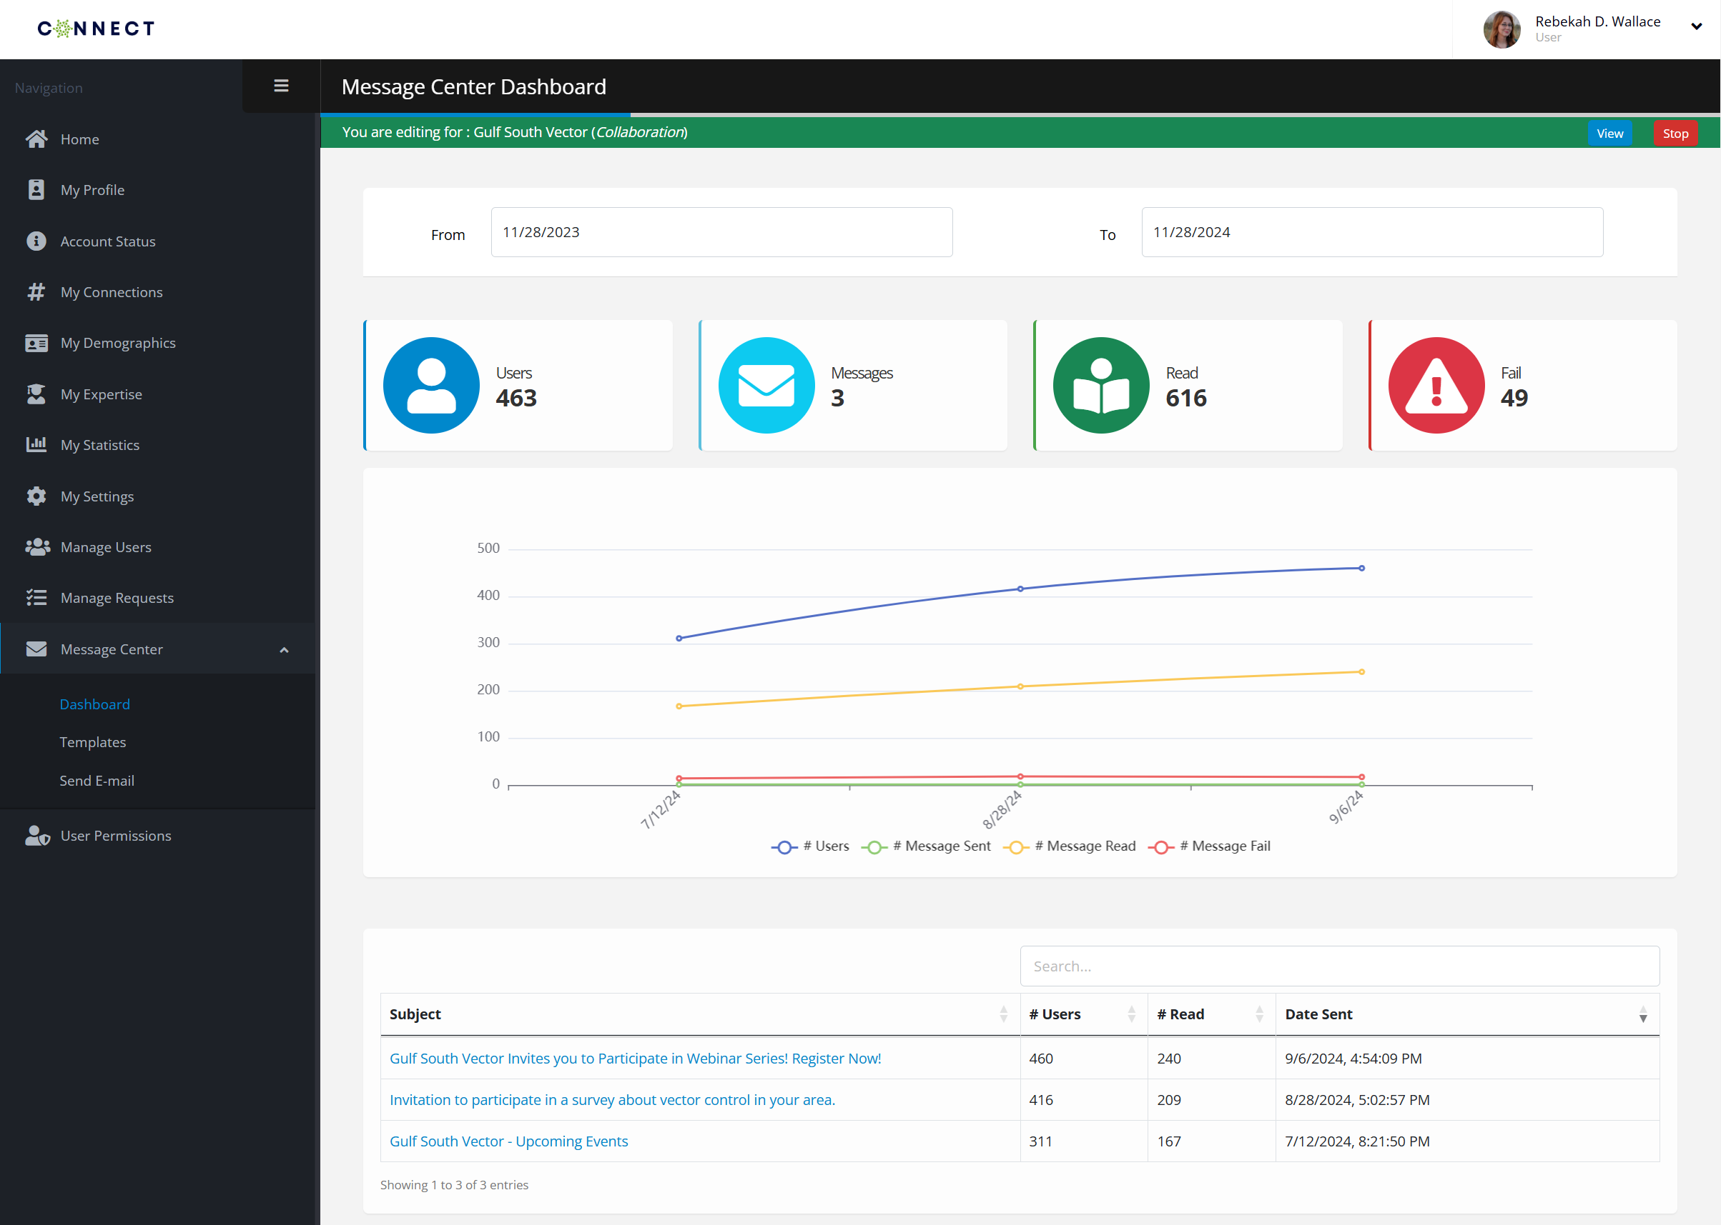
Connect – Collaborate: Messaging

Slide 17
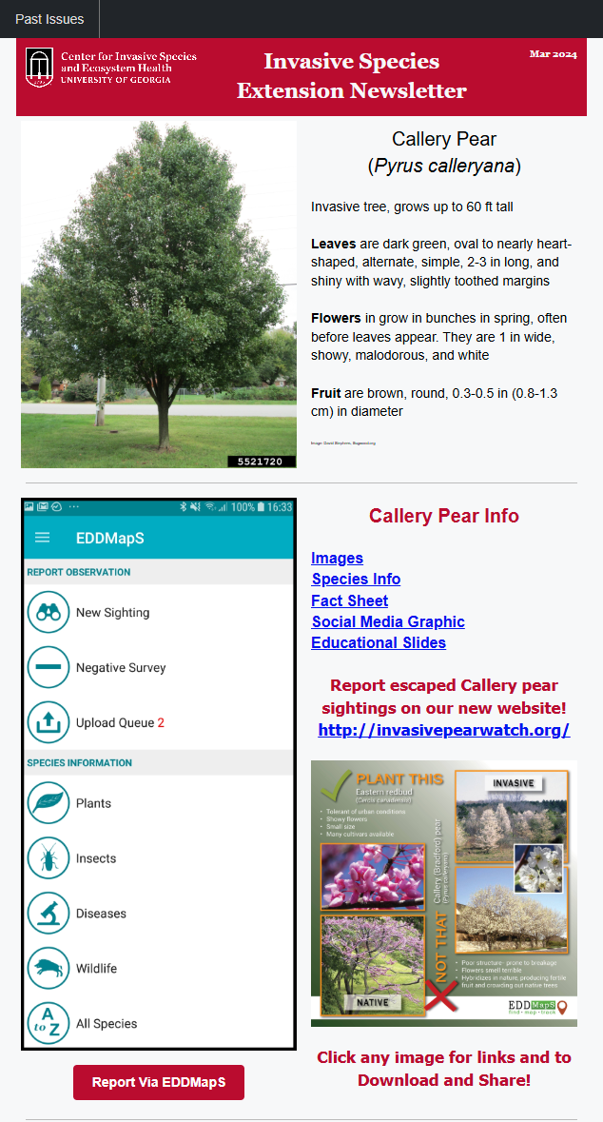
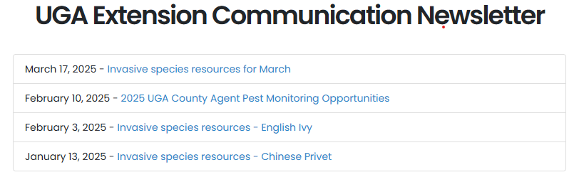
Connect – Collaborate: Messaging

Slide 18
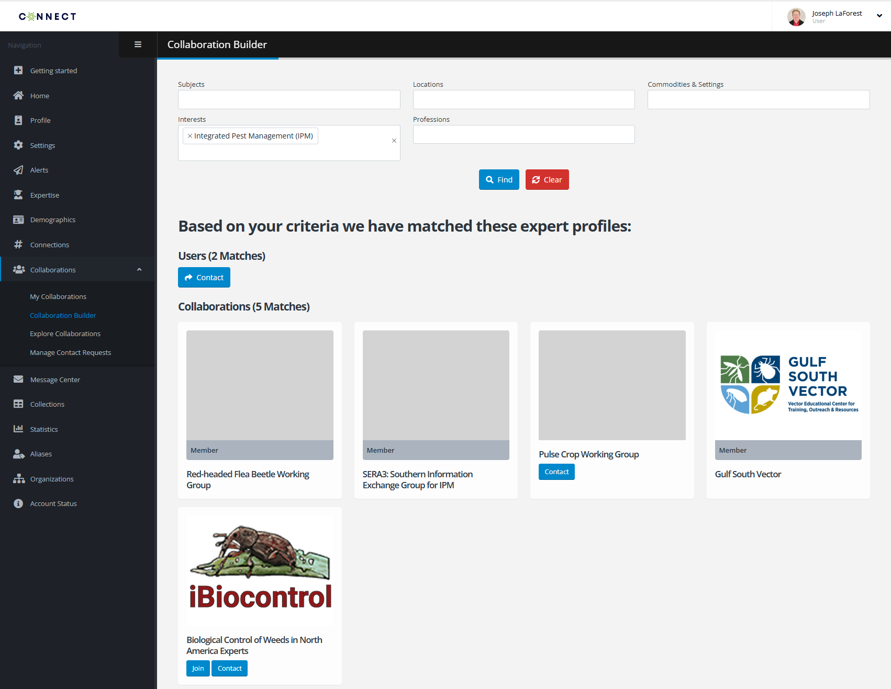
Connect – Collaborate: Recruiting & building

Slide 19
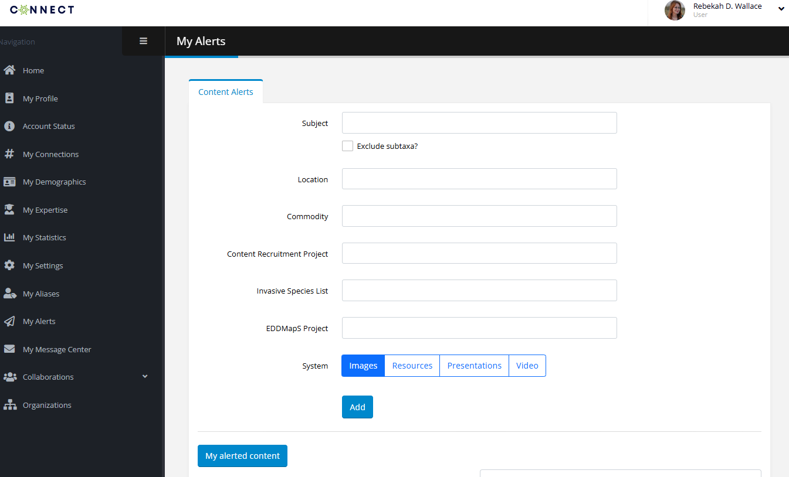
Connect Content Alerts –
Support Outreach and Education
Set up Alerts to get emails when new images, resources, presentations, and videos are added to Bugwood content systems.
Aids identification, outreach, management, etc.
https://connect.bugwood.org

Slide 20
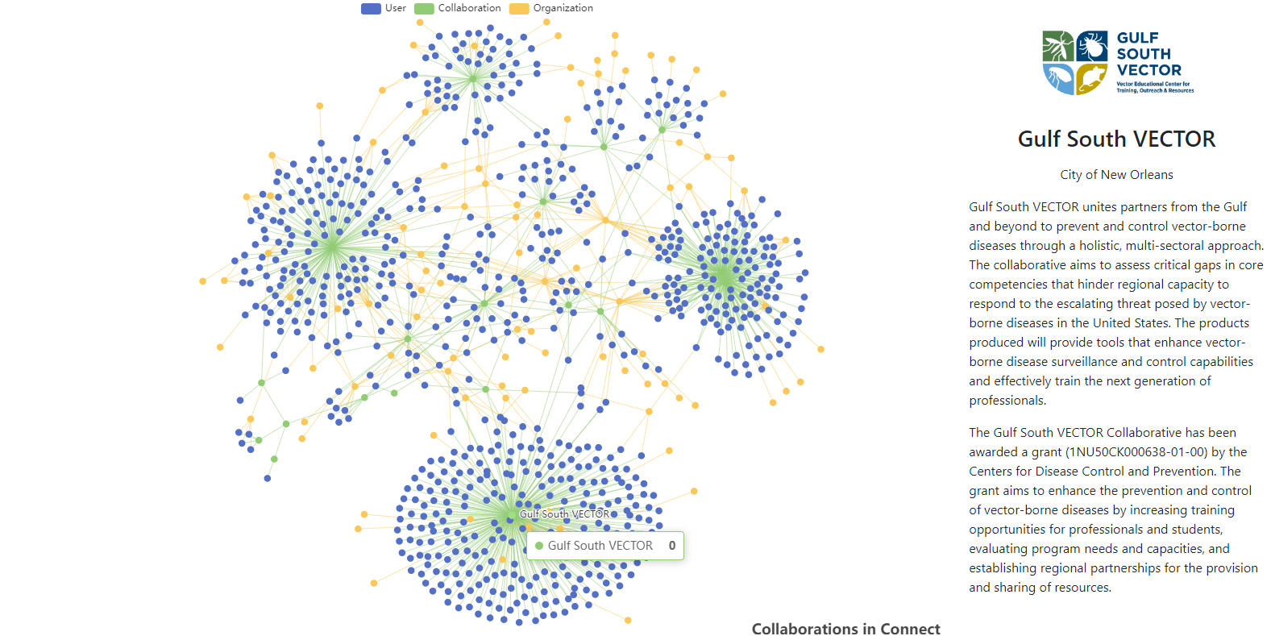
Highlighting partners & network

Slide 21
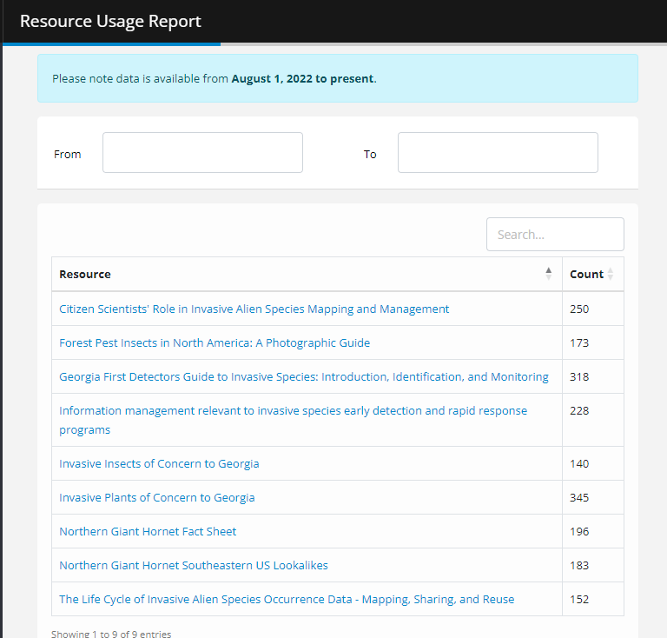
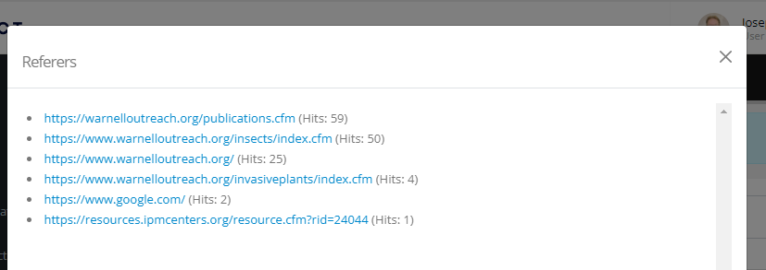
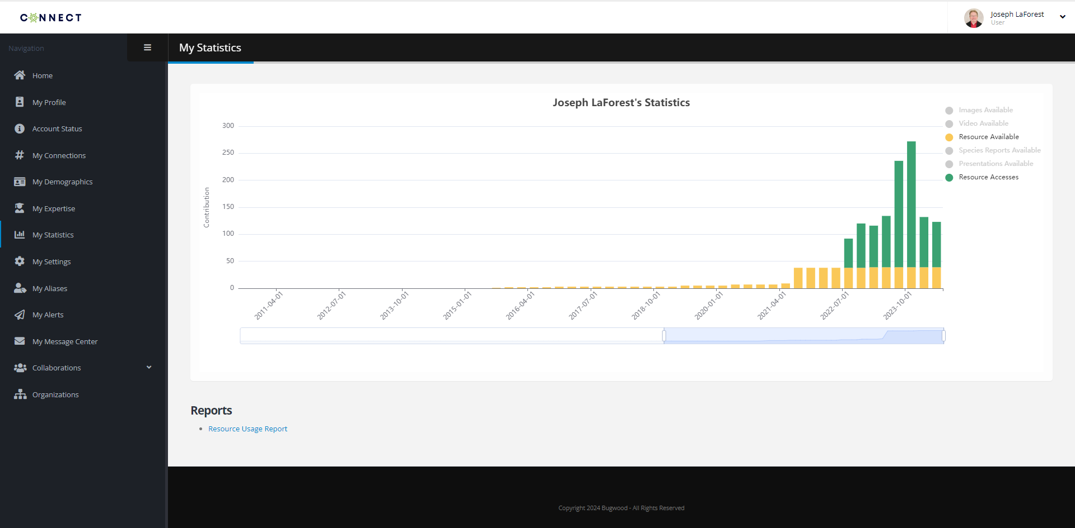
Documenting outputs & showing impact

Slide 22
Questions? Comments?
Interest?
People matter.
Yes, I mean you.
Notes:
Stronger internal and external collaborations are necessary to maximize the impact of IPM programs.
Expanding the Connect database will improve networking and collaboration among IPM professionals, facilitating better coordination within the Crop Protection and Pest Management Program.
Additionally, strategic partnerships with allied programs such as SARE, IR-4 and NPDN will enhance IPM outreach and implementation.
Strengthening communication pathways between research, extension and industry professionals will ensure IPM remains responsive to evolving challenges.

Slide 23

Goal 4
Leverage and Share Resources
What came first, the people or the tool
Notes:
Developing, cataloging and promoting publicly available IPM resources will strengthen the reach and accessibility of pest management tools.
Support for multi-state programs such as MyIPM, AgPest Monitor and the Crop Protection Network will expand resource availability.
Investing in IT infrastructure to support data-sharing, collaborative research and enterprise-wide evaluation will promote research efficiencies and facilitate economic analyses to document the value of public IPM investments.

Slide 24
Support & expand online resources, and other multi-state programs
Crop Protection Network
MyIPM
AgPest Monitor / EDDMapS
Get Rid Of Weeds (GROW)
Soybean Science For Success
Southern Region Extension Forestry
Extension Foundation
…and MANY other multi-state programs!

Slide 25
Create a centralized directory of IPM resources
improve accessibility for professionals and stakeholders
Help in promotion of new resources
Sign up for alerts on new resources in
Enabling sharing of resource lists between groups
Does something already exist?
Can I help to make it better?
Can I use what someone else made as a starting point for my tool?

Slide 26
Improve IT capacity to support data-sharing and collaborative research.
Existing platforms, frameworks, and templates may be available
Are there digital assets from other projects I can reuse in my work?
  Images
  Occurrence data
  Efficacy data
  Models (predictive, 3D Printer, decision support, machine learning)
Is there infrastructure that will support my widget?
Why go it alone if you don’t have to?

