Slide 1
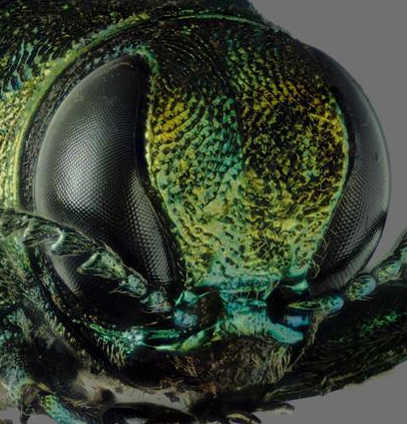
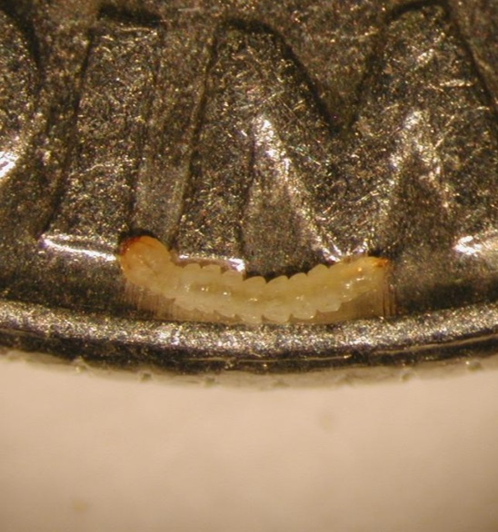
Treatment options for
Emerald Ash Borer
( How and when to treat )
Joseph LaForest, University of Georgia
Center for Invasive Species and Ecosystem Health
Steven Valley, Oregon Department of Agriculture, Bugwood.org

Slide 2
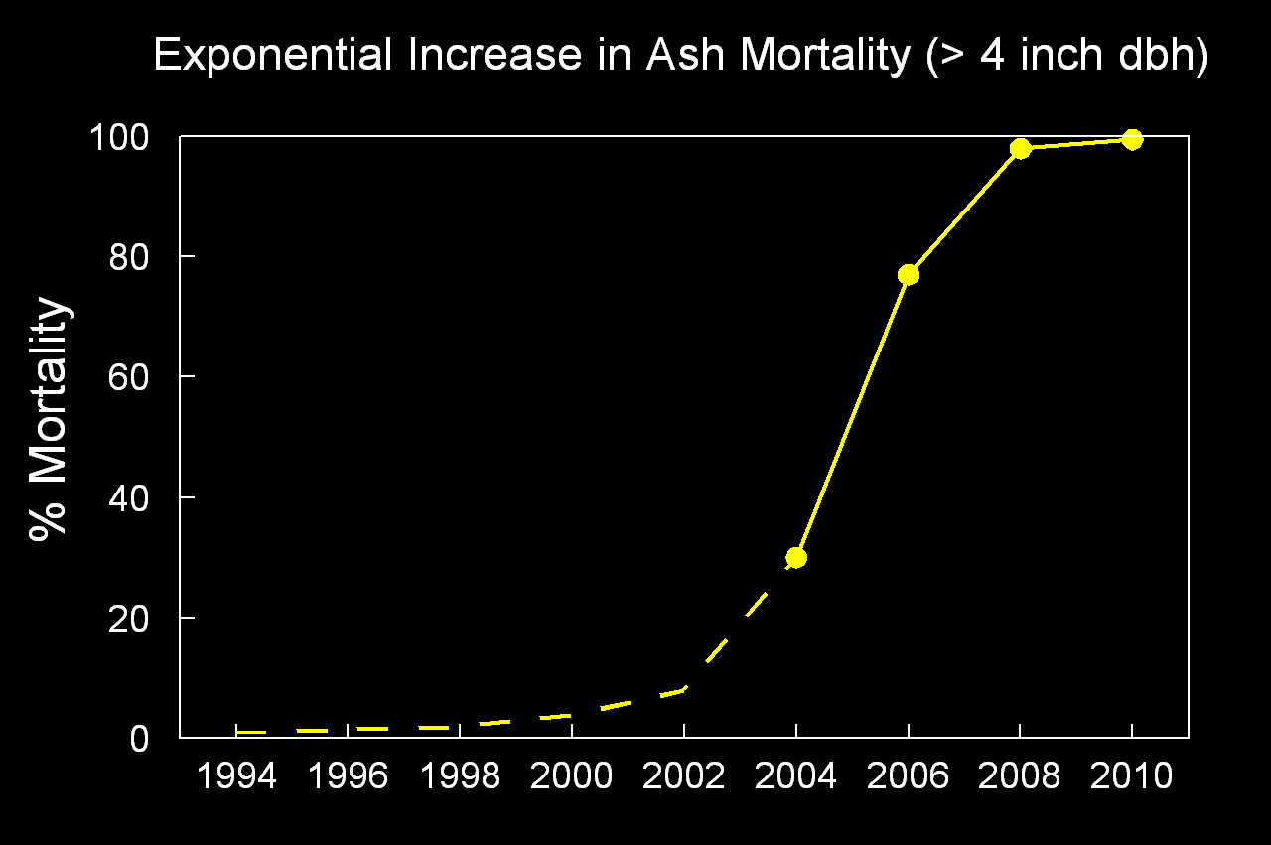
If nothing is done…
EAB-Induced Ash Mortality in the Upper Huron River Watershed, SE Michigan
Herms, D.A. Efficacy of Insecticide Treatments for EAB:They do work! July 2012

Slide 3
Treatment options

Slide 4
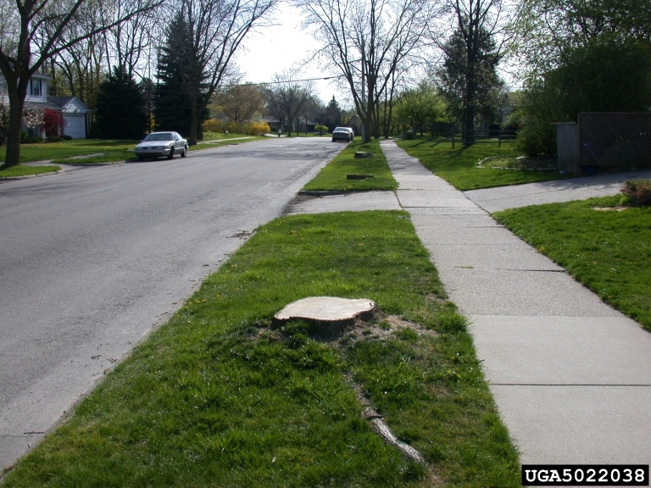
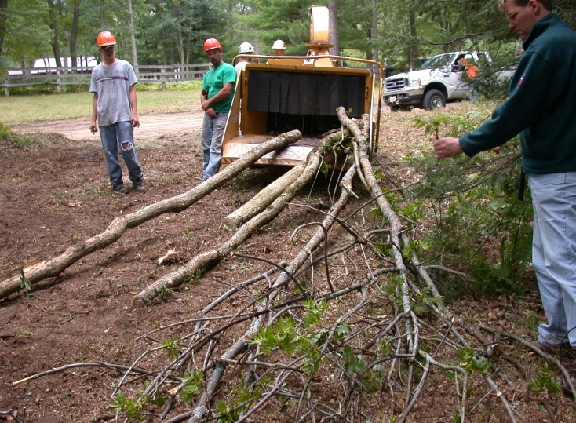
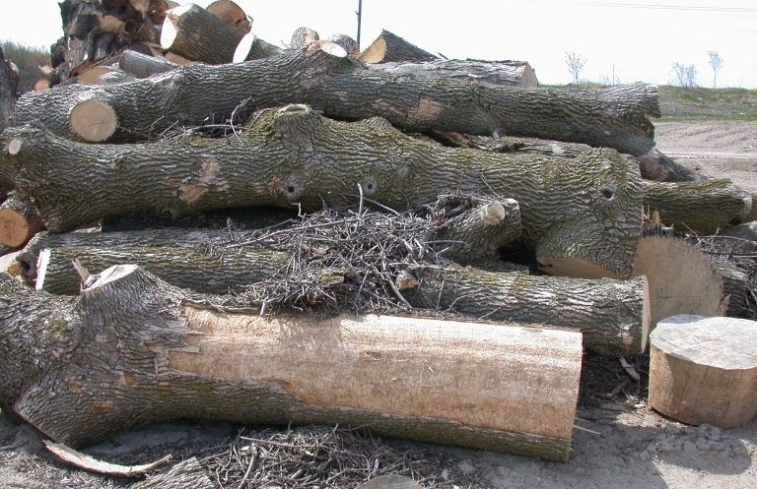
Mechanical: Tree Removal

Slide 5
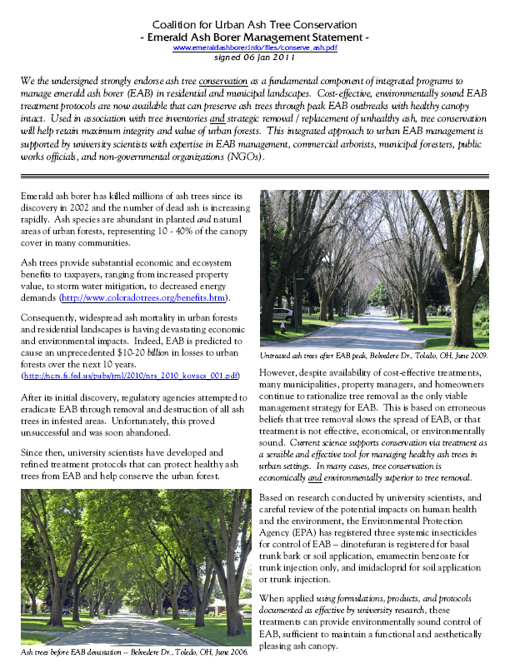

Mechanical: Tree Removal
Preemptive removal of healthy trees?
  Dose NOT slow spread!
  Insecticides can be effective at controlling EAB
  Significant political cost
Heavy upfront cost, but cheaper control in the long run

Slide 6
Chemical Control Options
READ & FOLLOW THE LABEL!!!
Application rates and recommendations vary based on
  Size of tree
  Proximity to bodies of water
  Soil type
  Amount of product already applied to the area in a year
Labeled does not equal effective
For the latest information
  www.EmeraldAshBorer.info
  (National Information)
  www.GAInvasives.org/EAB/
(Georgia Updates)

Slide 7
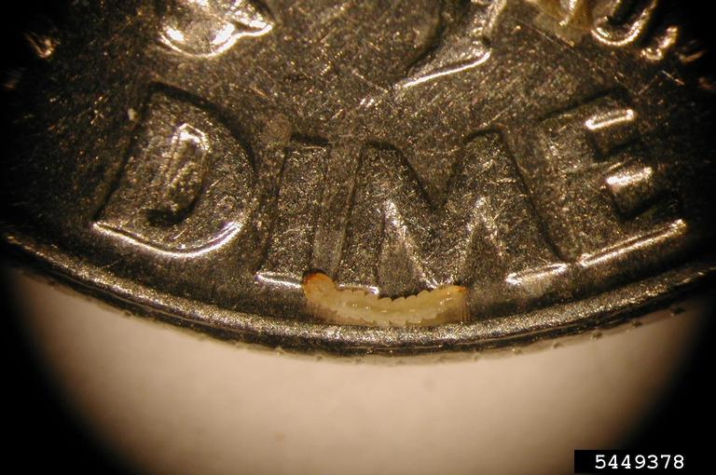
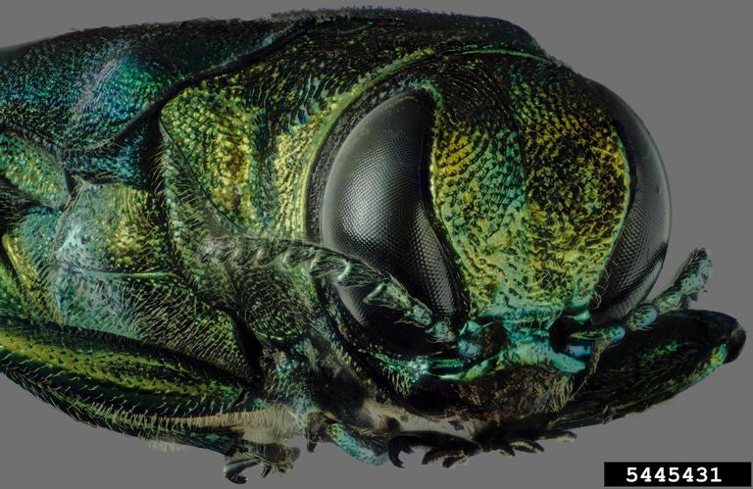
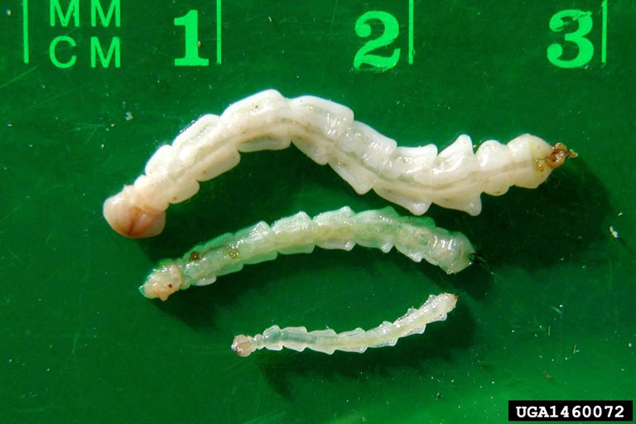
Chemical Control Targets

Slide 8
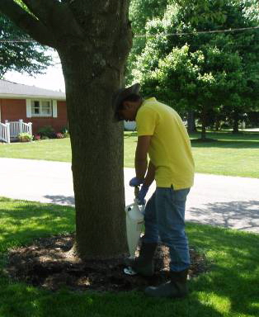
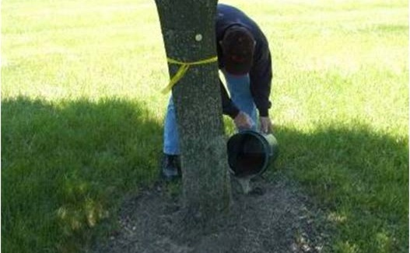
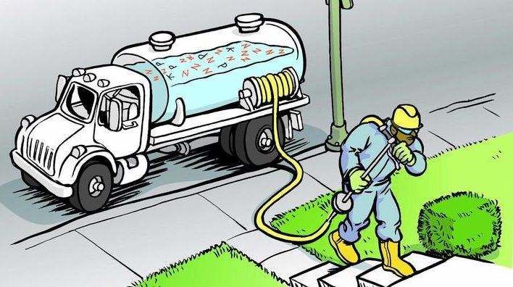
Chemical: Soil Drench and Injection

Slide 9
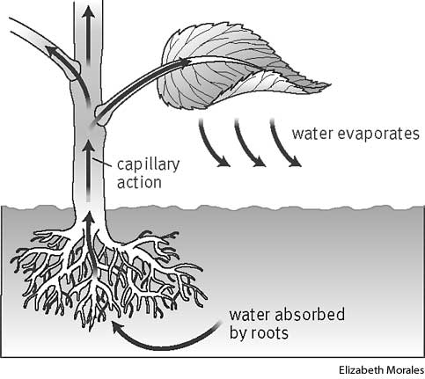
Transpiration

Slide 10
Chemical: Soil Drench
No specialized equipment needed for drench
Pull back mulch at base – Mix – Pour – Put mulch back
Drench is available to homeowners… and the ONLY chemical treatment option available to homeowners

Slide 11
Chemical: Soil Injection
Put solution under turf and mulch and at root zone
  2-4 inches below the surface
  Within 18 inches of trunk
Kioritz
Fertigation needle (~30psi)
Fertilizer does NOT improve uptake

Slide 12
Chemical: Soil Drench and Injection
Imidacloprid
  Merit 2F
  Xytect 2F
  Criterion 2F
  Lesco Bandit 2F
  Prokoz Zenith 2F
  Merit 75WSP
  Criterion 75WSP
  Lesco Bandit 75WSP
  Prokoz Zenith 75WSP
  Merit 75WP
  Xytecy 75WSP
  Bayer Advanced 12 Month Tree & Shrub Insect Control Concentrate
  Bayer Advanced 12 Month Tree & Shrub Protect & Feed
  Bonide Annual Tree and Shrub Control
  ferti-lome Tree and Shrub Systemic Insect Drench
  Ortho Bug B gon Year-Long Tree & Shrub Insect Control
Dinotefuran
  Safari
  Zylam

Slide 13
Imidacloprid Soil Drenches (14-20 inch DBH)
Merit 2F, 1.4 g ai / inch DBH, spring
Merit 2F, 1.4 g ai / inch DBH, fall
Xytect 75WP, 1.4 g ai / inch DBH, fall
Xytect 75WP, 2.8 g ai / inch DBH, spring
Xytect 75WP, 2.8 g ai / inch DBH, fall
Untreated control
Herms, D.A. Efficacy of Insecticide Treatments for EAB:They do work! July 2012

Slide 14
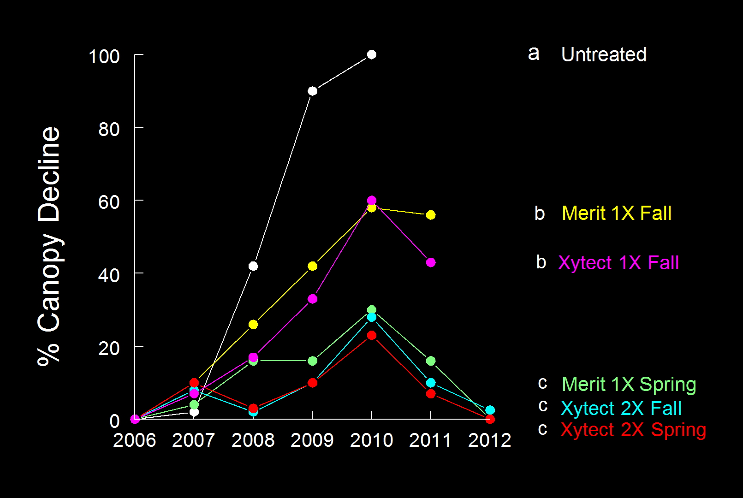
Imidacloprid Soil Drenches (14-20 inch DBH)
Herms, D.A. Efficacy of Insecticide Treatments for EAB:They do work! July 2012

Slide 15
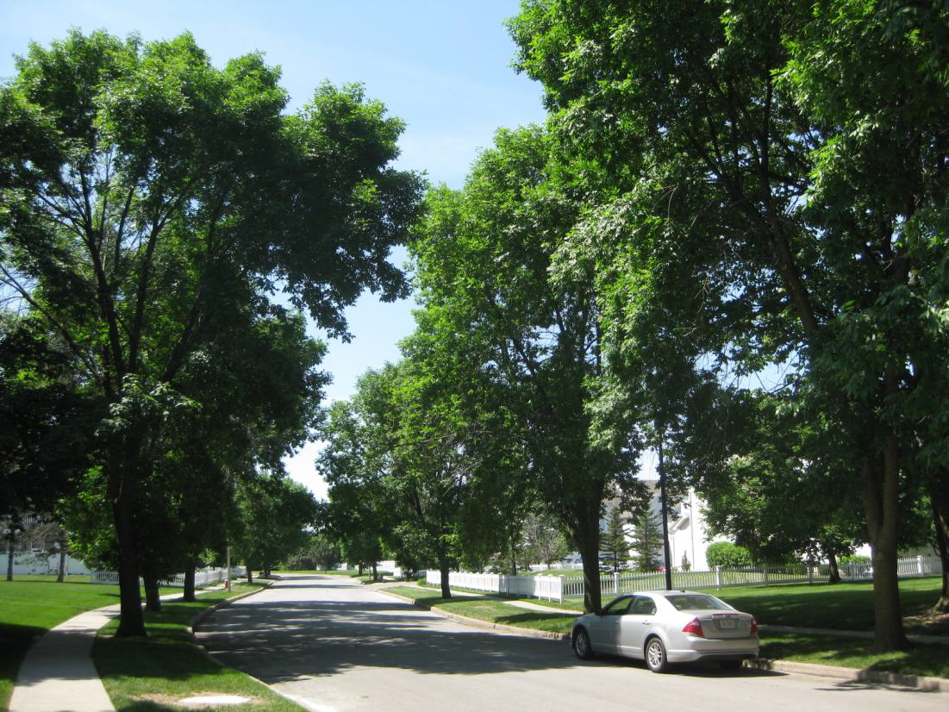
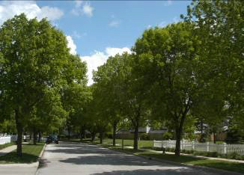
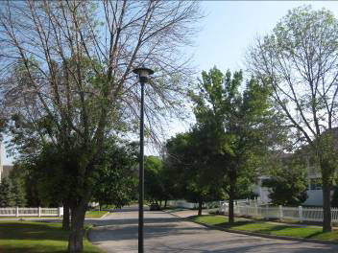
Imidacloprid Soil Drenches (14-20 inch DBH)
2006
2009
2012
Herms, D.A. Efficacy of Insecticide Treatments for EAB:They do work! July 2012

Slide 16
Chemical: Soil Drench and Injection
Product is applied to the soil
Imidacloprid soil drenches most effective on large trees when applied at the 2X (2.8 g ai / inch DBH) rate.
Fall imidacloprid soil drench requires higher rate than spring.
The maximum rate of imidacloprid allowed per acre per year is 0.4 lbs.
  1X rate the maximum amount of imidacloprid allowed per year is the amount that would be used to treat ash trees of a cumulative diameter (DBH) of 126 inches.
  2X rate, (larger trees) the maximum amount is met at when trees of a cumulative diameter of 63 inches are treated

Slide 17
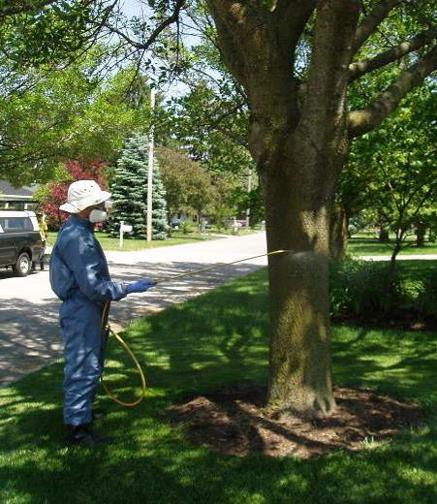
Chemical: Systemic Bark Spray
Drenching spray on lower trunk (4-5 feet) & root flares
Dinotefuran
  Safari
  Zylam
SYSTEMIC
No special equipment

Slide 18
Comparing Soil Injection & Bark Spray

Slide 19
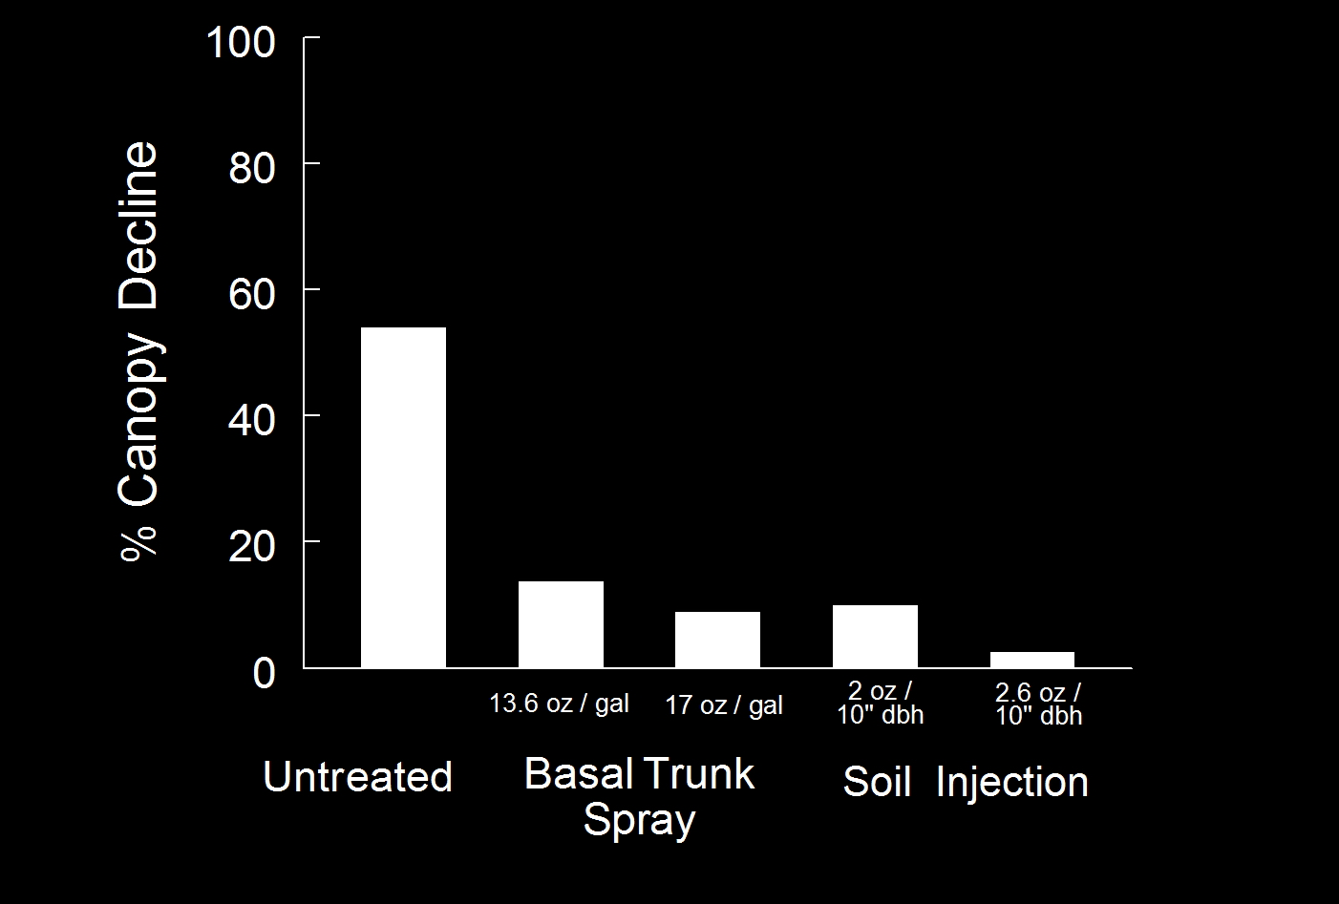
Safari (Dinotefuran) treatments for EAB
Herms, D.A. Efficacy of Insecticide Treatments for EAB:They do work! July 2012

Slide 20
Chemical: Systemic Bark Spray
Safari soil and basal bark spray treatments providing good and equivalent control.
0.54 lbs/acre/year
  ~2.7 lbs of the formulated Safari 20SG product.
  High rate (24 oz) applied to 50 inches diameter
  Maximum amount of dinotefuran is reached when tree with a cumulative diameter of 80 inches are treated IF AT HIGH RATE

Slide 21
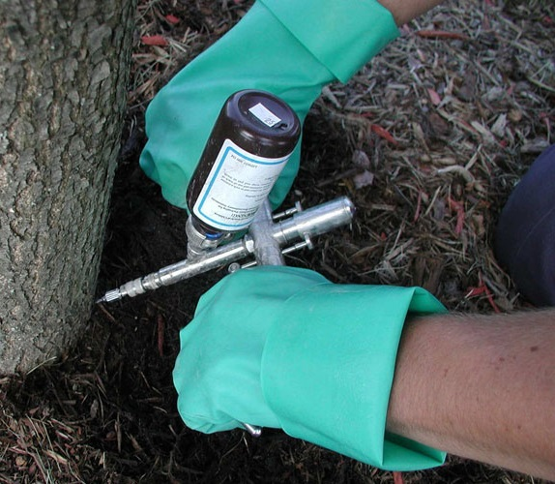
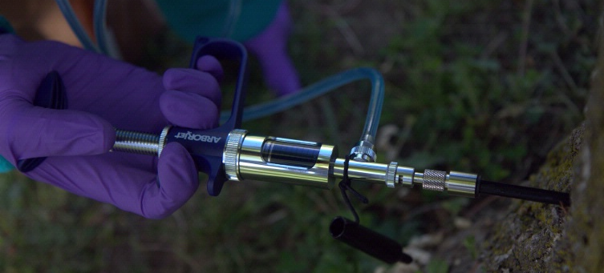
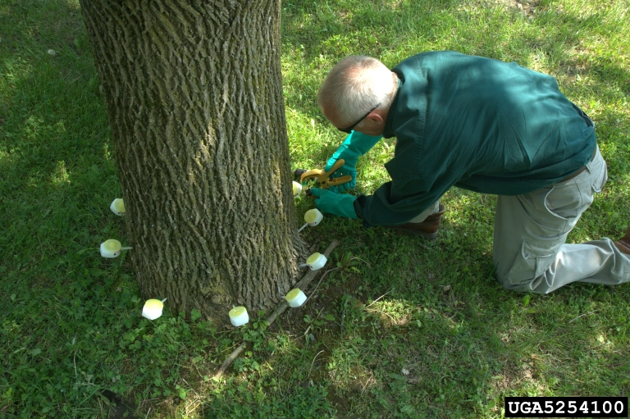
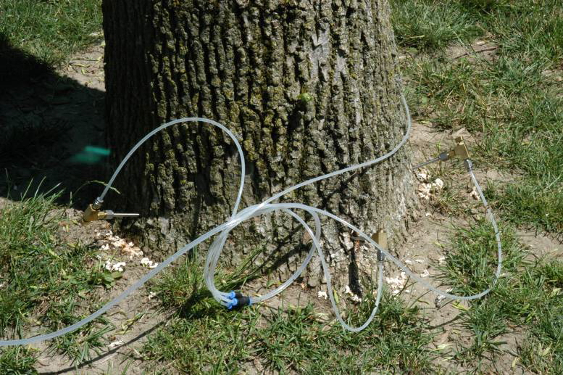
Chemical: Trunk Injection
Notes:
Wedgel Direct Inject, Arborjet QUIK-jet, Mauget capsule, Tree IV

Slide 22
Chemical: Trunk Injection
Make a hole (or horizontal cut)
  11/64” (Mauget Capsule)
  3/8” (Quik-Jet, TreeIV)
  7/32” or 9/32” (Viper)
  3/32” (Wedgle)
Apply solution under pressure
Uptake time varies
  Sometimes GREATLY!

Slide 23
Chemical: Trunk Injection
Imidacloprid
  IMA-Jet
  Imicide
  Pointer
Azadirachtin
  TreeAzin
  AzaSol
  Bidrin
  Inject-A-Cide B
Emamectin benzoate
  TREE-Age
Variable efficacy
Now in testing
Not effective for EAB
Excellent control

Slide 24
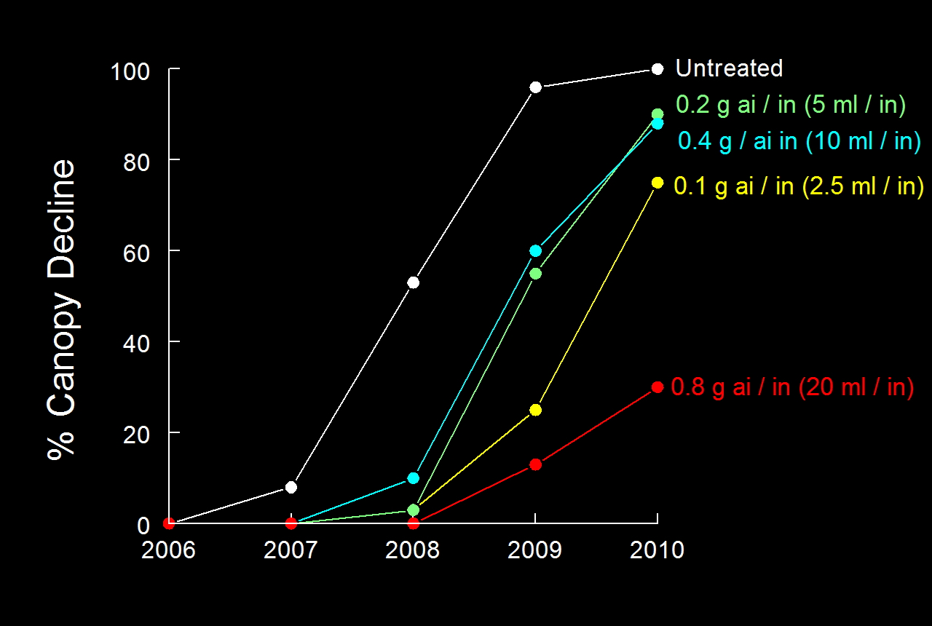
Tree-äge rate study (20-25 inch DBH)
Herms, D.A. Efficacy of Insecticide Treatments for EAB:They do work! July 2012

Slide 25
Chemical: Trunk Injection
Emamectin benzoate
  Most expensive product
  Tree-Age - Only product sold by ArborJet
  Restricted Use Pesticide
  No per acre/per year restrictions
  2 years of control on large trees even at lowest rate.
Product is delivered directly to the tree
Trunk injections DO wound the tree
Training is recommended for tree and operator safety

Slide 26
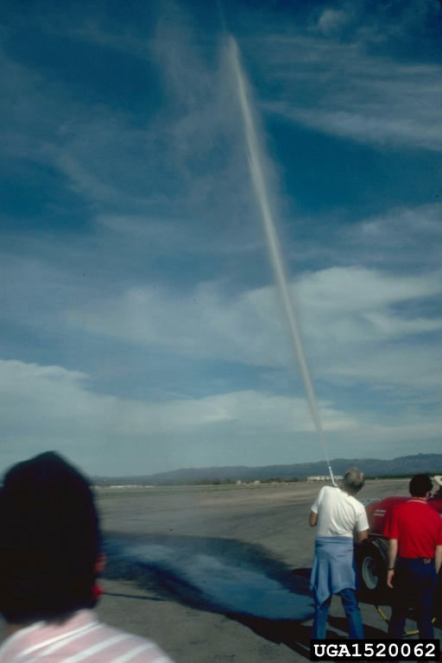
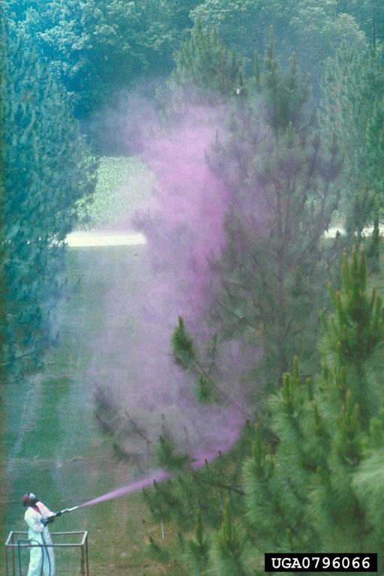
Chemical: Foliar spray

Slide 27
Chemical: Foliar / bark spray
Preventive bark and foliage cover sprays
  Astro® (Permethrin)
  Onyx™ (Bifenthrin)
  Tempo® (Cyfluthrin)
  Sevin® SL (Carbaryl)
2 applications at 4-week intervals; first spray should occur when black locust is blooming (early May in southern Ohio to early June in mid-Michigan)
“A single, well-timed spray was also found to provide good control of EAB, although two sprays may provide extra assurance given the long period of adult EAB activity”
“It should be noted that spraying large trees is likely to result in a considerable amount of insecticide drift, even when conditions are ideal. Drift and potential effects of insecticides on non-target organisms should be considered when selecting options for EAB control.”

Slide 28
When (and IF) to treat

Slide 29
What shape is the tree in?
>50% Canopy decline - Survival is unlikely
Tree Removal and sanitation is recommended
  BEFORE adults emerge again
  BEFORE it becomes a hazard

Slide 30
What can you afford?
How important is the tree?
  Focal point of landscape?
  World champion ash?
  They really tie the yard together?
  Just another ash?
What’s in the budget?
  Soil Drench
    Imidacloprid
  Soil Injection / Systemic Trunk Spray
    Dinotefuran
  Trunk injection
    Imidacloprid
    Emamectin Benzoate (2 year control with one application)
  Tree Removal

Slide 31
What is going on?
Has EAB been found within 15 miles of your location?
What treatments are being done?
What is the current state of management in the area?
What was done to the trees last year?
What is the plan for the future?
  5 years?
  10 years?
  25 years?

Slide 32
Management Decisions

Slide 33
Management Options
Do Nothing
Remove and Replace
Sustained insecticide treatments
Combination of the above

Slide 34
Things to consider
Trees have value
  Aesthetic
  Stormwater handling
  Temperature moderation
  Air purification
Budgets are limited
Treatment options are available
  Tree removal - $750 to $1172 per tree
  Replacement - $300
  Emamectin benzoate treatment - $3.03 to $3.62 per 2.5 cm of DBH

Slide 35
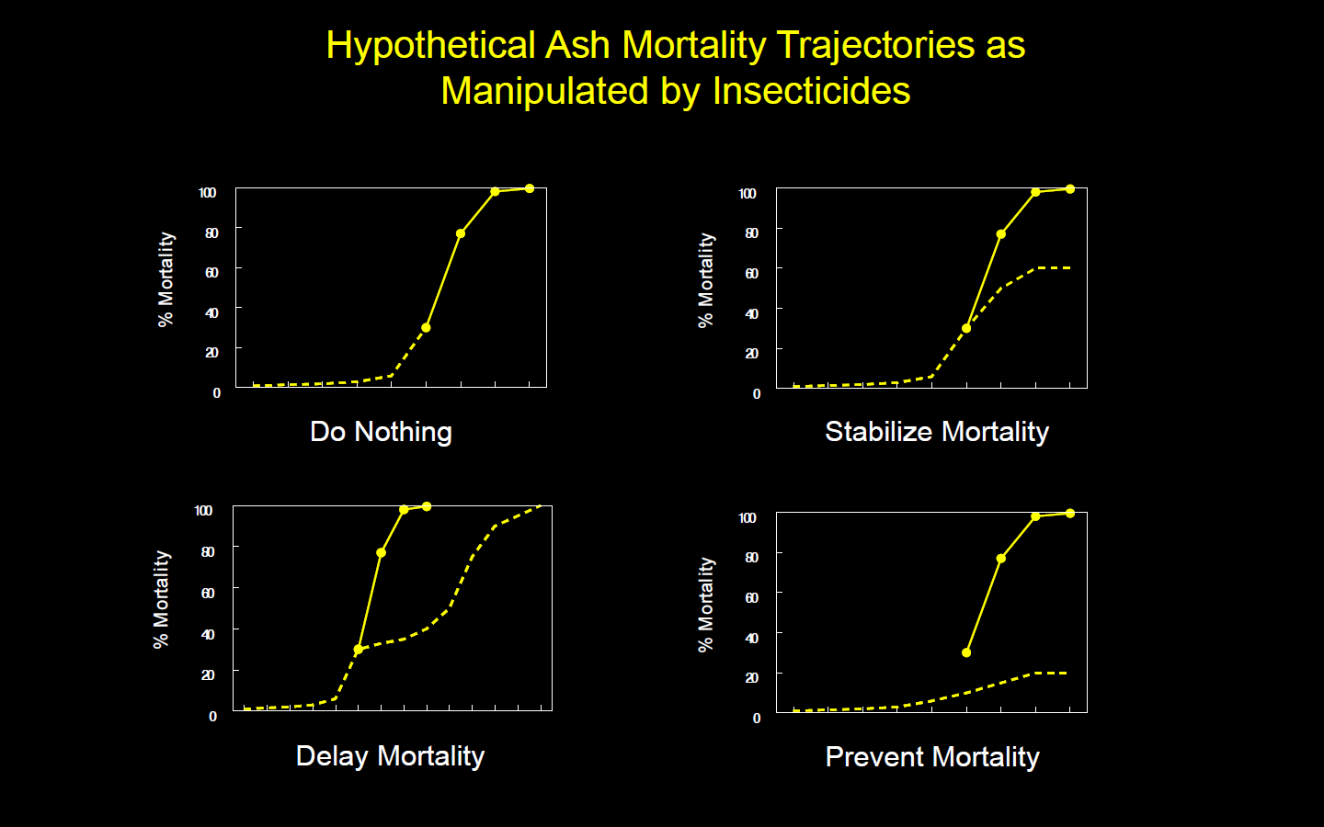
How will treatments be used?
Herms, D.A. Efficacy of Insecticide Treatments for EAB:They do work! July 2012

Slide 36
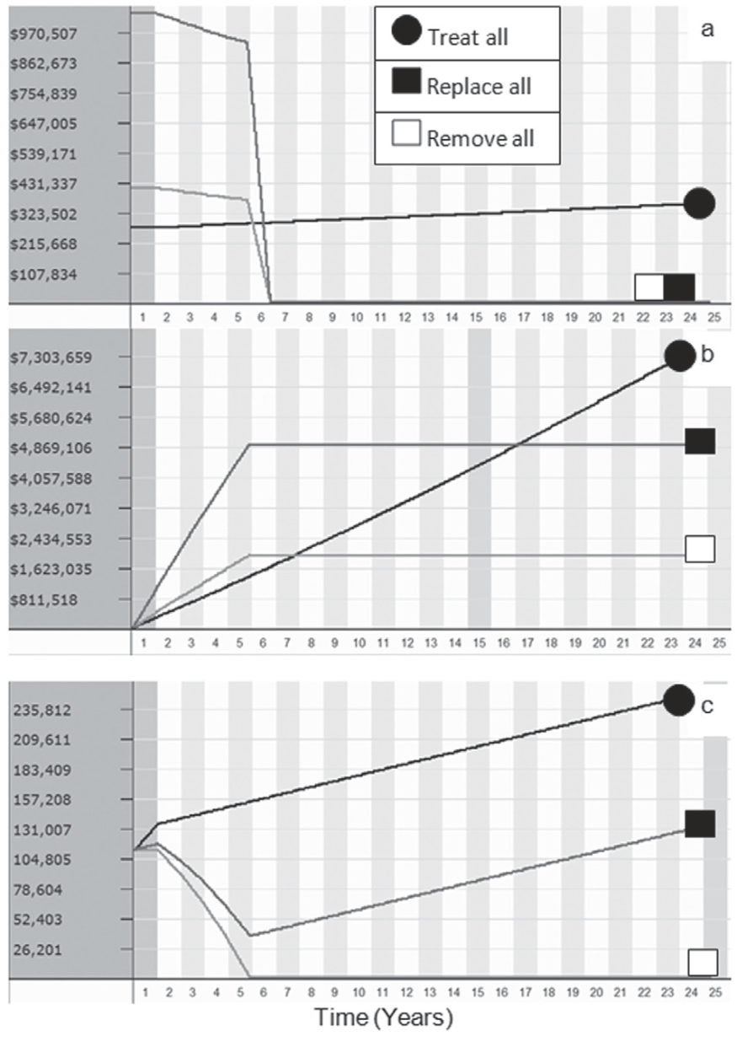
http://extension.entm.purdue.edu/treecomputer
Annual Treatment Cost
Cumulative Treatment Cost
Cumulative Ash Diameter
Sadof et al.: Restoration Capacity and Costs of Managing the Emerald Ash Borer in Urban Forests. Arboriculture & Urban Forestry 2011. 37(2): 74–83

Slide 37
SLAM – SLow Ash Mortality
http://www.slameab.info/
“The goal is to slow the local invasion process and allow land managers time to be proactive rather than simply reacting to overwhelming numbers of dead, often hazardous trees”
EAB Survey
Ash Inventory
Suppression of EAB
  Systemic insecticides to kill EAB adults and larvae;
  Removal of infested ash trees before EAB adults can emerge;
  Attracting or concentrating EAB in girdled trees
  Harvesting and utilizing ash trees
  Encourage natural enemies
Regulatory efforts
Public Outreach
Evaluation

Slide 38
What now?
  www.EmeraldAshBorer.info
  (National Information)
  www.GAInvasives.org/EAB/
(Georgia Updates)
EAB University
www.emeraldashborer.info/eab_university.cfm

