Slide 1


Midwest
Training
Revisit and Edit Your Data
Notes:
Welcome to the EDDMapS Midwest training on how to revisit and edit your data.

Slide 2
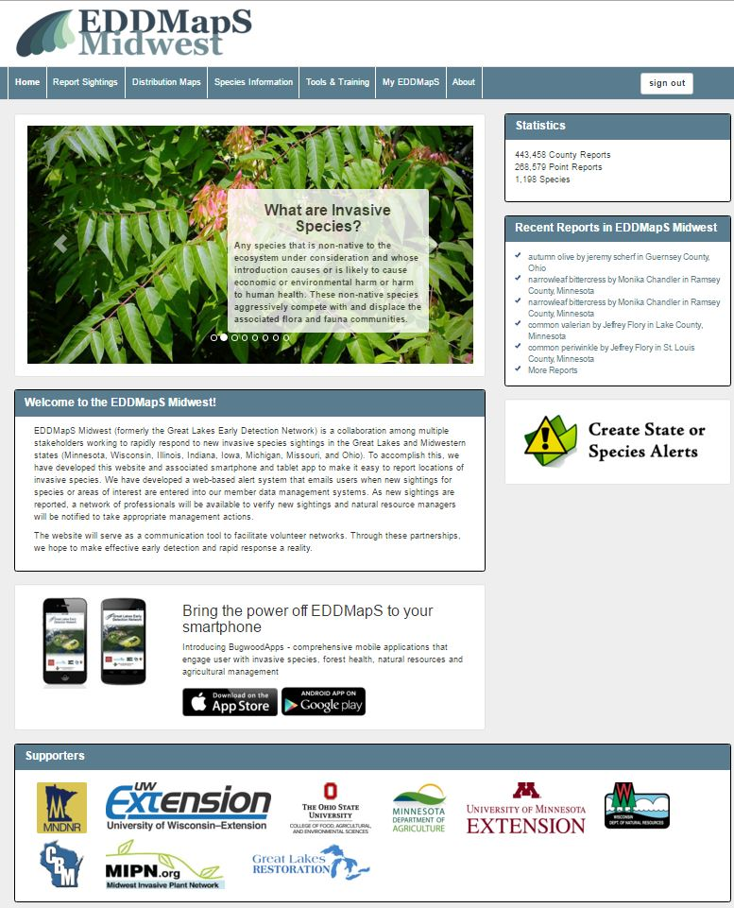

First Step – Sign In
Notes:
EDDMapS allows you to edit and revisit data you have entered. Revisits allow you add data on management activities to your report and Edits can be made on existing reports. The first step is to sign in.

Slide 3
Click on your My EDDMapS
Notes:
Click on your My EDDMapS page to get to your dashboard.

Slide 4
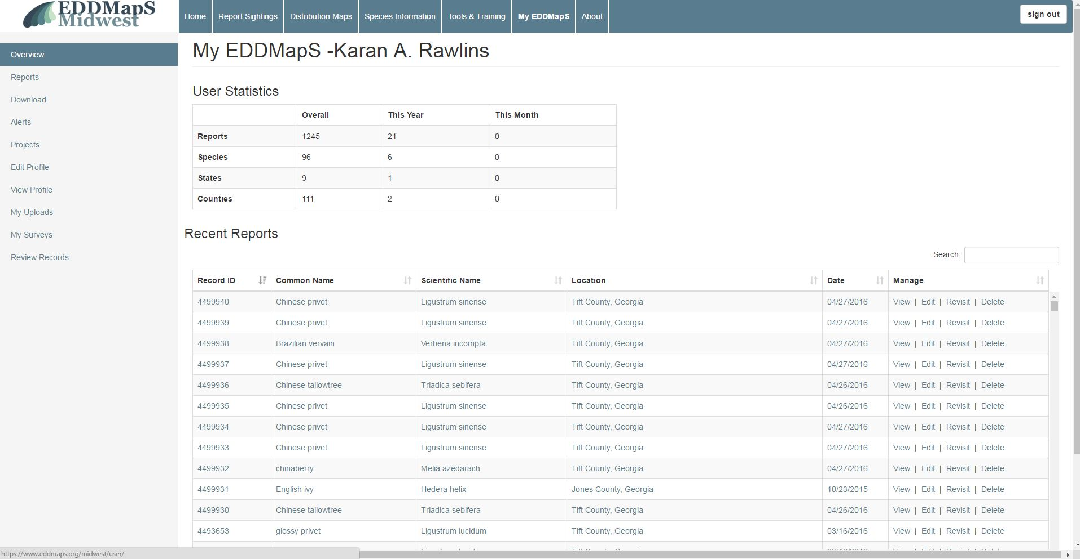
Your Dashboard Includes:
Your Statistics
Recent Reports
Reports
  View
  Edit
  Revisit
  Delete
Downloaded data
Alerts
Projects
Edit your profile
View your profile
Your uploads
Your surveys
Notes:
Your Dashboard Includes: Reports which you can View, Edit, Revisit, and Delete. This is where you can also find your Downloaded data; manage your Alerts; view your Projects; View or Edit your profile; view Your uploads; and view Your surveys.
The main goal for this training will be to cover how to Edit and Revisit the data you have submitted.

Slide 5
Your Statistics
Number of Reports
Number of different Species
Number of different States
Number of different Counties
Overall Total Reports
Reports This Year
Reports This Month
Notes:
User Statistics gives you a snapshot of the data you have submitted. Here you can quickly see how many reports you submitted on how many species, states and counties.

Slide 6
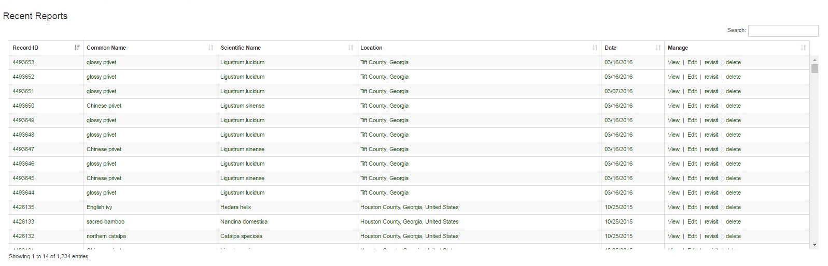
Your Recent Reports
Listed conveniently on your dashboard
Notes:
Your Recent Reports are Listed conveniently on your dashboard, so you can quickly and easily see them.

Slide 7
Reports
Click Reports to access all of your reports
Notes:
Click Reports to access all of your reports

Slide 8
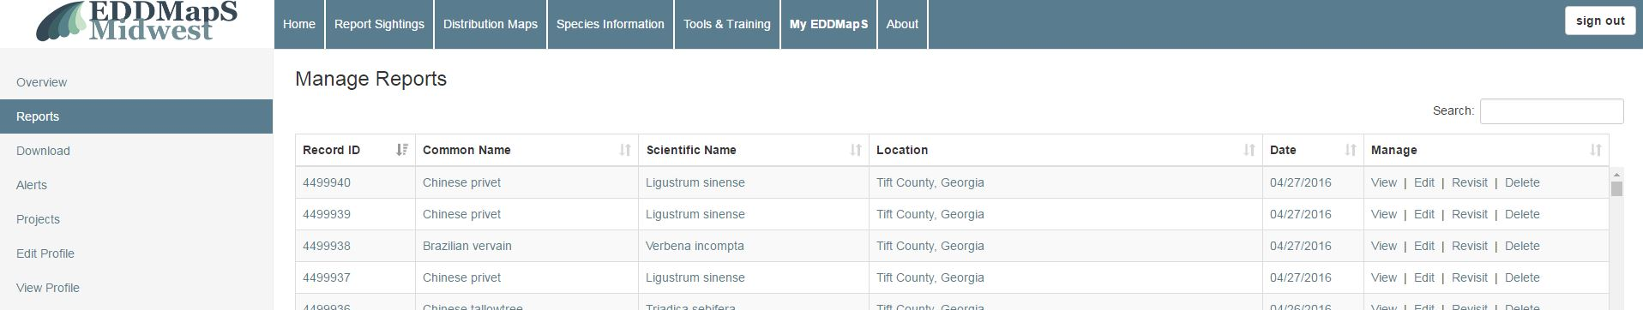
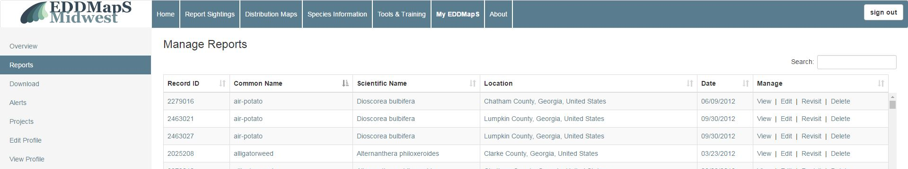
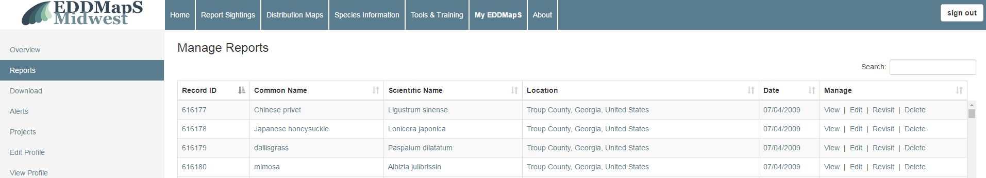
Manage Reports
Search by location, species, or record number
Location
Species name
Record number
Notes:
You can search by different criteria under Manage Reports. You can search by location, species, or record number

Slide 9
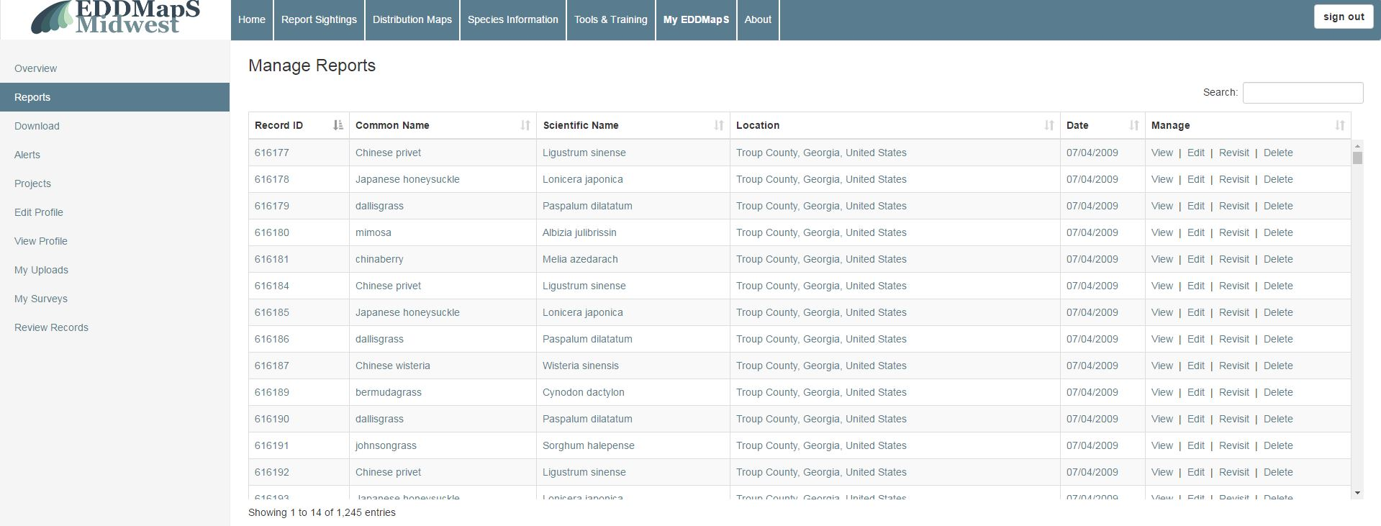

Manage Reports - Editing
Clicking Edit takes you to an editing page for that report
Notes:
Clicking Edit takes you to an editing page for that report.

Slide 10
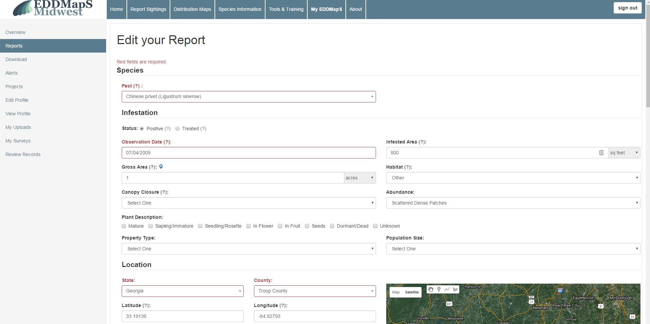
Manage Reports - Editing
The form has the same fields as the EDDMapS web form
You can edit reports you submitted
  On EDDMapS Midwest website
  From the smartphone apps
First section
Information on the pest
Notes:
The form has the same fields as the EDDMapS web form. You can edit reports you submitted either On EDDMapS Midwest website or From the smartphone apps. You can make edits Before the verifier validates the record.

Slide 11
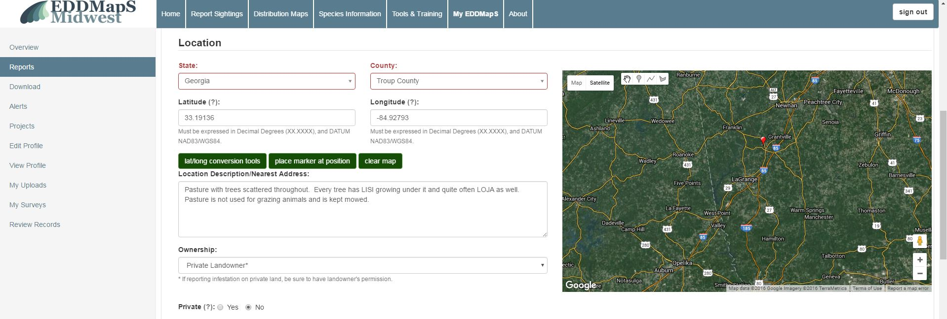
Manage Reports - Editing
Second section
Location information
Notes:
Add any additional information here

Slide 12
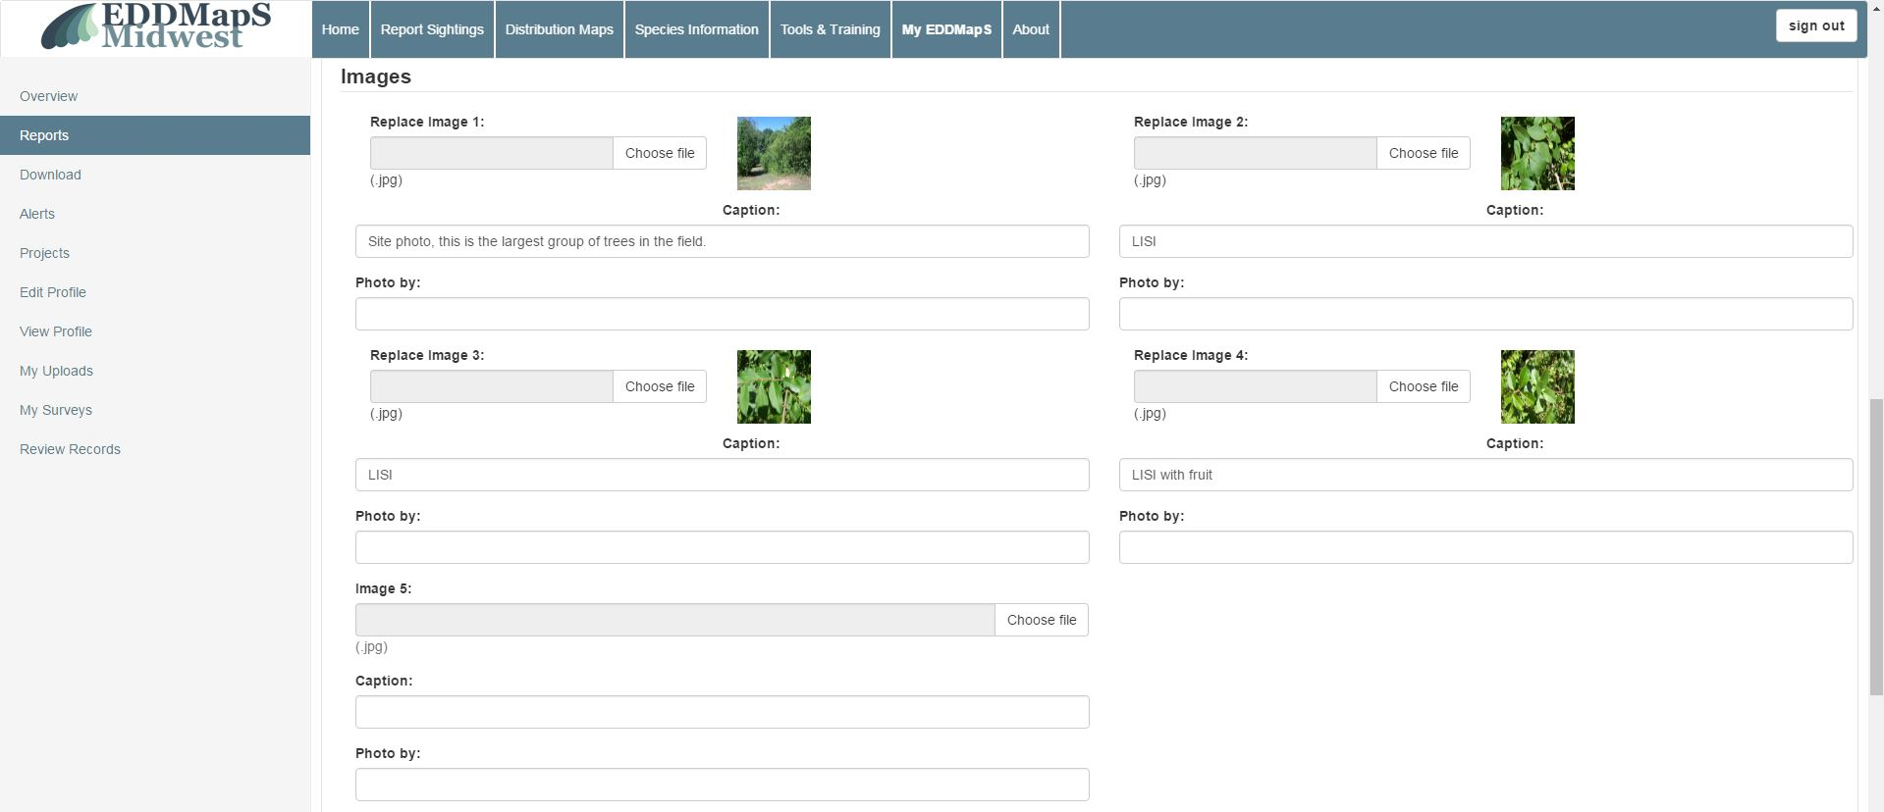
Manage Reports - Editing
Third section
Upload additional images
Notes:
Manage Reports – Editing, Third section Upload additional images. You can upload additional images from your camera or phone here.

Slide 13
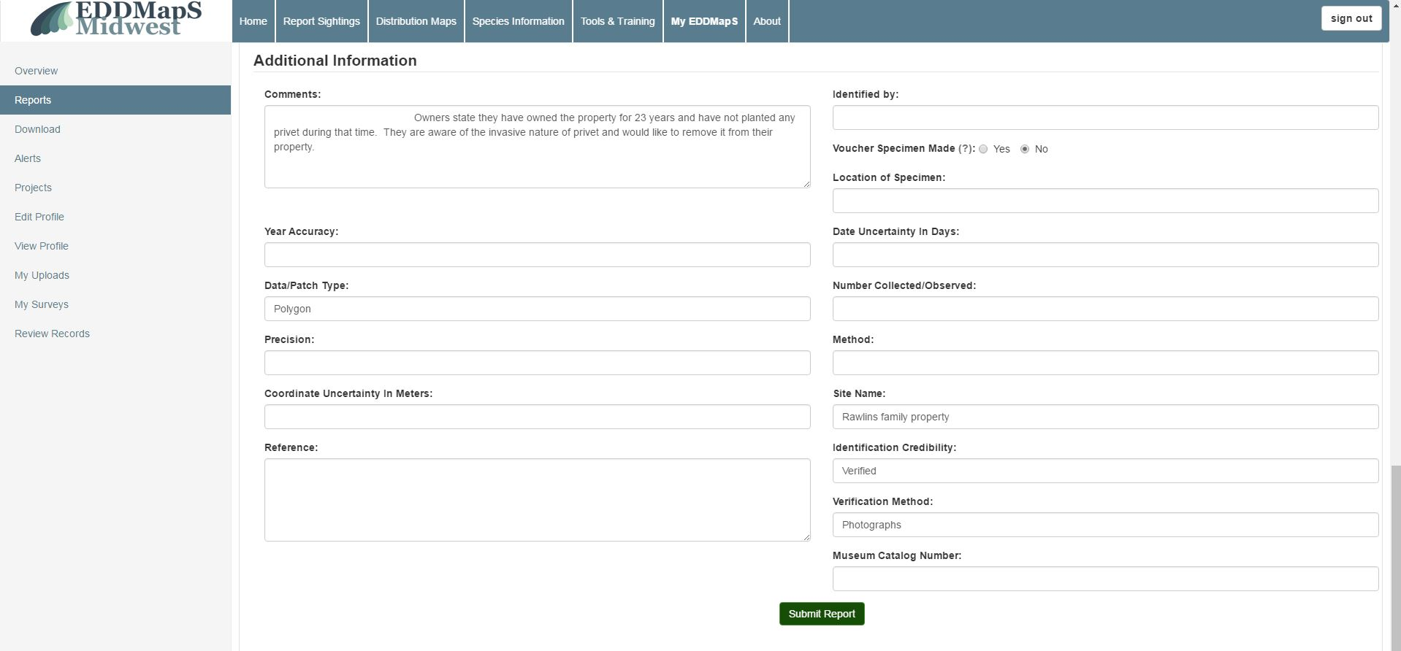
Manage Reports - Editing
Fourth section
Edit Additional Information as needed
sapling
Remember to Submit Report
Notes:
Manage reports – editing. The fourth section is where you can add any additional information that might be helpful in locating or managing the infestation. You might also add your plan for management here. It is also the place to put herbarium information if you collect a specimen. Remember to Submit Report

Slide 14
Manage Reports - Revisits
Revisits are used to record
Changes in the infestation over time
Document management plans, actions and outcomes
Click on Revisit
Notes:
Manage Reports – Revisits. Revisits are used to record Changes in the infestation over time and to Document management plans, actions and outcomes. Click on revisit to begin.

Slide 15
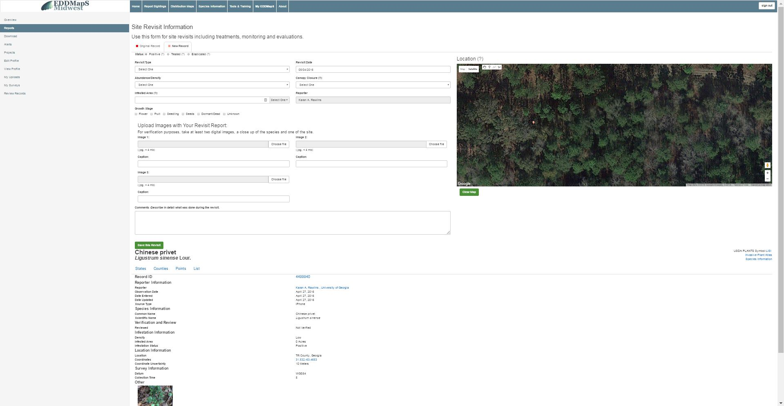
Manage Reports - Revisits
The original record and any revisits are permanently linked
Revisit
Original record
Notes:
The original record and any revisits are permanently linked

Slide 16
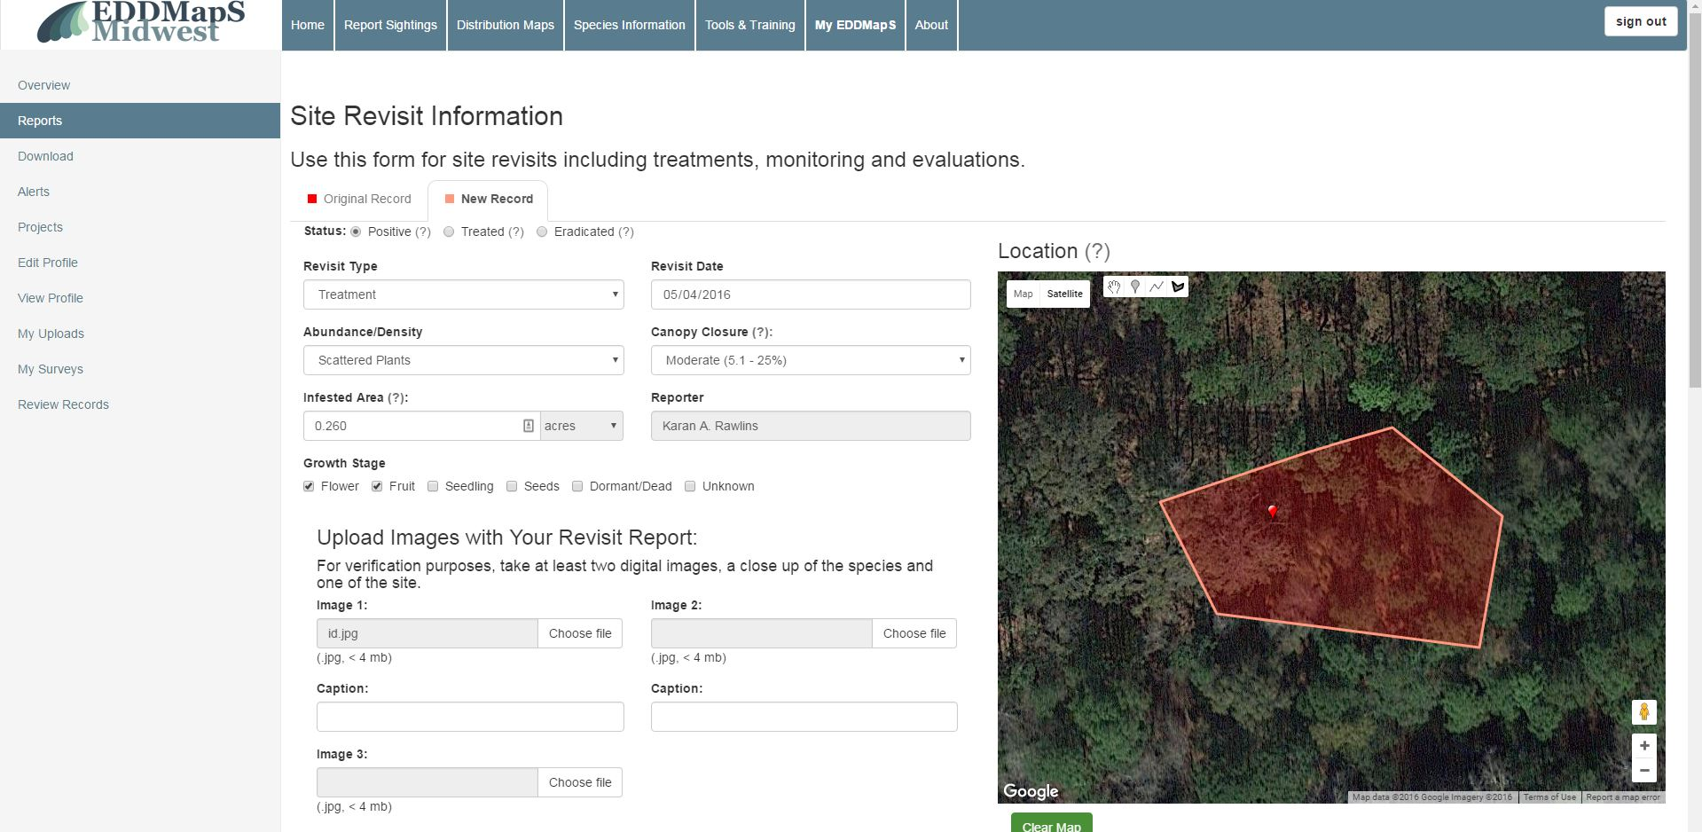
Manage Reports - Revisits
Allow you to keep track of management activities
Allow you to show change over time
Notes:
Revisits allow you to keep track of management activities and to show change over time

Slide 17
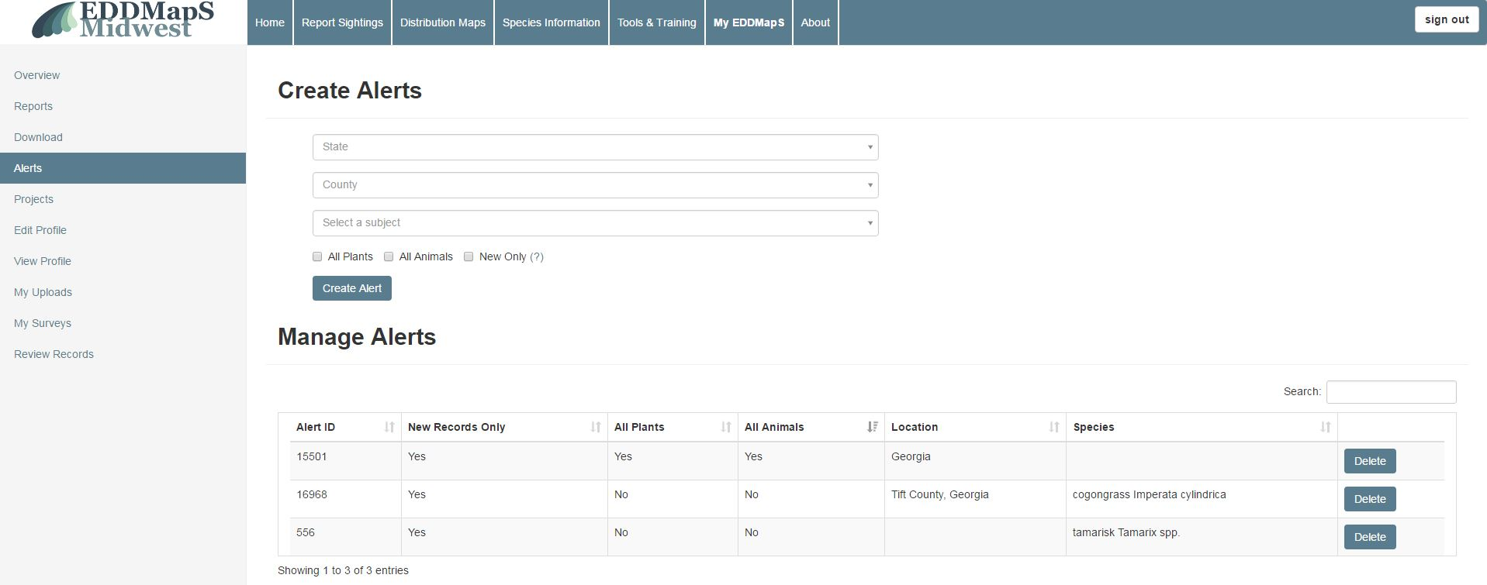
Alerts
Get email alerts when species of interest are reported in your region
Location
  State
  County
Species
  First time reports only
  Every time it is reported
Notes:
Create an alert based on State, county or species of interest. For example anytime a new plant or animal is reported in your state. When a report that meets your criteria is entered, you receive an email alerting you to the report. Alerts are quick and easy to set up or to delete.

Slide 18
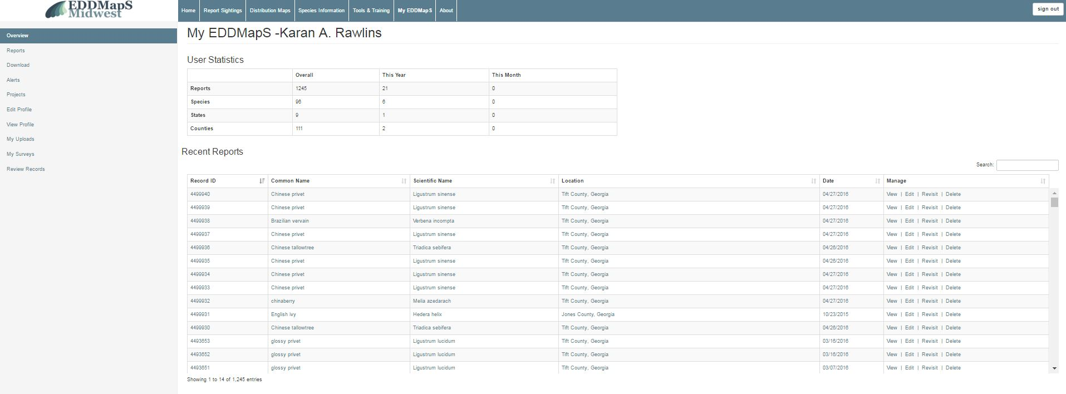
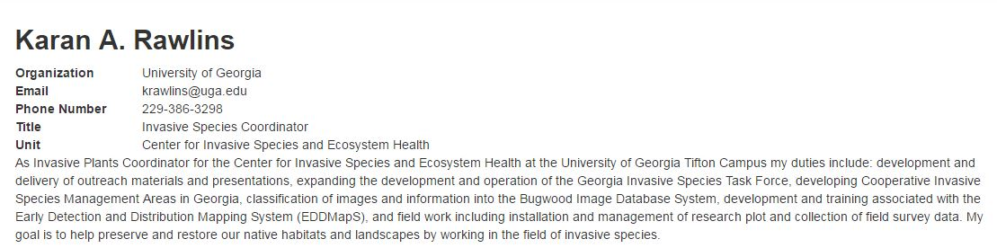
View Your Profile
Click View Profile
Notes:
To View your profile, click on view Profile

Slide 19
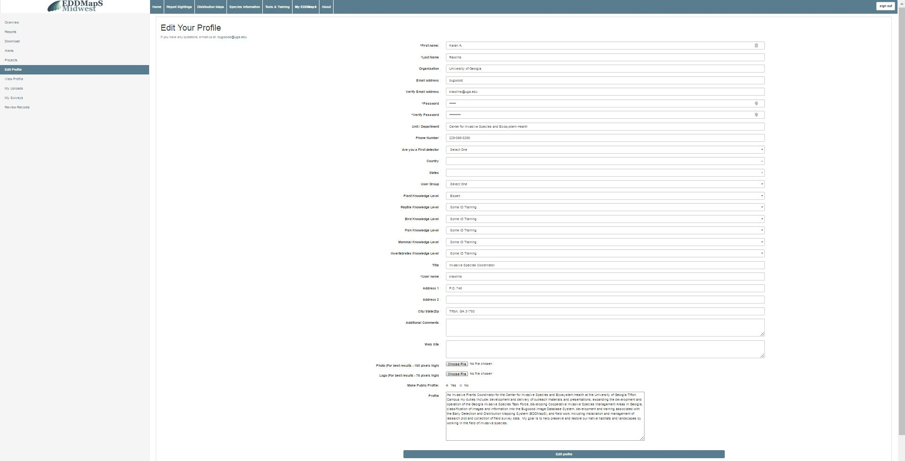
Edit Your Profile
Your profile information is easy to update at anytime
Click on Edit Profile
Notes:
Click Reports to access all of your reports

Slide 20
Thank you for participating in this EDDMapS Midwest training.
This and other trainings are available on the EDDMapS Midwest Website.
Notes:
Thank you for participating in this EDDMapS Midwest training. This and other trainings are available on the EDDMapS Midwest Website.

